Slide 1
Question Answering Using Answer Classification and Query Expansion
LING573
David Lin Edward Wong Chris Staley

Slide 2
Goals
Improve our QA system by adding more sophisticated techniques
Add Question Classification
Use Basic Query Expansion
Add Question Reformulation, and support for answering questions in a series
Compare our results with our baseline
Strict score improved from .0073 to .018, an improvement of 147%
Lenient score improved from .022 to .10, an improvement of 355%

Slide 3
Approach
Question Classification
Trained a Support Vector Machine (SVM) to classify into 6 coarse buckets
Used the associated probabilities to assign the classification to one of three likelihoods
Web Search
Use Pattern package to return snippets from Google based on the queries
Separated answers into individual sentences and deduped
Web search is cached per query question, if the query question does not exist a web search is made

Slide 4
Approach
Question Reformulation
Replaces question topics based on NER and POS tags
Topic NER is based on the most common NER type
Uses a topicMap hash table to map NER types to acceptable POS tags to replace
Includes logic to ensure topic hasn't already been replaced

Slide 5
Approach
Answer Extraction
N-gram redundancy method to return N-grams that appear most frequently in the document
Answer boosting based on predicted answer type
Heuristics to remove invalid answers
Document Retrieval
Submit answers to Lucene-based IR engine to find relevant document

Slide 6
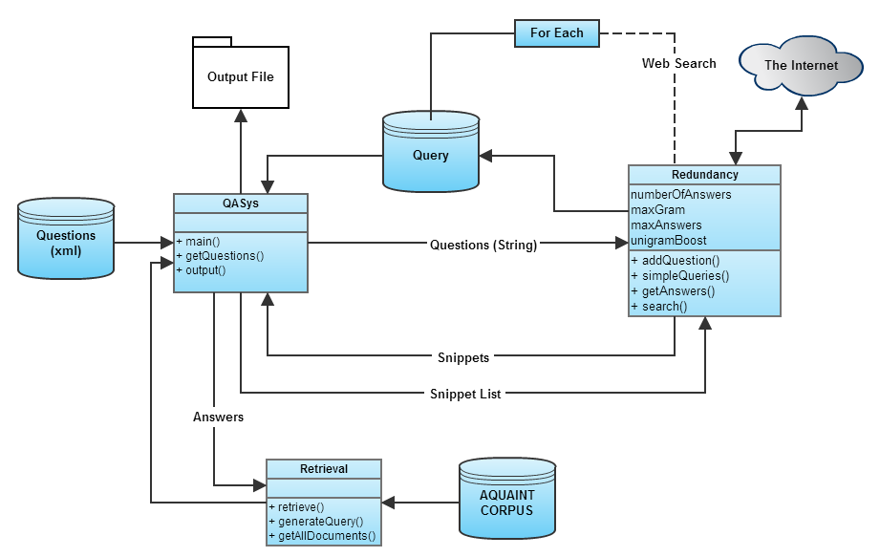
Implementation

Slide 7
Issues and Successes
Significant improvement against our baseline, especially in our lenient score
Test early and often
It's not going to run perfectly the first time
Document Retrieval
Issue retrieving documents from answer strings with punctuations and other characters
Overall program run time improvements due to caching

Slide 8
Planned Improvements
Query Formulation
More sophisticated parsing of the question
Tune the classification algorithm
IR Engine
Use the documents as the main source of snippets to search rather than the web
Increase accuracy to improve Strict score
Answer extraction
Investigate incorrect answers to improve methods for finding the answer in the candidate passages

