Slide 1
Question-Answering: Overview
Ling573
Systems & Applications
April 4, 2013

Slide 2
Roadmap
Dimensions of the problem
A (very) brief history
Architecture of a QA system
QA and resources
Evaluation
Challenges
Logistics Check-in

Slide 3
Dimensions of QA
Basic structure:
Question analysis
Answer search
Answer selection and presentation

Slide 4
Dimensions of QA
Basic structure:
Question analysis
Answer search
Answer selection and presentation
Rich problem domain: Tasks vary on
Applications
Users
Question types
Answer types
Evaluation
Presentation

Slide 5
Applications
Applications vary by:
Answer sources
Structured: e.g., database fields
Semi-structured: e.g., database with comments
Free text

Slide 6
Applications
Applications vary by:
Answer sources
Structured: e.g., database fields
Semi-structured: e.g., database with comments
Free text
Web
Fixed document collection (Typical TREC QA)

Slide 7
Applications
Applications vary by:
Answer sources
Structured: e.g., database fields
Semi-structured: e.g., database with comments
Free text
Web
Fixed document collection (Typical TREC QA)

Slide 8
Applications
Applications vary by:
Answer sources
Structured: e.g., database fields
Semi-structured: e.g., database with comments
Free text
Web
Fixed document collection (Typical TREC QA)
Book or encyclopedia
Specific passage/article (reading comprehension)

Slide 9
Applications
Applications vary by:
Answer sources
Structured: e.g., database fields
Semi-structured: e.g., database with comments
Free text
Web
Fixed document collection (Typical TREC QA)
Book or encyclopedia
Specific passage/article (reading comprehension)
Media and modality:
Within or cross-language; video/images/speech

Slide 10
Users
Novice
Understand capabilities/limitations of system

Slide 11
Users
Novice
Understand capabilities/limitations of system
Expert
Assume familiar with capabilties
Wants efficient information access
Maybe desirable/willing to set up profile

Slide 12
Question Types
Could be factual vs opinion vs summary

Slide 13
Question Types
Could be factual vs opinion vs summary
Factual questions:
Yes/no; wh-questions

Slide 14
Question Types
Could be factual vs opinion vs summary
Factual questions:
Yes/no; wh-questions
Vary dramatically in difficulty
Factoid, List

Slide 15
Question Types
Could be factual vs opinion vs summary
Factual questions:
Yes/no; wh-questions
Vary dramatically in difficulty
Factoid, List
Definitions
Why/how..

Slide 16
Question Types
Could be factual vs opinion vs summary
Factual questions:
Yes/no; wh-questions
Vary dramatically in difficulty
Factoid, List
Definitions
Why/how..
Open ended: ‘What happened?’

Slide 17
Question Types
Could be factual vs opinion vs summary
Factual questions:
Yes/no; wh-questions
Vary dramatically in difficulty
Factoid, List
Definitions
Why/how..
Open ended: ‘What happened?’
Affected by form
Who was the first president?

Slide 18
Question Types
Could be factual vs opinion vs summary
Factual questions:
Yes/no; wh-questions
Vary dramatically in difficulty
Factoid, List
Definitions
Why/how..
Open ended: ‘What happened?’
Affected by form
Who was the first president? Vs Name the first president

Slide 19
Answers
Like tests!

Slide 20
Answers
Like tests!
Form:
Short answer
Long answer
Narrative

Slide 21
Answers
Like tests!
Form:
Short answer
Long answer
Narrative
Processing:
Extractive vs generated vs synthetic

Slide 22
Answers
Like tests!
Form:
Short answer
Long answer
Narrative
Processing:
Extractive vs generated vs synthetic
In the limit -> summarization
What is the book about?

Slide 23
Evaluation & Presentation
What makes an answer good?

Slide 24
Evaluation & Presentation
What makes an answer good?
Bare answer

Slide 25
Evaluation & Presentation
What makes an answer good?
Bare answer
Longer with justification

Slide 26
Evaluation & Presentation
What makes an answer good?
Bare answer
Longer with justification
Implementation vs Usability
QA interfaces still rudimentary
Ideally should be

Slide 27
Evaluation & Presentation
What makes an answer good?
Bare answer
Longer with justification
Implementation vs Usability
QA interfaces still rudimentary
Ideally should be
Interactive, support refinement, dialogic

Slide 28
(Very) Brief History
Earliest systems: NL queries to databases (60s-70s)
BASEBALL, LUNAR

Slide 29
(Very) Brief History
Earliest systems: NL queries to databases (60-s-70s)
BASEBALL, LUNAR
Linguistically sophisticated:
Syntax, semantics, quantification, ,,,

Slide 30
(Very) Brief History
Earliest systems: NL queries to databases (60-s-70s)
BASEBALL, LUNAR
Linguistically sophisticated:
Syntax, semantics, quantification, ,,,
Restricted domain!

Slide 31
(Very) Brief History
Earliest systems: NL queries to databases (60-s-70s)
BASEBALL, LUNAR
Linguistically sophisticated:
Syntax, semantics, quantification, ,,,
Restricted domain!
Spoken dialogue systems (Turing!, 70s-current)
SHRDLU (blocks world), MIT’s Jupiter , lots more

Slide 32
(Very) Brief History
Earliest systems: NL queries to databases (60-s-70s)
BASEBALL, LUNAR
Linguistically sophisticated:
Syntax, semantics, quantification, ,,,
Restricted domain!
Spoken dialogue systems (Turing!, 70s-current)
SHRDLU (blocks world), MIT’s Jupiter , lots more
Reading comprehension: (~2000)

Slide 33
(Very) Brief History
Earliest systems: NL queries to databases (60-s-70s)
BASEBALL, LUNAR
Linguistically sophisticated:
Syntax, semantics, quantification, ,,,
Restricted domain!
Spoken dialogue systems (Turing!, 70s-current)
SHRDLU (blocks world), MIT’s Jupiter , lots more
Reading comprehension: (~2000)
Information retrieval (TREC); Information extraction (MUC)

Slide 34
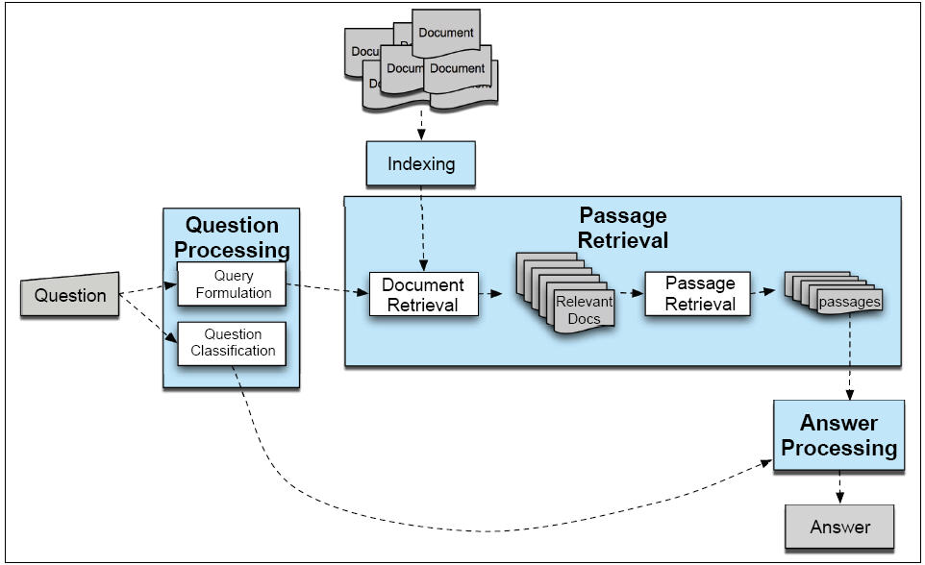
General Architecture

Slide 35
Basic Strategy
Given a document collection and a query:

Slide 36
Basic Strategy
Given a document collection and a query:
Execute the following steps:

Slide 37
Basic Strategy
Given a document collection and a query:
Execute the following steps:
Question processing
Document collection processing
Passage retrieval
Answer processing and presentation
Evaluation

Slide 38
Basic Strategy
Given a document collection and a query:
Execute the following steps:
Question processing
Document collection processing
Passage retrieval
Answer processing and presentation
Evaluation
Systems vary in detailed structure, and complexity

Slide 39
AskMSR
Shallow Processing for QA
1
2
3
5
4

Slide 40
Deep Processing Technique for QA
LCC (Moldovan, Harabagiu, et al)

Slide 41
Query Formulation
Convert question to suitable form for IR
Strategy depends on document collection
Web (or similar large collection):

Slide 42
Query Formulation
Convert question suitable form for IR
Strategy depends on document collection
Web (or similar large collection):
‘stop structure’ removal:
Delete function words, q-words, even low content verbs
Corporate sites (or similar smaller collection):

Slide 43
Query Formulation
Convert question suitable form for IR
Strategy depends on document collection
Web (or similar large collection):
‘stop structure’ removal:
Delete function words, q-words, even low content verbs
Corporate sites (or similar smaller collection):
Query expansion
Can’t count on document diversity to recover word variation

Slide 44
Query Formulation
Convert question suitable form for IR
Strategy depends on document collection
Web (or similar large collection):
‘stop structure’ removal:
Delete function words, q-words, even low content verbs
Corporate sites (or similar smaller collection):
Query expansion
Can’t count on document diversity to recover word variation
Add morphological variants, WordNet as thesaurus

Slide 45
Query Formulation
Convert question suitable form for IR
Strategy depends on document collection
Web (or similar large collection):
‘stop structure’ removal:
Delete function words, q-words, even low content verbs
Corporate sites (or similar smaller collection):
Query expansion
Can’t count on document diversity to recover word variation
Add morphological variants, WordNet as thesaurus
Reformulate as declarative: rule-based
Where is X located -> X is located in

Slide 46
Question Classification
Answer type recognition
Who

Slide 47
Question Classification
Answer type recognition
Who -> Person
What Canadian city ->

Slide 48
Question Classification
Answer type recognition
Who -> Person
What Canadian city -> City
What is surf music -> Definition
Identifies type of entity (e.g. Named Entity) or form (biography, definition) to return as answer

Slide 49
Question Classification
Answer type recognition
Who -> Person
What Canadian city -> City
What is surf music -> Definition
Identifies type of entity (e.g. Named Entity) or form (biography, definition) to return as answer
Build ontology of answer types (by hand)
Train classifiers to recognize

Slide 50
Question Classification
Answer type recognition
Who -> Person
What Canadian city -> City
What is surf music -> Definition
Identifies type of entity (e.g. Named Entity) or form (biography, definition) to return as answer
Build ontology of answer types (by hand)
Train classifiers to recognize
Using POS, NE, words

Slide 51
Question Classification
Answer type recognition
Who -> Person
What Canadian city -> City
What is surf music -> Definition
Identifies type of entity (e.g. Named Entity) or form (biography, definition) to return as answer
Build ontology of answer types (by hand)
Train classifiers to recognize
Using POS, NE, words
Synsets, hyper/hypo-nyms

Slide 52
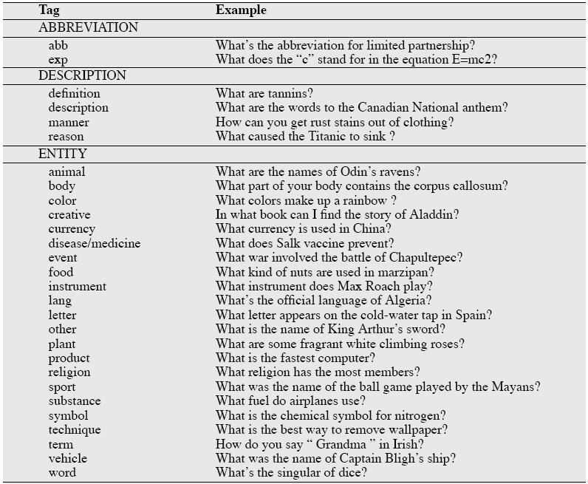

Slide 53
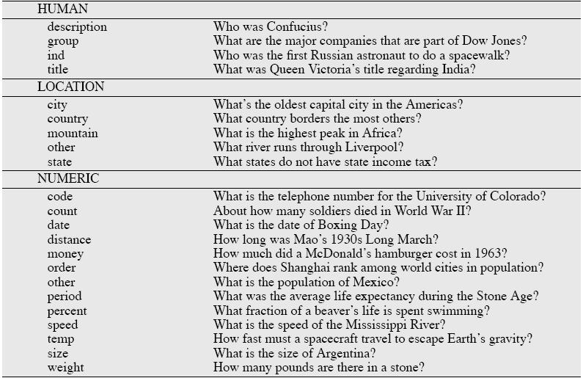

Slide 54
Passage Retrieval
Why not just perform general information retrieval?

Slide 55
Passage Retrieval
Why not just perform general information retrieval?
Documents too big, non-specific for answers
Identify shorter, focused spans (e.g., sentences)

Slide 56
Passage Retrieval
Why not just perform general information retrieval?
Documents too big, non-specific for answers
Identify shorter, focused spans (e.g., sentences)
Filter for correct type: answer type classification
Rank passages based on a trained classifier
Features:
Question keywords, Named Entities
Longest overlapping sequence,
Shortest keyword-covering span
N-gram overlap b/t question and passage

Slide 57
Passage Retrieval
Why not just perform general information retrieval?
Documents too big, non-specific for answers
Identify shorter, focused spans (e.g., sentences)
Filter for correct type: answer type classification
Rank passages based on a trained classifier
Features:
Question keywords, Named Entities
Longest overlapping sequence,
Shortest keyword-covering span
N-gram overlap b/t question and passage
For web search, use result snippets

Slide 58
Answer Processing
Find the specific answer in the passage

Slide 59
Answer Processing
Find the specific answer in the passage
Pattern extraction-based:
Include answer types, regular expressions
Similar to relation extraction:
Learn relation b/t answer type and aspect of question

Slide 60
Answer Processing
Find the specific answer in the passage
Pattern extraction-based:
Include answer types, regular expressions
Similar to relation extraction:
Learn relation b/t answer type and aspect of question
E.g. date-of-birth/person name; term/definition
Can use bootstrap strategy for contexts
<NAME> (<BD>-<DD>) or <NAME> was born on <BD>

Slide 61
Resources
System development requires resources
Especially true of data-driven machine learning

Slide 62
Resources
System development requires resources
Especially true of data-driven machine learning
QA resources:
Sets of questions with answers for development/test

Slide 63
Resources
System development requires resources
Especially true of data-driven machine learning
QA resources:
Sets of questions with answers for development/test
Specifically manually constructed/manually annotated

Slide 64
Resources
System development requires resources
Especially true of data-driven machine learning
QA resources:
Sets of questions with answers for development/test
Specifically manually constructed/manually annotated
‘Found data’

Slide 65
Resources
System development requires resources
Especially true of data-driven machine learning
QA resources:
Sets of questions with answers for development/test
Specifically manually constructed/manually annotated
‘Found data’
Trivia games!!!, FAQs, Answer Sites, etc

Slide 66
Resources
System development requires resources
Especially true of data-driven machine learning
QA resources:
Sets of questions with answers for development/test
Specifically manually constructed/manually annotated
‘Found data’
Trivia games!!!, FAQs, Answer Sites, etc
Multiple choice tests (IP???)

Slide 67
Resources
System development requires resources
Especially true of data-driven machine learning
QA resources:
Sets of questions with answers for development/test
Specifically manually constructed/manually annotated
‘Found data’
Trivia games!!!, FAQs, Answer Sites, etc
Multiple choice tests (IP???)
Partial data: Web logs – queries and click-throughs

Slide 68
Information Resources
Proxies for world knowledge:
WordNet: Synonymy; IS-A hierarchy

Slide 69
Information Resources
Proxies for world knowledge:
WordNet: Synonymy; IS-A hierarchy
Wikipedia

Slide 70
Information Resources
Proxies for world knowledge:
WordNet: Synonymy; IS-A hierarchy
Wikipedia
Web itself
….
Term management:
Acronym lists
Gazetteers
….

Slide 71
Software Resources
General: Machine learning tools

Slide 72
Software Resources
General: Machine learning tools
Passage/Document retrieval:
Information retrieval engine:
Lucene, Indri/lemur, MG
Sentence breaking, etc..

Slide 73
Software Resources
General: Machine learning tools
Passage/Document retrieval:
Information retrieval engine:
Lucene, Indri/lemur, MG
Sentence breaking, etc..
Query processing:
Named entity extraction
Synonymy expansion
Parsing?

Slide 74
Software Resources
General: Machine learning tools
Passage/Document retrieval:
Information retrieval engine:
Lucene, Indri/lemur, MG
Sentence breaking, etc..
Query processing:
Named entity extraction
Synonymy expansion
Parsing?
Answer extraction:
NER, IE (patterns)

Slide 75
Evaluation
Candidate criteria:
Relevance
Correctness
Conciseness:
No extra information
Completeness:
Penalize partial answers
Coherence:
Easily readable
Justification
Tension among criteria

Slide 76
Evaluation
Consistency/repeatability:
Are answers scored reliability

Slide 77
Evaluation
Consistency/repeatability:
Are answers scored reliability?
Automation:
Can answers be scored automatically?
Required for machine learning tune/test

Slide 78
Evaluation
Consistency/repeatability:
Are answers scored reliability?
Automation:
Can answers be scored automatically?
Required for machine learning tune/test
Short answer answer keys
Litkowski’s patterns

Slide 79
Evaluation
Classical:
Return ranked list of answer candidates

Slide 80
Evaluation
Classical:
Return ranked list of answer candidates
Idea: Correct answer higher in list => higher score
Measure: Mean Reciprocal Rank (MRR)

Slide 81
Evaluation
Classical:
Return ranked list of answer candidates
Idea: Correct answer higher in list => higher score
Measure: Mean Reciprocal Rank (MRR)
For each question,
Get reciprocal of rank of first correct answer
E.g. correct answer is 4 => ¼
None correct => 0
Average over all questions

Slide 82
Dimensions of TREC QA
Applications

Slide 83
Dimensions of TREC QA
Applications
Open-domain free text search
Fixed collections
News, blogs

Slide 84
Dimensions of TREC QA
Applications
Open-domain free text search
Fixed collections
News, blogs
Users
Novice
Question types

Slide 85
Dimensions of TREC QA
Applications
Open-domain free text search
Fixed collections
News, blogs
Users
Novice
Question types
Factoid -> List, relation, etc
Answer types

Slide 86
Dimensions of TREC QA
Applications
Open-domain free text search
Fixed collections
News, blogs
Users
Novice
Question types
Factoid -> List, relation, etc
Answer types
Predominantly extractive, short answer in context
Evaluation:

Slide 87
Dimensions of TREC QA
Applications
Open-domain free text search
Fixed collections
News, blogs
Users
Novice
Question types
Factoid -> List, relation, etc
Answer types
Predominantly extractive, short answer in context
Evaluation:
Official: human; proxy: patterns
Presentation: One interactive track

Slide 88
Watson & Jeopardy!™ vs QA
QA vs Jeopardy!
TREC QA systems on Jeopardy! task
Design strategies
Watson components
DeepQA on TREC

Slide 89
TREC QA vs Jeopardy!
Both:

Slide 90
TREC QA vs Jeopardy!
Both:
Open domain ‘questions’; factoids
TREC QA:
‘Small’ fixed doc set evidence, can access Web
No timing, no penalty for guessing wrong, no betting

Slide 91
TREC QA vs Jeopardy!
Both:
Open domain ‘questions’; factoids
TREC QA:
‘Small’ fixed doc set evidence, can access Web
No timing, no penalty for guessing wrong, no betting
Jeopardy!:
Timing, confidence key; betting
Board; Known question categories; Clues & puzzles
No live Web access, no fixed doc set

Slide 92
TREC QA Systems for Jeopardy!
TREC QA somewhat similar to Jeopardy!

Slide 93
TREC QA Systems for Jeopardy!
TREC QA somewhat similar to Jeopardy!
Possible approach: extend existing QA systems
IBM’s PIQUANT:
Closed document set QA, in top 3 at TREC: 30+%
CMU’s OpenEphyra:
Web evidence-based system: 45% on TREC2002

Slide 94
TREC QA Systems for Jeopardy!
TREC QA somewhat similar to Jeopardy!
Possible approach: extend existing QA systems
IBM’s PIQUANT:
Closed document set QA, in top 3 at TREC: 30+%
CMU’s OpenEphyra:
Web evidence-based system: 45% on TREC2002
Applied to 500 random Jeopardy questions
Both systems under 15% overall
PIQUANT ~45% when ‘highly confident’

Slide 95
DeepQA Design Strategies
Massive parallelism
Consider multiple paths and hypotheses

Slide 96
DeepQA Design Strategies
Massive parallelism
Consider multiple paths and hypotheses
Combine experts
Integrate diverse analysis components

Slide 97
DeepQA Design Strategies
Massive parallelism
Consider multiple paths and hypotheses
Combine experts
Integrate diverse analysis components
Confidence estimation:
All components estimate confidence; learn to combine

Slide 98
DeepQA Design Strategies
Massive parallelism
Consider multiple paths and hypotheses
Combine experts
Integrate diverse analysis components
Confidence estimation:
All components estimate confidence; learn to combine
Integrate shallow/deep processing approaches

Slide 99
Watson Components: Content
Content acquisition:
Corpora: encyclopedias, news articles, thesauri, etc
Automatic corpus expansion via web search
Knowledge bases: DBs, dbPedia, Yago, WordNet, etc

Slide 100
Watson Components: Question Analysis
Uses
“Shallow & deep parsing, logical forms, semantic role labels, coreference, relations, named entities, etc”

Slide 101
Watson Components: Question Analysis
Uses
“Shallow & deep parsing, logical forms, semantic role labels, coreference, relations, named entities, etc”
Question analysis: question types, components
Focus & LAT detection:
Finds lexical answer type and part of clue to replace with answer

Slide 102
Watson Components: Question Analysis
Uses
“Shallow & deep parsing, logical forms, semantic role labels, coreference, relations, named entities, etc”
Question analysis: question types, components
Focus & LAT detection:
Finds lexical answer type and part of clue to replace with answer
Relation detection: Syntactic or semantic rel’s in Q
Decomposition: Breaks up complex Qs to solve

Slide 103
Watson Components: Hypothesis Generation
Applies question analysis results to support search in resources and selection of answer candidates

Slide 104
Watson Components: Hypothesis Generation
Applies question analysis results to support search in resources and selection of answer candidates
‘Primary search’:
Recall-oriented search returning 250 candidates
Document- & passage-retrieval as well as KB search

Slide 105
Watson Components: Hypothesis Generation
Applies question analysis results to support search in resources and selection of answer candidates
‘Primary search’:
Recall-oriented search returning 250 candidates
Document- & passage-retrieval as well as KB search
Candidate answer generation:
Recall-oriented extracted of specific answer strings
E.g. NER-based extraction from passages

Slide 106
Watson Components: Filtering & Scoring
Previous stages generated 100s of candidates
Need to filter and rank

Slide 107
Watson Components: Filtering & Scoring
Previous stages generated 100s of candidates
Need to filter and rank
Soft filtering:
Lower resource techniques reduce candidates to ~100

Slide 108
Watson Components: Filtering & Scoring
Previous stages generated 100s of candidates
Need to filter and rank
Soft filtering:
Lower resource techniques reduce candidates to ~100
Hypothesis & Evidence scoring:
Find more evidence to support candidate
E.g. by passage retrieval augmenting query with candidate
Many scoring fns and features, including IDF-weighted overlap, sequence matching, logical form alignment, temporal and spatial reasoning, etc, etc..

Slide 109
Watson Components: Answer Merging and Ranking
Merging:
Uses matching, normalization, and coreference to integrate different forms of same concept
e.g., ‘President Lincoln’ with ‘Honest Abe’

Slide 110
Watson Components: Answer Merging and Ranking
Merging:
Uses matching, normalization, and coreference to integrate different forms of same concept
e.g., ‘President Lincoln’ with ‘Honest Abe’
Ranking and Confidence estimation:
Trained on large sets of questions and answers
Metalearner built over intermediate domain learners
Models built for different question classes

Slide 111
Watson Components: Answer Merging and Ranking
Merging:
Uses matching, normalization, and coreference to integrate different forms of same concept
e.g., ‘President Lincoln’ with ‘Honest Abe’
Ranking and Confidence estimation:
Trained on large sets of questions and answers
Metalearner built over intermediate domain learners
Models built for different question classes
Also tuned for speed, trained for strategy, betting

Slide 112
Retuning to TREC QA
DeepQA system augmented with TREC-specific:
Question analysis and classification
Answer extraction
Used PIQUANT and OpenEphyra answer typing

Slide 113
Retuning to TREC QA
DeepQA system augmented with TREC-specific:
Question analysis and classification
Answer extraction
Used PIQUANT and OpenEphyra answer typing
2008: Unadapted: 35% -> Adapted: 60%
2010: Unadapted: 51% -> Adapted: 67%

Slide 114
Summary
Many components, analyses similar to TREC QA
Question analysis →Passage Retrieval → Answer extr.
May differ in detail, e.g. complex puzzle questions
Some additional:
Intensive confidence scoring, strategizing, betting
Some interesting assets:
Lots of QA training data, sparring matches
Interesting approaches:
Parallel mixtures of experts; breadth, depth of NLP

