Slide 1
Deep Processing QA & Information Retrieval
Ling573
NLP Systems and Applications
April 11, 2013

Slide 2
Roadmap
PowerAnswer-2: Deep processing Q/A
Problem:
Matching Topics and Documents
Methods:
Vector Space Model
Retrieval evaluation

Slide 3
PowerAnswer2
Language Computer Corp.
Lots of UT Dallas affiliates
Tasks: factoid questions
Major novel components:
Web-boosting of results
COGEX logic prover
Temporal event processing
Extended semantic chains
Results: “Above median”: 53.4% main

Slide 4
Challenges: Co-reference
Single, basic referent:

Slide 5
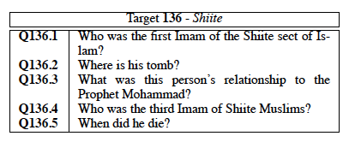
Challenges: Co-reference
Single, basic referent:
Multiple possible antecedents:
Depends on previous correct answers

Slide 6
Challenges: Events
Event answers:
Not just nominal concepts

Slide 7
Challenges: Events
Event answers:
Not just nominal concepts
Nominal events:
Preakness 1998

Slide 8
Challenges: Events
Event answers:
Not just nominal concepts
Nominal events:
Preakness 1998
Complex events:
Plane clips cable wires in Italian resort

Slide 9
Challenges: Events
Event answers:
Not just nominal concepts
Nominal events:
Preakness 1998
Complex events:
Plane clips cable wires in Italian resort
Establish question context, constraints

Slide 10
Handling Question Series
Given target and series, how deal with reference?

Slide 11
Handling Question Series
Given target and series, how deal with reference?
Shallowest approach:
Concatenation:
Add the ‘target’ to the question

Slide 12
Handling Question Series
Given target and series, how deal with reference?
Shallowest approach:
Concatenation:
Add the ‘target’ to the question
Shallow approach:
Replacement:
Replace all pronouns with target

Slide 13
Handling Question Series
Given target and series, how deal with reference?
Shallowest approach:
Concatenation:
Add the ‘target’ to the question
Shallow approach:
Replacement:
Replace all pronouns with target
Least shallow approach:
Heuristic reference resolution

Slide 14
Question Series Results
No clear winning strategy

Slide 15
Question Series Results
No clear winning strategy
All largely about the target
So no big win for anaphora resolution
If using bag-of-words features in search, works fine

Slide 16
Question Series Results
No clear winning strategy
All largely about the target
So no big win for anaphora resolution
If using bag-of-words features in search, works fine
‘Replacement’ strategy can be problematic
E.g. Target=Nirvana:
What is their biggest hit?

Slide 17
Question Series Results
No clear winning strategy
All largely about the target
So no big win for anaphora resolution
If using bag-of-words features in search, works fine
‘Replacement’ strategy can be problematic
E.g. Target=Nirvana:
What is their biggest hit?
When was the band formed?

Slide 18
Question Series Results
No clear winning strategy
All largely about the target
So no big win for anaphora resolution
If using bag-of-words features in search, works fine
‘Replacement’ strategy can be problematic
E.g. Target=Nirvana:
What is their biggest hit?
When was the band formed?
Wouldn’t replace ‘the band’

Slide 19
Question Series Results
No clear winning strategy
All largely about the target
So no big win for anaphora resolution
If using bag-of-words features in search, works fine
‘Replacement’ strategy can be problematic
E.g. Target=Nirvana:
What is their biggest hit?
When was the band formed?
Wouldn’t replace ‘the band’
Most teams concatenate

Slide 20
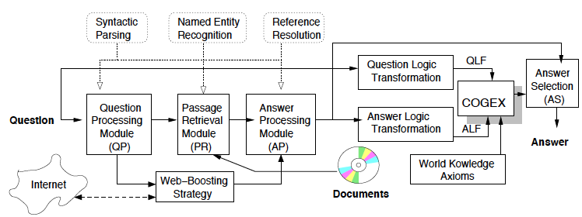
PowerAnswer-2
Factoid QA system:

Slide 21
PowerAnswer-2
Standard main components:
Question analysis, passage retrieval, answer processing

Slide 22
PowerAnswer-2
Standard main components:
Question analysis, passage retrieval, answer processing
Web-based answer boosting

Slide 23
PowerAnswer-2
Standard main components:
Question analysis, passage retrieval, answer processing
Web-based answer boosting
Complex components:

Slide 24
PowerAnswer-2
Standard main components:
Question analysis, passage retrieval, answer processing
Web-based answer boosting
Complex components:
COGEX abductive prover
Word knowledge, semantics:
Extended WordNet, etc
Temporal processing

Slide 25
Web-Based Boosting
Create search engine queries from question

Slide 26
Web-Based Boosting
Create search engine queries from question
Extract most redundant answers from search
Cf. Dumais et al – AskMSR; Lin – ARANEA

Slide 27
Web-Based Boosting
Create search engine queries from question
Extract most redundant answers from search
Cf. Dumais et al - AskMSR; Lin – ARANEA
Increase weight on TREC candidates that match
Higher weight if higher frequency

Slide 28
Web-Based Boosting
Create search engine queries from question
Extract most redundant answers from search
Cf. Dumais et al - AskMSR; Lin – ARANEA
Increase weight on TREC candidates that match
Higher weight if higher frequency
Intuition:
Common terms in search likely to be answer
QA answer search too focused on query terms

Slide 29
Web-Based Boosting
Create search engine queries from question
Extract most redundant answers from search
Cf. Dumais et al - AskMSR; Lin – ARANEA
Increase weight on TREC candidates that match
Higher weight if higher frequency
Intuition:
Common terms in search likely to be answer
QA answer search too focused on query terms
Reweighting improves
Web-boosting improves significantly: 20%

Slide 30
Deep Processing: Query/Answer Formulation
Preliminary shallow processing:
Tokenization, POS tagging, NE recognition, Preprocess

Slide 31
Deep Processing: Query/Answer Formulation
Preliminary shallow processing:
Tokenization, POS tagging, NE recognition, Preprocess
Parsing creates syntactic representation:
Focused on nouns, verbs, and particles
Attachment

Slide 32
Deep Processing: Query/Answer Formulation
Preliminary shallow processing:
Tokenization, POS tagging, NE recognition, Preprocess
Parsing creates syntactic representation:
Focused on nouns, verbs, and particles
Attachment
Coreference resolution links entity references

Slide 33
Deep Processing: Query/Answer Formulation
Preliminary shallow processing:
Tokenization, POS tagging, NE recognition, Preprocess
Parsing creates syntactic representation:
Focused on nouns, verbs, and particles
Attachment
Coreference resolution links entity references
Translate to full logical form
As close as possible to syntax

Slide 34
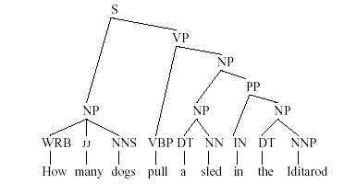
Syntax to Logical Form

Slide 35
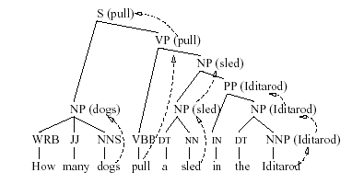
Syntax to Logical Form

Slide 36
Syntax to Logical Form

Slide 37
Deep Processing: Answer Selection
Lexical chains:
Bridge gap in lexical choice b/t Q and A
Improve retrieval and answer selection

Slide 38
Deep Processing: Answer Selection
Lexical chains:
Bridge gap in lexical choice b/t Q and A
Improve retrieval and answer selection
Create connections between synsets through topicality
Q: When was the internal combustion engine invented?
A: The first internal-combustion engine was built in 1867.
invent → create_mentally → create → build

Slide 39
Deep Processing: Answer Selection
Lexical chains:
Bridge gap in lexical choice b/t Q and A
Improve retrieval and answer selection
Create connections between synsets through topicality
Q: When was the internal combustion engine invented?
A: The first internal-combustion engine was built in 1867.
invent → create_mentally → create → build
Perform abductive reasoning b/t QLF & ALF
Tries to justify answer given question

Slide 40
Deep Processing: Answer Selection
Lexical chains:
Bridge gap in lexical choice b/t Q and A
Improve retrieval and answer selection
Create connections between synsets through topicality
Q: When was the internal combustion engine invented?
A: The first internal-combustion engine was built in 1867.
invent → create_mentally → create → build
Perform abductive reasoning b/t QLF & ALF
Tries to justify answer given question
Yields 12% improvement in accuracy!

Slide 41
Temporal Processing
16% of factoid questions include time reference

Slide 42
Temporal Processing
16% of factoid questions include time reference
Index documents by date: absolute, relative

Slide 43
Temporal Processing
16% of factoid questions include time reference
Index documents by date: absolute, relative
Identify temporal relations b/t events
Store as triples of (S, E1, E2)
S is temporal relation signal – e.g. during, after

Slide 44
Temporal Processing
16% of factoid questions include time reference
Index documents by date: absolute, relative
Identify temporal relations b/t events
Store as triples of (S, E1, E2)
S is temporal relation signal – e.g. during, after
Answer selection:
Prefer passages matching Question temporal constraint
Discover events related by temporal signals in Q & As
Perform temporal unification; boost good As

Slide 45
Temporal Processing
16% of factoid questions include time reference
Index documents by date: absolute, relative
Identify temporal relations b/t events
Store as triples of (S, E1, E2)
S is temporal relation signal – e.g. during, after
Answer selection:
Prefer passages matching Question temporal constraint
Discover events related by temporal signals in Q & As
Perform temporal unification; boost good As
Improves only by 2%
Mostly captured by surface forms

Slide 46
Results

Slide 47
Matching Topics and Documents
Two main perspectives:
Pre-defined, fixed, finite topics:
“Text Classification”

Slide 48
Matching Topics and Documents
Two main perspectives:
Pre-defined, fixed, finite topics:
“Text Classification”
Arbitrary topics, typically defined by statement of information need (aka query)
“Information Retrieval”
Ad-hoc retrieval

Slide 49
Information Retrieval Components
Document collection:
Used to satisfy user requests, collection of:

Slide 50
Information Retrieval Components
Document collection:
Used to satisfy user requests, collection of:
Documents:
Basic unit available for retrieval

Slide 51
Information Retrieval Components
Document collection:
Used to satisfy user requests, collection of:
Documents:
Basic unit available for retrieval
Typically: Newspaper story, encyclopedia entry

Slide 52
Information Retrieval Components
Document collection:
Used to satisfy user requests, collection of:
Documents:
Basic unit available for retrieval
Typically: Newspaper story, encyclopedia entry
Alternatively: paragraphs, sentences; web page, site

Slide 53
Information Retrieval Components
Document collection:
Used to satisfy user requests, collection of:
Documents:
Basic unit available for retrieval
Typically: Newspaper story, encyclopedia entry
Alternatively: paragraphs, sentences; web page, site
Query:
Specification of information need

Slide 54
Information Retrieval Components
Document collection:
Used to satisfy user requests, collection of:
Documents:
Basic unit available for retrieval
Typically: Newspaper story, encyclopedia entry
Alternatively: paragraphs, sentences; web page, site
Query:
Specification of information need
Terms:
Minimal units for query/document

Slide 55
Information Retrieval Components
Document collection:
Used to satisfy user requests, collection of:
Documents:
Basic unit available for retrieval
Typically: Newspaper story, encyclopedia entry
Alternatively: paragraphs, sentences; web page, site
Query:
Specification of information need
Terms:
Minimal units for query/document
Words, or phrases

Slide 56
Information Retrieval Architecture

Slide 57
Vector Space Model
Basic representation:
Document and query semantics defined by their terms

Slide 58
Vector Space Model
Basic representation:
Document and query semantics defined by their terms
Typically ignore any syntax
Bag-of-words (or Bag-of-terms)
Dog bites man == Man bites dog

Slide 59
Vector Space Model
Basic representation:
Document and query semantics defined by their terms
Typically ignore any syntax
Bag-of-words (or Bag-of-terms)
Dog bites man == Man bites dog
Represent documents and queries as
Vectors of term-based features

Slide 60
Vector Space Model
Basic representation:
Document and query semantics defined by their terms
Typically ignore any syntax
Bag-of-words (or Bag-of-terms)
Dog bites man == Man bites dog
Represent documents and queries as
Vectors of term-based features
E.g.
N:

Slide 61
Vector Space Model
Basic representation:
Document and query semantics defined by their terms
Typically ignore any syntax
Bag-of-words (or Bag-of-terms)
Dog bites man == Man bites dog
Represent documents and queries as
Vectors of term-based features
E.g.
N:
# of terms in vocabulary of collection: Problem?

Slide 62
Representation
Solution 1:
Binary features:
w=1 if term present, 0 otherwise
Similarity:
Number of terms in common
Dot product
Issues?

Slide 63
VSM Weights
What should the weights be?
“Aboutness”
To what degree is this term what document is about?
Within document measure
Term frequency (tf): # occurrences of t in doc j
Examples:
Terms: chicken, fried, oil, pepper
D1: fried chicken recipe: (8, 2, 7,4)
D2: poached chick recipe: (6, 0, 0, 0)
Q: fried chicken: (1, 1, 0, 0)

Slide 64
Vector Space Model (II)
Documents & queries:
Document collection: term-by-document matrix
View as vector in multidimensional space
Nearby vectors are related
Normalize for vector length

Slide 65
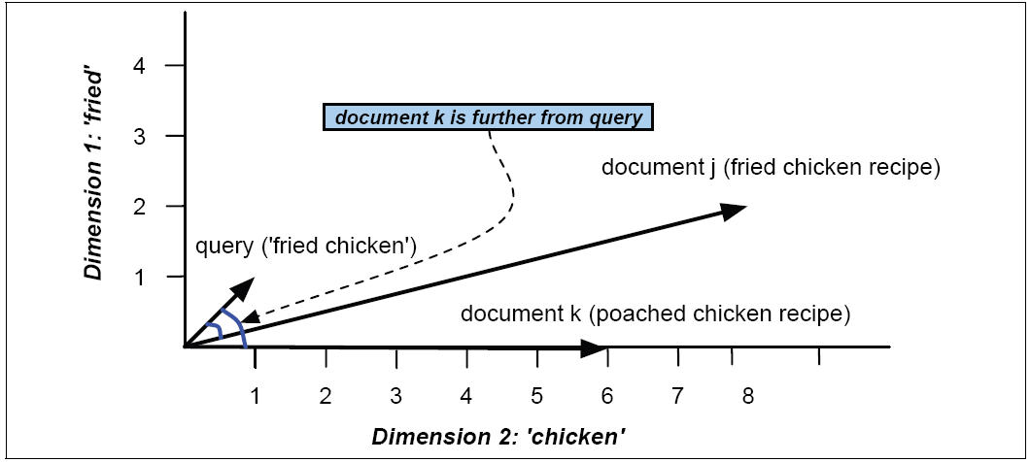
Vector Space Model

Slide 66
Vector Similarity Computation
Normalization:
Improve over dot product
Capture weights
Compensate for document length
:

Slide 67
Vector Similarity Computation
Normalization:
Improve over dot product
Capture weights
Compensate for document length
Cosine similarity

Slide 68
Vector Similarity Computation
Normalization:
Improve over dot product
Capture weights
Compensate for document length
Cosine similarity
Identical vectors:

Slide 69
Vector Similarity Computation
Normalization:
Improve over dot product
Capture weights
Compensate for document length
Cosine similarity
Identical vectors: 1
No overlap:

Slide 70
Vector Similarity Computation
Normalization:
Improve over dot product
Capture weights
Compensate for document length
Cosine similarity
Identical vectors: 1
No overlap: 0

Slide 71
Term Weighting Redux
“Aboutness”
Term frequency (tf): # occurrences of t in doc j

Slide 72
Term Weighting Redux
“Aboutness”
Term frequency (tf): # occurrences of t in doc j
Chicken: 6; Fried: 1 vs Chicken: 1; Fried: 6

Slide 73
Term Weighting Redux
“Aboutness”
Term frequency (tf): # occurrences of t in doc j
Chicken: 6; Fried: 1 vs Chicken: 1; Fried: 6
Question: what about ‘Representative’ vs ‘Giffords’?

Slide 74
Term Weighting Redux
“Aboutness”
Term frequency (tf): # occurrences of t in doc j
Chicken: 6; Fried: 1 vs Chicken: 1; Fried: 6
Question: what about ‘Representative’ vs ‘Giffords’?
“Specificity”
How surprised are you to see this term?
Collection frequency
Inverse document frequency (idf):

Slide 75
Term Weighting Redux
“Aboutness”
Term frequency (tf): # occurrences of t in doc j
Chicken: 6; Fried: 1 vs Chicken: 1; Fried: 6
Question: what about ‘Representative’ vs ‘Giffords’?
“Specificity”
How surprised are you to see this term?
Collection frequency
Inverse document frequency (idf):

Slide 76
Tf-idf Similarity
Variants of tf-idf prevalent in most VSM

Slide 77
Term Selection
Selection:
Some terms are truly useless

Slide 78
Term Selection
Selection:
Some terms are truly useless
Too frequent:
Appear in most documents

Slide 79
Term Selection
Selection:
Some terms are truly useless
Too frequent:
Appear in most documents
Little/no semantic content

Slide 80
Term Selection
Selection:
Some terms are truly useless
Too frequent:
Appear in most documents
Little/no semantic content
Function words
E.g. the, a, and,…

Slide 81
Term Selection
Selection:
Some terms are truly useless
Too frequent:
Appear in most documents
Little/no semantic content
Function words
E.g. the, a, and,…
Indexing inefficiency:
Store in inverted index:
For each term, identify documents where it appears
‘the’: every document is a candidate match

Slide 82
Term Selection
Selection:
Some terms are truly useless
Too frequent:
Appear in most documents
Little/no semantic content
Function words
E.g. the, a, and,…
Indexing inefficiency:
Store in inverted index:
For each term, identify documents where it appears
‘the’: every document is a candidate match
Remove ‘stop words’ based on list
Usually document-frequency based

Slide 83
Term Creation
Too many surface forms for same concepts

Slide 84
Term Creation
Too many surface forms for same concepts
E.g. inflections of words: verb conjugations, plural
Process, processing, processed
Same concept, separated by inflection

Slide 85
Term Creation
Too many surface forms for same concepts
E.g. inflections of words: verb conjugations, plural
Process, processing, processed
Same concept, separated by inflection
Stem terms:
Treat all forms as same underlying
E.g., ‘processing’ -> ‘process’; ‘Beijing’ -> ‘Beije’
Issues:

Slide 86
Term Creation
Too many surface forms for same concepts
E.g. inflections of words: verb conjugations, plural
Process, processing, processed
Same concept, separated by inflection
Stem terms:
Treat all forms as same underlying
E.g., ‘processing’ -> ‘process’; ‘Beijing’ -> ‘Beije’
Issues:
Can be too aggressive
AIDS, aids -> aid; stock, stocks, stockings -> stock

Slide 87
Evaluating IR
Basic measures: Precision and Recall

Slide 88
Evaluating IR
Basic measures: Precision and Recall
Relevance judgments:
For a query, returned document is relevant or non-relevant
Typically binary relevance: 0/1

Slide 89
Evaluating IR
Basic measures: Precision and Recall
Relevance judgments:
For a query, returned document is relevant or non-relevant
Typically binary relevance: 0/1
T: returned documents; U: true relevant documents
R: returned relevant documents
N: returned non-relevant documents

Slide 90
Evaluating IR
Basic measures: Precision and Recall
Relevance judgments:
For a query, returned document is relevant or non-relevant
Typically binary relevance: 0/1
T: returned documents; U: true relevant documents
R: returned relevant documents
N: returned non-relevant documents

Slide 91
Evaluating IR
Issue: Ranked retrieval
Return top 1K documents: ‘best’ first

Slide 92
Evaluating IR
Issue: Ranked retrieval
Return top 1K documents: ‘best’ first
10 relevant documents returned:

Slide 93
Evaluating IR
Issue: Ranked retrieval
Return top 1K documents: ‘best’ first
10 relevant documents returned:
In first 10 positions?

Slide 94
Evaluating IR
Issue: Ranked retrieval
Return top 1K documents: ‘best’ first
10 relevant documents returned:
In first 10 positions?
In last 10 positions?

Slide 95
Evaluating IR
Issue: Ranked retrieval
Return top 1K documents: ‘best’ first
10 relevant documents returned:
In first 10 positions?
In last 10 positions?
Score by precision and recall – which is better?

Slide 96
Evaluating IR
Issue: Ranked retrieval
Return top 1K documents: ‘best’ first
10 relevant documents returned:
In first 10 positions?
In last 10 positions?
Score by precision and recall – which is better?
Identical !!!
Correspond to intuition? NO!

Slide 97
Evaluating IR
Issue: Ranked retrieval
Return top 1K documents: ‘best’ first
10 relevant documents returned:
In first 10 positions?
In last 10 positions?
Score by precision and recall – which is better?
Identical !!!
Correspond to intuition? NO!
Need rank-sensitive measures

Slide 98
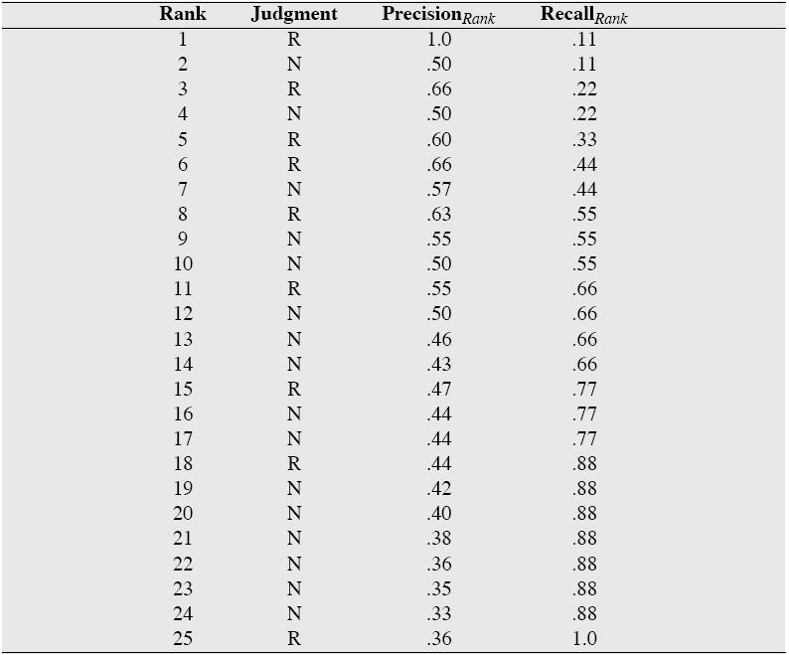
Rank-specific P & R

Slide 99
Rank-specific P & R
Precision_{rank}: based on fraction of reldocs at rank
Recall_{rank}: similarly

Slide 100
Rank-specific P & R
Precision_{rank}: based on fraction of reldocs at rank
Recall_{rank}: similarly
Note: Recall is non-decreasing; Precision varies

Slide 101
Rank-specific P & R
Precision_{rank}: based on fraction of reldocs at rank
Recall_{rank}: similarly
Note: Recall is non-decreasing; Precision varies
Issue: too many numbers; no holistic view

Slide 102
Rank-specific P & R
Precision_{rank}: based on fraction of reldocs at rank
Recall_{rank}: similarly
Note: Recall is non-decreasing; Precision varies
Issue: too many numbers; no holistic view
Typically, compute precision at 11 fixed levels of recall
Interpolated precision:
Can smooth variations in precision

Slide 103
Interpolated Precision

Slide 104
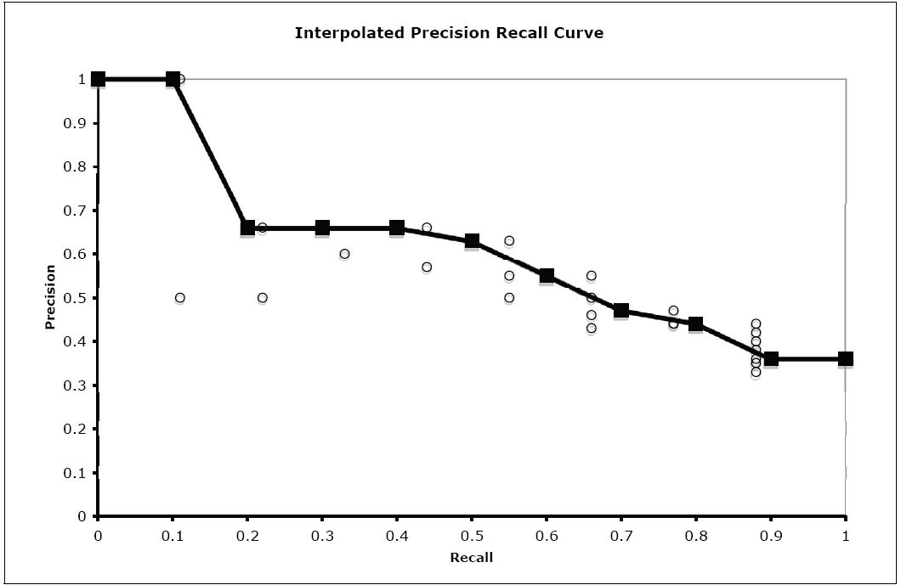
Comparing Systems
Create graph of precision vs recall
Averaged over queries
Compare graphs

Slide 105
Mean Average Precision (MAP)
Traverse ranked document list:
Compute precision each time relevant doc found

Slide 106
Mean Average Precision (MAP)
Traverse ranked document list:
Compute precision each time relevant doc found
Average precision up to some fixed cutoff
R_{r}: set of relevant documents at or above r
Precision(d) : precision at rank when doc d found

Slide 107
Mean Average Precision (MAP)
Traverse ranked document list:
Compute precision each time relevant doc found
Average precision up to some fixed cutoff
R_{r}: set of relevant documents at or above r
Precision(d) : precision at rank when doc d found
Mean Average Precision: 0.6
Compute average over all queries of these averages

Slide 108
Mean Average Precision (MAP)
Traverse ranked document list:
Compute precision each time relevant doc found
Average precision up to some fixed cutoff
R_{r}: set of relevant documents at or above r
Precision(d) : precision at rank when doc d found
Mean Average Precision: 0.6
Compute average of all queries of these averages
Precision-oriented measure

Slide 109
Mean Average Precision (MAP)
Traverse ranked document list:
Compute precision each time relevant doc found
Average precision up to some fixed cutoff
R_{r}: set of relevant documents at or above r
Precision(d) : precision at rank when doc d found
Mean Average Precision: 0.6
Compute average of all queries of these averages
Precision-oriented measure
Single crisp measure: common TREC Ad-hoc

Slide 110
Roadmap
Retrieval systems
Improving document retrieval
Compression & Expansion techniques
Passage retrieval:
Contrasting techniques
Interactions with document retreival

Slide 111
Retrieval Systems
Three available systems
Lucene: Apache
Boolean systems with Vector Space Ranking
Provides basic CLI/API (Java, Python)
Indri/Lemur: Umass /CMU
Language Modeling system (best ad-hoc)
‘Structured query language
Weighting,
Provides both CLI/API (C++,Java)
Managing Gigabytes (MG):
Straightforward VSM

Slide 112
Retrieval System Basics
Main components:
Document indexing
Reads document text
Performs basic analysis
Minimally – tokenization, stopping, case folding
Potentially stemming, semantics, phrasing, etc
Builds index representation

Slide 113
Retrieval System Basics
Main components:
Document indexing
Reads document text
Performs basic analysis
Minimally – tokenization, stopping, case folding
Potentially stemming, semantics, phrasing, etc
Builds index representation
Query processing and retrieval
Analyzes query (similar to document)
Incorporates any additional term weighting, etc
Retrieves based on query content
Returns ranked document list

Slide 114
Example (I/L)
indri-5.0/buildindex/IndriBuildIndex parameter_file
XML parameter file specifies:
Minimally:
Index: path to output
Corpus (+): path to corpus, corpus type
Optionally:
Stemmer, field information
indri-5.0/runquery/IndriRunQuery query_parameter_file -count=1000 \
-index=/path/to/index -trecFormat=true > result_file
Parameter file: formatted queries w/query #

Slide 115
Lucene
Collection of classes to support IR
Less directly linked to TREC
E.g. query, doc readers
IndexWriter class
Builds, extends index
Applies analyzers to content
SimpleAnalyzer: stops, case folds, tokenizes
Also Stemmer classes, other langs, etc
Classes to read, search, analyze index
QueryParser parses query (fields, boosting, regexp)

