Slide 1
Passage Retrieval & Re-ranking
Ling573
NLP Systems & Applications
April 18, 2013

Slide 2
Roadmap
Passage retrieval vs passage ranking
Comparisons of
Passage unit size
Passage type
Passage re-ranking
Exploiting deeper processing
Dependency matching
Answer types

Slide 3
Units of Retrieval
Simple is Best: Experiments with Different Document Segmentation Strategies for Passage Retrieval
Tiedemann and Mur, 2008

Slide 4
Units of Retrieval
Simple is Best: Experiments with Different Document Segmentation Strategies for Passage Retrieval
Tiedemann and Mur, 2008
Comparison of units for retrieval in QA
Documents
Paragraphs
Sentences
Semantically-based units (discourse segments)
Spans

Slide 5
Motivation
Passage units necessary for QA
Focused sources for answers
Typically > 20 passage candidates yield poor QA

Slide 6
Motivation
Passage units necessary for QA
Focused sources for answers
Typically > 20 passage candidates yield poor QA
Retrieval fundamentally crucial

Slide 7
Motivation
Passage units necessary for QA
Focused sources for answers
Typically > 20 passage candidates yield poor QA
Retrieval fundamentally crucial
Re-ranking passages is hard

Slide 8
Motivation
Passage units necessary for QA
Focused sources for answers
Typically > 20 passage candidates yield poor QA
Retrieval fundamentally crucial
Re-ranking passages is hard
Tellex et al experiments
Improvements for passage reranking, but
Still dramatically lower than oracle retrieval rates

Slide 9
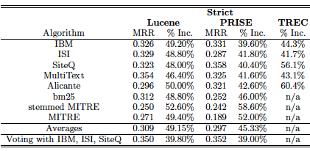
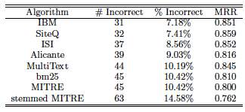

Slide 10
Passages
Some basic advantages for retrieval (vs documents)

Slide 11
Passages
Some basic advantages for retrieval (vs documents)
Documents vary in

Slide 12
Passages
Some basic advantages for retrieval (vs documents)
Documents vary in
Length,
Topic term density,
Etc
across type

Slide 13
Passages
Some basic advantages for retrieval (vs documents)
Documents vary in
Length,
Topic term density,
Etc
across type
Passages can be less variable
Effectively normalizing for length

Slide 14
What Makes a Passage?
Sources of passage information

Slide 15
What Makes a Passage?
Sources of passage information
Manual:
Existing markup

Slide 16
What Makes a Passage?
Sources of passage information
Manual:
Existing markup
E.g., Sections, Paragraphs
Issues: ?

Slide 17
What Makes a Passage?
Sources of passage information
Manual:
Existing markup
E.g., Sections, Paragraphs
Issues: ?
Still highly variable:
Wikipedia vs Newswire

Slide 18
What Makes a Passage?
Sources of passage information
Manual:
Existing markup
E.g., Sections, Paragraphs
Issues: ?
Still highly variable:
Wikipedia vs Newswire
Potentially ambiguous:
blank lines separate …..

Slide 19
What Makes a Passage?
Sources of passage information
Manual:
Existing markup
E.g., Sections, Paragraphs
Issues: ?
Still highly variable:
Wikipedia vs Newswire
Potentially ambiguous:
blank lines separate …..
Not always available

Slide 20
What Makes a Passage?
Automatic:

Slide 21
What Makes a Passage?
Automatic:
Semantically motivated document segmentation
Linguistic content
Lexical patterns and relations

Slide 22
What Makes a Passage?
Automatic:
Semantically motivated document segmentation
Linguistic content
Lexical patterns and relations
Fixed length units:
In words/chars or sentences/paragraphs
Overlapping?
Can be determined empirically
All experiments use Zettair retrieval engine

Slide 23
Coreference Chains
Coreference:
NPs that refer to same entity
Create an equivalence class

Slide 24
Coreference Chains
Coreference:
NPs that refer to same entity
Create an equivalence class
Chains of coreference suggest entity-based coherence

Slide 25
Coreference Chains
Coreference:
NPs that refer to same entity
Create an equivalence class
Chains of coreference suggest entity-based coherence
Passage:
All sentences spanned by a coreference chain
Can create overlapping passages
Built with cluster-based ranking with own coref. system
System has F-measure of 54.5%

Slide 26
Coreference Chains
Coreference:
NPs that refer to same entity
Create an equivalence class
Chains of coreference suggest entity-based coherence
Passage:
All sentences spanned by a coreference chain
Can create overlapping passages
Built with cluster-based ranking with own coref. System
System has F-measure of 54.5%

Slide 27
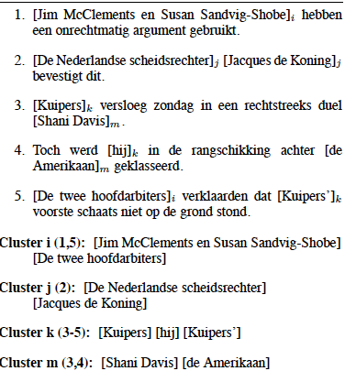

Slide 28
TextTiling (Hearst)
Automatic topic, sub-topic segmentation

Slide 29
TextTiling (Hearst)
Automatic topic, sub-topic segmentation
Computes similarity between neighboring text blocks
Based on weighted cosine similarity

Slide 30
TextTiling (Hearst)
Automatic topic, sub-topic segmentation
Computes similarity between neighboring text blocks
Based on weighted cosine similarity
Compares similarity values
Hypothesizes topic shift at dips b/t peaks in similarity

Slide 31
TextTiling (Hearst)
Automatic topic, sub-topic segmentation
Computes similarity between neighboring text blocks
Based on weighted cosine similarity
Compares similarity values
Hypothesizes topic shift at dips b/t peaks in similarity
Produces linear topic segmentation

Slide 32
TextTiling (Hearst)
Automatic topic, sub-topic segmentation
Computes similarity between neighboring text blocks
Based on weighted cosine similarity
Compares similarity values
Hypothesizes topic shift at dips b/t peaks in similarity
Produces linear topic segmentation
Existing implementations

Slide 33
Window-based Segmentation
Fixed width windows:
Based on words? Characters? Sentences?

Slide 34
Window-based Segmentation
Fixed width windows:
Based on words? Characters? Sentences?
Sentences required for downstream deep processing

Slide 35
Window-based Segmentation
Fixed width windows:
Based on words? Characters? Sentences?
Sentences required for downstream deep processing
Overlap? No overlap?

Slide 36
Window-based Segmentation
Fixed width windows:
Based on words? Characters? Sentences?
Sentences required for downstream deep processing
Overlap? No overlap?
No overlap is simple, but
Not guaranteed to line up with natural boundaries
Including document boundaries

Slide 37
Evaluation
Indexing and retrieval in Zettair system
CLEF Dutch QA track
Computes
Lenient MRR measure

Slide 38
Evaluation
Indexing and retrieval in Zettair system
CLEF Dutch QA track
Computes
Lenient MRR measure
Too few participants to assume pooling exhaustive
Redundancy: Average # relevant passage per query

Slide 39
Evaluation
Indexing and retrieval in Zettair system
CLEF Dutch QA track
Computes
Lenient MRR measure
Too few participants to assume pooling exhaustive
Redundancy: Average # relevant passage per query
Coverage: Proportion of Qs w/at least one relpass

Slide 40
Evaluation
Indexing and retrieval in Zettair system
CLEF Dutch QA track
Computes
Lenient MRR measure
Too few participants to assume pooling exhaustive
Redundancy: Average # relevant passage per query
Coverage: Proportion of Qs w/at least one relpass
MAP

Slide 41
Evaluation
Indexing and retrieval in Zettair system
CLEF Dutch QA track
Computes
Lenient MRR measure
Too few participants to assume pooling exhaustive
Redundancy: Average # relevant passage per query
Coverage: Proportion of Qs w/at least one relpass
MAP
Focus on MRR for prediction of end-to-end QA

Slide 42
Baselines
Existing markup:
Documents, paragraphs, sentences

Slide 43
Baselines
Existing markup:
Documents, paragraphs, sentences
MRR-IR; MRR-QA (top 5); CLEF: end-to-end score

Slide 44
Baselines
Existing markup:
Documents, paragraphs, sentences
MRR-IR; MRR-QA (top 5); CLEF: end-to-end score
Surprisingly good sentence results in top-5 and CLEF
Sensitive to exact retrieval weighting

Slide 45
Semantic Passages
Contrast:
Sentence/coref: Sentences in coref. chains

Slide 46
Semantic Passages
Contrast:
Sentence/coref: Sentences in coref. chains → too long

Slide 47
Semantic Passages
Contrast:
Sentence/coref: Sentences in coref. chains → too long
Bounded length
Paragraphs and coref chains (bounded)

Slide 48
Semantic Passages
Contrast:
Sentence/coref: Sentences in coref. chains → too long
Bounded length
Paragraphs and coref chains (bounded)
TextTiling (CPAN)

Slide 49
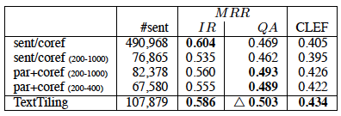
Semantic Passages
Contrast:
Sentence/coref: Sentences in coref. chains → too long
Bounded length
Paragraphs and coref chains (bounded)
TextTiling (CPAN) – Best : beats baseline

Slide 50
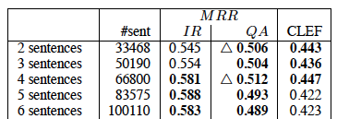
Fixed Size Windows
Different lengths: non-overlapping
2-, 4-sentence units improve over semantic units

Slide 51
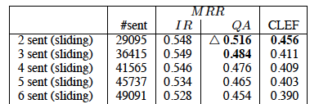
Sliding Windows
Fixed length windows, overlapping
Best MRR-QA values
Small units with overlap
Other settings weaker

Slide 52
Observations
Competing retrieval demands:
IR performance
vs
QA performance

Slide 53
Observations
Competing retrieval demands:
IR performance
vs
QA performance
MRR at 5 favors:

Slide 54
Observations
Competing retrieval demands:
IR performance
vs
QA performance
MRR at 5 favors:
Small, fixed width units
Advantageous for downstream processing too

Slide 55
Observations
Competing retrieval demands:
IR performance
vs
QA performance
MRR at 5 favors:
Small, fixed width units
Advantageous for downstream processing too
Any benefit of more sophisticated segments
Outweighed by increased processing

Slide 56
Reranking with Deep Processing
Passage Reranking for Question Answering Using Syntactic Structures and Answer Types
Atkolga et al, 2011
Reranking of retrieved passages
Integrates
Syntactic alignment
Answer type
Named Entity information

Slide 57
Motivation
Issues in shallow passage approaches:
From Tellex et al.

Slide 58
Motivation
Issues in shallow passage approaches:
From Tellex et al.
Retrieval match admits many possible answers
Need answer type to restrict

Slide 59
Motivation
Issues in shallow passage approaches:
From Tellex et al.
Retrieval match admits many possible answers
Need answer type to restrict
Question implies particular relations
Use syntax to ensure

Slide 60
Motivation
Issues in shallow passage approaches:
From Tellex et al.
Retrieval match admits many possible answers
Need answer type to restrict
Question implies particular relations
Use syntax to ensure
Joint strategy required
Checking syntactic parallelism when no answer, useless
Current approach incorporates all (plus NER)

Slide 61
Baseline Retrieval
Bag-of-Words unigram retrieval (BOW)

Slide 62
Baseline Retrieval
Bag-of-Words unigram retrieval (BOW)
Question analysis: QuAn
ngram retrieval, reformulation

Slide 63
Baseline Retrieval
Bag-of-Words unigram retrieval (BOW)
Question analysis: QuAn
ngram retrieval, reformulation
Question analysis + Wordnet: QuAn-Wnet
Adds 10 synonyms of ngrams in QuAn

Slide 64
Baseline Retrieval
Bag-of-Words unigram retrieval (BOW)
Question analysis: QuAn
ngram retrieval, reformulation
Question analysis + Wordnet: QuAn-Wnet
Adds 10 synonyms of ngrams in QuAn
Best performance: QuAn-Wnet (baseline)

Slide 65
Dependency Information
Assume dependency parses of questions, passages
Passage = sentence
Extract undirected dependency paths b/t words

Slide 66
Dependency Information
Assume dependency parses of questions, passages
Passage = sentence
Extract undirected dependency paths b/t words
Find path pairs between words (q_{k},a_{l}),(q_{r},a_{s})
Where q/a words ‘match’
Word match if a) same root or b) synonyms

Slide 67
Dependency Information
Assume dependency parses of questions, passages
Passage = sentence
Extract undirected dependency paths b/t words
Find path pairs between words (q_{k},a_{l}),(q_{r},a_{s})
Where q/a words ‘match’
Word match if a) same root or b) synonyms
Later: require one pair to be question word/Answer term
Train path ‘translation pair’ probabilities

Slide 68
Dependency Information
Assume dependency parses of questions, passages
Passage = sentence
Extract undirected dependency paths b/t words
Find path pairs between words (q_{k},a_{l}),(q_{r},a_{s})
Where q/a words ‘match’
Word match if a) same root or b) synonyms
Later: require one pair to be question word/Answer term
Train path ‘translation pair’ probabilities
Use true Q/A pairs, <path_{q},path_{a}>
GIZA++, IBM model 1
Yields Pr(label_{a},label_{q})

Slide 69
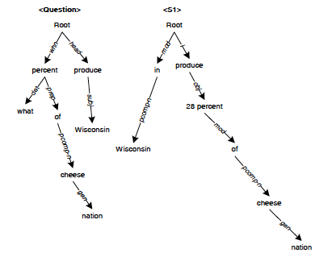
Dependency Path Similarity
From Cui

Slide 70
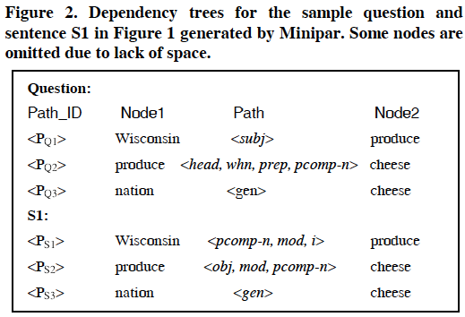
Dependency Path Similarity

Slide 71
Similarity
Dependency path matching

Slide 72
Similarity
Dependency path matching
Some paths match exactly
Many paths have partial overlap or differ due to question/declarative contrasts

Slide 73
Similarity
Dependency path matching
Some paths match exactly
Many paths have partial overlap or differ due to question/declarative contrasts
Approaches have employed
Exact match
Fuzzy match
Both can improve over baseline retrieval, fuzzy more

Slide 74
Dependency Path Similarity
Cui et al scoring
Sum over all possible paths in a QA candidate pair

Slide 75
Dependency Path Similarity
Cui et al scoring
Sum over all possible paths in a QA candidate pair

Slide 76
Dependency Path Similarity
Cui et al scoring
Sum over all possible paths in a QA candidate pair

Slide 77
Dependency Path Similarity
Atype-DP
Restrict first q,a word pair to Qword, ACand
Where Acand has correct answer type by NER

Slide 78
Dependency Path Similarity
Atype-DP
Restrict first q,a word pair to Qword, ACand
Where Acand has correct answer type by NER
Sum over all possible paths in a QA candidate pair
with best answer candidate

Slide 79
Dependency Path Similarity
Atype-DP
Restrict first q,a word pair to Qword, ACand
Where Acand has correct answer type by NER
Sum over all possible paths in a QA candidate pair
with best answer candidate

Slide 80
Comparisons
Atype-DP-IP
Interpolates DP score with original retrieval score

Slide 81
Comparisons
Atype-DP-IP
Interpolates DP score with original retrieval score
QuAn-Elim:
Acts a passage answer-type filter
Excludes any passage w/o correct answer type

Slide 82
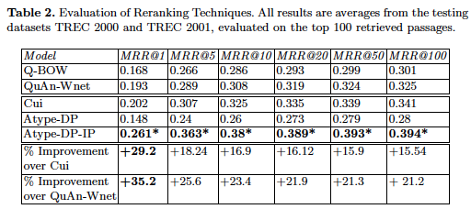
Results
Atype-DP-IP best

Slide 83
Results
Atype-DP-IP best
Raw dependency:‘brittle’; NE failure backs off to IP

Slide 84
Results
Atype-DP-IP best
Raw dependency:‘brittle’; NE failure backs off to IP
QuAn-Elim: NOT significantly worse

Slide 85
Learning Passage Ranking
Alternative to heuristic similarity measures
Identify candidate features
Allow learning algorithm to select

Slide 86
Learning Passage Ranking
Alternative to heuristic similarity measures
Identify candidate features
Allow learning algorithm to select
Learning and ranking:
Employ general classifiers
Use score to rank (e.g., SVM, Logistic Regression)

Slide 87
Learning Passage Ranking
Alternative to heuristic similarity measures
Identify candidate features
Allow learning algorithm to select
Learning and ranking:
Employ general classifiers
Use score to rank (e.g., SVM, Logistic Regression)
Employ explicit rank learner
E.g. RankBoost

Slide 88
Shallow Features & Ranking
Is Question Answering an Acquired Skill?
Ramakrishnan et al, 2004
Full QA system described
Shallow processing techniques
Integration of Off-the-shelf components
Focus on rule-learning vs hand-crafting
Perspective: questions as noisy SQL queries

Slide 89
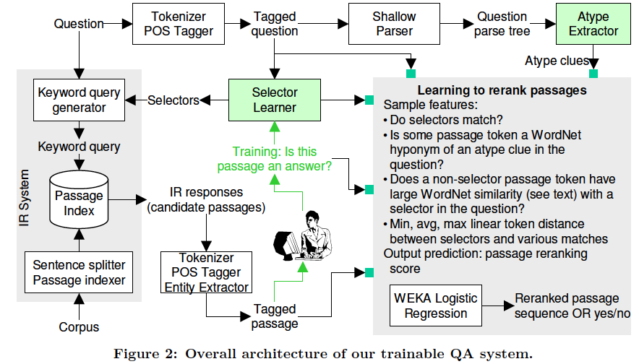
Architecture

Slide 90
Basic Processing
Initial retrieval results:
IR ‘documents’:
3 sentence windows (Tellex et al)
Indexed in Lucene
Retrieved based on reformulated query

Slide 91
Basic Processing
Initial retrieval results:
IR ‘documents’:
3 sentence windows (Tellex et al)
Indexed in Lucene
Retrieved based on reformulated query
Question-type classification
Based on shallow parsing
Synsets or surface patterns

Slide 92
Selectors
Intuition:
‘Where’ clause in an SQL query – selectors

Slide 93
Selectors
Intuition:
‘Where’ clause in an SQL query – selectors
Portion(s) of query highly likely to appear in answer
Train system to recognize these terms
Best keywords for query
Tokyo is the capital of which country?
Answer probably includes…..

Slide 94
Selectors
Intuition:
‘Where’ clause in an SQL query – selectors
Portion(s) of query highly likely to appear in answer
Train system to recognize these terms
Best keywords for query
Tokyo is the capital of which country?
Answer probably includes…..
Tokyo+++
Capital+
Country?

Slide 95
Selector Recognition
Local features from query:
POS of word
POS of previous/following word(s), in window
Capitalized?

Slide 96
Selector Recognition
Local features from query:
POS of word
POS of previous/following word(s), in window
Capitalized?
Global features of word:
Stopword?
IDF of word
Number of word senses
Average number of words per sense

Slide 97
Selector Recognition
Local features from query:
POS of word
POS of previous/following word(s), in window
Capitalized?
Global features of word:
Stopword?
IDF of word
Number of word senses
Average number of words per sense
Measures of word specificity/ambiguity

Slide 98
Selector Recognition
Local features from query:
POS of word
POS of previous/following word(s), in window
Capitalized?
Global features of word:
Stopword?
IDF of word
Number of word senses
Average number of words per sense
Measures of word specificity/ambiguity
Train Decision Tree classifier on gold answers: +/-S

Slide 99
Passage Ranking
For question q and passage r, in a good passage:

Slide 100
Passage Ranking
For question q and passage r, in a good passage:
All selectors in q appear in r

Slide 101
Passage Ranking
For question q and passage r, in a good passage:
All selectors in q appear in r
r has answer zone A w/o selectors

Slide 102
Passage Ranking
For question q and passage r, in a good passage:
All selectors in q appear in r
r has answer zone A w/o selectors
Distances b/t selectors and answer zone A are small

Slide 103
Passage Ranking
For question q and passage r, in a good passage:
All selectors in q appear in r
r has answer zone A w/o selectors
Distances b/t selectors and answer zone A are small
A has high similarity with question type

Slide 104
Passage Ranking
For question q and passage r, in a good passage:
All selectors in q appear in r
r has answer zone A w/o selectors
Distances b/t selectors and answer zone A are small
A has high similarity with question type
Relationship b/t Qtype, A’s POS and NE tag (if any)

Slide 105
Passage Ranking Features
Find candidate answer zone A* as follows for (q.r)
Remove all matching q selectors in r
For each word (or compound in r) A
Compute Hyperpath distance b/t Qtype & A
Where HD is Jaccard overlap between hypernyms of Qtype & A

Slide 106
Passage Ranking Features
Find candidate answer zone A* as follows for (q.r)
Remove all matching q selectors in r
For each word (or compound in r) A
Compute Hyperpath distance b/t Qtype & A
Where HD is Jaccard overlap between hypernyms of Qtype & A
Compute L as set of distances from selectors to A*
Feature vector:

Slide 107
Passage Ranking Features
Find candidate answer zone A* as follows for (q.r)
Remove all matching q selectors in r
For each word (or compound in r) A
Compute Hyperpath distance b/t Qtype & A
Where HD is Jaccard overlap between hypernyms of Qtype & A
Compute L as set of distances from selectors to A*
Feature vector:
IR passage rank; HD score; max, mean, min of L

Slide 108
Passage Ranking Features
Find candidate answer zone A* as follows for (q.r)
Remove all matching q selectors in r
For each word (or compound in r) A
Compute Hyperpath distance b/t Qtype & A
Where HD is Jaccard overlap between hypernyms of Qtype & A
Compute L as set of distances from selectors to A*
Feature vector:
IR passage rank; HD score; max, mean, min of L
POS tag of A*; NE tag of A*; Qwords in q

Slide 109
Passage Ranking
Train logistic regression classifier
Positive example:

Slide 110
Passage Ranking
Train logistic regression classifier
Positive example: question + passage with answer
Negative example:

Slide 111
Passage Ranking
Train logistic regression classifier
Positive example: question + passage with answer
Negative example: question w/any other passage
Classification:
Hard decision: 80% accurate, but

Slide 112
Passage Ranking
Train logistic regression classifier
Positive example: question + passage with answer
Negative example: question w/any other passage
Classification:
Hard decision: 80% accurate, but
Skewed, most cases negative: poor recall

Slide 113
Passage Ranking
Train logistic regression classifier
Positive example: question + passage with answer
Negative example: question w/any other passage
Classification:
Hard decision: 80% accurate, but
Skewed, most cases negative: poor recall
Use regression scores directly to rank

Slide 114
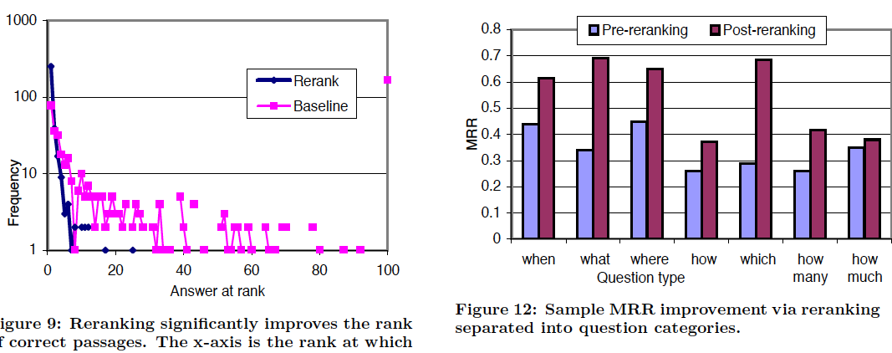
Passage Ranking

