Slide 1
Question Classification
Ling573
NLP Systems and Applications
April 25, 2013

Slide 2
Deliverable #3
Posted: Code & results due May 10
Focus: Question processing
Classification, reformulation, expansion, etc
Additional: general improvement motivated by D#2

Slide 3
Question Classification: Li&Roth

Slide 4
Roadmap
Motivation:

Slide 5
Why Question Classification?

Slide 6
Why Question Classification?
Question classification categorizes possible answers

Slide 7
Why Question Classification?
Question classification categorizes possible answers
Constrains answers types to help find, verify answer
Q: What Canadian city has the largest population?
Type?

Slide 8
Why Question Classification?
Question classification categorizes possible answers
Constrains answers types to help find, verify answer
Q: What Canadian city has the largest population?
Type? -> City
Can ignore all non-city NPs

Slide 9
Why Question Classification?
Question classification categorizes possible answers
Constrains answers types to help find, verify answer
Q: What Canadian city has the largest population?
Type? -> City
Can ignore all non-city NPs
Provides information for type-specific answer selection
Q: What is a prism?
Type? ->

Slide 10
Why Question Classification?
Question classification categorizes possible answers
Constrains answers types to help find, verify answer
Q: What Canadian city has the largest population?
Type? -> City
Can ignore all non-city NPs
Provides information for type-specific answer selection
Q: What is a prism?
Type? -> Definition
Answer patterns include: ‘A prism is…’

Slide 11
Challenges

Slide 12
Challenges
Variability:
What tourist attractions are there in Reims?
What are the names of the tourist attractions in Reims?
What is worth seeing in Reims?
Type?

Slide 13
Challenges
Variability:
What tourist attractions are there in Reims?
What are the names of the tourist attractions in Reims?
What is worth seeing in Reims?
Type? -> Location

Slide 14
Challenges
Variability:
What tourist attractions are there in Reims?
What are the names of the tourist attractions in Reims?
What is worth seeing in Reims?
Type? -> Location
Manual rules?

Slide 15
Challenges
Variability:
What tourist attractions are there in Reims?
What are the names of the tourist attractions in Reims?
What is worth seeing in Reims?
Type? -> Location
Manual rules?
Nearly impossible to create sufficient patterns
Solution?

Slide 16
Challenges
Variability:
What tourist attractions are there in Reims?
What are the names of the tourist attractions in Reims?
What is worth seeing in Reims?
Type? -> Location
Manual rules?
Nearly impossible to create sufficient patterns
Solution?
Machine learning – rich feature set

Slide 17
Approach
Employ machine learning to categorize by answer type
Hierarchical classifier on semantic hierarchy of types
Coarse vs fine-grained
Up to 50 classes
Differs from text categorization?

Slide 18
Approach
Employ machine learning to categorize by answer type
Hierarchical classifier on semantic hierarchy of types
Coarse vs fine-grained
Up to 50 classes
Differs from text categorization?
Shorter (much!)
Less information, but
Deep analysis more tractable

Slide 19
Approach
Exploit syntactic and semantic information
Diverse semantic resources

Slide 20
Approach
Exploit syntactic and semantic information
Diverse semantic resources
Named Entity categories
WordNet sense
Manually constructed word lists
Automatically extracted semantically similar word lists

Slide 21
Approach
Exploit syntactic and semantic information
Diverse semantic resources
Named Entity categories
WordNet sense
Manually constructed word lists
Automatically extracted semantically similar word lists
Results:
Coarse: 92.5%; Fine: 89.3%
Semantic features reduce error by 28%

Slide 22
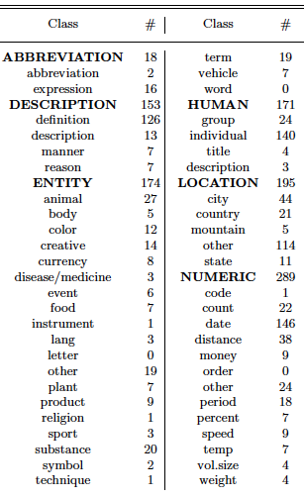
Question Hierarchy

Slide 23
Learning a Hierarchical Question Classifier
Many manual approaches use only :

Slide 24
Learning a Hierarchical Question Classifier
Many manual approaches use only :
Small set of entity types, set of handcrafted rules

Slide 25
Learning a Hierarchical Question Classifier
Many manual approaches use only :
Small set of entity types, set of handcrafted rules
Note: Webclopedia’s 96 node taxo w/276 manual rules

Slide 26
Learning a Hierarchical Question Classifier
Many manual approaches use only :
Small set of entity types, set of handcrafted rules
Note: Webclopedia’s 96 node taxo w/276 manual rules
Learning approaches can learn to generalize
Train on new taxonomy, but

Slide 27
Learning a Hierarchical Question Classifier
Many manual approaches use only :
Small set of entity types, set of handcrafted rules
Note: Webclopedia’s 96 node taxo w/276 manual rules
Learning approaches can learn to generalize
Train on new taxonomy, but
Someone still has to label the data…
Two step learning: (Winnow)
Same features in both cases

Slide 28
Learning a Hierarchical Question Classifier
Many manual approaches use only :
Small set of entity types, set of handcrafted rules
Note: Webclopedia’s 96 node taxo w/276 manual rules
Learning approaches can learn to generalize
Train on new taxonomy, but
Someone still has to label the data…
Two step learning: (Winnow)
Same features in both cases
First classifier produces (a set of) coarse labels
Second classifier selects from fine-grained children of coarse tags generated by the previous stage
Select highest density classes above threshold

Slide 29
Features for Question Classification
Primitive lexical, syntactic, lexical-semantic features
Automatically derived
Combined into conjunctive, relational features
Sparse, binary representation

Slide 30
Features for Question Classification
Primitive lexical, syntactic, lexical-semantic features
Automatically derived
Combined into conjunctive, relational features
Sparse, binary representation
Words
Combined into ngrams

Slide 31
Features for Question Classification
Primitive lexical, syntactic, lexical-semantic features
Automatically derived
Combined into conjunctive, relational features
Sparse, binary representation
Words
Combined into ngrams
Syntactic features:
Part-of-speech tags
Chunks
Head chunks : 1st N, V chunks after Q-word

Slide 32
Syntactic Feature Example
Q: Who was the first woman killed in the Vietnam War?

Slide 33
Syntactic Feature Example
Q: Who was the first woman killed in the Vietnam War?
POS: [Who WP] [was VBD] [the DT] [first JJ] [woman NN] [killed VBN] [in IN] [the DT] [Vietnam NNP] [War NNP] [? .]

Slide 34
Syntactic Feature Example
Q: Who was the first woman killed in the Vietnam War?
POS: [Who WP] [was VBD] [the DT] [first JJ] [woman NN] [killed VBN] {in IN] [the DT] [Vietnam NNP] [War NNP] [? .]
Chunking: [NP Who] [VP was] [NP the first woman] [VP killed] [PP in] [NP the Vietnam War] ?

Slide 35
Syntactic Feature Example
Q: Who was the first woman killed in the Vietnam War?
POS: [Who WP] [was VBD] [the DT] [first JJ] [woman NN] [killed VBN] {in IN] [the DT] [Vietnam NNP] [War NNP] [? .]
Chunking: [NP Who] [VP was] [NP the first woman] [VP killed] [PP in] [NP the Vietnam War] ?
Head noun chunk: ‘the first woman’

Slide 36
Semantic Features
Treat analogously to syntax?

Slide 37
Semantic Features
Treat analogously to syntax?
Q1:What’s the semantic equivalent of POS tagging?

Slide 38
Semantic Features
Treat analogously to syntax?
Q1:What’s the semantic equivalent of POS tagging?
Q2: POS tagging > 97% accurate;
Semantics? Semantic ambiguity?

Slide 39
Semantic Features
Treat analogously to syntax?
Q1:What’s the semantic equivalent of POS tagging?
Q2: POS tagging > 97% accurate;
Semantics? Semantic ambiguity?
A1: Explore different lexical semantic info sources
Differ in granularity, difficulty, and accuracy

Slide 40
Semantic Features
Treat analogously to syntax?
Q1:What’s the semantic equivalent of POS tagging?
Q2: POS tagging > 97% accurate;
Semantics? Semantic ambiguity?
A1: Explore different lexical semantic info sources
Differ in granularity, difficulty, and accuracy
Named Entities
WordNet Senses
Manual word lists
Distributional sense clusters

Slide 41
Tagging & Ambiguity
Augment each word with semantic category
What about ambiguity?
E.g. ‘water’ as ‘liquid’ or ‘body of water’

Slide 42
Tagging & Ambiguity
Augment each word with semantic category
What about ambiguity?
E.g. ‘water’ as ‘liquid’ or ‘body of water’
Don’t disambiguate
Keep all alternatives
Let the learning algorithm sort it out
Why?

Slide 43
Semantic Categories
Named Entities
Expanded class set: 34 categories
E.g. Profession, event, holiday, plant,…

Slide 44
Semantic Categories
Named Entities
Expanded class set: 34 categories
E.g. Profession, event, holiday, plant,…
WordNet: IS-A hierarchy of senses
All senses of word + direct hyper/hyponyms

Slide 45
Semantic Categories
Named Entities
Expanded class set: 34 categories
E.g. Profession, event, holiday, plant,…
WordNet: IS-A hierarchy of senses
All senses of word + direct hyper/hyponyms
Class-specific words
Manually derived from 5500 questions
E.g. Class: Food
{alcoholic, apple, beer, berry, breakfast brew butter candy cereal champagne cook delicious eat fat ..}
Class is semantic tag for word in the list

Slide 46
Semantic Types
Distributional clusters:
Based on Pantel and Lin
Cluster based on similarity in dependency relations
Word lists for 20K English words

Slide 47
Semantic Types
Distributional clusters:
Based on Pantel and Lin
Cluster based on similarity in dependency relations
Word lists for 20K English words
Lists correspond to word senses
Water:
Sense 1: { oil gas fuel food milk liquid}
Sense 2: {air moisture soil heat area rain}
Sense 3: {waste sewage pollution runoff}

Slide 48
Semantic Types
Distributional clusters:
Based on Pantel and Lin
Cluster based on similarity in dependency relations
Word lists for 20K English words
Lists correspond to word senses
Water:
Sense 1: { oil gas fuel food milk liquid}
Sense 2: {air moisture soil heat area rain}
Sense 3: {waste sewage pollution runoff}
Treat head word as semantic category of words on list

Slide 49
Evaluation
Assess hierarchical coarse->fine classification
Assess impact of different semantic features
Assess training requirements for diff’t feature set

Slide 50
Evaluation
Assess hierarchical coarse->fine classification
Assess impact of different semantic features
Assess training requirements for diff’t feature set
Training:
21.5K questions from TREC 8,9; manual; USC data
Test:
1K questions from TREC 10,11

Slide 51
Evaluation
Assess hierarchical coarse->fine classification
Assess impact of different semantic features
Assess training requirements for diff’t feature set
Training:
21.5K questions from TREC 8,9; manual; USC data
Test:
1K questions from TREC 10,11
Measures: Accuracy and class-specific precision

Slide 52
Results
Syntactic features only:
POS useful; chunks useful to contribute head chunks
Fine categories more ambiguous

Slide 53
Results
Syntactic features only:
POS useful; chunks useful to contribute head chunks
Fine categories more ambiguous
Semantic features:
Best combination: SYN, NE, Manual & Auto word lists
Coarse: same; Fine: 89.3% (28.7% error reduction)

Slide 54
Results
Syntactic features only:
POS useful; chunks useful to contribute head chunks
Fine categories more ambiguous
Semantic features:
Best combination: SYN, NE, Manual & Auto word lists
Coarse: same; Fine: 89.3% (28.7% error reduction)
Wh-word most common class: 41%

Slide 55
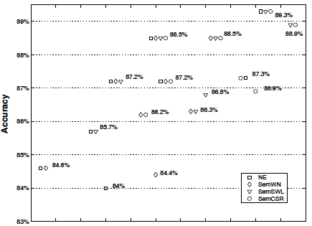

Slide 56
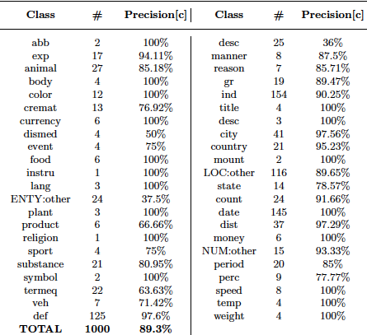

Slide 57
Observations
Effective coarse and fine-grained categorization
Mix of information sources and learning
Shallow syntactic features effective for coarse
Semantic features improve fine-grained
Most feature types help
WordNet features appear noisy
Use of distributional sense clusters dramatically increases feature dimensionality

