Slide 1
Question Classification II
Ling573
NLP Systems and Applications
April 30, 2013

Slide 2
Roadmap
Question classification variations:
SVM classifiers
Sequence classifiers
Sense information improvements
Question series

Slide 3
Question Classification with Support Vector Machines
Hacioglu & Ward 2003
Same taxonomy, training, test data as Li & Roth

Slide 4
Question Classification with Support Vector Machines
Hacioglu & Ward 200
Same taxonomy, training, test data as Li & Roth
Approach:
Shallow processing
Simpler features
Strong discriminative classifiers

Slide 5
Question Classification with Support Vector Machines
Hacioglu & Ward 2003
Same taxonomy, training, test data as Li & Roth
Approach:
Shallow processing
Simpler features
Strong discriminative classifiers

Slide 6
Features & Processing
Contrast: (Li & Roth)
POS, chunk info; NE tagging; other sense info

Slide 7
Features & Processing
Contrast: (Li & Roth)
POS, chunk info; NE tagging; other sense info
Preprocessing:
Only letters, convert to lower case, stopped, stemmed

Slide 8
Features & Processing
Contrast: (Li & Roth)
POS, chunk info; NE tagging; other sense info
Preprocessing:
Only letters, convert to lower case, stopped, stemmed
Terms:
Most informative 2000 word N-grams
Identifinder NE tags (7 or 9 tags)

Slide 9
Classification & Results
Employs support vector machines for classification
Best results: Bi-gram, 7 NE classes

Slide 10
Classification & Results
Employs support vector machines for classification
Best results: Bi-gram, 7 NE classes
Better than Li & Roth w/POS+chunk, but no semantics

Slide 11
Classification & Results
Employs support vector machines for classification
Best results: Bi-gram, 7 NE classes
Better than Li & Roth w/POS+chunk, but no semantics
Fewer NE categories better
More categories, more errors

Slide 12
Enhanced Answer Type Inference … Using Sequential Models
Krishnan, Das, and Chakrabarti 2005
Improves QC with CRF extraction of ‘informer spans’

Slide 13
Enhanced Answer Type Inference … Using Sequential Models
Krishnan, Das, and Chakrabarti 2005
Improves QC with CRF extraction of ‘informer spans’
Intuition:
Humans identify Atype from few tokens w/little syntax

Slide 14
Enhanced Answer Type Inference … Using Sequential Models
Krishnan, Das, and Chakrabarti 2005
Improves QC with CRF extraction of ‘informer spans’
Intuition:
Humans identify Atype from few tokens w/little syntax
Who wrote Hamlet?

Slide 15
Enhanced Answer Type Inference … Using Sequential Models
Krishnan, Das, and Chakrabarti 2005
Improves QC with CRF extraction of ‘informer spans’
Intuition:
Humans identify Atype from few tokens w/little syntax
Who wrote Hamlet?

Slide 16
Enhanced Answer Type Inference … Using Sequential Models
Krishnan, Das, and Chakrabarti 2005
Improves QC with CRF extraction of ‘informer spans’
Intuition:
Humans identify Atype from few tokens w/little syntax
Who wrote Hamlet?
How many dogs pull a sled at Iditarod?

Slide 17
Enhanced Answer Type Inference … Using Sequential Models
Krishnan, Das, and Chakrabarti 2005
Improves QC with CRF extraction of ‘informer spans’
Intuition:
Humans identify Atype from few tokens w/little syntax
Who wrote Hamlet?
How many dogs pull a sled at Iditarod?

Slide 18
Enhanced Answer Type Inference … Using Sequential Models
Krishnan, Das, and Chakrabarti 2005
Improves QC with CRF extraction of ‘informer spans’
Intuition:
Humans identify Atype from few tokens w/little syntax
Who wrote Hamlet?
How many dogs pull a sled at Iditarod?
How much does a rhino weigh?

Slide 19
Enhanced Answer Type Inference … Using Sequential Models
Krishnan, Das, and Chakrabarti 2005
Improves QC with CRF extraction of ‘informer spans’
Intuition:
Humans identify Atype from few tokens w/little syntax
Who wrote Hamlet?
How many dogs pull a sled at Iditarod?
How much does a rhino weigh?

Slide 20
Enhanced Answer Type Inference … Using Sequential Models
Krishnan, Das, and Chakrabarti 2005
Improves QC with CRF extraction of ‘informer spans’
Intuition:
Humans identify Atype from few tokens w/little syntax
Who wrote Hamlet?
How many dogs pull a sled at Iditarod?
How much does a rhino weigh?
Single contiguous span of tokens

Slide 21
Enhanced Answer Type Inference … Using Sequential Models
Krishnan, Das, and Chakrabarti 2005
Improves QC with CRF extraction of ‘informer spans’
Intuition:
Humans identify Atype from few tokens w/little syntax
Who wrote Hamlet?
How many dogs pull a sled at Iditarod?
How much does a rhino weigh?
Single contiguous span of tokens
How much does a rhino weigh?

Slide 22
Enhanced Answer Type Inference … Using Sequential Models
Krishnan, Das, and Chakrabarti 2005
Improves QC with CRF extraction of ‘informer spans’
Intuition:
Humans identify Atype from few tokens w/little syntax
Who wrote Hamlet?
How many dogs pull a sled at Iditarod?
How much does a rhino weigh?
Single contiguous span of tokens
How much does a rhino weigh?
Who is the CEO of IBM?

Slide 23
Informer Spans as Features
Sensitive to question structure
What is Bill Clinton’s wife’s profession?

Slide 24
Informer Spans as Features
Sensitive to question structure
What is Bill Clinton’s wife’s profession?

Slide 25
Informer Spans as Features
Sensitive to question structure
What is Bill Clinton’s wife’s profession?
Idea: Augment Q classifier word ngrams w/IS info

Slide 26
Informer Spans as Features
Sensitive to question structure
What is Bill Clinton’s wife’s profession?
Idea: Augment Q classifier word ngrams w/IS info
Informer span features:
IS ngrams

Slide 27
Informer Spans as Features
Sensitive to question structure
What is Bill Clinton’s wife’s profession?
Idea: Augment Q classifier word ngrams w/IS info
Informer span features:
IS ngrams
Informer ngrams hypernyms:
Generalize over words or compounds

Slide 28
Informer Spans as Features
Sensitive to question structure
What is Bill Clinton’s wife’s profession?
Idea: Augment Q classifier word ngrams w/IS info
Informer span features:
IS ngrams
Informer ngrams hypernyms:
Generalize over words or compounds
WSD?

Slide 29
Informer Spans as Features
Sensitive to question structure
What is Bill Clinton’s wife’s profession?
Idea: Augment Q classifier word ngrams w/IS info
Informer span features:
IS ngrams
Informer ngrams hypernyms:
Generalize over words or compounds
WSD? No

Slide 30
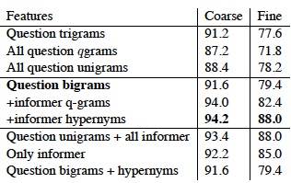
Effect of Informer Spans
Classifier: Linear SVM + multiclass

Slide 31
Effect of Informer Spans
Classifier: Linear SVM + multiclass
Notable improvement for IS hypernyms

Slide 32
Effect of Informer Spans
Classifier: Linear SVM + multiclass
Notable improvement for IS hypernyms
Better than all hypernyms – filter sources of noise
Biggest improvements for ‘what’, ‘which’ questions

Slide 33
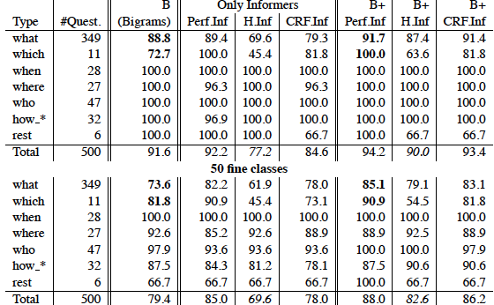
Perfect vs CRF Informer Spans

Slide 34
Recognizing Informer Spans
Idea: contiguous spans, syntactically governed

Slide 35
Recognizing Informer Spans
Idea: contiguous spans, syntactically governed
Use sequential learner w/syntactic information

Slide 36
Recognizing Informer Spans
Idea: contiguous spans, syntactically governed
Use sequential learner w/syntactic information
Tag spans with B(egin),I(nside),O(outside)
Employ syntax to capture long range factors

Slide 37
Recognizing Informer Spans
Idea: contiguous spans, syntactically governed
Use sequential learner w/syntactic information
Tag spans with B(egin),I(nside),O(outside)
Employ syntax to capture long range factors
Matrix of features derived from parse tree

Slide 38
Recognizing Informer Spans
Idea: contiguous spans, syntactically governed
Use sequential learner w/syntactic information
Tag spans with B(egin),I(nside),O(outside)
Employ syntax to capture long range factors
Matrix of features derived from parse tree
Cell:x[i,l], i is position, l is depth in parse tree, only 2
Values:
Tag: POS, constituent label in the position
Num: number of preceding chunks with same tag

Slide 39
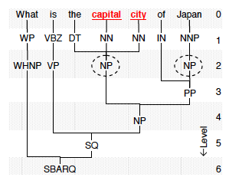
Parser Output
Parse

Slide 40
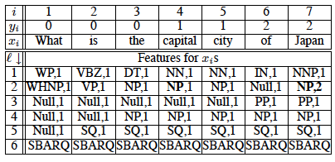
Parse Tabulation
Encoding and table:

Slide 41
CRF Indicator Features
Cell:
IsTag, IsNum: e.g. y₄ = 1 and x[4,2].tag=NP
Also, IsPrevTag, IsNextTag

Slide 42
CRF Indicator Features
Cell:
IsTag, IsNum: e.g. y₄ = 1 and x[4,2].tag=NP
Also, IsPrevTag, IsNextTag
Edge:
IsEdge: (u,v) , y_{i-1}=u and y_{i}=v
IsBegin, IsEnd

Slide 43
CRF Indicator Features
Cell:
IsTag, IsNum: e.g. y₄ = 1 and x[4,2].tag=NP
Also, IsPrevTag, IsNextTag
Edge:
IsEdge: (u,v) , y_{i-1}=u and y_{i}=v
IsBegin, IsEnd
All features improve

Slide 44
CRF Indicator Features
Cell:
IsTag, IsNum: e.g. y₄ = 1 and x[4,2].tag=NP
Also, IsPrevTag, IsNextTag
Edge:
IsEdge: (u,v) , y_{i-1}=u and y_{i}=v
IsBegin, IsEnd
All features improve
Question accuracy: Oracle: 88%; CRF: 86.2%

Slide 45
Question Classification Using Headwords and Their Hypernyms
Huang, Thint, and Qin 2008
Questions:
Why didn’t WordNet/Hypernym features help in L&R?

Slide 46
Question Classification Using Headwords and Their Hypernyms
Huang, Thint, and Qin 2008
Questions:
Why didn’t WordNet/Hypernym features help in L&R?
Best results in L&R - ~200,000 feats; ~700 active
Can we do as well with fewer features?

Slide 47
Question Classification Using Headwords and Their Hypernyms
Huang, Thint, and Qin 2008
Questions:
Why didn’t WordNet/Hypernym features help in L&R?
Best results in L&R - ~200,000 feats; ~700 active
Can we do as well with fewer features?
Approach:
Refine features:

Slide 48
Question Classification Using Headwords and Their Hypernyms
Huang, Thint, and Qin 2008
Questions:
Why didn’t WordNet/Hypernym features help in L&R?
Best results in L&R - ~200,000 feats; ~700 active
Can we do as well with fewer features?
Approach:
Refine features:
Restrict use of WordNet to headwords

Slide 49
Question Classification Using Headwords and Their Hypernyms
Huang, Thint, and Qin 2008
Questions:
Why didn’t WordNet/Hypernym features help in L&R?
Best results in L&R - ~200,000 feats; ~700 active
Can we do as well with fewer features?
Approach:
Refine features:
Restrict use of WordNet to headwords
Employ WSD techniques
SVM, MaxEnt classifiers

Slide 50
Head Word Features
Head words:
Chunks and spans can be noisy

Slide 51
Head Word Features
Head words:
Chunks and spans can be noisy
E.g. Bought a share in which baseball team?

Slide 52
Head Word Features
Head words:
Chunks and spans can be noisy
E.g. Bought a share in which baseball team?
Type: HUM: group (not ENTY:sport)
Head word is more specific

Slide 53
Head Word Features
Head words:
Chunks and spans can be noisy
E.g. Bought a share in which baseball team?
Type: HUM: group (not ENTY:sport)
Head word is more specific
Employ rules over parse trees to extract head words

Slide 54
Head Word Features
Head words:
Chunks and spans can be noisy
E.g. Bought a share in which baseball team?
Type: HUM: group (not ENTY:sport)
Head word is more specific
Employ rules over parse trees to extract head words
Issue: vague heads
E.g. What is the proper name for a female walrus?
Head = ‘name’?

Slide 55
Head Word Features
Head words:
Chunks and spans can be noisy
E.g. Bought a share in which baseball team?
Type: HUM: group (not ENTY:sport)
Head word is more specific
Employ rules over parse trees to extract head words
Issue: vague heads
E.g. What is the proper name for a female walrus?
Head = ‘name’?
Apply fix patterns to extract sub-head (e.g. walrus)

Slide 56
Head Word Features
Head words:
Chunks and spans can be noisy
E.g. Bought a share in which baseball team?
Type: HUM: group (not ENTY:sport)
Head word is more specific
Employ rules over parse trees to extract head words
Issue: vague heads
E.g. What is the proper name for a female walrus?
Head = ‘name’?
Apply fix patterns to extract sub-head (e.g. walrus)
Also, simple regexp for other feature type
E.g. ‘what is’ cue to definition type

Slide 57
WordNet Features
Hypernyms:
Enable generalization: dog->..->animal
Can generate noise: also

Slide 58
WordNet Features
Hypernyms:
Enable generalization: dog->..->animal
Can generate noise: also dog ->…-> person

Slide 59
WordNet Features
Hypernyms:
Enable generalization: dog->..->animal
Can generate noise: also dog ->…-> person
Adding low noise hypernyms
Which senses?

Slide 60
WordNet Features
Hypernyms:
Enable generalization: dog->..->animal
Can generate noise: also dog ->…-> person
Adding low noise hypernyms
Which senses?
Restrict to matching WordNet POS

Slide 61
WordNet Features
Hypernyms:
Enable generalization: dog->..->animal
Can generate noise: also dog ->…-> person
Adding low noise hypernyms
Which senses?
Restrict to matching WordNet POS
Which word senses?

Slide 62
WordNet Features
Hypernyms:
Enable generalization: dog->..->animal
Can generate noise: also dog ->…-> person
Adding low noise hypernyms
Which senses?
Restrict to matching WordNet POS
Which word senses?
Use Lesk algorithm: overlap b/t question & WN gloss

Slide 63
WordNet Features
Hypernyms:
Enable generalization: dog->..->animal
Can generate noise: also dog ->…-> person
Adding low noise hypernyms
Which senses?
Restrict to matching WordNet POS
Which word senses?
Use Lesk algorithm: overlap b/t question & WN gloss
How deep?

Slide 64
WordNet Features
Hypernyms:
Enable generalization: dog->..->animal
Can generate noise: also dog ->…-> person
Adding low noise hypernyms
Which senses?
Restrict to matching WordNet POS
Which word senses?
Use Lesk algorithm: overlap b/t question & WN gloss
How deep?
Based on validation set: 6

Slide 65
WordNet Features
Hypernyms:
Enable generalization: dog->..->animal
Can generate noise: also dog ->…-> person
Adding low noise hypernyms
Which senses?
Restrict to matching WordNet POS
Which word senses?
Use Lesk algorithm: overlap b/t question & WN gloss
How deep?
Based on validation set: 6
Q Type similarity: compute similarity b/t headword & type
Use type as feature

Slide 66
Other Features
Question wh-word:
What,which,who,where,when,how,why, and rest

Slide 67
Other Features
Question wh-word:
What,which,who,where,when,how,why, and rest
N-grams: uni-,bi-,tri-grams

Slide 68
Other Features
Question wh-word:
What,which,who,where,when,how,why, and rest
N-grams: uni-,bi-,tri-grams
Word shape:
Case features: all upper, all lower, mixed, all digit, other

Slide 69
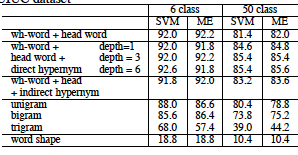
Results
Per feature-type results:

Slide 70
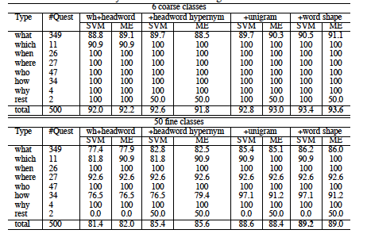
Results: Incremental
Additive improvement:

Slide 71
Error Analysis
Inherent ambiguity:
What is mad cow disease?
ENT: disease or DESC:def

Slide 72
Error Analysis
Inherent ambiguity:
What is mad cow disease?
ENT: disease or DESC:def
Inconsistent labeling:
What is the population of Kansas? NUM: other
What is the population of Arcadia, FL ?

Slide 73
Error Analysis
Inherent ambiguity:
What is mad cow disease?
ENT: disease or DESC:def
Inconsistent labeling:
What is the population of Kansas? NUM: other
What is the population of Arcadia, FL ? NUM:count
Parser error

Slide 74
Question Classification: Summary
Issue:
Integrating rich features/deeper processing

Slide 75
Question Classification: Summary
Issue:
Integrating rich features/deeper processing
Errors in processing introduce noise

Slide 76
Question Classification: Summary
Issue:
Integrating rich features/deeper processing
Errors in processing introduce noise
Noise in added features increases error

Slide 77
Question Classification: Summary
Issue:
Integrating rich features/deeper processing
Errors in processing introduce noise
Noise in added features increases error
Large numbers of features can be problematic for training

Slide 78
Question Classification: Summary
Issue:
Integrating rich features/deeper processing
Errors in processing introduce noise
Noise in added features increases error
Large numbers of features can be problematic for training
Alternative solutions:

Slide 79
Question Classification: Summary
Issue:
Integrating rich features/deeper processing
Errors in processing introduce noise
Noise in added features increases error
Large numbers of features can be problematic for training
Alternative solutions:
Use more accurate shallow processing, better classifier

Slide 80
Question Classification: Summary
Issue:
Integrating rich features/deeper processing
Errors in processing introduce noise
Noise in added features increases error
Large numbers of features can be problematic for training
Alternative solutions:
Use more accurate shallow processing, better classifier
Restrict addition of features to

Slide 81
Question Classification: Summary
Issue:
Integrating rich features/deeper processing
Errors in processing introduce noise
Noise in added features increases error
Large numbers of features can be problematic for training
Alternative solutions:
Use more accurate shallow processing, better classifier
Restrict addition of features to
Informer spans
Headwords

Slide 82
Question Classification: Summary
Issue:
Integrating rich features/deeper processing
Errors in processing introduce noise
Noise in added features increases error
Large numbers of features can be problematic for training
Alternative solutions:
Use more accurate shallow processing, better classifier
Restrict addition of features to
Informer spans
Headwords
Filter features to be added

