Slide 1
Answer Extraction: Semantics
Ling573
NLP Systems and Applications
May 23, 2013

Slide 2
Semantic Structure-based Answer Extraction
Shen and Lapata, 2007
Intuition:
Surface forms obscure Q&A patterns
Q: What year did the U.S. buy Alaska?
S_{A}:…before Russia sold Alaska to the United States in 1867

Slide 3
Semantic Structure-based Answer Extraction
Shen and Lapata, 2007
Intuition:
Surface forms obscure Q&A patterns
Q: What year did the U.S. buy Alaska?
S_{A}:…before Russia sold Alaska to the United States in 1867
Learn surface text patterns?

Slide 4
Semantic Structure-based Answer Extraction
Shen and Lapata, 2007
Intuition:
Surface forms obscure Q&A patterns
Q: What year did the U.S. buy Alaska?
S_{A}:…before Russia sold Alaska to the United States in 1867
Learn surface text patterns?
Long distance relations, require huge # of patterns to find
Learn syntactic patterns?

Slide 5
Semantic Structure-based Answer Extraction
Shen and Lapata, 2007
Intuition:
Surface forms obscure Q&A patterns
Q: What year did the U.S. buy Alaska?
S_{A}:…before Russia sold Alaska to the United States in 1867
Learn surface text patterns?
Long distance relations, require huge # of patterns to find
Learn syntactic patterns?
Different lexical choice, different dependency structure
Learn predicate-argument structure?

Slide 6
Semantic Structure-based Answer Extraction
Shen and Lapata, 2007
Intuition:
Surface forms obscure Q&A patterns
Q: What year did the U.S. buy Alaska?
S_{A}:…before Russia sold Alaska to the United States in 1867
Learn surface text patterns?
Long distance relations, require huge # of patterns to find
Learn syntactic patterns?
Different lexical choice, different dependency structure
Learn predicate-argument structure?
Different argument structure: Agent vs recipient, etc

Slide 7
Semantic Similarity
Semantic relations:
Basic semantic domain:
Buying and selling

Slide 8
Semantic Similarity
Semantic relations:
Basic semantic domain:
Buying and selling
Semantic roles:
Buyer, Goods, Seller

Slide 9
Semantic Similarity
Semantic relations:
Basic semantic domain:
Buying and selling
Semantic roles:
Buyer, Goods, Seller
Examples of surface forms:
[Lee]Seller sold a textbook [to Abby]Buyer
[Kim]Seller sold [the sweater]Goods
[Abby]Seller sold [the car]Goods [for cash]Means.

Slide 10
Semantic Roles & QA
Approach:
Perform semantic role labeling
FrameNet
Perform structural and semantic role matching
Use role matching to select answer

Slide 11
Semantic Roles & QA
Approach:
Perform semantic role labeling
FrameNet
Perform structural and semantic role matching
Use role matching to select answer
Comparison:
Contrast with syntax or shallow SRL approach

Slide 12
Frames
Semantic roles specific to Frame
Frame:
Schematic representation of situation

Slide 13
Frames
Semantic roles specific to Frame
Frame:
Schematic representation of situation
Evokation:
Predicates with similar semantics evoke same frame

Slide 14
Frames
Semantic roles specific to Frame
Frame:
Schematic representation of situation
Evokation:
Predicates with similar semantics evoke same frame
Frame elements:
Semantic roles
Defined per frame
Correspond to salient entities in the evoked situation

Slide 15
FrameNet
Database includes:
Surface syntactic realizations of semantic roles
Sentences (BNC) annotated with frame/role info
Frame example: Commerce_Sell

Slide 16
FrameNet
Database includes:
Surface syntactic realizations of semantic roles
Sentences (BNC) annotated with frame/role info
Frame example: Commerce_Sell
Evoked by:

Slide 17
FrameNet
Database includes:
Surface syntactic realizations of semantic roles
Sentences (BNC) annotated with frame/role info
Frame example: Commerce_Sell
Evoked by: sell, vend, retail; also: sale, vendor
Frame elements:

Slide 18
FrameNet
Database includes:
Surface syntactic realizations of semantic roles
Sentences (BNC) annotated with frame/role info
Frame example: Commerce_Sell
Evoked by: sell, vend, retail; also: sale, vendor
Frame elements:
Core semantic roles:

Slide 19
FrameNet
Database includes:
Surface syntactic realizations of semantic roles
Sentences (BNC) annotated with frame/role info
Frame example: Commerce_Sell
Evoked by: sell, vend, retail; also: sale, vendor
Frame elements:
Core semantic roles: Buyer, Seller, Goods
Non-core (peripheral) semantic roles:

Slide 20
FrameNet
Database includes:
Surface syntactic realizations of semantic roles
Sentences (BNC) annotated with frame/role info
Frame example: Commerce_Sell
Evoked by: sell, vend, retail; also: sale, vendor
Frame elements:
Core semantic roles: Buyer, Seller, Goods
Non-core (peripheral) semantic roles:
Means, Manner
Not specific to frame

Slide 21
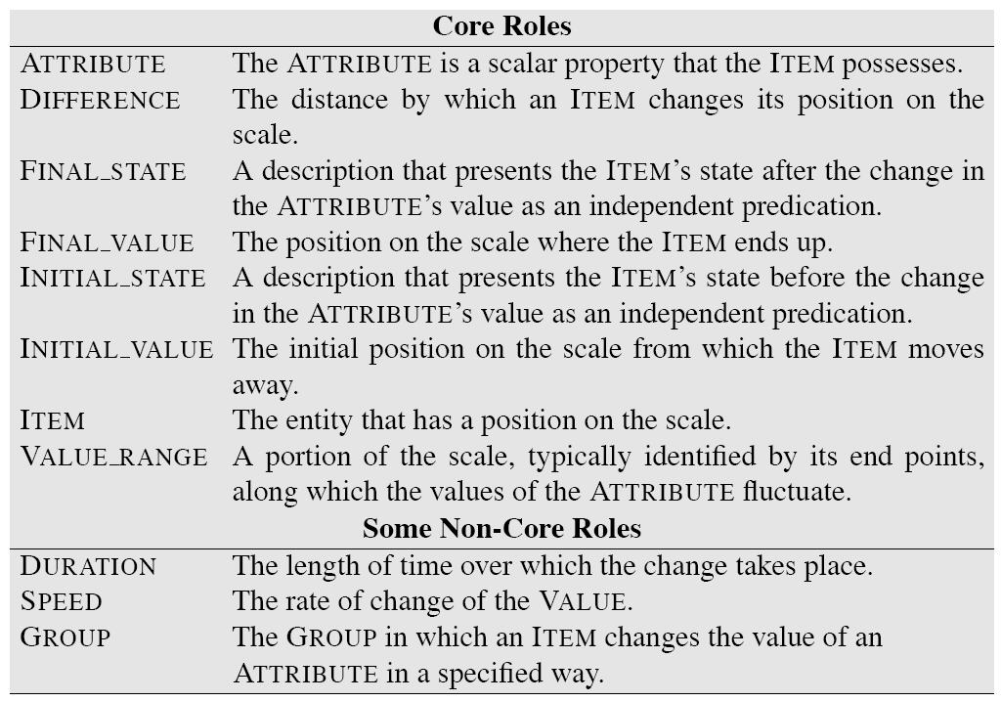

Slide 22
Bridging Surface Gaps in QA
Semantics: WordNet
Query expansion
Extended WordNet chains for inference
WordNet classes for answer filtering

Slide 23
Bridging Surface Gaps in QA
Semantics: WordNet
Query expansion
Extended WordNet chains for inference
WordNet classes for answer filtering
Syntax:
Structure matching and alignment
Cui et al, 2005; Aktolga et al, 2011

Slide 24
Semantic Roles in QA
Narayanan and Harabagiu, 2004
Inference over predicate-argument structure
Derived from PropBank and FrameNet

Slide 25
Semantic Roles in QA
Narayanan and Harabagiu, 2004
Inference over predicate-argument structure
Derived from PropBank and FrameNet
Sun et al, 2005
ASSERT Shallow semantic parser based on PropBank
Compare pred-arg structure b/t Q & A
No improvement due to inadequate coverage

Slide 26
Semantic Roles in QA
Narayanan and Harabagiu, 2004
Inference over predicate-argument structure
Derived from PropBank and FrameNet
Sun et al, 2005
ASSERT Shallow semantic parser based on PropBank
Compare pred-arg structure b/t Q & A
No improvement due to inadequate coverage
Kaisser et al, 2006
Question paraphrasing based on FrameNet
Reformulations sent to Google for search
Coverage problems due to strict matching

Slide 27
Approach
Standard processing:
Question processing:
Answer type classification

Slide 28
Approach
Standard processing:
Question processing:
Answer type classification
Similar to Li and Roth
Question reformulation

Slide 29
Approach
Standard processing:
Question processing:
Answer type classification
Similar to Li and Roth
Question reformulation
Similar to AskMSR/Aranea

Slide 30
Approach (cont’d)
Passage retrieval:
Top 50 sentences from Lemur
Add gold standard sentences from TREC

Slide 31
Approach (cont’d)
Passage retrieval:
Top 50 sentences from Lemur
Add gold standard sentences from TREC
Select sentences which match pattern
Also with >= 1 question key word

Slide 32
Approach (cont’d)
Passage retrieval:
Top 50 sentences from Lemur
Add gold standard sentences from TREC
Select sentences which match pattern
Also with >= 1 question key word
NE tagged:
If matching Answer type, keep those NPs
Otherwise keep all NPs

Slide 33
Semantic Matching
Derive semantic structures from sentences
P: predicate
Word or phrase evoking FrameNet frame

Slide 34
Semantic Matching
Derive semantic structures from sentences
P: predicate
Word or phrase evoking FrameNet frame
Set(SRA): set of semantic role assignments
<w,SR,s>:
w: frame element; SR: semantic role; s: score

Slide 35
Semantic Matching
Derive semantic structures from sentences
P: predicate
Word or phrase evoking FrameNet frame
Set(SRA): set of semantic role assignments
<w,SR,s>:
w: frame element; SR: semantic role; s: score
Perform for questions and answer candidates
Expected Answer Phrases (EAPs) are Qwords
Who, what, where
Must be frame elements
Compare resulting semantic structures
Select highest ranked

Slide 36
Semantic Structure Generation Basis
Exploits annotated sentences from FrameNet
Augmented with dependency parse output
Key assumption:

Slide 37
Semantic Structure Generation Basis
Exploits annotated sentences from FrameNet
Augmented with dependency parse output
Key assumption:
Sentences that share dependency relations will also share semantic roles, if evoked same frames

Slide 38
Semantic Structure Generation Basis
Exploits annotated sentences from FrameNet
Augmented with dependency parse output
Key assumption:
Sentences that share dependency relations will also share semantic roles, if evoked same frames
Lexical semantics argues:
Argument structure determined largely by word meaning

Slide 39
Predicate Identification
Identify predicate candidates by lookup
Match POS-tagged tokens to FrameNet entries

Slide 40
Predicate Identification
Identify predicate candidates by lookup
Match POS-tagged tokens to FrameNet entries
For efficiency, assume single predicate/question:
Heuristics:

Slide 41
Predicate Identification
Identify predicate candidates by lookup
Match POS-tagged tokens to FrameNet entries
For efficiency, assume single predicate/question:
Heuristics:
Prefer verbs
If multiple verbs,

Slide 42
Predicate Identification
Identify predicate candidates by lookup
Match POS-tagged tokens to FrameNet entries
For efficiency, assume single predicate/question:
Heuristics:
Prefer verbs
If multiple verbs, prefer least embedded
If no verbs,

Slide 43
Predicate Identification
Identify predicate candidates by lookup
Match POS-tagged tokens to FrameNet entries
For efficiency, assume single predicate/question:
Heuristics:
Prefer verbs
If multiple verbs, prefer least embedded
If no verbs, select noun
Lookup predicate in FrameNet:
Keep all matching frames: Why?

Slide 44
Predicate Identification
Identify predicate candidates by lookup
Match POS-tagged tokens to FrameNet entries
For efficiency, assume single predicate/question:
Heuristics:
Prefer verbs
If multiple verbs, prefer least embedded
If no verbs, select noun
Lookup predicate in FrameNet:
Keep all matching frames: Why?
Avoid hard decisions

Slide 45
Predicate ID Example
Q: Who beat Floyd Patterson to take the title away?
Candidates:

Slide 46
Predicate ID Example
Q: Who beat Floyd Patterson to take the title away?
Candidates:
Beat, take away, title

Slide 47
Predicate ID Example
Q: Who beat Floyd Patterson to take the title away?
Candidates:
Beat, take away, title
Select: Beat
Frame lookup: Cause_harm
Require that answer predicate ‘match’ question

Slide 48
Semantic Role Assignment
Assume dependency path R=<r₁,r₂,…,r_{L}>
Mark each edge with direction of traversal: U/D
R = <subj_{U},obj_{D}>

Slide 49
Semantic Role Assignment
Assume dependency path R=<r₁,r₂,…,r_{L}>
Mark each edge with direction of traversal: U/D
R = <subj_{U},obj_{D}>
Assume words (or phrases) w with path to p are FE
Represent frame element by path

Slide 50
Semantic Role Assignment
Assume dependency path R=<r₁,r₂,…,r_{L}>
Mark each edge with direction of traversal: U/D
R = <subj_{U},obj_{D}>
Assume words (or phrases) w with path to p are FE
Represent frame element by path
In FrameNet:
Extract all dependency paths b/t w & p
Label according to annotated semantic role

Slide 51
Computing Path Compatibility
M: Set of dep paths for role SR in FrameNet

Slide 52
Computing Path Compatibility
M: Set of dep paths for role SR in FrameNet
P(R_{SR}): Relative frequency of role in FrameNet

Slide 53
Computing Path Compatibility
M: Set of dep paths for role SR in FrameNet
P(R_{SR}): Relative frequency of role in FrameNet
Sim(R1,R2): Path similarity

Slide 54
Computing Path Compatibility
M: Set of dep paths for role SR in FrameNet
P(R_{SR}): Relative frequency of role in FrameNet
Sim(R1,R2): Path similarity
Adapt string kernel
Weighted sum of common subsequences

Slide 55
Computing Path Compatibility
M: Set of dep paths for role SR in FrameNet
P(R_{SR}): Relative frequency of role in FrameNet
Sim(R1,R2): Path similarity
Adapt string kernel
Weighted sum of common subsequences
Unigram and bigram sequences
Weight: tf-idf like: association b/t role and dep. relation

Slide 56
Assigning Semantic Roles
Generate set of semantic role assignments
Represent as complete bipartite graph
Connect frame element to all SRs licensed by predicate
Weight as above

Slide 57
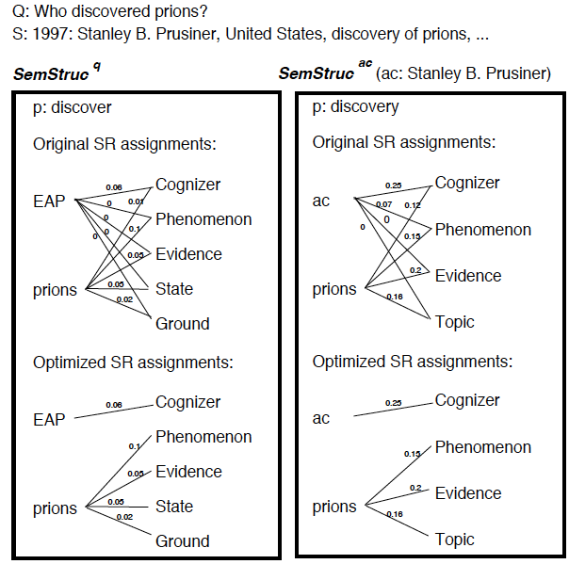

Slide 58
Assigning Semantic Roles
Generate set of semantic role assignments
Represent as complete bipartite graph
Connect frame element to all SRs licensed by predicate
Weight as above
How can we pick mapping of words to roles?

Slide 59
Assigning Semantic Roles
Generate set of semantic role assignments
Represent as complete bipartite graph
Connect frame element to all SRs licensed by predicate
Weight as above
How can we pick mapping of words to roles?
Pick highest scoring SR?

Slide 60
Assigning Semantic Roles
Generate set of semantic role assignments
Represent as complete bipartite graph
Connect frame element to all SRs licensed by predicate
Weight as above
How can we pick mapping of words to roles?
Pick highest scoring SR?
‘Local’: could assign multiple words to the same role!
Need global solution:

Slide 61
Assigning Semantic Roles
Generate set of semantic role assignments
Represent as complete bipartite graph
Connect frame element to all SRs licensed by predicate
Weight as above
How can we pick mapping of words to roles?
Pick highest scoring SR?
‘Local’: could assign multiple words to the same role!
Need global solution:
Minimum weight bipartite edge cover problem
Assign semantic role to each frame element
FE can have multiple roles (soft labeling)

Slide 63
Semantic Structure Matching
Measure similarity b/t question and answers
Two factors:

Slide 64
Semantic Structure Matching
Measure similarity b/t question and answers
Two factors:
Predicate matching

Slide 65
Semantic Structure Matching
Measure similarity b/t question and answers
Two factors:
Predicate matching:
Match if evoke same frame

Slide 66
Semantic Structure Matching
Measure similarity b/t question and answers
Two factors:
Predicate matching:
Match if evoke same frame
Match if evoke frames in hypernym/hyponym relation
Frame: inherits_from or is_inherited_by

Slide 67
Semantic Structure Matching
Measure similarity b/t question and answers
Two factors:
Predicate matching:
Match if evoke same frame
Match if evoke frames in hypernym/hyponym relation
Frame: inherits_from or is_inherited_by
SR assignment match (only if preds match)
Sum of similarities of subgraphs
Subgraph is FE w and all connected SRs

Slide 68
Comparisons
Syntax only baseline:
Identify verbs, noun phrases, and expected answers
Compute dependency paths b/t phrases
Compare key phrase to expected answer phrase to
Same key phrase and answer candidate
Based on dynamic time warping approach

Slide 69
Comparisons
Syntax only baseline:
Identify verbs, noun phrases, and expected answers
Compute dependency paths b/t phrases
Compare key phrase to expected answer phrase to
Same key phrase and answer candidate
Based on dynamic time warping approach
Shallow semantics baseline:
Use Shalmaneser to parse questions and answer cand
Assigns semantic roles, trained on FrameNet
If frames match, check phrases with same role as EAP
Rank by word overlap

Slide 70
Evaluation
Q1: How does incompleteness of FrameNet affect utility for QA systems?
Are there questions for which there is no frame or no annotated sentence data?

Slide 71
Evaluation
Q1: How does incompleteness of FrameNet affect utility for QA systems?
Are there questions for which there is no frame or no annotated sentence data?
Q2: Are questions amenable to FrameNet analysis?
Do questions and their answers evoke the same frame? The same roles?

Slide 72
FrameNet Applicability
Analysis:
NoFrame: No frame for predicate: sponsor, sink

Slide 73
FrameNet Applicability
Analysis:
NoFrame: No frame for predicate: sponsor, sink
NoAnnot: No sentences annotated for pred: win, hit

Slide 74
FrameNet Applicability
Analysis:
NoFrame: No frame for predicate: sponsor, sink
NoAnnot: No sentences annotated for pred: win, hit
NoMatch: Frame mismatch b/t Q & A

Slide 75
FrameNet Utility
Analysis on Q&A pairs with frames, annotation, match
Good results, but

Slide 76
FrameNet Utility
Analysis on Q&A pairs with frames, annotation, match
Good results, but
Over-optimistic
SemParse still has coverage problems

Slide 77
FrameNet Utility (II)
Q3: Does semantic soft matching improve?
Approach:
Use FrameNet semantic match

Slide 78
FrameNet Utility (II)
Q3: Does semantic soft matching improve?
Approach:
Use FrameNet semantic match
If no answer found

Slide 79
FrameNet Utility (II)
Q3: Does semantic soft matching improve?
Approach:
Use FrameNet semantic match
If no answer found, back off to syntax based approach
Soft match best: semantic parsing too brittle, Q

Slide 80
Summary
FrameNet and QA:
FrameNet still limited (coverage/annotations)
Bigger problem is lack of alignment b/t Q & A frames
Even if limited,
Substantially improves where applicable
Useful in conjunction with other QA strategies
Soft role assignment, matching key to effectiveness

Slide 81
Thematic Roles
Describe semantic roles of verbal arguments
Capture commonality across verbs

Slide 82
Thematic Roles
Describe semantic roles of verbal arguments
Capture commonality across verbs
E.g. subject of break, open is AGENT
AGENT: volitional cause
THEME: things affected by action

Slide 83
Thematic Roles
Describe semantic roles of verbal arguments
Capture commonality across verbs
E.g. subject of break, open is AGENT
AGENT: volitional cause
THEME: things affected by action
Enables generalization over surface order of arguments
John_{AGENT} broke the window_{THEME}

Slide 84
Thematic Roles
Describe semantic roles of verbal arguments
Capture commonality across verbs
E.g. subject of break, open is AGENT
AGENT: volitional cause
THEME: things affected by action
Enables generalization over surface order of arguments
John_{AGENT} broke the window_{THEME}
The rock_{INSTRUMENT} broke the window_{THEME}

Slide 85
Thematic Roles
Describe semantic roles of verbal arguments
Capture commonality across verbs
E.g. subject of break, open is AGENT
AGENT: volitional cause
THEME: things affected by action
Enables generalization over surface order of arguments
John_{AGENT} broke the window_{THEME}
The rock_{INSTRUMENT} broke the window_{THEME}
The window_{THEME} was broken by John_{AGENT}

Slide 86
Thematic Roles
Thematic grid, θ-grid, case frame
Set of thematic role arguments of verb

Slide 87
Thematic Roles
Thematic grid, θ-grid, case frame
Set of thematic role arguments of verb
E.g. Subject:AGENT; Object:THEME, or
Subject: INSTR; Object: THEME

Slide 88
Thematic Roles
Thematic grid, θ-grid, case frame
Set of thematic role arguments of verb
E.g. Subject:AGENT; Object:THEME, or
Subject: INSTR; Object: THEME
Verb/Diathesis Alternations
Verbs allow different surface realizations of roles

Slide 89
Thematic Roles
Thematic grid, θ-grid, case frame
Set of thematic role arguments of verb
E.g. Subject:AGENT; Object:THEME, or
Subject: INSTR; Object: THEME
Verb/Diathesis Alternations
Verbs allow different surface realizations of roles
Doris_{AGENT} gave the book_{THEME} to Cary_{GOAL}

Slide 90
Thematic Roles
Thematic grid, θ-grid, case frame
Set of thematic role arguments of verb
E.g. Subject:AGENT; Object:THEME, or
Subject: INSTR; Object: THEME
Verb/Diathesis Alternations
Verbs allow different surface realizations of roles
Doris_{AGENT} gave the book_{THEME} to Cary_{GOAL}
Doris_{AGENT} gave Cary_{GOAL} the book_{THEME}

Slide 91
Thematic Roles
Thematic grid, θ-grid, case frame
Set of thematic role arguments of verb
E.g. Subject:AGENT; Object:THEME, or
Subject: INSTR; Object: THEME
Verb/Diathesis Alternations
Verbs allow different surface realizations of roles
Doris_{AGENT} gave the book_{THEME} to Cary_{GOAL}
Doris_{AGENT} gave Cary_{GOAL} the book_{THEME}
Group verbs into classes based on shared patterns

Slide 92
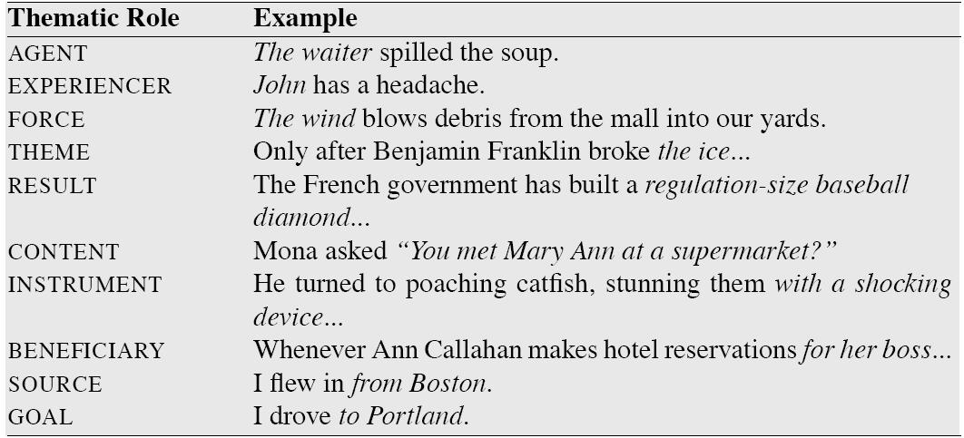
Canonical Roles

Slide 93
Thematic Role Issues
Hard to produce

Slide 94
Thematic Role Issues
Hard to produce
Standard set of roles
Fragmentation: Often need to make more specific
E,g, INSTRUMENTS can be subject or not

Slide 95
Thematic Role Issues
Hard to produce
Standard set of roles
Fragmentation: Often need to make more specific
E,g, INSTRUMENTS can be subject or not
Standard definition of roles
Most AGENTs: animate, volitional, sentient, causal
But not all….

Slide 96
Thematic Role Issues
Hard to produce
Standard set of roles
Fragmentation: Often need to make more specific
E,g, INSTRUMENTS can be subject or not
Standard definition of roles
Most AGENTs: animate, volitional, sentient, causal
But not all….
Strategies:
Generalized semantic roles: PROTO-AGENT/PROTO-PATIENT
Defined heuristically: PropBank

Slide 97
Thematic Role Issues
Hard to produce
Standard set of roles
Fragmentation: Often need to make more specific
E,g, INSTRUMENTS can be subject or not
Standard definition of roles
Most AGENTs: animate, volitional, sentient, causal
But not all….
Strategies:
Generalized semantic roles: PROTO-AGENT/PROTO-PATIENT
Defined heuristically: PropBank
Define roles specific to verbs/nouns: FrameNet

Slide 98
PropBank
Sentences annotated with semantic roles
Penn and Chinese Treebank

Slide 99
PropBank
Sentences annotated with semantic roles
Penn and Chinese Treebank
Roles specific to verb sense
Numbered: Arg0, Arg1, Arg2,…
Arg0: PROTO-AGENT; Arg1: PROTO-PATIENT, etc

Slide 100
PropBank
Sentences annotated with semantic roles
Penn and Chinese Treebank
Roles specific to verb sense
Numbered: Arg0, Arg1, Arg2,…
Arg0: PROTO-AGENT; Arg1: PROTO-PATIENT, etc
E.g. agree.01
Arg0: Agreer

Slide 101
PropBank
Sentences annotated with semantic roles
Penn and Chinese Treebank
Roles specific to verb sense
Numbered: Arg0, Arg1, Arg2,…
Arg0: PROTO-AGENT; Arg1: PROTO-PATIENT, etc
E.g. agree.01
Arg0: Agreer
Arg1: Proposition

Slide 102
PropBank
Sentences annotated with semantic roles
Penn and Chinese Treebank
Roles specific to verb sense
Numbered: Arg0, Arg1, Arg2,…
Arg0: PROTO-AGENT; Arg1: PROTO-PATIENT, etc
E.g. agree.01
Arg0: Agreer
Arg1: Proposition
Arg2: Other entity agreeing

Slide 103
PropBank
Sentences annotated with semantic roles
Penn and Chinese Treebank
Roles specific to verb sense
Numbered: Arg0, Arg1, Arg2,…
Arg0: PROTO-AGENT; Arg1: PROTO-PATIENT, etc
E.g. agree.01
Arg0: Agreer
Arg1: Proposition
Arg2: Other entity agreeing
Ex1: [_{Arg0}The group] agreed [_{Arg1}it wouldn’t make an offer]

