Slide 1
Shallow & Deep QA Systems
Ling 573
NLP Systems and Applications
April 9, 2013

Slide 2
Announcement
Thursday’s class will be pre-recorded.
Will be accessed from the Adobe Connect recording.
Will be linked before regular Thursday class time.
Please post any questions to the GoPost.

Slide 3
Roadmap
Two extremes in QA systems:
Redundancy-based QA: Aranea
LCC’s PowerAnswer-2
Deliverable #2

Slide 4
Redundancy-based QA
AskMSR (2001,2002); Aranea (Lin, 2007)

Slide 5
Redundancy-based QA
Systems exploit statistical regularity to find “easy” answers to factoid questions on the Web

Slide 6
Redundancy-based QA
Systems exploit statistical regularity to find “easy” answers to factoid questions on the Web
—When did Alaska become a state?
(1) Alaska became a state on January 3, 1959.
(2) Alaska was admitted to the Union on January 3, 1959.

Slide 7
Redundancy-based QA
Systems exploit statistical regularity to find “easy” answers to factoid questions on the Web
—When did Alaska become a state?
(1) Alaska became a state on January 3, 1959.
(2) Alaska was admitted to the Union on January 3, 1959.
—Who killed Abraham Lincoln?
(1) John Wilkes Booth killed Abraham Lincoln.
(2) John Wilkes Booth altered history with a bullet. He will forever be known as the man who ended Abraham Lincoln’s life.

Slide 8
Redundancy-based QA
Systems exploit statistical regularity to find “easy” answers to factoid questions on the Web
—When did Alaska become a state?
(1) Alaska became a state on January 3, 1959.
(2) Alaska was admitted to the Union on January 3, 1959.
—Who killed Abraham Lincoln?
(1) John Wilkes Booth killed Abraham Lincoln.
(2) John Wilkes Booth altered history with a bullet. He will forever be known as the man who ended Abraham Lincoln’s life.
Text collection

Slide 9
Redundancy-based QA
Systems exploit statistical regularity to find “easy” answers to factoid questions on the Web
—When did Alaska become a state?
(1) Alaska became a state on January 3, 1959.
(2) Alaska was admitted to the Union on January 3, 1959.
—Who killed Abraham Lincoln?
(1) John Wilkes Booth killed Abraham Lincoln.
(2) John Wilkes Booth altered history with a bullet. He will forever be known as the man who ended Abraham Lincoln’s life.
Text collection may only have (2), but web?

Slide 10
Redundancy-based QA
Systems exploit statistical regularity to find “easy” answers to factoid questions on the Web
—When did Alaska become a state?
(1) Alaska became a state on January 3, 1959.
(2) Alaska was admitted to the Union on January 3, 1959.
—Who killed Abraham Lincoln?
(1) John Wilkes Booth killed Abraham Lincoln.
(2) John Wilkes Booth altered history with a bullet. He will forever be known as the man who ended Abraham Lincoln’s life.
Text collection may only have (2), but web? anything

Slide 11
Redundancy & Answers
How does redundancy help find answers?

Slide 12
Redundancy & Answers
How does redundancy help find answers?
Typical approach:
Answer type matching
E.g. NER, but
Relies on large knowledge-base
Redundancy approach:

Slide 13
Redundancy & Answers
How does redundancy help find answers?
Typical approach:
Answer type matching
E.g. NER, but
Relies on large knowledge-based
Redundancy approach:
Answer should have high correlation w/query terms
Present in many passages
Uses n-gram generation and processing

Slide 14
Redundancy & Answers
How does redundancy help find answers?
Typical approach:
Answer type matching
E.g. NER, but
Relies on large knowledge-based
Redundancy approach:
Answer should have high correlation w/query terms
Present in many passages
Uses n-gram generation and processing
In ‘easy’ passages, simple string match effective

Slide 15
Redundancy Approaches
AskMSR (2001):
Lenient: 0.43; Rank: 6/36; Strict: 0.35; Rank: 9/36

Slide 16
Redundancy Approaches
AskMSR (2001):
Lenient: 0.43; Rank: 6/36; Strict: 0.35; Rank: 9/36
Aranea (2002, 2003):
Lenient: 45%; Rank: 5; Strict: 30%; Rank:6-8

Slide 17
Redundancy Approaches
AskMSR (2001):
Lenient: 0.43; Rank: 6/36; Strict: 0.35; Rank: 9/36
Aranea (2002, 2003):
Lenient: 45%; Rank: 5; Strict: 30%; Rank:6-8
Concordia (2007): Strict: 25%; Rank 5

Slide 18
Redundancy Approaches
AskMSR (2001):
Lenient: 0.43; Rank: 6/36; Strict: 0.35; Rank: 9/36
Aranea (2002, 2003):
Lenient: 45%; Rank: 5; Strict: 30%; Rank:6-8
Concordia (2007): Strict: 25%; Rank 5
Many systems incorporate some redundancy
Answer validation
Answer reranking
LCC: huge knowledge-based system, redundancy improved

Slide 19
Intuition
Redundancy is useful!
If similar strings appear in many candidate answers, likely to be solution
Even if can’t find obvious answer strings

Slide 20
Intuition
Redundancy is useful!
If similar strings appear in many candidate answers, likely to be solution
Even if can’t find obvious answer strings
Q: How many times did Bjorn Borg win Wimbledon?
Bjorn Borg blah blah blah Wimbledon blah 5 blah
Wimbledon blah blah blah Bjorn Borg blah 37 blah.
blah Bjorn Borg blah blah 5 blah blah Wimbledon
5 blah blah Wimbledon blah blah Bjorn Borg.

Slide 21
Intuition
Redundancy is useful!
If similar strings appear in many candidate answers, likely to be solution
Even if can’t find obvious answer strings
Q: How many times did Bjorn Borg win Wimbledon?
Bjorn Borg blah blah blah Wimbledon blah 5 blah
Wimbledon blah blah blah Bjorn Borg blah 37 blah.
blah Bjorn Borg blah blah 5 blah blah Wimbledon
5 blah blah Wimbledon blah blah Bjorn Borg.
Probably 5

Slide 22
Query Reformulation
Identify question type:
E.g. Who, When, Where,…
Create question-type specific rewrite rules:

Slide 23
Query Reformulation
Identify question type:
E.g. Who, When, Where,…
Create question-type specific rewrite rules:
Hypothesis: Wording of question similar to answer
For ‘where’ queries, move ‘is’ to all possible positions
Where is the Louvre Museum located? =>
Is the Louvre Museum located
The is Louvre Museum located
The Louvre Museum is located, .etc.

Slide 24
Query Reformulation
Identify question type:
E.g. Who, When, Where,…
Create question-type specific rewrite rules:
Hypothesis: Wording of question similar to answer
For ‘where’ queries, move ‘is’ to all possible positions
Where is the Louvre Museum located? =>
Is the Louvre Museum located
The is Louvre Museum located
The Louvre Museum is located, .etc.
Create type-specific answer type (Person, Date, Loc)

Slide 25
Query Form Generation
3 query forms:
Initial baseline query

Slide 26
Query Form Generation
3 query forms:
Initial baseline query
Exact reformulation: weighted 5 times higher
Attempts to anticipate location of answer

Slide 27
Query Form Generation
3 query forms:
Initial baseline query
Exact reformulation: weighted 5 times higher
Attempts to anticipate location of answer
Extract using surface patterns
“When was the telephone invented?”

Slide 28
Query Form Generation
3 query forms:
Initial baseline query
Exact reformulation: weighted 5 times higher
Attempts to anticipate location of answer
Extract using surface patterns
“When was the telephone invented?”
“the telephone was invented ?x”

Slide 29
Query Form Generation
3 query forms:
Initial baseline query
Exact reformulation: weighted 5 times higher
Attempts to anticipate location of answer
Extract using surface patterns
“When was the telephone invented?”
“the telephone was invented ?x”
Generated by ~12 pattern matching rules on terms, POS
E.g. wh-word did A verb B -

Slide 30
Query Form Generation
3 query forms:
Initial baseline query
Exact reformulation: weighted 5 times higher
Attempts to anticipate location of answer
Extract using surface patterns
“When was the telephone invented?”
“the telephone was invented ?x”
Generated by ~12 pattern matching rules on terms, POS
E.g. wh-word did A verb B -> A verb+ed B ?x (general)
Where is A? ->

Slide 31
Query Form Generation
3 query forms:
Initial baseline query
Exact reformulation: weighted 5 times higher
Attempts to anticipate location of answer
Extract using surface patterns
“When was the telephone invented?”
“the telephone was invented ?x”
Generated by ~12 pattern matching rules on terms, POS
E.g. wh-word did A verb B -> A verb+ed B ?x (general)
Where is A? -> A is located in ?x (specific)
Inexact reformulation: bag-of-words

Slide 32
Query Reformulation
Examples

Slide 33
Redundancy-based Answer Extraction
Prior processing:
Question formulation
Web search
Retrieve snippets – top 100

Slide 34
Redundancy-based Answer Extraction
Prior processing:
Question formulation
Web search
Retrieve snippets – top 100
N-grams:
Generation
Voting
Filtering
Combining
Scoring
Reranking

Slide 35
N-gram Generation & Voting
N-gram generation from unique snippets:
Approximate chunking – without syntax
All uni-, bi-, tri-, tetra- grams
Concordia added 5-grams (prior errors)

Slide 36
N-gram Generation & Voting
N-gram generation from unique snippets:
Approximate chunking – without syntax
All uni-, bi-, tri-, tetra- grams
Concordia added 5-grams (prior errors)
Score: based on source query: exact 5x, others 1x
N-gram voting:
Collates n-grams
N-gram gets sum of scores of occurrences
What would be highest ranked ?

Slide 37
N-gram Generation & Voting
N-gram generation from unique snippets:
Approximate chunking – without syntax
All uni-, bi-, tri-, tetra- grams
Concordia added 5-grams (prior errors)
Score: based on source query: exact 5x, others 1x
N-gram voting:
Collates n-grams
N-gram gets sum of scores of occurrences
What would be highest ranked ?
Specific, frequent: Question terms, stopwords

Slide 38
N-gram Filtering
Throws out ‘blatant’ errors
Conservative or aggressive?

Slide 39
N-gram Filtering
Throws out ‘blatant’ errors
Conservative or aggressive?
Conservative: can’t recover error
Question-type-neutral filters:

Slide 40
N-gram Filtering
Throws out ‘blatant’ errors
Conservative or aggressive?
Conservative: can’t recover error
Question-type-neutral filters:
Exclude if begin/end with stopword
Exclude if contain words from question, except
‘Focus words’ : e.g. units
Question-type-specific filters:

Slide 41
N-gram Filtering
Throws out ‘blatant’ errors
Conservative or aggressive?
Conservative: can’t recover error
Question-type-neutral filters:
Exclude if begin/end with stopword
Exclude if contain words from question, except
‘Focus words’ : e.g. units
Question-type-specific filters:
‘how far’, ‘how fast’:

Slide 42
N-gram Filtering
Throws out ‘blatant’ errors
Conservative or aggressive?
Conservative: can’t recover error
Question-type-neutral filters:
Exclude if begin/end with stopword
Exclude if contain words from question, except
‘Focus words’ : e.g. units
Question-type-specific filters:
‘how far’, ‘how fast’: exclude if no numeric
‘who’,’where’:

Slide 43
N-gram Filtering
Throws out ‘blatant’ errors
Conservative or aggressive?
Conservative: can’t recover error
Question-type-neutral filters:
Exclude if begin/end with stopword
Exclude if contain words from question, except
‘Focus words’ : e.g. units
Question-type-specific filters:
‘how far’, ‘how fast’: exclude if no numeric
‘who’,’where’: exclude if not NE (first & last caps)

Slide 44
N-gram Filtering
Closed-class filters:
Exclude if not members of an enumerable list

Slide 45
N-gram Filtering
Closed-class filters:
Exclude if not members of an enumerable list
E.g. ‘what year ‘ -> must be acceptable date year

Slide 46
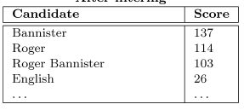
N-gram Filtering
Closed-class filters:
Exclude if not members of an enumerable list
E.g. ‘what year ‘ -> must be acceptable date year
Example after filtering:
Who was the first person to run a sub-four-minute mile?

Slide 47
N-gram Filtering
Impact of different filters:
Highly significant differences when run w/subsets

Slide 48
N-gram Filtering
Impact of different filters:
Highly significant differences when run w/subsets
No filters: drops 70%

Slide 49
N-gram Filtering
Impact of different filters:
Highly significant differences when run w/subsets
No filters: drops 70%
Type-neutral only: drops 15%

Slide 50
N-gram Filtering
Impact of different filters:
Highly significant differences when run w/subsets
No filters: drops 70%
Type-neutral only: drops 15%
Type-neutral & Type-specific: drops 5%

Slide 51
N-gram Combining
Current scoring favors longer or shorter spans?

Slide 52
N-gram Combining
Current scoring favors longer or shorter spans?
E.g. Roger or Bannister or Roger Bannister or Mr…..

Slide 53
N-gram Combining
Current scoring favors longer or shorter spans?
E.g. Roger or Bannister or Roger Bannister or Mr…..
Bannister pry highest – occurs everywhere R.B. +
Generally, good answers longer (up to a point)

Slide 54
N-gram Combining
Current scoring favors longer or shorter spans?
E.g. Roger or Bannister or Roger Bannister or Mr…..
Bannister pry highest – occurs everywhere R.B. +
Generally, good answers longer (up to a point)
Update score: S_{c} += ΣS_{t}, where t is unigram in c
Possible issues:

Slide 55
N-gram Combining
Current scoring favors longer or shorter spans?
E.g. Roger or Bannister or Roger Bannister or Mr…..
Bannister pry highest – occurs everywhere R.B. +
Generally, good answers longer (up to a point)
Update score: S_{c} += ΣS_{t}, where t is unigram in c
Possible issues:
Bad units: Roger Bannister was

Slide 56
N-gram Combining
Current scoring favors longer or shorter spans?
E.g. Roger or Bannister or Roger Bannister or Mr…..
Bannister pry highest – occurs everywhere R.B. +
Generally, good answers longer (up to a point)
Update score: S_{c} += ΣS_{t}, where t is unigram in c
Possible issues:
Bad units: Roger Bannister was – blocked by filters
Also, increments score so long bad spans lower
Improves significantly

Slide 57
N-gram Scoring
Not all terms created equal

Slide 58
N-gram Scoring
Not all terms created equal
Usually answers highly specific
Also disprefer non-units
Solution

Slide 59
N-gram Scoring
Not all terms created equal
Usually answers highly specific
Also disprefer non-units
Solution: IDF-based scoring
S_{c}=S_{c} * average_unigram_idf

Slide 60
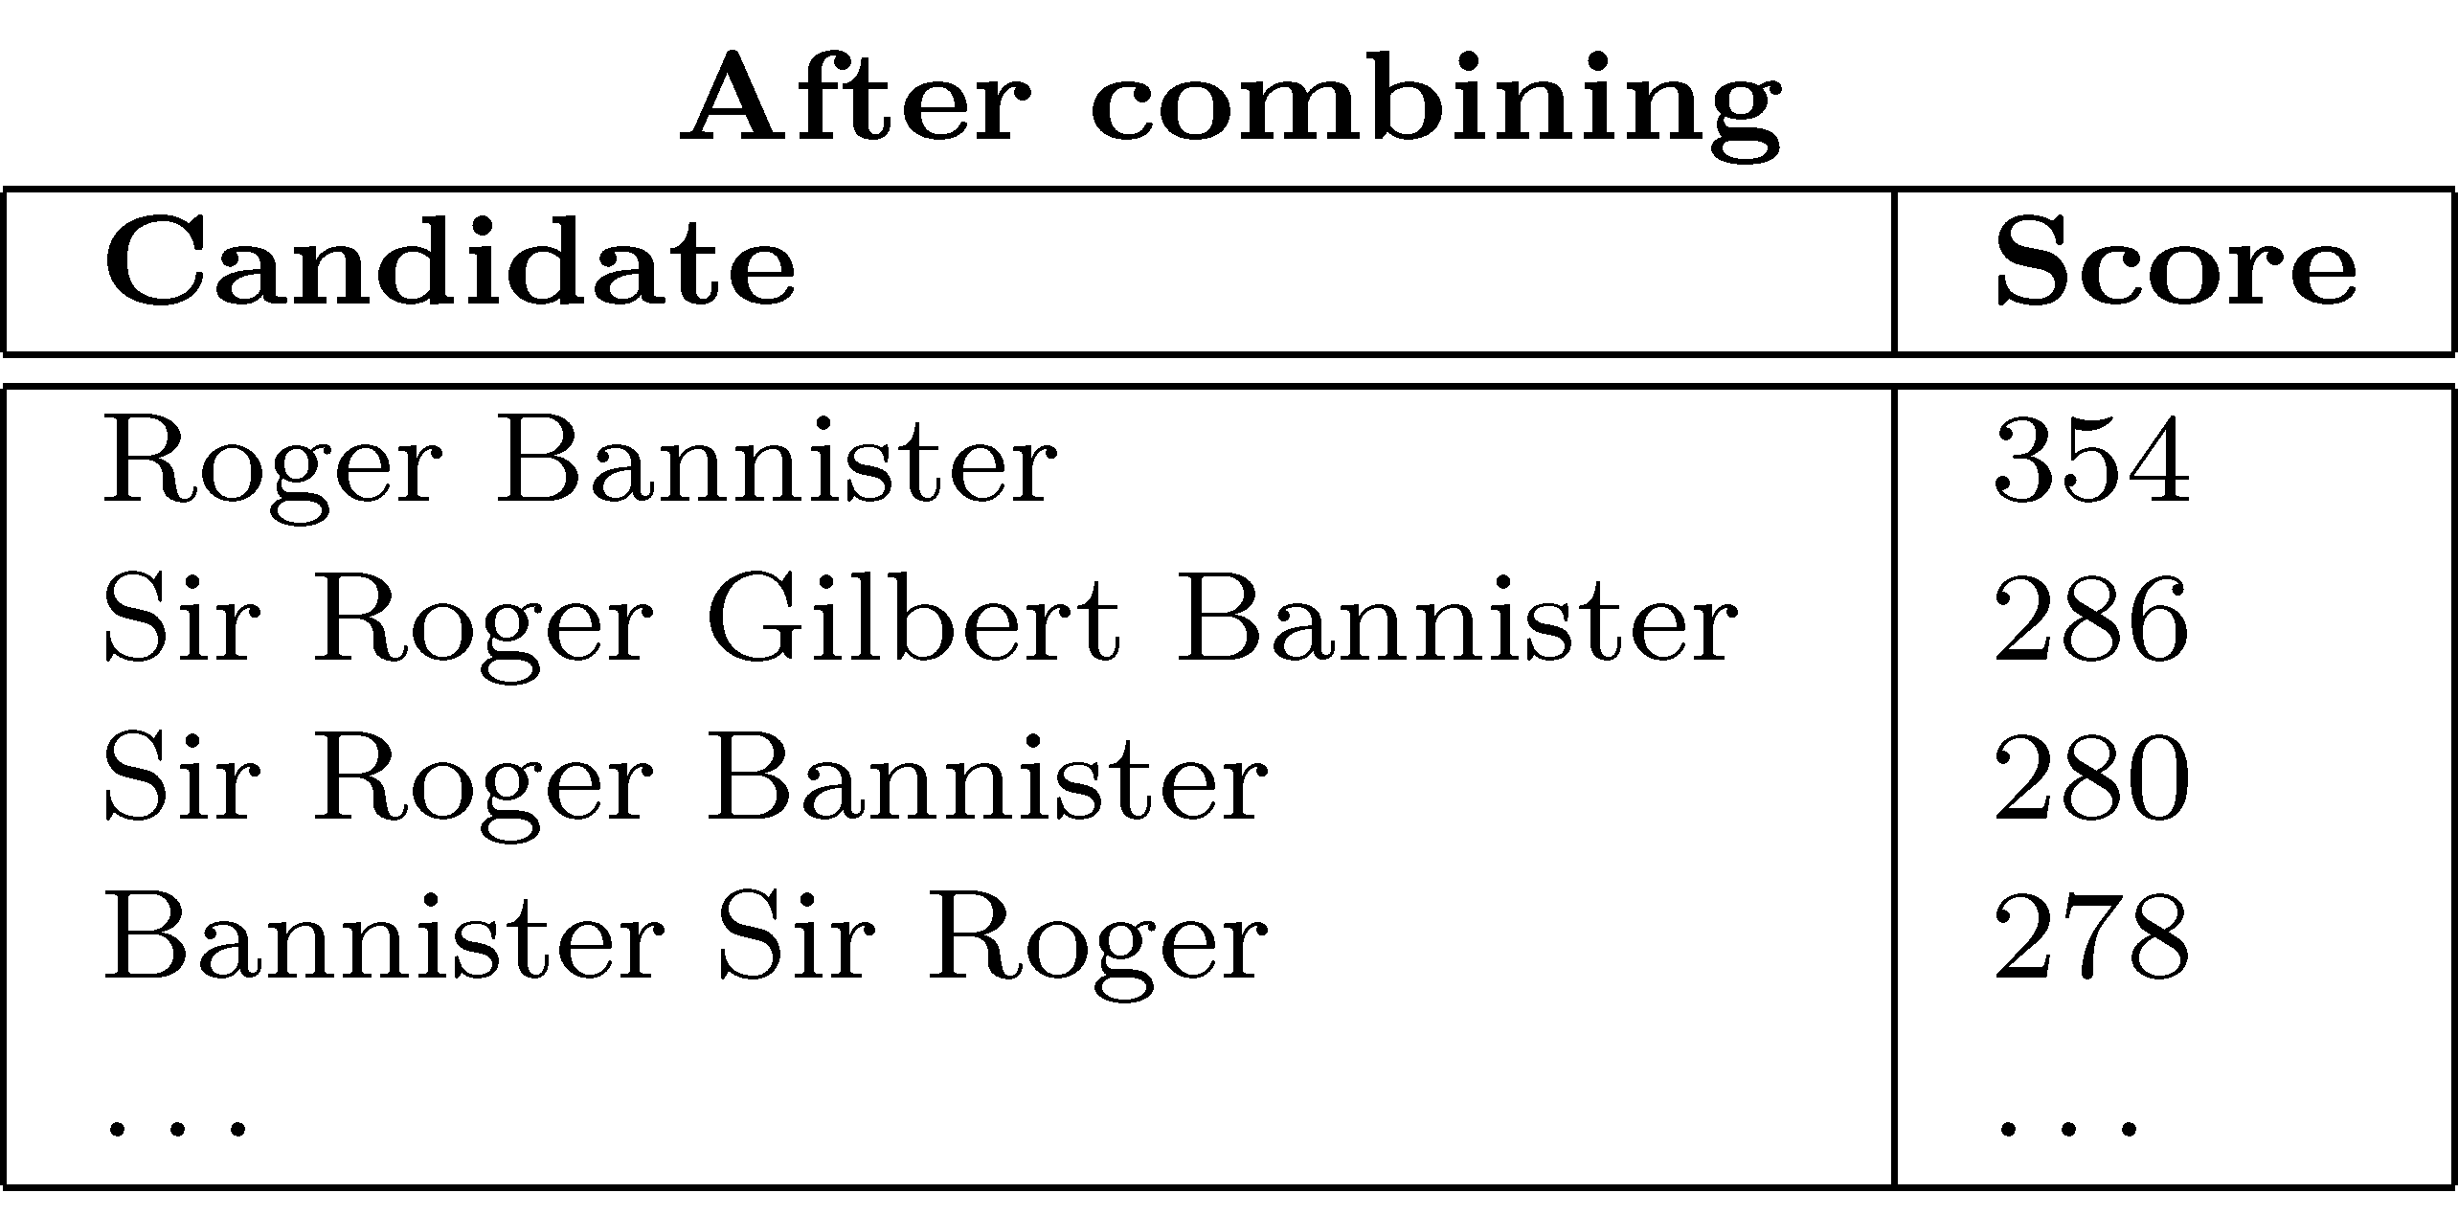
N-gram Scoring
Not all terms created equal
Usually answers highly specific
Also disprefer non-units
Solution: IDF-based scoring
S_{c}=S_{c} * average_unigram_idf

Slide 61
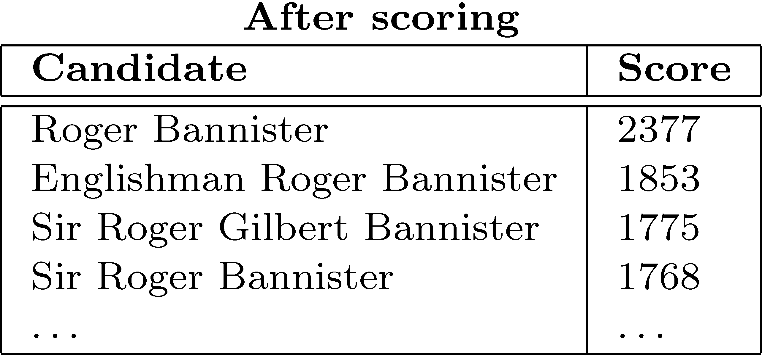
N-gram Scoring
Not all terms created equal
Usually answers highly specific
Also disprefer non-units
Solution: IDF-based scoring
S_{c}=S_{c} * average_unigram_idf

Slide 62
N-gram Reranking
Promote best answer candidates:

Slide 63
N-gram Reranking
Promote best answer candidates:
Filter any answers not in at least two snippets

Slide 64
N-gram Reranking
Promote best answer candidates:
Filter any answers not in at least two snippets
Use answer type specific forms to raise matches
E.g. ‘where’ -> boosts ‘city, state’
Small improvement depending on answer type

Slide 65
Summary
Redundancy-based approaches
Leverage scale of web search
Take advantage of presence of ‘easy’ answers on web
Exploit statistical association of question/answer text

Slide 66
Summary
Redundancy-based approaches
Leverage scale of web search
Take advantage of presence of ‘easy’ answers on web
Exploit statistical association of question/answer text
Increasingly adopted:
Good performers independently for QA
Provide significant improvements in other systems
Esp. for answer filtering

Slide 67
Summary
Redundancy-based approaches
Leverage scale of web search
Take advantage of presence of ‘easy’ answers on web
Exploit statistical association of question/answer text
Increasingly adopted:
Good performers independently for QA
Provide significant improvements in other systems
Esp. for answer filtering
Does require some form of ‘answer projection’
Map web information to TREC document

Slide 68
Summary
Redundancy-based approaches
Leverage scale of web search
Take advantage of presence of ‘easy’ answers on web
Exploit statistical association of question/answer text
Increasingly adopted:
Good performers independently for QA
Provide significant improvements in other systems
Esp. for answer filtering
Does require some form of ‘answer projection’
Map web information to TREC document
Aranea download:
http://www.umiacs.umd.edu/~jimmylin/resources.html

Slide 69
Deliverable #2: Due 4/19
Baseline end-to-end Q/A system:
Redundancy-based with answer projection
also viewed as
Retrieval with web-based boosting
Implementation: Main components
Basic redundancy approach
Basic retrieval approach (IR next lecture)

Slide 70
Data
Questions:
XML formatted questions and question series
Answers:
Answer ‘patterns’ with evidence documents
Training/Devtext/Evaltest:
Training: Thru 2005
Devtest: 2006
Held-out: …
Will be in /dropbox directory on patas
Documents:
AQUAINT news corpus data with minimal markup

