Slide 1
Topic Orientation + Information Ordering
Syed Sameer Arshad
Tristan Chong

Slide 2
What we did for Topic Orientation
We wanted to acquire the concept of a “document theme”.
We decided to exploit the fact that all the documents were news articles.
In news articles, what we care most about is:
What was the event that happened?
Where did the event happen?
Who was involved with this event?
In first-order-logic formal semantics, an event can be defined by the existence of a “verb”.
The place where an event happened would be a Named Entity.
The people involved with an event would also be Named Entities.

Slide 3
Themes, Verbs and Named Entities
Therefore, to spot the themes in the document, we could possibly do the following:
Find the most commonly used verb stems
Find the most commonly mentioned Named Entities
These pieces of information would be the main themes of the document set we are summarizing.

Slide 4
Theme Example
For example, a document set containing information on Ian Thorpe competing at the Beijing Olympics and winning gold would have the following themes:
Verb Stems: compete, win
Named Entities: Ian, Thorpe, Beijing, Olympics, gold
Any sentences that have these Named Entities or have verbs that would stem to “compete” or “win” should be given priority over others for being chosen for summarization content, because they are more in-line with the theme of the document-set

Slide 5
Our Approach
For every document set
Use NLTK’s POS Tagger to tag all sentences
Extract all verb-related POS tags.
Stem them with the Porter Stemmer.
Store the set of stems that were found along with the counts of those stems.
Normalize these counts with min-max normalization between 0 and 1.
Call this the “verb_counts” dictionary.
Also store the average word index of each of these stems.
Where word index is defined as the percentage of a document that has been traversed on average whenever this stem shows up in a document.
Call this the “verb_average_indices” dictionary.
Normalize these indices with min-max normalization between 0 and 1.
This is used for information ordering later.
Use NLTK’s Named Entity Recognizer to tag all named-entities.
Store the set of Named Entities that wer found along with their counts.
Call this the “named_entitiy_counts” dictionary.
Normalize these counts with min-max normalization between 0 and 1.

Slide 6
Changes to MEAD relevance score for sentences
Normally, the mead score is a weighted sum of the centroid-score, first-sentence-relevance score and position-score of a sentence.
We will now add a fourth number to this weighted sum, which is the topic-orientation score.
For each sentence:
The topic orientation score is the sum of the count values of all verb stems that have a match in the verb_counts dictionary plus the sum of all the count values of all named-entities that have a match in the named_entities_counts dictionary.
The final score of a sentence involves using a weight of 1.8 to be multiplied with the topic-orientation score of a sentence.

Slide 7
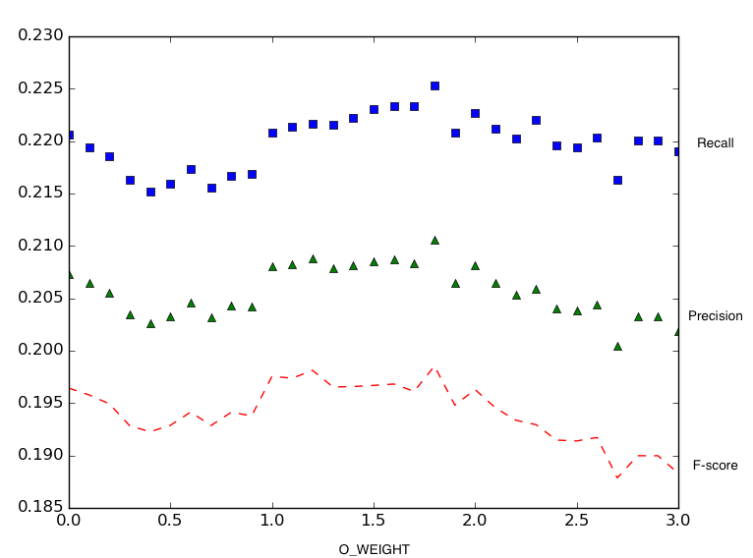
Why 1.8?
We ran an optimization study on it.
The best combination of the ROUGE-1 recall, precision and f-score was when the weight of the topic-orientation score was 1.8

Slide 8
Information Ordering Approach
Our approach is to find factors that could be useful in information ordering.
And then make a numerical representation of those factors.
And find an information-ordering score that is a weighted sum of these numbers.
We found two factors that can be calculated for each sentence:
MEAD Position Score.
We calculated this as a main-quest for the content-selection work.
Average of Verb-Stem Average Indices
We calculated this as a side-quest for the topic orientation work.

Slide 9
Position Score and the Verb Index Score
We already have the position-Score from the MEAD calculations for each sentence.
These are normalized percentage-style numerical representations of how much of a sentence’s parent document has been traversed in order to get to that sentence.
We already have the average verb-stem index from the topic-orientation calculations for each sentence.
The Verb-Stem Index is a normalized percentage-style numerical representation of how much of a sentence’s parent document has been traversed when a particular verb-stem shows up.
We average this across all instances of the verb-stem.
And then average that across all documents.
And that’s our Verb Index Score.
The Information Ordering score just becomes a weighted sum of these two scores.
The weights that worked best were 0.8 for the position score and 0.2 for the verb index score.
The weight assignments should add up to 1 because we assigned Information Ordering Score to be between 0 and 1.
There was a 3% precision swing between the worst weight combination and the best one.
Information Ordering scores near 0 imply that a sentence should be near the beginning of a summary, 0.5 implies the middle of the summary and scores near 1 implies the end of the summary.

Slide 10
Results
ROUGE-1 ROUGE-2 ROUGE-3 ROUGE-4
Recall 0.20354 0.0417 0.01285 0.0032
Precision 0.22967 0.04686 0.01436 0.00354
F-Score 0.21533 0.04404 0.01354 0.00335

