Slide 1
Referring Expressions & Alternate Views of Summarization
Ling 573
Systems and Applications
May 24, 2016

Slide 2
Roadmap
Content realization:
Referring expressions
Alternate views of summarization:
Dimensions of the TAC model
Other methods, goals, data
Abstractive summarization
Summarizing reviews
Summarizing speech

Slide 3
Referring to People in News Summaries
Intuition:
Referring expressions common source of errors
References to people prevalent in news data, summaries
Information status constrains realization
Targeted rewriting can improve readability

Slide 4
Referring to People in News Summaries
Intuition:
Referring expressions common source of errors
References to people prevalent in news data, summaries
Information status constrains realization
Targeted rewriting can improve readability
Approach:
Exploit information status distinctions
Automatically identified
Use to guide rule-based generation of referring expressions

Slide 5
Challenges

Slide 6
Challenges
Lack of training data:
No summary data labeled for information status
Readers sensitive to referring expressions
Prior work on NP rewriting has shown mixed results
Some improvement, some failures
Relies on potentially errorful coref, other processing

Slide 7
NP Rewrite: very good example
While the British government defended the arrest, it took no stand on extradition of Pinochet to Spain, leaving it to the courts.
While the British government defended the arrest in London of former Chilean dictator Augusto Pinochet, it took no stand on extradition of Pinochet to Spain, leaving it to British courts.

Slide 8
NP Rewrite: mixed example
Duisenberg has said growth in the euro area countries next year will be about 2.5 percent, lower than the 3 percent predicted earlier.
Wim Duisenberg, the head of the new European Central Bank, has said growth in the euro area countries next year will be about 2.5 percent, lower than just 1 percent in the euro-zone unemployment predicted earlier.

Slide 9
Information Status
Build on three key distinctions:
Discourse-new vs discourse-old:
First mention handling vs others

Slide 10
Information Status
Build on three key distinctions:
Discourse-new vs discourse-old:
First mention handling vs others
Hearer-new vs hearer-old:
Distinguish well-known individuals from others
Don’t waste space describing well-known individuals
E.g. President Obama, Kim Kardashian

Slide 11
Information Status
Build on three key distinctions:
Discourse-new vs discourse-old:
First mention handling vs others
Hearer-new vs hearer-old:
Distinguish well-known individuals from others
Don’t waste space describing well-known individuals
E.g. President Obama, Kim Kardashian
Major vs minor character:
Salience of the person in the event
E.g., Former East German leader Erich Honecker vs
“the man who succeeded him as Communist leader only to be ousted later”

Slide 12
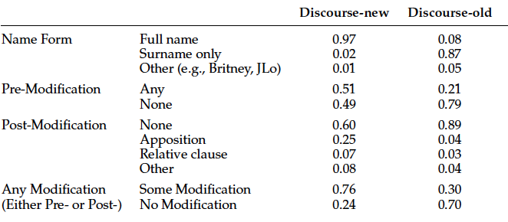
Corpus Analysis
Assess relation between:
information status and referring expressions

Slide 13
Summary Example
Honecker has come under investigation for charges of corruption and living in luxury at the cost of the state. Former East German leader Erich Honecker may be moved to a monastery to protect him from a possible lynching by enraged citizens. As protests gathered strength last fall, Erich Honecker, East Germany’s longtime orthodox leader “lost touch with reality,” according to the man who succeeded him as Communist leader only to be ousted later. Ousted East German leader Erich Honecker, who is expected to be indicted for high treason, was arrested Monday morning…..

Slide 14
Summary Example
Honecker has come under investigation for charges of corruption and living in luxury at the cost of the state. Former East German leader Erich Honecker may be moved to a monastery to protect him from a possible lynching by enraged citizens. As protests gathered strength last fall, Erich Honecker, East Germany’s longtime orthodox leader “lost touch with reality,” according to the man who succeeded him as Communist leader only to be ousted later. Ousted East German leader Erich Honecker, who is expected to be indicted for high treason, was arrested Monday morning…..

Slide 15
Generating Discourse-New/Old
If discourse-new,
If the NP head is a person name,
If appears with pre-modifier in text, write as:
Longest pre-modifier + full name
Else if it appears with an apposition modifier
Add that to the reference
Else don’t rewrite
Else use surname only

Slide 16
Generating Discourse-New/Old
If discourse-new,
If the NP head is a person name,
If appears with pre-modifier in text, write as:
Longest pre-modifier + full name
Else if it appears with an apposition modifier
Add that to the reference
Else don’t rewrite
Else use surname only
Significantly preferred over original forms

Slide 17
Summary Example
Former East German leader Erich Honecker has come under investigation for charges of corruption and living in luxury at the cost of the state. Honecker may be moved to a monastery to protect him from a possible lynching by enraged citizens. As protests gathered strength last fall, Honecker, “lost touch with reality,” according to the man who succeeded him as Communist leader only to be ousted later. Honecker, who is expected to be indicted for high treason, was arrested Monday morning…..

Slide 18
Hearer & Salience
Discourse-new status:

Slide 19
Hearer & Salience
Discourse-new status:
Obvious from summary
How do we establish hearer or major/minor status?

Slide 20
Hearer & Salience
Discourse-new status:
Obvious from summary
How do we establish hearer or major/minor status?
Categorize based on human summaries (gold)
Specifically by their referring expressions:

Slide 21
Hearer & Salience
Discourse-new status:
Obvious from summary
How do we establish hearer or major/minor status?
Categorize based on human summaries (gold)
Specifically by their referring expressions:
Hearer-old (i.e. familiar)

Slide 22
Hearer & Salience
Discourse-new status:
Obvious from summary
How do we establish hearer or major/minor status?
Categorize based on human summaries (gold)
Specifically by their referring expressions:
Hearer-old (i.e. familiar)
Title/role+surname or unmodified fullname
Major:

Slide 23
Hearer & Salience
Discourse-new status:
Obvious from summary
How do we establish hearer or major/minor status?
Categorize based on human summaries (gold)
Specifically by their referring expressions:
Hearer-old (i.e. familiar)
Title/role+surname or unmodified fullname
Major:
Referred to by name in some human summary of topic
258 major/3926 minor by data

Slide 24
Training
Trained classifiers to recognize

Slide 25
Training
Trained classifiers to recognize
Using features in document set
Frequency, lexical, syntactic
Classifiers:
SVM, Decision trees

Slide 26
Training
Trained classifiers to recognize
Using features in document set
Frequency, lexical, syntactic
Classifiers:
SVM, Decision trees
Hearer-New/Old: F-measure: 0.75 on both classes
Major/Minor: F: Major: 0.6; Minor: 0.98
All significantly better than baseline

Slide 27
Application
If discourse-new and NP head is person name:
If MINOR:

Slide 28
Application
If discourse-new and NP head is person name:
If MINOR:
Exclude name, use only role, modifiers, etc
If MAJOR and Hearer-Old:

Slide 29
Application
If discourse-new and NP head is person name:
If MINOR:
Exclude name, use only role, modifiers, etc
If MAJOR and Hearer-Old:
Include name and role/temporal (only)
If MAJOR and Hearer-New:

Slide 30
Application
If discourse-new and NP head is person name:
If MINOR:
Exclude name, use only role, modifiers, etc
If MAJOR and Hearer-Old:
Include name and role/temporal (only)
If MAJOR and Hearer-New:
Include name and role/temporal
Also include affiliation, post-mod (classifier)

Slide 31
Application
If discourse-new and NP head is person name:
If MINOR:
Exclude name, use only role, modifiers, etc
If MAJOR and Hearer-Old:
Include name and role/temporal (only)
If MAJOR and Hearer-New:
Include name and role/temporal
Also include affiliation, post-mod (classifier)
If discourse-old:

Slide 32
Application
If discourse-new and NP head is person name:
If MINOR:
Exclude name, use only role, modifiers, etc
If MAJOR and Hearer-Old:
Include name and role/temporal (only)
If MAJOR and Hearer-New:
Include name and role/temporal
Also include affiliation, post-mod (classifier)
If discourse-old:
Surname ONLY

Slide 33
Evaluation
Created (nearly) deterministic rule set
Based on information status classification
To rewrite referring expressions in extractive summaries

Slide 34
Evaluation
Created (nearly) deterministic rule set
Based on information status classification
To rewrite referring expressions in extractive summaries
Evaluated in paired preference tests over:
Original Extractive and Rewritten Summaries

Slide 35
Evaluation
Created (nearly) deterministic rule set
Based on information status classification
To rewrite referring expressions in extractive summaries
Evaluated in paired preference tests over:
Original Extractive and Rewritten Summaries
Where a preference was expressed,
Rewritten summaries rated as more coherent
Extractive rated as more informative - why?

Slide 36
Evaluation
Created (nearly) deterministic rule set
Based on information status classification
To rewrite referring expressions in extractive summaries
Evaluated in paired preference tests over:
Original Extractive and Rewritten Summaries
Where a preference was expressed,
Rewritten summaries rated as more coherent
Extractive rated as more informative
Why? Rewrite rules generally shrink rather than add content

Slide 37
Discussion
Pros:

Slide 38
Discussion
Pros:
Intuitive, interpretable model
Solid results: ~0.75 accuracy, higher if humans agree
Often preferred to extract
Cons:

Slide 39
Discussion
Pros:
Intuitive, interpretable model
Solid results: ~0.75 accuracy, higher if humans agree
Often preferred to extract
Cons:
Limited: only applies to person names
Error propagation: coreference, NP extraction
Ignores other aspects of realization, i.e. length

Slide 40
Summary
Can identify particular correlates of readability scores
Can automatically predict linguistic quality scores
Build systems that focus on frequent violations
Yield systematic improvements in linguistic quality

Slide 41
Alternate Views of Summarization

Slide 42
Dimensions of TAC Summarization
Use purpose: Reflective summaries
Audience: Analysts
Derivation (extactive vs abstractive): Largely extractive
Coverage (generic vs focused): “Guided”
Units (single vs multi): Multi-document
Reduction: 100 words
Input/Output form factors (language, genre, register, form)
English, newswire, paragraph text

Slide 43
Other Types of Summaries

Slide 44
Meeting Summaries
What do you want out of a summary?

Slide 45
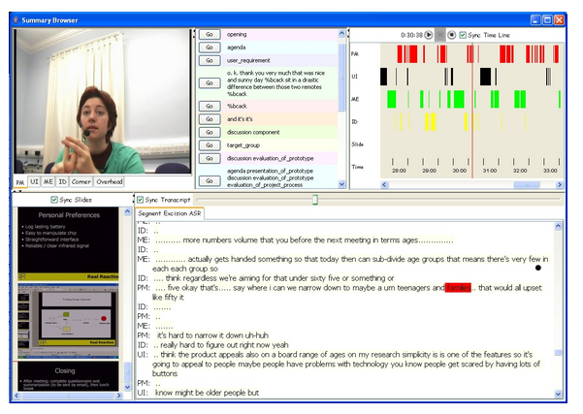
Example
Browser:

Slide 46
Meeting Summaries
What do you want out of a summary?
Minutes?
Agenda-based?
To-do list
Points of (Dis)agreement

Slide 47
Dimensions of Meeting Summaries
Use purpose:
Audience
Derivation (extactive vs abstractive):.
Coverage (generic vs focused):
Units (single vs multi):
Reduction:
Input/Output form factors (language, genre, register, form)

Slide 48
Dimensions of Meeting Summaries
Use purpose: Catch up on missed meetings
Audience: Ordinary attendees
Derivation (extactive vs abstractive): Extractive or Abstr.
Coverage (generic vs focused): User-based?
Units (single vs multi): Single event
Reduction: ?
Input/Output form factors (language, genre, register, form)
English, speech+, lists/bullets/todos

Slide 49
Examples
Decision summary:
1. The remote will resemble the potato prototype
2. There will be no feature to help find the remote when it is misplaced;
instead the remote will be in a bright colour to address this issue.
3. The corporate logo will be on the remote.
4. One of the colours for the remote will contain the corporate colours.
5. The remote will have six buttons.
6. The buttons will all be one colour.
7. The case will be single curve.
8. The case will be made of rubber.
9. The case will have a special colour.

Slide 50
Examples
Action items:
They will receive specific instructions for the next meeting by email.
They will fill out the questionnaire.

Slide 51
Examples
Abstractive summary:
When this functional design meeting opens the project manager tells the group about the project restrictions he received from management by email. The marketing expert is first to present, summarizing user requirements data from a questionnaire given to 100 respondents. The marketing expert explains various user preferences and complaints about remotes as well as different interests among age groups. He prefers that they aim users from ages 16-45, improve the most-used functions, and make a placeholder for the remote…

Slide 52
Abstractive Summarization
Basic components:
Content selection
Information ordering
Content realization

Slide 53
Abstractive Summarization
Basic components:
Content selection
Information ordering
Content realization
Comparable to extractive summarization
Fundamental differences:

Slide 54
Abstractive Summarization
Basic components:
Content selection
Information ordering
Content realization
Comparable to extractive summarization
Fundamental differences:
What do the processes operate on?
Extractive?

Slide 55
Abstractive Summarization
Basic components:
Content selection
Information ordering
Content realization
Comparable to extractive summarization
Fundamental differences:
What do the processes operate on?
Extractive? Sentences (or subspans)
Abstractive?

Slide 56
Abstractive Summarization
Basic components:
Content selection
Information ordering
Content realization
Comparable to extractive summarization
Fundamental differences:
What do the processes operate on?
Extractive? Sentences (or subspans)
Abstractive? Major question
Need some notion of concepts, relations in text

Slide 57
Levels of Representation
How can we represent concepts, relations from text?
Ideally, abstract away from surface sentences

Slide 58
Levels of Representation
How can we represent concepts, relations from text?
Ideally, abstract away from surface sentences
Build on some deep NLP representation:

Slide 59
Levels of Representation
How can we represent concepts, relations from text?
Ideally, abstract away from surface sentences
Build on some deep NLP representation:
Dependency trees: (Cheung & Penn, 2014)
Discourse parse trees: (Gerani et al, 2014)

Slide 60
Levels of Representation
How can we represent concepts, relations from text?
Ideally, abstract away from surface sentences
Build on some deep NLP representation:
Dependency trees: (Cheung & Penn, 2014)
Discourse parse trees: (Gerani et al, 2014)
Logical Forms
Abstract Meaning Representation (AMR): (Liu et al, 2015)

Slide 61
Representations
Different levels of representation:
Syntax, Semantics, Discourse

Slide 62
Representations
Different levels of representation:
Syntax, Semantics, Discourse
All embed:
Some nodes/substructure capturing concepts
Some arcs, etc capturing relations
In some sort of graph representation (maybe a tree)

Slide 63
Representations
Different levels of representation:
Syntax, Semantics, Discourse
All embed:
Some nodes/substructure capturing concepts
Some arcs, etc capturing relations
In some sort of graph representation (maybe a tree)
What’s the right level of representation??

Slide 64
Typical Approach
Parse original documents to deep representation

Slide 65
Typical Approach
Parse original documents to deep representation
Manipulate resulting graph for content selection
Splice dependency trees, remove satellite nodes, etc

Slide 66
Typical Approach
Parse original documents to deep representation
Manipulate resulting graph for content selection
Splice dependency trees, remove satellite nodes, etc
Generate based on resulting revised graph

Slide 67
Typical Approach
Parse original documents to deep representation
Manipulate resulting graph for content selection
Splice dependency trees, remove satellite nodes, etc
Generate based on resulting revised graph
All rely on parsing/generation to/from representation

Slide 68
AMR
“Abstract Meaning Representation”
Sentence-level semantic representation

Slide 69
AMR
“Abstract Meaning Representation”
Sentence-level semantic representation
Nodes: Concepts:
English words, PropBank predicates, or keywords (‘person’)

Slide 70
AMR
“Abstract Meaning Representation”
Sentence-level semantic representation
Nodes: Concepts:
English words, PropBank predicates, or keywords (‘person’)
Edges: Relations:
PropBank thematic roles (ARG0-ARG5)
Others including ‘location’, ‘name’, ‘time’, etc…
~100 in total

Slide 71
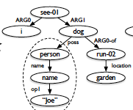
AMR 2
AMR Bank: (now) ~40K annotated sentences
JAMR parser: 63% F-measure (2015)
Alignments b/t word spans & graph fragments
Example: “I saw Joe’s dog, which was running in the garden.”
Liu et al, 2015.

Slide 72
AMR-Based Summarization
Use JAMR to parse input sentences to AMR

Slide 73
AMR-Based Summarization
Use JAMR to parse input sentences to AMR
Perform “concept merging” to link coref nodes
Join sentence AMRs to dummy ROOT
Create other connections as needed

Slide 74
AMR-Based Summarization
Use JAMR to parse input sentences to AMR
Perform “concept merging” to link coref nodes
Join sentence AMRs to dummy ROOT
Create other connections as needed
Select subset of nodes for inclusion in summary
*Generate surface realization of AMR (future work)

Slide 75
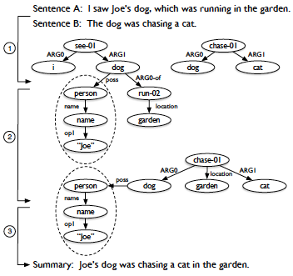
Toy Example
Liu et al, 2015.

Slide 76
Graph Creation
Concept merging:
Constrained
Applied to Named entities & dates
Treat fragment as unary entity
Merge with identical nodes
Barak Obama = Barak Obama; Barak Obama ≠ Obama
Replace multiple edges b/t two nodes with unlabeled edge

Slide 77
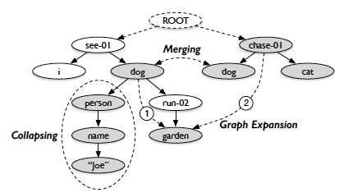
Merged Graph Example
Liu et al, 2015; Fig 3.

Slide 78
Graph Creation
Concept merging:
Constrained
Applied to Named entities & dates
Treat fragment as unary entity
Merge with identical nodes
Barak Obama = Barak Obama; Barak Obama ≠ Obama
Replace multiple edges b/t two nodes with unlabeled edge
Compare to gold standard AMR edges for articles
“proxy report”
~ single document summary In style of analyst’s report
All sentences paired w/AMR

Slide 79
Content Selection
Formulated as subgraph selection
Modeled as ILP

Slide 80
Content Selection
Formulated as subgraph selection
Modeled as ILP
Maximize the graph score (over edges, nodes)
Inclusion score for nodes, edges
Subject to:
Graph validity: edges must include endpoint nodes
Graph connectivity
Tree structure (one incoming edge/node)
Compression constraint (size of graph in edges)

Slide 81
Content Selection
Formulated as subgraph selection
Modeled as ILP
Maximize the graph score (over edges, nodes)
Inclusion score for nodes, edges
Subject to:
Graph validity: edges must include endpoint nodes
Graph connectivity
Tree structure (one incoming edge/node)
Compression constraint (size of graph in edges)
Features: Concept/label, frequency, depth, position,
Span, NE?, Date?

Slide 82
Evaluation
Compare to gold-standard “proxy report”
Single-document summaries
Subgraph overlap with AMR
ROUGE-1 w/text
Generating most freq subspans associated w/fragments

Slide 83
Evaluation
Compare to gold-standard “proxy report”
Single-document summaries
Subgraph overlap with AMR
ROUGE-1 w/text
Generating most freq subspans associated w/fragments
Results:
ROUGE-1: P: 0.5; R: 0.4; F: 0.44
Similar for manual AMR and auto parse
Oracle: P: 0.85; R: 0.44; F: 0.58
Based on similar bag-of-phrase generation from gold AMR

Slide 84
Summary
Interesting strategy based on semantic represent’n
Builds on graph structure over deep model
Promising strategy
Limitations:

Slide 85
Summary
Interesting strategy based on semantic represent’n
Builds on graph structure over deep model
Promising strategy
Limitations:
Single-document
Does extension to multi-doc make sense?
Literal matching:
Reference, lexical content
Generation

