Slide 1
Alternative Summarization: Reviews & Speech
Ling 573
Systems and Applications
May 26, 2016

Slide 2
Roadmap
Abstractive summarization example
Using Abstract Meaning Representation
Review summarization:
Basic approach
Learning what users want
Speech summarization:
Application of speech summarization
Speech vs Text
Text-free summarization

Slide 3
Generic Abstractive Summarization Approach
Parse original documents to deep representation
Manipulate resulting graph for content selection
Splice trees, remove nodes, etc
Generate based on resulting revised graph
All rely on parsing/generation to/from representation

Slide 4
Summarization Using Abstract Meaning Representation
Use JAMR to parse input sentences to AMR

Slide 5
Summarization Using Abstract Meaning Representation
Use JAMR to parse input sentences to AMR
Create unified document graph
Link coreferent nodes by “concept merging”
Join sentence AMRs to common (dummy) ROOT
Create other connections as needed

Slide 6
Summarization Using Abstract Meaning Representation
Use JAMR to parse input sentences to AMR
Create unified document graph
Link coreferent nodes by “concept merging”
Join sentence AMRs to common (dummy) ROOT
Create other connections as needed
Select subset of nodes for inclusion in summary
*Generate surface realization of AMR (future work)
Liu et al, 2015.

Slide 7
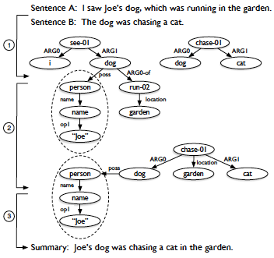
Toy Example
Liu et al, 2015.

Slide 8
Creating a Unified Document Graph
Concept merging:
Idea: Combine nodes for same entity in diff’t sentences
Highly Constrained
Applies ONLY to Named entities & dates
Collapse multi-node entities to single node
Merge ONLY identical nodes
Barak Obama = Barak Obama; Barak Obama ≠ Obama
Replace multiple edges b/t two nodes with unlabeled edge

Slide 9
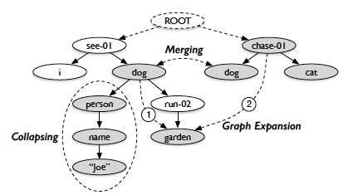
Merged Graph Example
Liu et al, 2015; Fig 3.

Slide 10
Content Selection
Formulated as subgraph selection
Modeled as Integer Linear Programming (ILP)

Slide 11
Content Selection
Formulated as subgraph selection
Modeled as Integer Linear Programming (ILP)
Maximize the graph score (over edges, nodes)
Inclusion score for nodes, edges
Subject to:
Graph validity: edges must include endpoint nodes
Graph connectivity
Tree structure (one incoming edge/node)
Compression constraint (size of graph in edges)

Slide 12
Content Selection
Formulated as subgraph selection
Modeled as Integer Linear Programming (ILP)
Maximize the graph score (over edges, nodes)
Inclusion score for nodes, edges
Subject to:
Graph validity: edges must include endpoint nodes
Graph connectivity
Tree structure (one incoming edge/node)
Compression constraint (size of graph in edges)
Features: Concept/label, frequency, depth, position,
Span, NE?, Date?

Slide 13
Evaluation
Compare to gold-standard “proxy report”
~ Single document summary In style of analyst’s report
All sentences paired w/AMR
Fully intrinsic measure:
Subgraph overlap with AMR
Slightly less intrinsic measure:
Generate Bag-of-Phrases via most frequent subspans
Associated with graph fragments
Compute ROUGE-1, aka word overlap

Slide 14
Evaluation
Results:
ROUGE-1: P: 0.5; R: 0.4; F: 0.44
Similar for manual AMR and automatic parse
Topline:
Oracle: P: 0.85; R: 0.44; F: 0.58
Based on similar bag-of-phrase generation from gold AMR

Slide 15
Summary
Interesting strategy based on semantic represent’n
Builds on graph structure over deep model
Promising strategy
Limitations:

Slide 16
Summary
Interesting strategy based on semantic represent’n
Builds on graph structure over deep model
Promising strategy
Limitations:
Single-document
Does extension to multi-doc make sense?
Literal matching:
Reference, lexical content
Generation

Slide 17
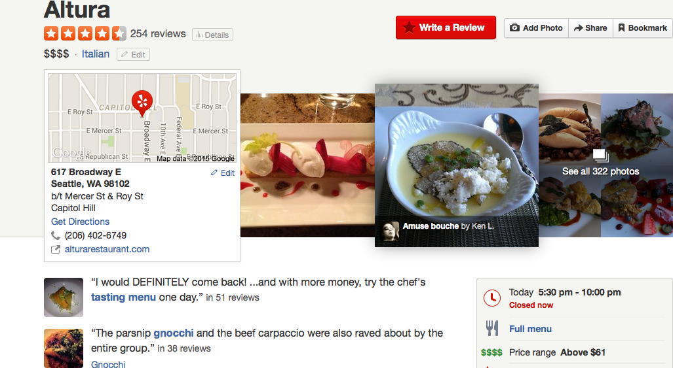
Review Summaries

Slide 18
Review Summary Dimensions
Use purpose:
Audience:
Derivation (extactive vs abstractive):
Coverage (generic vs focused):
Units (single vs multi):
Reduction:
Input/Output form factors (language, genre, register, form)

Slide 19
Review Summary Dimensions
Use purpose: Product selection, comparison
Audience: Ordinary people/customers
Derivation (extactive vs abstractive): Extractive+
Coverage (generic vs focused): Aspect-oriented
Units (single vs multi): Multi-document
Reduction: Varies
Input/Output form factors (language, genre, register, form)
??, user reviews, less formal, pros & cons, tables, etc

Slide 20
Sentiment Summarization
Classic approach: (Hu and Liu, 2004)
Summarization of product reviews (e.g. Amazon)
Identify product features mentioned in reviews
Identify polarity of sentences about those features
For each product,
For each feature,
For each polarity: provide illustrative examples

Slide 21
Example Summary
Feature: picture
Positive: 12
Overall this is a good camera with a really good picture clarity.
The pictures are absolutely amazing - the camera captures the minutest of details.
After nearly 800 pictures I have found that this camera takes incredible pictures.
…
Negative: 2
The pictures come out hazy if your hands shake even for a moment during the entire process of taking a picture.
Focusing on a display rack about 20 feet away in a brightly lit room during day time, pictures produced by this camera were blurry and in a shade of orange.

Slide 22
Learning Sentiment Summarization
Classic approach is heuristic:
May not scale, etc.

Slide 23
Learning Sentiment Summarization
Classic approach is heuristic:
May not scale, etc.
What do users want?

Slide 24
Learning Sentiment Summarization
Classic approach is heuristic:
May not scale, etc.
What do users want?
Which example sentences should be selected?
Strongest sentiment?
Most diverse sentiments?
Broadest feature coverage?

Slide 25
Review Summarization Factors
Posed as optimizing score for given length summary
Using a sentence extractive strategy

Slide 26
Review Summarization Factors I
Posed as optimizing score for given length summary
Using a sentence extractive strategy
Key factors:
Sentence sentiment score
Sentiment mismatch: b/t summary and product rating
Diversity:
Measure of how well diff’t “aspects” of product covered
Related to both quality of coverage, importance of aspect

Slide 27
Review Summarization Models I
Sentiment Match (SM): Neg(Mismatch)
Prefer summaries w/sentiment matching product
Issue?

Slide 28
Review Summarization Models I
Sentiment Match (SM): Neg(Mismatch)
Prefer summaries w/sentiment matching product
Issue?
Neutral rating ➔ neutral summary sentences
Approach: Force system to select stronger sents first

Slide 29
Review Summarization Models II
Sentiment Match + Aspect Coverage (SMAC):
Linear combination of:
Sentiment intensity, mismatch, & diversity
Issue?

Slide 30
Review Summarization Models II
Sentiment Match + Aspect Coverage (SMAC):
Linear combination of:
Sentiment intensity, mismatch, & diversity
Issue?
Optimizes overall sentiment match, but not per-aspect

Slide 31
Review Summarization Models III
Sentiment-Aspect Match (SAM):
Maximize coverage of aspects
*consistent* with per-aspect sentiment
Computed using probabilistic model
Minimize KL-divergence b/t summary, orig documents

Slide 32
Human Evaluation
Pairwise preference tests for different summaries
Side-by-side, along with overall product rating
Judged: No pref, Strongly – Weakly prefer A/B
Also collected comments that justify rating

Slide 33
Human Evaluation
Pairwise preference tests for different summaries
Side-by-side, along with overall product rating
Judged: No pref, Strongly – Weakly prefer A/B
Also collected comments that justify rating
Usually some preference, but not significant
Except between SAM (highest) and SMAC (lowest)
Do users care at all?

Slide 34
Human Evaluation
Pairwise preference tests for different summaries
Side-by-side, along with overall product rating
Judged: No pref, Strongly – Weakly prefer A/B
Also collected comments that justify rating
Usually some preference, but not significant
Except between SAM (highest) and SMAC (lowest)
Do users care at all?
Yes!! SMAC significantly better than LEAD baseline
(70% vs 25%)

Slide 35
Qualitative Comments
Preferred:

Slide 36
Qualitative Comments
Preferred:
Summaries with list (pro vs con)
Disliked:

Slide 37
Qualitative Comments
Preferred:
Summaries with list (pro vs con)
Disliked:
Summary sentences w/o sentiment
Non-specific sentences
Inconsistency b/t overall rating and summary

Slide 38
Qualitative Comments
Preferred:
Summaries with list (pro vs con)
Disliked:
Summary sentences w/o sentiment
Non-specific sentences
Inconsistency b/t overall rating and summary
Preferences differed depending on overall rating
Prefer SMAC for neutral vs SAM for extremes
(SAM excludes low polarity sentences)

Slide 39
Conclusions
Ultimately, trained meta-classifier to pick model
Improved prediction of user preferences

Slide 40
Conclusions
Ultimately, trained meta-classifier to pick model
Improved prediction of user preferences
Similarities and contrasts w/TAC:
Similarities:

Slide 41
Conclusions
Ultimately, trained meta-classifier to pick model
Improved prediction of user preferences
Similarities and contrasts w/TAC:
Similarities:
Diversity ~ Non-redundancy
Product aspects ~ Topic aspects: coverage, importance
Differences:

Slide 42
Conclusions
Ultimately, trained meta-classifier to pick model
Improved prediction of user preferences
Similarities and contrasts w/TAC:
Similarities:
Diversity ~ Non-redundancy
Product aspects ~ Topic aspects: coverage, importance
Differences:
Strongly task/user oriented
Sentiment focused (overall, per-sentence)
Presentation preference: lists vs narratives

Slide 43
Speech Summarization

Slide 44
Speech Summary Applications
Why summarize speech?
Meeting summarization

Slide 45
Speech Summary Applications
Why summarize speech?
Meeting summarization
Lecture summarization
Voicemail summarization
Broadcast news
Debates, etc….

Slide 46
Speech and Text Summarization
Commonalities:

Slide 47
Speech and Text Summarization
Commonalities:
Require key content selection
Linguistic cues: lexical, syntactic, discourse structure
Alternative strategies: extractive, abstractive

Slide 48
Speech vs Text
Challenges of speech (summarization):

Slide 49
Speech vs Text
Challenges of speech (summarization):
Recognition (and ASR errors)
Downstream NLP processing issues, errors
Segmentation: speaker, story, sentence
Channel issues (anchor vs remote)
Disfluencies
Overlaps
“Lower information density”: off-talk, chitchat, etc
Generation: text? Speech? Resynthesis?
Other text cues: capitalization, paragraphs, etc
New information

Slide 50
Speech vs Text
Challenges of speech (summarization):
Recognition (and ASR errors)
Downstream NLP processing issues, errors
Segmentation: speaker, story, sentence
Channel issues (anchor vs remote)
Disfluencies
Overlaps
“Lower information density”: off-talk, chitchat, etc
Generation: text? Speech? Resynthesis?
Other text cues: capitalization, paragraphs, etc
New information: audio signal, prosody, dialog structure

Slide 51
Text vs. Speech Summarization (NEWS)
Speech Signal
Speech Channels
- phone, remote satellite, station
Error-free Text
Transcripts
- ASR, Close Captioned
Transcript- Manual
Lexical Features
Many Speakers
- speaking styles
Some Lexical Features
Segmentation
-sentences
Story presentation
style
Structure
-Anchor, Reporter Interaction
Prosodic Features
-pitch, energy, duration
NLP tools
Commercials, Weather Report
Hirschberg, 2006

Slide 52
Current Approaches
Predominantly extractive
Significant focus on compression
Why?

Slide 53
Current Approaches
Predominantly extractive
Significant focus on compression
Why?
Fluency: raw speech is often messy
Speed: speech is (relatively) slow, if using playback
Integration of speech features

Slide 54
Current Data
Speech summary data:
Broadcast news
Lectures
Meetings
Talk shows
Conversations (Switchboard, Callhome)
Voicemail

Slide 55
Common Strategies
Basically, do ASR and treat like text

Slide 56
Common Strategies
Basically, do ASR and treat like text
Unsupervised approaches:
Tf-idf cosine; LSA; MMR

Slide 57
Common Strategies
Basically, do ASR and treat like text
Unsupervised approaches:
Tf-idf cosine; LSA; MMR
Classification-based approaches:
Features include:
Sentence position, sentence length, sentence score/weight
Discourse & local context features
Modeling approaches:
SVMs, logistic regression, CRFs, etc

Slide 58
What about “Speech”?
Automatic sentence segmentation

Slide 59
What about “Speech”?
Automatic sentence segmentation
Disfluency tagging, filtering

Slide 60
What about “Speech”?
Automatic sentence segmentation
Disfluency tagging, filtering
Speaker-related features:

Slide 61
What about “Speech”?
Automatic sentence segmentation
Disfluency tagging, filtering
Speaker-related features:
Speaker role (e.g. anchor), proportion of speech
ASR confidence scores:

Slide 62
What about “Speech”?
Automatic sentence segmentation
Disfluency tagging, filtering
Speaker-related features:
Speaker role (e.g. anchor), proportion of speech
ASR confidence scores:
Intuition: use more reliable content
Prosody:
Pitch, intensity, speaking rate
Can indicate

Slide 63
What about “Speech”?
Automatic sentence segmentation
Disfluency tagging, filtering
Speaker-related features:
Speaker role (e.g. anchor), proportion of speech
ASR confidence scores:
Intuition: use more reliable content
Prosody:
Pitch, intensity, speaking rate
Can indicate: emphasis, new topic, new information

Slide 64
Speech-focused Summarization
Intuition:
How something is said is as important as what is said

Slide 65
Speech-focused Summarization
Intuition:
How something is said is as important as what is said
Hypothesis:
Speakers use pitch, intensity, speaking rate to mark important information

Slide 66
Speech-focused Summarization
Intuition:
How something is said is as important as what is said
Hypothesis:
Speakers use pitch, intensity, speaking rate to mark important information
Test:
Can we do speech summarization without speech transcription?
At least competitively with ASR

Slide 67
Approach
Maskey & Hirschberg, 2006
Data: Broadcast News (e.g. CNN)
Single-document summarization
Has sentence, turn, topic annotation

Slide 68
Approach
Maskey & Hirschberg, 2006
Data: Broadcast News (e.g. CNN)
Single-document summarization
Has sentence, turn, topic annotation
Bayesian Network model here:
Later HMM model:
Summary vs non-summary states

Slide 69
Approach
Maskey & Hirschberg, 2006
Data: Broadcast News (e.g. CNN)
Single-document summarization
Has sentence, turn, topic annotation
Bayesian Network model here:
Later used HMM model:
Summary vs non-summary states
Observations:
Acoustic-prosodic measures: pitch, intensity,…
Structural features: which speaker, role, position, etc
Lexical: word information
Discourse features: Ratio of given/new information

Slide 70
Results
Features | ROUGE score
Baseline | 0.5

Slide 71
Results
Features | ROUGE score
Acoustic+Structural | 0.68
Acoustic | 0.63
Baseline | 0.5

Slide 72
Results
Acoustic, speaker results competitive w/lexical
Combined best
Features | ROUGE score
All features | 0.8
Lexical | 0.7
Acoustic+Structural | 0.68
Acoustic | 0.63
Baseline | 0.5

Slide 73
Summary
Speech summarization:
Builds on text based models
Extends to
Overcome speech-specific challenges
Exploit speech-specific cues
Can be highly domain/task dependent
Highly challenging

Slide 74
Conclusions
Summarization:
Broad range of applications
Differ across dimensions
Delved into TAC summarization in depth
Draws on wide range of:
Shallow, deep NLP methods
Machine learning models
Many remaining challenges, opportunities

Slide 75
Reminders
Final code deliverable due Sunday
Doodle for presentation times
Manual evaluation instructions/data out Monday

