Slide 1
Content Selection: Supervision & Discourse
Ling573
Systems & Applications
April 14, 2016

Slide 2
Roadmap
Content selection
Supervised content selection
Analysis & Regression with rich features
“CLASSY”: HMM methods
Discourse structure
Models of discourse structure
Structure and relations for summarization

Slide 3
Supervised Word Selection
RegSumm:
Improving the Estimation of Word Importance for News Multi-Document Summarization (Hong & Nenkova, ’14)
Key ideas:
Supervised method for word selection
Diverse, rich feature set: unsupervised measures, POS, NER, position, etc
Identification of common “important” words via side corpus of news articles and human summaries

Slide 4
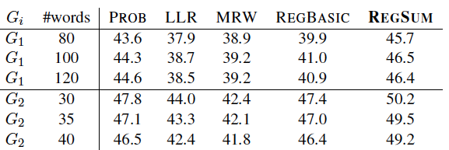
Assessment: Words
Select N highest ranked keywords via regression
Compute F-measure over words in summaries
G_{i}: i = # of summaries in which word appears

Slide 5
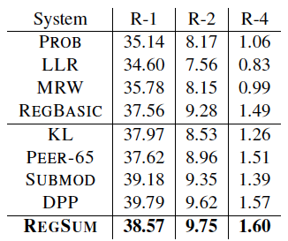
Assessment: Summaries
Compare summarization w/ROUGE-1,2,4
Basic
Systems
State of
The Art
Systems

Slide 6
CLASSY
“Clustering, Linguistics and Statistics for Summarization Yield”
Conroy et al. 2000-2011
Highlights:
High performing system
Often rank 1 in DUC/TAC, commonly used comparison
Topic signature-type system (LLR)
HMM-based content selection
Redundancy handling

Slide 7
Using LLR for Weighting
Compute weight for all cluster terms
weight(w_{i}) = 1 if -2log λ> 10, 0 o.w.
Use that to compute sentence weights
How do we use the weights?
One option: directly rank sentences for extraction
LLR-based systems historically perform well
Better than tf*idf generally

Slide 8
HMM Sentence Selection
CLASSY strategy: Use LLR as feature in HMM
How does HMM map to summarization?

Slide 9
HMM Sentence Selection
CLASSY strategy: Use LLR as feature in HMM
How does HMM map to summarization?
Key idea:
Two classes of states: summary, non-summary
Feature(s)?

Slide 10
HMM Sentence Selection
CLASSY strategy: Use LLR as feature in HMM
How does HMM map to summarization?
Key idea:
Two classes of states: summary, non-summary
Feature(s)?: log(#sig+1) (tried: length, position,..)
Lower cased, white-space tokenized (a-z), stopped
Topology:

Slide 11
HMM Sentence Selection
CLASSY strategy: Use LLR as feature in HMM
How does HMM map to summarization?
Key idea:
Two classes of states: summary, non-summary
Feature(s)?: log(#sig+1) (tried: length, position,..)
Lower cased, white-space tokenized (a-z), stopped
Topology:

Slide 12
HMM Sentence Selection
CLASSY strategy: Use LLR as feature in HMM
How does HMM map to summarization?
Key idea:
Two classes of states: summary, non-summary
Feature(s)?: log(#sig+1) (tried: length, position,..)
Lower cased, white-space tokenized (a-z), stopped
Topology:
Select sentences with highest posterior (in “summary”)

Slide 13
Matrix-based Selection
Redundancy minimizing selection
Create term x sentence matrix
If term in sentence, weight is nonzero

Slide 14
Matrix-based Selection
Redundancy minimizing selection
Create term x sentence matrix
If term in sentence, weight is nonzero
Loop:
Select highest scoring sentence
Based on Euclidean norm

Slide 15
Matrix-based Selection
Redundancy minimizing selection
Create term x sentence matrix
If term in sentence, weight is nonzero
Loop:
Select highest scoring sentence
Based on Euclidean norm
Subtract those components from remaining sentences
Until enough sentences

Slide 16
Matrix-based Selection
Redundancy minimizing selection
Create term x sentence matrix
If term in sentence, weight is nonzero
Loop:
Select highest scoring sentence
Based on Euclidean norm
Subtract those components from remaining sentences
Until enough sentences
Effect: selects highly ranked but different sentences
Relatively insensitive to weighting schemes

Slide 17
Combining Approaches
Both HMM and Matrix method select sentences
Can combine to further improve

Slide 18
Combining Approaches
Both HMM and Matrix method select sentences
Can combine to further improve
Approach:
Use HMM method to compute sentence scores
(e.g. rather than just weight based)
Incorporates context information, prior states

Slide 19
Combining Approaches
Both HMM and Matrix method select sentences
Can combine to further improve
Approach:
Use HMM method to compute sentence scores
(e.g. rather than just weight based)
Incorporates context information, prior states
Loop:
Select highest scoring sentence

Slide 20
Combining Approaches
Both HMM and Matrix method select sentences
Can combine to further improve
Approach:
Use HMM method to compute sentence scores
(e.g. rather than just weight based)
Incorporates context information, prior states
Loop:
Select highest scoring sentence
Update matrix scores
Exclude those with too low matrix scores
Until enough sentences are found

Slide 21
Other Linguistic Processing
Sentence manipulation (before selection):
Remove uninteresting phrases based on POS tagging
Gerund clauses, restr. rel. appos, attrib, lead adverbs

Slide 22
Other Linguistic Processing
Sentence manipulation (before selection):
Remove uninteresting phrases based on POS tagging
Gerund clauses, restr. rel. appos, attrib, lead adverbs
Coreference handling (Serif system)
Created coref chains initially
Replace all mentions with longest mention (# caps)
Used only for sentence selection

Slide 23
Outcomes
HMM, Matrix: both effective, better combined
Linguistic pre-processing improves
Best ROUGE-1,ROUGE-2 in DUC
Coref handling improves:
Best ROUGE-3, ROUGE-4; 2nd ROUGE-2

Slide 24
Discourse Structure for Content Selection

Slide 25
Text Coherence
Cohesion – repetition, etc – does not imply coherence
Coherence relations:
Possible meaning relations between utts in discourse

Slide 26
Text Coherence
Cohesion – repetition, etc – does not imply coherence
Coherence relations:
Possible meaning relations between utts in discourse
Examples:
Result: Infer state of S₀ cause state in S₁
The Tin Woodman was caught in the rain. His joints rusted.

Slide 27
Text Coherence
Cohesion – repetition, etc – does not imply coherence
Coherence relations:
Possible meaning relations between utts in discourse
Examples:
Result: Infer state of S₀ cause state in S₁
The Tin Woodman was caught in the rain. His joints rusted.
Explanation: Infer state in S₁ causes state in S₀
John hid Bill’s car keys. He was drunk.

Slide 28
Text Coherence
Cohesion – repetition, etc – does not imply coherence
Coherence relations:
Possible meaning relations between utts in discourse
Examples:
Result: Infer state of S₀ cause state in S₁
The Tin Woodman was caught in the rain. His joints rusted.
Explanation: Infer state in S₁ causes state in S₀
John hid Bill’s car keys. He was drunk.
Elaboration: Infer same prop. from S₀ and S₁.
Dorothy was from Kansas. She lived in the great Kansas prairie.
Pair of locally coherent clauses: discourse segment

Slide 29
Rhetorical Structure Theory
Mann & Thompson (1987)
Goal: Identify hierarchical structure of text
Cover wide range of TEXT types
Language contrasts
Relational propositions (intentions)
Derives from functional relations b/t clauses

Slide 30
Components of RST
Relations:
Hold b/t two text spans, nucleus and satellite
Nucleus core element, satellite peripheral
Constraints on each, between
Units: Elementary discourse units (EDUs), e.g. clauses

Slide 31
RST Relations
Evidence
The program really works. (N)
I entered all my info and it matched my results. (S)
Evidence
1
2

Slide 32
RST Relations
Core of RST
RST analysis requires building tree of relations
Relations include:
Circumstance, Solutionhood, Elaboration. Background, Enablement, Motivation, Evidence, etc
Captured in:
RST treebank: corpus of WSJ articles with analysis
RST parsers: Marcu, Peng and Hirst 2014

Slide 33
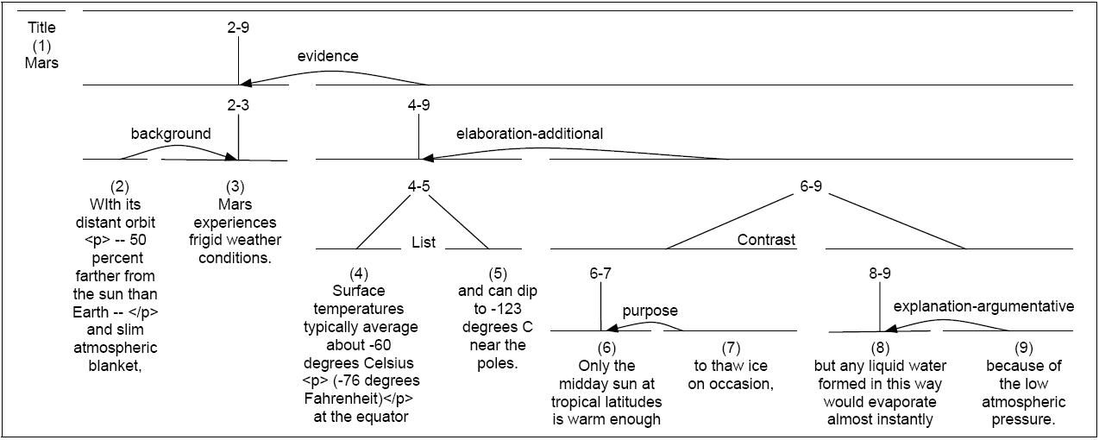

Slide 34
GraphBank
Alternative discourse structure model
Wolf & Gibson, 2005

Slide 35
GraphBank
Alternative discourse structure model
Wolf & Gibson, 2005
Key difference:
Analysis of text need not be tree-structure, like RST
Can be arbitrary graph, allowing crossing dependency

Slide 36
GraphBank
Alternative discourse structure model
Wolf & Gibson, 2005
Key difference:
Analysis of text need not be tree-structure, like RST
Can be arbitrary graph, allowing crossing dependency
Similar relations among spans (clauses)
Slightly different inventory

Slide 37
Penn Discourse Treebank
PDTB (Prasad et al, 2008)
“Theory-neutral” discourse model
No stipulation of overall structure, identifies local rels

Slide 38
Penn Discourse Treebank
PDTB (Prasad et al, 2008)
“Theory-neutral” discourse model
No stipulation of overall structure, identifies local rels
Two types of annotation:
Explicit: triggered by lexical markers (‘but’) b/t spans
Arg2: syntactically bound to discourse connective, ow Arg1

Slide 39
Penn Discourse Treebank
PDTB (Prasad et al, 2008)
“Theory-neutral” discourse model
No stipulation of overall structure, identifies local rels
Two types of annotation:
Explicit: triggered by lexical markers (‘but’) b/t spans
Arg2: syntactically bound to discourse connective, ow Arg1
Implicit: Adjacent sentences assumed related
Arg1: first sentence in sequence

Slide 40
Penn Discourse Treebank
PDTB (Prasad et al, 2008)
“Theory-neutral” discourse model
No stipulation of overall structure, identifies local rels
Two types of annotation:
Explicit: triggered by lexical markers (‘but’) b/t spans
Arg2: syntactically bound to discourse connective, ow Arg1
Implicit: Adjacent sentences assumed related
Arg1: first sentence in sequence
Senses/Relations:
Comparison, Contingency, Expansion, Temporal
Broken down into finer-grained senses too

Slide 41
Discourse & Summarization
Intuitively, discourse should be useful
Selection, ordering, realization

Slide 42
Discourse & Summarization
Intuitively, discourse should be useful
Selection, ordering, realization
Selection:
Sense

Slide 43
Discourse & Summarization
Intuitively, discourse should be useful
Selection, ordering, realization
Selection:
Sense: some relations more important
E.g. cause vs elaboration
Structure

Slide 44
Discourse & Summarization
Intuitively, discourse should be useful
Selection, ordering, realization
Selection:
Sense: some relations more important
E.g. cause vs elaboration
Structure: some information more core
Nucleus vs satellite, promotion, centrality
Compare these, contrast with lexical info
Louis et al, 2010

Slide 45
Framework
Association with extractive summary sentences
Statistical analysis
Chi-squared (categorical), t-test (continuous)

Slide 46
Framework
Association with extractive summary sentences
Statistical analysis
Chi-squared (categorical), t-test (continuous)
Classification:
Logistic regression
Different ensembles of features
Classification F-measure
ROUGE over summary sentences

Slide 47
RST Parsing
Learn and apply classifiers for
Segmentation and parsing of discourse

Slide 48
RST Parsing
Learn and apply classifiers for
Segmentation and parsing of discourse
Assign coherence relations between spans

Slide 49
RST Parsing
Learn and apply classifiers for
Segmentation and parsing of discourse
Assign coherence relations between spans
Create a representation over whole text => parse
Discourse structure
RST trees
Fine-grained, hierarchical structure
Clause-based units

Slide 50
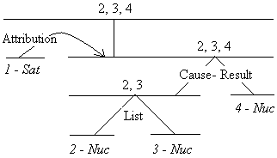
Discourse Structure Example
1. [Mr. Watkins said] 2. [volume on Interprovincial’s system is down about 2% since January] 3. [and is expected to fall further,] 4. [making expansion unnecessary until perhaps the mid-1990s.]

Slide 51
Discourse Structure Features
Satellite penalty:
For each EDU: # of satellite nodes b/t it and root
1 satellite in tree: (1), one step to root: penalty = 1

Slide 52
Discourse Structure Features
Satellite penalty:
For each EDU: # of satellite nodes b/t it and root
1 satellite in tree: (1), one step to root: penalty = 1
Promotion set:
Nuclear units at some level of tree
At leaves, EDUs are themselves nuclear

Slide 53
Discourse Structure Features
Satellite penalty:
For each EDU: # of satellite nodes b/t it and root
1 satellite in tree: (1), one step to root: penalty = 1
Promotion set:
Nuclear units at some level of tree
At leaves, EDUs are themselves nuclear
Depth score:
Distance from lowest tree level to EDU’s highest rank
2,3,4: score= 4; 1: score= 3

Slide 54
Discourse Structure Features
Satellite penalty:
For each EDU: # of satellite nodes b/t it and root
1 satellite in tree: (1), one step to root: penalty = 1
Promotion set:
Nuclear units at some level of tree
At leaves, EDUs are themselves nuclear
Depth score:
Distance from lowest tree level to EDU’s highest rank
2,3,4: score= 4; 1: score= 3
Promotion score:
# of levels span is promoted:
1: score = 0; 4: score = 2; 2,3: score = 3

Slide 55
Converting to Sentence Level
Each feature has:
Raw score
Normalized score: Raw/sentence_length

Slide 56
Converting to Sentence Level
Each feature has:
Raw score
Normalized score: Raw/sentence_length
Sentence score for a feature:
Max over EDUs in sentence

Slide 57
“Semantic” Features
Capture specific relations on spans
Binary features over tuple of:
Implicit vs Explicit
Name of relation that holds
Top-level or second level
If relation is between sentences,
Indicate whether Arg1 or Arg2
E.g. “contains Arg1 of Implicit Restatement relation”
Also, # of relations, distance b/t args w/in sentence

Slide 58
Example I
In addition, its machines are easier to operate, so customers require less assistance from software.
Is there an explicit discourse marker?

Slide 59
Example I
In addition, its machines are easier to operate, so customers require less assistance from software.
Is there an explicit discourse marker?
Yes, ‘so’
Discourse relation?

Slide 60
Example I
In addition, its machines are easier to operate, so customers require less assistance from software.
Is there an explicit discourse marker?
Yes, ‘so’
Discourse relation?
‘Contingency’

Slide 61
Example II
(1)Wednesday’s dominant issue was Yasuda & Marine Insurance, which continued to surge on rumors of speculative buying. (2) It ended the day up 80 yen to 1880 yen.
Is there a discourse marker?

Slide 62
Example II
(1)Wednesday’s dominant issue was Yasuda & Marine Insurance, which continued to surge on rumors of speculative buying. (2) It ended the day up 80 yen to 1880 yen.
Is there a discourse marker?
No
Is there a relation?

Slide 63
Example II
(1)Wednesday’s dominant issue was Yasuda & Marine Insurance, which continued to surge on rumors of speculative buying. (2) It ended the day up 80 yen to 1880 yen.
Is there a discourse marker?
No
Is there a relation?
Implicit (by definition)
What relation?

Slide 64
Example II
(1)Wednesday’s dominant issue was Yasuda & Marine Insurance, which continued to surge on rumors of speculative buying. (2) It ended the day up 80 yen to 1880 yen.
Is there a discourse marker?
No
Is there a relation?
Implicit (by definition)
What relation?
Expansion (or more specifically (level 2) restatement)
What Args?

Slide 65
Example II
(1)Wednesday’s dominant issue was Yasuda & Marine Insurance, which continued to surge on rumors of speculative buying. (2) It ended the day up 80 yen to 1880 yen.
Is there a discourse marker?
No
Is there a relation?
Implicit (by definition)
What relation?
Expansion (or more specifically (level 2) restatement)
What Args? (1) is Arg1; (2) is Arg2 (by definition)

Slide 66
Non-discourse Features
Typical features:

Slide 67
Non-discourse Features
Typical features:
Sentence length
Sentence position
Probabilities of words in sent: mean, sum, product
# of signature words (LLR)

Slide 68
Significant Features
Associated with summary sentences
Structure: depth score, promotion score

Slide 69
Significant Features
Associated with summary sentences
Structure: depth score, promotion score
Semantic: Arg1 of Explicit Expansion, Implicit Contingency, Implicit Expansion, distance to arg

Slide 70
Significant Features
Associated with summary sentences
Structure: depth score, promotion score
Semantic: Arg1 of Explicit Expansion, Implicit Contingency, Implicit Expansion, distance to arg
Non-discourse: length, 1st in para, offset from end of para, # signature terms; mean, sum word probabilities

Slide 71
Significant Features
Associated with non-summary sentences
Structural: satellite penalty

Slide 72
Significant Features
Associated with non-summary sentences
Structural: satellite penalty
Semantic: Explicit expansion, explicit contingency, Arg2 of implicit temporal, implicit contingency,…
# shared relations

Slide 73
Significant Features
Associated with non-summary sentences
Structural: satellite penalty
Semantic: Explicit expansion, explicit contingency, Arg2 of implicit temporal, implicit contingency,…
# shared relations
Non-discourse: offset from para, article beginning; sent. probability

Slide 74
Observations
Non-discourse features good cues to summary
Structural features match intuition
Semantic features:

Slide 75
Observations
Non-discourse features good cues to summary
Structural features match intuition
Semantic features:
Relatively few useful for selecting summary sentences
Most associated with non-summary, but most sentences are non-summary

Slide 76
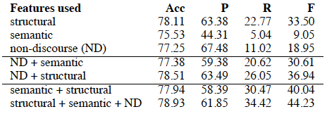
Evaluation

Slide 77
Evaluation
Structural best:
Alone and in combination

Slide 78
Evaluation
Structural best:
Alone and in combination
Best overall combine all types
Both F-1 and ROUGE

Slide 79
Graph-Based Comparison
Page-Rank-based centrality computed over:
RST link structure
Graphbank link structure
LexRank (sentence cosine similarity)

Slide 80
Graph-Based Comparison
Page-Rank-based centrality computed over:
RST link structure
Graphbank link structure
LexRank (sentence cosine similarity)
Quite similar:
F1: LR > GB > RST
ROUGE: RST > LR > GB

Slide 81
Notes

Slide 82
Notes
Single document, short (100 wd) summaries
What about multi-document? Longer?
Structure relatively better, all contribute

Slide 83
Notes
Single document, short (100 wd) summaries
What about multi-document? Longer?
Structure relatively better, all contribute
Manually labeled discourse structure, relations
Some automatic systems, but not perfect
However, better at structure than relation ID
Esp. implicit

