Slide 1
Entity- & Topic-Based Information Ordering
Ling 573
Systems and Applications
May 4, 2017

Slide 2
Roadmap
Entity-based cohesion model:
Models entity based transitions
Topic-based cohesion model:
Models sequence of topic transitions
Ordering as optimization

Slide 3
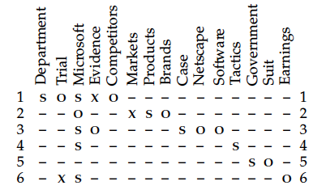

Slide 4
Vector Representation
Document vector:
Length: # of transition types
Values: Probabilities of each transition type
Can vary by transition types:
E.g. most frequent; all transitions of some length, etc

Slide 5
Dependencies & Comparisons
Tools needed:

Slide 6
Dependencies & Comparisons
Tools needed:
Coreference: Link mentions
Full automatic coref system vs

Slide 7
Dependencies & Comparisons
Tools needed:
Coreference: Link mentions
Full automatic coref system vs
Noun clusters based on lexical match
Grammatical role:
Extraction based on dependency parse (+passive rule) vs

Slide 8
Dependencies & Comparisons
Tools needed:
Coreference: Link mentions
Full automatic coref system vs
Noun clusters based on lexical match
Grammatical role:
Extraction based on dependency parse (+passive rule) vs
Simple present vs absent (X, _)

Slide 9
Dependencies & Comparisons
Tools needed:
Coreference: Link mentions
Full automatic coref system vs
Noun clusters based on lexical match
Grammatical role:
Extraction based on dependency parse (+passive rule) vs
Simple present vs absent (X, _)
Salience:
Distinguish focused vs not:?

Slide 10
Dependencies & Comparisons
Tools needed:
Coreference: Link mentions
Full automatic coref system vs
Noun clusters based on lexical match
Grammatical role:
Extraction based on dependency parse (+passive rule) vs
Simple present vs absent (X, _)
Salience:
Distinguish focused vs not: By frequency
Build different transition models by saliency group

Slide 11
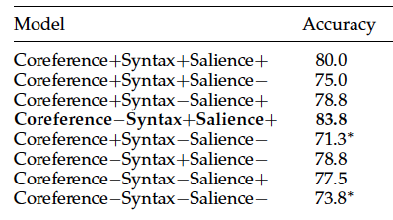
Experiments & Analysis
Trained SVM:
Salient: >= 2 occurrences; Transition length: 2
Train/Test: Is higher manual score set higher by system?
Feature comparison: DUC summaries

Slide 12
Discussion
Best results:
Use richer syntax and salience models
But NOT coreference (though not significant)
Why?

Slide 13
Discussion
Best results:
Use richer syntax and salience models
But NOT coreference (though not significant)
Why: Automatic summaries in training, unreliable coref
Worst results:
Significantly worse with both simple syntax, no salience
Extracted sentences still parse reliably
Still not horrible: 74% vs 84%

Slide 14
Discussion
Best results:
Use richer syntax and salience models
But NOT coreference (though not significant)
Why? Automatic summaries in training, unreliable coref
Worst results:
Significantly worse with both simple syntax, no salience
Extracted sentences still parse reliably
Still not horrible: 74% vs 84%
Much better than LSA model (52.5%)
Learning curve shows 80-100 pairs good enough

Slide 15
State-of-the-Art Comparisons
Two comparison systems:
Latent Semantic Analysis (LSA)
Barzilay & Lee (2004)

Slide 16
Comparison I
LSA model:
Motivation: Lexical gaps

Slide 17
Comparison I
LSA model:
Motivation: Lexical gaps
Pure surface word match misses similarity

Slide 18
Comparison I
LSA model:
Motivation: Lexical gaps
Pure surface word match misses similarity
Discover underlying concept representation
Based on distributional patterns

Slide 19
Comparison I
LSA model:
Motivation: Lexical gaps
Pure surface word match misses similarity
Discover underlying concept representation
Based on distributional patterns
Create term x document matrix over large news corpus

Slide 20
Comparison I
LSA model:
Motivation: Lexical gaps
Pure surface word match misses similarity
Discover underlying concept representation
Based on distributional patterns
Create term x document matrix over large news corpus
Perform SVD to create 100-dimensional dense matrix

Slide 21
Comparison I
LSA model:
Motivation: Lexical gaps
Pure surface word match misses similarity
Discover underlying concept representation
Based on distributional patterns
Create term x document matrix over large news corpus
Perform SVD to create 100-dimensional dense matrix
Score summary as:
Sentence represented as mean of its word vectors
Average of cosine similarity scores of adjacent sents
Local “concept” similarity score

Slide 22
“Catching the Drift”
Barzilay and Lee, 2004 (NAACL best paper)
Intuition:
Stories:
Composed of topics/subtopics
Unfold in systematic sequential way
Can represent ordering as sequence modeling over topics

Slide 23
“Catching the Drift”
Barzilay and Lee, 2004 (NAACL best paper)
Intuition:
Stories:
Composed of topics/subtopics
Unfold in systematic sequential way
Can represent ordering as sequence modeling over topics
Approach: HMM over topics

Slide 24
Strategy
Lightly supervised approach:
Learn topics in unsupervised way from data
Assign sentences to topics

Slide 25
Strategy
Lightly supervised approach:
Learn topics in unsupervised way from data
Assign sentences to topics
Learn sequences from document structure
Given clusters, learn sequence model over them

Slide 26
Strategy
Lightly supervised approach:
Learn topics in unsupervised way from data
Assign sentences to topics
Learn sequences from document structure
Given clusters, learn sequence model over them
No explicit topic labeling, no hand-labeling of sequence

Slide 27
Topic Induction
How can we induce a set of topics from doc set?
Assume we have multiple documents in a domain

Slide 28
Topic Induction
How can we induce a set of topics from doc set?
Assume we have multiple documents in a domain
Unsupervised approach:?

Slide 29
Topic Induction
How can we induce a set of topics from doc set?
Assume we have multiple documents in a domain
Unsupervised approach:? Clustering
Similarity measure?

Slide 30
Topic Induction
How can we induce a set of topics from doc set?
Assume we have multiple documents in a domain
Unsupervised approach:? Clustering
Similarity measure?
Cosine similarity over word bigrams
Assume some irrelevant/off-topic sentences
Merge clusters with few members into “etcetera” cluster

Slide 31
Topic Induction
How can we induce a set of topics from doc set?
Assume we have multiple documents in a domain
Unsupervised approach:? Clustering
Similarity measure?
Cosine similarity over word bigrams
Assume some irrelevant/off-topic sentences
Merge clusters with few members into “etcetera” cluster
Result: m topics, defined by clusters

Slide 32
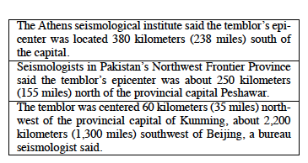
Induced Topics
Example earthquake topic

Slide 33
Sequence Modeling
Hidden Markov Model
States

Slide 34
Sequence Modeling
Hidden Markov Model
States = Topics
State m: special insertion state
Transition probabilities:
Evidence for ordering?

Slide 35
Sequence Modeling
Hidden Markov Model
States = Topics
State m: special insertion state
Transition probabilities:
Evidence for ordering?
Document ordering
Sentence from topic a appears before sentence from topic b

Slide 36
Sequence Modeling
Hidden Markov Model
States = Topics
State m: special insertion state
Transition probabilities:
Evidence for ordering?
Document ordering
Sentence from topic a appears before sentence from topic b

Slide 37
Sequence Modeling II
Emission probabilities:
Standard topic state:
Probability of observation given state (topic)

Slide 38
Sequence Modeling II
Emission probabilities:
Standard topic state:
Probability of observation given state (topic)
Probability of sentence under topic-specific bigram LM
Bigram probabilities

Slide 39
Sequence Modeling II
Emission probabilities:
Standard topic state:
Probability of observation given state (topic)
Probability of sentence under topic-specific bigram LM
Bigram probabilities

Slide 40
Sequence Modeling II
Emission probabilities:
Standard topic state:
Probability of observation given state (topic)
Probability of sentence under topic-specific bigram LM
Bigram probabilities
Etcetera state:
Forced complementary to other states

Slide 41
Sequence Modeling III
Viterbi re-estimation:
Intuition: Refine clusters, etc based on sequence info

Slide 42
Sequence Modeling III
Viterbi re-estimation:
Intuition: Refine clusters, etc based on sequence info
Iterate:
Run Viterbi decoding over original documents
Assign each sentence to cluster most likely to generate it
Use new clustering to recompute transition/emission

Slide 43
Sequence Modeling III
Viterbi re-estimation:
Intuition: Refine clusters, etc based on sequence info
Iterate:
Run Viterbi decoding over original documents
Assign each sentence to cluster most likely to generate it
Use new clustering to recompute transition/emission
Until stable (or fixed iterations)

Slide 44
Sentence Ordering Comparison
Restricted domain text:
Separate collections of earthquake, aviation accidents
LSA predictions:

Slide 45
Sentence Ordering Comparison
Restricted domain text:
Separate collections of earthquake, aviation accidents
LSA predictions: which order has higher score
Topic/content model:

Slide 46
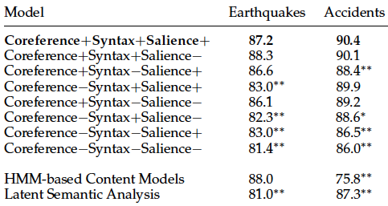
Sentence Ordering Comparison
Restricted domain text:
Separate collections of earthquake, aviation accidents
LSA predictions: which order has higher score
Topic/content model: highest probability under HMM

Slide 47
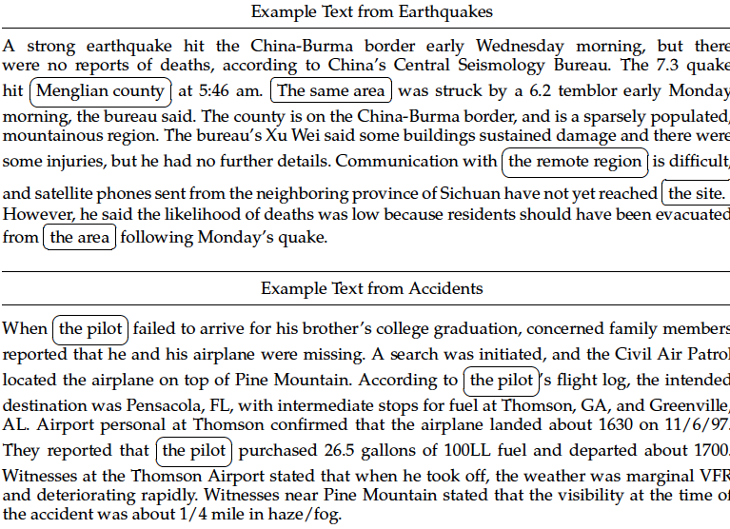
Examples
hi

Slide 48
Summary Coherence Scoring Comparison
Domain independent:
Too little data per domain to estimate topic-content model
Train: 144 pairwise summary rankings
Test: 80 pairwise summary rankings

Slide 49
Summary Coherence Scoring Comparison
Domain independent:
Too little data per domain to estimate topic-content model
Train: 144 pairwise summary rankings
Test: 80 pairwise summary rankings
Entity grid model (best): 83.8%
LSA model: 52.5%
Likely issue:

Slide 50
Summary Coherence Scoring Comparison
Domain independent:
Too little data per domain to estimate topic-content model
Train: 144 pairwise summary rankings
Test: 80 pairwise summary rankings
Entity grid model (best): 83.8%
LSA model: 52.5%
Likely issue:
Bad auto summaries highly repetitive ➔

Slide 51
Summary Coherence Scoring Comparison
Domain independent:
Too little data per domain to estimate topic-content model
Train: 144 pairwise summary rankings
Test: 80 pairwise summary rankings
Entity grid model (best): 83.8%
LSA model: 52.5%
Likely issue:
Bad auto summaries highly repetitive ➔
High inter-sentence similarity

Slide 52
Ordering as Optimization
Given a set of sentences to order
Define a local pairwise coherence score b/t sentences
Compute a total order optimizing local distances
Can we do this efficiently?

Slide 53
Ordering as Optimization
Given a set of sentences to order
Define a local pairwise coherence score b/t sentences
Compute a total order optimizing local distances
Can we do this efficiently?
Optimal ordering of this type is equivalent to TSP
Traveling Salesperson Problem: Given a list of cities and distances between cities, find the shortest route that visits each city exactly once and returns to the origin city.

Slide 54
Ordering as Optimization
Given a set of sentences to order
Define a local pairwise coherence score b/t sentences
Compute a total order optimizing local distances
Can we do this efficiently?
Optimal ordering of this type is equivalent to TSP
Traveling Salesperson Problem: Given a list of cities and distances between cities, find the shortest route that visits each city exactly once and returns to the origin city.
TSP is NP-complete (NP-hard)

Slide 55
Ordering as TSP
Can we do this practically?
DUC Summaries were 250 words, so 6-10 sentences
10 sentences have how many possible orders

Slide 56
Ordering as TSP
Can we do this practically?
DUC summaries were 250 words, so 6-10 sentences
10 sentences have how many possible orders? O(n!)
Not impossible
Alternatively,

Slide 57
Ordering as TSP
Can we do this practically?
DUC summaries are 250 words, so 6-10 sentences
10 sentences have how many possible orders? O(n!)
Not impossible
Alternatively,
Use an approximation methods
Take the best of a sample

Slide 58
CLASSY 2006
Formulates ordering as TSP
Requires pairwise sentence distance measure

Slide 59
CLASSY 2006
Formulates ordering as TSP
Requires pairwise sentence distance measure
Term-based similarity: # of overlapping terms

Slide 60
CLASSY 2006
Formulates ordering as TSP
Requires pairwise sentence distance measure
Term-based similarity: # of overlapping terms
Document similarity:
Multiply by a weight if in the same document (there, 1.6)

Slide 61
CLASSY 2006
Formulates ordering as TSP
Requires pairwise sentence distance measure
Term-based similarity: # of overlapping terms
Document similarity:
Multiply by a weight if in the same document (there, 1.6)
Normalize to between 0 and 1 (sqrt of product of selfsim)
Make distance: subtract from 1

Slide 62
Practicalities of Ordering
Brute force: O(n!)

Slide 63
Practicalities of Ordering
Brute force: O(n!)
“there are only 3,628,800 ways to order 10 sentences plus a lead sentence, so exhaustive search is feasible.“ (Conroy)

Slide 64
Practicalities of Ordering
Brute force: O(n!)
“there are only 3,628,800 ways to order 10 sentences plus a lead sentence, so exhaustive search is feasible.“ (Conroy)
Still,..
Used sample set to pick best
Candidates:
Random
Single-swap changes from good candidates

Slide 65
Practicalities of Ordering
Brute force: O(n!)
“there are only 3,628,800 ways to order 10 sentences plus a lead sentence, so exhaustive search is feasible.“ (Conroy)
Still,..
Used sample set to pick best
Candidates:
Random
Single-swap changes from good candidates
50K enough to consistently generate minimum cost order

Slide 66
Conclusions
Many cues to ordering:
Temporal, coherence, cohesion
Chronology, topic structure, entity transitions, similarity
Strategies:
Heuristic, machine learned; supervised, unsupervised
Incremental build-up versus generate & rank
Issues:
Domain independence, semantic similarity, reference

