Slide 1
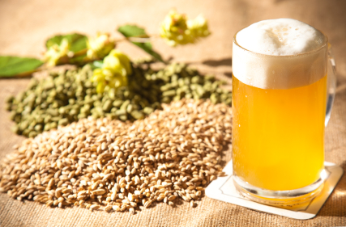
PhoneBrew (Home Brewing SDS)
Mike Foster
LING575
Spring 2013

Slide 2
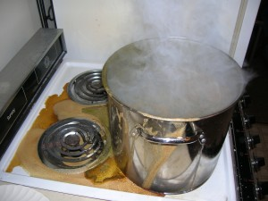
Motivations
Brewing is a messy, hands-on activity.
It is often necessary to be moving around during the process.
There are large spans of time when no interaction is required from the brewer, however timing is extremely important.
Recipes are vague and non-standardized.

Slide 3
Features
Library of recipes
Ingredient and equipment lists
Step-by-step instructions of the brewing process
Periodic timer reminders during downtimes
Look forward to next step
Email summary notes for future steps beyond the initial brewing.

Slide 4
Extended Demo

Slide 5
Short Demo

Slide 6
Questions?

