Slide 1
Mandarin Language Learning
Norah Hogoboom
LING 575 – Spoken Dialog Systems

Slide 2
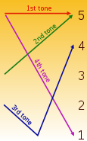
Summary
I worked on two parallel projects as I didn’t know which I would be technically able to do:
Tone Matching Game
First tone, or high-level tone (陰平/阴平 yīnpíng)
Second tone, or rising tone (陽平/阳平 yángpíng) high-rising:
Third tone, low or dipping tone (上 shǎng)
Fourth tone, falling tone, or high-falling (去 qù)
Fifth tone or zeroth tone (輕聲/轻声 qīng sheng
“Mandarin Express” commuter assisted language learning
happens to be my textbook for my Mandarin class…

Slide 3
Technology
Speech Recognition Grammar Specification Version 1.0
Microsoft Windows 8 Client (zh-CN)
Microsoft Speech Platform SDK v 11.0
Microsoft Speech Platform Runtime v 11.0
Redistributable Language Packs v 11.0
MSSpeech_SR_zh-CN_TELE.msi
MSSpeech_TTS_zh-CN_HuiHui.msi
Visual Studio International Feature Pack

Slide 4
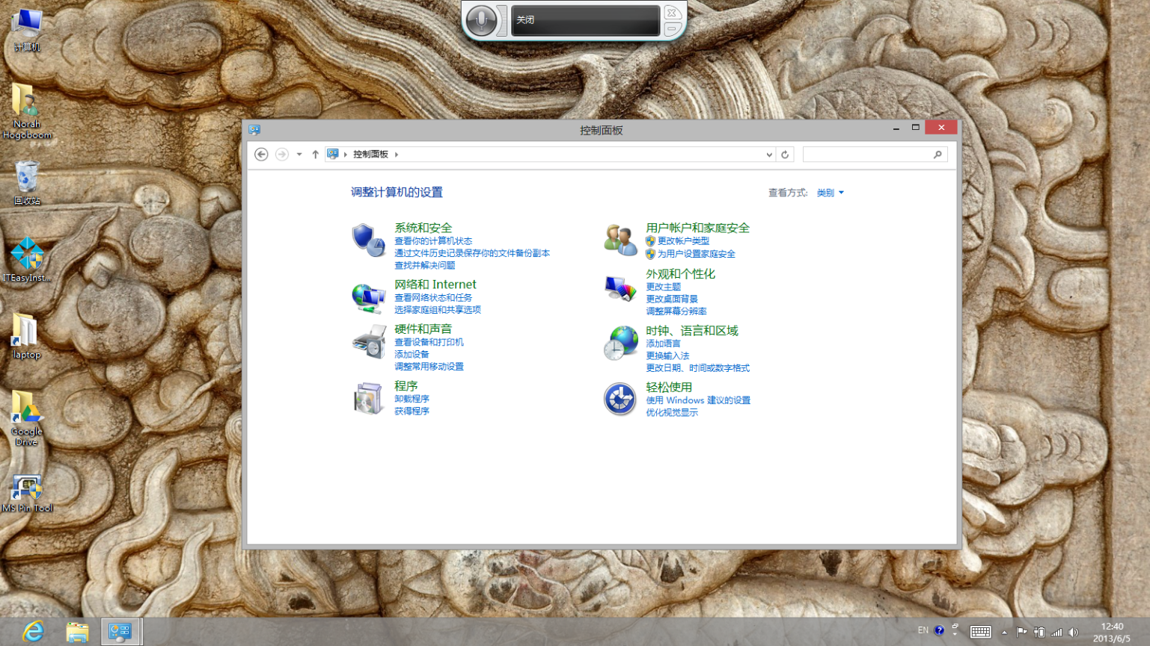
Challenges
The operating system has to be entirely Chinese, including the underlying code page in order for speech and non-Unicode features (like the command prompt) to work and display Chinese.
Learning the Microsoft Speech Technologies
More complicated constructions in SRGS (and writing well-formed XML in general)
Developing a UI in WPF (never have done that before)
Preparing all of the Chinese text, especially converting back and forth from Hanzi to PInyin

Slide 5
Demos
Tone Matching Game
C:\Users\norahh\Desktop\mandarinspeech\capture_tonegame.swf
Mandarin Express
C:\Users\norahh\Desktop\mandarinspeech\capture_mandarinexpress.swf

Slide 6
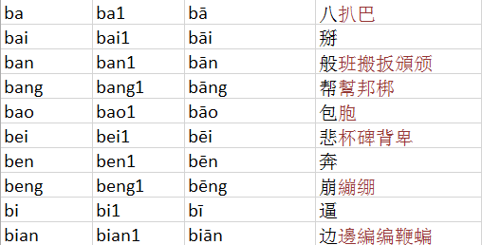
Mandarin Tone Game
- Used list of recognized phonemes in SAPI
- Looked up hanzi candidates for each of the tones
- Converted from numbered tones to tone marks
- Created text file to read into application.

Slide 7
Mandarin Express Grammars
<grammar version="1.0" xmlns="http://www.w3.org/2001/06/grammar"
xmlns:xsi="http://www.w3.org/2001/XMLSchema-instance"
xsi:schemaLocation="http://www.w3.org/2001/06/grammar
http://www.w3.org/TR/speech-grammar/grammar.xsd"
xml:lang="zh" mode="voice" root="wherefrom_ch3">
<rule id="wherefrom_ch3" scope="public">
<item>
<ruleref uri="#pronouns"/>从
<ruleref uri="#country_regions"/>来
</item>
</rule>
<rule id="pronouns" scope="private">
<example>我</example>
<one-of>
<item>我</item>
<item>你</item>
<item>您</item>
<item>她</item>
<item>他</item>
<item>我们</item>
<item>她们</item>
<item>他们</item>
<item>你们</item>
</one-of>
</rule>
<rule id="country_regions" scope="private">
<example>中国</example>
<one-of>
<item>德国</item>
<item>法国</item>
<item>美国</item>
<item>奥地利</item>
<item>中国</item>
<item>日本</item>
<item>加拿大</item>
<item>意大利</item>
<item>西班牙</item>
<item>韩国</item>
<item>马来西亚</item>
<item>瑞典</item>
<item>澳大利亚</item>
<item>新西兰</item>
<item>墨西哥</item>
<item>意大利</item>
<item>瑞士</item>
</one-of>
</rule>
</grammar>

Slide 8
Summary
Although working in Chinese was a bit more challenging than I expected, even for someone who works in non-English environments a great deal, researching Chinese phonetics and tones and applying them to a practical solution was very rewarding.
Apply SDS to language learning was really, really neat and all the testing I did of my grammar was already helpful for my class.
Next Steps:
1. Complete the Tone Game UI
2. Fix any outstanding Grammar bugs in Mandarin Express
An for the future…
- Create UIs for both games for Windows 8 Phone

