Slide 1
SDS: Intro &
Components: ASR
Ling575
Spoken Dialog Systems
April 10, 2013

Slide 2
Roadmap
Dialog and Dialog Systems
Facets of Conversation:
  Turn-taking
  Speech Acts
  Grounding
  Cooperativity
Spoken Dialogue Systems:
  Pipeline Architecture
  Finite-State, Frame-based, Information State Systems
  Evaluation
Components: ASR

Slide 3
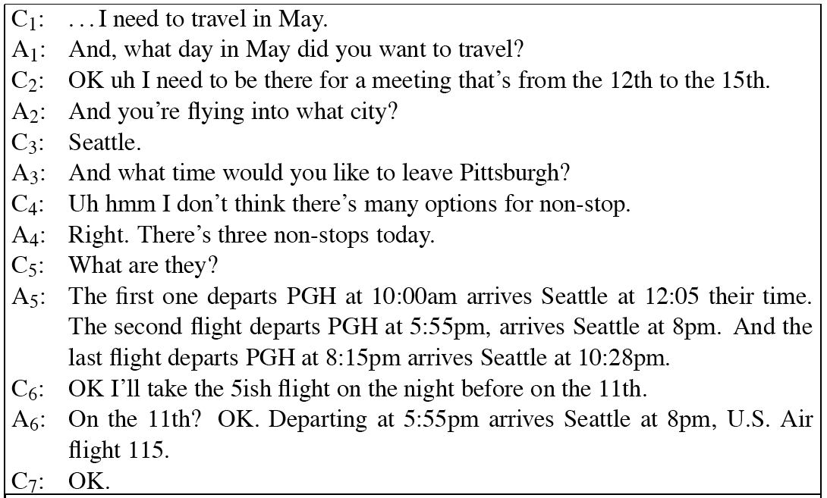
Dialog Example

Slide 4
Grounding
Display:
  C: I need to travel in May.
  A: And what day in May did you want to travel?

Slide 5
Grounding
Display:
  C: I need to travel in May.
  A: And what day in May did you want to travel?
Acknowledgment + Next relevant contribution:
  And what day in May did you want to travel?
  And you are flying into what city?
  And what time would you like to leave Pittsburgh?

Slide 6
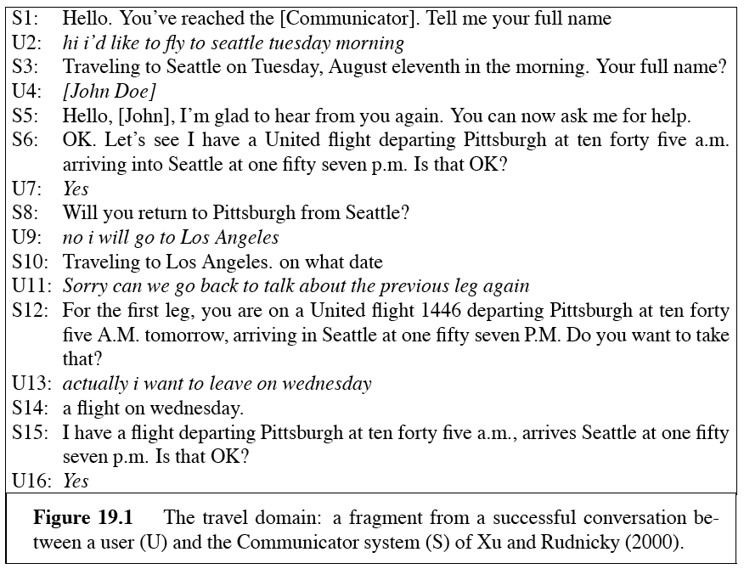
Travel Planning

Slide 7
Grounding in HCI
Key factor in HCI:
  Users confused if system fails to ground, confirm
    (Stifelman et al., 1993), (Yankelovich et al, 1995)
    S: Did you want to review some more of your profile?
    U: No.
    S: What’s next?

Slide 8
Grounding in HCI
Key factor in HCI:
  Users confused if system fails to ground, confirm
    (Stifelman et al., 1993), (Yankelovich et al, 1995)
    S: Did you want to review some more of your profile?
    U: No.
    S: What’s next?
    S: Did you want to review some more of your profile?
    U: No.
    S: Okay, what’s next?

Slide 9
Conversational Implicature
Meaning more than just literal contribution
  A: And, what day in May did you want to travel?
  C: OK uh I need to be there for a meeting the 12-15th
    Appropriate?

Slide 10
Conversational Implicature
Meaning more than just literal contribution
  A: And, what day in May did you want to travel?
  C: OK uh I need to be there for a meeting the 12-15th
    Appropriate? Yes
    Why?

Slide 11
Conversational Implicature
Meaning more than just literal contribution
  A: And, what day in May did you want to travel?
  C: OK uh I need to be there for a meeting the 12-15th
    Appropriate? Yes
    Why?
  Inference guides

Slide 12
Grice’s Maxims
Cooperative principle:
  Tacit agreement b/t conversants to cooperate

Slide 13
Grice’s Maxims
Cooperative principle:
  Tacit agreement b/t conversants to cooperate
Grice’s Maxims
  Quantity: Be as informative as required

Slide 14
Grice’s Maxims
Cooperative principle:
  Tacit agreement b/t conversants to cooperate
Grice’s Maxims
  Quantity: Be as informative as required
  Quality: Be truthful
    Don’t lie, or say things without evidence

Slide 15
Grice’s Maxims
Cooperative principle:
  Tacit agreement b/t conversants to cooperate
Grice’s Maxims
  Quantity: Be as informative as required
  Quality: Be truthful
    Don’t lie, or say things without evidence
  Relevance: Be relevant
  Manner: “Be perspicuous”
    Don’t be obscure, ambiguous, prolix, or disorderly

Slide 16
Relevance
Client: I need to be there for a meeting that’s from the 12th to the 15th
  Hearer thinks:

Slide 17
Relevance
Client: I need to be there for a meeting that’s from the 12th to the 15th
  Hearer thinks: Speaker is following maxims, would only have mentioned meeting if it was relevant. How could meeting be relevant? If client meant me to understand that he had to depart in time for the mtg.

Slide 18
Quantity
A:How much money do you have on you?
B: I have 5 dollars
  Implication

Slide 19
Quantity
A:How much money do you have on you?
B: I have 5 dollars
  Implication: not 6 dollars
A: Did you do the reading for today’s class?
B: I intended to
  Implication:

Slide 20
Quantity
A:How much money do you have on you?
B: I have 5 dollars
  Implication: not 6 dollars
A: Did you do the reading for today’s class?
B: I intended to
  Implication: No
  B’s answer would be true if B intended to do the reading AND did the reading, but would then violate maxim

Slide 21
From Human to Computer
Conversational agents
  Systems that (try to) participate in dialogues
  Examples: Directory assistance, travel info, weather, restaurant and navigation info
Issues:

Slide 22
From Human to Computer
Conversational agents
  Systems that (try to) participate in dialogues
  Examples: Directory assistance, travel info, weather, restaurant and navigation info
Issues:
  Limited understanding: ASR errors, interpretation
  Computational costs

Slide 23
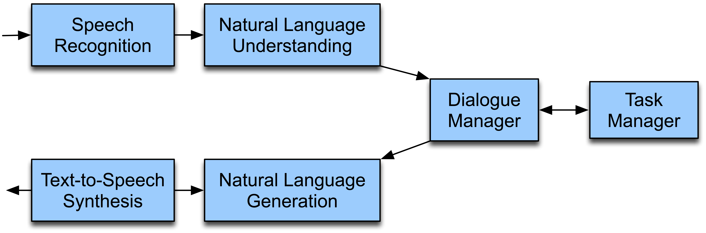
Dialogue System Architecture

Slide 24
Speech Recognition
(aka ASR)
Input: acoustic waveform
  Telephone, microphone, and smartphone

Slide 25
Speech Recognition
(aka ASR)
Input: acoustic waveform
  Telephone, microphone, and smartphone
Output: recognized word string

Slide 26
Speech Recognition
(aka ASR)
Input: acoustic waveform
  Telephone, microphone, and smartphone
Output: recognized word string
Requirements:

Slide 27
Speech Recognition
(aka ASR)
Input: acoustic waveform
  Telephone, microphone, and smartphone
Output: recognized word string
Requirements:
  Acoustic models: map acoustics to phone [ae] [k]
  Pronunciation dictionary: words to phones: cat: [k][ae][t]
  Grammar: legal word sequences
  Search procedure: best word sequence given audio

Slide 28
Recognition in SDS

Slide 29
Recognition in SDS
Create domain specific vocabulary, grammar
  Typically hand-crafted in most commercial systems
  Based on human-human interactions
  Grammars: finite-state, context-free, language model

Slide 30
Recognition in SDS
Create domain specific vocabulary, grammar
  Typically hand-crafted in most commercial systems
  Based on human-human interactions
  Grammars: finite-state, context-free, language model
Activate only portion of grammar based on dialog state
  E.g. Where are you leaving from?

Slide 31
Recognition in SDS
Create domain specific vocabulary, grammar
  Typically hand-crafted in most commercial systems
  Based on human-human interactions
  Grammars: finite-state, context-free, language model
Activate only portion of grammar based on dialog state
  E.g. Where are you leaving from?
  {I want to (leave|depart) from} CITYNAME {STATENAME}
  ‘Yes/No’ grammar for confirmations

Slide 32
Natural Language Understanding
Most systems use frame-slot semantics
  Show me morning flights from Boston to SFO on Tuesday
  Alternatives:
      Full parser with semantic attachments
      Domain-specific analyzers
  SHOW:
  FLIGHTS:
    ORIGIN:
      CITY: Boston
      DATE:
        DAY-OF-WEEK: Tuesday
      TIME:
        PART-OF-DAY: Morning
    DEST:
      CITY: San Francisco

Slide 33
Generation and TTS
Generation:
  Identify concepts to express
  Convert to words
  Assign appropriate prosody, intonation

Slide 34
Generation and TTS
Generation:
  Identify concepts to express
  Convert to words
  Assign appropriate prosody, intonation
TTS:
  Input words, prosodic markup
  Synthesize acoustic waveform

Slide 35
Generation
Content planning:
  What to say:
    Question, answer, etc?
    Often merged with dialog manager

Slide 36
Generation
Content planning:
  What to say:
    Question, answer, etc?
    Often merged with dialog manager
Language generation:
  How to say it
    Select syntactic structure and words
    Most common: Template-based generation (prompts)
      Templates with variable: When do you want to leave CITY?

Slide 37
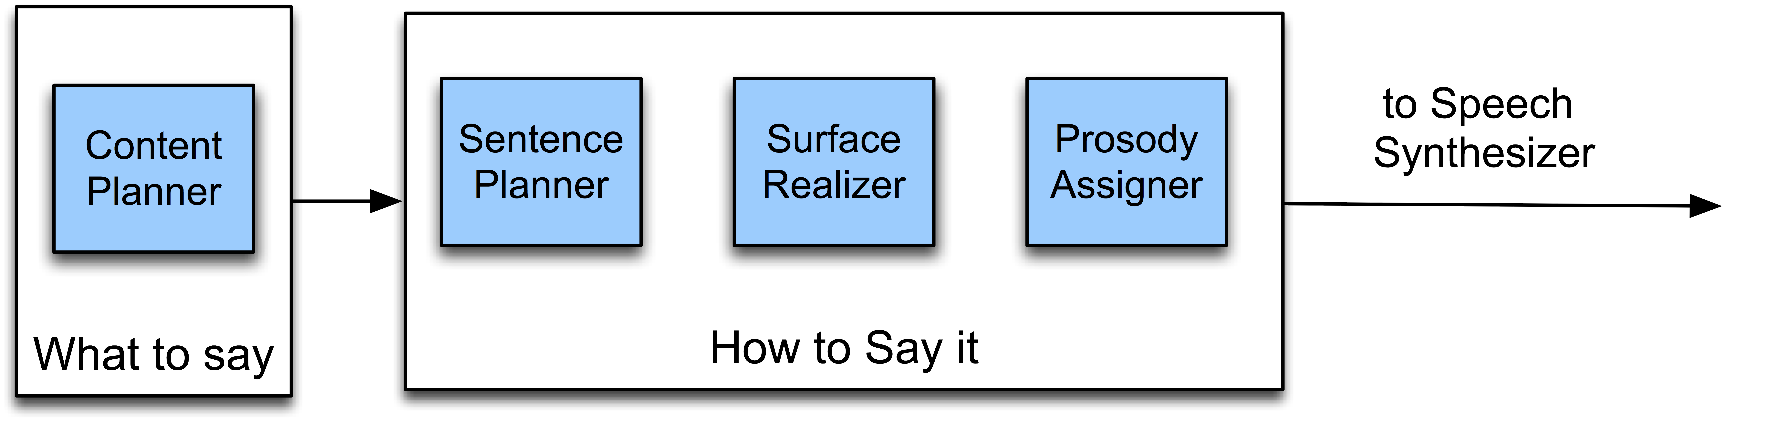
Full NLG
Converts representation from dialog manager

Slide 38
Dialogue Manager
Holds system together: Governs interaction style

Slide 39
Dialogue Manager
Holds system together: Governs interaction style
  Takes input from ASR/NLU

Slide 40
Dialogue Manager
Holds system together: Governs interaction style
  Takes input from ASR/NLU
  Maintains dialog state, history
    Incremental frame construction
    Reference, ellipsis resolution
    Determines what system does next

Slide 41
Dialogue Manager
Holds system together: Governs interaction style
  Takes input from ASR/NLU
  Maintains dialog state, history
    Incremental frame construction
    Reference, ellipsis resolution
    Determines what system does next
  Interfaces with task manager/backend app

Slide 42
Dialogue Manager
Holds system together: Governs interaction style
  Takes input from ASR/NLU
  Maintains dialog state, history
    Incremental frame construction
    Reference, ellipsis resolution
    Determines what system does next
  Interfaces with task manager/backend app
  Formulates basic response, passes to NLG,TTS

Slide 43
Dialog Management Types
Finite-State Dialog Management
Frame-based Dialog Management
Information State Manager
Statistical Dialog Management

Slide 44
Finite-State Management

Slide 45
Finite-State Dialogue
Management
Simplest type of dialogue management
  States:
    Questions system asks user
  Arcs:
    User responses

Slide 46
Finite-State Dialogue
Management
Simplest type of dialogue management
  States:
    Questions system asks user
  Arcs:
    User responses
System controls interactions:
  Interprets all input based on current state
  Assumes any user input is response to last question

Slide 47
Finite-State Dialogue Management
Initiative:
  Control of the interaction
Who’s in control here?

Slide 48
Finite-State Dialogue Management
Initiative:
  Control of the interaction
Who’s in control here?
  System!
    “system initiative”/”single initiative”
  Natural?

Slide 49
Finite-State Dialogue Management
Initiative:
  Control of the interaction
Who’s in control here?
  System!
    “system initiative”/”single initiative”
  Natural? No!
    Human conversation goes back and forth
Deploy targeted vocabulary / grammar for state
  Add ‘universals’ – accessible anywhere in dialog
    ‘Help’, ‘Start over’

Slide 50
Pros and Cons
Advantages

Slide 51
Pros and Cons
Advantages
  Straightforward to encode
  Clear mapping of interaction to model
  Well-suited to simple information access
  System initiative
Disadvantages

Slide 52
Pros and Cons
Advantages
  Straightforward to encode
  Clear mapping of interaction to model
  Well-suited to simple information access
  System initiative
Disadvantages
  Limited flexibility of interaction
    Constrained input – single item
    Fully system controlled
    Restrictive dialogue structure, order
  Ill-suited to complex problem-solving

Slide 53
Frame-based Dialogue Management
Essentially form-filling
  User can include any/all of the pieces of form
  System must determine which entered, remain
  Rules determine next action, question, information presentation

Slide 54
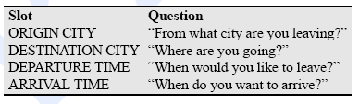
Frame-based Dialogue Management
Essentially form-filling
  User can include any/all of the pieces of form
  System must determine which entered, remain
  Rules determine next action, question, information presentation

Slide 55
Frames and Initiative
Mixed initiative systems:
  A) User/System can shift control arbitrarily, any time
    Difficult to achieve
  B) Mix of control based on prompt type

Slide 56
Frames and Initiative
Mixed initiative systems:
  A) User/System can shift control arbitrarily, any time
    Difficult to achieve
  B) Mix of control based on prompt type
Prompts:
  Open prompt: ‘How may I help you?’

Slide 57
Frames and Initiative
Mixed initiative systems:
  A) User/System can shift control arbitrarily, any time
    Difficult to achieve
  B) Mix of control based on prompt type
Prompts:
  Open prompt: ‘How may I help you?’
    Open-ended, user can respond in any way
  Directive prompt: ‘Say yes to accept call, or no o.w.’

Slide 58
Frames and Initiative
Mixed initiative systems:
  A) User/System can shift control arbitrarily, any time
    Difficult to achieve
  B) Mix of control based on prompt type
Prompts:
  Open prompt: ‘How may I help you?’
    Open-ended, user can respond in any way
  Directive prompt: ‘Say yes to accept call, or no o.w.’
    Stipulates user response type, form

Slide 59
Dialogue Management:
Confirmation
Miscommunication common in SDS
  “Error spirals” of sequential errors
    Highly problematic
  Recognition, recovery crucial
Confirmation strategies can detect, mitigate
  Explicit confirmation:

Slide 60
Dialog Example

Slide 61
Travel Planning

Slide 62
Dialogue Management:
Confirmation
Miscommunication common in SDS
  “Error spirals” of sequential errors
    Highly problematic
  Recognition, recovery crucial
Confirmation strategies can detect, mitigate
  Explicit confirmation:
    Ask for verification of each input
  Implicit confirmation:

Slide 63
Dialogue Management:
Confirmation
Miscommunication common in SDS
  “Error spirals” of sequential errors
    Highly problematic
  Recognition, recovery crucial
Confirmation strategies can detect, mitigate
  Explicit confirmation:
    Ask for verification of each input
  Implicit confirmation:
    Include input information in subsequent prompt

Slide 64
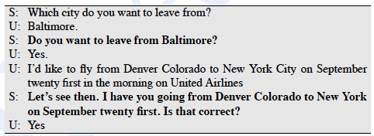
Confirmation Strategies
Explicit:

Slide 65

Confirmation Strategy
Implicit:

Slide 66
Pros and Cons
Grounding of user input
  Weakest grounding
    I.e. continued att’n, next relevant contibution

Slide 67
Pros and Cons
Grounding of user input
  Weakest grounding insufficient
    I.e. continued att’n, next relevant contibution
  Explicit:

Slide 68
Pros and Cons
Grounding of user input
  Weakest grounding insufficient
    I.e. continued att’n, next relevant contibution
  Explicit: highest: repetition
  Implicit:

Slide 69
Pros and Cons
Grounding of user input
  Weakest grounding insufficient
    I.e. continued att’n, next relevant contibution
  Explicit: highest: repetition
  Implicit: demonstration, display
Explicit;

Slide 70
Pros and Cons
Grounding of user input
  Weakest grounding insufficient
    I.e. continued att’n, next relevant contibution
  Explicit: highest: repetition
  Implicit: demonstration, display
Explicit;
  Pro: easier to correct; Con: verbose, awkward, non-human
Implicit:

Slide 71
Pros and Cons
Grounding of user input
  Weakest grounding insufficient
    I.e. continued att’n, next relevant contibution
  Explicit: highest: repetition
  Implicit: demonstration, display
Explicit;
  Pro: easier to correct; Con: verbose, awkward, non-human
Implicit:
  Pro: more natural, efficient; Con: less easy to correct

Slide 72
VoiceXML
W3C standard for simple frame-based dialogues
  Fairly common in commercial settings
Construct forms, menus
  Forms get field data
    Using attached prompts
    With specified grammar (CFG)
    With simple semantic attachments

Slide 73
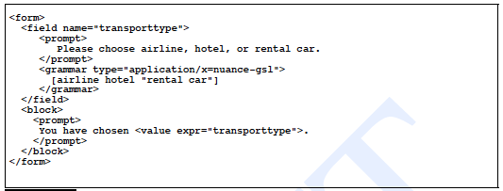
Simple VoiceXML Example

Slide 74
Frame-based Systems:
Pros and Cons
Advantages
  Relatively flexible input – multiple inputs, orders
  Well-suited to complex information access (air)
  Supports different types of initiative
Disadvantages
  Ill-suited to more complex problem-solving
    Form-filling applications

Slide 75
Information State
Dialogue Management
Problem: Not every task is equivalent to form-filling
Real tasks require:
  Proposing ideas, refinement, rejection, grounding, clarification, elaboration, etc
Information state models include:
  Information state
  Dialogue act interpreter
  Dialogue act generator
  Update rules
  Control structure

Slide 76
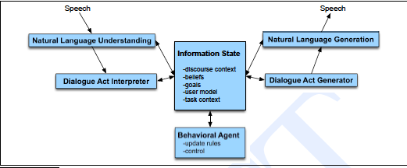
Information State Architecture
Simple ideas, complex execution

Slide 77
Dialogue Acts
Extension of speech acts
  Adds structure related to conversational phenomena
    Grounding, adjacency pairs, etc
Many proposed tagsets

Slide 78
Dialogue Act Interpretation
Automatically tag utterances in dialogue
Some simple cases:
  YES-NO-Q: Will breakfast be served on USAir 1557?
  I don’t care about lunch.
  Show me flights from L.A. to Orlando

Slide 79
Dialogue Act Interpretation
Automatically tag utterances in dialogue
Some simple cases:
  YES-NO-Q: Will breakfast be served on USAir 1557?
  Statement: I don’t care about lunch.
  Show me flights from L.A. to Orlando

Slide 80
Dialogue Act Interpretation
Automatically tag utterances in dialogue
Some simple cases:
  YES-NO-Q: Will breakfast be served on USAir 1557?
  Statement: I don’t care about lunch.
  Command: Show me flights from L.A. to Orlando
Is it always that easy?
  Can you give me the flights from Atlanta to Boston?
  Yeah.

Slide 81
Dialogue Act Interpretation
Automatically tag utterances in dialogue
Some simple cases:
  YES-NO-Q: Will breakfast be served on USAir 1557?
  Statement: I don’t care about lunch.
  Command: Show me flights from L.A. to Orlando
Is it always that easy?
  Can you give me the flights from Atlanta to Boston?
  Yeah.
    Depends on context: Y/N answer; agreement; back-channel

Slide 82
Dialogue Act Recognition
How can we classify dialogue acts?
Sources of information:
  Word information:
    Please, would you: request; are you: yes-no question
    N-gram grammars
  Prosody:
    Final rising pitch: question; final lowering: statement
    Reduced intensity: Yeah: agreement vs backchannel
  Adjacency pairs:
    Y/N question, agreement vs Y/N question, backchannel
    DA bi-grams

Slide 83
Detecting Correction Acts
Miscommunication is common in SDS
  Utterances after errors misrecognized >2x as often
    Frequently repetition or paraphrase of original input

Slide 84
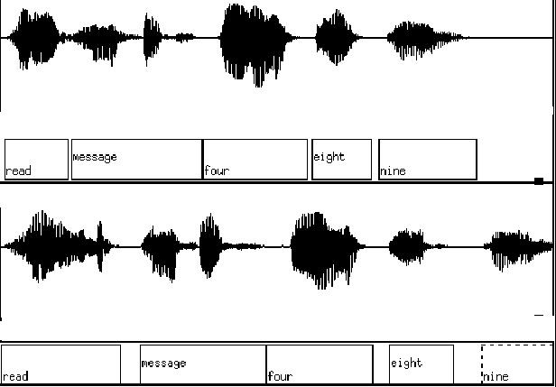


Slide 85
Detecting Correction Acts
Miscommunication is common in SDS
  Utterances after errors misrecognized >2x as often
    Frequently repetition or paraphrase of original input
Systems need to detect, correct

Slide 86
Detecting Correction Acts
Miscommunication is common in SDS
  Utterances after errors misrecognized >2x as often
    Frequently repetition or paraphrase of original input
Systems need to detect, correct
Corrections are spoken differently:
  Hyperarticulated (slower, clearer) -> lower ASR conf.
  Some word cues: ‘No’,’ I meant’, swearing..

Slide 87
Detecting Correction Acts
Miscommunication is common in SDS
  Utterances after errors misrecognized >2x as often
    Frequently repetition or paraphrase of original input
Systems need to detect, correct
Corrections are spoken differently:
  Hyperarticulated (slower, clearer) -> lower ASR conf.
  Some word cues: ‘No’,’ I meant’, swearing..
Can train classifiers to recognize with good acc.

Slide 88
Designing Dialog
Apply user-centered design

Slide 89
Designing Dialog
Apply user-centered design
  Study user and task: How?

Slide 90
Designing Dialog
Apply user-centered design
  Study user and task: How?
    Interview potential users, record human-human tasks
  Study how the user interacts with the system

Slide 91
Designing Dialog
Apply user-centered design
  Study user and task: How?
    Interview potential users, recorded human-human tasks
  Study how the user interacts with the system
    But it’s not built yet….

Slide 92
Designing Dialog
Apply user-centered design
  Study user and task: How?
    Interview potential users, recorded human-human tasks
  Study how the user interacts with the system
    But it’s not built yet….
      Wizard-of-Oz systems: Simulations
        User thinks they’re interacting with a system, but it’s driven by a human
      Prototypes

Slide 93
Designing Dialog
Apply user-centered design
  Study user and task: How?
    Interview potential users, recorded human-human tasks
  Study how the user interacts with the system
    But it’s not built yet….
      Wizard-of-Oz systems: Simulations
        User thinks they’re interacting with a system, but it’s driven by a human
      Prototypes
  Iterative redesign:
    Test system: see how users really react, what problems occur, correct, repeat

Slide 94
SDS Evaluation
Goal: Determine overall user satisfaction
  Highlight systems problems; help tune

Slide 95
SDS Evaluation
Goal: Determine overall user satisfaction
  Highlight systems problems; help tune
Classically: Conduct user surveys

Slide 96
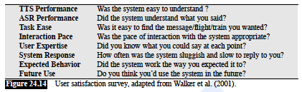
SDS Evaluation
Goal: Determine overall user satisfaction
  Highlight systems problems; help tune
Classically: Conduct user surveys

Slide 97
SDS Evaluation
User evaluation issues:

Slide 98
SDS Evaluation
User evaluation issues:
  Expensive; often unrealistic; hard to get real user to do
Create model correlated with human satisfaction
Criteria:

Slide 99
SDS Evaluation
User evaluation issues:
  Expensive; often unrealistic; hard to get real user to do
Create model correlated with human satisfaction
Criteria:
  Maximize task success
    Measure task completion: % subgoals; Kappa of frame values
  Minimize task costs
    Efficiency costs: time elapsed; # turns; # error correction turns
    Quality costs: # rejections; # barge-in; concept error rate

Slide 100
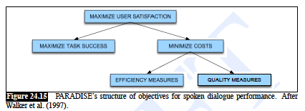
PARADISE Model

Slide 101
PARADISE Model
Compute user satisfaction with questionnaires
Extract task success and costs measures from corresponding dialogs
  Automatically or manually
Perform multiple regression:
  Assign weights to all factors of contribution to Usat
  Task success, Concept accuracy key
Allows prediction of accuracy on new dialog

Slide 102
Now that we have a success metric
Could we use it to help drive learning?
In recent work we use this metric to help us learn an optimal policy or strategy for how the conversational agent should behave

Slide 103
A threshold is a human-designed policy!
Could we learn what the right action is
  Rejection
  Explicit confirmation
  Implicit confirmation
  No confirmation
By learning a policy which,
  given various information about the current state,
  dynamically chooses the action which maximizes dialogue success

Slide 104
Another strategy decision
Open versus directive prompts
When to do mixed initiative
How we do this optimization?
Markov Decision Processes

Slide 105
Summary
Spoken Dialogue Systems:
  Build on existing text-based NLP techniques, but
  Incorporate dialogue specific factors:
    Turn-taking, grounding, dialogue acts
  Affected by computational and modal constraints
    Recognition errors, processing speed, etc.
    Speech transience, slowness
  Becoming more widespread and more flexible

Slide 106
Speech Recognition
Applications of Speech Recognition (ASR)
  Dictation
  Telephone-based Information (directions, air travel, banking, etc)
  Hands-free (in car)
  Speaker Identification
  Language Identification
  Second language ('L2') (accent reduction)
  Audio archive searching

Slide 107
LVCSR
Large Vocabulary Continuous Speech Recognition
~20,000-64,000 words
Speaker independent (vs. speaker-dependent)
Continuous speech (vs isolated-word)

Slide 108
Current error rates
Ballpark numbers; exact numbers depend very much on the specific corpus
Task | Vocabulary | Error Rate%
Digits | 11 | 0.5
WSJ read speech | 5K | 3
WSJ read speech | 20K | 3
Broadcast news | 64,000+ | 10
Conversational Telephone | 64,000+ | 20

Slide 109
HSR versus ASR
Task | Vocab | ASR | Hum SR
Continuous digits | 11 | .5 | .009
WSJ 1995 clean | 5K | 3 | 0.9
WSJ 1995 w/noise | 5K | 9 | 1.1
SWBD 2004 | 65K | 20 | 4
Conclusions:
  Machines about 5 times worse than humans
  Gap increases with noisy speech
  These numbers are rough, take with grain of salt

Slide 110

Why is conversational speech harder?
A piece of an utterance without context
The same utterance with more context

Slide 111
LVCSR Design Intuition
Build a statistical model of the speech-to-words process
Collect lots and lots of speech, and transcribe all the words.
Train the model on the labeled speech
Paradigm: Supervised Machine Learning + Search

Slide 112
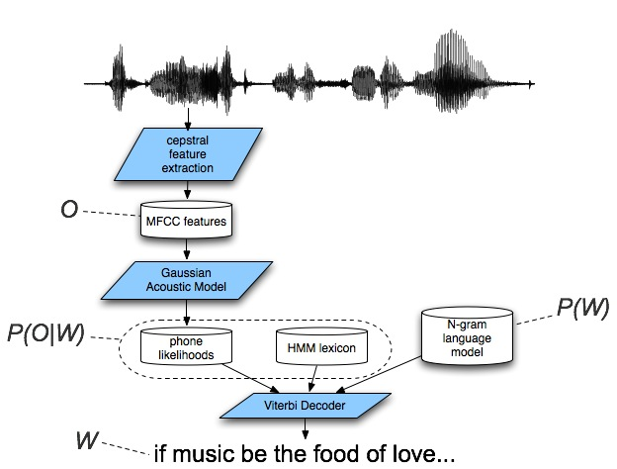
Speech Recognition Architecture

Slide 113
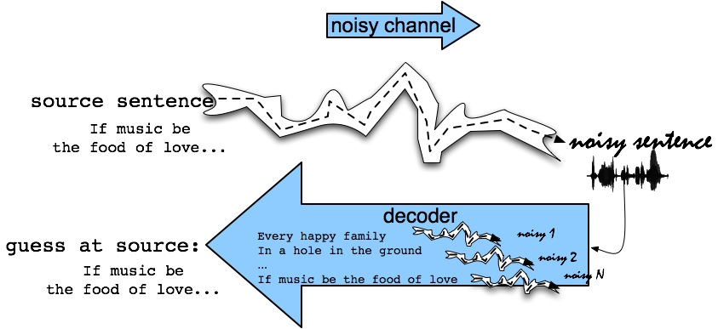
The Noisy Channel Model
Search through space of all possible sentences.
Pick the one that is most probable given the waveform.

Slide 114
Decomposing Speech Recognition
Q1: What speech sounds were uttered?
  Human languages: 40-50 phones
    Basic sound units: b, m, k, ax, ey, …(arpabet)
    Distinctions categorical to speakers
      Acoustically continuous
    Part of knowledge of language
      Build per-language inventory
      Could we learn these?

Slide 115
Decomposing Speech Recognition
Q2: What words produced these sounds?
  Look up sound sequences in dictionary
  Problem 1: Homophones
    Two words, same sounds: too, two
  Problem 2: Segmentation
    No “space” between words in continuous speech
    “I scream”/”ice cream”, “Wreck a nice beach”/”Recognize speech”
Q3: What meaning produced these words?
  NLP (But that’s not all!)

Slide 117
The Noisy Channel Model (II)
What is the most likely sentence out of all sentences in the language L given some acoustic input O?
Treat acoustic input O as sequence of individual observations
  O = o₁,o₂,o₃,…,o_{t}
Define a sentence as a sequence of words:
  W = w₁,w₂,w₃,…,w_{n}

Slide 118
Noisy Channel Model (III)
Probabilistic implication: Pick the highest prob S = W:
We can use Bayes rule to rewrite this:
Since denominator is the same for each candidate sentence W, we can ignore it for the argmax:

Slide 119
Noisy channel model
likelihood
prior

Slide 120
The noisy channel model
Ignoring the denominator leaves us with two factors: P(Source) and P(Signal|Source)

Slide 121
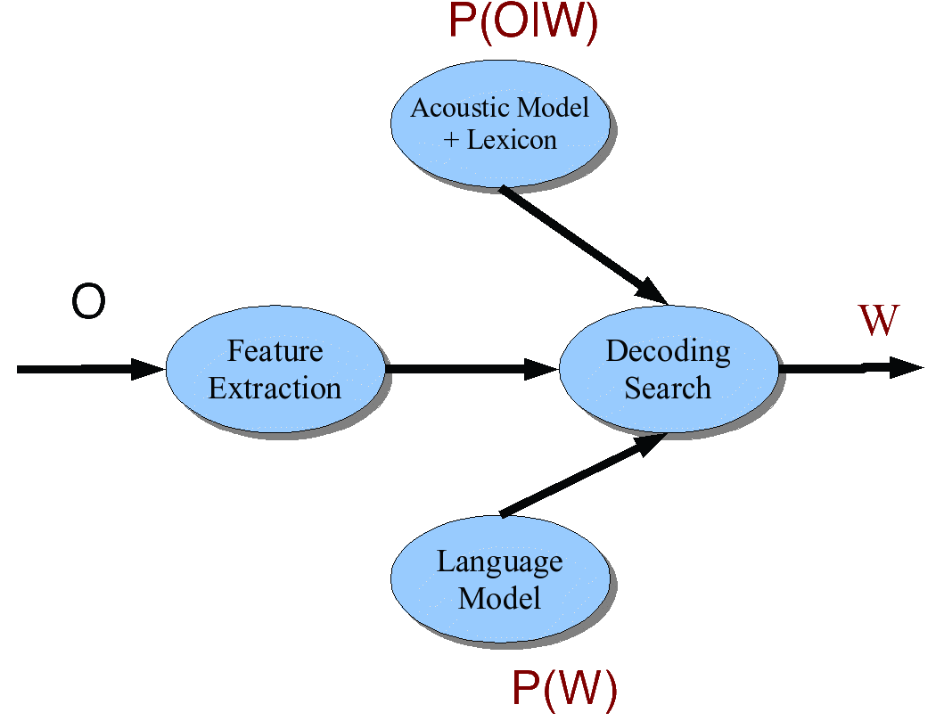
Speech Architecture meets Noisy Channel

Slide 122
ASR Components
Lexicons and Pronunciation:
  Hidden Markov Models
Feature extraction
Acoustic Modeling
Decoding
Language Modeling:
  Ngram Models

Slide 123
Lexicon
A list of words
Each one with a pronunciation in terms of phones
We get these from on-line pronunciation dictionary
CMU dictionary: 127K words
  http://www.speech.cs.cmu.edu/cgi-bin/cmudict
We’ll represent the lexicon as an HMM

Slide 124
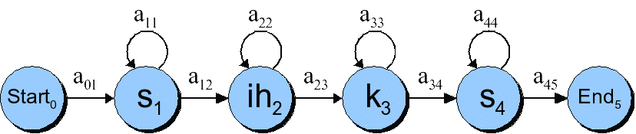
HMMs for speech: the word “six”

Slide 125
Phones are not homogeneous!

Slide 126
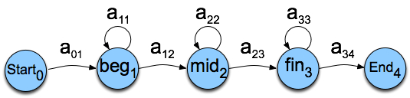
Each phone has 3 subphones

Slide 127
HMM word model for “six”
Resulting model with subphones

Slide 128
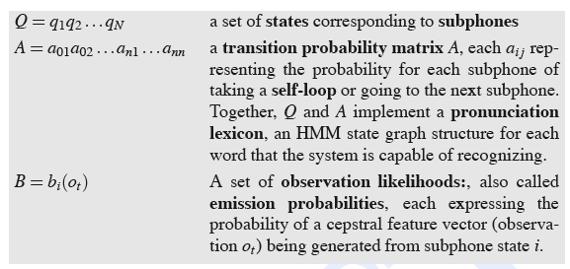
HMMs for speech

Slide 129
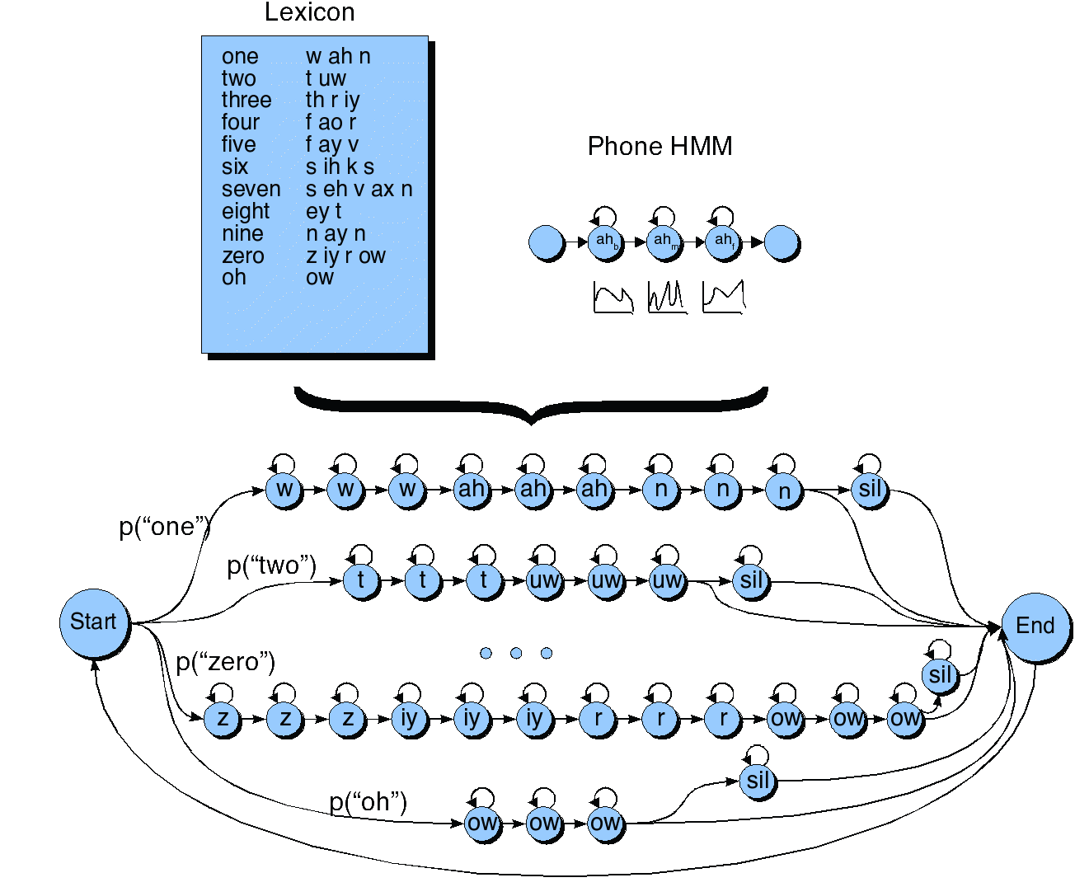
HMM for the digit recognition task

Slide 130
Detecting Phones
Two stages
  Feature extraction
    Basically a slice of a spectrogram
  Phone classification
    Using GMM classifier

Slide 131
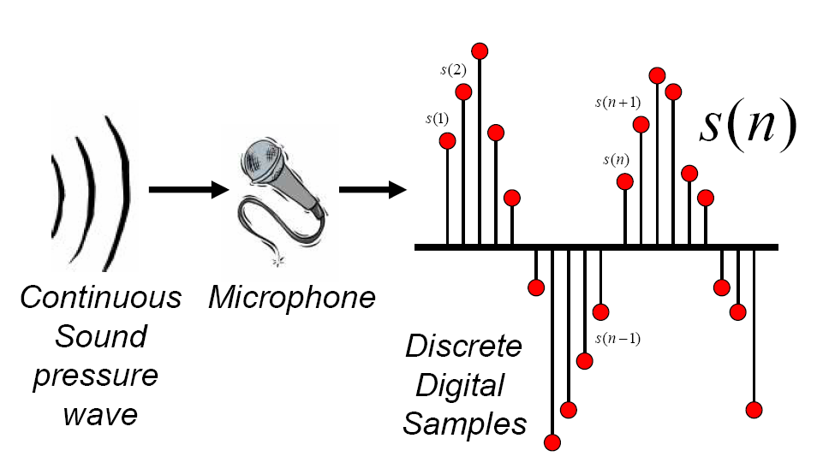
Discrete Representation of Signal
Represent continuous signal into discrete form.
Thanks to Bryan Pellom for this slide

Slide 132
Digitizing the signal (A-D)
Sampling:
  measuring amplitude of signal at time t
  16,000 Hz (samples/sec) Microphone (“Wideband”):
  8,000 Hz (samples/sec) Telephone
  Why?
    Need at least 2 samples per cycle
    max measurable frequency is half sampling rate
    Human speech < 10,000 Hz, so need max 20K
    Telephone filtered at 4K, so 8K is enough

Slide 133
Digitizing Speech (II)
Quantization
  Representing real value of each amplitude as integer
  8-bit (-128 to 127) or 16-bit (-32768 to 32767)
Formats:
  16 bit PCM
  8 bit mu-law; log compression
LSB (Intel) vs. MSB (Sun, Apple)
Headers:
  Raw (no header)
  Microsoft wav
  Sun .au
40 byte
header

Slide 134
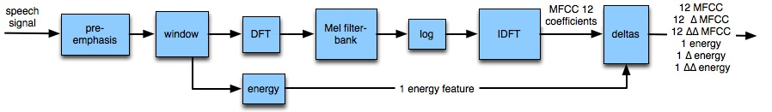
MFCC: Mel-Frequency Cepstral Coefficients

Slide 135
Typical MFCC features
Window size: 25ms
Window shift: 10ms
Pre-emphasis coefficient: 0.97
MFCC:
  12 MFCC (mel frequency cepstral coefficients)
  1 energy feature
  12 delta MFCC features
  12 double-delta MFCC features
  1 delta energy feature
  1 double-delta energy feature
Total 39-dimensional features

Slide 136
Why is MFCC so popular?
Efficient to compute
Incorporates a perceptual Mel frequency scale
Separates the source and filter
Fits well with HMM modelling

Slide 137
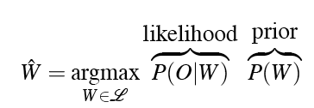


Decoding
In principle:
In practice:

Slide 138
Why is ASR decoding hard?

Slide 139
The Evaluation (forward) problem for speech
The observation sequence O is a series of MFCC vectors
The hidden states W are the phones and words
For a given phone/word string W, our job is to evaluate P(O|W)
Intuition: how likely is the input to have been generated by just that word string W

Slide 140
Evaluation for speech: Summing over all different paths!
f ay ay ay ay v v v v
f f ay ay ay ay v v v
f f f f ay ay ay ay v
f f ay ay ay ay ay ay v
f f ay ay ay ay ay ay ay ay v
f f ay v v v v v v v

Slide 141
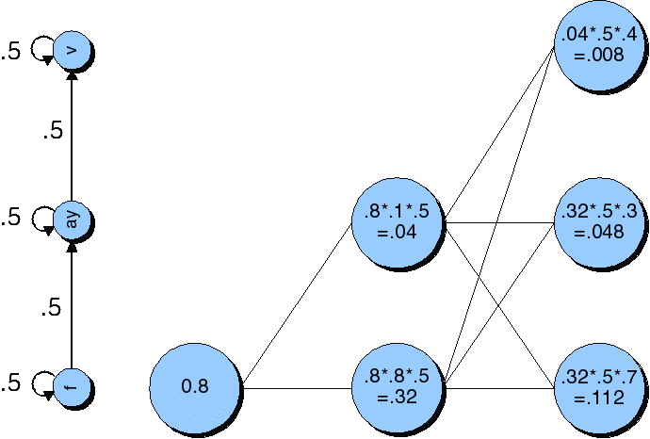
Viterbi trellis for “five”

Slide 142
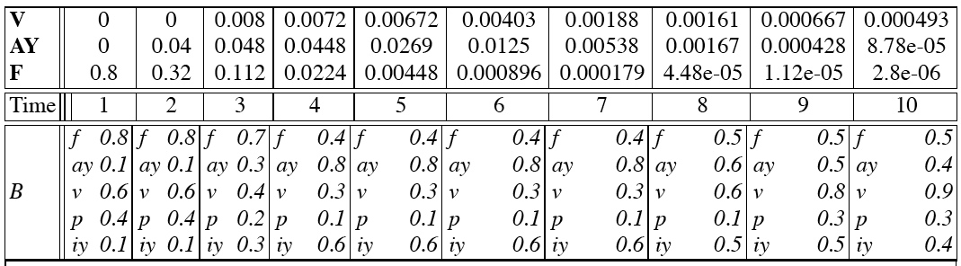
Viterbi trellis for “five”

Slide 143
Language Model
Idea: some utterances more probable
Standard solution: “n-gram” model
  Typically tri-gram: P(w_{i}|w_{i-1},w_{i-2})
    Collect training data from large side corpus
      Smooth with bi- & uni-grams to handle sparseness
  Product over words in utterance:

Slide 144
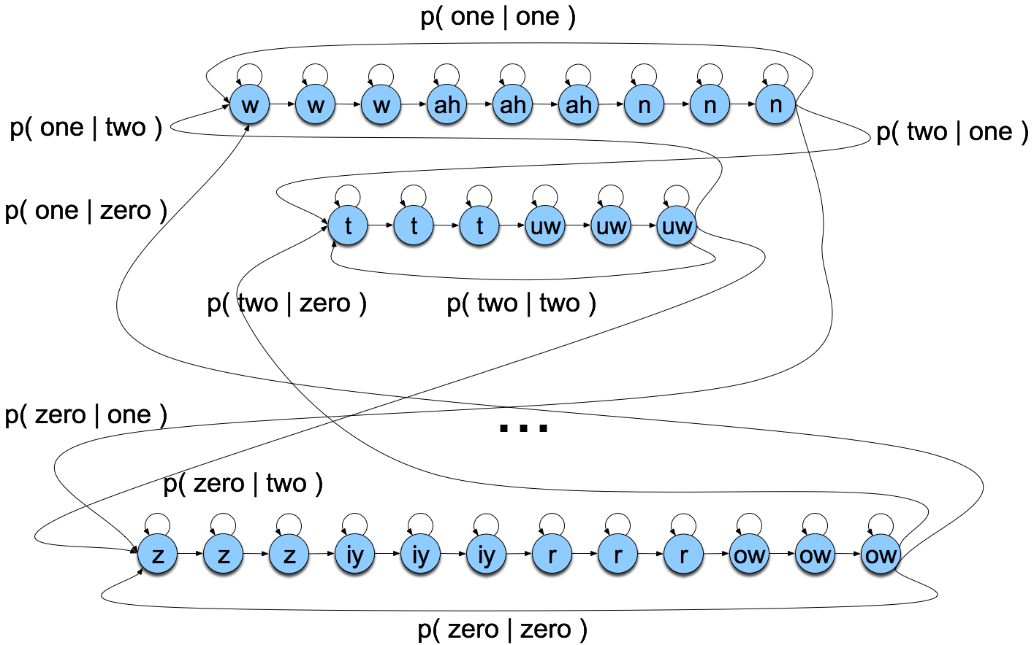
Search space with bigrams

Slide 145
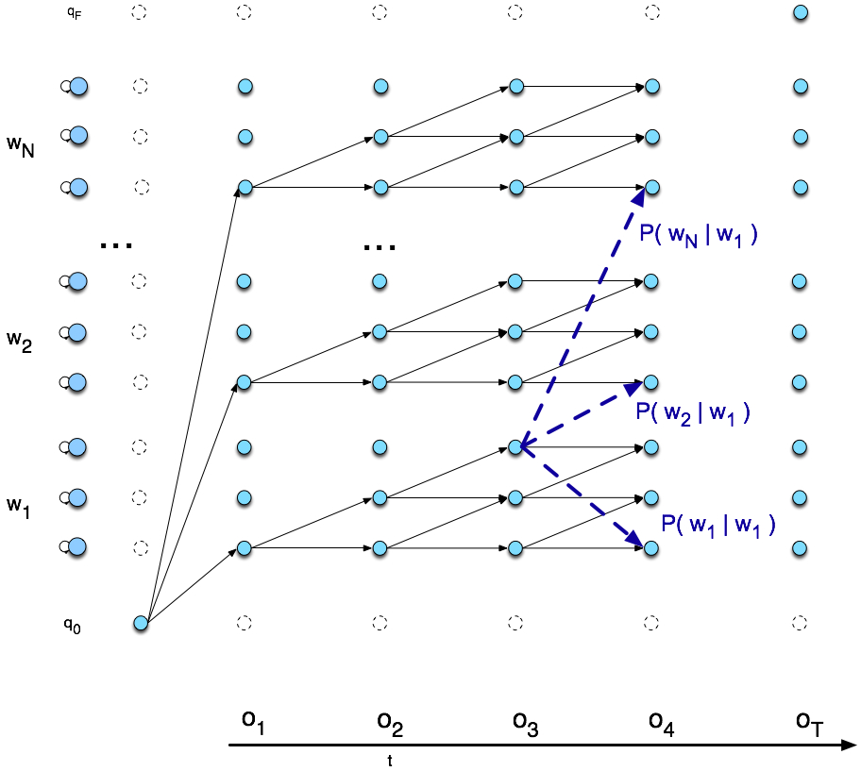
Viterbi trellis

Slide 146
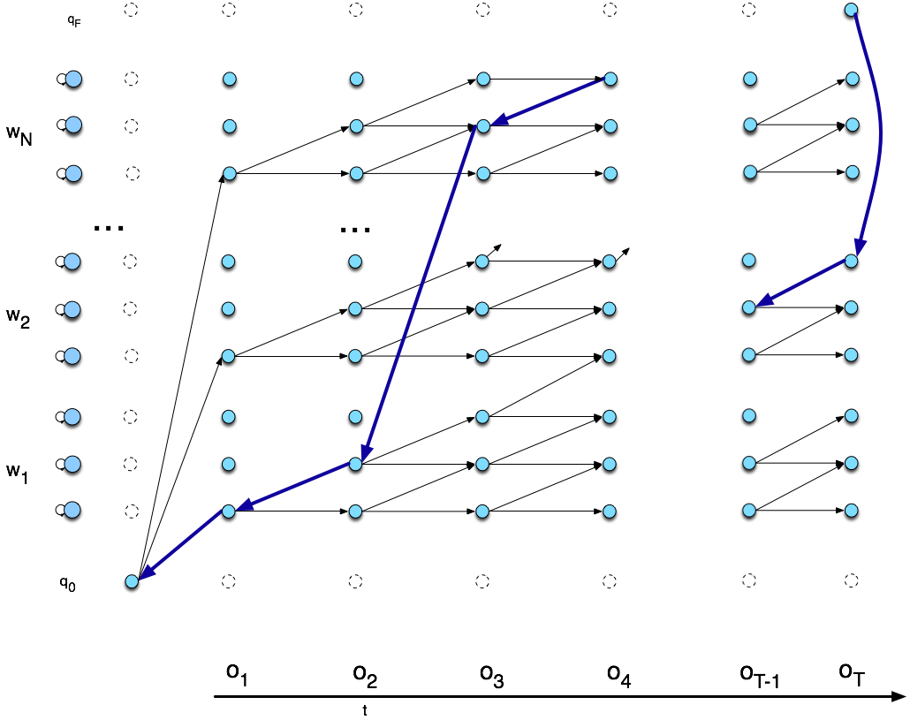
Viterbi backtrace

Slide 147
Natural Language Understanding

Slide 148
Natural Language Understanding
Generally:
  Given a string of words representing a natural language utterance, produce a meaning representation

Slide 149
Natural Language Understanding
Generally:
  Given a string of words representing a natural language utterance, produce a meaning representation
For well-formed natural language text (see ling571),
  Full parsing with a probabilistic context-free grammar
    Augmented with semantic attachments in FOPC
    Producing a general lambda calculus representation

Slide 150
Natural Language Understanding
Generally:
  Given a string of words representing a natural language utterance, produce a meaning representation
For well-formed natural language text (see ling571),
  Full parsing with a probabilistic context-free grammar
    Augmented with semantic attachments in FOPC
    Producing a general lambda calculus representation
What about spoken dialog systems?

Slide 151
NLU for SDS
Few SDS fully exploit this approach

Slide 152
NLU for SDS
Few SDS fully exploit this approach
Why not?

Slide 153
NLU for SDS
Few SDS fully exploit this approach
Why not?
  Examples of travel air speech input (due to A. Black)
    Eh, I wanna go, wanna go to Boston tomorrow
    If its not too much trouble I’d be very grateful if one might be able to aid me in arranging my travel arrangements to Boston, Logan airport, at sometime tomorrow morning, thank you.
    Boston, tomorrow

Slide 154
NLU for SDS
Analyzing speech vs text

Slide 155
NLU for SDS
Analyzing speech vs text
  Utterances:
    ill-formed, disfluent, fragmentary, desultory, rambling
      Vs well-formed

Slide 156
NLU for SDS
Analyzing speech vs text
  Utterances:
    ill-formed, disfluent, fragmentary, desultory, rambling
      Vs well-formed
  Domain:
    Restricted, constrains interpretation
      Vs. unrestricted

Slide 157
NLU for SDS
Analyzing speech vs text
  Utterances:
    ill-formed, disfluent, fragmentary, desultory, rambling
      Vs well-formed
  Domain:
    Restricted, constrains interpretation
      Vs. unrestricted
  Interpretation:
    Need specific pieces of data
      Vs. full, complete representation

Slide 158
NLU for SDS
Analyzing speech vs text
  Utterances:
    ill-formed, disfluent, fragmentary, desultory, rambling
      Vs well-formed
  Domain:
    Restricted, constrains interpretation
      Vs. unrestricted
  Interpretation:
    Need specific pieces of data
      Vs. full, complete representation
  Speech recognition:
    Error-prone, perfect full analysis difficult to obtain

Slide 159
NLU for Spoken Dialog
Call routing (aka call classification):
    (Chu-Carroll & Carpenter, 1998, Al-Shawi 2003)
  Shallow form of NLU

Slide 160
NLU for Spoken Dialog
Call routing (aka call classification):
    (Chu-Carroll & Carpenter, 1998, Al-Shawi 2003)
  Shallow form of NLU
  Goal:
    Given a spoken utterance, assign to class c, in finite set C

Slide 161
NLU for Spoken Dialog
Call routing (aka call classification):
    (Chu-Carroll & Carpenter, 1998, Al-Shawi 2003)
  Shallow form of NLU
  Goal:
    Given a spoken utterance, assign to class c, in finite set C
  Banking Example:
    Open prompt: "How may I direct your call?”

Slide 162
NLU for Spoken Dialog
Call routing (aka call classification):
    (Chu-Carroll & Carpenter, 1998, Al-Shawi 2003)
  Shallow form of NLU
  Goal:
    Given a spoken utterance, assign to class c, in finite set C
  Banking Example:
    Open prompt: "How may I direct your call?”
    Responses: may I have consumer lending?,

Slide 163
NLU for Spoken Dialog
Call routing (aka call classification):
    (Chu-Carroll & Carpenter, 1998, Al-Shawi 2003)
  Shallow form of NLU
  Goal:
    Given a spoken utterance, assign to class c, in finite set C
  Banking Example:
    Open prompt: "How may I direct your call?”
    Responses: may I have consumer lending?,
      l'd like my checking account balance, or

Slide 164
NLU for Spoken Dialog
Call routing (aka call classification):
    (Chu-Carroll & Carpenter, 1998, Al-Shawi 2003)
  Shallow form of NLU
  Goal:
    Given a spoken utterance, assign to class c, in finite set C
  Banking Example:
    Open prompt: "How may I direct your call?”
    Responses: may I have consumer lending?,
      l'd like my checking account balance, or
      "ah I'm calling 'cuz ah a friend gave me this number and ah she told me ah with this number I can buy some cars or whatever but she didn't know how to explain it to me so l just called you you know to get that information."

Slide 165
Call Routing
General approach:
  Build classification model based on labeled training data, e.g. manually routed calls
    Apply classifier to label new data

Slide 166
Call Routing
General approach:
  Build classification model based on labeled training data, e.g. manually routed calls
    Apply classifier to label new data
Vector-based call routing:
  Model

Slide 167
Call Routing
General approach:
  Build classification model based on labeled training data, e.g. manually routed calls
    Apply classifier to label new data
Vector-based call routing:
  Model: Vector of word unigram, bigrams, trigrams
    Filtering:

Slide 168
Call Routing
General approach:
  Build classification model based on labeled training data, e.g. manually routed calls
    Apply classifier to label new data
Vector-based call routing:
  Model: Vector of word unigram, bigrams, trigrams
    Filtering: by frequency

Slide 169
Call Routing
General approach:
  Build classification model based on labeled training data, e.g. manually routed calls
    Apply classifier to label new data
Vector-based call routing:
  Model: Vector of word unigram, bigrams, trigrams
    Filtering: by frequency
      Exclude high frequency stopwords, low frequency rare words
    Weighting

Slide 170
Call Routing
General approach:
  Build classification model based on labeled training data, e.g. manually routed calls
    Apply classifier to label new data
Vector-based call routing:
  Model: Vector of word unigram, bigrams, trigrams
    Filtering: by frequency
      Exclude high frequency stopwords, low frequency rare words
    Weighting: term frequency * inverse document frequency

Slide 171
Call Routing
General approach:
  Build classification model based on labeled training data, e.g. manually routed calls
    Apply classifier to label new data
Vector-based call routing:
  Model: Vector of word unigram, bigrams, trigrams
    Filtering: by frequency
      Exclude high frequency stopwords, low frequency rare words
    Weighting: term frequency * inverse document frequency
    (Dimensionality reduction by singular value decomposition)
  Compute cosine similarity for new call & training examples

Slide 172
Meaning Representations for Spoken Dialog
Typical model: Frame-slot semantics
  Majority of spoken dialog systems
    Almost all deployed spoken dialog systems

Slide 173
Meaning Representations for Spoken Dialog
Typical model: Frame-slot semantics
  Majority of spoken dialog systems
    Almost all deployed spoken dialog systems
Frame:
  Domain-dependent information structure
  Set of attribute-value pairs
  Information relevant to answering questions in domain

Slide 174
Natural Language Understanding
Most systems use frame-slot semantics
  Show me morning flights from Boston to SFO on Tuesday
  SHOW:
  FLIGHTS:
    ORIGIN:
      CITY: Boston
      DATE:
        DAY-OF-WEEK: Tuesday
      TIME:
        PART-OF-DAY: Morning
    DEST:
      CITY: San Francisco

Slide 175
Another NLU Example
Sagae et 2009
Utterance (speech): we are prepared to give you guys generators for electricity downtown
ASR (NLU input): we up apparently give you guys generators for a letter city don town
Frame (NLU output):
  <s>.mood declarative
  <s>.sem.agent kirk
  <s>.sem.event deliver
  <s>.sem.modal.possibility can
  <s>.sem.speechact.type offer
  <s>.sem.theme power-generator
  <s>.sem.type event

Slide 176
Question
Given an ASR output string, how can we tractably and robustly derive a meaning representation?

Slide 177
Question
Given an ASR output string, how can we tractably and robustly derive a meaning representation?
Many approaches:
  Shallow transformation:
    Terminal substitution

Slide 178
Question
Given an ASR output string, how can we tractably and robustly derive a meaning representation?
Many approaches:
  Shallow transformation:
    Terminal substitution
  Integrated parsing and semantic analysis
    E.g. semantic grammars

Slide 179
Question
Given an ASR output string, how can we tractably and robustly derive a meaning representation?
Many approaches:
  Shallow transformation:
    Terminal substitution
  Integrated parsing and semantic analysis
    E.g. semantic grammars
  Classification or sequence labeling approaches
    HMM-based, MaxEnt-based

Slide 180
Grammars
Formal specification of strings in a language
A 4-tuple:
  A set of terminal symbols: Σ
  A set of non-terminal symbols: N
  A set of productions P: of the form A -> α
  A designated start symbol S
In regular grammars:
  A is a non-terminal and α is of the form {N}Σ*
In context-free grammars:
  A is a non-terminal and α in (Σ U N)*

Slide 181
Simple Air Travel Grammar
  LIST -> show me | I want | can I see|…
  DEPARTTIME -> (after|around|before) HOUR| morning | afternoon | evening
  HOUR -> one|two|three…|twelve (am|pm)
  FLIGHTS -> (a) flight|flights
  ORIGIN -> from CITY
  DESTINATION -> to CITY
  CITY -> Boston | San Francisco | Denver | Washington

Slide 182
Shallow Semantics
Terminal substitution
  Employed by some speech toolkits, e.g. CSLU

Slide 183
Shallow Semantics
Terminal substitution
  Employed by some speech toolkits, e.g. CSLU
Rules convert terminals in grammar to semantics
  LIST -> show me | I want | can I see|…

Slide 184
Shallow Semantics
Terminal substitution
  Employed by some speech toolkits, e.g. CSLU
Rules convert terminals in grammar to semantics
  LIST -> show me | I want | can I see|…
    e.g. show -> LIST

Slide 185
Shallow Semantics
Terminal substitution
  Employed by some speech toolkits, e.g. CSLU
Rules convert terminals in grammar to semantics
  LIST -> show me | I want | can I see|…
    e.g. show -> LIST
    see -> LIST
    I -> ε
    can -> ε
    * Boston -> Boston

Slide 186
Shallow Semantics
Terminal substitution
  Employed by some speech toolkits, e.g. CSLU
Rules convert terminals in grammar to semantics
  LIST -> show me | I want | can I see|…
    e.g. show -> LIST
    see -> LIST
    I -> ε
    can -> ε
    * Boston -> Boston
Simple, but…
  VERY limited, assumes direct correspondence

Slide 187
Semantic Grammars
Domain-specific semantic analysis

Slide 188
Semantic Grammars
Domain-specific semantic analysis
Syntactic structure:
  Context-free grammars (CFGs) (typically)
    Can be parsed by standard CFG parsing algorithms
      e.g. Earley parsers or CKY

Slide 189
Semantic Grammars
Domain-specific semantic analysis
Syntactic structure:
  Context-free grammars (CFGs) (typically)
    Can be parsed by standard CFG parsing algorithms
      e.g. Earley parsers or CKY
Semantic structure:
  Some designated non-terminals correspond to slots
    Associate terminal values to corresponding slot

Slide 190
Semantic Grammars
Domain-specific semantic analysis
Syntactic structure:
  Context-free grammars (CFGs) (typically)
    Can be parsed by standard CFG parsing algorithms
      e.g. Earley parsers or CKY
Semantic structure:
  Some designated non-terminals correspond to slots
    Associate terminal values to corresponding slot
Frames can be nested
Widely used: Phoenix NLU (CU, CMU), vxml grammars

Slide 191
  Show me morning flights from Boston to SFO on Tuesday
LIST -> show me | I want | can I see|…
DEPARTTIME -> (after|around|before) HOUR| morning | afternoon | evening
HOUR -> one|two|three…|twelve (am|pm)
FLIGHTS -> (a) flight|flights
ORIGIN -> from CITY
DESTINATION -> to CITY
CITY -> Boston | San Francisco | Denver | Washington
SHOW:
FLIGHTS:
  ORIGIN:
    CITY: Boston
    DATE:
      DAY-OF-WEEK: Tuesday
    TIME:
      PART-OF-DAY: Morning
  DEST:
    CITY: San Francisco

Slide 192
Semantic Grammars: Issues
Issues:

Slide 193
Semantic Grammars: Issues
Issues:
  Generally manually constructed
    Can be expensive, hard to update/maintain

Slide 194
Semantic Grammars: Issues
Issues:
  Generally manually constructed
    Can be expensive, hard to update/maintain
  Managing ambiguity:
    Can associate probabilities with parse & analysis
    Build rules manually, then train probabilities w/data

Slide 195
Semantic Grammars: Issues
Issues:
  Generally manually constructed
    Can be expensive, hard to update/maintain
  Managing ambiguity:
    Can associate probabilities with parse & analysis
    Build rules manually, then train probabilities w/data
  Domain- and application-specific
    Hard to port

Slide 196
Learning Probabilistic
Slot Filling
Goal: Use machine learning to map from recognizer strings to semantic slots and fillers

Slide 197
Learning Probabilistic
Slot Filling
Goal: Use machine learning to map from recognizer strings to semantic slots and fillers
Motivation:
  Improve robustness – fail-soft
  Improve ambiguity handling – probabilities
  Improve adaptation – train for new domains, apps

Slide 198
Learning Probabilistic
Slot Filling
Goal: Use machine learning to map from recognizer strings to semantic slots and fillers
Motivation:
  Improve robustness – fail-soft
  Improve ambiguity handling – probabilities
  Improve adaptation – train for new domains, apps
Many alternative classifier models
  HMM-based, MaxEnt-based

Slide 199
HMM-Based Slot Filling
Find best concept sequence C given words W

Slide 200
HMM-Based Slot Filling
Find best concept sequence C given words W
C*= argmax P(C|W)

Slide 201
HMM-Based Slot Filling
Find best concept sequence C given words W
C*= argmax P(C|W)
= argmax P(W|C)P(C)/P(W)

Slide 202
HMM-Based Slot Filling
Find best concept sequence C given words W
C*= argmax P(C|W)
= argmax P(W|C)P(C)/P(W)
= argmax P(W|C)P(C)

Slide 203
HMM-Based Slot Filling
Find best concept sequence C given words W
C*= argmax P(C|W)
= argmax P(W|C)P(C)/P(W)
= argmax P(W|C)P(C)
Assume limited M-concept history, N-gram words
  =

Slide 204

Probabilistic Slot Filling
Example HMM

Slide 205
Semantic Grammars
Alternatives:
  Full parser with semantic attachments
  Domain-specific analyzers
CFG in which the LHS of rules is a semantic category:
  LIST -> show me | I want | can I see|…
  DEPARTTIME -> (after|around|before) HOUR| morning | afternoon | evening
  HOUR -> one|two|three…|twelve (am|pm)
  FLIGHTS -> (a) flight|flights
  ORIGIN -> from CITY
  DESTINATION -> to CITY
  CITY -> Boston | San Francisco | Denver | Washington

Slide 206
Result
  SHOW FLIGHT ORIGIN DEST DEP_DATE DEP_TIME
  Show me flights from Boston to SFO on Tuesday morning

Slide 207
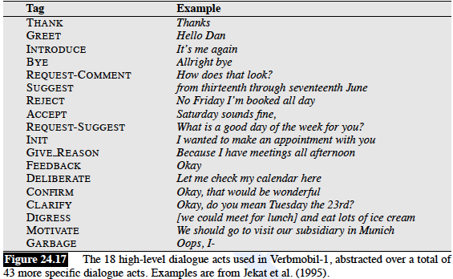
Verbmobil DA
18 high level tags

Slide 208
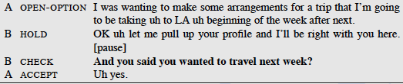
Dialogue Act Ambiguity
Indirect speech acts

Slide 209
Performance Functions for 3 Systems
ELVIS User Sat.= .21* COMP + .47 * MRS - .15 * ET
TOOT User Sat.= .35* COMP + .45* MRS - .14*ET
ANNIE User Sat.= .33*COMP + .25* MRS +.33* Help
    COMP: User perception of task completion (task success)
    MRS: Mean (concept) recognition accuracy (cost)
    ET: Elapsed time (cost)
    Help: Help requests (cost)

