Slide 1
Components: ASR
Ling575
Spoken Dialog Systems
April 17, 2013

Slide 2
Speech Recognition
Applications of Speech Recognition (ASR)
  Dictation
  Telephone-based Information (directions, air travel, banking, etc)
  Hands-free (in car)
  Speaker Identification
  Language Identification
  Second language ('L2') (accent reduction)
  Audio archive searching

Slide 3
LVCSR
Large Vocabulary Continuous Speech Recognition
~20,000-64,000 words
Speaker independent (vs. speaker-dependent)
Continuous speech (vs isolated-word)

Slide 4
Current error rates
Ballpark numbers; exact numbers depend very much on the specific corpus
Task | Vocabulary | Error Rate%
Digits | 11 | 0.5
WSJ read speech | 5K | 3
WSJ read speech | 20K | 3
Broadcast news | 64,000+ | 10
Conversational Telephone | 64,000+ | 20

Slide 5
HSR versus ASR
Task | Vocab | ASR | Hum SR
Continuous digits | 11 | .5 | .009
WSJ 1995 clean | 5K | 3 | 0.9
WSJ 1995 w/noise | 5K | 9 | 1.1
SWBD 2004 | 65K | 20 | 4
Conclusions:
  Machines about 5 times worse than humans
  Gap increases with noisy speech
  These numbers are rough, take with grain of salt

Slide 6

Why is conversational speech harder?
A piece of an utterance without context
The same utterance with more context

Slide 7
LVCSR Design Intuition
Build a statistical model of the speech-to-words process
Collect lots and lots of speech, and transcribe all the words.
Train the model on the labeled speech
Paradigm: Supervised Machine Learning + Search

Slide 8
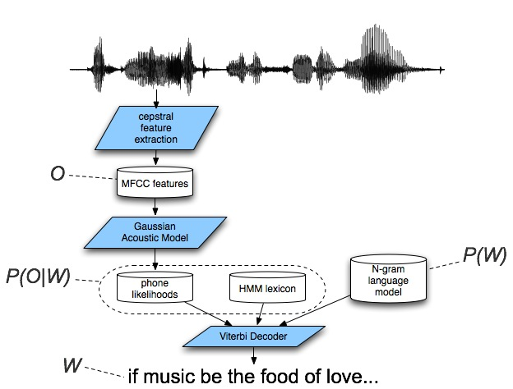
Speech Recognition Architecture

Slide 9
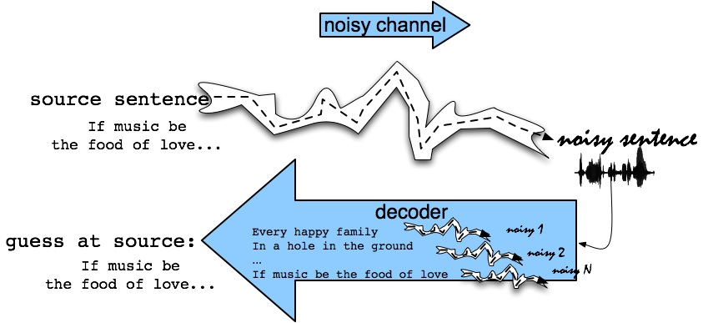
The Noisy Channel Model
Search through space of all possible sentences.
Pick the one that is most probable given the waveform.

Slide 10
Decomposing Speech Recognition
Q1: What speech sounds were uttered?
  Human languages: 40-50 phones
    Basic sound units: b, m, k, ax, ey, …(arpabet)
    Distinctions categorical to speakers
      Acoustically continuous
    Part of knowledge of language
      Build per-language inventory
      Could we learn these?

Slide 11
Decomposing Speech Recognition
Q2: What words produced these sounds?
  Look up sound sequences in dictionary
  Problem 1: Homophones
    Two words, same sounds: too, two
  Problem 2: Segmentation
    No “space” between words in continuous speech
    “I scream”/”ice cream”, “Wreck a nice beach”/”Recognize speech”
Q3: What meaning produced these words?
  NLP (But that’s not all!)

Slide 12
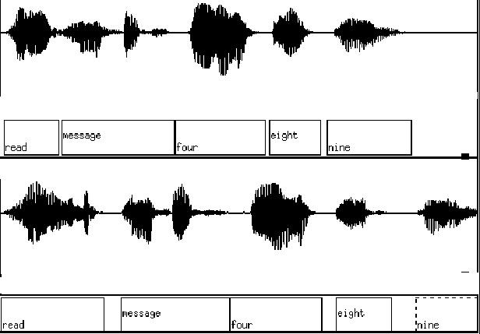


Slide 13
The Noisy Channel Model (II)
What is the most likely sentence out of all sentences in the language L given some acoustic input O?
Treat acoustic input O as sequence of individual observations
  O = o₁,o₂,o₃,…,o_{t}
Define a sentence as a sequence of words:
  W = w₁,w₂,w₃,…,w_{n}

Slide 14
Noisy Channel Model (III)
Probabilistic implication: Pick the highest prob S = W:
We can use Bayes rule to rewrite this:
Since denominator is the same for each candidate sentence W, we can ignore it for the argmax:

Slide 15
Noisy channel model
likelihood
prior

Slide 16
The noisy channel model
Ignoring the denominator leaves us with two factors: P(Source) and P(Signal|Source)

Slide 17
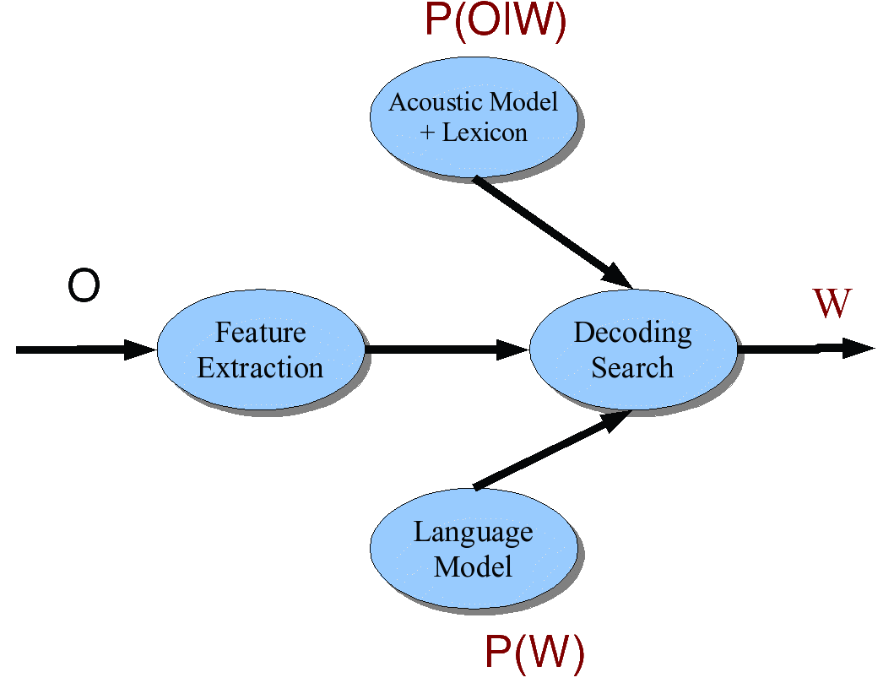
Speech Architecture meets Noisy Channel

Slide 18
ASR Components
Lexicons and Pronunciation:
  Hidden Markov Models
Feature extraction
Acoustic Modeling
Decoding
Language Modeling:
  Ngram Models

Slide 19
Lexicon
A list of words
Each one with a pronunciation in terms of phones
We get these from on-line pronunciation dictionary
CMU dictionary: 127K words
  http://www.speech.cs.cmu.edu/cgi-bin/cmudict
We’ll represent the lexicon as an HMM

Slide 20
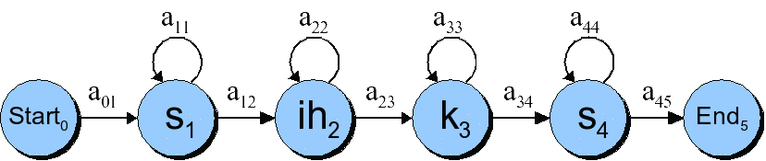
HMMs for speech: the word “six”

Slide 21
Phones are not homogeneous!

Slide 22
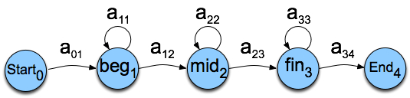
Each phone has 3 subphones

Slide 23
HMM word model for “six”
Resulting model with subphones

Slide 24
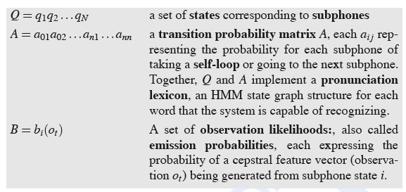
HMMs for speech

Slide 25
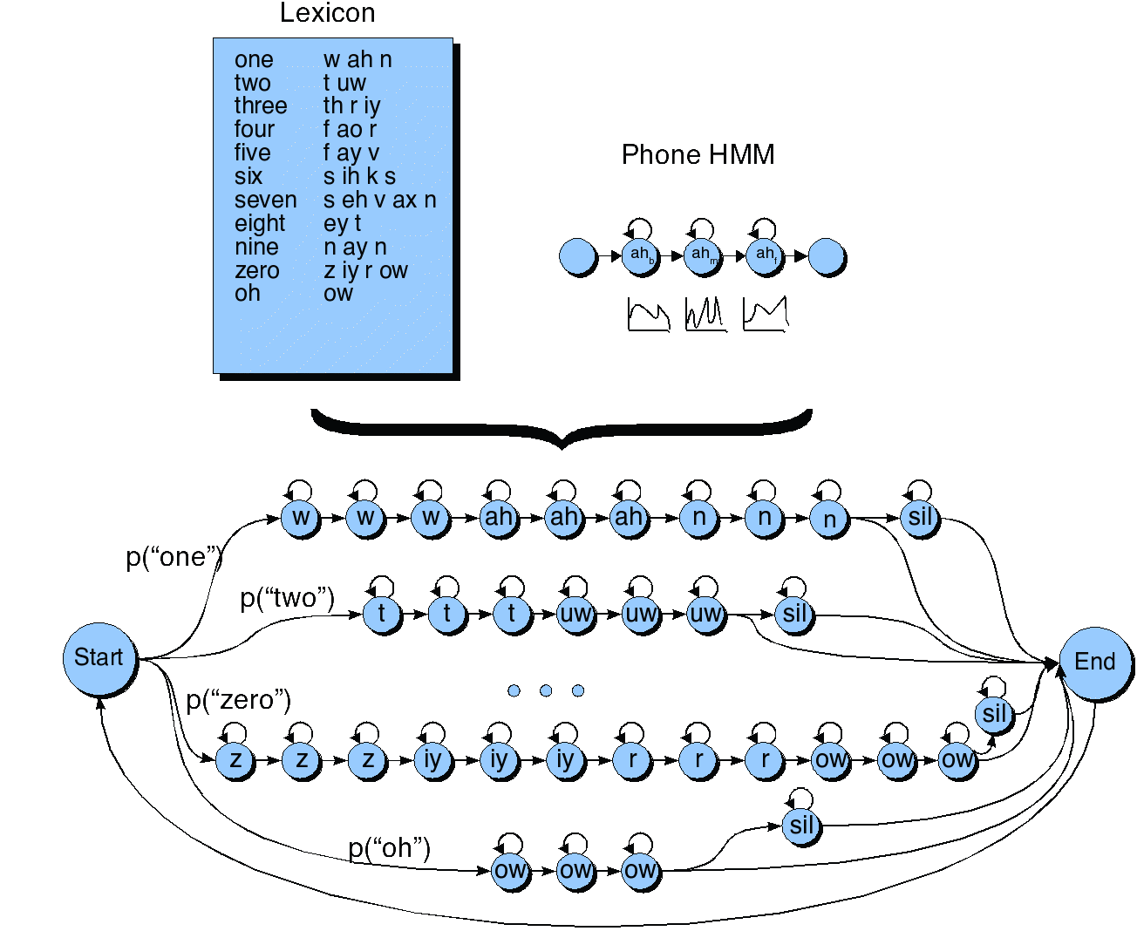
HMM for the digit recognition task

Slide 26
Typical MFCC features
Window size: 25ms
Window shift: 10ms
Pre-emphasis coefficient: 0.97
MFCC:
  12 MFCC (mel frequency cepstral coefficients)
  1 energy feature
  12 delta MFCC features
  12 double-delta MFCC features
  1 delta energy feature
  1 double-delta energy feature
Total 39-dimensional features

Slide 27
Why is MFCC so popular?
Efficient to compute
Incorporates a perceptual Mel frequency scale
Separates the source and filter
Fits well with HMM modelling

Slide 28
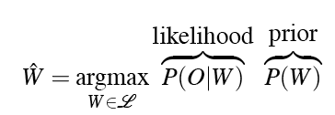


Decoding
In principle:
In practice:

Slide 29
Why is ASR decoding hard?

Slide 30
The Evaluation (forward) problem for speech
The observation sequence O is a series of MFCC vectors
The hidden states W are the phones and words
For a given phone/word string W, our job is to evaluate P(O|W)
Intuition: how likely is the input to have been generated by just that word string W

Slide 31
Evaluation for speech: Summing over all different paths!
f ay ay ay ay v v v v
f f ay ay ay ay v v v
f f f f ay ay ay ay v
f f ay ay ay ay ay ay v
f f ay ay ay ay ay ay ay ay v
f f ay v v v v v v v

Slide 32
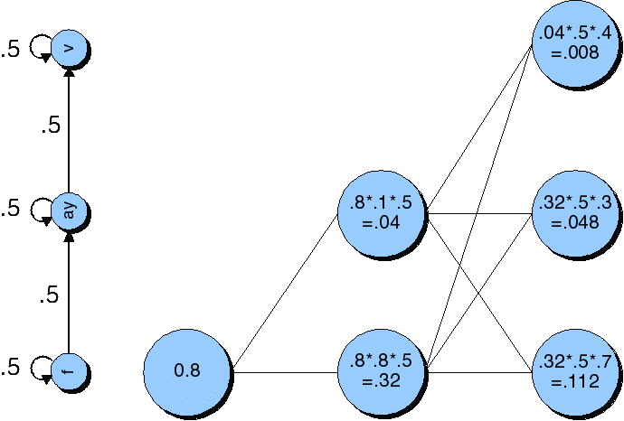
Viterbi trellis for “five”

Slide 33
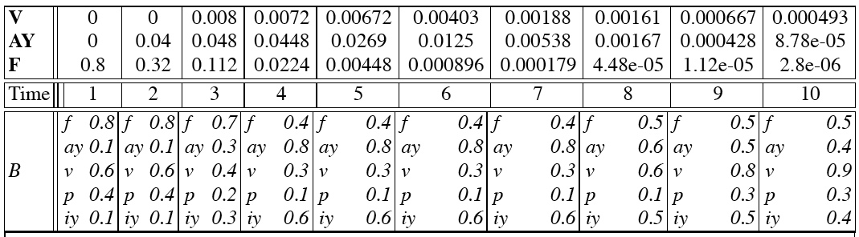
Viterbi trellis for “five”

Slide 34
Language Model
Idea: some utterances more probable
Standard solution: “n-gram” model
  Typically tri-gram: P(w_{i}|w_{i-1},w_{i-2})
    Collect training data from large side corpus
      Smooth with bi- & uni-grams to handle sparseness
  Product over words in utterance:

Slide 35
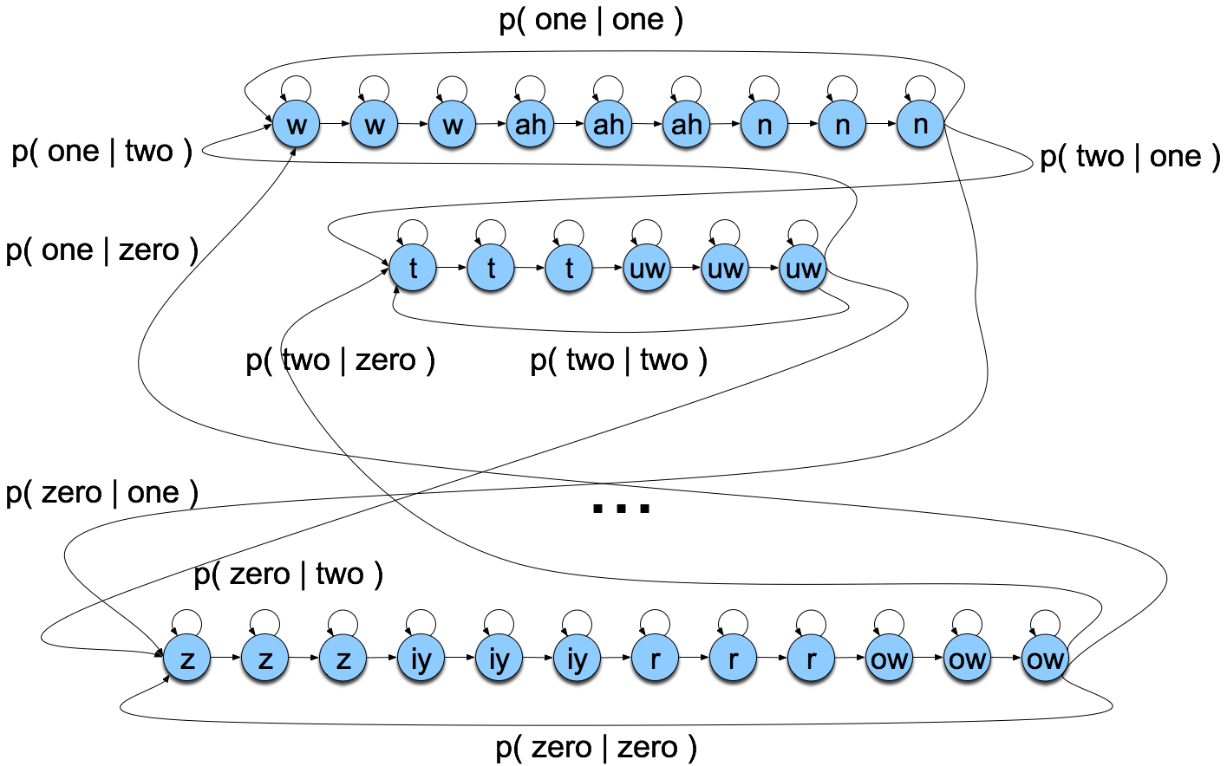
Search space with bigrams

Slide 36
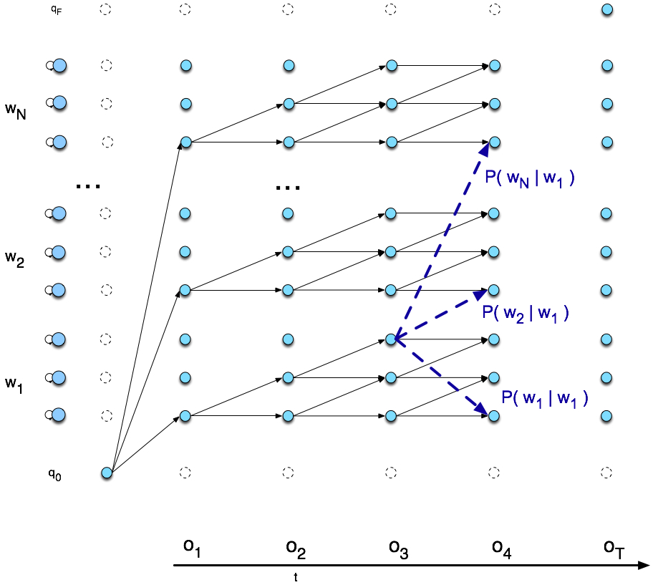
Viterbi trellis

Slide 37
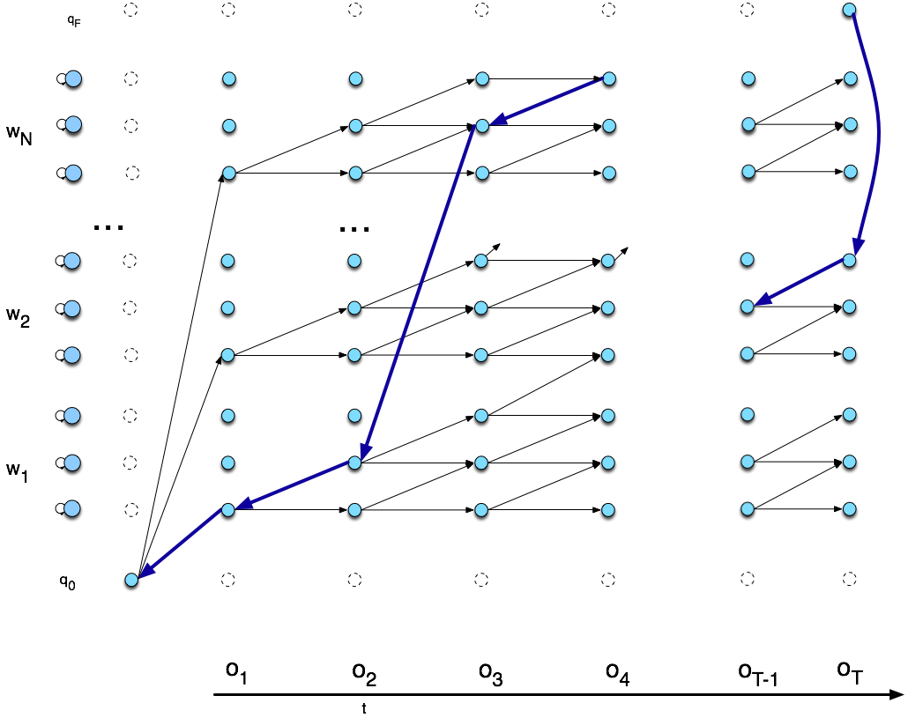
Viterbi backtrace

Slide 38
Detecting Phones
Two stages
  Feature extraction
    Basically a slice of a spectrogram
  Phone classification
    Using GMM classifier

Slide 39
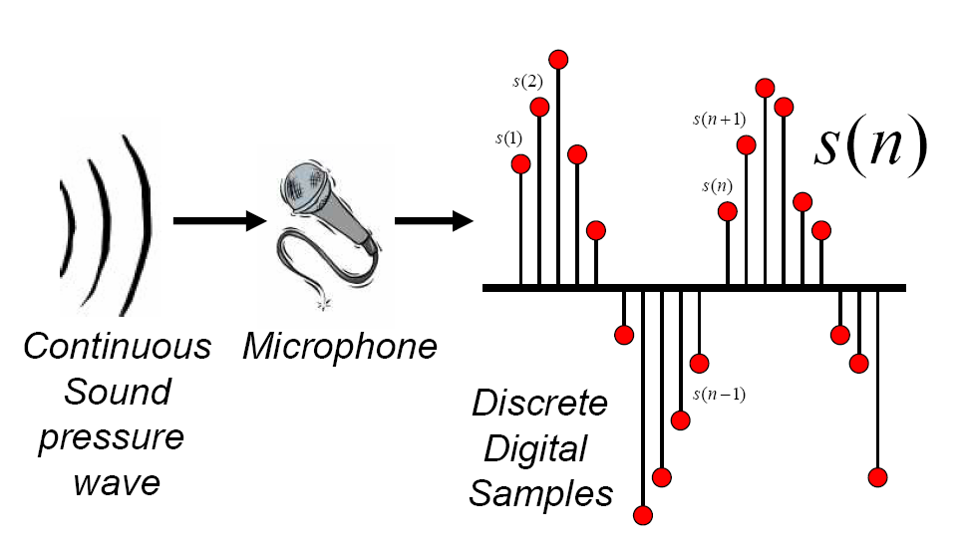
Discrete Representation of Signal
Represent continuous signal into discrete form.
Thanks to Bryan Pellom for this slide

Slide 40
Digitizing the signal (A-D)
Sampling:
  measuring amplitude of signal at time t
  16,000 Hz (samples/sec) Microphone (“Wideband”):
  8,000 Hz (samples/sec) Telephone
  Why?
    Need at least 2 samples per cycle
    max measurable frequency is half sampling rate
    Human speech < 10,000 Hz, so need max 20K
    Telephone filtered at 4K, so 8K is enough

Slide 41
Digitizing Speech (II)
Quantization
  Representing real value of each amplitude as integer
  8-bit (-128 to 127) or 16-bit (-32768 to 32767)
Formats:
  16 bit PCM
  8 bit mu-law; log compression
LSB (Intel) vs. MSB (Sun, Apple)
Headers:
  Raw (no header)
  Microsoft wav
  Sun .au
40 byte
header

Slide 42
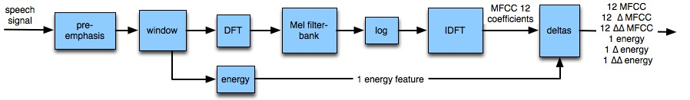
MFCC: Mel-Frequency Cepstral Coefficients

