Slide 1
Incremental Dialogue Processing
Ling575
Spoken Dialog Systems
May 8, 2013
Sanae Sato

Slide 2
Objectives
Introduction & Motivation
The Model:
Basic Concepts
Components & Modules
Network Topology
IU (Incremental Unit)
Operation
Example I – NUMBERS
Example II - Extended Work 1
Extended Work 2
Summary & Discussion
Notes:
Paper: A General, Abstract Model of Incremental Dialogue Processing
David Schlangen & Gabriel Skantze @ European ACL 2009
Paper: Incremental Dialgue Processing in a Micro-Domain
Gabriel Skantze & David Schlangen @ European ACL 2009
本論文は、Incremental Processing に関して Abstract な概念が書かれているが、実際の開発を念頭において書かれているため、
今後、なんらかの開発に際した場合、コンセプトを理解しておくことは、非常に有用であると考える。
なお、具体例（NUMBER システム）に関した論文も別途発表されており、併せて参照すると非常に理解しやすい。
----
Objectives

Slide 3
Introduction & Motivation
Key Takeaways ：
General Model
Conceptual Framework
Topology
Network Modules
Information Flow
Available Options (when you design the system)
Abstract Data Types & Methods
Possible Constrains
Examples in the real world
Future Approach
Notes:
Key Take-Aways ：
General Model
Conceptual Framework
Topology
Network Modules
Information Flow
Available Options (when you design the system)
Abstract Data Types & Methods
Possible Constrains
-----------
Abstract Specification of a wide range : from “non-incremental pipelines” to “fully incremental, asynchronous, parallel, predictive systems”
What are the similarities & Differences in these systems?
それを理解できれば、おのずとChoices & Trade-Off がわかるはず
特に、Conceptual Framework ※このペーパーは特にどれかひとつのアーキテクチャを取り上げて、良し悪しを述べているのではない。
（The paper is not talking about some specific architectures / or describing one particular “best architecture”.）

Slide 4
Introduction & Motivation
What does it mean by “Incremental”?
No dialogue agent (artificial or natural) processes whole dialogues by participants taking turns
In this sense, most current implemented dialogue systems are incremental: they process user utterances as a whole and produce their response utterances as a whole
BUT – “Incremental Processing” has more to offer
“Processing starts before the input is complete” (Kilger and Flinkler 1995)
“Each processing component will be triggered into activity by a minimal amount of its characteristic input (Levelt, 1989)”
Notes:
Characteristic Input of a dialogue system
たとえば、Utterance 等
もちろん、Utternace より小さい単位とすることも可能

Slide 5
Introduction & Motivation
Incremental: what is good about this?
Enables rapid response
Enables giving early feedback
error correction/back-channel etc.
Possibly be able to take more active role in conversation
More dynamic turn-taking
May be more natural, human-like interactions?
Incremental: any Drawbacks?
Input is based on prediction (uncertain)
Therefore output is unstable and so prone to revision
Notes:
Pros: React Quicker
Cons
According to Aist (Aist et al. 2007) incremental system react 20% faster than non-incremental system.

Slide 6
Objectives
Introduction & Motivation
The Model:
Basic Concepts
Components & Modules
Network Topology
IU (Incremental Unit)
Operation
Example I – NUMBERS
Example II - Extended Work 1
Extended Work 2
Summary & Discussion
Notes:
Paper: A General, Abstract Model of Incremental Dialogue Processing
David Schlangen & Gabriel Skantze @ European ACL 2009
Paper: Incremental Dialgue Processing in a Micro-Domain
Gabriel Skantze & David Schlangen @ European ACL 2009
本論文は、Incremental Processing に関して Abstract な概念が書かれているが、実際の開発を念頭において書かれているため、
今後、なんらかの開発に際した場合、コンセプトを理解しておくことは、非常に有用であると考える。
なお、具体例（NUMBER システム）に関した論文も別途発表されており、併せて参照すると非常に理解しやすい。
----
Objectives

Slide 7
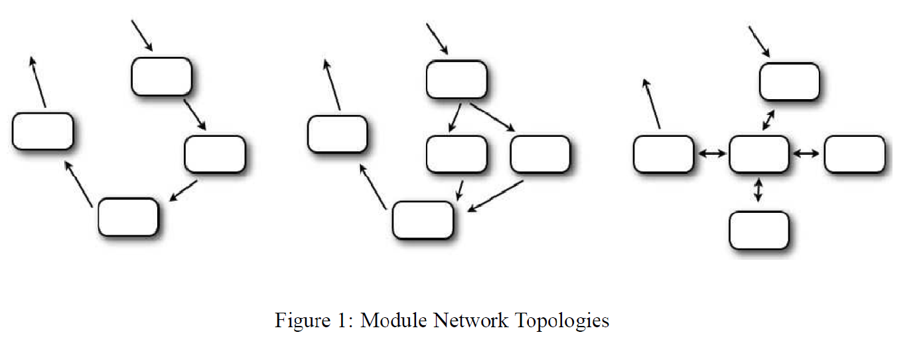
The Model: Basic Concdepts
Module Networks
Box : Module
Arrow & Direction: Information path & flow
Information Flow
Directed Edges/
Notes:
まずはじめに重要なこと
Give & Facilitate …
Exact interpretation & Concise Description
Understand the difference between module networks such as in these example
Informally…
Network on the left: a simple pipeline with no parallel paths
Network in the middle: a pipeline enhanced with a parallel path
Network on the right: a star-architecture
Type of network & Constrains
----
次に、
Information Flow
In the system
Between the modules
(なお、概念的な説明なので、ここでは、実際のInformationについては触れない。)
Directed Edges
direction of information flow
Parallel information streams (Modules in the middle)

Slide 8
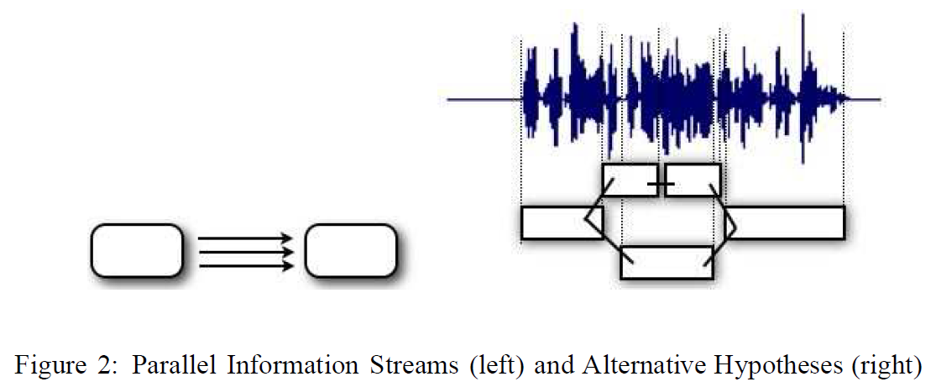
The Model: Basic Concepts
Parallel information streams between modules
* Not that there are three actual communications channels active
Parallelism is incorporated within its design
Notes:
Give & Facilitate …
Exact interpretation & Concise Description
Understand the difference between module networks such as in these example
Informally…
Network on the left: a simple pipeline with no parallel paths
Network in the middle: a pipeline enhanced with a parallel path
Network on the right: a star-architecture
Type of network & Constrains
----
次に、
Information Flow
In the system
Between the modules
(なお、概念的な説明なので、ここでは、実際のInformationについては触れない。)
Directed Edges
direction of information flow
Parallel information streams (Modules in the middle)

Slide 9
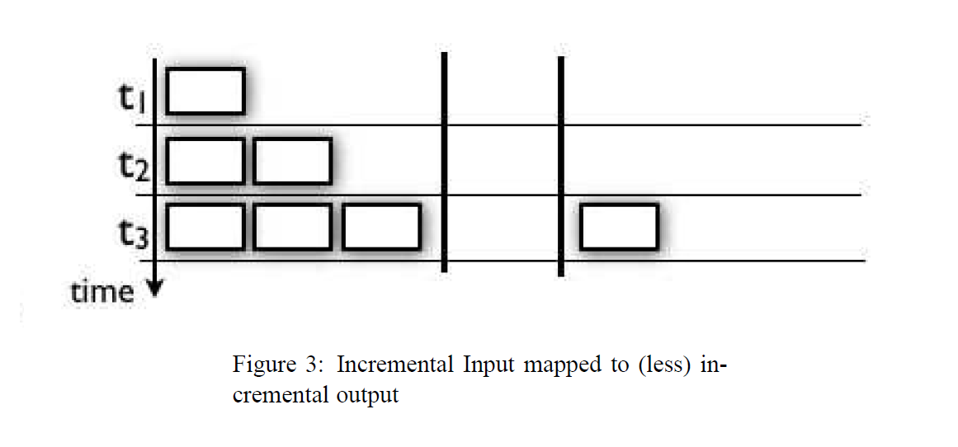
The Model: Basic Concepts
How do we specify/relate incremental bits of input to incremental bits of output?
Here is the possible configuration example:
Left Column : incremental bits of input over time
Right Column: incremental bits of output over time
Notes:
Give & Facilitate …
Exact interpretation & Concise Description
Understand the difference between module networks such as in these example
Informally…
Network on the left: a simple pipeline with no parallel paths
Network in the middle: a pipeline enhanced with a parallel path
Network on the right: a star-architecture
Type of network & Constrains
----
次に、
Information Flow
In the system
Between the modules
(なお、概念的な説明なので、ここでは、実際のInformationについては触れない。)
Directed Edges
direction of information flow
Parallel information streams (Modules in the middle)

Slide 10
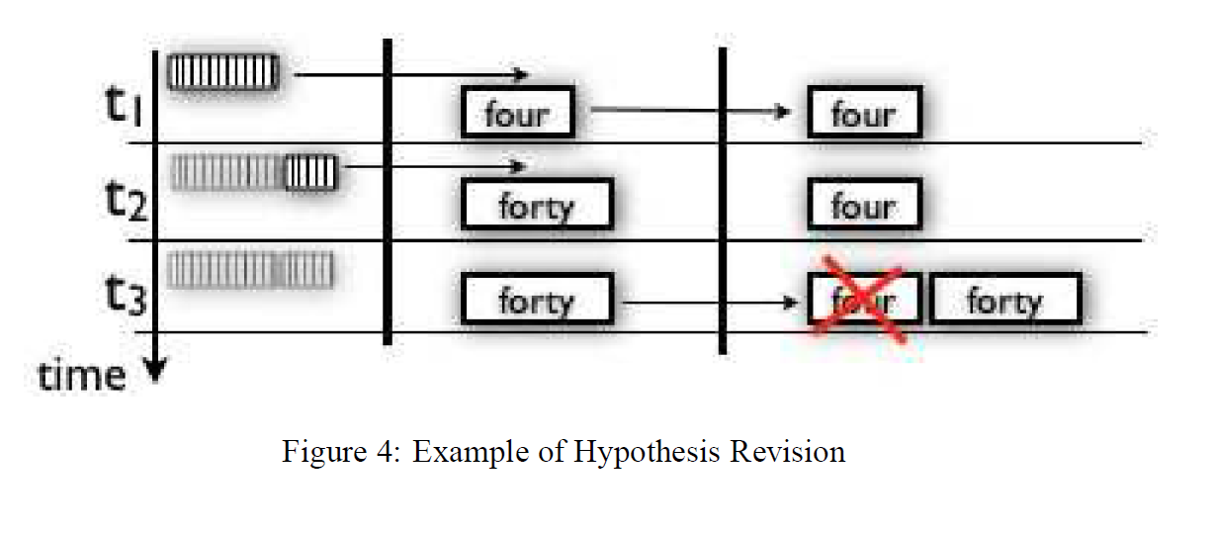
The Model: Basic Concepts
Recall: It is in the nature of incremental processing model where output is generated on the basis of incomplete input.
There is a case such that output needs to be revised when more information become available! (Hypothesis Revision)
Notes:
Give & Facilitate …
Exact interpretation & Concise Description
Understand the difference between module networks such as in these example
Informally…
Network on the left: a simple pipeline with no parallel paths
Network in the middle: a pipeline enhanced with a parallel path
Network on the right: a star-architecture
Type of network & Constrains
----
次に、
Information Flow
In the system
Between the modules
(なお、概念的な説明なので、ここでは、実際のInformationについては触れない。)
Directed Edges
direction of information flow
Parallel information streams (Modules in the middle)

Slide 11
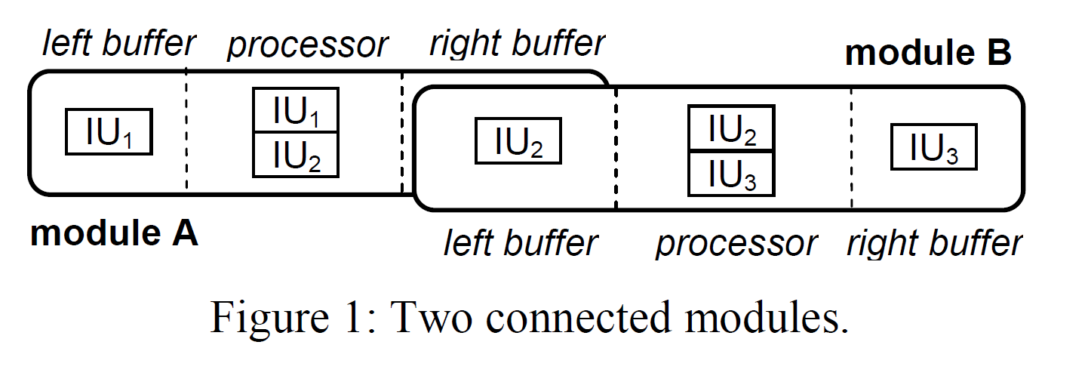
The Model: Components & Modules
Third Component (Modules & its Connections)
“Incremental Unit (IU)”: basic unit of information that is communicated between the modules
The processing module
Left Buffer (LB)
Processor proper
Right Buffer (RB)
Combining these terms:
Left Buffer – Incremental Unit etc

Slide 12
The Model: Network Topology
Network Topology
Connectedness Axioms: connections between modules are expressed through these axioms.
Connectedness Axioms simply state that IUs in one module’s right buffer are also in another buffer’s left buffer.
Example:
“All and only NPs in module 1’s RB appear in module 2 LB”

Slide 13
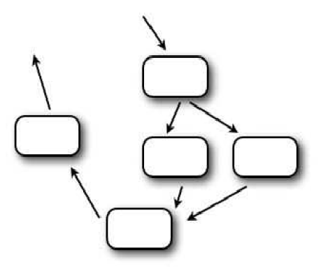
The Model: Network Topology
Network Topology (cont’d)
If desired, a given RB can be connected to more than one LB, and more than one RB can feed into the same LB
Different topology types can them be defined through constrains on module sets and their connections.
Pipeline System
Together, the set of these axioms define the network topology of a concrete system.
Note: This is different from copying of data structure, rather, invoking token identity.
Bi-directionality property: if processor makes changes to IUs in their buffers, those changes are automatically percolate through the network.

Slide 14
The Model: IU
Incremental Units
IU is holding a “minimal amount of characteristic input (or output)”
What do we see as the most complete version of IUs so that we can build more complex system?
Operations
Hypothesis Revision
Prediction
Parallel Hypothesis Processing
Relations & Levels of IU
on the same level ←→ grounded

Slide 15
The Model: IU
Incremental Units (cont’d)
Apart from relations we have looked so far, we want IUs to carry 3 other types of information:
A confidence Score
A field recording whether revisions of the IS are still to be expected or not
A field recording whether the IU has already been processed by consumers, and if so, by whom
Formally, we define IUs as tuple
Identity / Link level / Grounded / Confidence or Trust / Committed / Seen

Slide 16
The Model: Operations
Operations
Purge
LB-IUs are revoked by their producer
This is done by setting confidence score to the special value (i.e. 0 / -1 : depends on the system)
Update
New LB-IUs are integrated into the internal state, and eventually new RB-IUs are build based on them
Commit
There are three ways in which a processor may have to deal with commits
It can decide for itself to commit RB-IUs
A processor may notice that a previous module has committed to IUs in its LB.
The commitment of previous kind will lead modules to also commit to its output (Chain of commitments)

Slide 17
Objectives
Introduction & Motivation
The Model:
Basic Concepts
Components & Modules
Network Topology
IU (Incremental Unit)
Operation
Example I – NUMBERS
Example II - Extended Work 1
Extended Work 2
Summary & Discussion
Notes:
Paper: A General, Abstract Model of Incremental Dialogue Processing
David Schlangen & Gabriel Skantze @ European ACL 2009
Paper: Incremental Dialgue Processing in a Micro-Domain
Gabriel Skantze & David Schlangen @ European ACL 2009
本論文は、Incremental Processing に関して Abstract な概念が書かれているが、実際の開発を念頭において書かれているため、
今後、なんらかの開発に際した場合、コンセプトを理解しておくことは、非常に有用であると考える。
なお、具体例（NUMBER システム）に関した論文も別途発表されており、併せて参照すると非常に理解しやすい。
----
Objectives

Slide 18
Example I – NUMBERS
NUMBERS: a fully incremental dialogue system that can engage in dialogues in a simple domain, number dictation.
Network Topology of the system:
Notes:
Network Topology of the system:
Pretty much “standard layout” except..
Prosodic analysis is done in the ASR
The dialogue management (red - square) is divided into a discourse modelling module & Action Manager
Self-monitoring feedback loop

Slide 19
Example I – NUMBERS

Slide 20
Example – NUMBERS
Illustration of incremental speech recognition
Update: processor needs to update its internal state. Speech recognizer has to continuously add incoming audio frames into its internal state.
Purge: at time t₂, as more audio frames are consumed by the recognizer, the module must revoke “four” and add new IU “forty”. All other IU consumes the IU “four” has to purge.
Commit: as more audio frames are consumed, and no more words are identified at t₄, the module nay decide to commit to the IUs that it has produced.

Slide 21
Objectives
Introduction & Motivation
The Model:
Basic Concepts
Components & Modules
Network Topology
IU (Incremental Unit)
Operation
Example I – NUMBERS
Example II - Extended Work 1
Extended Work 2
Summary & Discussion

Slide 22
Example II: Extended Work 1 (D. DeVault et al. 2009)
SASO-EN scenario
(Hartholt et al., 2008)
Designed to allow a trainee to practice multi-party negotiation skills by engaging in face to face negotiation with virtual humans.
Objective: “negotiate about the possible re-location of a medical clinic in an Iraqi village”
The NLU component is based on Incremental Processing techniques:
Incremental interpretation based on partial speech recognition results
Provide responses before waiting for the final speech result

Slide 23
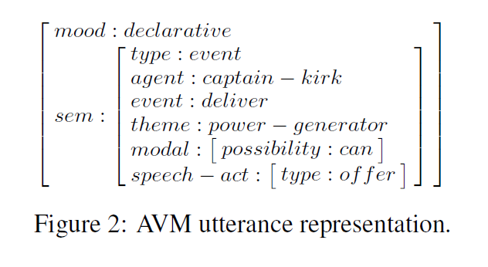
Example II: Extended Work 1 (D. DeVault et al. 2009)
NLU output
AVM (attribute-value matrix)
Its attribute-value pair (frame elements) is representing semantic information
Figure 2 shows an example representation of:
“We can provide you with power generators.”
Figure 3 shows an example of the linearized AVM using a path-value notation

Slide 24
Example II: Extended Work 1 (D. DeVault et al. 2009)
How well is the system understanding?
Use machine learning to more closely characterize the performance of a maximum entropy based incremental NLU module.
Want to know “when” is “good-enough”?
The paper stated that their “aim is to identify strategic points in time, as a specific utterance is occurring, when the system might react with confidence that the interpretation will not significantly improve during the rest of the utterance.”

Slide 25
Example II: Extended Work 1 (D. DeVault et al. 2009)
Notes:
This Figure illustrates the incremental output of mxNLU as a user askes, “Elder, do you agree to move the clinic downtown?”
- ASR processes captured audio in 200 ms chunks
- Figure shows partial ASR results after the ASR has processed each 200 ms of audio, along with the F-score
Note:
- F-score is flucturateing somewhat as the ASR revises its incremental hypotheses
But it is increasing over time in general
Final F-score was 0.91
But in fact, mxNLU already achieves this maximal F-score at the moment it interprets the partial ASR result “elder do you agree to move the” at 1800ms

Slide 26
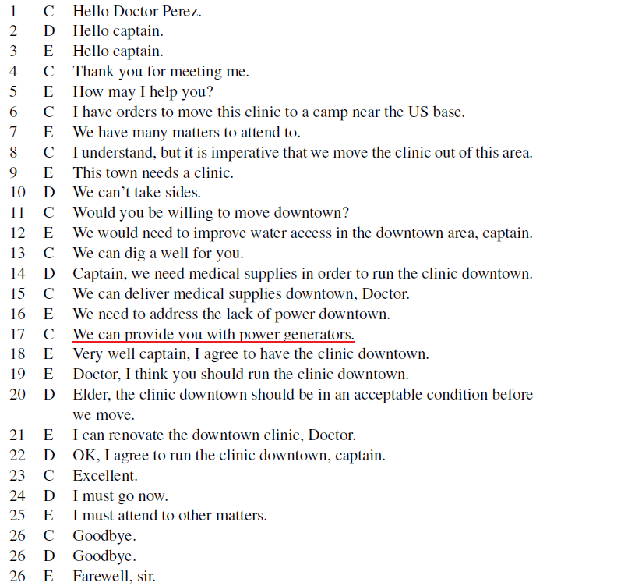
Example II: Extended Work 1 (D. DeVault et al. 2009)

Slide 27
Objectives
Introduction & Motivation
The Model:
Basic Concepts
Components & Modules
Network Topology
IU (Incremental Unit)
Operation
Example I – NUMBERS
Example II - Extended Work 1
Extended Work 2
Summary & Discussion

Slide 28
Extended Work 2 (E. Selfridge et al. 2011)
Recall:
Drawbacks of Incremental Speech Recognition (ISR)
ISR output is unstable and so prone to revision
How can we increase “stability” and “accuracy”?
Prediction of “stability” and “accuracy”
SM (Stability Measure): Likelihood of a partial result remaining unchanged compared to the final result
CM (Confidence Measure): Likelihood of partial correctness
Lattice-Aware ISR (LAISR)
Integrate terminal & immortal ISR
Terminal: medially restrictive method
Immortal: highly restrictive method
Notes:
過去のStabilityに関する研究は、Delay を入れることによって対処するものが多かったよう。
この論文は、Delay することなく、Stability の向上を目標としている。

Slide 29
Extended Work 2 (E. Selfridge et al. 2011)
Domain Corpus
Bus information queries/calls in Pittsburgh US: call to the Carnegie Mellon “Let’s Go!” system
Speech Engine
AT&T WATSON speech recognition engine
Tasks & 3 Models used
Rule-based language models
Neighborhood names & Street names (RLM1)
Only neighborhood names (RLM2)
Statistical language model (SLM)
Notes:
過去のStabilityに関する研究は、Delay を入れることによって対処するものが多かったよう。
この論文は、Delay することなく、Stability の向上を目標としている。
WER:
RLM : 60-68%
SLM : 35 %

Slide 30
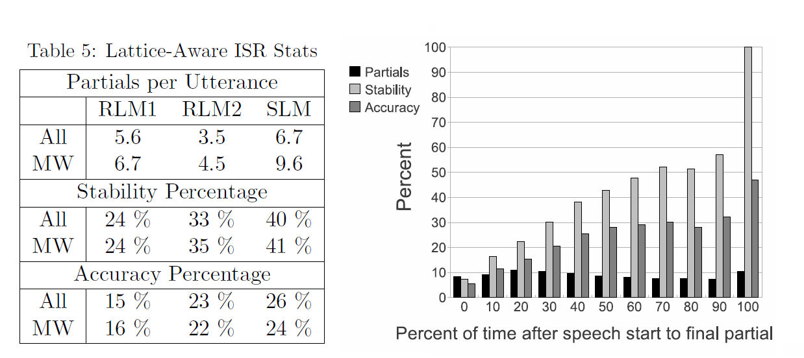
Extended Work 2 (E. Selfridge et al. 2011)
For “All” utterance, there appears to be a very slight improvements
For “MW (Multi-Words)” utterance, improvements increase
Notes:
All – all of the utterances are analyzed
MW – Multi Words – only utterances whose transcribed speech (what was actually said) has more than one word.
ISR should yield better result by its nature
Table 5
First two rows sho the average # of partials / utterance for each task

Slide 31
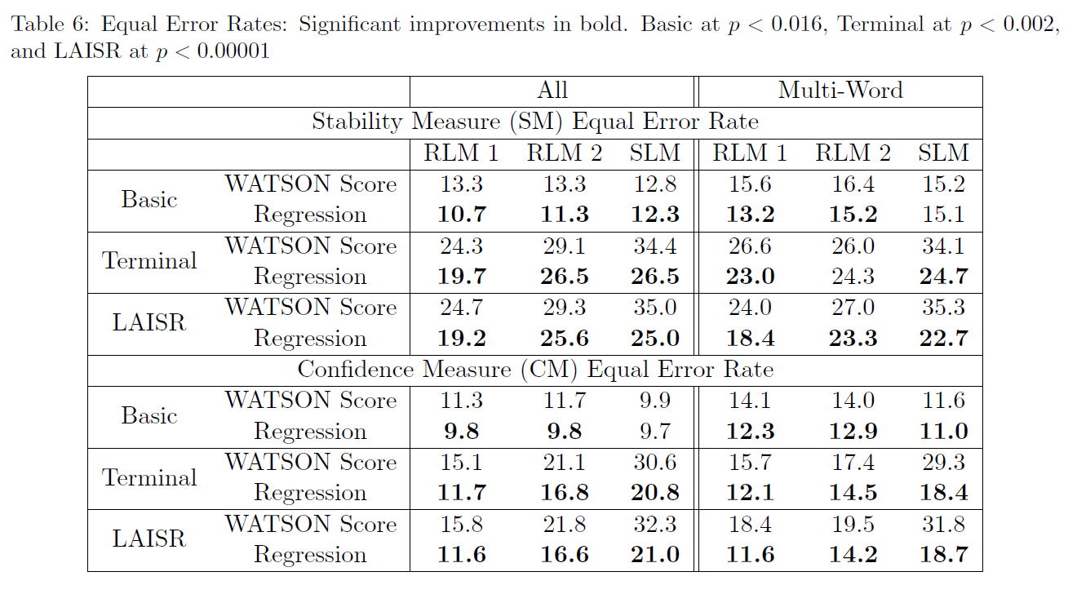
Extended Work 2 (E. Selfridge et al. 2011)

Slide 32
Summary & Discussion
Pros and Cons of Incremental Processing
Conceptual Framework
Topology
Network Modules
Information Flow
Abstract Data Types & Methods
IU
LB & RB
Purge/Update/Commit etc.
Possible Constrains
Examples in the real world
NUMBERS
SASO-EN negotiation scenario
Future Approach
Increasing stability and accuracy of ISR

Slide 33
References
David Schlangen & Gabriel Skantze A General, Abstract Model of Incremental Dialogue Processing @ European ACL 2009
Gabriel Skantze & David Schlangen: Incremental Dialgue Processing in a Micro-Domain @ European ACL 2009
David DeVault, Kenji Sage, and David Traum. 2009. Can I finish? Learning when to respond to incremental interpretations results in interactive dialogue. In Proc. SIGdial 2009 Conference, pages 11-20
Ethan O. Selfridge, et al. 2011. Stability and accuracy in Incremental Speech Recognition

Slide 34
Project Topic (sanaes)
Questions:
We have observed that NUMBERS system was evaluated as “preferred” system. If incremental processing was the right approach to increase user satisfaction, what other aspect of human communication can be incorporated in the system?
Task 1 : Research Psycholinguistic Facts
Task 2 : Consider Possible Implementation
Refereces (TBD)
Incremental Processing:
Volha Petukhova, Harry Bunt. 2011. Incremental dialogue act understanding
Discourse:
Yafa Al-Raheb 2006 Semantic and Pragmatic presupposition in Discourse Representation Theory
Psycholinguistic:
TBD

