Slide 1
Crowdsourcing for Spoken Dialogue System Evaluation
Ling 575
Spoken Dialog
April 30, 2015

Slide 2
Roadmap
Spoken Dialogue Systems (SDS) Evaluation
The PARADISE Model
Challenges: Judgments, Portability
Data: Let’s Go!, Spoken Dialogue Challenge
Crowdsourcing SDS Evaluation
Predicting SDS scores:
Semi-supervised learning
Collaborative filtering

Slide 3
Evaluating Spoken Dialogue Systems
Q: How good is a spoken dialogue system (SDS)?
A: Ask users!
Typically conduct survey after interaction
Q: What factors contribute to user satisfaction?
Combine measures spanning
Task success:
Found information, recognized user request, etc
Dialogue cost:
# turns, dialogue length, # ASR errors, etc…

Slide 4
PARADISE Model
Q: How do we weight these components?
Q: How can we create a predictive model?
‘Paradigm for Dialogue System Evaluation’
Walker et al (1997)
Computes user satisfaction based on surveys
Extracts success, cost measures from dialogues
Employs multiple regression models to train weights
Resulting model should predict score on new systems

Slide 5
Trouble in PARADISE
Adaptation:
Ideally, should train on Sys A, apply to Sys B
In practice, models do not transfer very well from system to system
Walker et al applied to variants of same system
User satisfaction:
How can we collect ratings?
Real users don’t hang around for surveys
Collecting ‘expert’ ratings: expensive, slow

Slide 6
Strategy
Employ crowdsourcing to collect evaluations
Lots, cheaply
Employ machine learning to help generalize, adapt
Semi-supervised learning, collaborative filtering

Slide 7
Let’s Go! Corpus
Spoken Dialogue System provides bus info
Developed at CMU, deployed in Pittsburgh
ONLY phone transit info service after hours
Real users!!!
Simple information seeking dialogue
Bus #, Start, Destination, Start time, Arrival time
Success: Gives bus information
Out-of-scope: Knows only subset of routes
Failure: No information

Slide 8
Let’s Go! Example
S: What can I do for you?
U: Leaving Lawrenceville.
S: Leaving from Lawrenceville. Did I get that right?
U: Yes.
S: Alright. Where do you wanna go?
U: Downtown.
S: Going to downtown. Is that correct?
U: Yes.
S: Right. When do you want to travel?
U: Now..
S: he next 54C leaves MAIN STREET AT PENN at 1 10 a.m.

Slide 9
Crowdsourcing SDS Evaluation
Amazon Mechanical Turk:
Create HITs (Human Intelligence Tasks) for Mturkers
Text transcript of dialogue + questionnaire
Q1: Did you understand what the user wanted?
Q2: Did the system provide the info the user wanted?
Q3: Did the system work as you would expect?
Q4: Overall, is this a good system?
Q5: Was the task completed successfully? (detailed)
Two HIT types:
Overall evaluation: $0.05/dialog; 11,000 dialogues
Inter-rater Agreement: $1.50 for 30 dialogues

Slide 10
Validation & Collection
Issue: Quality control
Automatic validation:
Spent enough time? Didn’t give all same answers?
Completion-related responses consistent?
With each other? With heuristic classification?
11K HITS rated by 700 Mturkers in 45 days
~8,400 dialogues accepted; $350

Slide 11
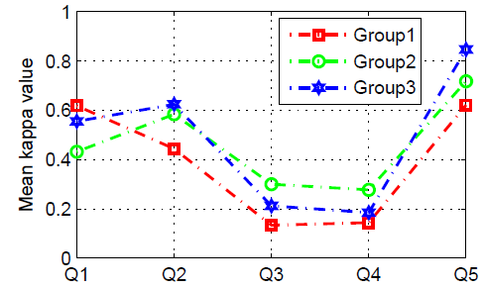
Inter-rater Agreement
Cohen’s weighted Kappa
Fair-Good agreement on task-completion related item
What constitutes a ‘good’ system is more nebulous

Slide 12
Learning to Evaluate
Semi-supervised learning approaches
Employ small amounts of labeled data
Augmented with large amounts of unlabeled data
To train evaluating classifiers
Compare 2 semi-supervised approaches
Semi-supervised variant of SVM (S3VM)
Co-training: train 2 classifiers on different views of data
Dialogue features; Meta-communication features
Classifier is logistic regression
Supervised techniques:
Linear regr’n., logistic regr’n, kNN, SVM

Slide 13
Experiments
Data: ~5K Mturked dialogues
500 held out for test; vary training
Binary classification: Good/Bad
Features:
Task/Communication-related: #User turns, # System turns, Words per user utt, Average speaking rate, #User questions, #System questions
Meta-communication-related: #Barge-in, #DTMF, #Help requests, Average recognition confidence
All features automatically derived from logs

Slide 14
Results
Training on 0.3% of available data
At low training rate, Co-training best
At high training rate, all similar

Slide 15
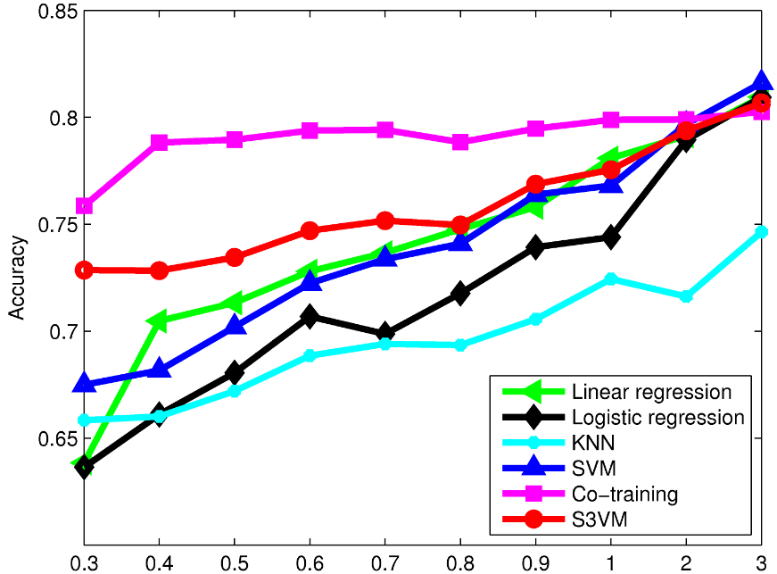
Results II
Accuracy with increasing amounts of training data (%)

Slide 16
Conclusions & Future Work
Crowdsourcing can support spoken dialogue system evaluation
Semi-supervised approaches, esp. co-training, can enable adaptation to new domain quickly
Compare crowdsourcing to expert SDS evaluation
Contrast evaluation on transcripts to that on audio
Explore more fine-grained (non-binary) classification

Slide 17
Thanks
Human-Computer Communication Laboratory, Chinese University of Hong Kong: Helen Meng, Irwin King, Baichuan Li, Zhaojun Yang, Yi Zhu
Spoken Dialogue Challenge
http://www.dialrc.org/sdc
Alan Black, Maxine Eskenazi

