Slide 1
Turn-taking and Backchannels
Ryan Lish

Slide 2
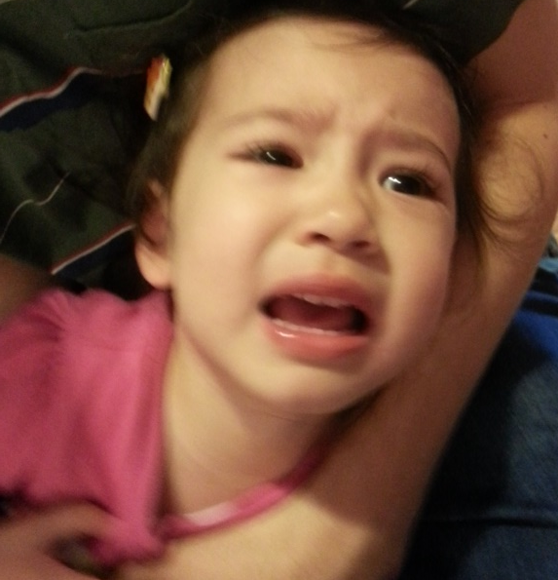
Turn-taking
We all learned it in preschool, right?
Also an essential part of conversation
Basic phenomenon of language:
Minimize simultaneous turns
Minimize silence
Relies on a number of signals
Something we should try to model for SDS

Slide 3
Identifying When to Change Turns
Transition Relevance Point (TRP)
A number of cues in the signal:
Silence
Pragmatics
Intonation
Grammar
Complex TRP (cTRP)
All the cues converge at one point to indicate the end of an utterance
Most systems rely on silence

Slide 4
Selfridge & Heeman (2009): 3 models compared
Single-utterance approach
Keep-or-release approach
Raux & Eskanazi (2009)
Turn-bidding approach
Selfridge & Heeman (2009)

Slide 5
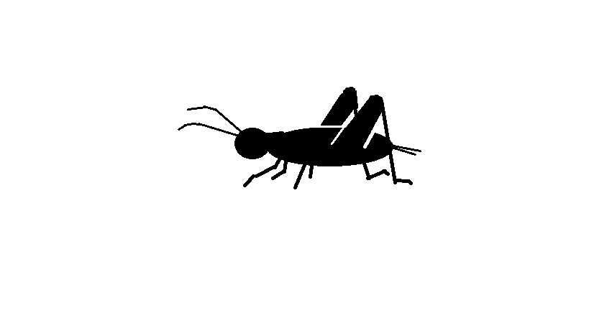
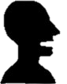
Why not single-utt approach?
Crickets
(too much silence)
~~~~~~~~~! ~~~~~~~~~!
~~~~~~~~~! ~~~~~~~~~!
~~~~~~~~~! ~~~~~~~~~!
~~~~~~~~~! ~~~~~~~~~!

Slide 6
Why not single-utt approach?
Conversational Dysrhythmia
~~~~~~~~~! ~~~~~~~~~!
~~~~~~~~~! ~~~~~~~~~!
~~~~~~~~~! ~~~~~~~~~!
~~~~~~~~~! ~~~~~~~~~!

Slide 7
Keep-or-Release: 4-State Model
Original model proposed by Jaffe and Feldstein (1970)
4-state FSM
Participant A
Both
Free
Participant B

Slide 8
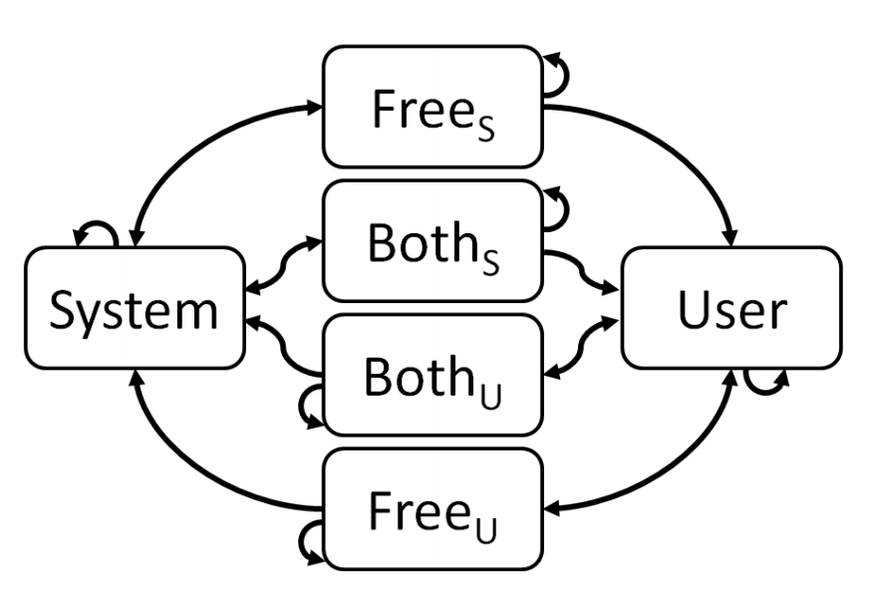
Keep-or-Release: 6-state Model
4 Possible Actions:
Grab the floor
Keep the floor
Release the floor
Wait
Transitions expressed as System/User pairs
(G, W) – The system grabs the floor and the user waits
Actions have costs assigned to minimize time spent in Free or Both states

Slide 9
Turn-Bidding
People keep or grab the turn according to importance of utterance
Strength of turn cues vary according to importance
Main point of bidding is at pauses
More important utts spoken sooner
Bid winner is the one who speaks first

Slide 10
Turn-Bidding Implementation
Bidding occurs at the end of every utterance (at every pause?)
5 bid values:
Strongest to Weakest
Shortest to Longest
User modeled as “novice” or “expert”
User only used one bid value
Tied bids resolved randomly

Slide 11
Evaluation
2 Different Objectives:
Keep-or-Release:
Minimize silence between turns without increasing overlaps
Turn-bidding:
Cut out unnecessary turns

Slide 12
Evaluation: Keep-or-Release
Minimize silence between turns without increasing overlaps
Compared average latency and barge-in rates with fixed threshold baseline
Two tests: corpus and live
Corpus: 29.5% decrease in latency
Live: 193 ms decrease in latency

Slide 13
Evaluation: Turn-Bidding
Compared total cost of conversation
Same number of turns as Keep-or-Release when using only one kind of user
Fewer turns when there was a mix of novice and expert users
Two pros of turn-bidding:
System able to provide help without prompt (after a long user bid)
System does not reprompt expert user (after a short user bid)

Slide 14
Backchannels
Provide feedback to the speaker
Lack of backchannels could mean:
Audience can’t hear
Audience isn’t listening
Audience doesn’t understand
Forms of backchannels:
Confirmation – “yeah” “uh-huh” “wow”
Completion of sentences
Request for clarification
Restatement of utterance
Generally given at TRPs

Slide 15
Backchannel models
Rely on silence, part of speech n-grams, f0 contour
Cathcart et al. (2003) runs 4 models:
After a constant number of words
After a period of silence
After trigram patterns
Combination of silence and trigrams

Slide 16
Evaluation: Backchannel
Used Map Task corpus
Models tried to identify where backchannels should appear
Baseline: Every 7 words : 6%
Silence: 900ms : 32%
Silence and Trigrams : 32%
Recall often in the 50-60% range
Precision usually down around 20-30%

Slide 17
Discussion
Turn-taking:
Would it be plausible to combine the turn-bidding and keep-or-release models?
What other TRP cues could be realistically included in a model?
Is turn-bidding useful outside of form-filling tasks?
Backchannels:
Are backchannels necessary for SDS?
How could precision be improved?
What threshold needs to be reached before the extra backchannels become tolerable?

Slide 18
End

