Slide 1
Phyla Cnidaria and Ctenophora: An Overview

Slide 2
Cnidaria
Diploblastic (blastula has endo- and ectoderm)
Tissue-level organization
True mouth (a.k.a. anus)
“Naked” nerve nets- no CNS
Unique presence of Nematocysts
Planktonic or sessile

Slide 3
Ctenophora
(Comb jellies)
Weak swimmers- planktonic or benthic
Statocyst present- organ determines orientation, contains statoliths and four groups of fused cilia
Often source of nighttime multi-colored bioluminescence

Slide 4
Radiata Side by Side
Jellyfish, anemones, corals
Mainly carnivorous
Move by water propulsion
Exclusively aquatic, mostly marine
Tentacles unbranched, around mouths of polyps, margin of medusae
Tentacles hollow w/ nematocysts
Comb Jellies
Carnivorous
Move by ctenes (fused cilia)
Exclusively Aquatic, mostly marine
If present; two tentacles, branched and extensile
Tentacles solid w/ colloblasts

Slide 5
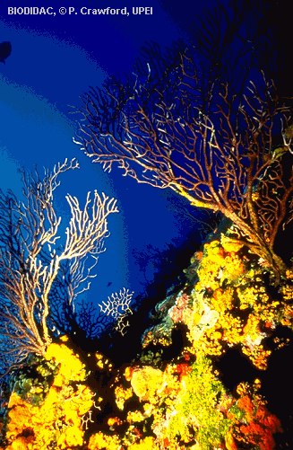
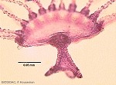
Cnidaria- Major Classes
Anthozoa
(corals and
anemones)
About 6500 species
No medusa stage
Some hermaphroditic
Thrive best in presence
of symbionts-
(usually heterotrophic
dinomastigotes)
Hydrozoa
(hydras and man-of-war)
About 3100 species
Most medusae with velum
Many with small
or absent medusa
Polyps usually bud daughter polyps
Medusae reproduce sexually
Deep water gorgonians,
corals and encrusting sponge.
Obelia- Detail of the bell margin of a
Hydrozoan medusa
(Margulis, Schwartz: 1998)

Slide 6
Scyphozoa
(“True” jellyfish)
200 species- all marine
Thick mesoglea
No vela
Alternation of generations
Medusae sexual, giving rise to polyps
Polyps sessile and asexual, giving rise to ephyra
Cubozoa
(Sea wasps)
One or more tentacles at each of the four corners of their medusae
Tropical and subtropical swimmers
Nasty stingers
Among most complex invertebrate eyes
Alternation of generations
(Margulis, Schwartz: 1998; and Kozloff: 1993)

Slide 7
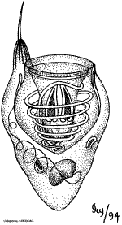
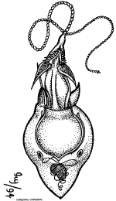
When is a jellyfish like a honey bee?
Nematocysts: More firearm than syringe?
Study sequenced mediterrean jellyfish, Rhopilema nomadica venom.
Identifed unique mechanical process of venom translocation.
Polypeptide lysis of cells
Neurotoxic effects
Affect neurotransmitters
Striking similarity to Gila monster venom
(Lotan, et al.: 1996)

Slide 8
Citations
Kozloff, E. Seashore Life of the Northern Pacific Coast. 1993. Seattle: University of
Washington Press.
Lotan, A., L. Fishman, and E. Zlotkin. 1996. Toxin compartmentation and delivery in the cnidaria: The nematocyst’s tubule as a multiheaded poisonous arrow. Comparative Physiology and Biochemistry. 275:444-451.
Margulis, L., and K. Schwartz. 1998. Five Kingdoms: An illustrated guide to the phyla of life on Earth. New York: Holt.
University of California, Irvine. April 2, 2006. Cnidaria home page.
http://tolweb.org/Cnidaria/2461/1997.04.24 in The Tree of Life Web Project,
http://tolweb.org/
University of Ottawa. April 1, 2006. Cnidarian information page. http://biodidac.bio.uottawa.ca

