Slide 1
ME 355 Introduction to Manufacturing Processes
Junlan Wang
Winter 2015

Slide 2
General Terminology
Manufacturing
Concurrent Engineering
Design for Manufacturing, Assembly, Disassembly, Service
Green Design, Sustainable Manufacturing, Product Life Cycle
Materials Selection, Process Selection
Computer Integrated Manufacturing
Lean Production, Agile Manufacturing
Quality Control, Total Quality Assurance
Manufacturing Cost, Global Competitiveness

Slide 3
Manufacturing
The process of converting raw materials into products; encompasses the deign and manufacturing of goods using various production methods and techniques.
~ came from Latin “manu factus” – made by hand
Interchangeably used with “production”
Manufactured item has monetary worth (added value) than raw materials
Manufacturing is closely linked to national and global economy

Slide 4
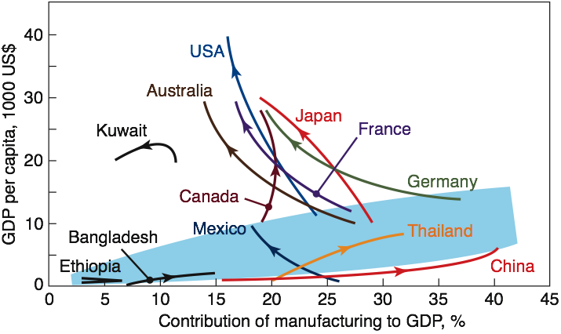
Importance of Manufacturing to Economy
Traditionally, higher % contribution of manufacturing, higher GDP
Exceptions:
Nations with natural resources have higher living standards
Nations with higher GDP have economic activity concentrated on high value-added products, e.g, airplanes, automobiles, electronics.
Labor intensive manufacturing is associated with countries who follow the traditional trend.
Source: After J.A. Schey with data from the World Development Report, World Bank, various years.

Slide 5
Concurrent Engineering
~ Simultaneous Engineering
A systematic approach integrating the design and manufacture of the products with the view toward optimizing all elements involved in the life cycle of the product
Basic goal
Minimize design and manufacture changes
Minimize time and cost in taking the product from conceptual design to production and introduction of the product to market
Key to success:
Full support of an organization’s top management
Multifunctional and interacting work team, including support groups
Utilization of all available state-of-the-art technologies

Slide 6
Design for Manufacture, Assembly, Disassembly, and Service
Each part or component of a product must be designed to not only meets design requirements and specifications, but also to be manufactured economically and with relative ease.
Product must be designed that individual parts can be assembled together with ease, speed, and minimum cost.
Product must also be designed so that disassembly is possible with relative ease and require little time, enabling the product to be taken apart for maintenance, servicing, or recycling of their components.
Product must be designed so that individual parts are easy to reach and service.
Notes:
Designs should be as simple as possible to manufacture, assembly, dissemble, service and recycle.
Materials should be chosen for their appropriate design and manufacturing characteristics as well as their service life.
Dimensional accuracy and surface finish specified should be as broad as permissible.
Secondary and finishing operations should be avoided or minimized to reduce cost.

Slide 7
Green Design, Sustainable Manufacturing, and Product Life Cycle
Green Design - Design for Recycling (DFR) - Design for Environment (DFE)
Sustainable Manufacturing
Reducing waste of materials at their source by refinement in product design and the amount of materials used
Reducing the use of hazardous materials in products and processes
Ensuring proper handling and disposal of all waste
Improving waste treatment and recycling and reuse of materials
Product Life Cycle (PLC)
Product development
Market Introduction
Growth
Maturation
Decline
Notes:
Green design – environmentally safe and friendly

Slide 8
Materials Selection
Materials used in today’s manufacturing
Metals
Ferrous metals: carbon steels, alloy steels, stainless steels, and tool and die steels
Nonferrous metals and alloys: Al, Mg, Cu, Ni, superalloys, Ti, refractory metals (Mb, Nb, W, Ta), beryllium, Zr, low melting alloys (lead, zinc and tin), and precious metals
Plastics: Thermosets, thermoplastics, and elastomers
Ceramics: Glass ceramics, glasses, graphite, and diamond
Composites: Reinforced plastics, metal-matrix and ceramics-matrix composites, and honeycomb structures
Nanomaterials, shape-memory alloys, metal foams, amorphous alloys, super conductors and semiconductors
Material properties: mechanical, physical, chemical, manufacturing
Cost and availability, Service life and recycling

Slide 9
Manufacturing Process Selection
Categories of manufacturing processes
Casting: expandable molding and permanent molding
Forming and shaping: rolling, forging, extrusion, drawing, sheet forming, powder metallurgy and molding
Machining: turning, boring, drilling, milling, planing, shaping, broaching, grinding, ultrasonic machining; chemical, electrical, and electrochemical machining and high energy electron beam machining
Joining: welding, brazing, soldering, diffusion bonding, adhesive bonding and mechanical joining
Micro and nano manufacturing: surface micromachining, dry and wet etching, and electroforming
Finishing: honing, lapping, polishing, burnishing, deburring, surface treating, coating and plating
Factors affecting process selection
Component/part shape
Materials characteristics – castability, formability, machinability, weldability, etc
Part size and dimensional accuracy
Manufacturing and operational cost

Slide 10
Computer Integrated Manufacturing
CIM applications
Control and optimization of manufacturing process
Materials handling
Assembly
Automated inspection and testing of products
Inventory control
Management
Advantages
Improved responsiveness
Better use of materials, machinery and personnel, reduction in inventory
Better control of production and management
Manufacturing high-quality at low-cost

Slide 11
Lean Production and Agile Manufacturing
Lean Production (~lean manufacturing): a manufacturing practice that considers the expenditure of resources for any goals other than creating values for the end customer as wasteful, thus a target for elimination
A major assessment of each activity of a company regarding the efficiency and effectiveness of its operations (company operation)
The efficiency of the machinery and equipment used in the operation while maintaining and improving quality (equipment)
The number of personnel involved in a particular operation (personnel)
A thorough analysis in order to reduce the cost of each activity, including both productive and nonproductive labor (activity cost effectiveness)
Goal: continuously improving the efficiency and profitability by reducing all types of waste from its operation (“0”-base waste) and dealing with problems asap.
Agile Manufacturing
Ensuring flexibility (agility) in the manufacturing enterprise so that it can quickly respond to changes in product variety and demand, and customer needs
To be achieved through
Machines and equipment with Built-in flexibility (reconfigurable machines) using modular components that can be arranged and rearranged in different ways
Advanced computer hardware and software
Reduced changeover time and implementing advanced communication systems.

Slide 12
Quality Assurance and Total Quality Management
Product quality affects marketability and customer satisfaction
Quality Assurance (QA) is now part of the concurrent engineering process and is built into every stage of the manufacturing process
Total Quality Management (TQM) and QA are the responsibility of everyone involved in the design and manufacturing of a product
Product liability – consequence of using a product that has malfunctioned, causing bodily injury, or even death, and the financial loss to a person as well as the organization manufacturing the product.

Slide 13
Manufacturing Cost and Global Competitiveness
Manufacturing cost
~40% of product selling price
Includes cost of materials, tooling and labor, as well fixed and capital costs
Can be minimized by optimizing design, least cost material, while maintaining the intended function and characteristics, and materials substitution.
Global competitiveness impacts manufacturing
Markets become multinational and dynamic
Demand for high-quality, low-cost and timely delivery
Increased product variety, complexity and shorter product life cycle
Wide disparity in manufacturing labor cost leads to outsourcing
Outsourcing – a practice of taking internal company activities and paying outside firm to perform them.
Notes:
Other costs:
Marketing and selling
Operation expenses to own and run the business (labor, renting….)
Cost of borrowing money (debt service cost)
Salary of owner and manager
A return on the capital you and any other owners or shareholders have invested.
Capital for future expansion and replacement of fixed assets as they age.
U.S. profits from sales of the $499 iPad may be more than 20 times greater than the cost of Chinese labor for assembling the device, according to a 2011 study cited by the NSF. The U.S. share of the value pie for iPhone sales is even bigger — more than 30 times greater than China's labor costs.
The iPad value difference translates into a $162 value for the U.S. compared with an $8 value for China. The estimated value of each country's share comes from researchers at the University of California, Berkeley, and Syracuse University in New York.

Slide 14
General Trend in Manufacturing
Better Materials
Better control of composition, purity, and defects to enhance their overall properties, manufacturing characteristics, reliability, and service life while keeping cost low
Better recyclability, and higher strength-, stiffness-to-weight ratio materials due to concerns over energy and material saving
Better tool, die and mold materials with better resistance to process variable, thus higher efficiency and economics of manufacturing processes
Improved efficiency and reliability of all manufacturing processes, equipment and systems due to continuing development in computers, controls, industrial robots, automated inspection, handling and assembly, and sensor technology

Slide 15
Summary
Manufacturing and its importance to economy
Concurrent Engineering
Design for Manufacturing, Assembly, Disassembly, Service
Green Design, Sustainable Manufacturing, Product Life Cycle
Materials Selection, Process Selection
Computer Integrated Manufacturing
Lean Production, Agile Manufacturing
Quality Control, Total Quality Assurance
Manufacturing Cost, Global Competitiveness, Outsourcing

Slide 16
Pop Quiz
One one-plot, draw engineering stress-strain curve and true stress- strain curve of a ductile metal (e.g., Al)
Label Young’s modulus, ultimate tensile strength, toughness, yield strength
Answer:
How does temperature affect the strength of a metal?
How does the strain rate affect the strength of a metal?

Slide 17
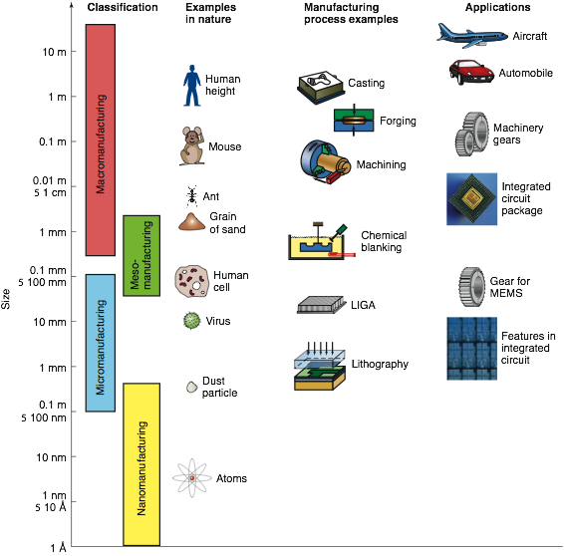
Factors affecting Process Selection
Component/part shape
Materials characteristics – castability, formability, machinability, weldability, etc
Part size and dimensional accuracy
Manufacturing and operational cost
FIGURE 1.7 Illustration of the range of common sizes of parts and the capabilities of manufacturing processes in producing these parts.

Slide 18
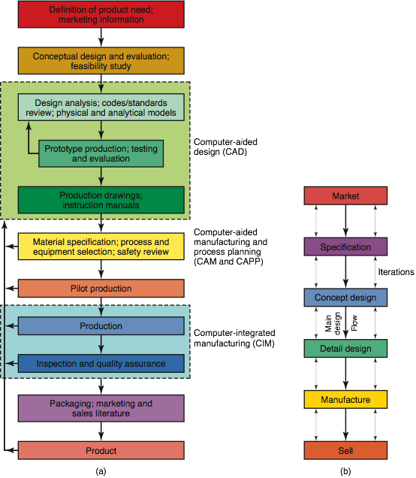
Concurrent Engineering
Sequential Process
Design ->Manufacturing
Waste resource, waste time
Concurrent Process
All disciplines are involved in the earliest stages of product design
Progress concurrently so iterations results in less wasted effort and time
Key to success: well-recognized communication among and within disciplines
FIGURE 1.3 (a) Chart showing various steps involved in designing and manufacturing a product. Depending on the complexity of the product and the type of materials used, the time span between the original concept and the marketing of a product may range from a few months to many years. (b) Chart showing general product flow, from market analysis to selling the product, and depicting concurrent engineering. Source: After S. Pugh.

Slide 19
Survey Results on Prior Manufacturing Experience
15 students – good amount of experience
Processes: casting/molding, CNC machining, Welding, cutting, drilling, waterjet …
Jobs/interns at industry
School teams/home projects: FSAE, UWHPS, high school robotics ….
Materials: wood, metals, composites, plastics…
…..
20 students – some limited machine shop experience
7 students – some experience with wood working
20 students – no experience

