Slide 1
Publication notes

Slide 2
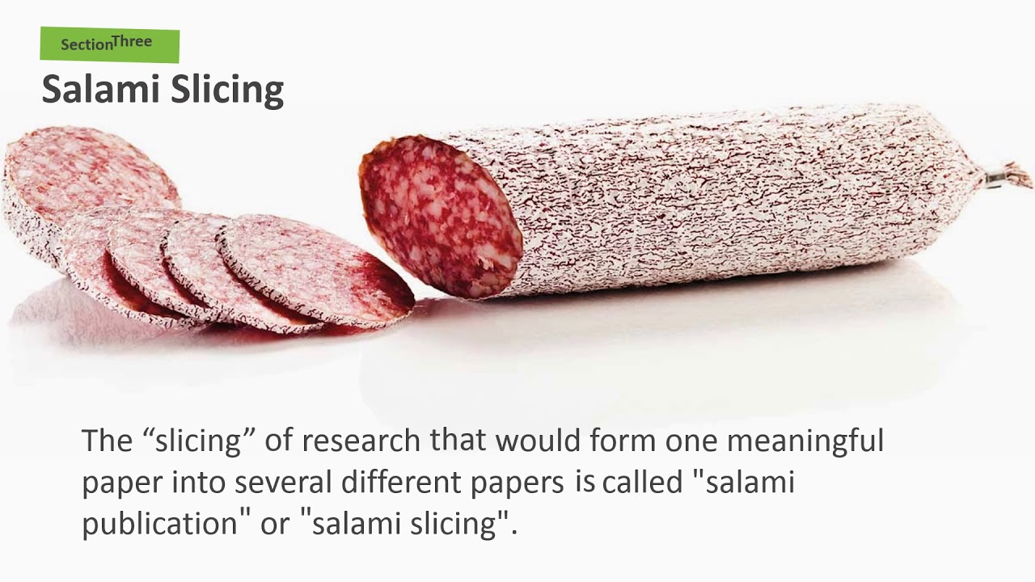
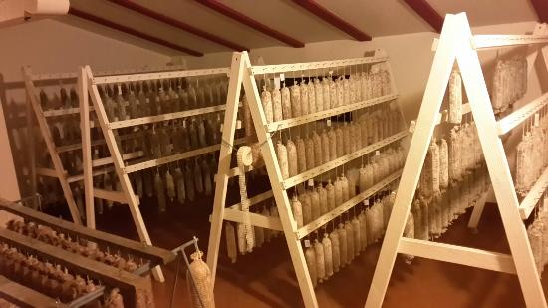
When to publish
Complete data set that answers an open question or provides a new hypothesis.
Extremes to avoid:
Salami slicing – splitting an otherwise complete scientific body of work into several less complete publications
$↓$ impact but $↑$ publications
Hoarding – holding off on publishing anything novel to strive for higher impact
PI should know when to stop and publish

Slide 3
Assembling a manuscript
1) Make sure all data analysis is complete
Look over it with a critical eye
Otherwise you’ll keep remaking figures
2) Write the methods
Details behind each method
Be extensive in detail, this will get trimmed down later
Do this early so you don’t have to rummage for experimental details later
3) Prepare figures and tables
May require some additional (supporting/supplementary) items
Keep figures so they can easily be adjusted later
Recolor, resize, change labels & font
Vector art (illustrator)
4) Write up results
all centered around the prepared figures

Slide 4
Assembling a manuscript
5) Write the discussion
Gather all necessary references to put data into context
Sometimes results/discussions are combined
Include any unresolved questions & suggestions for next steps
6) Write the introduction
Usually the hardest part
Can use a recent similar papers for an idea of the outline
Gather all necessary references
Use a citation manager (Endnote, Mendeley, Papers) compatible with Word.
7) Write the abstract
Should make the case for why the paper is important
Without overselling it

Slide 5
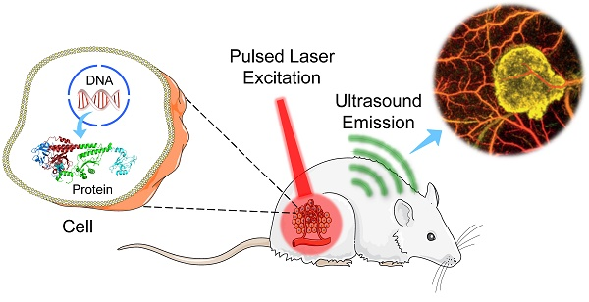
Assembling a manuscript
8) Write the acknowledgements
Materials provided, useful discussions, staff support
All sources of funding
9) Finalize authorship & order
Any co-authors
Write up author contributions (often required)
10) Some journals require table of contents figure (TOC)
High resolution with color
Minimal text
Can be a trimmed version of a main figure

Slide 6
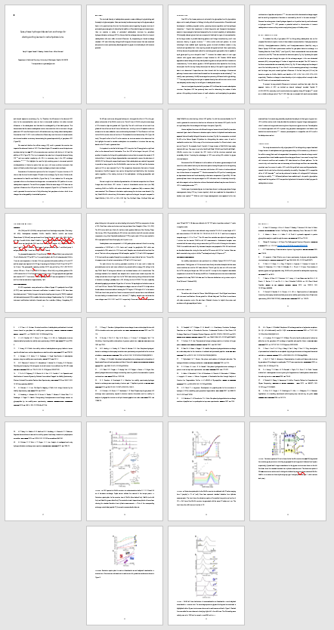
Assembling a manuscript
Cover page with title, authors and affiliations
Abstract page
Manuscript
Introduction
Materials/methods
Results
Discussion
Conclusions (optional)
Acknowledgements
References (formatted to journal guidelines)
Figures & legends

Slide 7
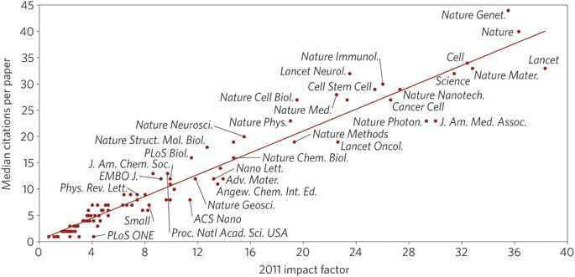
Finding an appropriate journal
Impact factor
How is this calculated
IF is a bit controversial
Suitability for journal
Online tool for journal selection: http://jane.biosemantics.org/
Length/scope
If you have the time then aim high.
Reviews can take months

Slide 8
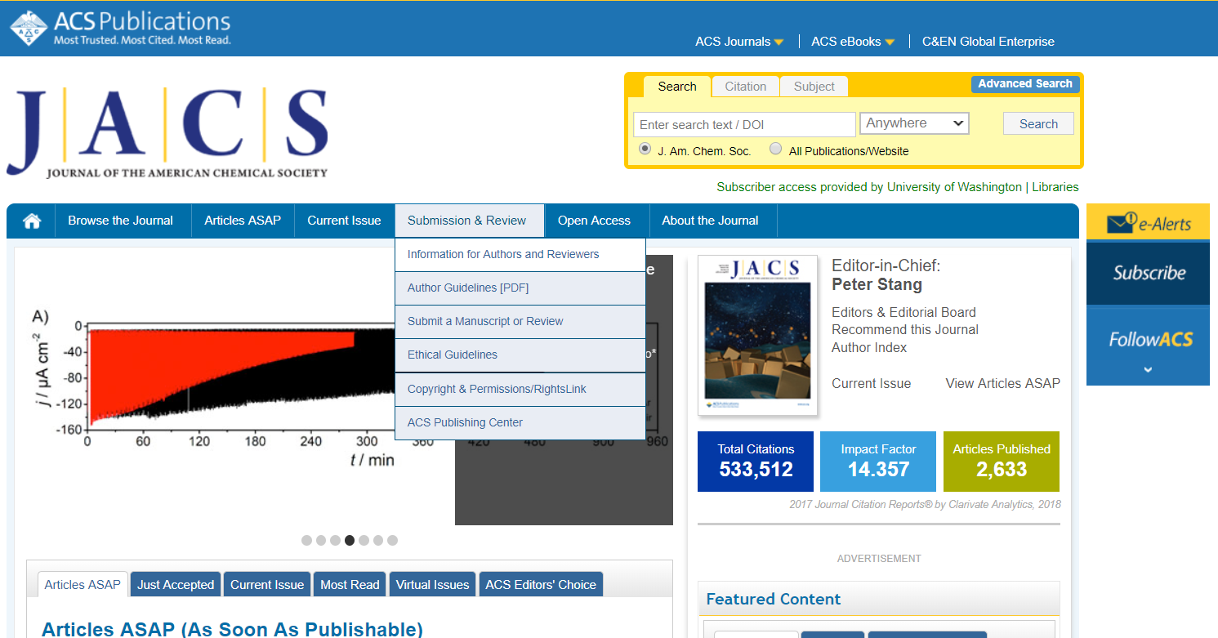
Formatting for a specific journal
Find the author guidelines section on the journal’s website.
Info on:
Page/character limits
Figure limits and sizes
Reference formatting
Formatting of supporting/supplementary information

Slide 9
Optional: Presubmission inquiry
High tier journals suggest (and sometimes require) a presubmission inquiry
Brief summary of the work, how it is a significant advance, and why this journal
Often they just delay the process
Takes just as long to get a response as if the paper was submitted for initial consideration
Sometimes they ask for the full paper and reject it then
Only saves time in terms of potentially reformatting the length, figures, and references.

Slide 10
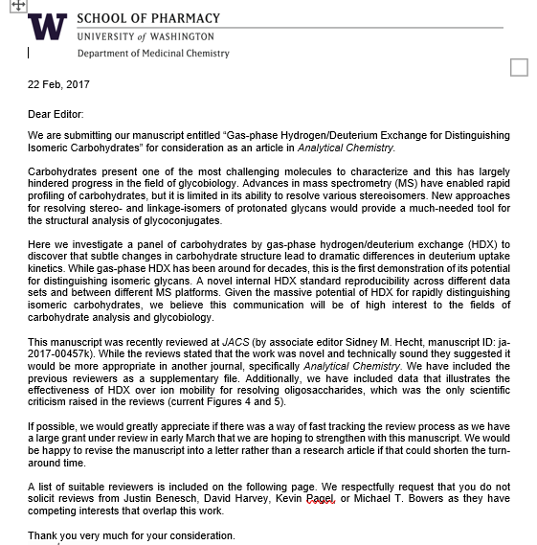
Cover letter
Introduce the study
What is the impact/significance/novelty
Why this journal
Opportunity for clarifying:
Previous publication attempts
Any potential parallel publications
Specific notes on reviewers (exclusions)
Can address to a specific editor

Slide 11
Selection of potential reviewers
Suggested:
Know the field and understand the experimental methods
Not a collaborator or scientific relative
Usually suggest at least 4, but more can help speed thing up
Some that know the methods, some that know the system
With papers using many methods there may need to be several that can effectively rate the paper.
Ideally does not work on the same system
Is not a demanding perfectionist (requesting unrelated follow up experiments)
Exclude:
Anyone known to be a unfair reviewer or in direct competition
Anyone who’s work is slandered by the new findings

Slide 12
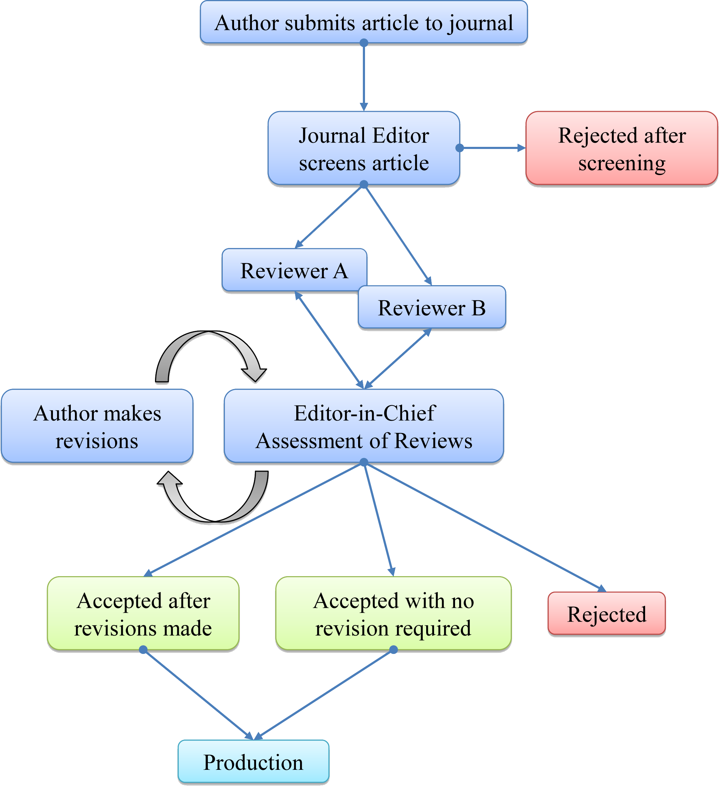
After manuscript submission
Editors:
Decide whether to consider submission or not
If not it can potentially get routed to a sister journal of the publishing group (~1 wk)
Is yes, then they have to find willing reviewers
Reviewers are given ~2 weeks to assess the manuscript
Editor pools the reviews and decides to:
Publish as is (almost never happens)
Request minor revisions (likely won’t need further review)
Request major revisions (will require further review)
Reject the submission
Appeals are possible, but are very rarely productive
Reviews:
Established faculty often won’t spend much time on reviewing and might outsource it to a student/fellow
They are given a two week deadline, but don’t get reviews back for a month.
What happens with mixed reviews?

Slide 13
The peer review process
What type of peer review does the journal use
Single blinded: reviewers anonymous
Double blinded: reviewers and authors anonymous
Open review: reviewers and authors all known and reviews are ultimately published
When to decline being a reviewer
Working in the same field or same topic
Won’t have time or effort to provide a thorough review
Look over the figures and read the results/discussion
Is this potentially interesting and does it look like quality work?
Are they claiming anything unsupported by the data?
Any of it already published? Usually run a brief search.
Look at methods and references
Did they cite the appropriate related articles
Are their methods sound and clearly described
Provide notes to the editor (authors won’t see)
E.g. methods are sounds, but I can’t judge the novelty, or vice versa.

Slide 14
Responding to reviews
Wait a day before writing responses
Reviews will nearly always upset the author
They usually misunderstand something “obvious” or request a useless revision/update
Thank the reviewers and placate their requests on minor things
You can probably get away with fixing 4 of the 5 things they request and make a case for keeping the 5th.
Include all details of what was updated
Including figure numbers, page numbers and lines of text
Here are some guidelines on putting together good responses:
https://journals.plos.org/ploscompbiol/article?id=10.1371/journal.pcbi.1005730
If anything is odd or suspect about the review then mention it in the cover letter to the editor during the revision submission.

Slide 15
Responding to reviews – round 2
If major revisions were requested
Usually gets sent to reviewers again
They have the option of wishing to see the revisions
If criticisms were addressed
Additional experiments conducted
Cannot ask for more additional experiments only minor revisions
If they missed something the 1st round then too bad.
But this is all ultimately up to the editor.

Slide 16
Galley Proofs
After the paper is accepted proofs arrive the month before it goes into print
Usually expect a very fast turn-around 24-48 hours.
Get all authors to inspect everything in the paper
Spelling errors, incorrect units (µM becomes mM)
Check all numbers, decimal places sometimes get shifted
Citations may be misnumbered
Major corrections usually not allowed at this stage.

Slide 17
Post-publication
Highlight
Short feature article to advertise the paper or place it into broader context
Comment
From another group finds an error or an alternative interpretation to correct something in the article.
Can be supportive or critical.
Addendum
If something needs to be corrected in a published article by the original authors/PI
Incorrect protocols, omitted details, corrected data
Retraction
Corrupted peer review
Fabricated/falsified data

Slide 18
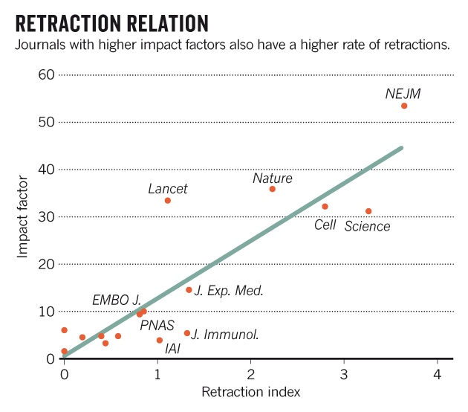
Retraction
Higher tier journals also have higher rates of retraction
More scrutiny?
More people doing follow up to reproduce work?
Authors taking shortcuts to get into top journals?

Slide 19
Can I use the same data for multiple papers?
The same figure: no.
Copyright & plagiarism issues are likely
The same data reformatted: maybe
To present a different argument
or
To serve as example data to support a finding other than the original
Example:
1) Comparative functional study of Protein A vs. B vs. C
2) In depth biophysical analysis of protein A
still uses some data from (1)
3) In depth biophysical characterization of protein B
uses A as a comparison from (2)

Slide 20
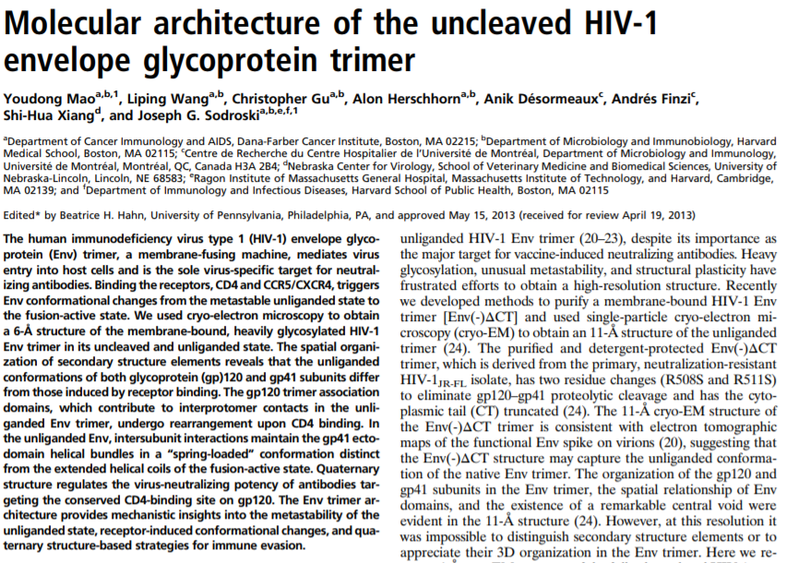
Some unique Journals
Proceeding of the national academy of sciences (PNAS)
Track 1
Editor’s review
“Communicated by”
“contributed by”
Track 2
True peer review
“edited by”

Slide 21
Open access journals
Public Library of Science (PLoS)
eLife
Pure open access as soon as articles are accepted.
PLoS One – reviews conclusions from data
Not prior dogma
↑ publication fees
Federally funded work gets open access 1 year after publication

