Slide 1
PyMOL basics

Slide 2
GUI overview
Top window
Commands
Bottom window
visualization

Slide 3
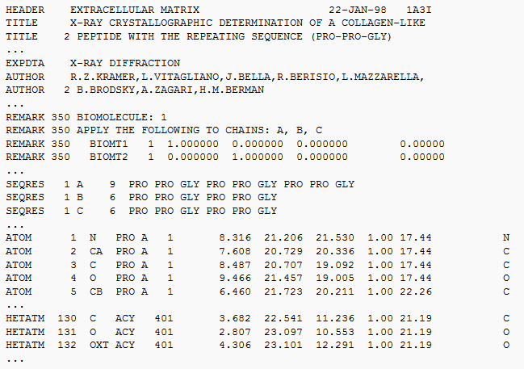
Opening a coordinate file
Protein databank (PDB)
Curated coordinate files
Download from pdb.org
or
Use fetch command
-> fetch 3ztn

Slide 4
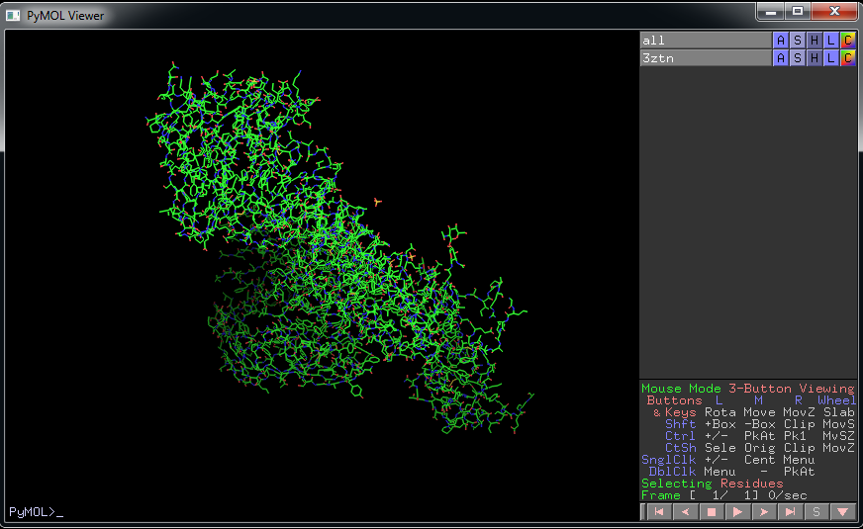
Visualization of coordinates
action
show
hide
label
color
Show sequence

Slide 5
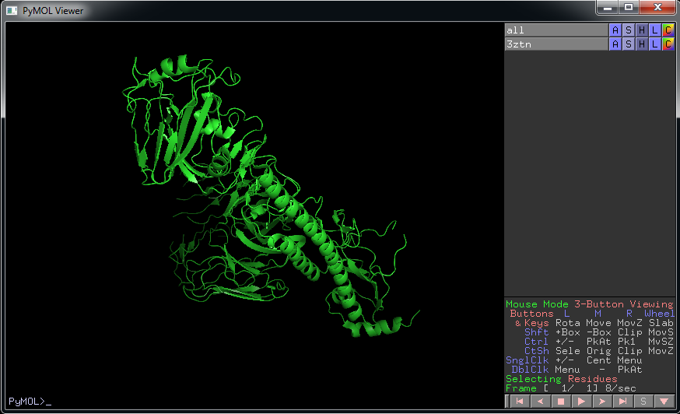
Visualization of coordinates
> hide all > show cartoon
action
show
hide
label
color

Slide 6
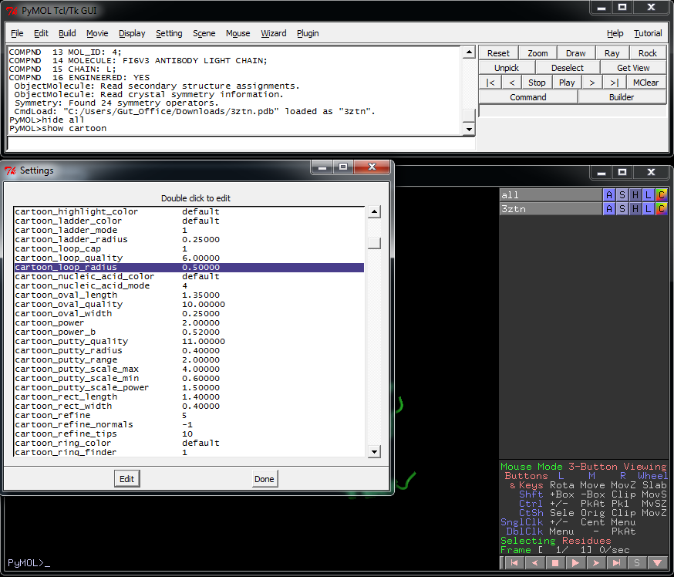
Visualization of coordinates
Can customize all visualization parameters
Menu: setting “Edit all…”
action
show
hide
label
color

Slide 7
Selecting sections of the coordinates
> Sele chain H + L
Selects all residues in chain H and L
> Sele resi 1-200
Selects residue numbers 1 to 200 for all chains
> Sele name n
Selects the backbone nitrogen for all residues
> Sele resn arg
Selects all residues named arg (ariginines)
> Sele chain H & resi 17 & name n
Selects only the backbone nitrogen on residue number 17 in chain H

Slide 8
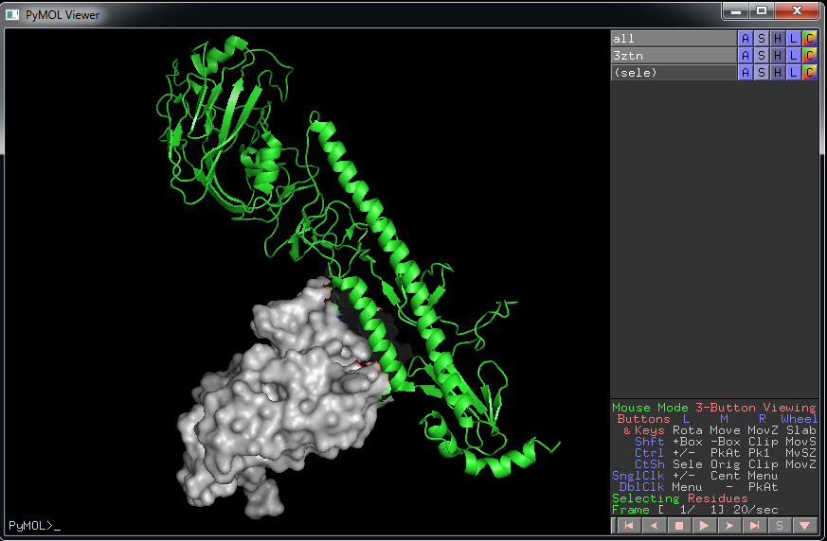
Showing protein complexes
Select H+L (the heavy and light chains of the Fab)
Hide cartoon on this selection
Show surface
Color light gray

Slide 9
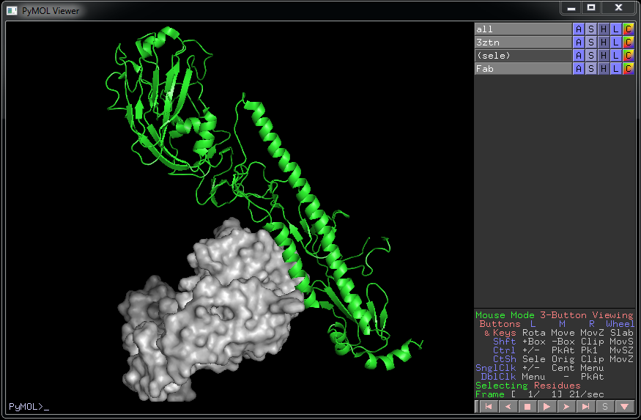
Showing protein complexes
> sele chain H+L > create Fab, sele
This creates a new object from just what was previously selected
You will have to hide the previously selected (Fab) portion of the 3ztn object

Slide 10
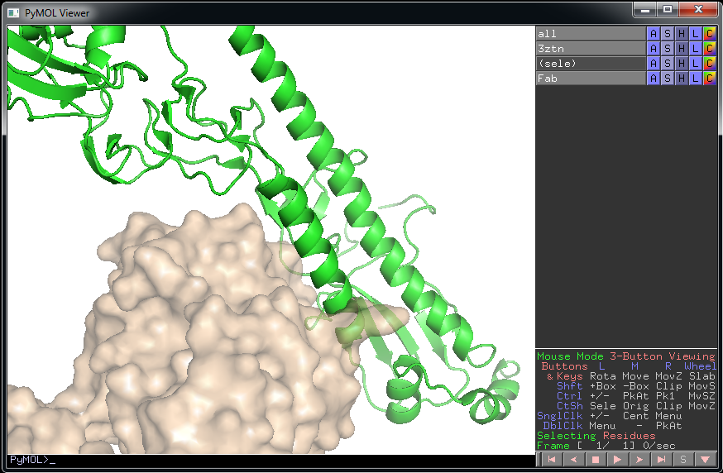
Showing protein complexes
> sele resi 43+46+50+53 & chain B
Select residues 53, 50, 46, 43 from chain B
For the selection: Show sticks, hide main chain

Slide 11
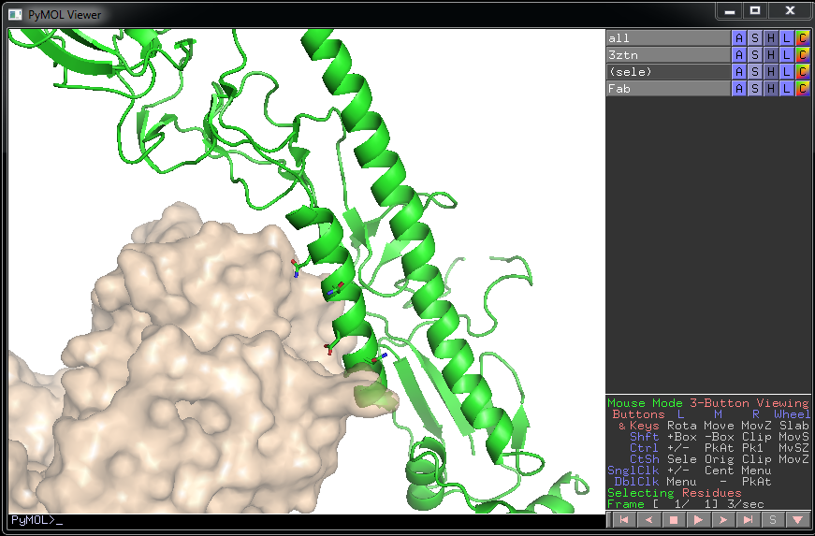
Showing protein complexes
> sele resi 43+46+50+53 & chain B
Select residues 53, 50, 46, 43 from chain B
For the selection: Show sticks, hide main chain

Slide 12
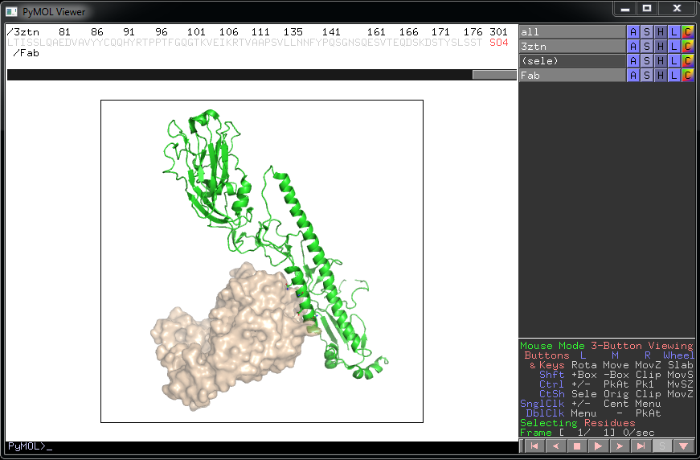
Export high resolution figures
Once you get the orientation and zoom as you like it
> get_view
This will print out a string that you can save and load back later using “set_view”
> ray 400, 400
Ray trace the image at 400 x 400 pixels
> draw 400, 00
Rasterize the image at 400 x 400 pixels
For quick checks I use 400x400
For publication figures 1200x1200 or more
For posters maybe even higher
Export using File: Save image
.png format

Slide 13
Basic PyMOL macros
You can assemble full sets of commands in a text editor (notepad)
To run from pymol use:
>@ test.pm
This macro basically does everything we did in one command.

