Slide 1
Data fitting using Excel

Slide 2
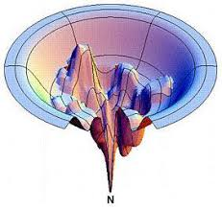
The Solver routine in Excel
Minimization of a function
Usually the sum of errors (Σchi²)
Different minimization algorithms
Brute force - tests all, very computationally heavy
Gets global mimima
Gradient descent – faster, but not as extensive
Gauss Newton & Levenberg–Marquardt
Local minima

Slide 3
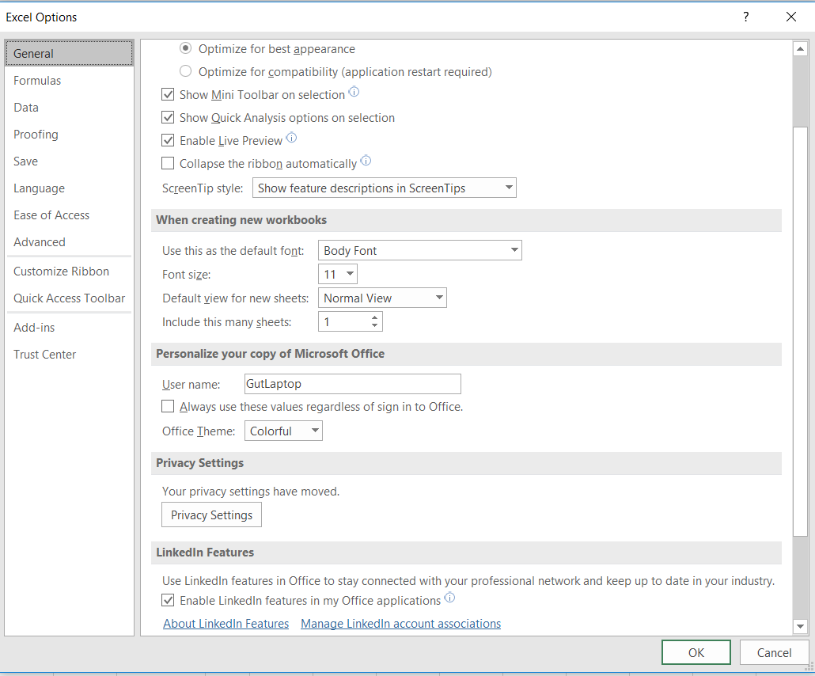
The Solver routine in Excel
Excel options
Add-ins
Solver feature (check)
This enables the solver function within the “data” ribbon in excel.
See excel sheet for example on fitting a single vs. double exponential function to data.

Slide 4
Commercial tools for incorporating statistics
https://statsolver.net/
Commercial
User friendly with documentation
https://www.freewebs.com/solverstat/solverstat/solverstat.htm
Free
Requires a little more work to install and setup for calculations

