Slide 1
Model selection and fitting
13 May 2019
Local UW resources for help with statistical analysis:
Here are two options for on-campus support regarding data analysis, visualization, and data science.
https://escience.washington.edu/office-hours/
https://www.stat.washington.edu/consulting/

Slide 2
Outline
Background
What is curve fitting?
How does it work?
Model selection and assessing fit quality
Goodness of fit parameters
Residuals as diagnostics
Fitting process and options
Constraints
Weights
Local vs. global fitting
Fitting software
GraphPad Prism demonstration

Slide 3
What is curve fitting?
EC50
1.96 ± 0.21 μM
13.3 ± 1.51 μM
Using a mathematical model to approximate an experimental dataset
Why bother to fit data?
Extract simple parameters from complex datasets
Quantitatively compare datasets

Slide 4
How does curve fitting work?
Choose some model (equation) and calculate parameter values that allow for best agreement between the data and the model
(Minimize the residual sum of squares)
$$Residual=Observed −Predicted$$
$$RSS= \sum{{(Observed −Predicted)}^{2}}$$
$$y=mx+b$$
Parameters to fit

Slide 5
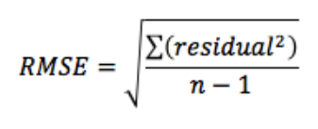
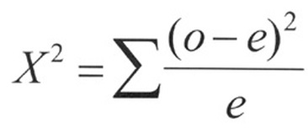
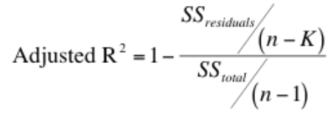
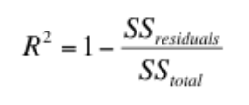
Assessing fit quality
Want to minimize differences between data and fit
Want to maximize R² (1 is max)
Adjusted R² more useful if comparing models with different number of parameters (R² will always increase when more parameters added)

Slide 6
Residuals as fit diagnostics
What are desirable features of the residual distribution?
Small residual values
Symmetrically distributed about zero (no systematic error)

Slide 7
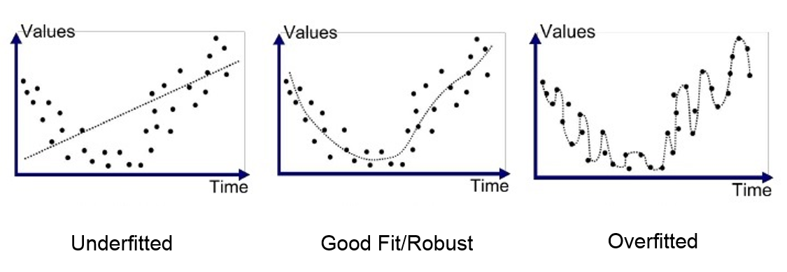
Choosing a model
High error,
simple model
Balance between
low error, simplicity
Low error,
complex model
What are the primary considerations when trying to decide between a set of models?
Simplest model possible -- fewest number of parameters
Lowest error possible -- best agreement with data
(Physiological or experimental relevance)
https://medium.com/greyatom/what-is-underfitting-and-overfitting-in-machine-learning-and-how-to-deal-with-it-6803a989c76

Slide 8
When to favor simplicity
$$y=a+bx$$
$$y=a+bx+cx^{2}$$
$$y=a+bx+cx^{2}+dx^{3}+ex^{4}$$
Overfitting
Using overly complex model with too many floating parameters
Fitting noise rather than the experimental phenomenon of interest
Relevance of extracted parameters becomes questionable

Slide 9
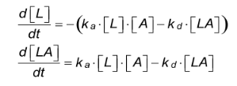
When to favor a more complex model
Free analyte
Immobilized ligand
One-to-one model
Bivalent analyte model
https://www.sprpages.nl/data-fitting/models

Slide 10
When to favor a more complex model
One-to-one model
Bivalent analyte model
χ² = 4.17
χ² = 0.36
Can experiment be re-designed to allow for simpler model?
→ Immobilize the antibody instead of the antigen

Slide 11
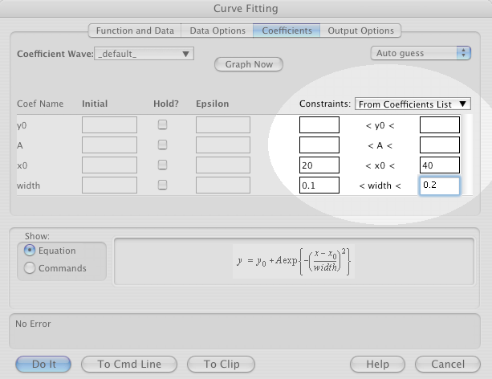
Constraining and fixing parameters
Fit parameters can be fixed to a known value or allowed to ‘float’ (with or without constraints)
Parameter constraints
Bounds for a parameter set prior to fitting
Based on mathematical or experimental limits
Examples?
Fixed parameters
Value known independently from other experiments
Fixing a parameter can increase confidence in fitted parameters
EC₅₀ and K_{D} > 0
https://www.wavemetrics.com/products/igorpro/dataanalysis/curvefitting/constraints

Slide 12
Weighting datapoints differently
Point has high error;
Weight it less in fit
Weighting can be used to emphasize those datapoints with less relative error
Common weighting methods:
Weight points by 1/Y²: When error is proportional to signal
Weight points by 1/SD²: When some points contain higher error
With multiple replicates, it is usually best to consider each replicate as a separate point (rather than fitting average and weighting by SD)

Slide 13
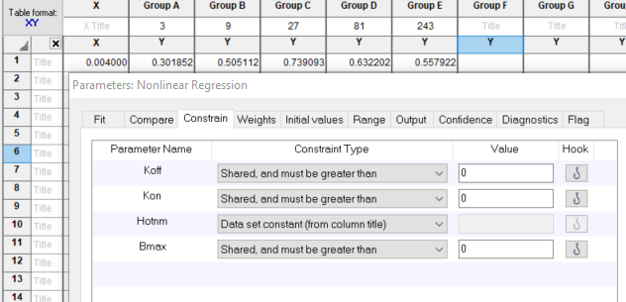
Local and global fitting
When fitting multiple datasets to the same model, some parameters can be globally fit (shared between datasets)
e.g. binding kinetics with different concentrations of ligand
Advantages of global fitting
Increased confidence in globally fit parameters
Parameter | Global value
k_{off} (s⁻¹) | 0.0784
k_{on} (M⁻¹s⁻¹) | 649000
B_{max} (mAU) | 101.2

Slide 14
Examples of fitting software
Prism: intuitive, many built-in functions
MATLAB, Mathematica: good for complex, custom models
R: statistical emphasis

Slide 15
Summary
Curve fitting allows for extraction of experimental parameters from datasets and facilitates data comparison
Curve fitting algorithms work by minimizing residuals
Goodness of fit can be assessed numerically using statistics and graphically using residual plots
Model selection should balance simplicity, error minimization, and experimental relevance
Appropriate constraints and weighting promote good fits
Global fitting increases confidence in shared parameters

Slide 16
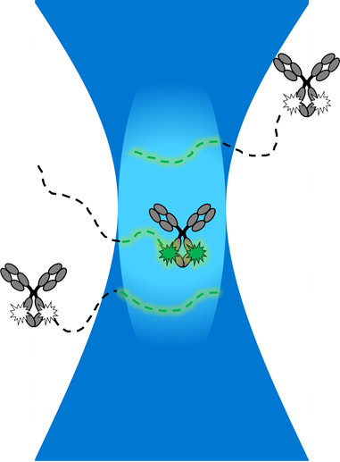
Demonstration: fitting FCS data
Fluorescence correlation spectroscopy
Monitor diffusion of fluorescently labeled particle as it moves across focal volume of confocal microscope
Most interested in the diffusion time (t_{d}) parameter, which is a measure of hydrodynamic radius
3-dimensional diffusion model:
$$G\left(τ\right)=\left(\frac{1}{N}\right)\left(\frac{1}{1+\frac{τ}{td}}\right){\left(\frac{1}{1+s^{2}\frac{τ}{td}}\right)}^{0.5}$$
N: average number of particles in focal volume
td: diffusion (residence) time
s: ratio of radial to axial dimensions
Independently known – fix the known value

Slide 17
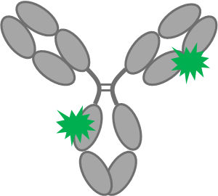
Free dye contamination
In the data, we are observing diffusion of labeled protein as well as diffusion of contaminating free dye
Two-component model
Alternative to more complex model:
Better sample cleanup
Observable species:
+
$$G\left(τ\right)=\left(\frac{1}{N1}\right)\left(\frac{1}{1+\frac{τ}{td1}}\right){\left(\frac{1}{1+s^{2}\frac{τ}{td1}}\right)}^{0.5}+\left(\frac{1}{N2}\right)\left(\frac{1}{1+\frac{τ}{td2}}\right){\left(\frac{1}{1+s^{2}\frac{τ}{td2}}\right)}^{0.5}$$
Now 5 parameters:
N1, N2, td1, td2, s

Slide 18
Initial values (‘first guesses’)
For floating parameters, an initial guess can be used to speed up the fit or increase chances of a successful fit
More important for complex models with many parameters
For a robust fit, the parameters should converge to the same values regardless of the initial values chosen

