Slide 1
Surviving MS DOS
When lost, google it

Slide 2
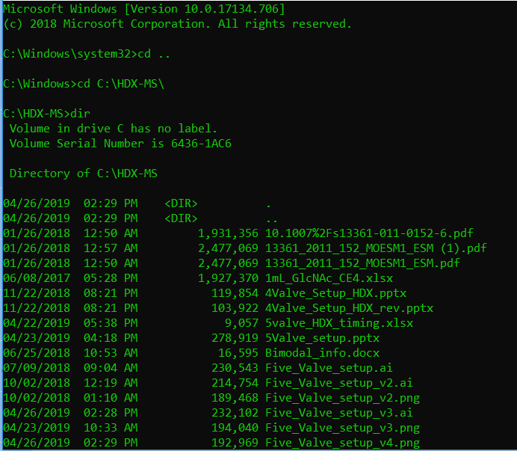
Navigating DOS
Type “cmd” into the windows start menu
If you need admin privileges then right click and select “run as administrator”
Be careful not to move/delete anything critical
Navigation is similar (not identical) to linux.
“cd” change directory
“copy”, “move”, etc
“dir” list files in directory

Slide 3
Why use DOS?
Catastrophic windows crashes
Command line execution:
Many custom programs need to be run as a command line
Execute a binary with flags
Binary – an compiled executable file
Flag - option
They generally can be run with a “-- help” flag to get a list of all the flags
“random.exe -input C:\temp\data.txt –output C:\temp\output.txt”
This executes random.exe and specifies data.txt as the input file, and output.txt as the output file.

