Slide 1
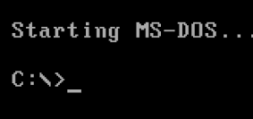
Linux is for people who want to know why it works.
Apple is for people who don’t want to know why it works.
DOS is for people who want to know why it doesn’t work.
Windows is for people who don’t want to know why it doesn’t work.

