Slide 1
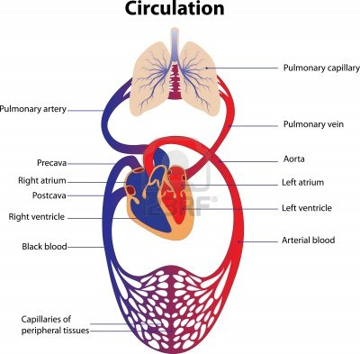
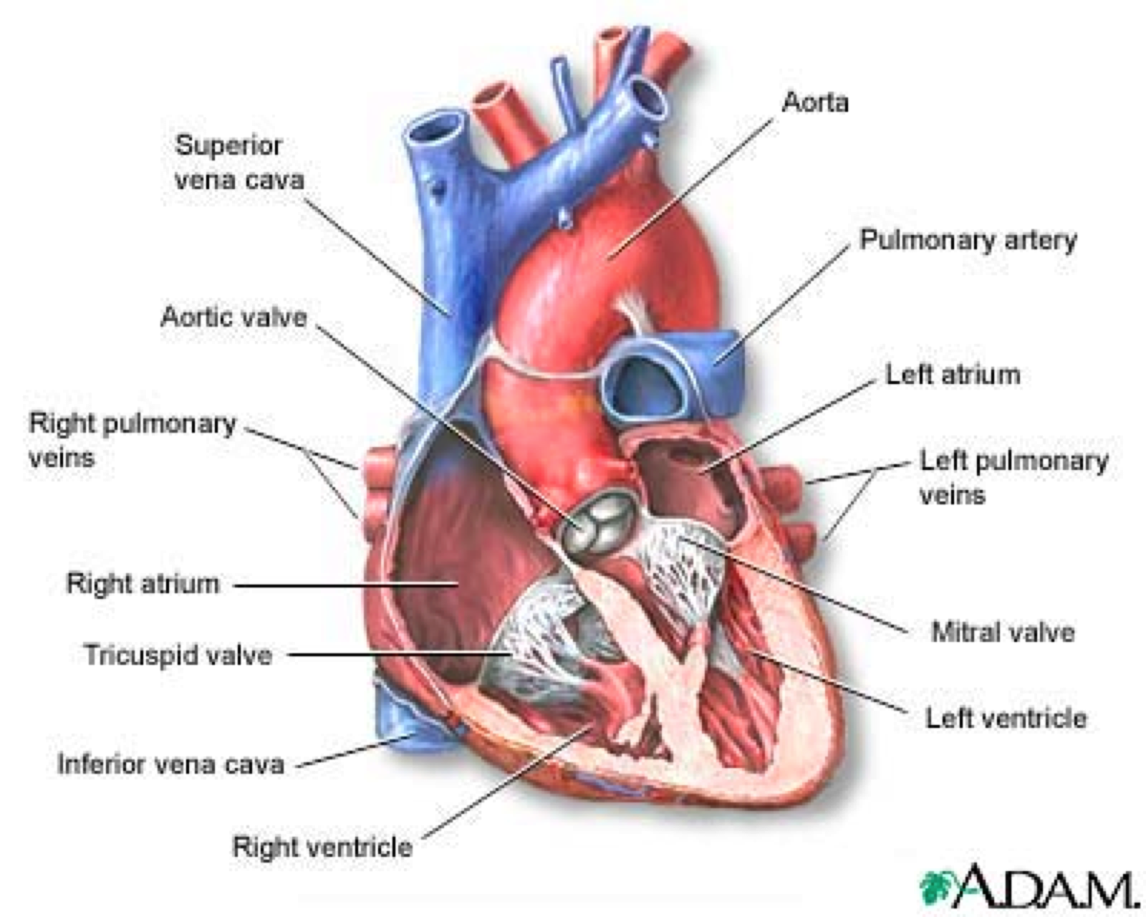
Primer on Cardiovascular Anatomy and Physiology
Lecture 1. Monday, March 30

Slide 2
Lecture 1. Sources and recommended reading
Conservation Laws | Chapter 1. Biomech-Circulation
Heart Anatomy | Chapter 2. Biomech-Circulation and Chapter 5. Biomech-Motion, flow, stress and growth.
Physiology of the Heart | Chapter 5. Biomech-Motion, flow, stress and growth. Chapter 2. Biomech-Circulation
Anatomy of the Vascular Vessels: the Arteries and Veins | Chapter 5. Biomech-Motion, flow, stress and growth. Chapter 5. Biomech-Circulation. Flow in Arteries and Veins. Notes.

Slide 3
Heart Anatomy
Skeletal-Muscle Cell (myocites)
Cardiomyocites (Heart Muscle Cells)

Slide 4
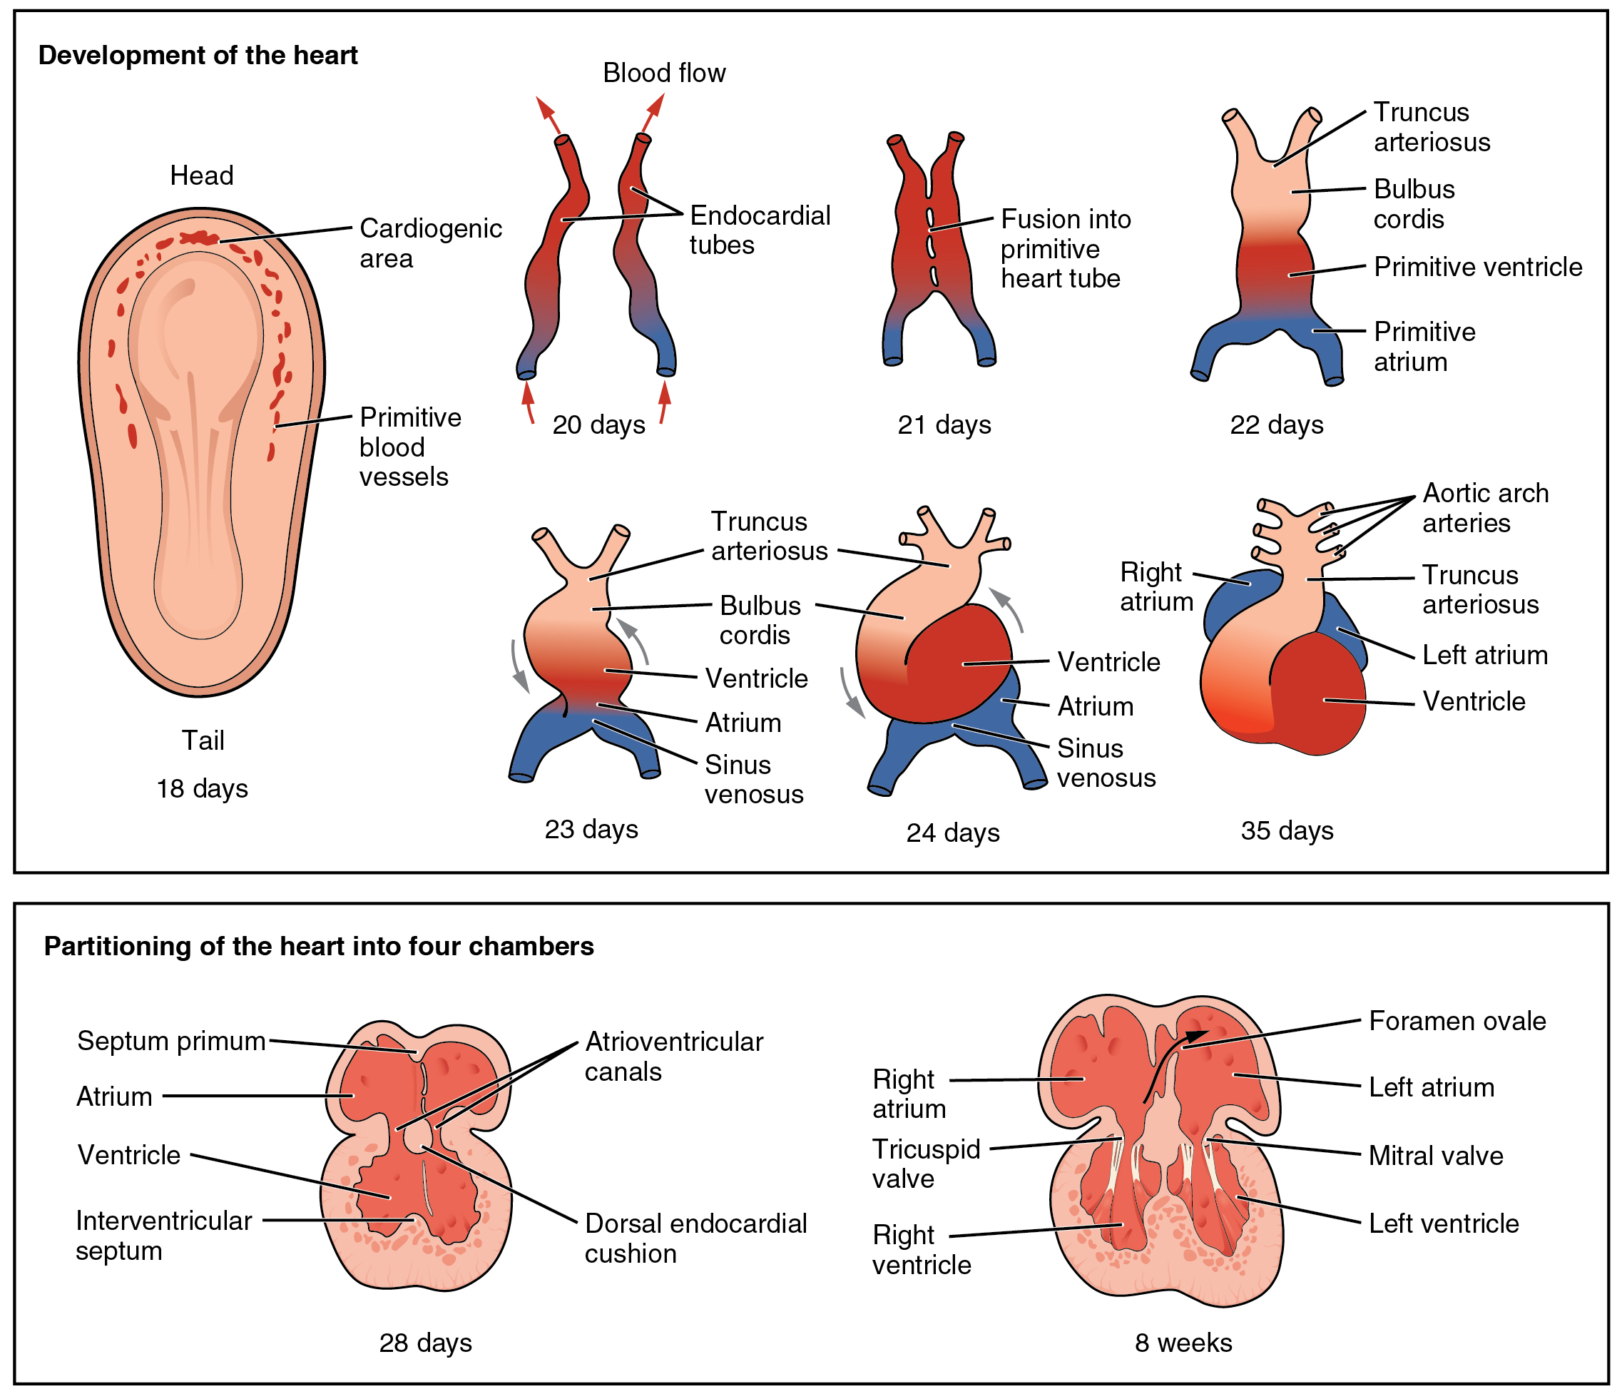
Heart Embryology
http://www.youtube.com/watch?v=5DIUk9IXUaI

Slide 5
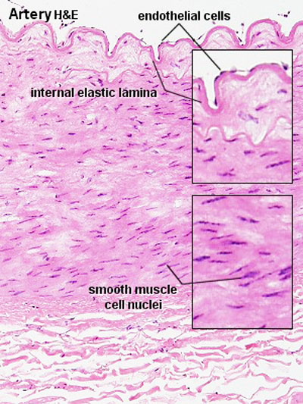
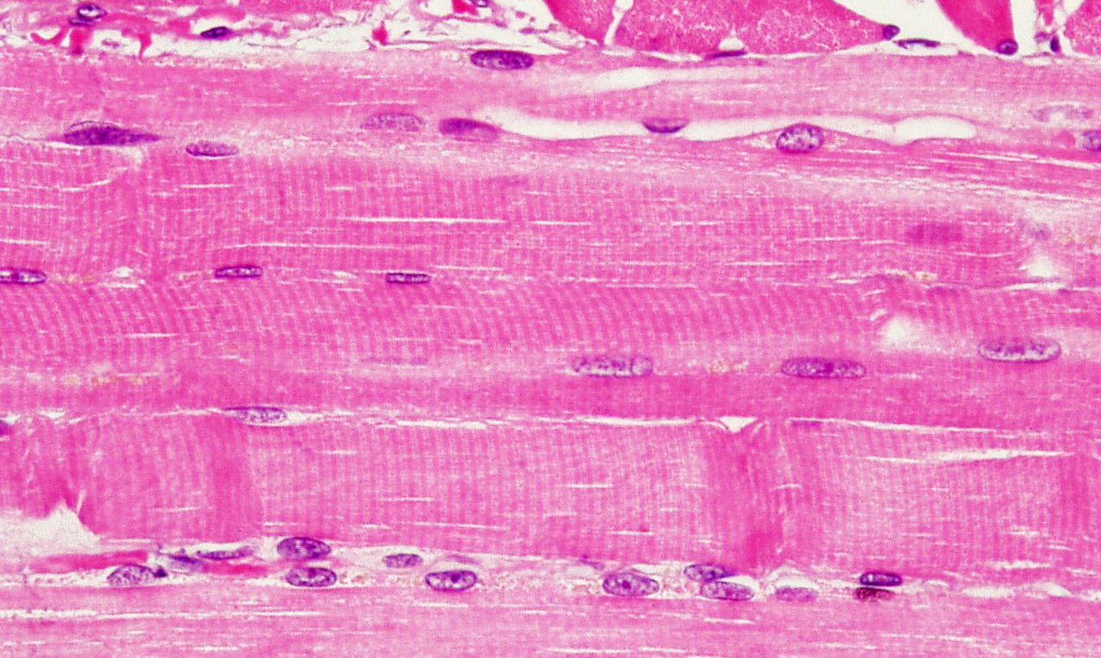
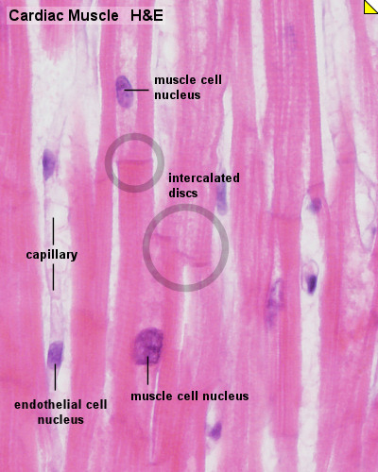
Heart Muscle Cells
Skeletal-Muscle Cell (myocites)
Smooth Muscle Cells
Vascular walls are only one of many locations in the body.
Cardiomyocites (Heart Muscle Cells)

Slide 6
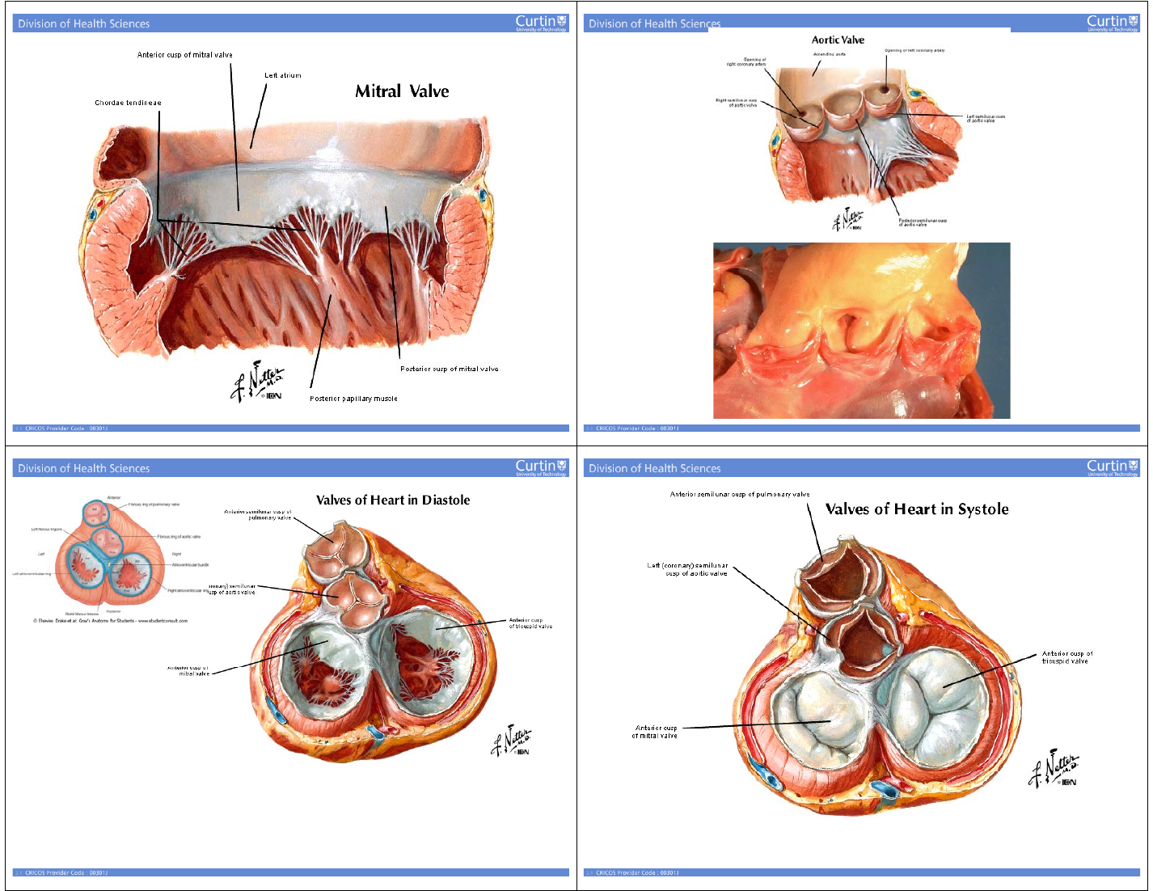
Heart Valve Anatomy
Wall Shear Stress averaged over the cardiac cycle

Slide 7
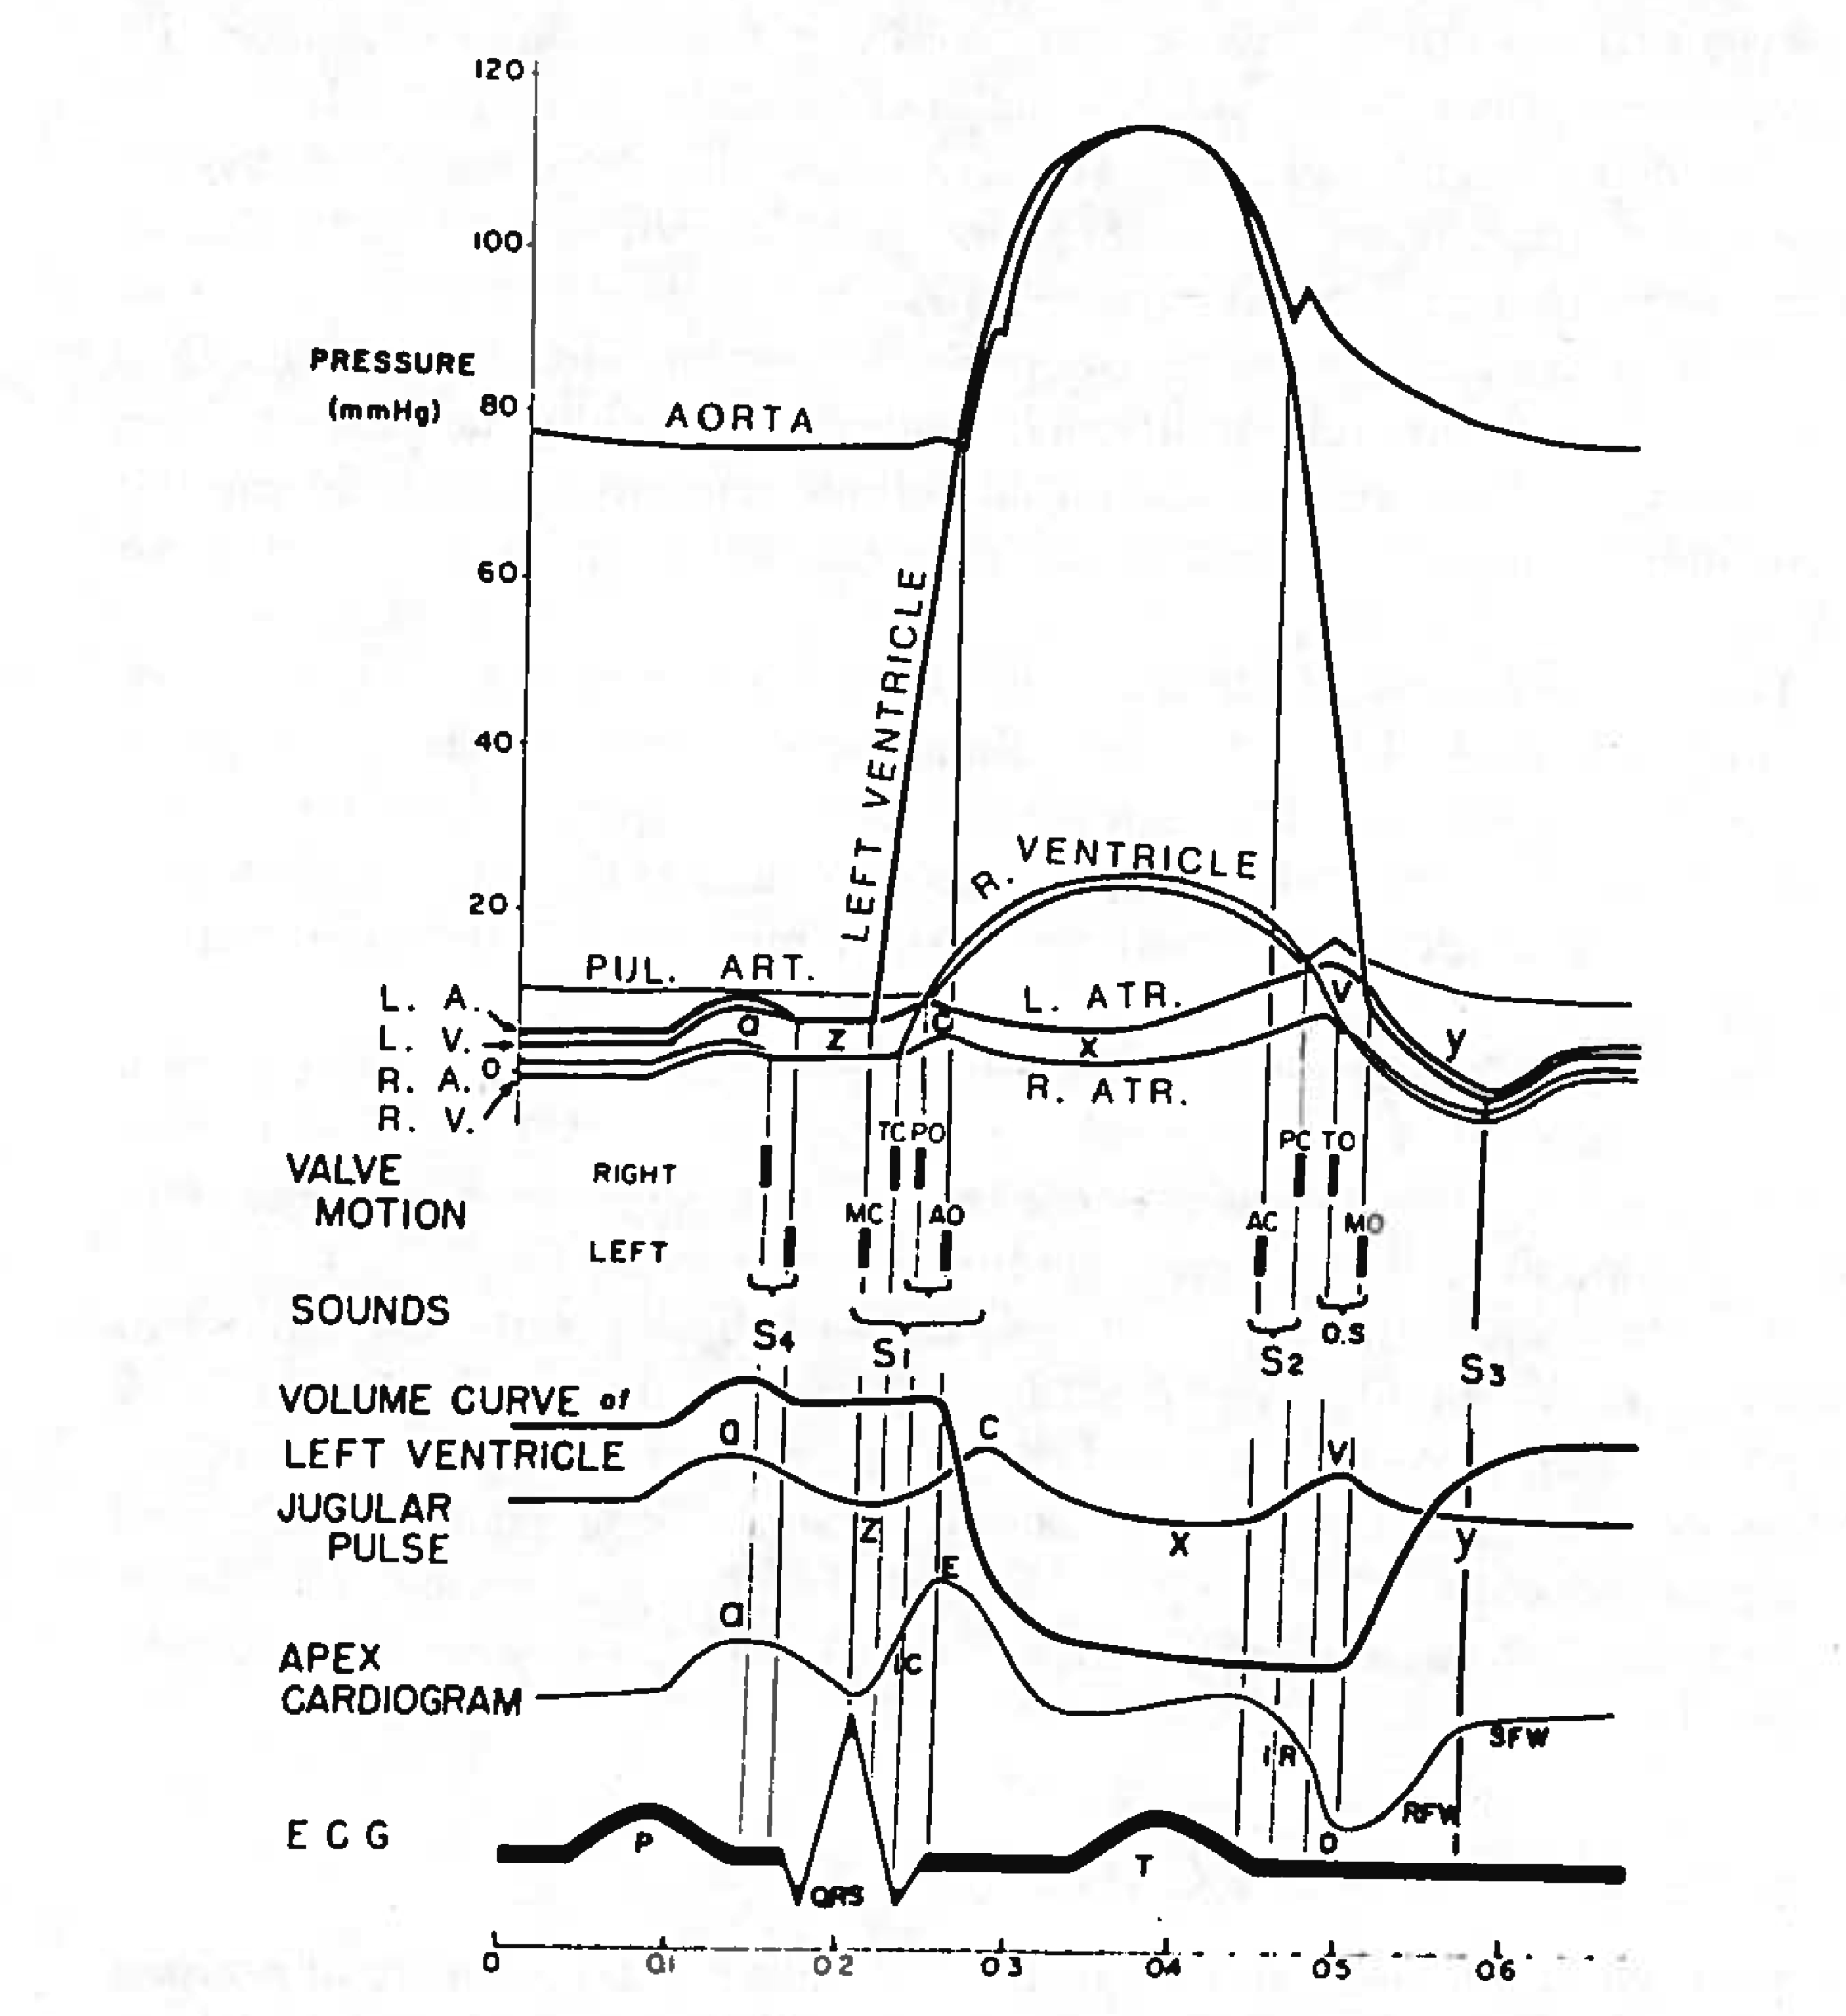
Heart Physiology

Slide 8
Heart Valve Anatomy

Slide 9
Heart Valve Anatomy

Slide 10
Mitral Valve Anatomy
Wall Shear Stress averaged over the cardiac cycle

Slide 11
Aortic Valve Anatomy

Slide 12
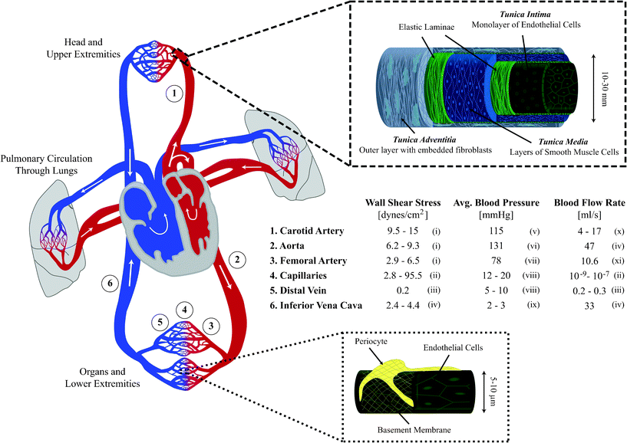
Systemic Circulation Anatomy
Instantaneous visualization of the Wall Shear Stress in an Arterio-Venous fistula.
Notice the oscillating stagnation point flow where the flow from the proximal artery impinges on the vein wall.
Instantaneous visualization of the vorticity (Q criterion) shedding from the anastomosis of an Arterio-Venous fistula
Wall Shear Stress averaged over the cardiac cycle

Slide 13
Arterial vs Venous Anatomy
Intima | Media | Adventitia
Endothelial Cells | Smooth Muscle Cells | Collagen Fibers
Basal Lamina Collagen sheets. | Elastin sheets | Ground Substances
Collagen bundles | Collagen bundles | Connective Tissue
Elastic fibrils | Network of Elastin bundles | Smooth Muscle Cells
Smooth Muscle Cells |  | Fibroblasts
Fibroblasts |  | Macrophages
 |  | Vasa Vasorum
 |  | Nerves: myelinated and non-myelinated

Slide 14
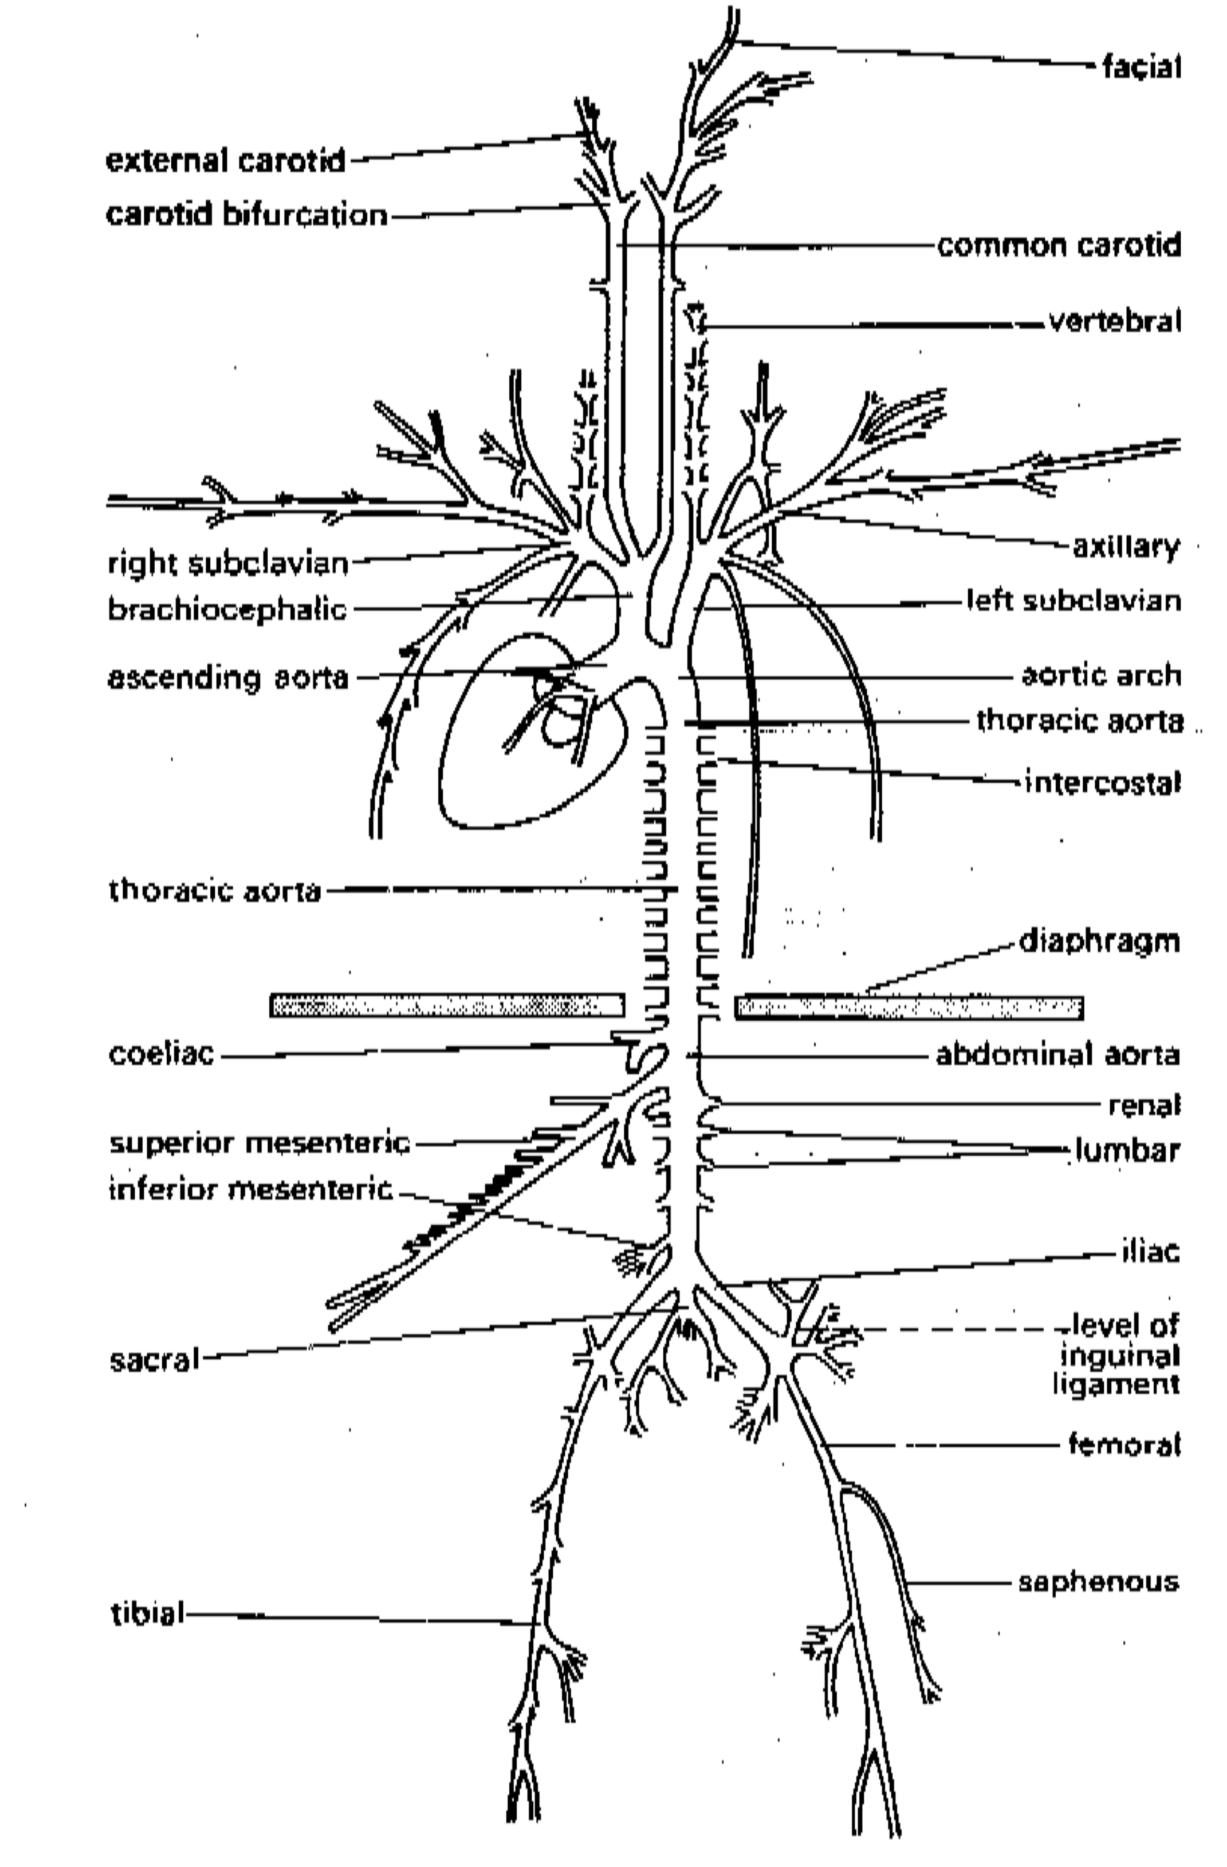
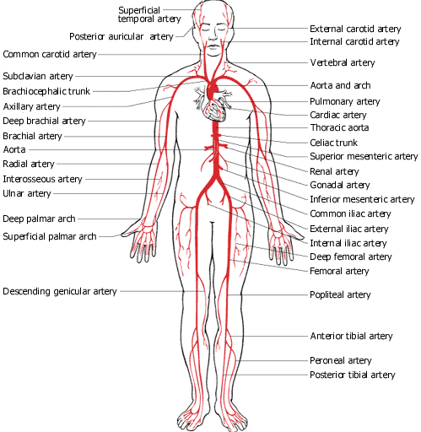
Human Vascular System: Major Arteries

Slide 15
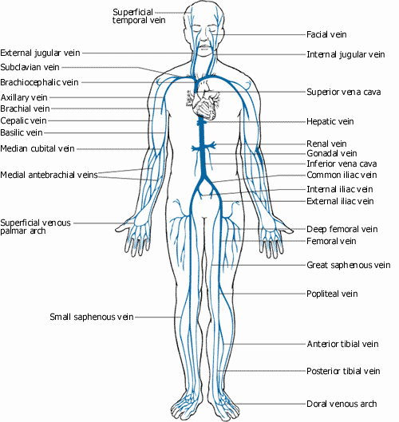
Human Vascular System: Major Veins

Slide 16
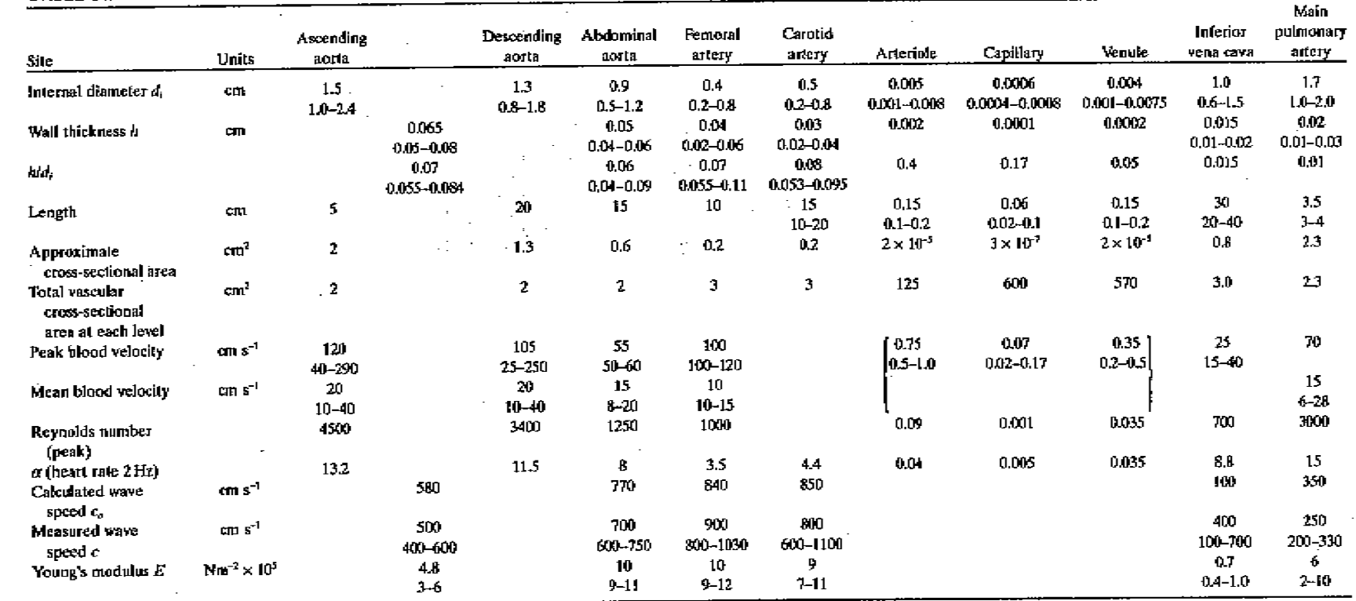
Typical Magnitude of flow parameters in Arteries and Veins

Slide 17
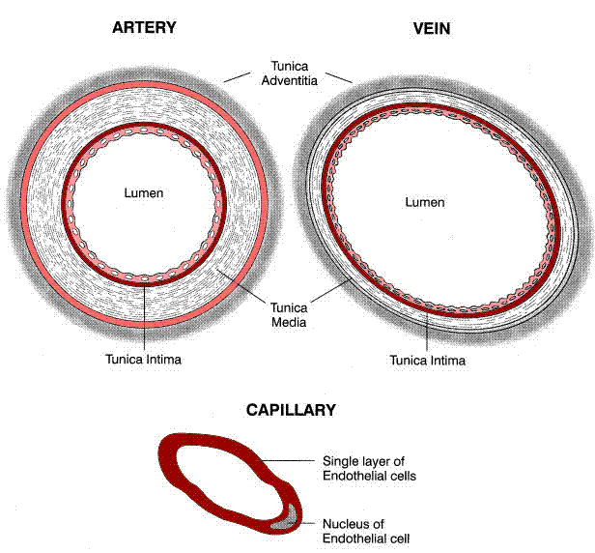
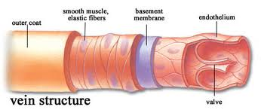
Arterial vs Venous Anatomy

Slide 18
Cardiovascular Fluid Mechanics
Recommended Reading Material:
1. “Biodynamics, Circulation”, Fung, Y. C. 1984, Springer-Verlag, New York.
2. “Biomechanics: Motion, Flow, Stress, & Growth”, Fung, Y. C. 1990. Springer-Verlag, New York.
3. “Biomechanics: Mechanical Properties of Living Tissue”, Fung, Y. C., 1993. 2nd edition. Springer-Verlag, New York.
4. “The Mechanics of the Circulation” Caro, C. G., Pedley, T. J., Schroter, R. C., Seed, W. A. 1978. Oxford Medical Publications, Oxford.
Recommended links:
http://www.aha.org

