Slide 1
Nutrient Needs: Part 1
Basis
Water
Energy
CHO, Fat, Protein

Slide 2
Objectives
Basis for nutritional recommendations
  Public health approach
  Indvidual needs
Influence on growth, development, and health throughout the life course
Specific Nutrients

Slide 3
Feeding Guidelines and Recommendations
Population health and policy
Individual health
    Optimal growth and development
    Prevention of Chronic Illness
    Safety

Slide 4
Public health vs individual
Prevalence of nutrient deficiencies
Balance incidence, burden, and treatment
  Eg: Vitamin K and hemorrhagic disease of newborn
Prevalence and evidence of chronic conditions associated with dietary practices
Etiology of nutrient deficiencies and/or chronic conditions
  Eg: allergy, obesity, anemia, dental caries,…

Slide 5
1940’s
Rickets (D)
Pellagra (Niacin)
Scurvy (C)
Beriberi (Thiamin)
Xeropthalmia (A)
Goiter (Iodine)

Slide 6

United Nations 5th report on World Nutrition: March 2004
Prevalence (%) | 1990 | 2005
underweight | 35.2 | 26.5
Iodine deficiency |  | 35.2

Slide 7
United Nations 5th report on World Nutrition: March 2004
Vitamin A deficiency
  140 million preschoolers
  7 million pregnant women
Iron Deficiency
  One of most prevalent
  4-5 billion affected
Reports in the U.S. of PEM, Ricketts, Zinc deficiency

Slide 8
Reports in US of PEM, Rickets, Zinc deficiencies

Slide 9
Causes
Nutrition ←-→ Disease
Access
Food
Health Care
Environment
Economics
Education

Slide 10
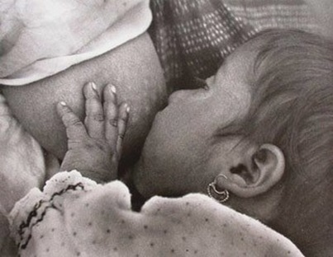
Nutrient Needs in Infancy
Nutrient needs in infancy reflects:
  Rates of growth
  Activity
  Basal needs
  Nutrient interactions
  Physiological and developmental progressions

Slide 11
Individual Requirements
  Genetics
  Adaptation
  Environment
  Behavior/activity
  Choices, access, resources
  other

Slide 12
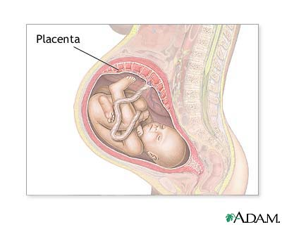
Nutrition: Growth, development and health throughout life course
Maternal-fetal interactions
Critical Periods
Genetics
Environment

Slide 13
Lifecourse theory
Complex interplay of biological, behavioral, psychological, social and environmental factors contribute to health outcomes across the course of a person’s life.
Early Programming model
Cummulative pathway model
Critical Periods

Slide 14
Programming by Early Diet
Exposures in early life influence future reproductive potential (intergenerational) and adult health outcomes
Nutrient composition in early diet may have long term effects on GI
function and metabolism
Animal models show that glucose and amino acid transport activities are programmed by composition of early diet
Animals weaned onto high CHO diet have higher rates of glucose absorption as adults compared to those weaned on high protein diet
Barker Hypothesis:
  Association between BMI and chronic disease: HTN and cardiovascular, SGA/IUGR

Slide 15
Cummulative Pathway Model
Chronic accommodation to stress results negatively impacts adaptive systems, leading to declining health and function overtime
Health is not a static phenomena.
Individual health takes on a trajectory that results from the cumulative influence of multiple risk and protective factors programmed into an individuals biobehavioral regulatory systems
Choices

Slide 16
Cochrane Review
Osborn et al: Formulas containing hydrolysed protein for prevention of allergy and food intolerance in infants 2006;18
Concluded that use of hydrolysed formula in non breastfed infants at risk for allergy (atopic dermatitis) for at least 4 months reduces the incidence of allergy.

Slide 17
Approaches to Estimating Nutrient Requirements
Direct experimental evidence (ie protein and amino acids)
extrapolation from experimental evidence relating to human subjects of other age groups or animal models
  ie thiamin--related to energy intake .3-.5 mg/1000 kcal
Breast milk as gold standard (average [] X usual intake)
Metabolic balance studies (ie protein, minerals)
Clinical Observation (eg: manufacturing errors B6, Cl)
Factorial approach
Population studies

Slide 18
Recommendations/guidelines
DRI: Dietary Reference Intakes
  AI
  UL
  EER
AAP
Bright Futures
Start Healthy feeding guidelines

Slide 19
American Academy of Pediatrics
Recommendations for Infant Feeding
Breastfeeding for full 1st year of life
  Supplement with Vitamin D & fluoride from birth
  Supplement with iron no later than 4-6 months of age
Commercial infant formula for full 1st year (if not breastfeeding)
  use iron fortified infant formula or iron supplement from birth & fluoride as indicated
Introduction of solid foods delayed until 6 mo of life
No cow’s milk in any form in the first year

Slide 20
DRI: Dietary Reference Intakes
  periodically revised recommendations (or guidelines) of the National Academy of Sciences
  quantitative estimates of nutrient intakes for planning and assessing diets for healthy people
AI: Adequate Intake
UL: Tolerable Upper Intake Level
EER: Estimated Energy Requirement

Slide 21
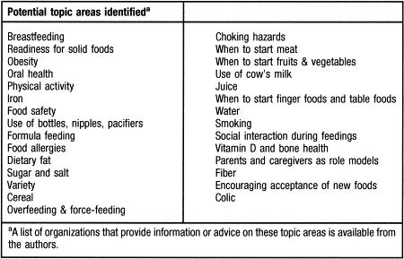
The Start Healthy Feeding Guidelines for Infants and Toddlers (JADA, 2004)

Slide 22
Bright Futures
AAP/HRSA/MCHB
http://www.brightfutures.org
“Bright Futures is a practical development approach to providing health supervision for children of all ages from birth through adolescence.”

Slide 23

Examples
Transition
Supplements to breastmilk
Safety
Allergy prevention
Dental health
other

Slide 24
Water
Water requirement is determined by:
  water loss
    evaporation through the skin and respiratory tract (insensible water loss)
    perspiration when the environmental temperature is elevated
    elimination in urine and feces.
  water required for growth
  solutes derived from the diet

Slide 25
Water
Water lost by evaporation in infancy and early childhood accounts for more than 60% of that needed to maintain homeostasis, as compared to 40% to 50% later in life
NAS recommends 1.5 ml water per kcal in infancy.

Slide 26
Water
Individual needs
Renal concentrating ability
Solute in diet
Health
environment

Slide 27
Water
Water balance
  RSL in diet
  Water in
  Water out
  Renal concentrating ability

Slide 28
Water- prudent recommendation
1.4 ml/kcal of energy expenditure of infants and young children
Criteria for recommendation
  Large surface area per unit of body weight
  Higher %age of body water
  High rate of water turnover
  Limited capacity of kidneys to handle solute load from high protein intakes required for growth
  Susceptibility to dehydration
  Inability to express thirst
Recommendation corresponds to water-energy ratio in human milk and formulas

Slide 29
Water Needs

Slide 30
Renal solute load
Samuel Foman J Pediatrics Jan 1999 134 # 1 (11-14)
RSL is important consideration in maintaining water balance:
    In acute febrile illness
    Feeding energy dense formulas
    Altered renal concentrating ability
    Limited fluid intake

Slide 31
Water vs fluid
Concentrating formula decreases free water and increases RSL
What is the % water in 20 kcal/oz infant formula?
  90%
  To achieve 100 ml/kg/d needs to consume at least 110 cc/kg/d

Slide 32
Energy Requirements
Higher than at any other time per unit of body weight
Highest in first month and then declines
High variability - SD in first months is about 15 kcal/kg/d
Breastfed infants many have slighly lower energy needs
RDA represents average for each half of first year

Slide 33
Energy Requirements, cont.
RDA represents additional 5% over actual needs and is likely to be above what most infants need.
Energy expended for growth declines from approximately 32.8% of intake during the first 4 months to 7.4% of intake from 4 to 12 months

Slide 34
Energy Partition in Infancy (kcal/kg/d)
 | Birth-6 months | 6-12 months
Losses | 5 | 5
Activity | 10 | 25
Thermic effect of food | 10 | 10
Growth | 40 | 12
Resting metabolic rate | 50 | 55
Total | 115 | 107

Slide 35
Energy Intakes by Breastfed and Formula Fed Boys (kcal/kg)

Slide 36
EER
0-3 months (89 x wt -100) + 175
4-6 months (89 x wt -100) + 56
7-12 months (89 x wt -100) + 22
13-35 months (89 x wt -100) + 20
Equations for older children factor in weight, height and physical activity level (PAL)

Slide 37
Examples of EER by age and weight
Age | Weight (kg) | Total | Per kg
0-3 months | 2 3 4 | 253 342 431 | 126 114 108
4-6 months | 6 7 8 | 490 579 668 | 81 82 83
7-12 months | 9 10 11 | 723 812 901 | 80 81 81
13-35 months | 12 14 | 988 1166 | 82 83

Slide 38
Carbohydrates
Sources
  Dextrins
  Maltoses
  corn syrup solids
  sucrose
  lactose
Density
  40-50% of kcal as CHO

Slide 39
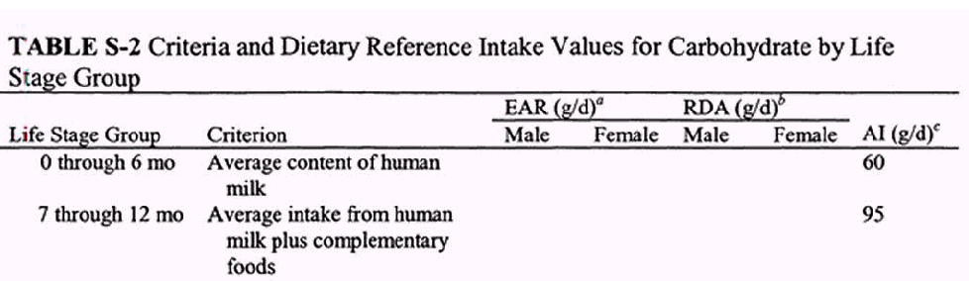
2002 Carbohydrate DRI

Slide 40
Fats and Fatty Acids
Sources
  Palm olein, soy, coconut, and high oleic sunflower oils (primary source)
  Mortierella alpina, Crypthecodinium cohnii oils (source of DHA and ARA)
Density
  Human milk
    ~ 50% of kcals as fat
    5% as EFA (mostly linoleic)
  AAP
    ~3.3 gm fat/100 kcals (30% of kcals)
    300 mg linoleic acid/100 kcals (2.7% of total kcals)
  Max 6 gm fat/100 kcals (54%)

Slide 41
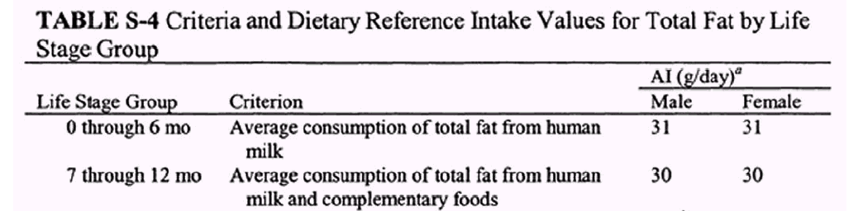
2002 Fat DRI

Slide 42
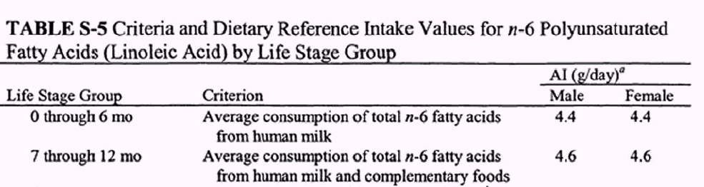

Slide 43
Essential Fatty Acids
The American Academy of Pediatrics and the Food and Drug Administration specify that infant formula should contain at least 300 mg of linoleate per 100 kilocalories or 2.7% of total kilocalories as linoleate.

Slide 44
LCPUFA
DHA and ARA

Slide 45
DHA represents 10% of total FA in brain grey matter, and 35% in rod and cone membranes of retina
Synthetic ability to convert linolenic acid to DHA present when diet sufficient in w-3 FA (alpha linolenic)
Alterations in visual and neurodevelopmental fx associate with insufficient DHA

Slide 46
LCPUFA: Background

Slide 47
LCPUFA: Background
Ability to synthesize 20 C FA from 18 C FA is limited.
n-3 and n-6 fatty acids compete for enzymes required for elongation and desaturation
Human milk reflects maternal diet, provides AA, EPA and DHA
n-3 important for neurodevelopment, high levels of DHA in neurological tissues
n-6 associated with growth & skin integrity

Slide 48
Formula Supplemented with DHA & ARA: A Critical Review of the Research (Wright et al, 2006)
10 RCTs from 1997-2003 of variable quality
Considered the strength of each study by looking at indices of research quality.

Slide 49
Wright et al, cont.
Vision (6 trials)
  2 found better visual function with LCPUFA , 4 did not
Neurodevelopment
  1 of 4 found positive results on Bayley Scales of Infant Development II
  2 of 5 found positive information processing/IQ/cognitive effects

Slide 50
Wright et al, cont.
Growth (7 studies)
  no differences in weight, length, OFC
FA in blood (7 studies)
  DHA & ARA higher with supplementation
  those supplemented with only DHA had lower levels of ARA than those on standard formula
  Supplementation with LCPUFA for only 17 weeks lead to higher EFA levels at 1 year of age

Slide 51
Wright et al, cont
Conclusions
  No detrimental effects found
  Possibly a small improvement in visual acuity, but significance of this small effect in global development is questionable
  “thoughtful consideration is advised before recommending more expensive formula for term infants.”

Slide 52
Omega-3 FA and Neural Development to 2 years of Age: Do we Know enough for Dietary Recommendations: Innis JPGN 48:S16-24:2009
Estimated requirement and variability among individuals necessary to set DRI
Dietary recommendations affect food supply and supplements and are used in labeling
When scientific information is incomplete, consideration must be given to implications of recommendations

Slide 53
Omega-3 FA and Neural Development to 2 years of Age: Do we Know enough for Dietary Recommendations: Innis JPGN 48:S16-24:2009
“ While there is no doubt that DHA is critical for the developing brain, western diets poor in w-3 FA and rich in w-6 FA are becoming increasingly implicated in contributing to risk of poor neurodevelopment and function…..The w-3 FAs are clearly essential nutrients, suggesting that dietary recommendations, such as AI, to minimize risk of poor CNS development can be justified, and are consistent with a philosophy of dietary advice that promotes optimal child development and health. However, because dietary recommendations often promulgate changes in the food supply and supplement use…..premature recommendations based on incomplete science that focus on individual nutrients rather than dietary practices such as breastfeeding and foods such as fish rich in DHA are not necessarily in the best public interest”

Slide 54
Protein
Protein is needed for
  Tissue replacement
  Deposition of lean body mass
  growth
Protein needs during rapid growth of infants higher than adults or older children
Recommendations based on composition of human milk with assumption of 100% efficiency of utilization

Slide 55
Protein
Increases in body protein are estimated to average about 3.5 g/day for the first 4 months, and 3.1 g/day for the next 8 months.
The body content of protein increases from about 11.0% to 15.0% over the first year

Slide 56
Protein: Amino Acids
Require higher percentage of total amino acids as essential amino acids
Conditional essential amino acids
  Histidine (infant vs adult needs)
  Tyrosine, cystine, and taurine (premature infants)

Slide 57
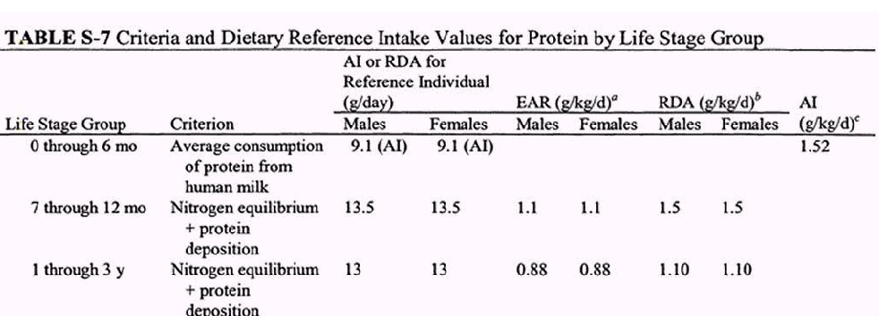
2002 Protein DRI

Slide 58
Protein content of milks
Food Pro (gm/oz)
Human milk 0.3
Infant formulas 0.5
Infant soy formulas 0.5
Homogenized milk 1.0

Slide 59
Distribution: Protein/CHO/Fat
Age | g/d Protein/CHO | AMDR protein/CHO/Fat
Infant | 9.1-11/60-95
1-3 | 13/130 | 5-20/45-65/30-40
4-8 | 19/130 | 10-30/45-65/25-35

Slide 60
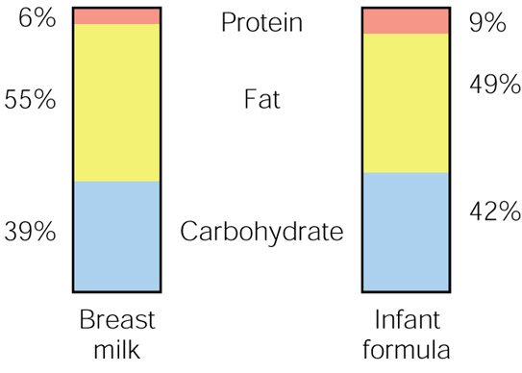
Comparison of breastmilk and infant formula
©2001 Brooks/Cole, a division of Thomson Learning, Inc. Thomson Learning™ is a trademark used herein under license.
Percentages of energy yielding nutrients in breastmilk and formula

Slide 61
Questions

