Slide 1
WIC Family Food Access Project, 2011

Slide 2
Phase 2, Team A: Financial Access and Food Insecurity
Sarah Bailey, Juli Louttit, Emily Faerber

Slide 3
Outline
Basic definition of food insecurity
Determinants of food insecurity in populations and households
Methods of assessing food insecurity
Rates of food insecurity in the US and among high risk groups
Recommended interventions to address food insecurity
Basic information about SNAP program

Slide 4
Definition of food insecurity

Slide 5
What is food insecurity?
“Limited or intermittent access to nutritionally adequate, safe, and acceptable foods accessed in socially acceptable ways”¹
Low food security: multiple indications of food access problems, but little or no actual reductions of food intake¹
Very low food security: eating patterns of one or more members were disrupted and food intake was reduced¹

Slide 6
What is food insecurity?
The term “food insecurity” includes low food security and very low food security
Before 2006¹
Low food security was known as “food insecure without hunger”
Very low food security was known as “food insecure with hunger”

Slide 7
Determinants of food insecurity in populations and households

Slide 8
Determinants of food insecurity
Food insecurity is associated with : high housing costs, high utility costs, lack of education, transportation costs, and health care costs¹
Food insecurity rates are highest in the south; lowest in the northeast¹
Food insecurity is more common in large cities than in rural areas¹

Slide 9
Determinants of food insecurity
Food insecurity is associated with an event that puts stress on the household budget¹
Food insecurity is more common among families that stopped receiving SNAP benefits in the previous year than in families currently receiving SNAP benefits²
Families living near or below the FPL experience higher rates of food insecurity¹
Food insecurity rates parallel poverty rates¹

Slide 10
Methods of assessing food insecurity

Slide 11
Food Security Assessment: A Brief History⁴
1994- USDA’s Food and Nutrition Service partnered with DPHHS to hold a conference to identify an appropriate tool to measure food insecurity.
Since 1996- The food security statistics are reported by ERS based on annual surveys developed by the U.S. Food Security Measurement Project, a collaboration among Federal agencies, academic researchers, and non-profit agencies.
2006- Release of IOM report, “Food Insecurity and Hunger in the United States: An Assessment of the Measure.” Recommended ongoing annual surveying with minor adjustments to the survey tool.
Notes:
So Donna has covered the basic history of assessing food security in the United States, but I just wanted to revisit it briefly.
As far back as the 1960s hunger had been a public issue, as a number of federal assistance programs were in place.
In the 1980s economic struggles led to efforts to limit the federal spending led to general consensus that hunger may be widespread.
However it was in the early 1990s that the real push for an appropriate conceptual basis for defining and measuring hunger in the U.S. began.
Finally in 1994 USDA brought together a group of stakeholders from a variety of agencies to develop a food security instrument. The outcome was the development of a survey, the Food Security Supplement, which has been added to the Current Population Survey every year since 1995. Within this Food Security Supplement is the Household Food Security Module (10 questions for households without children, 18 for those with).
The questions remained essentially unchanged until 2006 when the IOM report suggested use of changed verbiage- excluding the “hunger” component. Because hunger is a somewhat subjective, physiological trait, The old verbiage, “Food insecure with hunger” has now been changed to “Very Low Food Security.”

Slide 12
USDA Six-item Food Security Scale⁵
Developed by researchers at the National Center for Health Statistics
Focuses on financial constraints
Does not directly ask about children’s food security; thus the most severe form of food insecurity cannot be measured
Justified this exclusion through the rationale that surveys with time and resource constraints would not have the sample size to make precise estimates of the most severe form anyway
Notes:
Statistical testing was utilized to identify the strongest subset of six indicators from the full survey for achieving a good approximation of food security
Can not directly measure children, but obviously children in households with the most severe insecurity (5 of the 6 questions) have an increased PROBABILITY of food insecurity, so in a sense it is a measure of RISK for childhood hunger

Slide 13
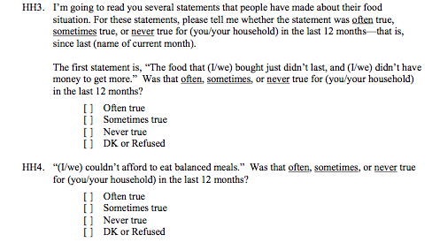
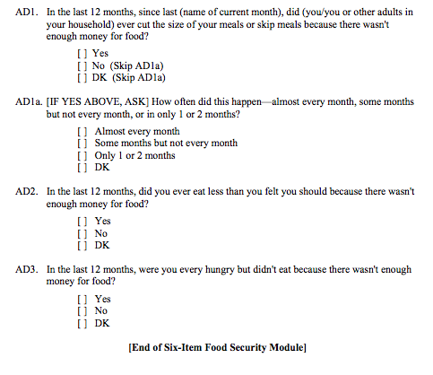
Six-Item Food Security Survey

Slide 14
Assessing household food insecurity through the six-item survey⁵
Raw Score 0-1: High or marginal food security
Raw Score 2-4: Low food security
Raw score 5-6: Very low food security
Food insecurity refers to low food security and very low food security
To minimize respondent burden, respondents may be screened after the first three questions.
Notes:
Items 1 and 2 are scored affirmative if response is “Often true”, or “Sometimes True” and negative if response is “Never True”
Itesms 3, 5, and 6 are scored affirmative if response is “Yes” and negative if response is “No”
Item 4 is scored affirmative if response is “Almost every month” or “Sometimes but not every month” and negative if “Only 1 or 2 months” or “Never”
For each affirmative you get a point, and from there you can tally the raw score.
If first three questions are Negative, the respondent can be screened out as Food Secure with only a 0.2 percent reduction in the specificity

Slide 15
How Good is It?
Does not directly address children’s food security, and may miss the most severe range of food insecurity
May ignore non-financial causes of food security
Does correctly classify 97.7% of households as food insecure, and has satisfactory sensitivity and specificity⁶.
Less respondent burden; can be screened after 3 items for food secure individuals

Slide 16
Conclusion
When feasible, use of the 18-item U.S. Household Food Security Survey Module is recommended.
Full scale survey categorizes households into Food Secure or Food Insecure, and further subdivides insecure into Low food Insecurity or Very Low Food Insecurity
While brief, the 6-item form has relatively small bias and is a potentially useful tool for national, state, and local applications

Slide 17
Rates of food insecurity

Slide 18
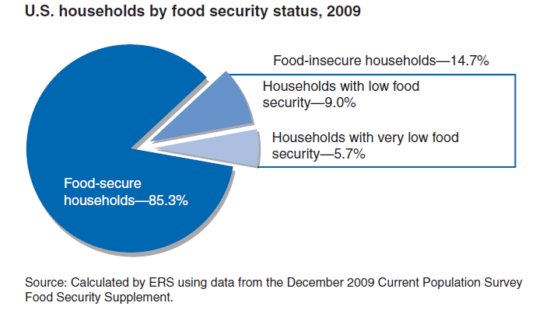
Rates of food insecurity
This is the highest rate of food insecurity since the first national food security survey in 1995³.

Slide 19
Rates of food insecurity in the US, 1998-2009¹

Slide 20
Basic information about SNAP Program

Slide 21
What is SNAP?⁸
1964- Food Stamp Program becomes permanent
1974- FSP goes nationwide
1996- Personal Responsibility and Work Opportunities Reconciliation Act
2008- Changed named to SNAP
The largest of the USDA’s nutrition assistance programs
2010 average monthly participation⁷
40 million people
18.6 million households
Washington Nov 2010 participation⁷
1 million people (a 13.7% increase since Nov 2009)
500,000 households (a 18.9% increase since Nov 2009)

Slide 22
SNAP Participation rates
SNAP participation follows trends in the poverty rate and the unemployment rate
2008 national participation rates⁹
66% among all eligible participants
54% among working poor
2008 Washington participation rates⁹
80% among all eligible participants
65% among working poor

Slide 23
Barriers to Participation¹⁰,¹¹
Barriers
Enhancers
Burden of application
Official language and threats of fine and jail time
Repeated visits to office during working hours
Low benefits
Language barriers
Social stigma
Lack of transportation
Lack of knowledge of program
Knowledge of program
Expectation of a large benefit
Large and sudden drop in household income
Change in household composition

Slide 24
Recommended interventions to address food insecurity

Slide 25
Recommended Interventions
Increase participation in food assistance programs
Streamline the application process for food assistance programs
Increase funding for school meals
Support food security through policies that strengthen infrastructure
Housing, transportation, employment
Social networks
Tax policies that support low income families

Slide 26
References
¹Position of the American Dietetic Association: Food Insecurity in the United States, 2010. Journal of the American Dietetic Association.
²Food Insecurity in Households with Children, Prevalence, Severity, and Household Characteristics. ERS Report Summary, Sept 2009. USDA/ERS
³Food Security in the United States. United States Department of Agriculture, Economic Research Service, The Economics of Food, Farming, Natural Resources, and Rural America.
⁴Johnson, Donna. January 11, 2011. Household Food Security in the United States. Public Health Nutrition.
⁵Economic Research Service, USDA. July 2008. Household Food Security Survey Module: Six item short form.
⁶S.J. Blumber; K. Bialostosky; W.L. Hamilton; R.R. Briefel. The effectiveness of a short form of the household food security scale. American Journal of Public Health. Vol 89, pp 1231-1234. 1999.

Slide 27
References
⁷Supplemental Nutrition Assistance Program Program Data. USDA, 02/01/2011. Web. 02/13/2011.
⁸A short history of SNAP. USDA, 04/30/2009. Web.
⁹Cunnygham, Karen E and Laura A. Castner. Reaching those in need: State supplemental assistance program participation rates in 2008. Mathematica Policy Research. 2010; 1-8.
¹⁰Wilde, Parke and Elizabeth Dagata. Food Stamp Participation by Eligible Older Americans Remains Low. Food Review. 2002; 25-29.
¹¹Bhattarai, Gandhi Raj, Patricia A. Duffy, and Jennie Raymond. Use of Food Pantries and Food Stamps in Low-Income Households in the United States. The Journal of Consumer Affairs. 2002; (39:2) 276-298.

