Slide 1
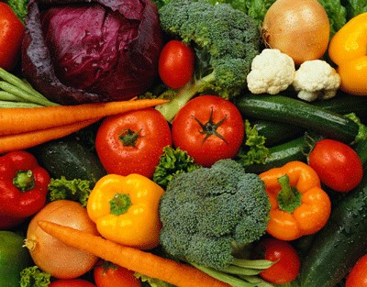
Physical and Geographic Access to Healthy Foods
Team B:
Kelly Peterson, Sarah Shimer & Kailee Farnum

Slide 2
Terms
Healthy Food
A food that provides the nutrients necessary to meet the dietary guidelines and provide a balanced diet
Access
Defined as Proximity, Economic Access, Nutritional Access & Cultural Access
Food Insecurity
Inadequate access at any time in the previous year to the healthy, nutritious food needed to live an active life

Slide 3
Determinants of Access to Healthy Food
Distance to a healthy food provider such as a supermarket, garden, farmer’s market or full-service restaurant (1, 2, 3, 4)
Income Level: ability to afford healthy food or live in a neighborhood with safe walking access to healthy food (1, 5, 6)
Ethnicity and living in an specific ethnically dominated neighborhood (7, 8, 9)
Living in a rural area (10,7)
Availability of nutritionally adequate to culturally appropriate foods at accessible stores (2, 9, 8)

Slide 4
Determinants of Access to Healthy Food Studies
Multivariate analysis study of 28 thousand US zip codes
Rural area and African-American neighborhoods = least access to supermarkets (7)
African American neighborhoods = most access to low cost fast food (11)
Food access studies in US 1985-2008
Rural, Low Income, Ethnic Minority = less access to stores with healthy foods (3)

Slide 5
Determinants of Access to Healthy Food Studies
Fruit and vegetable intake increases when they are more available in the household – Availability is determined by supermarket choices for fruits and vegetables (2)

Slide 6
Rates of Healthy Food Access
In the US
14.7% in 2009 food insecure (highest rate since 1995)
In WA State
At least 15% of WA residents are food insecure
In King County
6% are food insecure: 6 out of every 100 people are unsure where they will get their next meal

Slide 7
Differences in Food Prices
Notes:
Direct cost differences: Do people in low-income areas pay more for a specific product?
Within a super-market chain, are there price differences at different locations
Are there price differences between supermarket chains and smaller grocers and convenience stores?
Availability of package sizes which determine long-term savings?

Slide 8
Difference in Food Prices
Three components:
Price disparities
Who charges what?
Store availability
Where are they located?
Market-basket prices
What are you getting for your money?

Slide 9
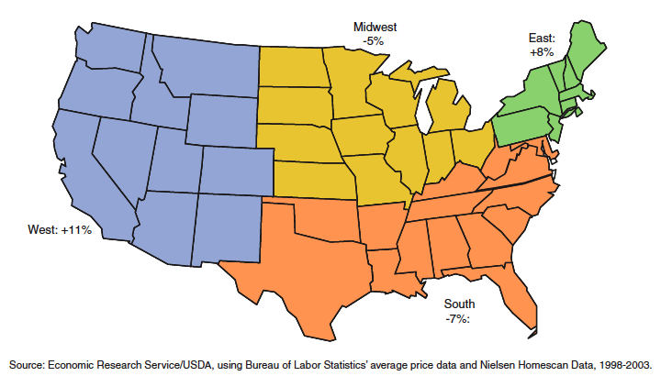
Price Disparities
Regional Differences (17)
Notes:
Regional Differences:
- Compared to the national average of prices of a representative mix of food products
- The national average (except Alaska and Hawaii) is what determine SNAP benefits

Slide 10
Price Disparities
No disparities within a given supermarket chain.
Chain stores tend to have lower prices than convenience stores or small grocers.
New Haven, CT: on average, prices were 51% higher in small neighborhood stores than supermarkets. (18)
Twin Cities, MN: With few exceptions, prices are lower by 10-40% in chain vs. small grocery or convenience stores.(19)
Notes:
There is no evidence that there are price disparities within a given chain.
The cause of price disparities is due to the differences between chain and non-chain stores.
New Haven, CT study = 2008, replicated a 1971 food disparities study
Twin Cities, MN: = 1999, more controlled study of food prices across stores in inner vs. suburban locations

Slide 11
Store Availability
There are fewer supermarket chains in low-income and minority neighborhoods.
It is believed that the lowest income neighborhoods had ~30% less supermarkets than the highest income neighborhoods. (20)
Twin Cities study, only 22% of chains located in inner-city, and 89% of chains located in areas with < 10% poverty rates. (19)
Availability of chain supermarkets in Black neighborhoods was 52% less than their White counterparts. (21)

Slide 12
Market Basket Prices
Are lower in:
Chain stores vs. non-chain
Suburbs vs. inner cities
Non-poor vs. poor (19)
The average thrifty food plan cost for small/medium stores was $102 compared to $81 in supermarkets.(22)
Quality, variety, and availability are often diminished as well.(23-25)
Notes:
Market Basket Prices from Twin Cities study:
- Chain vs. Non-chain = $16.62 (significant)
- Suburbs vs. Cities = $1.18
- Non-poor vs. poor = $5.15

Slide 13
Seattle-King County
Drewnowski studies (26-27):
No price differences within a given supermarket chain.
Geographical distribution indicates no food deserts.
Market basket studies show that major differences are due to:
Brand availability
Characteristics of meat and produce
Grocery Gap (28):
Higher food availability in more affluent areas.
Notes:
Drewnowskit
Grocery Gap Project: Queen Anne and

Slide 14
King County Food and Fitness Initiative
Community coalition in White Center and Delridge to support nutrition and exercise (29)
There are three action teams
School fitness and nutrition
Healthy food retail
Safe spaces to be active
Healthy Corner Stores
Challenging store owners to change business model. Initial results positive!
Notes:
Founded in 2006, supported by the Kellogg Foundation. Grant to implement Food and Fitness Community Action Plan.
School: improve nutrition education and access (school gardens), improve physical activity requirements and more of it!
Healthy food retail: improve retailers access to healthy foods, improve local network of food and distributors
Safe spaces: improve walkability/biking in school/community settings.

Slide 15
FEEST (Food Empowerment, Education & Sustainability Team)
Engage youth in Delridge
Strong youth social justice group for food access
Host monthly community potlucks
Volunteer and network
Support community development and access to food (30)
Notes:
Part of KCFFI

Slide 16
Communities Putting Prevention to Work
Funding for schools, local governments, and community organizations
$8.9 million to increase healthy choices in King County (31)

Slide 17
CPPW: Healthy Food Economic Incentive Program (Healthy Foods Here)
City of Seattle partners with Office of Economic Development
$1.1 million dedicated to providing business incentives to increase healthy food retail
Assistance in finding suppliers, marketing campaigns, and inventory management
Goals:
Increase availability of healthy products
Increase both supply and demand of healthy foods
Increase store participation in WIC/EBT (32)

Slide 18
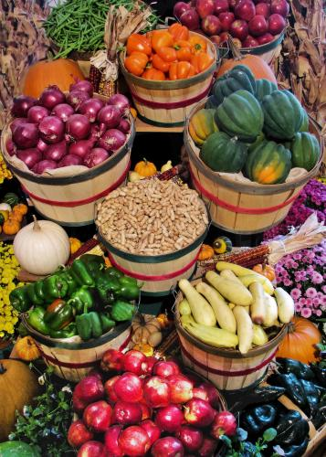
Farmers Markets
SNAP and WIC partnerships to encourage purchasing of fresh local produce
Host farmer’s markets at corner stores during the weekends
WIC Farmers Market Nutrition Program (33)

Slide 19
Clean Greens Farm and Market
Started by Rev. Robert Jeffery as a way of bringing poor people together to eat and grow good food
Enough crops to operate CSA, market, and outreach (Giveback Program)
Largely run by volunteers (34)

Slide 20
White Center Community Development Association
54 languages spoken!
Neighborhood Revitalization: repair and rehabilitate neighborhood ammenities, largely supported by Habitat for Humanity
Create neighborhood walking map and groups, supported by Feet First and Neighborhood House
Fresh Marketplace Initiative: Media and assistance for healthy foods by White Center CDA
Support fresh and healthy produce at food banks (35)
Notes:
Supp

Slide 21
Delridge Neighborhoods Development Association: TEAM Delridge
Thrive to Eat healthier, take Action and Move
SOUL Community Kitchens, monthly meetings
Training with recipes, cooking, awareness (36)

Slide 22
Recommended Interventions
Working Together!
Families
State and Local Agencies
Institutions
Community Groups
Regional Food Systems

Slide 23
Recommended Interventions
Further support & promotion for Healthy Corner Stores Initiative
Improve access to healthy food in local low income environment
Develop business relationship between local farmers to provide fresh fruits/vegetables to corner stores
Ability to use WIC checks at these stores
Give assistance to small business owners to become WIC providers

Slide 24
Recommended Interventions
Re-zoning in low income areas
Discourage fast food establishments
Encourage grocery stores
Increase land use for urban agriculture and community gardens

Slide 25
Recommended Interventions
Increase Information given to WIC clients
Hand out ethnically appropriate recipes that use fresh foods to WIC clients
Provide information in several languages
Develop and give out a bus route brochure that depicts how to take the bus in low income areas to WIC provider grocery stores
Rate grocery stores according to how much fresh produce is available

Slide 26
Recommended Interventions
Increase funding and information for community kitchens in low income areas
Give information about these kitchens to WIC clients
Promote cooking classes and recipe exchanges using fresh foods with ethnic recipes to demonstrate how to cook with fruits and vegetables
Provide day care at these classes
Use school kitchens as make-shift community kitchens

Slide 27
References
1. Algert, S., Agrawal, A., & Lewis, D. (2006). Disparities in access to fresh produce in low-income neighborhoods in Los Angeles. American Journal of Preventive Medicine, 30(5), 365-370.
2. Jago, R., Baranowski, T., & Baranowski, J. C. (2007a). Fruit and vegetable availability: a micro environmental mediating variable? Public Health Nutrition,10(07), 681-689.
3. Larson, N. I., Story, M. T., & Nelson, M. C. (2009). Neighborhood environments: Disparities in access to healthy foods in the U.S. American Journal of Preventive Medicine, 36(1), 74-81.e10.
4. Garasky, S., Morton, L., & Greder, K. (2005). The food environment and food insecurity: Perceptions of rural, suburban, and urban food pantry clients in Iowa. Family and Economics Nutrition Review, 16(2), 41-48.
5. Drewnowski, A. Obesity and the food environment: dietary energy density and diet costs. Am J Prev Med. 2004; 27(3S):154-162.
6. Jetter KM, Cassady DL. The availability and cost of healthier food alternatives. Am J Prev Med. 2006; 30(1):38-44.
7. Powell, L. M., Slater, S., Mirtcheva, D., Bao, Y., & Chaloupka, F. J. (2007a). Food store availability and neighborhood characteristics in the United States. Preventive Medicine, 44(3), 189-195
8. Franco, M., Diez Roux, A. V., Glass, T. A., Caballero, B., & Brancati, F. L. (2008).Neighborhood characteristics and availability of healthy foods in Baltimore. American Journal of Preventive Medicine, 35(6), 561-567.
9. Baker, E., Schootman, M., Barnidge, E., & Kelly, C. (2006). The role of race and poverty in access to foods that enable individuals to adhere to dietary guidelines. Preventing Chronic Disease, 3(3), 1-11.
10. Hosler, A. S., T Rajulu, D., Ronsani, A. E., & Fredrick, B. L. (2008). Assessing retail fruit and vegetable availability in urban and rural underserved communities. Preventing Chronic Disease, 5(4), 9.
11. Block, J. P., Scribner, R. A., & DeSalvo, K. B. (2004). Fast food, race/ethnicity, and income: A geographic analysis. American Journal of Preventive Medicine, 27(3), 211- 217.
12. USDA Economic Research Service. Household Food Security in the United States, 2009. http://www.ers.usda.gov/features/householdfoodsecurity/
13. Andrews, M., Nord, M. (2009). Food Insecurity Up In Recessionary Times. Amber Waves, 7(4), 32 – 36.
14. Opportunities for Increasing Access to Healthy Foods in Washington. A Report for the Access to Healthy Foods Coalition. Developed by the Access to Healthy Foods Coalition, The Washington State Department and the University of Washington Public Health Nutrition Department, June 2010.
15. Healthy Corner Stores Brief from The Food Trust. http://www.thefoodtrust.org/php/programs/Winter2011issuebrief.pdf
16. FoodLifeLine.org. Hunger in King County. 2010. http://www.foodlifeline.org/hunger/resources/documents/King_web.pdf

Slide 28
References
17. Leibtag, Ephraim S. The Impact of Big-Box Stores on Retail Food Prices and the CPI, Economic Research Report No. 33, U.S. Department of Agriculture, Economic Research Service, December 2006, available at: http://www.ers.usda.gov/Publications/err33/.
Andreyeva T, Blumenthal DM, Schwartz MB, Long MW, Brownell KD. Availability and prices of foods across stores and neighborhoods. Health Affairs. 2008:27(5):1381-88.
Chung C., and Myers S.L., Do the poor pay more for food? An analysis of grocery store availability and food price disparities. The Journal of Consumer Affairs. (33)1999; 276-296.
Weinburg, Z., 1995. No Place to Shop: The Lack of Supermarkets in Low-Income Neighborhooods. Public Voice for Food and Health Policy, Washington, DC 3.
Powell, LM., Slater, S., Mirtcheva, D., Bao, Y., Chaloupka, FJ. 2007. Food store availability and neighborhood characteristics in the United States. Preventive Medicine 44, 189-195.
Morris, PM., Neuhauser, L., Campbell, C., 1992. Food security in rural America: a study of the availability and costs of food. Journal of Nutrition Education 24(1);52S-58S.
Glanz, K., Sallis, JF., Saelens, BE., Frank, LD. 2007. Nutrition environment measures survey in stores (NEMS-S). American Journal of Preventive Medicine. 32(4): 282-289.
Hendrickson, D., Smith C., Eikenberry, N. 2006. Fruit and vegetable access in four low-income food deserts communities in Minnesota. Agriculture and Human Values 23, 371-383.
Zenk, SN., Schulz, AJ., Israel BA., James, SA., Bao, SM., Wilson, ML. 2006. Fruit and vegetable access differs by community racial composition and socioeconomic position in Detroit, Michigan. Ethnicity & Disease 16, 275-280.
Mahmud NK., Monsivais P., Drewnowski A. The search for affordable nutrient rich foods: A comparison of supermarket food prices in Seattle-King County. CPHN Public Health Research Brief. July 2009, UW Center for Public Health Nutrition: Seattle. 1-5.

Slide 29
References
Drewnowski A., Eichelsdoerfer P. Can Low-Income Americans Afford a Healthy Diet? CPHN Public Health Research Brief. March 2009, UW Center for Public Health Nutrition: Seattle. 1-6.
Jordan, Jamillah. The Grocery Gap Project: Race, Hunger, and Food Access. Solid Ground. February 2007, 1-23.
King County Food and Fitness Initiative. http://king.wsu.edu/foodandfarms/KCFFI.html
KCFFI FEEST Program http://king.wsu.edu/foodandfarms/KCFFIYouthCoordination.html
Communities Putting Prevention to Work. DOH. http://www.kingcounty.gov/healthservices/health/partnerships/CPPW.aspx
CPPW Healthy Foods Here http://www.kingcounty.gov/healthservices/health/partnerships/CPPW/whosinvolved.aspx
Farmers Markets http://www.seattlefarmersmarkets.org/markets/ebt-senior-and-wic-fmnp-vouchers
Clean Greens Farm and Market http://www.cleangreensfarm.com/
White Center Community Development Association http://www.wccda.org/index.php
TEAM Delridge. http://www.dnda.org/programs/team-delridge

