Slide 1
Phase Two Team D:
Data Compilation
Nutrition 531, Winter 2011
Katie Garrett, Bridget Igoe, Jamie Kowatch, Richard Lau,
Lola Stronach, Amanda Wood

Slide 2
Total Surveys: 92

Slide 3
Primary Grocery Stores

Slide 4
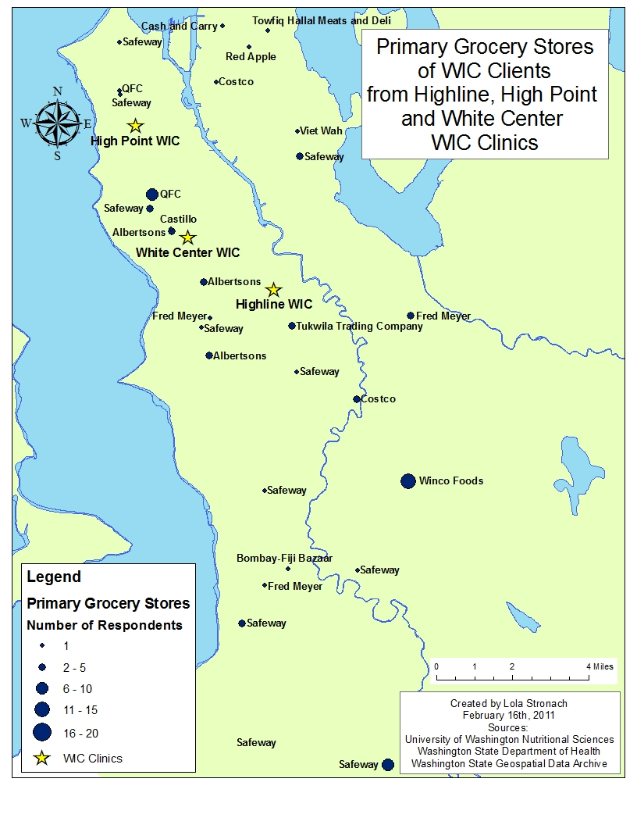

Slide 5
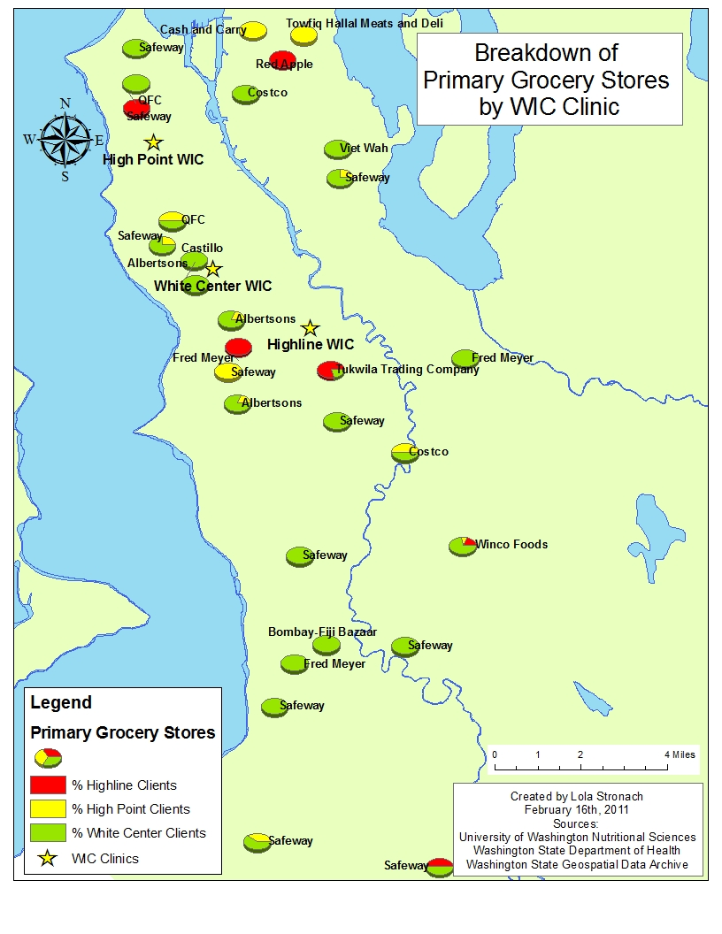

Slide 6
WIC Stores

Slide 7
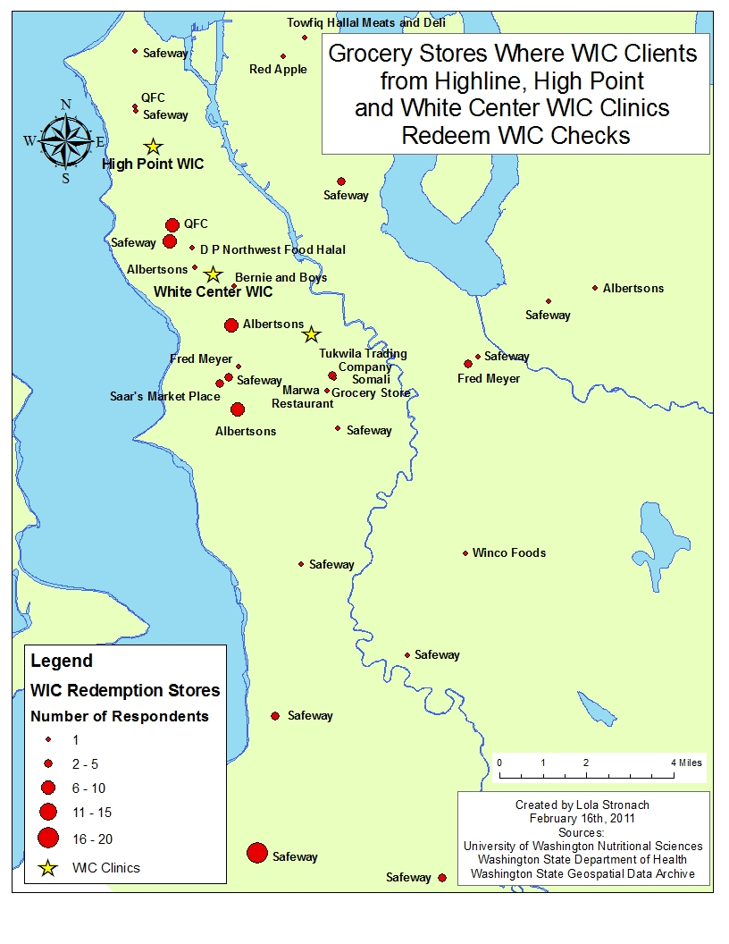

Slide 8
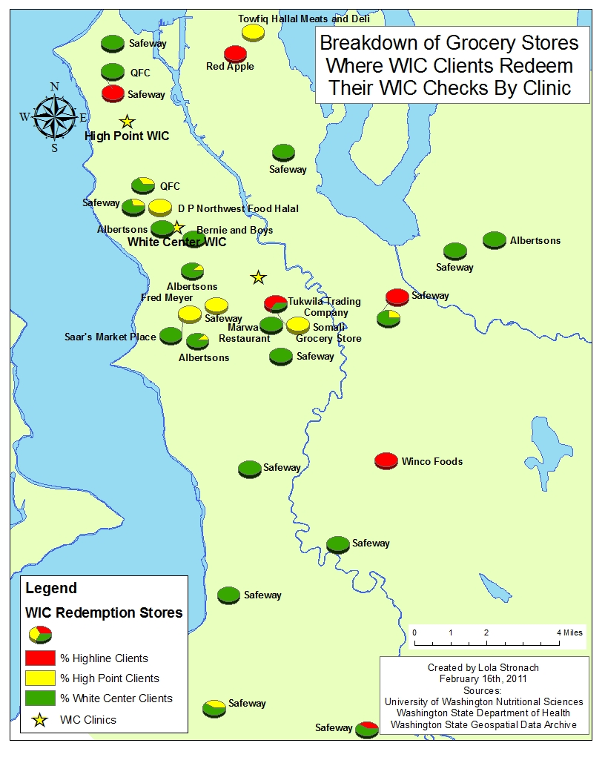

Slide 9
WIC Store and Primary Store the Same?

Slide 10
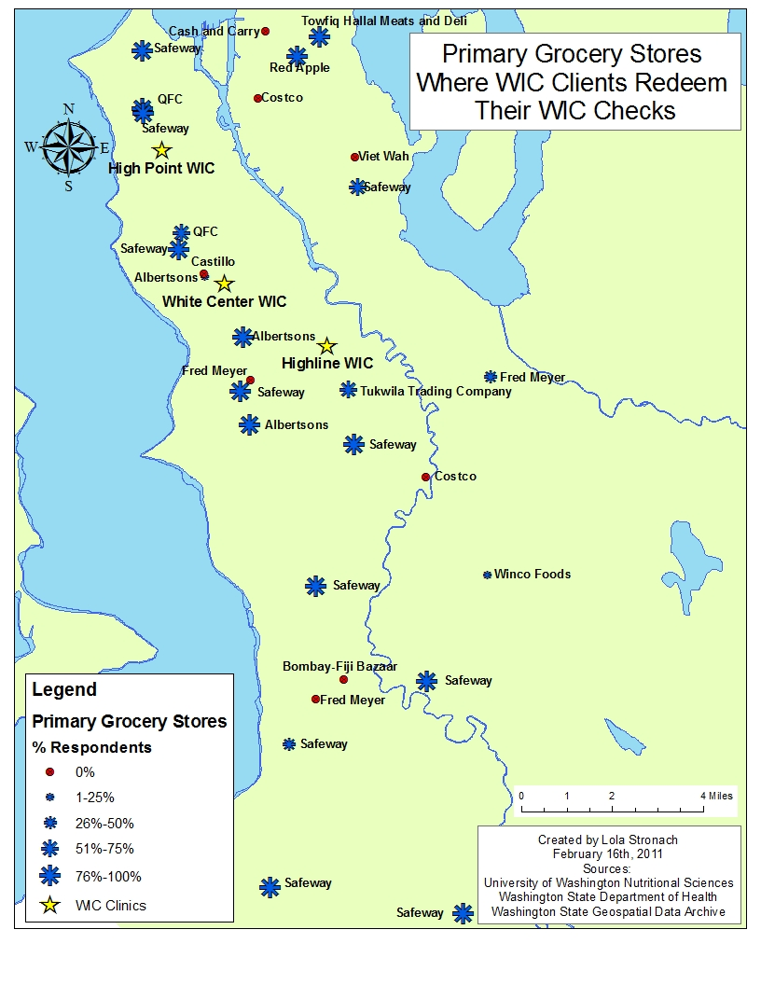

Slide 11
Item 4: Transportation to and from PRIMARY store
*The “Ride with Friends” category also included family members with a car.
Bike and taxi are not included because they had no respondents.
Item 5: Transportation to and from SECONDARY stores was very similar.

Slide 12
Other Food Stores

Slide 13
Other reported places HH acquires food (item 8)
Notes:
DK = Don’t know

Slide 14
In the past 12 months, did anyone in your HH receive SNAP? (item 9)
Notes:
Bar graph representation

Slide 15
How easy or hard is it for you to provide your family with foods that are nutritious and culturally appropriate? (items 10 & 11)
 | High Line n (%) | High Point n (%) | White Center n (%)
It is very easy/not too hard to provide my family with foods that are nutritious (item 10) | 9 (75.0 %) | 16 (80.0 %) | 53 (88.3 %)
It is very easy/not too hard to provide my family with foods that are right for my culture or religion (item 11) | 12 (100.0 %) | 18 (75.0 %) | 59 (98.3 %)

Slide 16
USDA Food Security
Total of all Surveys

Slide 17
USDA Food Security, by SNAP use

Slide 18
USDA Food Security, by Method of Transport

