Slide 1
HEALTHY FOOD ACCESS IN WIC HOUSEHOLDS
Nutrition 531: Public Health Nutrition
University of Washington
Winter 2011

Slide 2
INTRODUCTION & BACKGROUND
Healthy Food Access in WIC Households

Slide 3
The Project
GOALS¹
OBJECTIVES¹
Improve access to healthy foods in WIC families in targeted parts of south King County
Students will use mixed methods to assess the current status of WIC family access to healthy foods in selected neighborhoods in south King County. Students will use the recent report on Access to Healthy Foods in Washington State and the results of the assessment to develop recommendations for improving food access for these families. Project findings will be disseminated.
Assess the financial, physical, nutritional and cultural aspects of family food access in WIC families who are served by WIC clinics in the Highpoint, North SeaTac, and White Center neighborhoods.
Develop recommendations for policy changes to assure that WIC families have access to healthy foods.
Notes:
http://courses.washington.edu/nutr531/2011Project/WIC_Family_Food_Access.htm

Slide 4
Our Translation of The Project
Assess food insecurity among WIC clients and where they are currently using their WIC benefits
Report on outcomes of food access evaluation in WIC families
This information will provide current healthy food access and food security in WIC families and recommendations for WIC services in South King County
Notes:
image: http://profile.ak.fbcdn.net/hprofile-ak-snc4/41572_48893138184_5954153_n.jpg

Slide 5
Measuring Food Insecurity
“Limited or intermittent access to nutritionally adequate, safe and acceptable foods accessed in socially acceptable ways”²
2009 Statistics: 6% of King County Households were insecure, ~15% in Washington³
Indicators of food insecurity and access
SNAP participation
Question Survey Tools
Notes:
This concept of food insecurity can be further broken down into low food security and very low food
security. Low food security refers to a situation where there are multiple food access problems but
little, if any, reduction in food intake. Very low food security indicates eating patterns are disrupted
and food intake is reduced.
Participation in
SNAP follows trends in the poverty and unemployment rate, ensuring it is another good indicator of
food security status (11).
The determinants of food insecurity include high housing costs, high
utility costs, lack of education, transportation costs, and health care costs. Food insecurity is more
common in urban areas compared to rural areas, and it tends to be associated with an event that
puts stress on the household budget (3). Households with children and households with a single mother are at a greater risk for food insecurity (4, 5). Also, those households living near or below the
federal poverty level experience higher rates of food insecurity (3).
In 2009, 14.7% of U.S. households were food insecure; this is the highest rate since the first
national food insecurity survey in 1995 (6). In Washington State, approximately 15% of all
households were food insecure and in King County 6% of households were food insecure (1, 7).
These rates may be climbing due to the most recent recession and resultant high unemployment
rates in the U.S. and in Washington State (1).
The USDA Six-Item Food Security Scale was developed by researchers at the National Center for
Health Statistics and includes the strongest subset of six questions from the national annual survey
to assess food insecurity due to financial constraints (9).
image: http://farm4.static.flickr.com/3052/2929416071_9be08a77ea.jpg found at http://king.wsu.edu/foodandfarms/AFPCPublications.html
Map of areas in May 2008 in Seattle at risk for food insecurity with areas that lack access of transit to grocery stores

Slide 6
Determinants of Healthy Food Access
Physical Access
no true food deserts⁴
consider land use, public transportation and walkway safety⁵
Economical Access
income
housing costs & utilities²
household size⁶
Cultural & Nutritional Access
immigration status vs. U.S. citizen women^{6,7}
race⁶
cultural food preference⁸
Notes:
image: http://dss.sd.gov/images/photos/salestax.jpg
One potential
cultural barrier in the U.S. is the inconvenience of time-intensive food preparation that is generally required for fresh healthy foods. A study comparing the food preferences of recent immigrant
women with U.S.-born English speaking women found that the U.S.-born women were more
concerned with the convenience of food than with the nutritional quality, and were more likely to
purchase pre-made food products and fast food. This indicates that the current social norms in the
U.S. trend toward unhealthy food purchasing habits (4). Several studies have also demonstrated that the
longer immigrant families live in the U.S., the more they assimilate to U.S. culture and consume
popular unhealthy convenient foods (4, 29, 30). One recent study suggested that in low-income
African-American neighborhoods, residents may have never had the chance to develop a taste for
high quality produce because much of the produce available to low income residents is typically old
and bruised. Ultimately, this can lead to decreased produce purchases and increased food insecurity
(4, 29).

Slide 7
METHODS
Healthy Food Access in WIC Households

Slide 8
Study Design: Descriptive, cross-sectional study
AIM
DATA COLLECTION
To assess the current status of access to healthy foods and food insecurity in families who participate in WIC.
Key Informant Interviews were conducted at 3 WIC clinics in Seattle-King County.
White Center Public Health Center
Highline Medical Group
High Point Medical Clinic
Notes:
Institutional Review Board at the University of Washington

Slide 9
Key Informant Interviews
Interviews were conducted between Jan 13-Feb 3, 2011 by Nutritional Sciences grad students from UW
Food Access and Security Survey
8Q assessing food shopping patterns, use of food assistance benefits, and access to culturally relevant foods
3Q assessing SNAP usage and access to nutritious foods
USDA Six-Item Short Form of the Food Security Survey Module
Correctly classifies 97.7% of food insecure households⁹
Notes:
What does Key Informant Interview mean?

Slide 10
Analysis & Mapping
ANALYSIS
MAPPING
Data was entered into a Microsoft Excel spreadsheet database and analyzed for:
Food-shopping patterns
SNAP usage
Food security status
Determined by assigning food security scale scores based on the USDA six-item Food Security Survey⁹
Participants provided information regarding the location of the main store where their household purchases food
Information was combined with data from WA State Geospatial Data Archive and the WA State Department of Health
Notes:
ArchGIS 9.3 mapping software

Slide 11
Study Design: Descriptive, cross-sectional study
AIM
DATA COLLECTION
To assess the current status of access to healthy foods and food insecurity in families who participate in WIC.
Key Informant Interviews were conducted at 3 WIC clinics in Seattle-King County.
White Center Public Health Center
Highline Medical Group
High Point Medical Clinic
Notes:
Institutional Review Board at the University of Washington

Slide 12
Key Informant Interviews
Interviews were conducted between Jan 13-Feb 3, 2011 by Nutritional Sciences grad students from UW
Food Access and Security Survey
8Q assessing food shopping patterns, use of food assistance benefits, and access to culturally relevant foods
3Q assessing SNAP usage and access to nutritious foods
USDA Six-Item Short Form of the Food Security Survey Module
Correctly classifies 97.7% of food insecure households⁹
Incentive: enter a drawing for $25 gift card

Slide 13
Analysis & Mapping
ANALYSIS
MAPPING
Data was entered into a Microsoft Excel spreadsheet database and analyzed for:
Food-shopping patterns
SNAP usage
Food security status
determined by assigning food security scale scores based on the USDA six-item Food Security Survey⁹
Participants provided information regarding the location of the main store where their household purchases food
Information was combined with data from WA State Geospatial Data Archive and the WA State Department of Health
Notes:
ArchGIS 9.3 mapping software

Slide 14
RESULTS
Healthy Food Access in WIC Households

Slide 15
Characteristics of WIC survey participants (n=92) by clinic site
WIC Clinic | n (%)
White Center | 60 (65%)
High Point | 20 (22%)
Highline | 12 (13%)
Total | 92 (100%)
SNAP usage | n
White Center | 43
High Point | 16
Highline | 5
Total , n, (%) | 64 (70%)
Food Insecure* | n
White Center | 31
High Point | 9
Highline | 7
Total, n, (%) | 47 (51%)
Food-insecure households include those with low food security and very low food security
Notes:
N=92
65% White Center
70% reported SNAP usage in their households in the last 12 months
51% were living in food insecure households
29% were of low food security status and 22% of all respondents were very low food security (data not shown)

Slide 16
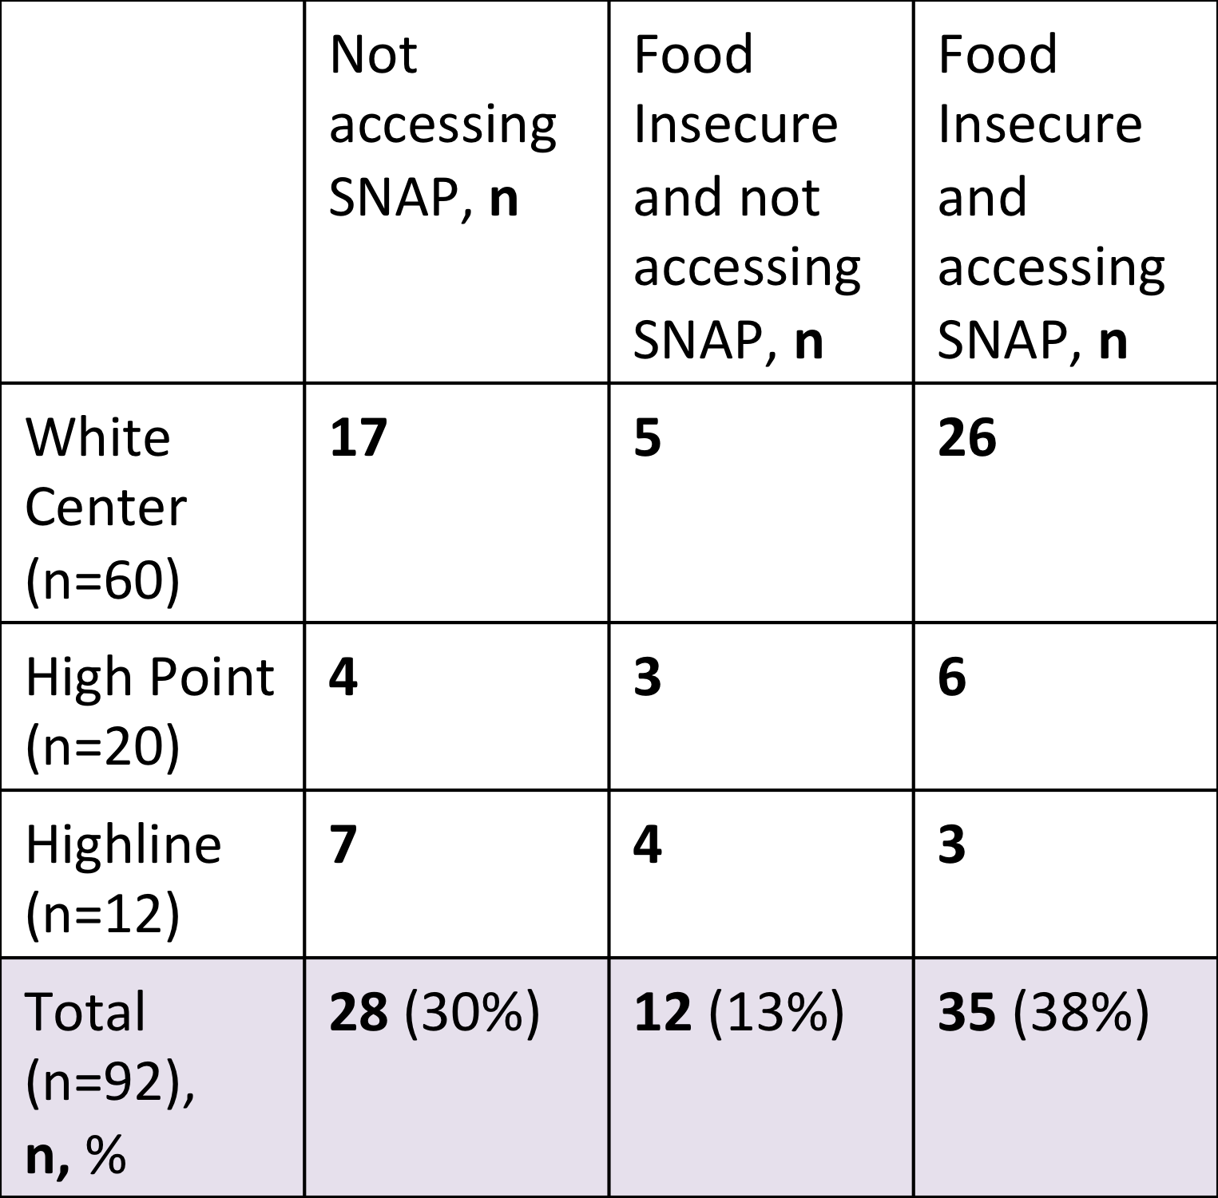
Food Insecurity* and SNAP access of WIC participants
*Food-insecure households include those with low food security and very low food security
Notes:
SNAP usage among food-insecure respondents
38% of all respondents were food insecure AND reported someone in their household did utilize SNAP in the last 12 months
13% of all respondents were food insecure yet reported that no one in their household utilized SNAP in the last 12 months
Total 47 respondents were identified to be food insecure, of these 25% reported they did not access SNAP

Slide 17
“Main store” where respondents (n=92) reported their household purchases food
*Ethnic: Bombay-Fiji Bazaar, Castillo, Towfiq Halla Meat & Deli, Viet Wah
Other retailers: Red Apple, Cash & Carry
Notes:
Survey participants were asked to name the main store where their household purchases food.
Reported a total of 13 food retailers as “main stores”
Safeway, Albertsons, and WinCo Foods were the most commonly reported
46% reported Safeway as their main store, 15% Albersons, 13% WinCo Foods
While only representing 3% of responses, notice that 4 different ethnic stores are in the primary category

Slide 18
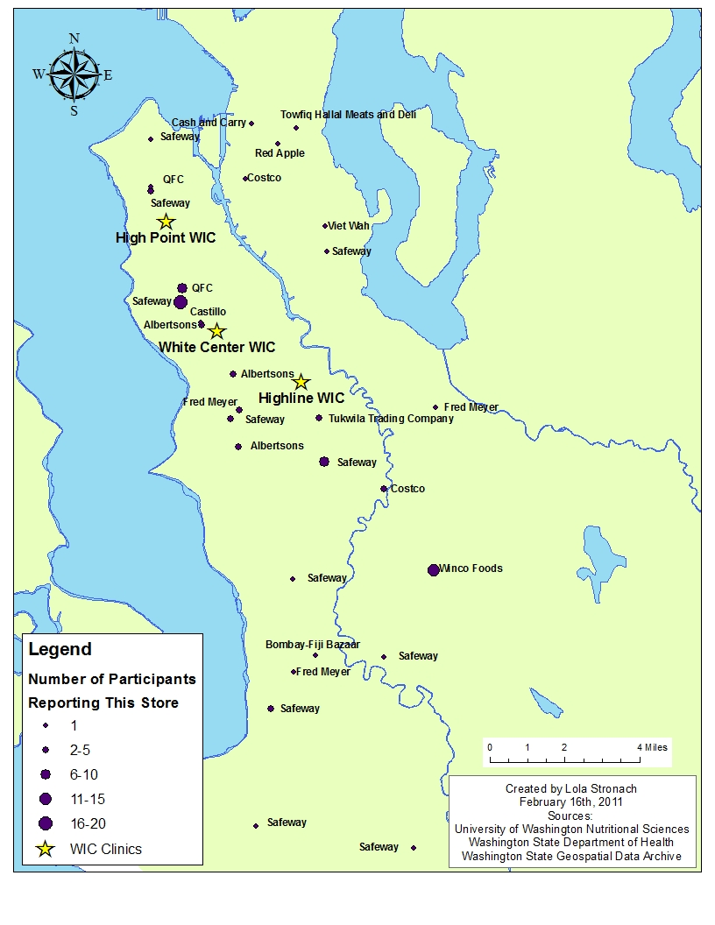
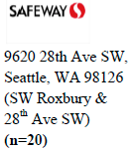
Locations of the “Main store” where respondents (n=92) reported their household purchases food
Notes:
This is a map of the surveyed WIC clinics and all grocery stores reported.
Stores with higher counts are represented as larger dots.
22% of all respondents reported shopping at one Safeway location in particular. This same Safeway was the most reported Safeway for WIC check redemption

Slide 19
“Other” grocery stores where participants (n=92) reported they purchase food
*Other large retailers: Trader Joes, Walgreens, Central Market, Red Apple, Seafood City, Sam’s Club, Target, Thriftway, Whole Foods
*Other small retailers: Saars, Tukwila Trading Co., Grocery Outlet, Larry in Tukwila, Sarah’s Market, Melina Market, High Point Mini Mart, Lam Seafood, Burney& Boys
*Ethnic: Viet Wah, Cambodian-Inco store, Asian supermarket, Somalian store, Africana store, Hing Long, Marwa, Castillo, 99 Ranch Market
Notes:
Participants were also asked to name any other stores where their household purchases food
Participants could name up to 5 “other” stores so 34 stores were reported in total
Safeway, Albertsons, and WinCo Foods were most commonly reported separate from main store

Slide 20
Grocery stores where participants (n=84) reported they redeem some of their WIC checks
*Other: Burney & Boys, Target, Saars, Tukwila Trading Co., Thriftway, Sarah's Market, Walgreens, Central Market, WinCo, Towfiq, Walmart, Marwa, Somalian Store
Notes:
Survey participants were also asked where they spend their WIC checks. Although our original N was 92, we were only able to analyze n=84 for this question.
Safeway was the most frequently reported store – 54% reported redeeming at least some of part of their WIC check here compared to 31% at Albertsons.
59% of respondents reported spending at least some of their WIC check at the same store where they primarily purchased food (main store)

Slide 21
Participants’ (n=92) reported method of transportation to the store where they primarily purchase food
Reported methods of transportation to “other” stores was very similar.
Bike and taxi are excluded because they were not selected by any respondents.
*The “Ride with Friends” category also included family members with a car.
Notes:
The most commonly reported method of transportation to any store to purchase food was by car.
Results were similar for traveling to main store or “other” stores.
84% responded that they use their own car
9% responded thaty they ride with friends or family
In sum, 93% of respondents access stores by car.

Slide 22
Other sources where participants (n=92) reported they obtain food
Notes:
Survey participants were also asked about any other sources where they obtain food.
Aside from grocery store retailers, the top three other sources where participants (n=92) reported they obtain food were: friends and family (33%), farmers’ markets (33%), and food banks (30%)

Slide 23
Participants’ beliefs/attitudes on ease of finding foods that are nutritious and culturally appropriate
 | It is very easy/not too hard to provide my family with foods that are nutritious | It is very easy/not too hard to provide my family with foods that are right for my culture or religion
White Center (n=60) | 53 | 59
High Point (n=20) | 16 | 18
Highline (n=12) | 9 | 12
Total (n=92), n, % | 78 (85%) | 89 (97%)
Notes:
85% of respondents reported it is very easy/not too hard to provide their family with foods that are nutritious
97% of all respondents reported is is very easy/not too hard to provide their family with foods that are right for their culture or religion

Slide 24
DISCUSSION
Healthy Food Access in WIC Households

Slide 25
Household Food Security
Higher rate than national average in 2006-receiving WIC benefits
51% food insecure
29% low food security
22% very low food security
Food insecurity is associated with adverse health effects
obesity, depression, behavioral problems in children, nutrient deficiencies^{2,10}
Limitation and considerations: current economic downturn and selection bias
Notes:
image: http://us.123rf.com/400wm/400/400/artstudio222/artstudio2220611/artstudio222061100024/598648.jpg
National: The United
States Department of Agriculture Economic Research Service determined that in 2006, the
nationwide rate of food insecurity among households receiving WIC benefits in the previous 30 days
was 37.2%, with 27.9% experiencing low food security and 9.3% experiencing very low food security
(34).
WIC has positive influence on combating this. WIC has been effective in improving health
outcomes of children and decreasing health care costs (36), and has also been shown to reduce the
risk of household food insecurity (35).
Discussion: in what ways has WIC currently been addressing this issue, and from our results, how can we address this issue?

Slide 26
SNAP Usage
Results
Considerations¹¹
a good portion of food insecure households are not using SNAP
70% live in household with SNAP in last 12 mos.
26% food insecure households did not receive SNAP in last 12 mos.
application barriers
food prices¹²
11% higher in Western region
SNAP value will purchase less than other regions
Notes:
Question: why a sizable % of food insecure households may not be accessing SNAP benefits if WIC users usually also qualify for SNAP benefits?

Slide 27
Grocery Store Utilization
Safeway is the main store for food purchases as well as WIC check use
59% redeem some of WIC checks at main store
3% ethnic grocery store was main, 5% as other
limitation of survey
Over 2/3 use WIC checks at Safeway or Albertsons
41% chose to redeem WIC checks other than main store
WinCo Foods, ethnic grocery store, Tukwila Trading Co., Costco
Other stores covered a wide geographical range
distance is not a determining factor
bias in study due to language or circumstance or sample size
Notes:
image:http://images.waterfrontmedia.com/EverydayHealth/article/photos/image/hc_family_health_grocery_shopping_on_budget_article.jpg
The survey results also showed that 84% of respondents used their own car to shop for
groceries. While this result would have interesting policy implications, we do not believe it can be
generalized beyond our surveyed population. We surveyed WIC participants and it is possible that
WIC participants are more likely than WIC non-participants in the same area to have cars. Studies
have shown that lack of access to transportation is a barrier to receiving SNAP benefits and it seems
reasonable that lack of transportation may also be a barrier to receiving WIC benefits (39, 40)
Question: Can you think of any reason that explains this phenomenon considering the limitations of the survey?

Slide 28
Other sources where respondents obtain food
More than 30% receive food from friends & family, farmer’s market and/or food bank in past 12 mos.
regional price disparities¹³ leads to other food source needs
multiple forms of assistance and coalitions with WIC & SNAP
Notes:
Question: Are there enough forms of assistance to feed a household to resolve food insecurity.
image: http://transformfxfitness.com/wp-content/uploads/2011/01/food_bank_contra_costa.jpg

Slide 29
Reported ease or difficulty in providing nutritious & culturally appropriate food for their families
97% say it’s very easy or not too hard to provide culturally appropriate food
language and selection bias
contradictory to literature reviews
existing interventions in place
85% say it’s very easy or not too hard to provide nutritious food
undefined, unclear
Farmer’s Markets
33% utilize this resource
significant nutrient value for low-income^{5,14}
culturally appropriate⁶
Notes:
image: http://www.localwin.com/julie/system/files/lu10/understand_healthy_food.jpg
28% of the respondents reported getting food from a farmers’ market. This
shows that WIC participants are at least interested in receiving food from this type of source, and
programs to encourage this practice should be preserved or expanded in order to increase fruit and
vegetable intake and stimulate the local economy. Farmers’ markets are especially important in low-
income neighborhoods where the quality and variety of foods available at retail outlets is likely to be
diminished (26, 42-44).
It is important to note the role
farmers’ markets may have had in providing healthy and culturally appropriate foods to the
respondents. Because immigrants have a greater commitment to food preparation, they may be
more likely to buy fresh produce and be attracted to the variety available at farmers’ markets (4).
Both of these results are surprising because they are counter
to existing studies in the area that show that access to healthy foods is lower in low-income
neighborhoods (23, 24) and that culturally appropriate foods are more expensive than more widely consumed foods (30)
WIC Farmer’s Market Nutrition Program, the King County Food and
Fitness Initiative, Food Empowerment Education and Sustainability Team (FEEST), Communities
Putting Prevention to Work: Healthy Foods Here Program (CPPW), White Center Community
Development Association and the Delridge Neighborhood Development Association, (45-51).
Question: In your personal interactions and observations at WIC clinics, do you feel these are an accurate reflection of what is happening?

Slide 30
Limitations
Language
Bias in owning a car
Investigator & response bias
Methods & study design
Notes:
image: http://www.premisemarketing.com/images/uploads/Diversity02_Transparent.gif
Limit of language
Miss minority groups that are known to be at a greater risk of food insecutiry
Influence in results regarding culturally appropriate food and rate of inclusion of ethnic grocery stores
Bias in owning a car
Affect geographic range of stores represented in the study
Ease of accessing nutritionally and culturally appropriate foods because can travel for such foods
Quick summary of limitations on here
Investigator bias and response bias
Incentive of the 25 gift card, food insecure individuals more inclined to participate
May have exaggerated food insecurity rates among WIC clients
Study itself
Store type inference because not defined only has respondent’s perception
Lack of definition of nutritious foods
Small sample size of 92

Slide 31
RECOMMENDATIONS
Healthy Food Access in WIC Households

Slide 32
Increase SNAP Usage
26% of the food insecure population surveyed are not enrolled in SNAP
Disconnect between WIC and SNAP Eligibility
Obstacles in the application process
Continue promotion of SNAP in WIC clinics
Notes:
image: http://t1.gstatic.com/images?q=tbn:ANd9GcQpKSXDtYmUBPDkgtK4RtZy8Brx9lHTsmJqUH-I4I7TC0XHQsrR
edited image right:http://www.co.kern.ca.us/dhs/images/0987.jpg

Slide 33
Increase Communication Between WIC and WIC Approved Stores
Promote availability of WIC authorized foods
WIC approved stores directory
shelf labels
Events aimed at WIC clients
cooking seminars
store tours
Beneficial to both parties
Notes:
In Missouri, website has a list of approved stores

Slide 34
Pair Up With Food Banks
33% of those surveyed had received food from a food bank
White Center WIC Clinic
75% of the 33% were White Center WIC clients
Convenience

Slide 35
Improve Access To Healthy Foods
Corner Stores
Healthy Corner Stores Initiative
WIC approval
Farmer’s Markets
33% of those surveyed purchased food from a farmer’s market
WIC Farmer’s Market Nutrition Program

Slide 36
Promote Nutrition Education
Community kitchens
SOUL community kitchen
Cooking classes
Social capital
Recipes
culturally and age appropriate
include WIC authorized foods
Notes:
Minnesota WIC has a website with a database of foods using WIC foods

Slide 37
More Research Is Needed
What makes highly frequented stores such as Safeway, the store of choice?
What are the zoning impacts on food access in these communities?
Is the Farmer’s Market usage and the WIC Farmer’s Market Nutrition Program linked and could it be expanded?
What are the shopping habits of WIC clients including transportation and store preference?
Continued monitoring of WIC participation and food security

Slide 38
FINAL QUESTIONS & THANKS!
To the audience & from the audience
Notes:
Image: http://bornangels.com/wp-content/uploads/2010/09/baby-solid-food.jpg

Slide 39
REFERENCES
Public Health Nutrition 531 Homepage. Donna Johnson. Available at: http://courses.washington.edu/nutr531/2011Project/WIC_Family_Food_Access.htm
2. Holben DH, Association AD. Position of the American Dietetic Association: food insecurity in the United States. J Am Diet Assoc. 2010 Sep;110:1368-77.
3. Opportunities for Increasing Access to Healthy Foods in Washington. Seattle, Washington June 2010.
4. Drewnowski A. Food Environment, Food Safety and Public Health-An Overview. University of Washington: Nutr 500 Food Safety Seminar.
5. Mahmud N, Monsivais P, Drewnowski A. The search for affordable nutrient rich foods: A comparison of supermarket food prices in Seattle-King County. CPHN Public Health Research Brief: UW Center for Public Health Nutrition: Seattle. p. 1-5.
6. Dubowitz T, Acevedo-Garcia D, Salkeld J, Lindsay AC, Subramanian SV, Peterson KE. Lifecourse, immigrant status and acculturation in food purchasing and preparation among low-income mothers. Public Health Nutr. 2007 Apr;10:396-404.
7. Zenk SN, Lachance LL, Schulz AJ, Mentz G, Kannan S, Ridella W. Neighborhood retail food
environment and fruit and vegetable intake in a multiethnic urban population. Am J Health Promot. 2009 2009 Mar-Apr;23:255-64.
Healthy Food Access in WIC Households

Slide 40
REFERENCES
8. Fisher K. Access to Healthy Foods Among WIC Families. In: Nicole F, editor. Public Health Seattle-King County: UW Public Health - NUTR531; PowerPoint presentation.
9. Nord M, Coleman-Jensen A. U.S. Household Food Security Survey Module: Six-Item Short Form: USDA; 2008 March 6, 2011.
10. Metallinos-Katsaras E, Gorman KS, Wilde P, Kallio J. A Longitudinal Study of WIC Participation on Household Food Insecurity. Matern Child Health J. 2010 May.
11. Kaiser L. Why do low-income women not use food stamps? Findings from the California Women's Health Survey. Public Health Nutr. 2008 Dec;11:1288-95.
12. Leibtag ES. The Impact of Big-Box Stores on Retail Food Prices and the CPI, Economic Research Report No. 33: U.S. Department of Agriculture, Economic Research Service; 2006.
13. Leibtag ES. Stretching the Food Stamp Dollar: Regional Price Differences Affect Affordability of Food. United States Department of Agriculture, Economic Research Service.
14. Glanz K, Sallis JF, Saelens BE, Frank LD. Nutrition Environment Measures Survey in stores (NEMS-S): development and evaluation. Am J Prev Med. 2007 Apr;32:282-9.
Healthy Food Access in WIC Households

