Slide 1
Free Water Access On UW-Seattle Campus
School of Public Health
Nutritional Sciences Program
March 19, 2013
Notes:
Good morning! Thank you for being here.
On behalf of my peers in the Nutritional Sciences Masters Program and Dr.s Donna Johnson and Erin McDougall I would like to welcome you to our discussion of free water access on the U of W’s Seattle Campus
In the interest of time we ask that you save your questions until the end of the presentation,
but If you have burning questions, we invite you to ask them

Slide 2
Introduction
Rising obesity prevalence
Public policy is a powerful tool
Sugary drinks = more calories
Weight gain → problems
Decreased productivity
Decreased quality of life
Medical costs
Chronic disease risk
Notes:
Obesity prevalence in the United States has increased dramatically in the past several decades and is closely linked to sugary beverage consumption
Increased energy intake is exacerbated by consumption of sugar-sweetened beverages.
Policy interventions in this domain are a powerful too for changing the health environment and population-level behavior
Recognize that overweight status and obesity are serious public health concerns:
decreased productivity and quality of life as they impose higher medical, psychological, and social costs, and is also associated with
higher risk of chronic diseases such as diabetes, heart disease, high blood pressure, depression, and some types of cancer

Slide 3
Creating A Healthy Environment
Healthy People 2020 Goals
Institute of Medicine Recommendations
Creating food and beverage environments that promote health by ensuring that healthy options are the routine, easy choice
Notes:
Public health is very concerned with creating a healthy environment.
Healthy People 2020: Healthy People provides science-based, 10-year national objectives for improving the health of all Americans
United States Department of Health & Human Services
One of those objectives is to create social and physical environments which promote health for all people,
echoed by the the Institute of Medicine
Recommendations from IOM:
Create food and beverage environments that allow healthy options become the routine, easy choice.
The IOM suggests:
policies which reduce consumption of sugar-sweetened beverages and
make clean potable water freely available in public places, worksites, and recreation areas

Slide 4
Factors Influencing Water Consumption
Safety concerns
Cleanliness
Water pressure
Functionality
Taste
Appearance
Notes:
Team A
Many of the respondents stated students did not want to drink from tap sources because of safety concerns
of poor taste and appearance of the water from drinking fountains influenced stakeholder views of free water sources
Perceptions of cleanliness and safety of tap water were the main drivers for whether tap water or bottled water was selected
Students also cited lack of cleanliness, water pressure problems, and lack of functioning machines as barriers to drinking fountain usage

Slide 5
Public Health Goal
Reduce chronic disease by lowering consumption of sugary drinks through promotion of free drinking water
Notes:
In light of the current obesity epidemic, and the recommendations from Healthy People and the IOM,
The long-term goal for us as PH practitioners is to….

Slide 6
Statement of Purpose
Assess sources of free drinking water
Quality
Ease of access
Understand barriers and policy solutions
Assess relevant policies and make recommendations
Notes:
First logical step in attaining our goal was to determine what alternatives to sugary beverages exist on campus.
Our purpose for this project was three-fold:
To assess publicly-accessible sources of drinking water in various Seattle campus buildings
Specifically to evaluate quality of the water and convenience of accessing free water
2. To understand the barriers that may prevent access or use of free water
3. To identify opportunities for policies that increase usage of public water sources on campus
***And now I will introduce Sally Barton who will describe our data collection and analysis

Slide 7
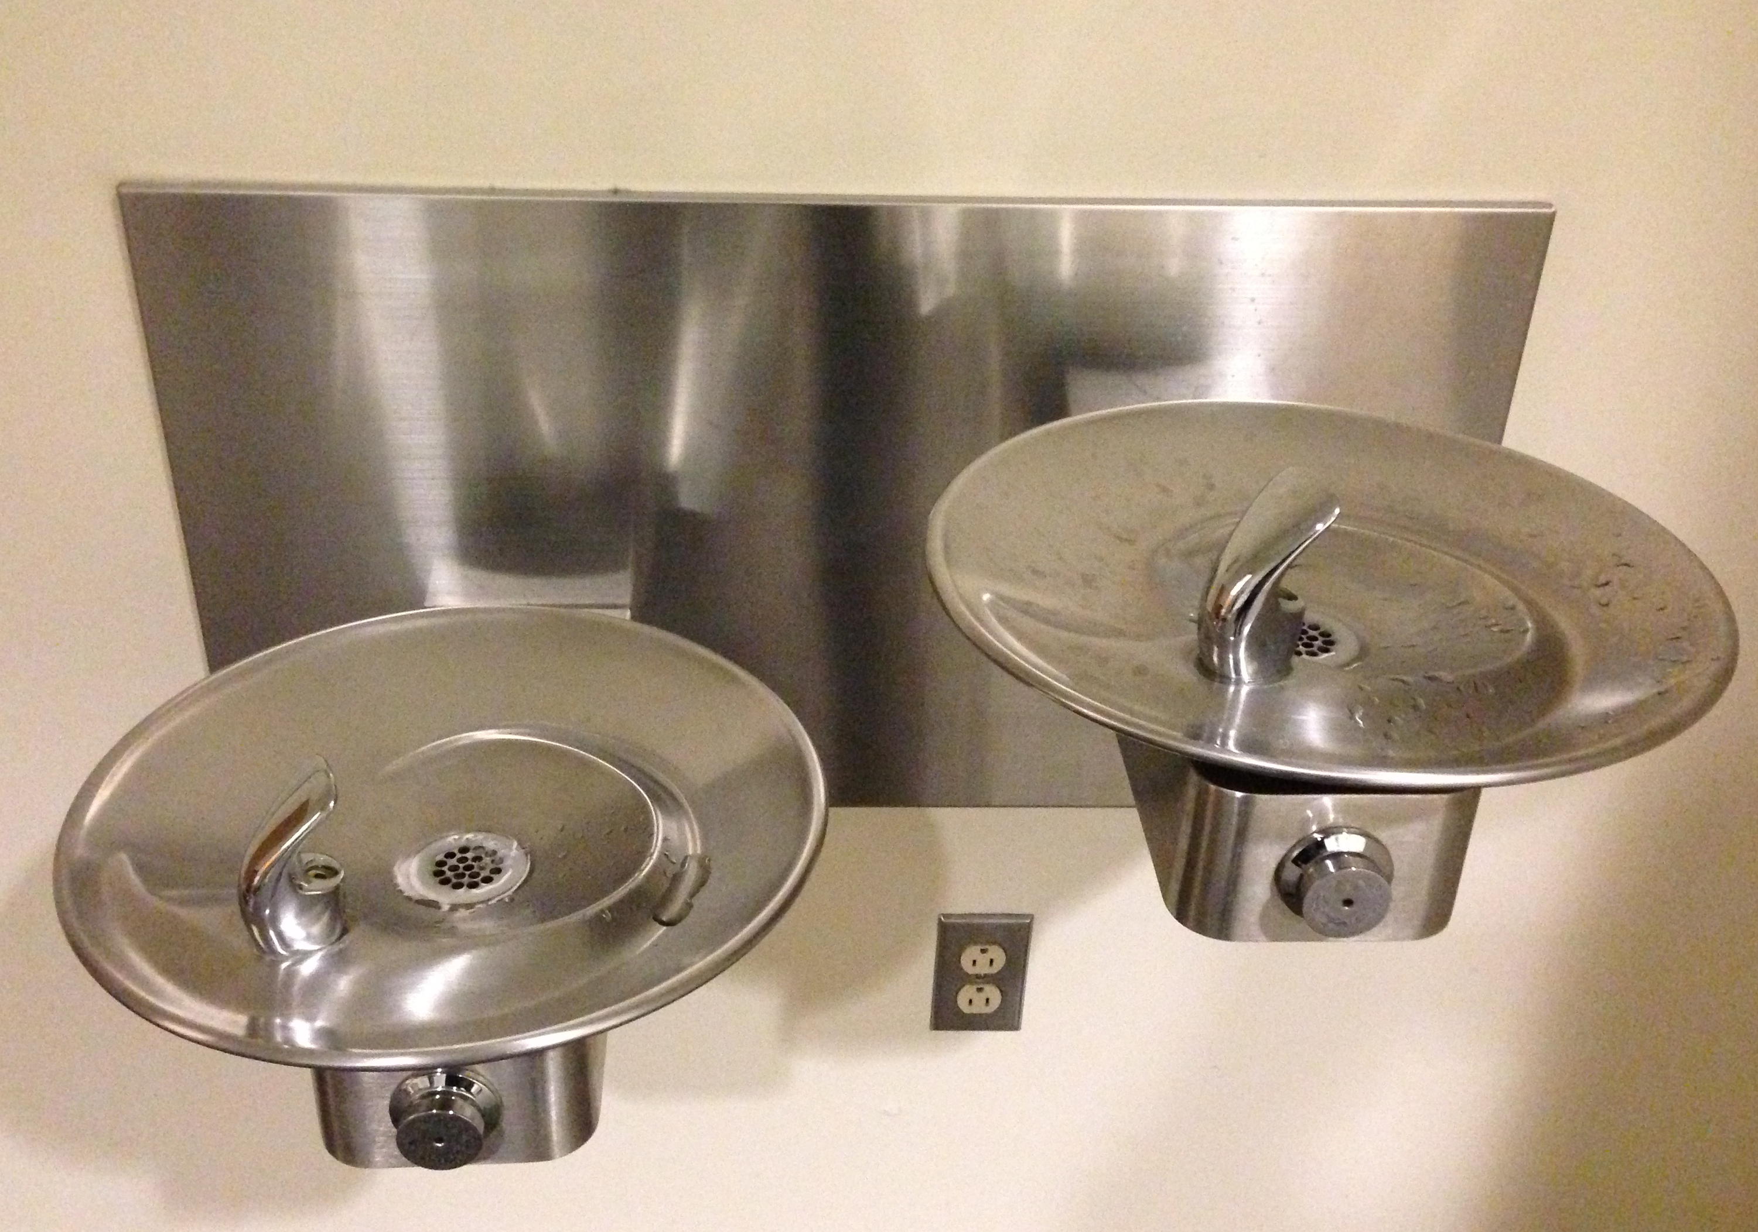
Data Collection
277 fountains and bottle fillers in 36 buildings
Flow rate
Temperature
Clarity, smell, color
Cleanliness
Ideal Fountain
Notes:
Team A
277 water fountains and hydration stations, # buildings
Flow rate
Temperature
Clarity, smell, and color (on a scale of 1-3, 1=ideal, 3=poor)
Overall cleanliness of the

Slide 8
Data Analysis
274 analyzed
Flow rate:
Fast: <40 sec
Medium: 40-72 sec
Slow: >72 sec
Temperature:
<15°C
15-20°C
>20°C
Appearance:
Clean
Dirty: solids, rust, stains
Notes:
Team A
n=274 used for data analysis
Flow rate:
fast: < 40s to fill 24oz bottle
medium: 40-72s
slow: >72s
Temperature: split in 0-15°C, 15.5-20°C, and 20.5+°C.
Cleanliness: clean and desirable VS. dirty and undesirable

Slide 9
Slow Drainage
Data Collection Photo
Notes:
Team A

Slide 10
Broken Fountain
Mineral Deposits on faucet
Notes:
Team A

Slide 11
Results
Measured Characteristics | Value
Average time to fill (seconds) | 27.0
Average temperature (°C) | 14.5
Clear water | 97.5%
Odorless water | 96.7%
Colorless water | 99.6%
Mold/mildew | 1.4%
Fluid waste | 0.7%
Solid waste | 13.1%
Rust | 9.9%
Damage-free | 99.3%
Mineral deposits | 21.5%
Notes:
Team A

Slide 12
Distribution of Problem Fountains
Temperature >15°
>40sec to fill 24oz bottle
24
24%
3%
2%
1%
58% had no problems
42% had problems
7%
0%
13%
Dirty (not including mineral deposits)
Notes:
Team A
Overall quality breakdown, percent ()

Slide 13
Time to Fill
Speed | # Fountains
Fast (desirable) | 254
Medium (less desirable) | 18
Slow (undesirable) | 2
Notes:
Team A

Slide 14
Water Temperature
Temperature | # Fountains
Cold (desirable) | 185
Medium (less desirable) | 58
Warm (undesirable) | 31
Notes:
Team A

Slide 15
Breakdown of Dirty Fountains
Notes:
Team A

Slide 16
Policy Review
Existing policies
Policy opportunities
Notes:
Team C

Slide 17
Existing Drinking Water Policies Relevant to UW
Federal
Occupational Safety & Health Admin
National Sanitation Foundation
State
WAC 246-290
WAC 51-50-2900
UW
Green Cleaning Policy
Notes:
Team C
Methodology of policy review.

Slide 18
WA State Drinking Fountain Policy
> 30 Occupants:
first 150 occupants: 1 drinking fountain
1 fountain for each additional 500 occupants
Sporting facilities:
1 drinking fountain for each 1000 occupants.
Notes:
Team C
Occupant loads over 30 shall have one drinking fountain for the first 150 occupants, then one per each additional 500 occupants. For sporting facilities with concessions serving drinks shall have one drinking fountain for each 1000 occupants.

Slide 19
Campus Building Services Policy
Clean and sanitary fountains
Problems:
Budget
Campus size
Number of custodians
Notes:
Team C
Green Cleaning Policy
Building Services Department at University of Washington
Fountains should be sanitary and clean.
APPA level 3: causal inattention . This could be due to the budget reduction that square footage per custodian increased. We are currently striving for APPA level 2: ordinary tidiness.
Building Services Department Green Cleaning Policy

Slide 20
Water Promotion Policy Leaders
Elimination of
Sugary Drinks
Howard County, MD
Boston, MA
Elimination of Bottled water
University of Vermont
Vassar College
Education Campaigns to Increase Tap
University of Wisconsin, Stout
University of California, Berkeley
88 others…
Notes:
Team C

Slide 21
Rationale for Policy Recommendations
Notes:
This slide might distract the audience. Will be removed. (or should be kept?)
TO BE DISCUSSED TUES MORNING
Team C

Slide 22
Policy Recommendations
Create new Freshmen Orientation module
Adopt healthy food and beverage guidelines for meetings on campus
Enforce existing fountain maintenance policy
Marketing campaign
Notes:
Team C

Slide 23
Freshmen Orientation Module
Current curriculum: Health and Wellness session
Policy recommendation: Add 30-min module to include research on sugary drinks
Discuss benefits of drinking tap water
Provide refillable bottle and map of fountains
Notes:
Recommended policies are reorganized into a new order so they are consistent.
Add key points of the policy.
Tap into existing policy for Freshman Orientation at UW: Health and Wellness session occurs on day 1 of orientation: we will present a 30-minute module highlighting the health benefits of increasing water consumption while decreasing sugary drinks

Slide 24
Adopt healthy food and beverage guidelines for meetings at UW
Specify tap water to be provided at meetings
Notes:
WA state dept of health: WA state guidelines to help energize your meetings
3-star rating currently says: Provide water at breaks and meals
No mention of water for 1 and 2-star rated meetings

Slide 25
Enforce Existing Fountain Maintenance Policy
Existing policy: fountains to be cleaned daily
Reality: cuts to higher education = greater demand on cleaning staff
Daily cleaning overlooked
Visual appeal important for fountain use
Notes:
Address the current issues and make proposals
Discuss Gene W. conversation with Erin: talk about square footage and number of staff responsible for health sciences building:
Discuss time it takes to clean area and inadequacy of staff man-power to cover each item on ‘Daily Pubic Area Cleaning’ list

Slide 26
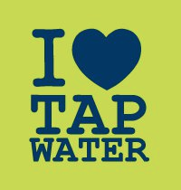
Marketing Campaign: Promote Campus-Wide Tap Usage
Notes:
Discuss activities that ‘I heart tap water’ campaign will include

Slide 27
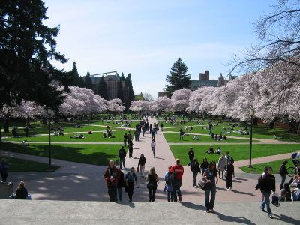
Marketing Campaign: Audience
Students
Primary Audience
Most affected by the problem
Most likely to change their behavior
Most feasible to reach
Contemplation stage→ ready to change
Faculty, facilities and maintenance staff
Secondary Audience
Notes:
Team D
Audience:
Most affected by the problem: thirsty students
Most likely to change their behavior: thirsty students
Most feasible to reach: students
Key secondary audiences: faculty and staff, facilities maintenance
Incentives
Aspirations:
Academic performance
Maintain health, not gain weight
Low Cost
competing behaviors against which you can "win”
Readiness:
Most of the student body is in the contemplation stage of change; promotional campaign will move students into preparation and action stage of change

Slide 28
Marketing Campaign: Audience
Aspirations of Students
Improve academic performance
Maintain health
Minimize weight gain
Reduce debt
How to get them to change?
Competing behaviors against which you can “win”
Notes:
Team D

Slide 29
Marketing Campaign: Outreach
Information channels used
Posters (shocking=most effective)
Peers, word of mouth
Freshmen Orientation
Specific activity
Poster campaign
Free, refillable water bottles
More water bottle fillers
Notes:
Team D
Specific
Measurable
Achievable
Relevant
Time-specific

Slide 30
Previously Developed Tap Water Campaigns
Are You Pouring on the Pounds
New York City
I Love Tap Water
University of Wisconsin-Stout
I Love Tap Water
UC Berkeley
Notes:
Team D

Slide 31
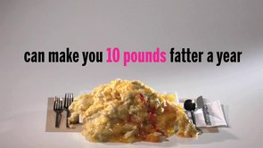
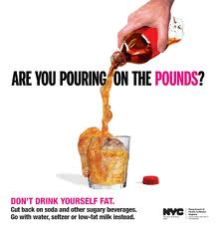
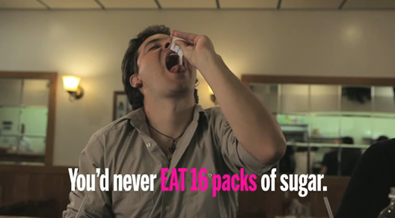
Are You Pouring on the Pounds? (New York City)
Notes:
Team D

Slide 32
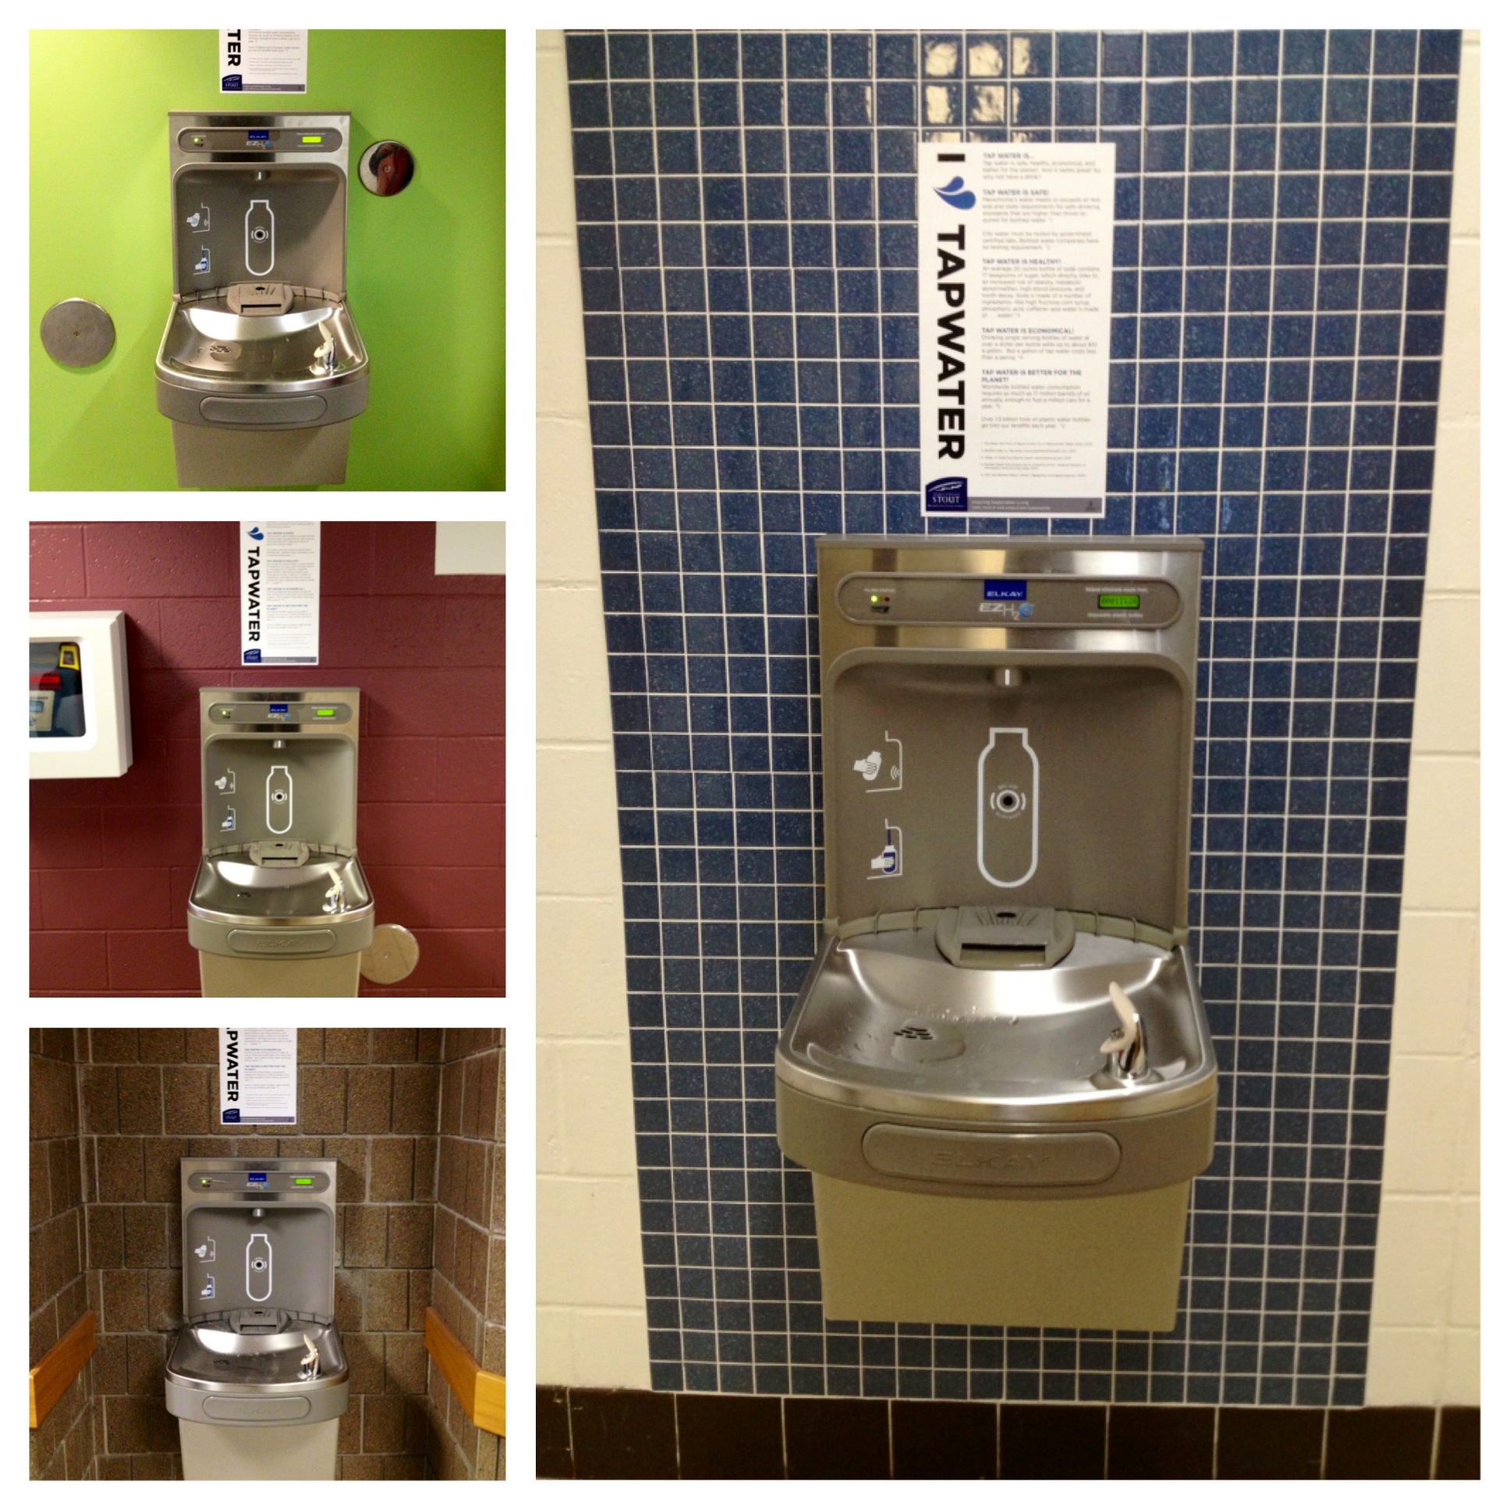
I Love Tap Water (University of Wisconsin-Stout)
Notes:
Team D

Slide 33
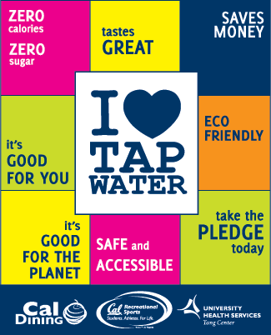
I Love Tap Water (University of California Berkeley)
Notes:
Team D –

Slide 34
Limitations of Assessment
Quality = Multi-factor measurements
Important measures not assessed
Contaminants in water
Spatial access
Slight intergroup differences in collecting the data
Notes:
Team B
Measurement of water quality and access is multifactorial, and not all of these factors could be addressed by our study. It was only practical in this study to measure water temperature, clarity, color, flow rate (time to fill a 3oz vial) and qualitative measures of fountain cleanliness. Some limitations include how we selected fountains, discrepancies in measurements between groups, and measurements of access and quality that were not made in this study. In most buildings, every fountain was assessed. In the Magnuson Health Sciences building fountains were chosen at random by the researchers due to the size and complex layout of the building. This particular building has different wings built in different years, which may result in variations in water access in the building that is not completely described by our sample.
Taste, pH, bacterial load, lead and other metal or mineral content of the water are important measures of water quality which we did not assess (Johnson & Scherer, 2012). We were not able to measure these qualities due to constraints in time, training, and the equipment necessary for an accurate assessment. Measures of spatial access to fountains within buildings were not addressed, but we did note that several buildings only had access points at one end of a building. The density of available fountains compared to population, the amount of individuals usually in a building at one time compared to drinking fountains, was also not accessed. Perceptions of water access point cleanliness and ease of use would have been difficult to measure. A large majority of the fountains tested were scored as clean with clear and cold water. Perceptions of water access points may provide important information on typical use of fountains, whether the measured flow is adequate for drinking or filling bottles and other insight into why fountains are or are not used.
Finally, there were slight discrepancies between groups in the measurement of water quality. Poor lighting in some buildings and the presence of bubbles in water at some access points made it difficult for groups to assess clarity and color. In addition, temperature measurements could be artificially inflated by the heat transferred by holding the vial in the hand between measuring fountains, and the length of time before the fountain cooling system turned on. Many groups noted that water temperatures measured before the audible start of the cooling system were higher than a second measurement taken after the cooling system had turned on. This issue would be mimicked in a real world scenario. Some groups rinsed their vials first to avoid artificially inflated temperatures due to heat transferred from the hand to the vial, while others did not. Finally, time to fill measurements were likely different between groups due to differences in vial-filling techniques or human error in stopwatch use.

Slide 35
Conclusion
Purpose:
Evaluate access to drinking water
Identify barriers to free water access
Identify opportunities for policy
Findings:
95% of fountains and bottle fillers were free of mold, mildew, odors, colors, and fluid waste
Notes:
The purpose of this project was three-fold:
First to evaluate the quality of free drinking water on campus
Identify reasons why people may choose sugary beverages over free water
Identify opportunities for policy to encourage consumption of free water
Our assessment showed that the majority of water sources on campus are desirable.
The average time to fill a 24-ounce water bottle was 27.04 seconds which was considered fast,
the average water temperature was desirable (14.5°C) and
more than 95% of the fountains were free of mold, mildew, undesirable odors and colors, and fluid wastes.

Slide 36
Conclusion
Policy Opportunities at UW:
Create new Freshmen Orientation module
Adopt healthy food and beverage guidelines for meetings on campus
Enforce existing fountain maintenance policy
Marketing campaign
Notes:
Policy:
Encouraging water consumption as part of the Freshman Orientation event
Implementing a promotional campaign similar to “I HEART water” campaigns on other campuses
Revise Energize Your Meeting Criteria to provide tap water
Enforce existing fountain maintenance to foster positive perceptions of drinking fountains
Goal with these policies is to make drinking tap water en vogue
In like with HP 2020 and IOM recommendations of creating environments where choosing tap water over sugary drinks is the popular choice the easy choice

Slide 37
Questions And Discussion
Notes:
Have a final report available which we are happy to share with you
At this time we would like to open it up to your questions and discussion

Slide 38
Thank You for Attending!
Notes:
Thank you again for attending

