Slide 1
Hypothesis test flow chart
START HERE
Test H₀: ρ=0
(17.2)
Table G
1
number of
correlations
correlation (r)
frequency
data
number of
variables
2
χ² test for
independence
(19.9) Table I
Measurement
scale
2
1
Test H₀: ρ₁= ρ₂
(17.4)
Tables H and A
Means
basic χ² test
(19.5)
Table I
z -test
(13.1)
Table A
Yes
Do you know
σ?
1
number of
means
More than 2
number of
factors
2
2-way ANOVA
Ch 21
Table E
No
2
1
t -test
(13.14)
Table D
1-way ANOVA
Ch 20
Table E
independent
samples?
Yes
No
Test H₀: μ₁= μ₂
(15.6)
Table D
Test H₀: D=0
(16.4)
Table D

Slide 2
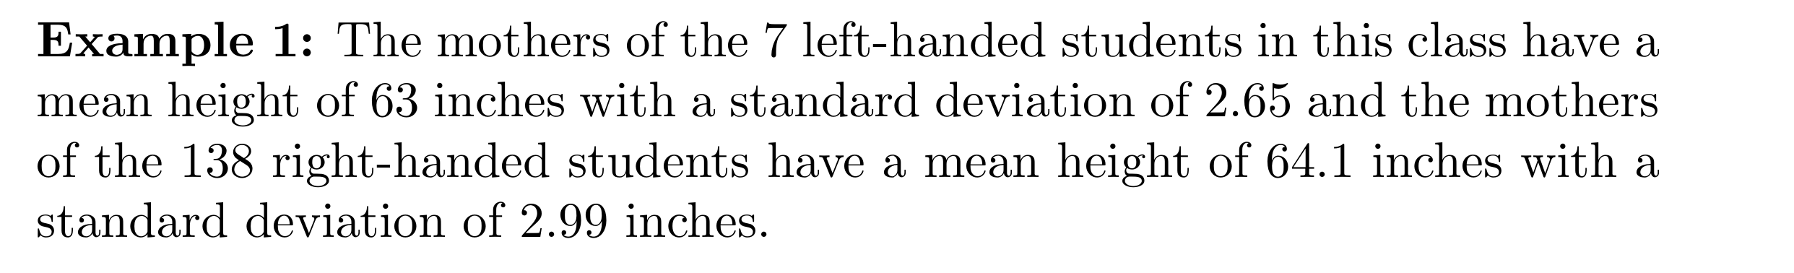
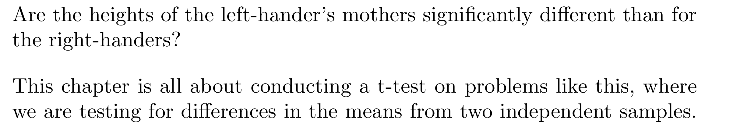
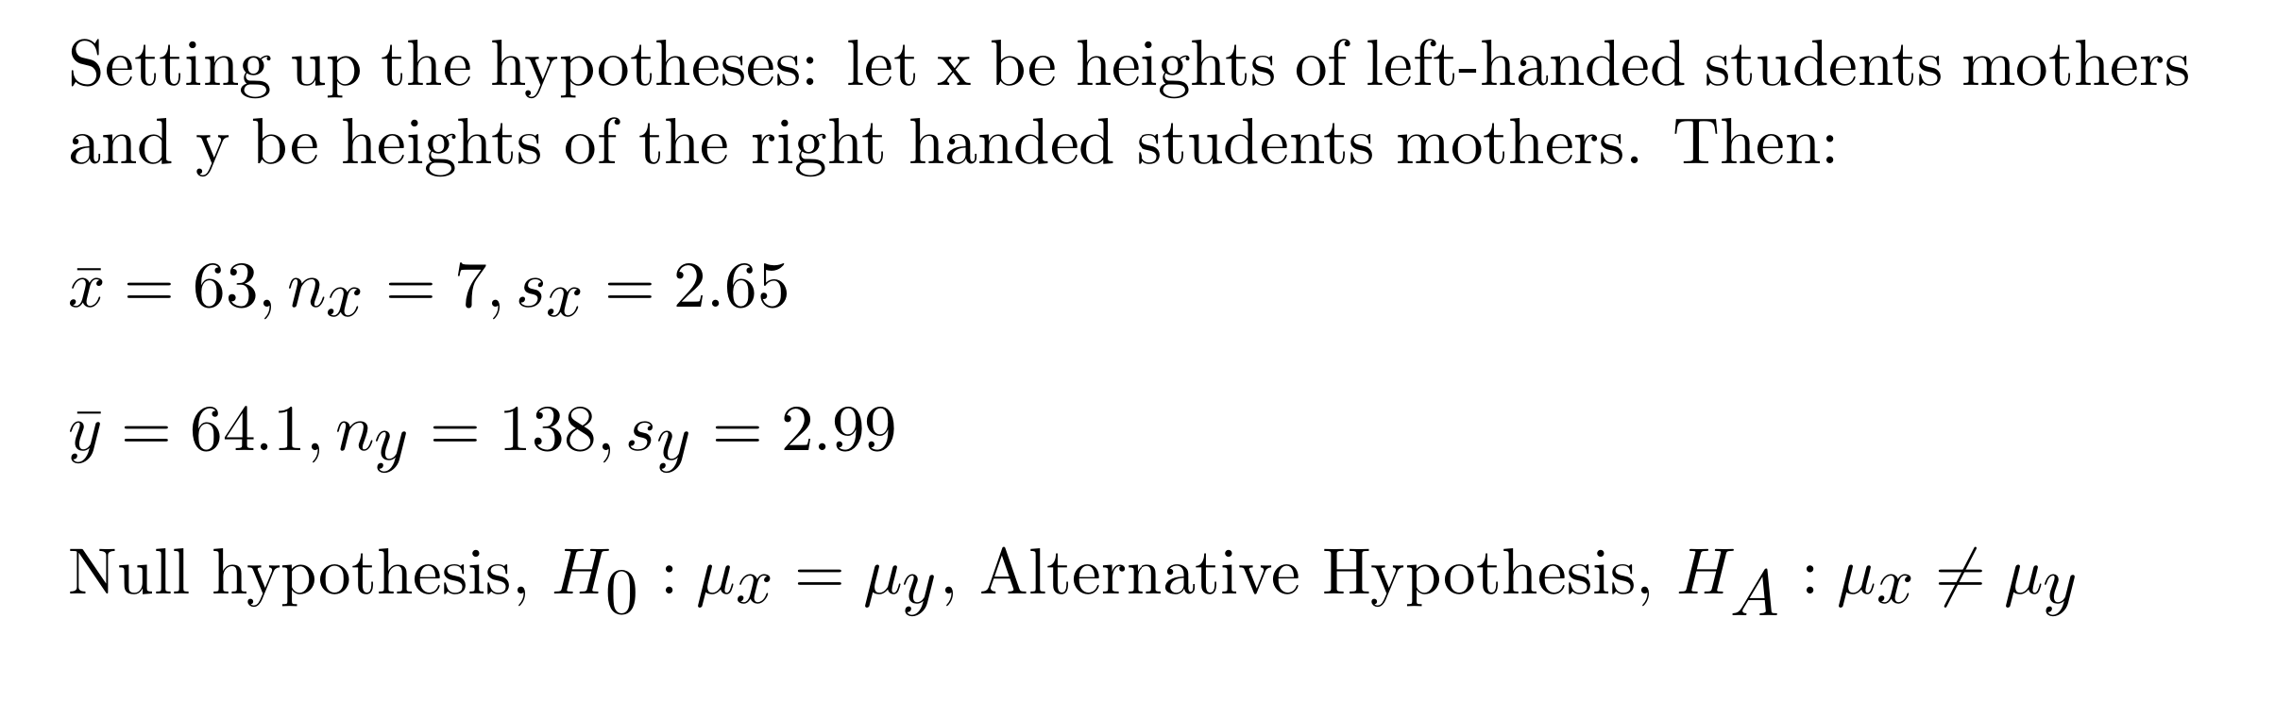
Chapter 14: Testing Hypotheses for Two Means

Slide 3
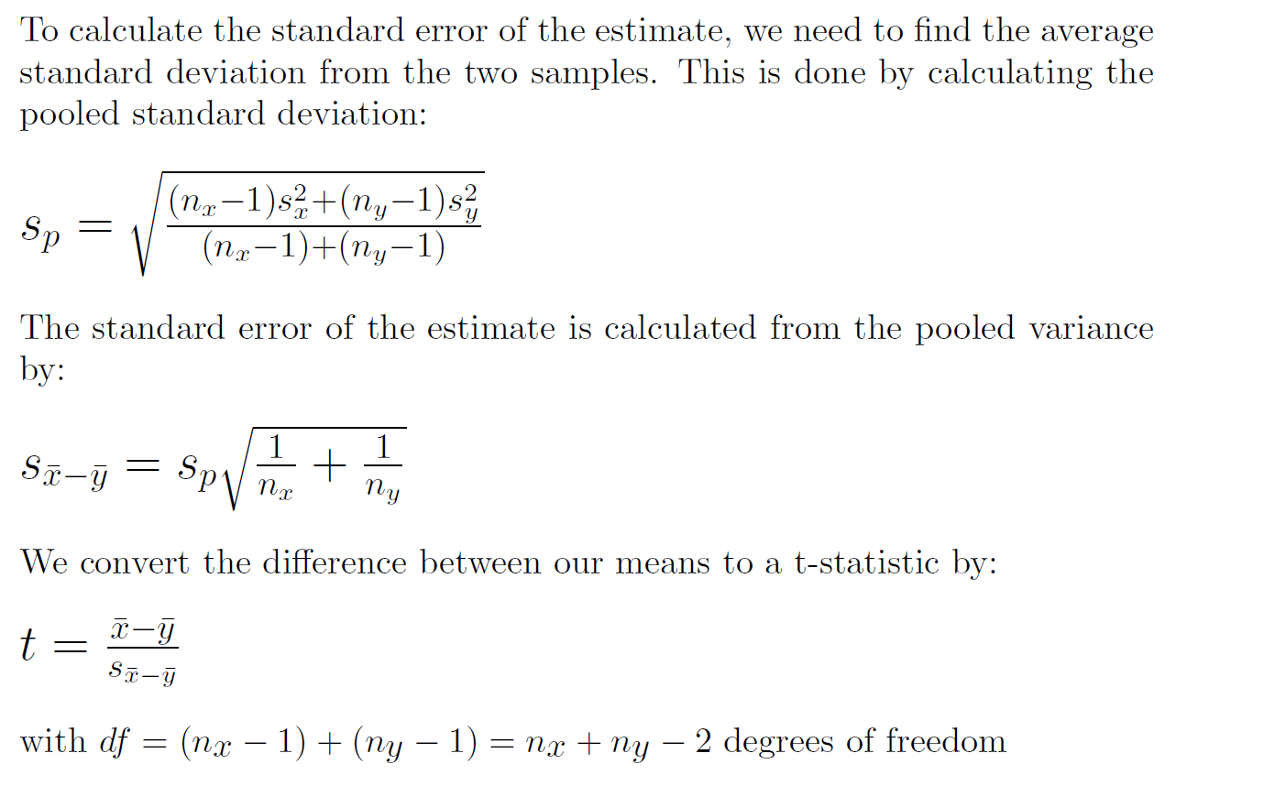

Slide 4
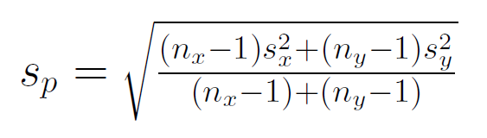
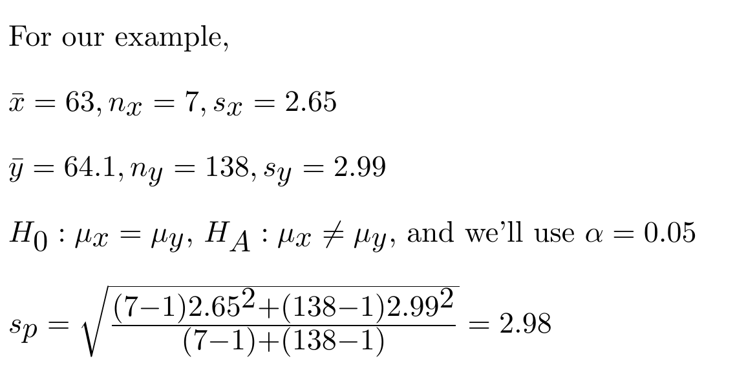
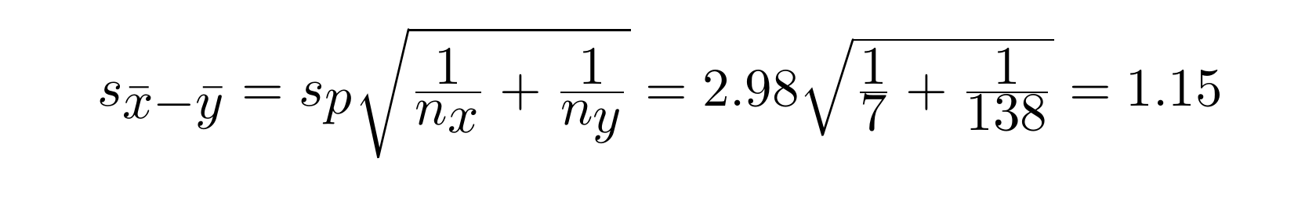
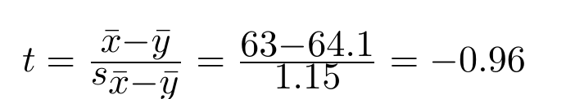
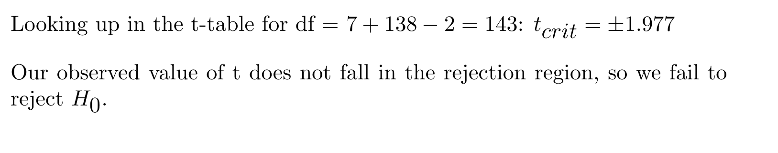

Slide 5
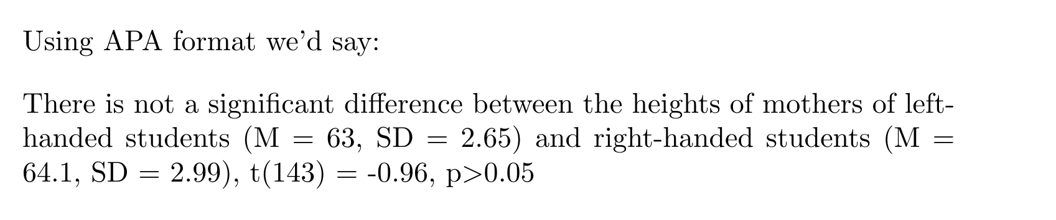

Slide 6
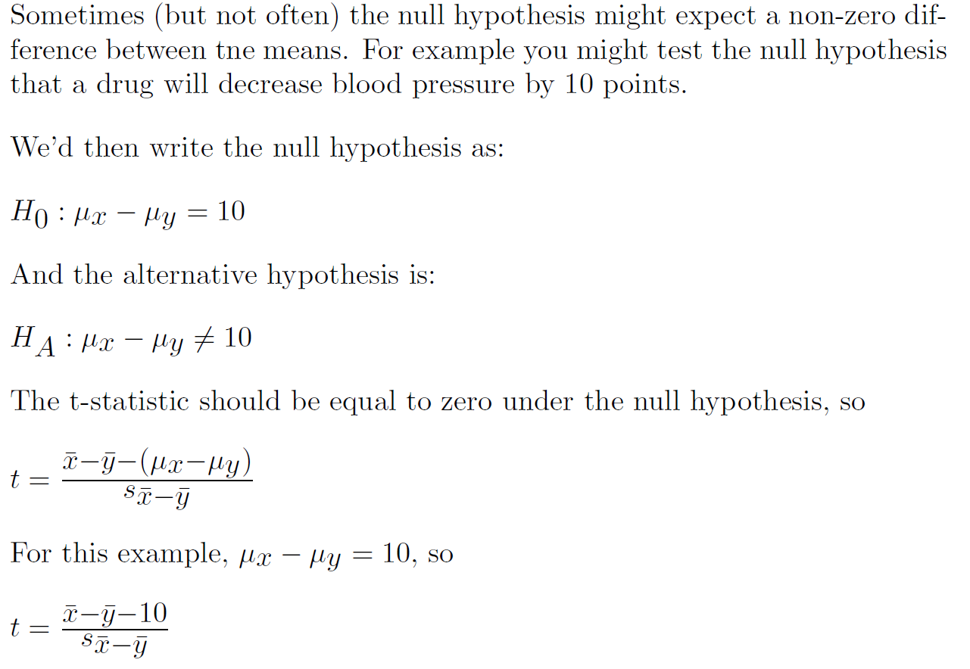

Slide 7
To apply a t-test on the difference between two independent means, we must assume:
Each sample is drawn at random from its respective population.
  This is the basis rule of random sampling, but for two populations.
The two random samples must be independently selected.
  i.e. there should be no expected correlation between X and Y.
Samples are drawn with replacement
This is almost never done, but if the population is large it doesn’t matter much.
4) The sampling distribution of the difference between means is normal.
  This where the central limit theorem comes to the rescue. The larger the sample size, the more normally distributed the difference of means will become.
Other names for this test are ‘Unpaired two-sample t-test’ and ‘Independent two-sample” t-test.

Slide 8
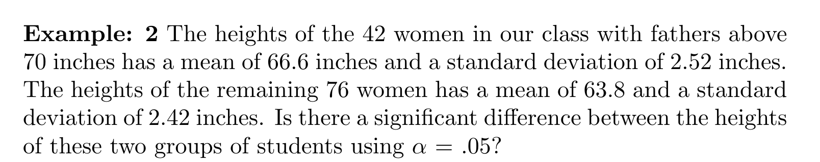
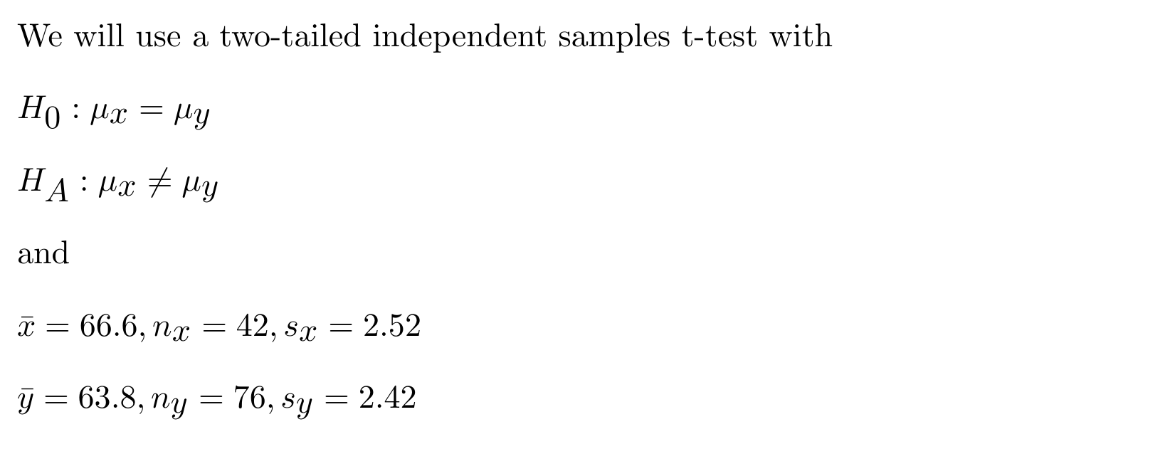

Slide 9
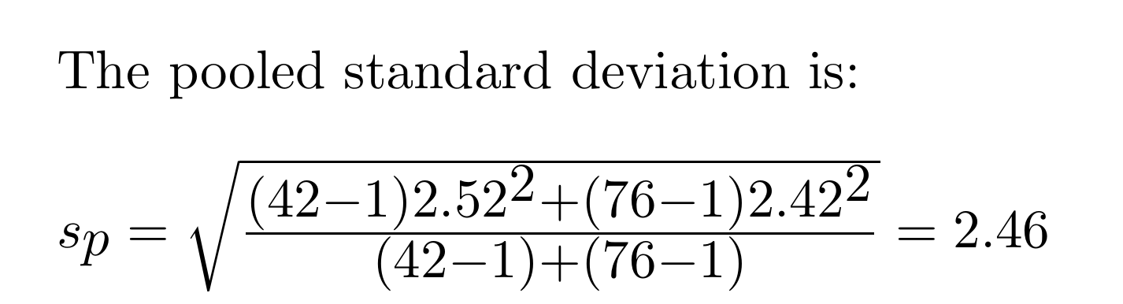
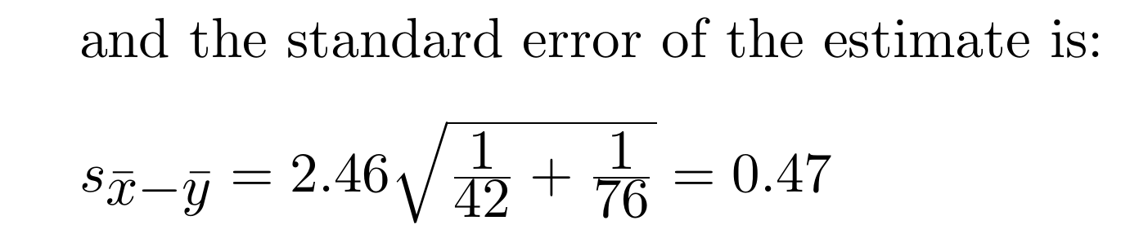
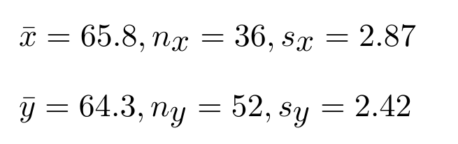
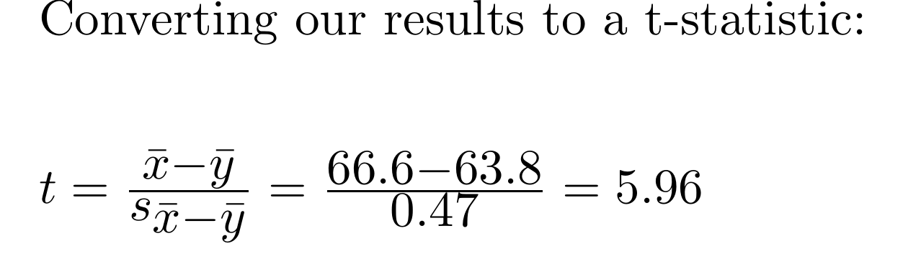

Slide 10
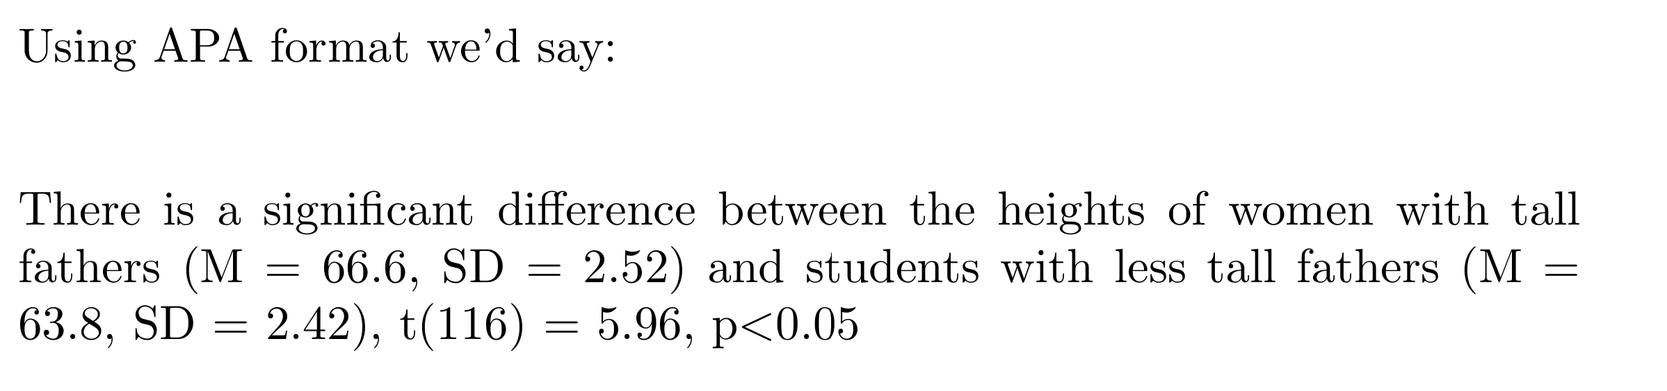

Slide 11
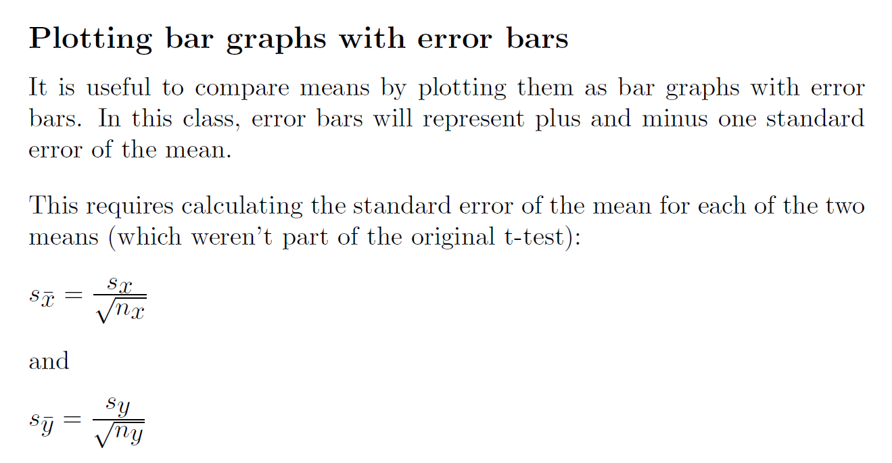

Slide 12
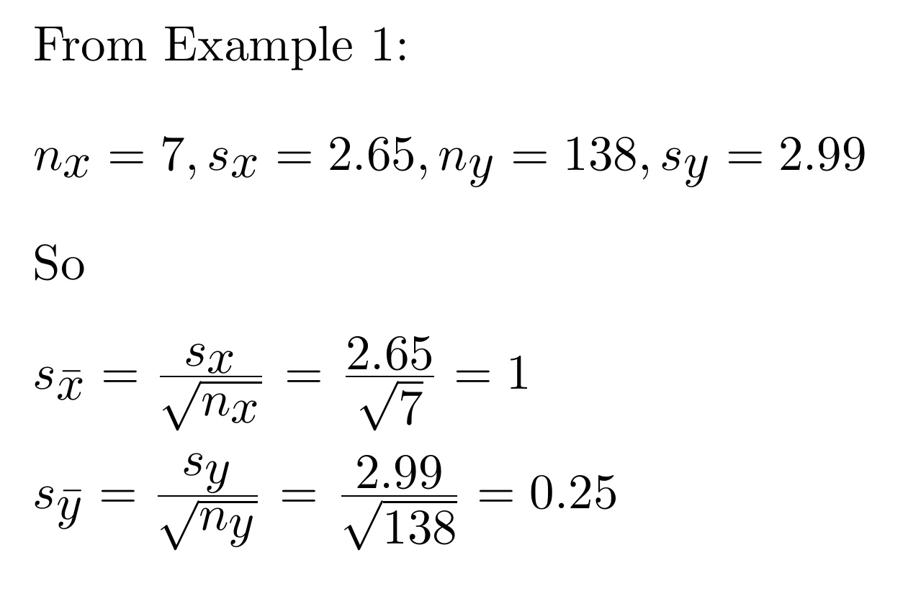
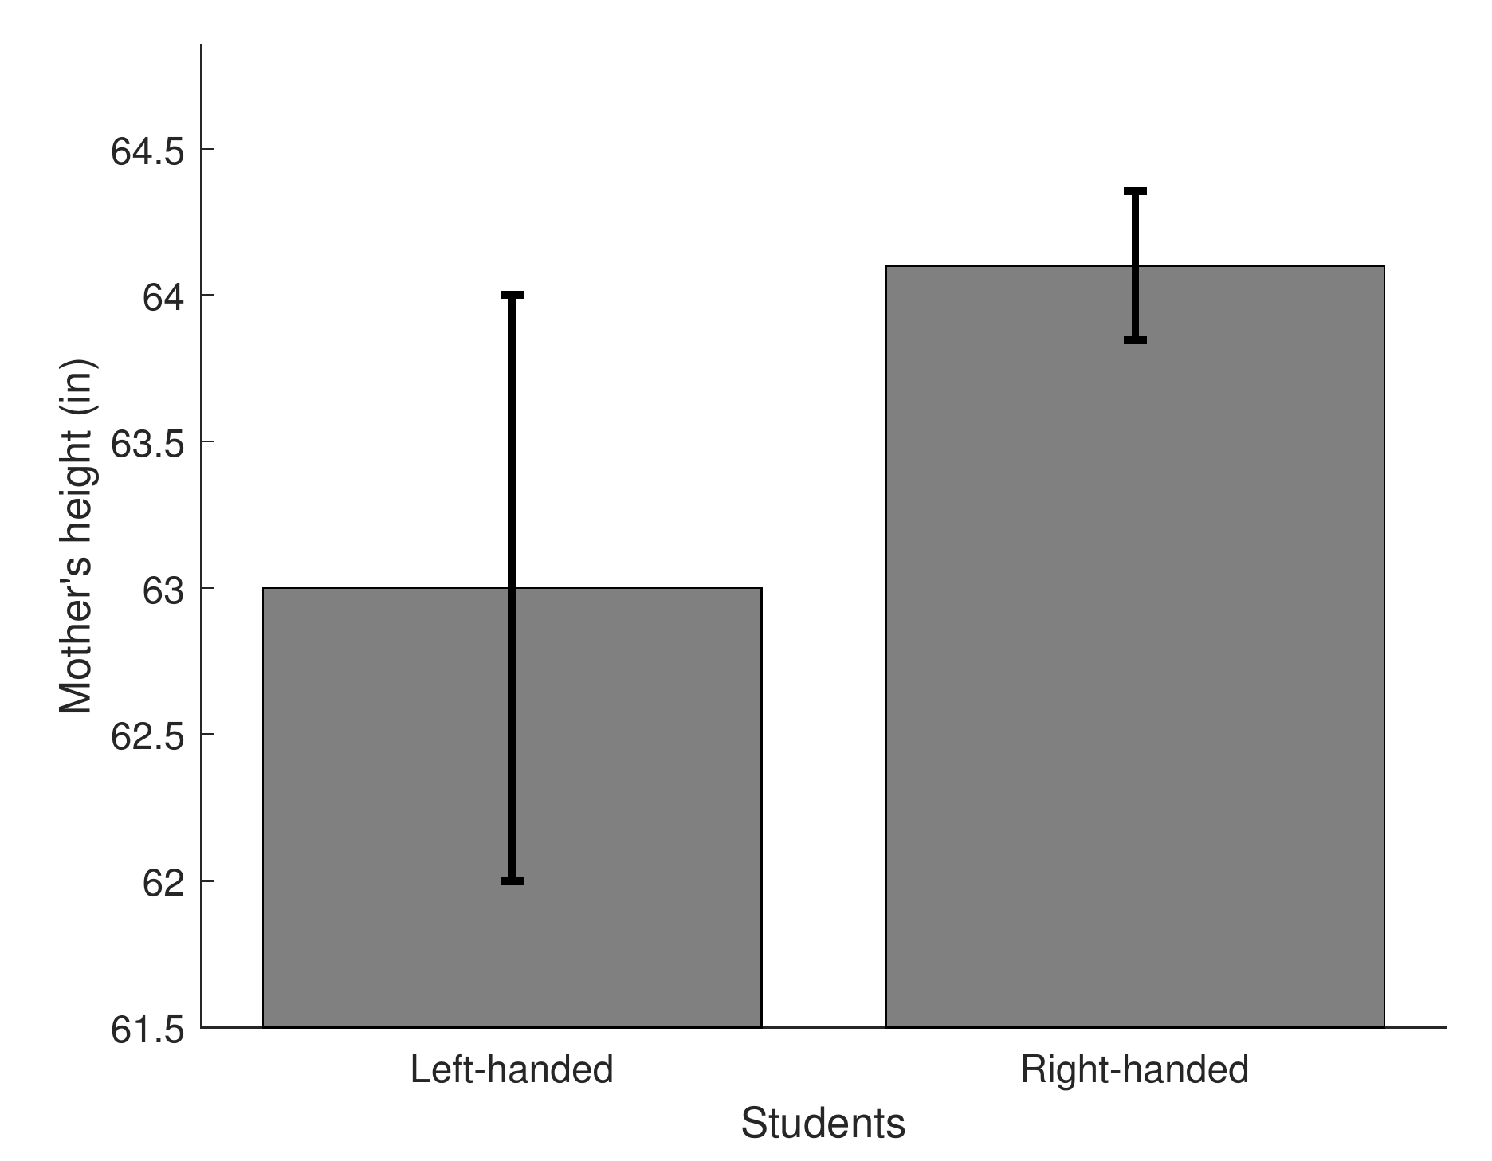

Slide 13
Rule of thumb: If the error bars representing standard errors of the mean overlap, a one-tailed t-test will probably fail to reject H_{O} with α = .05.
In general, the bars need a gap to reach statistical significance.

Slide 14
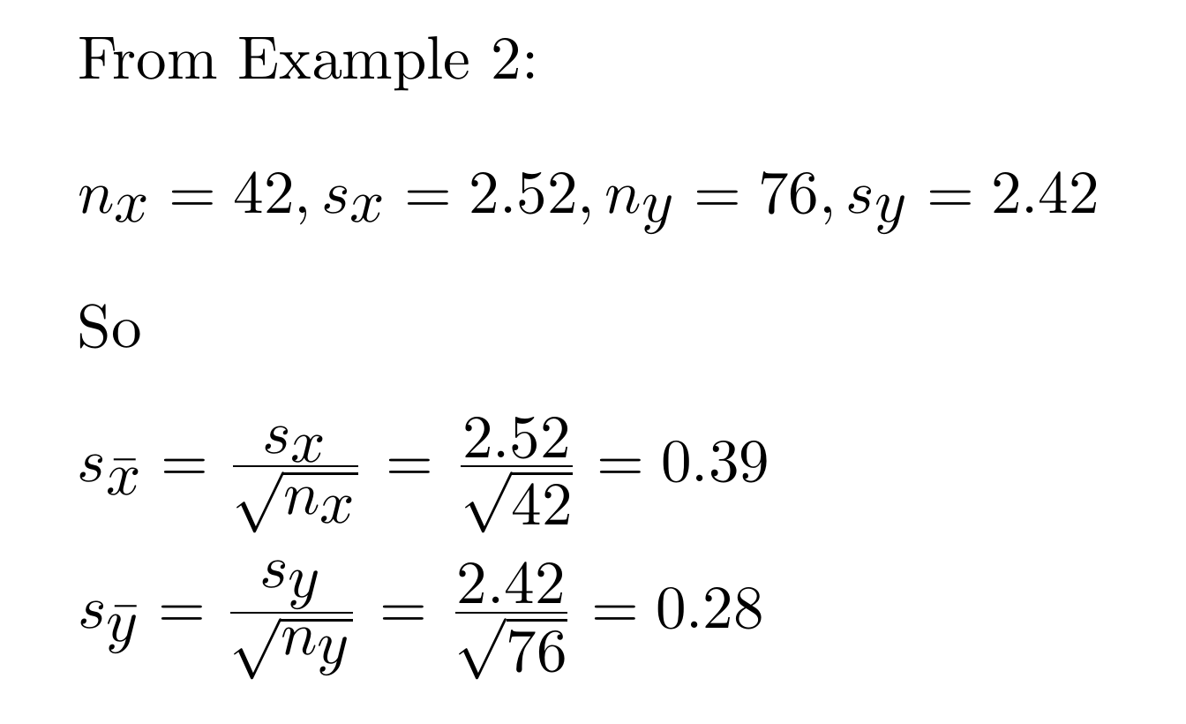
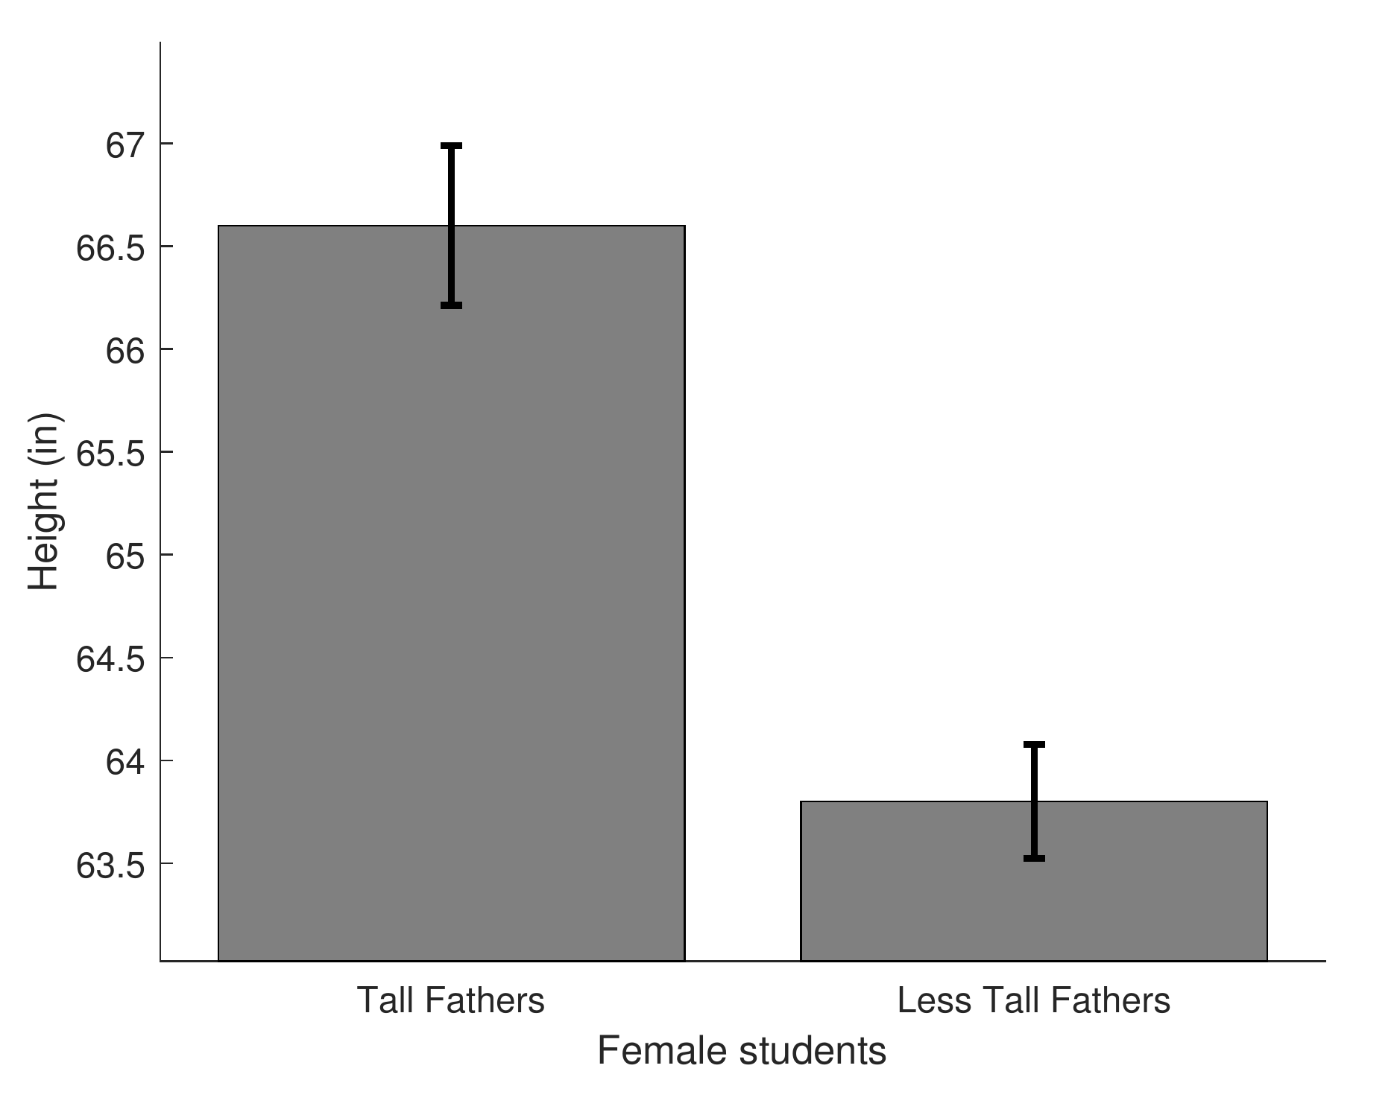

Slide 15
In the pursuit of science, you measure the anger of 10 fluffy and 10 noisy athletes and obtain for fluffy athletes a mean anger of 102.5 and a standard deviation of 19.21, and for noisy athletes a mean of 92.8 and a standard deviation of 20.96.
Using an alpha value of 0.05, is the mean anger of fluffy athletes significantly greater than for the noisy athletes?
We fail to reject H₀. (t(18) = 1.08, t_{crit} = 1.7341) The anger of fluffy athletes is not significantly greater than the anger of noisy athletes. p = 0.1474

Slide 16
Your Psych 315 professor asks you to measure the money of 10 laughable and 10 flimsy candy bars and obtain for laughable candy bars a mean money of 106 and a standard deviation of 12.25, and for flimsy candy bars a mean of 107.2 and a standard deviation of 17.4.
Using an alpha value of 0.05, is the mean money of laughable candy bars significantly greater than for the flimsy candy bars?
120
100
80
money
60
40
20
0
laughable
flimsy
candy bars
We fail to reject H₀. (t(18) = -0.18, t_{crit} = 1.7341) The money of laughable candy bars is not significantly greater than the money of flimsy candy bars. p = 0.5698

Slide 17
Tomorrow you measure the clothing of 10 kind and 10 red geeks and obtain for kind geeks a mean clothing of 110.2 and a standard deviation of 14.91, and for red geeks a mean of 87.4 and a standard deviation of 13.22.
Using an alpha value of 0.05, is the mean clothing of kind geeks significantly greater than for the red geeks?
120
100
80
clothing
60
40
20
0
kind
red
geeks
We reject H₀. (t(18) = 3.62, t_{crit} = 1.7341) The clothing of kind geeks is significantly greater than the clothing of red geeks. p = 0.0010

Slide 18
Just for fun, you measure the conductivity of 14 straight and 12 strange teams and obtain for straight teams a mean conductivity of 19.4 and a standard deviation of 11.74, and for strange teams a mean of 13.2 and a standard deviation of 11.77.
Using an alpha value of 0.05, is the mean conductivity of straight teams significantly greater than for the strange teams?
25
20
15
conductivity
10
5
0
straight
strange
teams
We fail to reject H₀. (t(24) = 1.34, t_{crit} = 1.7109) The conductivity of straight teams is not significantly greater than the conductivity of strange teams. p = 0.0963

Slide 19
On a dare, you measure the age of 20 capricious and 19 enthusiastic Asian food and obtain for capricious Asian food a mean age of 22.8 and a standard deviation of 12.05, and for enthusiastic Asian food a mean of 12.5 and a standard deviation of 14.82.
Using an alpha value of 0.05, is the mean age of capricious Asian food significantly greater than for the enthusiastic Asian food?
30
25
20
age
15
10
5
0
capricious
enthusiastic
Asian food
We reject H₀. (t(37) = 2.39, t_{crit} = 1.6871) The age of capricious Asian food is significantly greater than the age of enthusiastic Asian food. p = 0.0111

Slide 20
I measure the conduct of 17 aware and 19 easy beers and obtain for aware beers a mean conduct of 26.5 and a standard deviation of 14.9, and for easy beers a mean of 17.6 and a standard deviation of 15.04.
Using an alpha value of 0.05, is the mean conduct of aware beers significantly greater than for the easy beers?
35
30
25
20
conduct
15
10
5
0
aware
easy
beers
We reject H₀. (t(34) = 1.78, t_{crit} = 1.6909) The conduct of aware beers is significantly greater than the conduct of easy beers. p = 0.0420

Slide 21
We decide to measure the visual acuity of 12 husky and 16 wrathful Seattleites and obtain for husky Seattleites a mean visual acuity of 50.1 and a standard deviation of 11.45, and for wrathful Seattleites a mean of 42.4 and a standard deviation of 15.21.
Using an alpha value of 0.05, is the mean visual acuity of husky Seattleites significantly greater than for the wrathful Seattleites?
60
50
40
visual acuity
30
20
10
0
husky
wrathful
Seattleites
We fail to reject H₀. (t(26) = 1.47, t_{crit} = 1.7056) The visual acuity of husky Seattleites is not significantly greater than the visual acuity of wrathful Seattleites. p = 0.0772

Slide 22
I go and measure the water of 13 super and 20 tan brains and obtain for super brains a mean water of 41.5 and a standard deviation of 14.32, and for tan brains a mean of 31.9 and a standard deviation of 15.8.
Using an alpha value of 0.05, is the mean water of super brains significantly greater than for the tan brains?
We reject H₀. (t(31) = 1.77, t_{crit} = 1.6955) The water of super brains is significantly greater than the water of tan brains. p = 0.0435

Slide 23
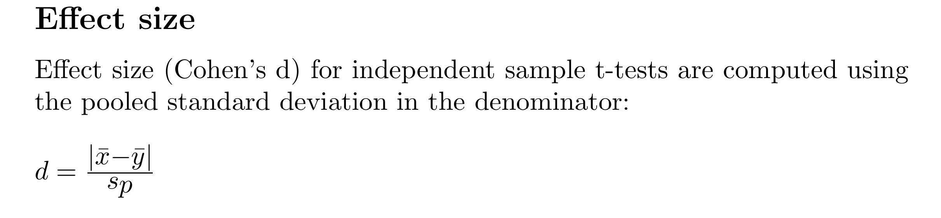
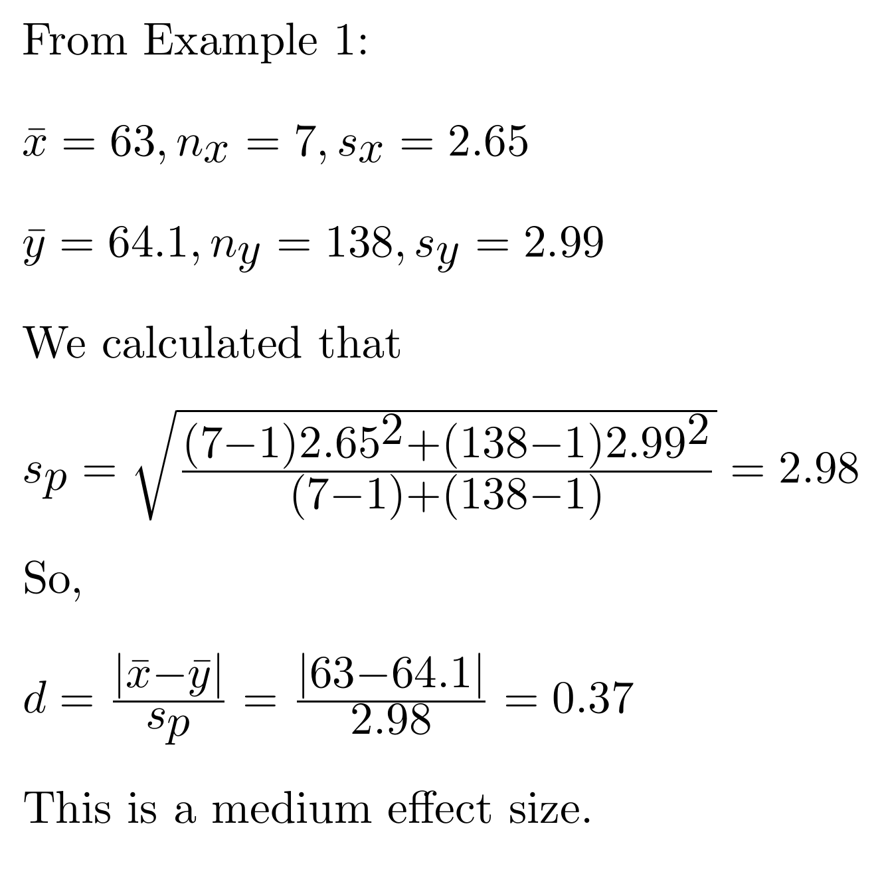

Slide 24
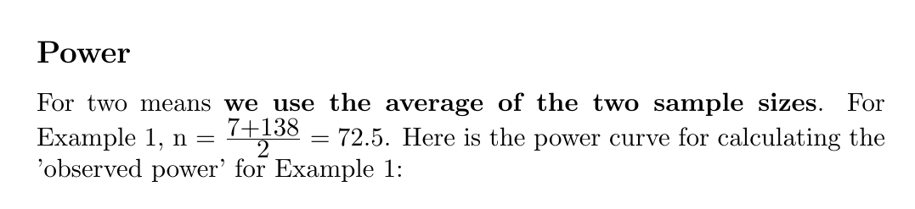
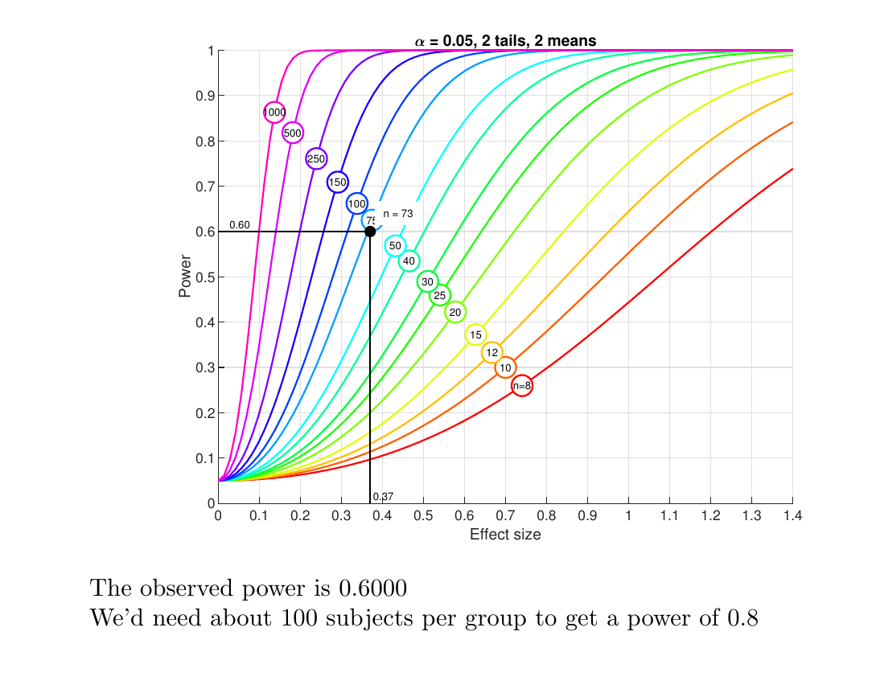

Slide 25
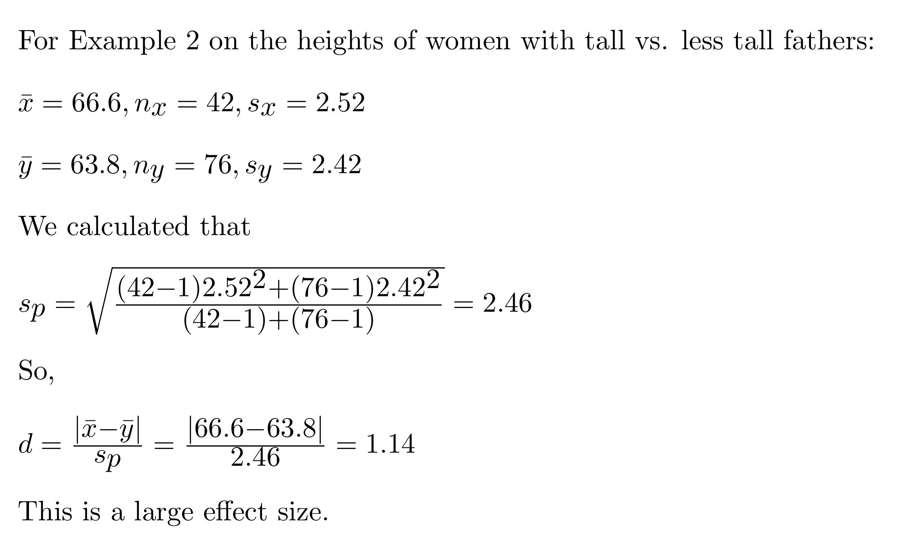

Slide 26
