Slide 1
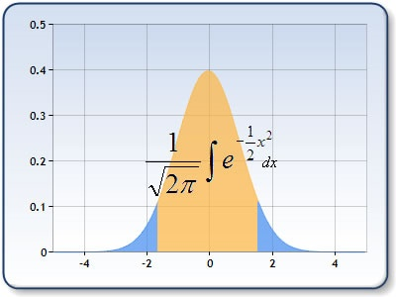
Welcome to Psych 315, Winter 2021
‘Understanding Statistics in Psychology’
Instructor: Geoffrey (Geoff) Boynton
TAs: Kelly Chang
Natalie Clay
Ryan Cummings
Course website: http://courses.washington.edu/psy315/

Slide 2
By the end of this quarter you should know how to:
-compute a statistic (means, variances, etc.)
-represent data in graphical form (bar graphs, scatter plots…) -make a statistical inference (generalize from sample a population)
-interpret a results section in an APA journal paper
-make conclusions from statistics presented to you in everyday life
-conduct statistical tests and make plots in R

Slide 3
What is/are ‘statistics’?
Statistics: The science of classifying, organizing and analyzing data
Statistic: A descriptive index of a sample. (e.g. average)
What are statistics good for?
Probably most important: Interpreting data sets in an objective way.

Slide 4
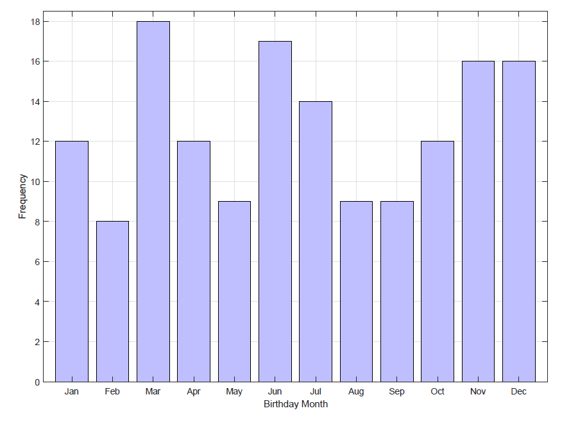
Distribution of birthdays by month:
How likely is it to get something like this by chance?

Slide 5
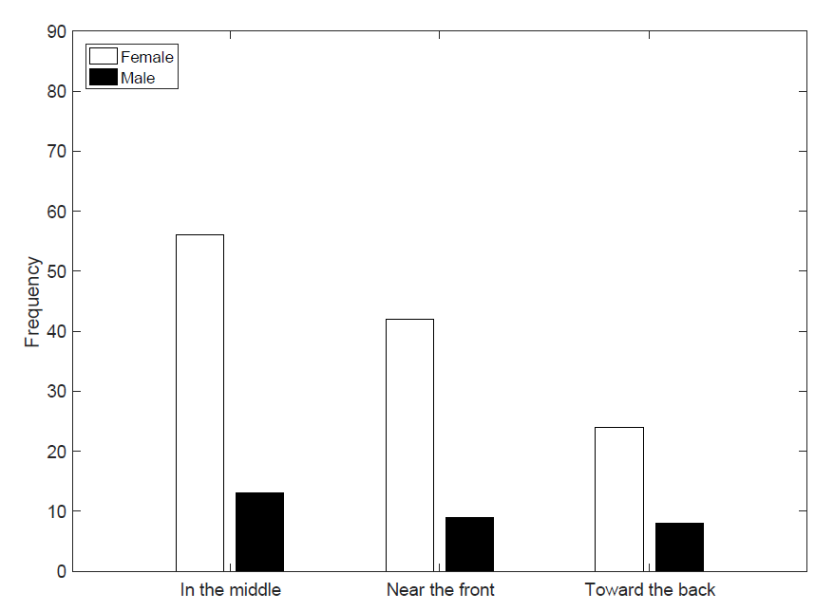
Does where you like to sit in class vary with gender?

Slide 6
Is there a relationship between your mother’s and father’s heights?
78
76
74
72
70
68
Father’s Height
66
64
62
60
58
45
50
55
60
65
70
75
Mother’s Height

Slide 7
Does how much alcohol you drink vary with how much exercise you get?
8
7
6
5
Alcoholic drinks per week
4
3
2
1
0
Not at all
Just a little
A fair amount
Very much
How much do you exercise?

Slide 8
Does the number of Facebook friends you have vary with your favorite sport?

Slide 9
Recommended (but not required) reading:

Slide 10
Recommended (but not required) reading:

Slide 11
Chapter 1: Introduction
Some basic definitions
population: the complete set of observations about which an investigator wishes to draw conclusions
parameter: a descriptive index of a population
sample: subset of a population
statistic: a descriptive index of a sample (a number that summarizes a sample)
Analogy:
A parameter is to a population as a statistic is to a sample
Random sample: a sample pulled from the population obtained in way that ensures that each sample of a given size has an equal chance of being selected from the population.

Slide 12
Chapter 1: Introduction
Two kinds of statistics: Descriptive and Inferential
Descriptive Statistics (Chapters 1-11)
Summarize observations with numbers
The mean is the most common descriptive statistic
Examples:
Kyle Seager batted .241 for the 2020 Mariners
Average high temperature for January in Seattle is 45 degrees (F)
There is an average of 19 days of rain in January in Seattle, with an average of 2.4 hours of sunshine per day

Slide 13
Two kinds of statistics: Descriptive and Inferential
Inferential Statistics (Chapters 12-22)
- Used to draw a conclusion about a population based a sample.
Example: Suppose you determine if the average IQ of Washington State citizens is greater than 100. How would you do this?

Slide 14
Scales of Measurement: Nominal, Ordinal, Interval, Ratio
Nominal Scale: mutually exclusive categories. Can’t be put in order
Example: rocks can be categorized as igneous, sedimentary and metamorphic
Ordinal Scale: like nominal, but the categories can be ranked in order.
Example: Winter Olympics Ice Dancing Scores
Interval Scale: like ordinal, but distance between measures has the same meaning across the entire range of values. Ratios are not meaningful
Examples: Temperature in Fahrenheit, Years A.D.
Ratio Scale: like interval, but the value of zero has meaning. Ratios are meaningful.
Examples: Temperature in Kelvin, height, weight, age, measures of time

Slide 15
Name that scale: Nominal, Ordinal, Interval, Ratio
Favorite color
Speed (mph)
Year A.D.
Rating on a scale from 0 to 10
Response time
Average high temperature (Fahrenheit)
Favorite number
Handedness
Mohs scale of mineral hardness (the hardness of a minerals as measured by its ability to scratch a softer one)
Parent’s height

