Slide 1
Hypothesis test flow chart
START HERE
Test H₀: ρ=0
(17.2)
Table G
1
number of
correlations
correlation (r)
frequency
data
number of
variables
2
χ² test for
independence
(19.9) Table I
Measurement
scale
2
1
Test H₀: ρ₁= ρ₂
(17.4)
Tables H and A
Means
basic χ² test
(19.5)
Table I
z -test
(13.1)
Table A
Yes
Do you know
σ?
1
number of
means
More than 2
number of
factors
2
2-way ANOVA
Ch 21
Table E
No
2
1
t -test
(13.14)
Table D
1-way ANOVA
Ch 20
Table E
independent
samples?
Yes
No
Test H₀: μ₁= μ₂
(15.6)
Table D
Test H₀: D=0
(16.4)
Table D

Slide 5
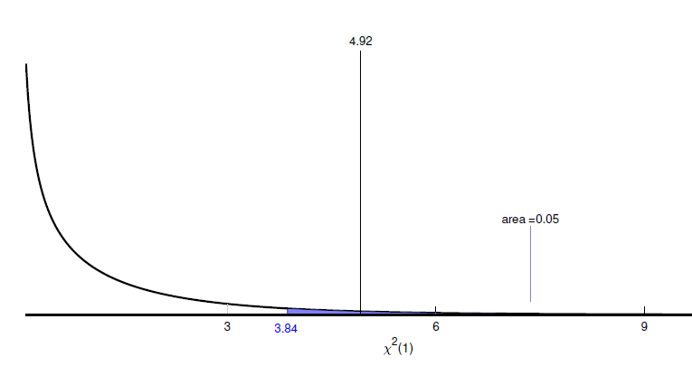

Slide 7
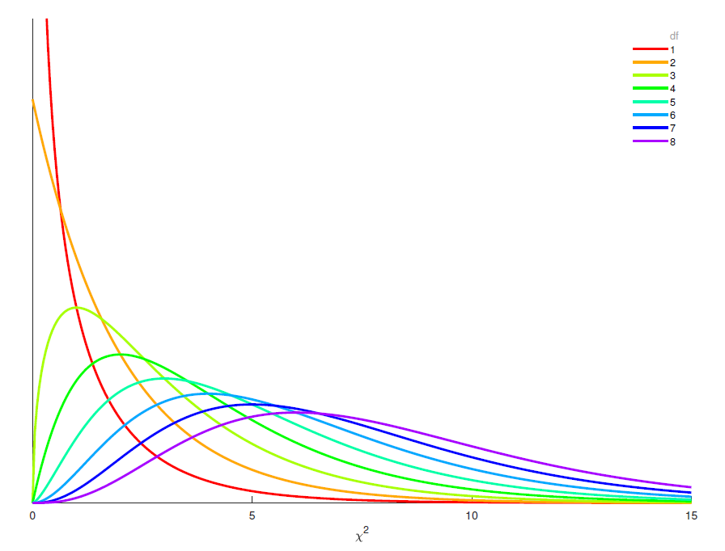
Something for the nerds out there…
A χ² distribution with k=df degrees of freedom is the probability distribution for drawing k scores from a standard normal distribution, squaring them, and adding them up.

Slide 8
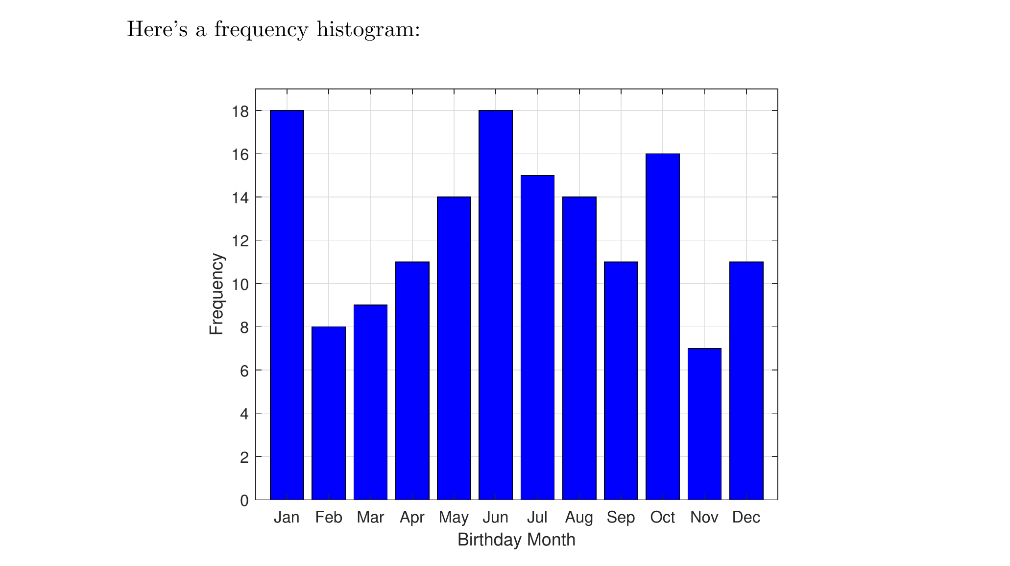

Slide 9
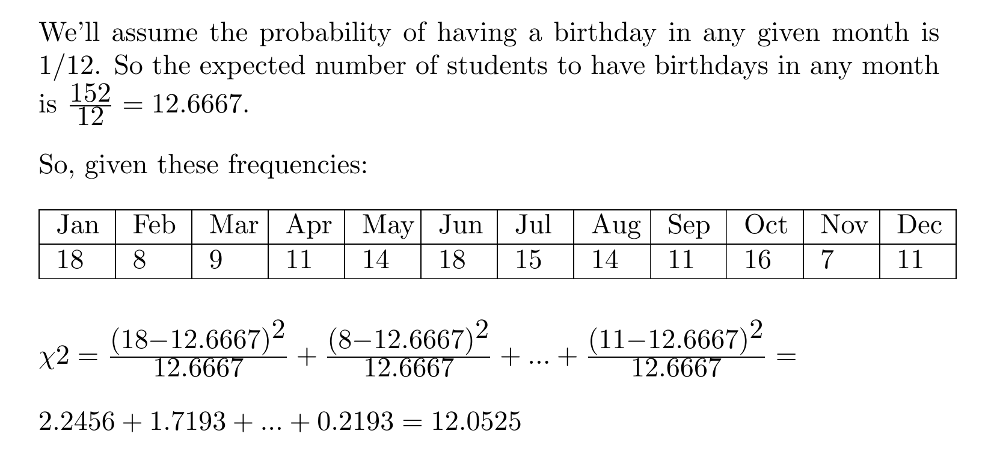

Slide 10
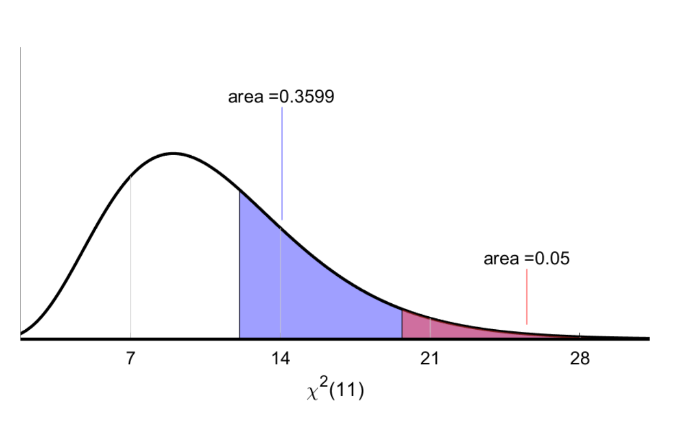

Slide 11
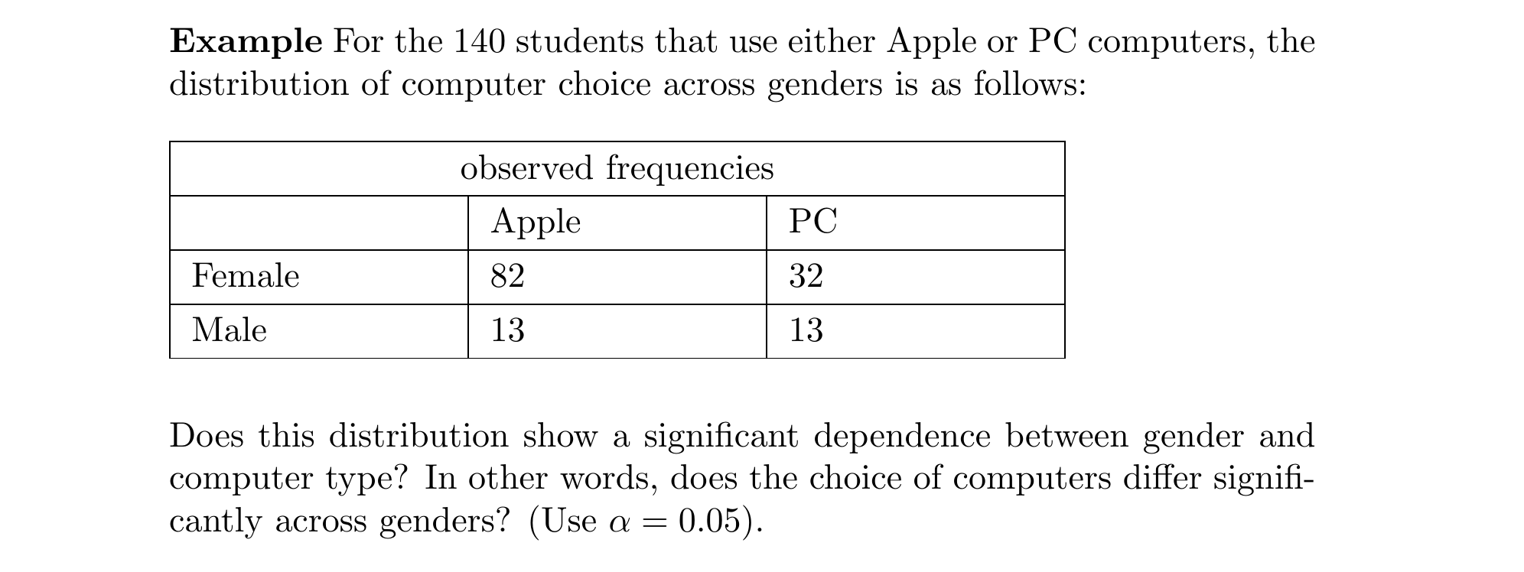

Slide 12
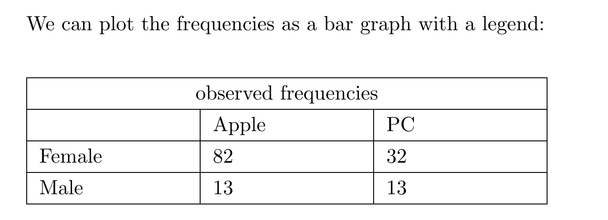
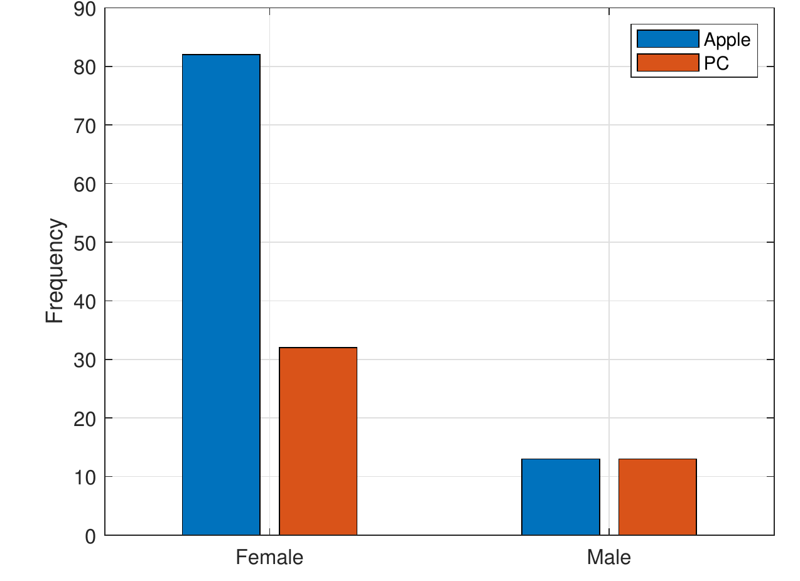

Slide 13
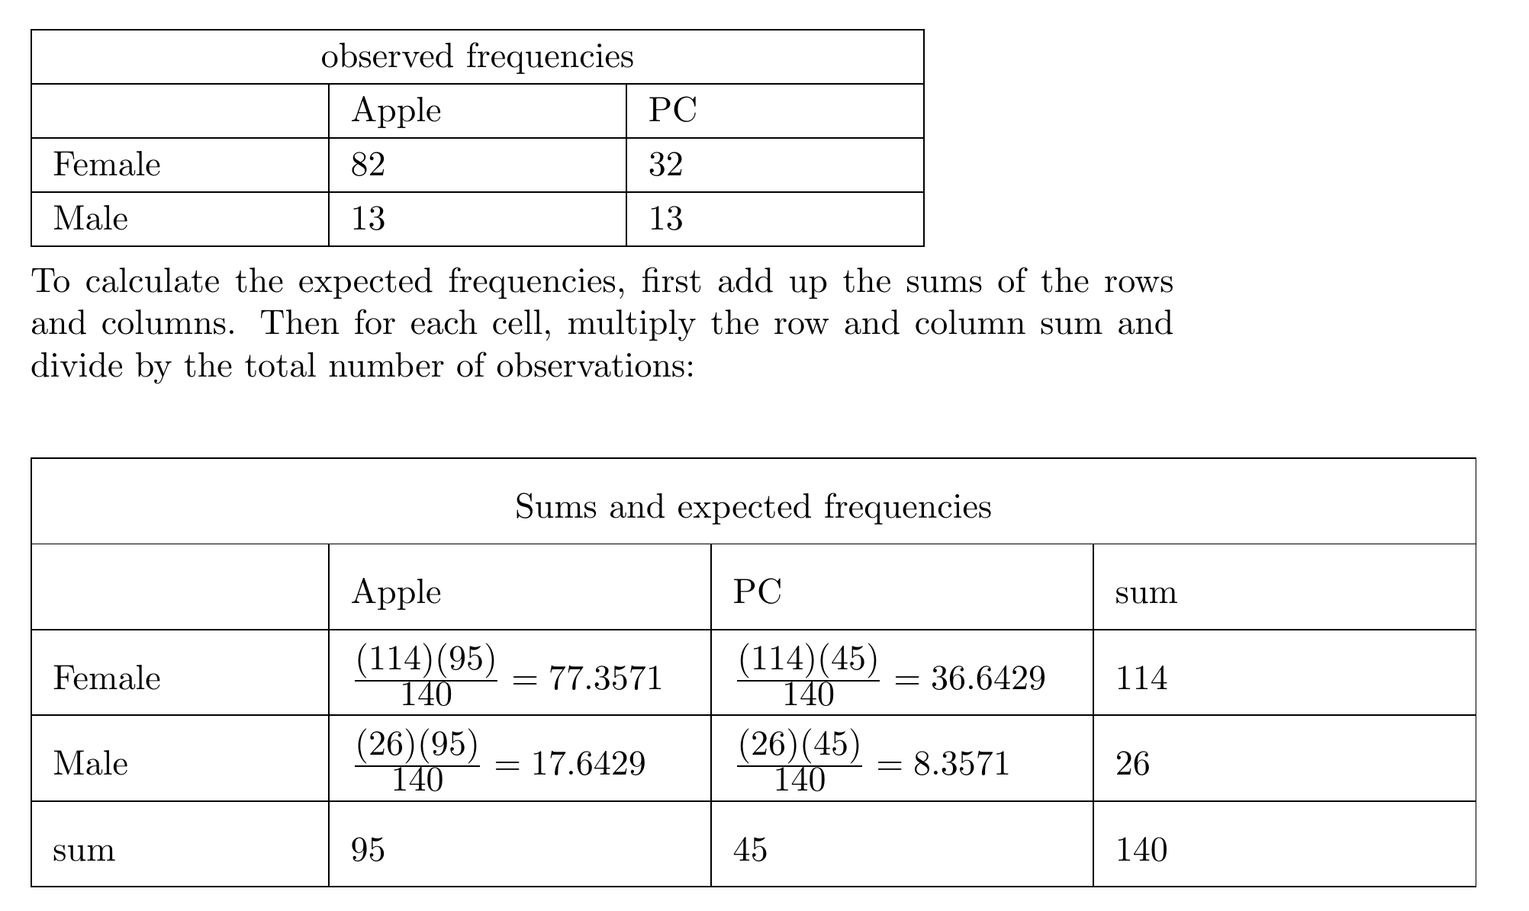

Slide 14
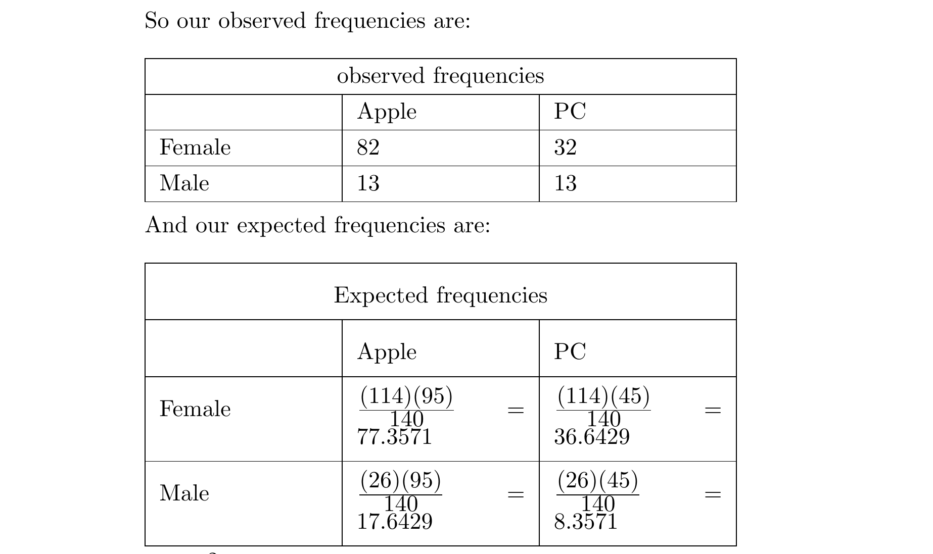

Slide 16
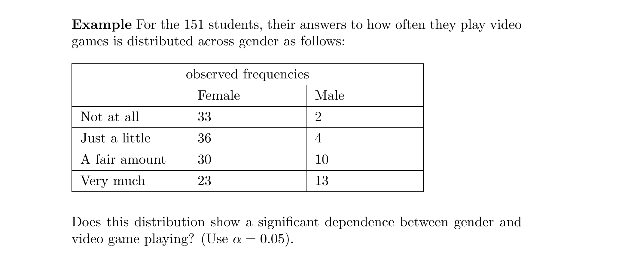

Slide 17
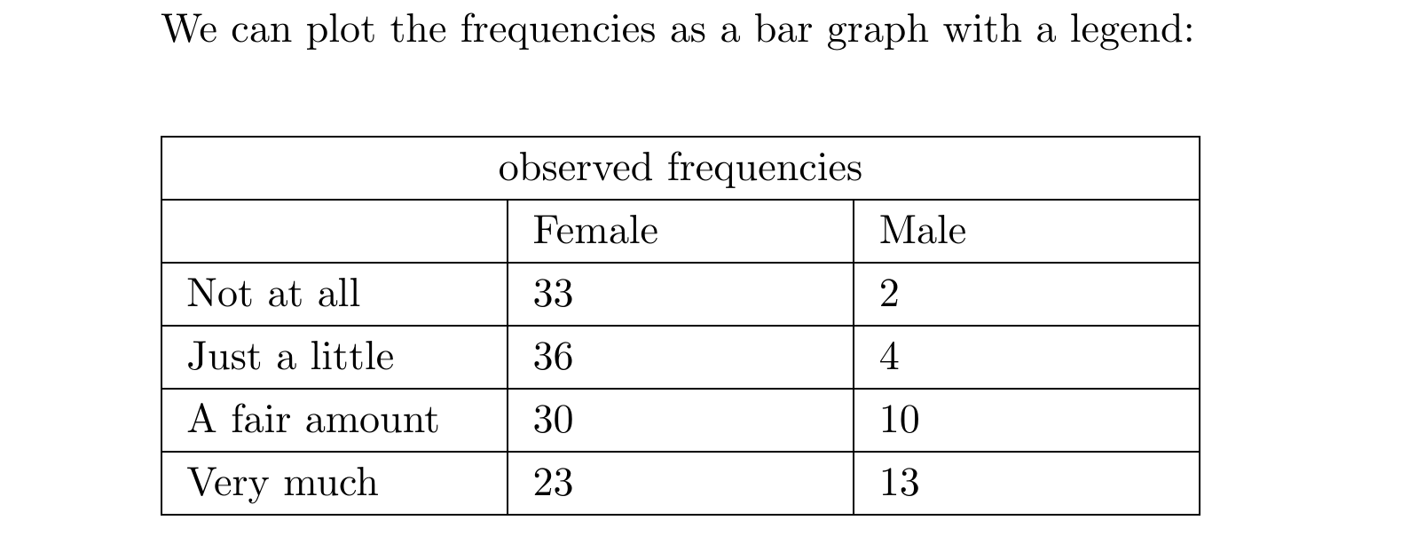
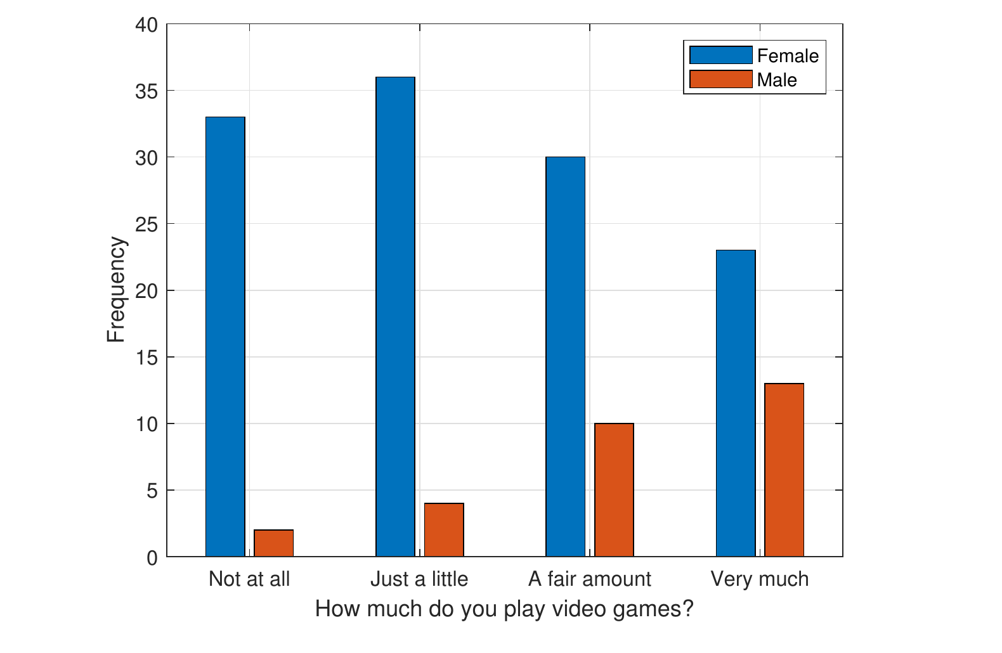

Slide 18
