Slide 1
Bone Remodeling Slides
Part 2
Susan Ott
2019

Slide 2
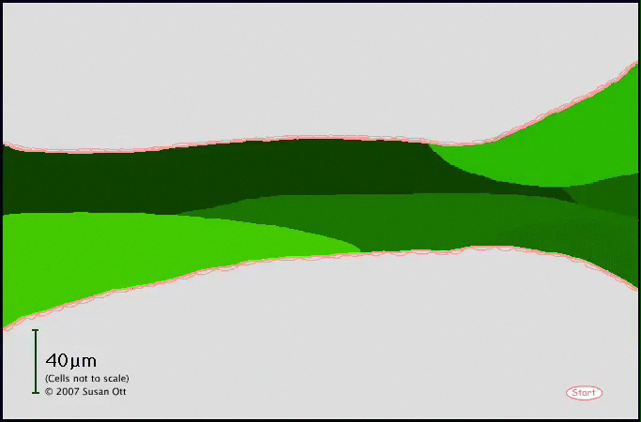
One BMU (Bone Metabolic Unit)
This sequence of resorption and formation will proceed along the surface of the bone.

Slide 3
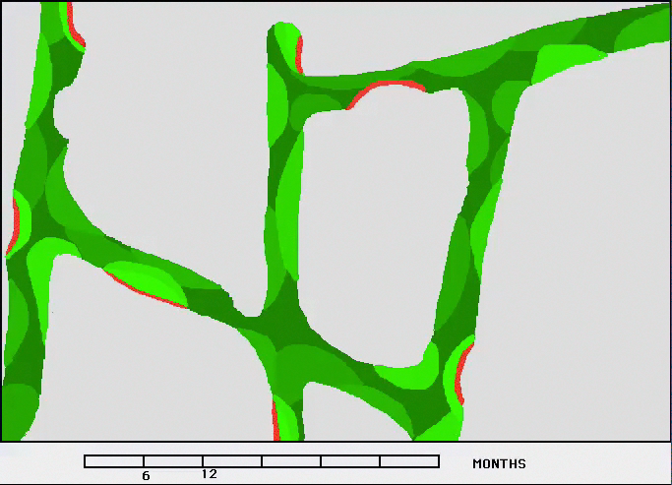
Normal Bone Remodeling
This is about 1mm of trabecular bone, drawn approximately to scale. Red is osteoid, green is mineralized bone, darker green has denser mineral.

Slide 4
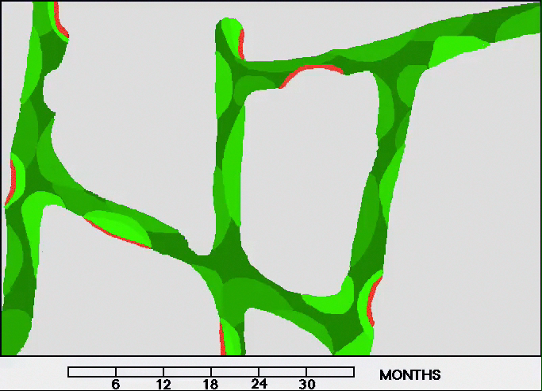
Menopause
The bone resorption is deeper and sometimes this causes perforation or microcallus.

Slide 5
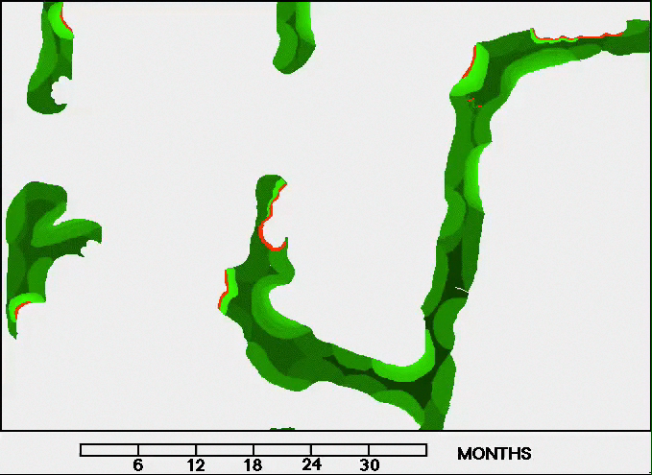
Treatment with estrogen/SERM
After 6 months, estrogen is given and there is reduction in the turnover, and no further perforations are seen.

Slide 6
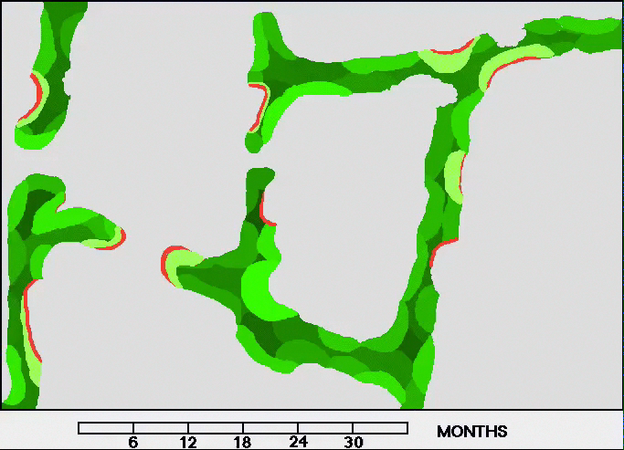
Treatment with bisphosphonate
After 6 months, bisphosphonates are given (blue diamonds which adhere to resorbing areas). Bone resorbion and formation are decreased and the bone becomes denser.

Slide 7

Treatment with teriparatide
After 6 months teriparatide is given. Notice rapid increase in bone formation and also more bone resorption and intratrabecular tunneling.

Slide 8
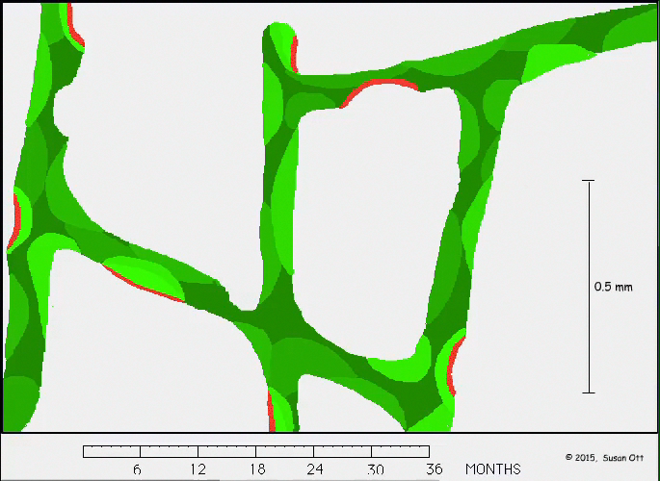
Treatment with denosumab
After an injection there is rapid reduction in resorption and formation stops. When a dose is skipped there is rebound and high resorption with perforation of the trabecular walls.

