Slide 1

Challenging cases in
Osteoporosis Management
Susan M. Ott

Slide 2

Disclosure
Last year I attended a scientific advisory committee meeting for Amgen but declined the honorarium

Slide 3
Key References
FDA. Summary Minutes of the Joint Meeting of the Advisory Committee for Reproductive Health Drugs and Drug Safety and Risk Management Advisory Committee. September 9, 2011.
Saag K, Shane E, Boonen S, Marin F, Donley DW, Taylor KA, et al. Teriparatide or alendronate in glucocorticoid-induced osteoporosis. N Engl J Med. 2007;357:2028-39.
Dell RM, Adams AL, Greene DF, Funahashi TT, Silverman SL, Eisemon EO, et al. Incidence of atypical nontraumatic diaphyseal fractures of the femur. J Bone Miner Res. 2012;27(12):2544-50.

Slide 4
If a clinical problem has been addressed by a randomized double-blinded clinical trial with significant and consistent results, then it would not be a challenging case. So most of this talk is going to involve non-trial evidence, opinion, and off-label use of medications.

Slide 5
What to do for patients who took bisphosphonates for five years and then stopped for five years?
How long to use denosumab? And then what?
How to treat patients starting on long-term steroids who have osteopenia but not osteoporosis? (especially those younger than 50)
How to treat patients with CKD grade 4-5 who have low bone density or fractures?
Should you treat when hip bone density is not osteoporotic at the hip but T-score lower than -2.5 at the spine, without fractures?
How to treat patients with serious liver dysfunction with osteoporotic fractures?
How to prevent fractures in early post-menopausal women who don’t yet have osteoporosis?

Slide 6
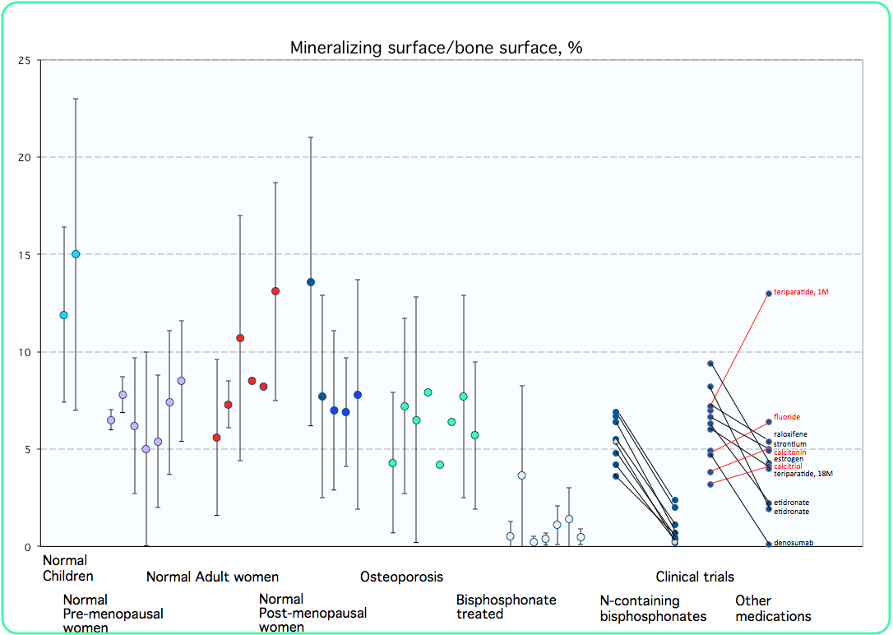

Slide 7
A Vietnamese-American woman with Still’s disease with onset in 2006, when she was 56, with fever and rash, was treated with prednisone usually 10mg/day up to 60mg/d with flares, and with various anti-inflammatory medications.
Bone density T-score of -2.1 at the spine and -1.8 at the hip in 2009.
Extensive review of chart found notes about bisphosphonate use that were not well documented, but she had received risedronate in about 2006, alendronate in 2008, followed by ibandronate. In 2012 she discontinued the oral bisphosphonates, and was then given zoledronate in 2013 and 2014.
In 2015 she developed stress fractures of the metatarsals, and was then given another dose of zoledronate and high doses of vitamin D.

Slide 9
2009
2016
In 2016 she had some
pain in the right thigh.

Slide 10
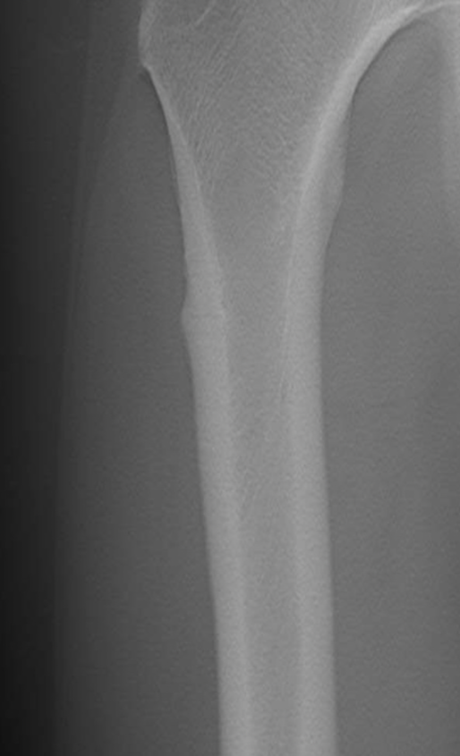
Tomosynthesis showed
fracture line

Slide 11
Labs:
Calcium 11.0
Phosphate 3.7
Creatinine 0.71
Uric acid 4.8
PTH 30
TSH 9.37
Alk Phos 51
Vitamin D 90.2

Slide 12
2017
2010

Slide 13
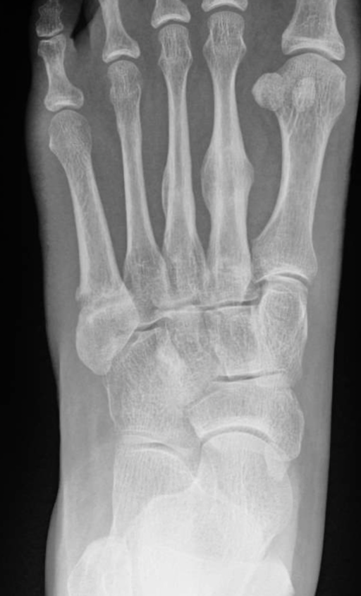
2019
A survey of 81 women who had an atypical femur fracture
found that 35% incurred a metatarsal fracture.
Continues on abaloparatide
What should we do when
she finishes that?
Schneider JP, et al. J Clin Endocrinol Metab. 2012;97(12):4324-8.

Slide 14
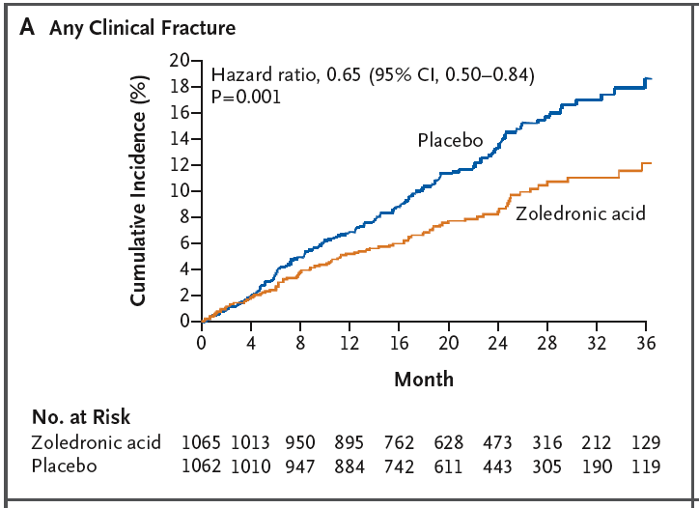
Zoledronic acid in hip fx patients
Lyles NEJM 2007

Slide 15
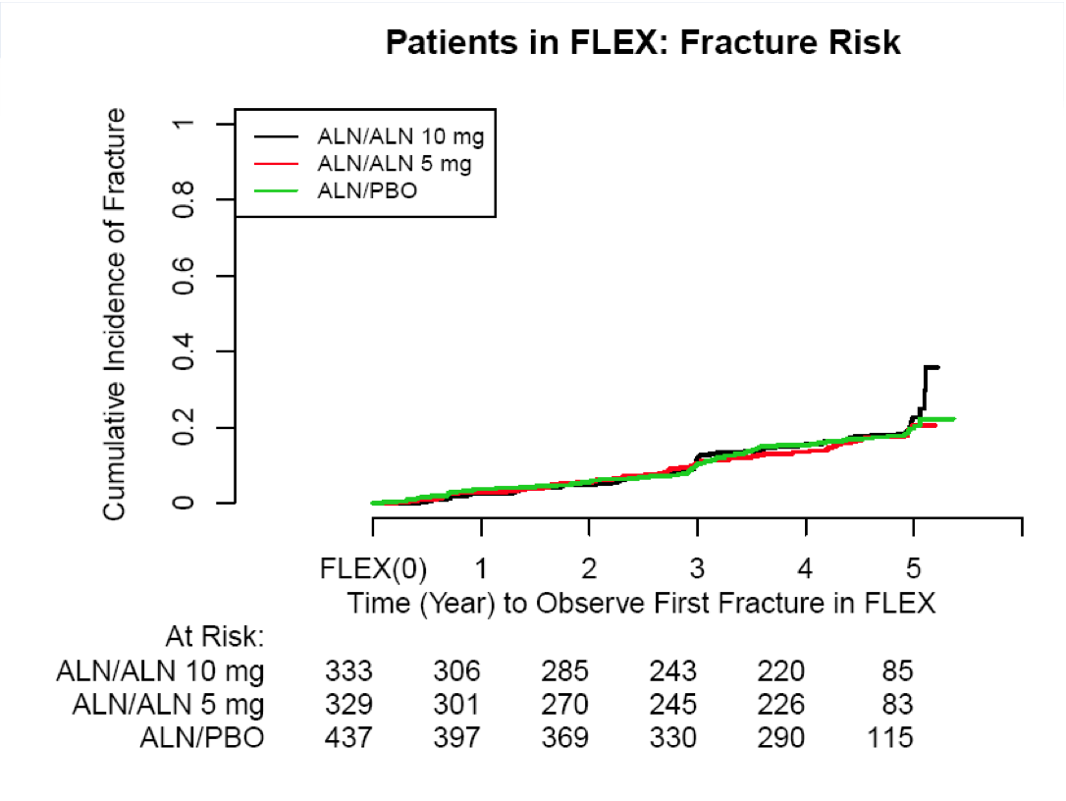
Whitaker, FDA report 2011

Slide 16
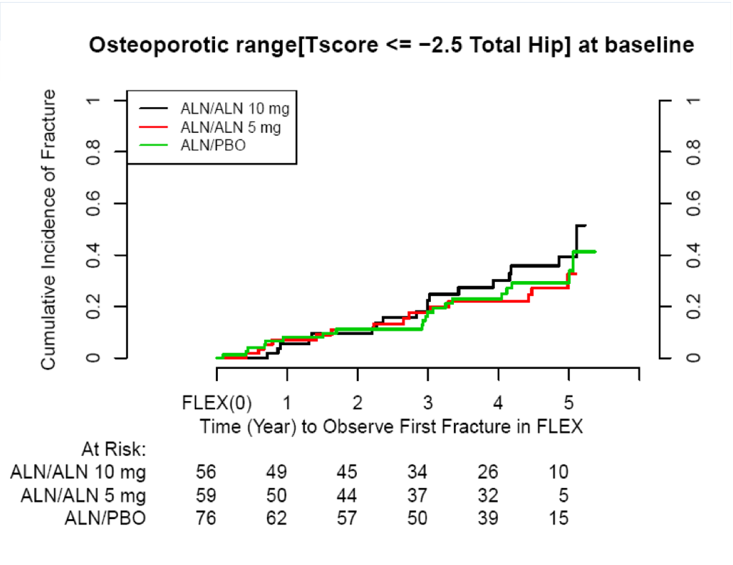
Whitaker, FDA report 2011

Slide 17
Reduction in microdamage
N = 31, Alendronate mean duration 63 months.
Treated with 24 months of teriparatide.
Dobnig, ASBMR ‘07

Slide 18
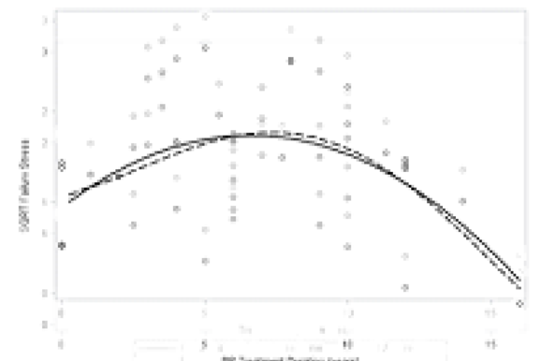
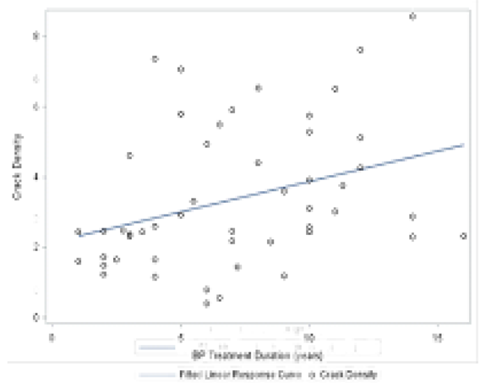
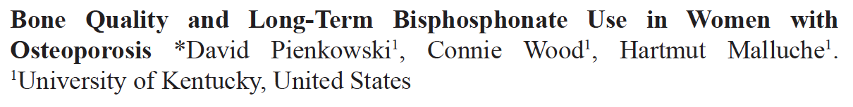
Long term bisphosphonate use
Bone strength
Crack density
Time 0 – 17 years
ASBMR abstracts 2019

Slide 19
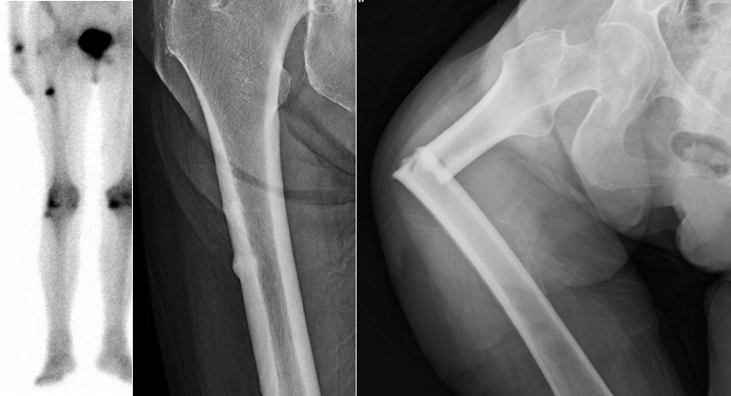

Slide 20
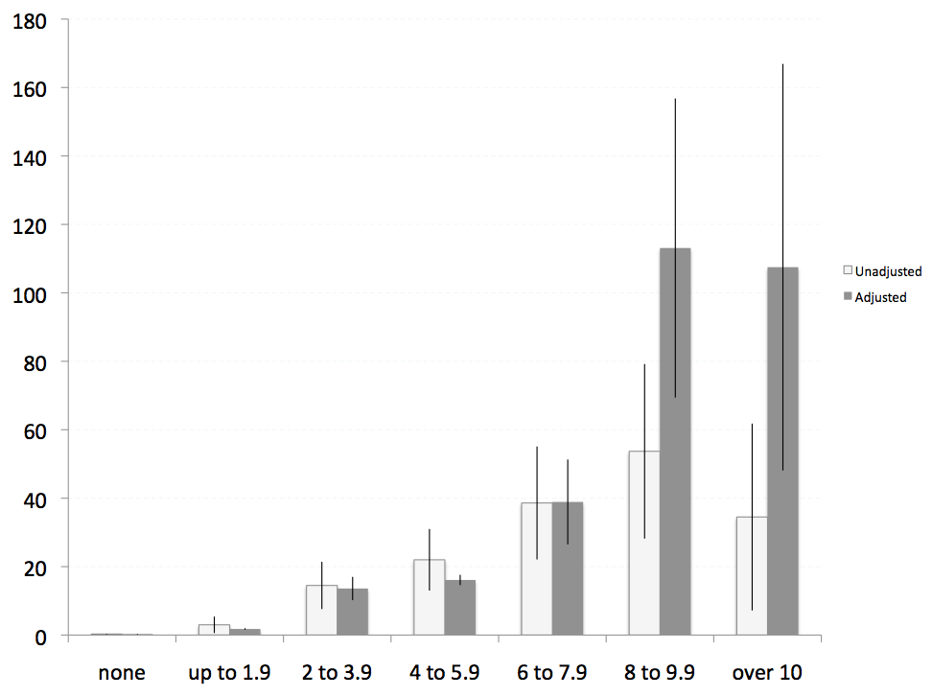
Incidence of atypical femur fracture
Rate/
100,000/
year
Duration bisphosphonate use, years
Dell, JBMR, 2012

Slide 21
76 year old woman
Had breast cancer 9 years ago, treated with anastrazole for 7 years
Treated with zoledronate a year after starting anastrazole, yearly for 4 years. No recurrence of the cancer.
Then switched to denosumab because she had CKD.
Over the next 5 years she received 6 doses because of delays and skipping doses. Last dose was 3 months ago.
3 years ago had a lumbar compression fracture.
Current bone density T-scores: Spine +1.1, total hip -1.3, forearm -1.7

Slide 22
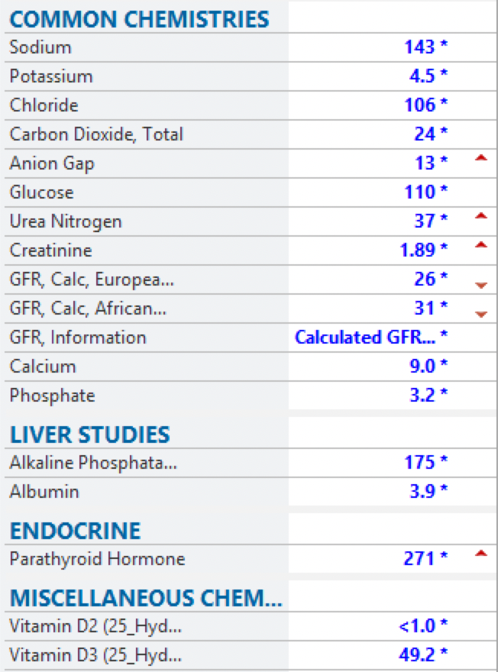
What to do when
the denosumab wears off?

Slide 23
80 year old patient with long history of osteoporosis
Took bisphosphonates for at least 8 years.
Fell and fractured R leg and L forearm.
Treated with teriparatide for 2 years.
Then given denosumab every 6 months for 4 doses.
Calcium was low so calcitriol was added. Kidney function normal.
Bone density T-score is -1.8 for the total hip. Spine has scoliosis.

Slide 24
She was treated with 30mg denosumab.
3 mo later urine NTX was low at 31
6 mo later it was 56
No new clinical problems.

Slide 25
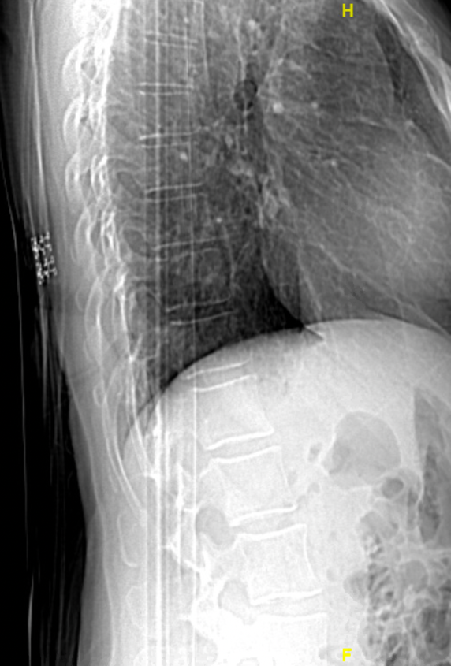
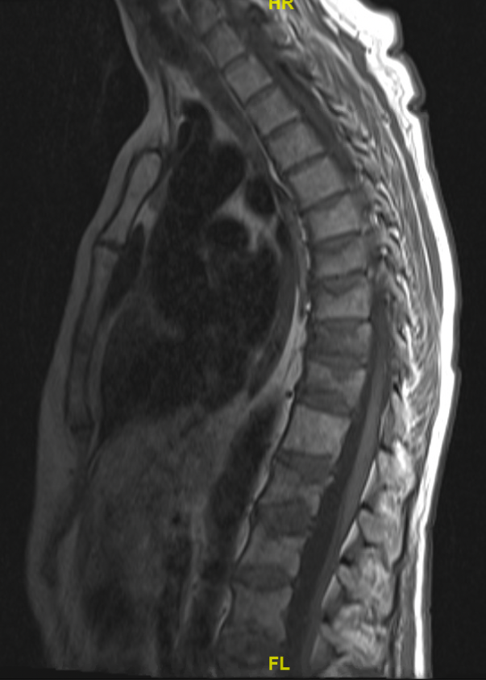
Before
and after skipping a dose of denosumab

Slide 26
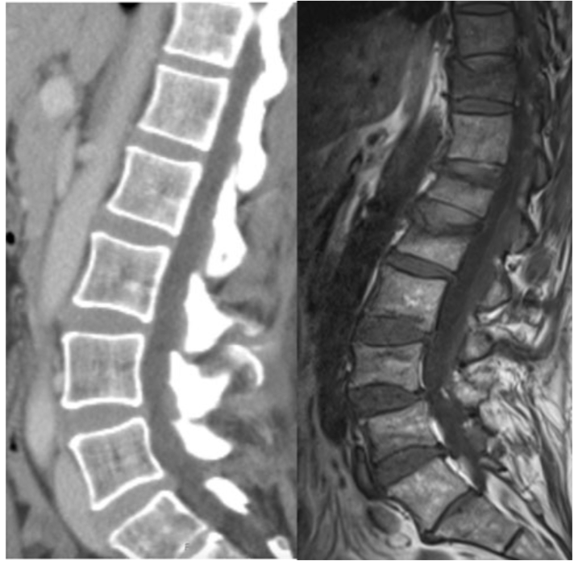
48 yr old woman with breast cancer treated with AI from 2010 to 2015 and denosumab from 2012-2015 with improvement in BMD. Within 6 months after stopping she developed multiple spine fractures.
Popp, Osteoporosis Int 2016

Slide 27
84 yr old woman from Taiwan
Osteoporosis diagnosed in 2001
Treated with alendronate for 7-10 years
Fracture of R hip in 2010
In 2011 had pemphigus and took high doses of steroids for 2 years
Fractured L3 in 2013.
Then took teriparatide for ten months
followed by denosumab for 4 doses
T-score of spine +0.3 and total hip -2.6
She had normal calcium, phosphate, alk phos and PTH
CKD grade 3 (eGFR 45)

Slide 28
She switched to raloxifene.
Urine NTX was 37 one month later, 7 months after last denosumab
Repeated at 8 and 10 months and it remained low at 29
18 months later she had some low back pain
with marrow edema in L5
but without any change in vertebral dimensions.
The pain improved with conservative treatment.
Otherwise she has been doing well.

Slide 29
ASBMR 2019 abstracts
McDonald: Intravital imaging of osteoclasts in vivo: discovered osteoclast fission, which is different from apoptosis and results in small round cells that accumulte with OPG treatment, and then they can re-fuse to form large active osteoclasts.
Kendler: N = 115 patients took DMAB for one year and then Alendronate 70/wk for one year.
Bone density stable after transition, but the ones with larger BMD increases in first year most likely to lose in year 2.
Tsai: N=53 patients took teriparatide for 9 months, DMAB at Mo 3 and 9 and zoledronate at month 15 (range 5 - 7 mo after DMAB injection. BMD did not decrease at spine during mo 15-27. At hip, 3% decrease in those treated early (<26 wks)

Slide 30
Zanchetta: N = 98, The 65 not treated after DMAB treatment (mean 2.3 yrs) lost 4.1% from spine. Those treated with bisphosphonates lost 3.3% Hip lost 3.3% vs 0.9%
Dickens: chart review 94 patients had received DMAB followed by bis. and 35 had complete data. Average 2.5 years treatment. BMD decrease less than 3% in 11/20 patients on oral and 8/15 on IV. 3 had vertebral fractures
Popp: N=20 CTX decreased after zol in women with at least 2 doses of DMAB and zol average 9 months later. But 12 mo after ZOL the CTX was again back as high as before the ZOL.
Selling: N = 60, treated for 4.6 yrs with DMAB and then ZOL at 6 mo or 9 mo or observed, but if CTX increased in 9mo or Obs they were also treated with ZOL. Half the obs group developed high CTZ and received ZOL.
One year after discontinuation, loss of spine was 4.8%, 4.2% and 4.9% in the groups

Slide 31
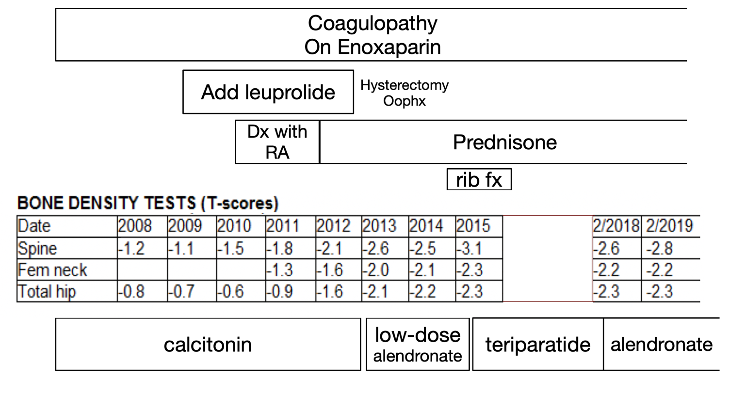
33 yr old
woman

Slide 32
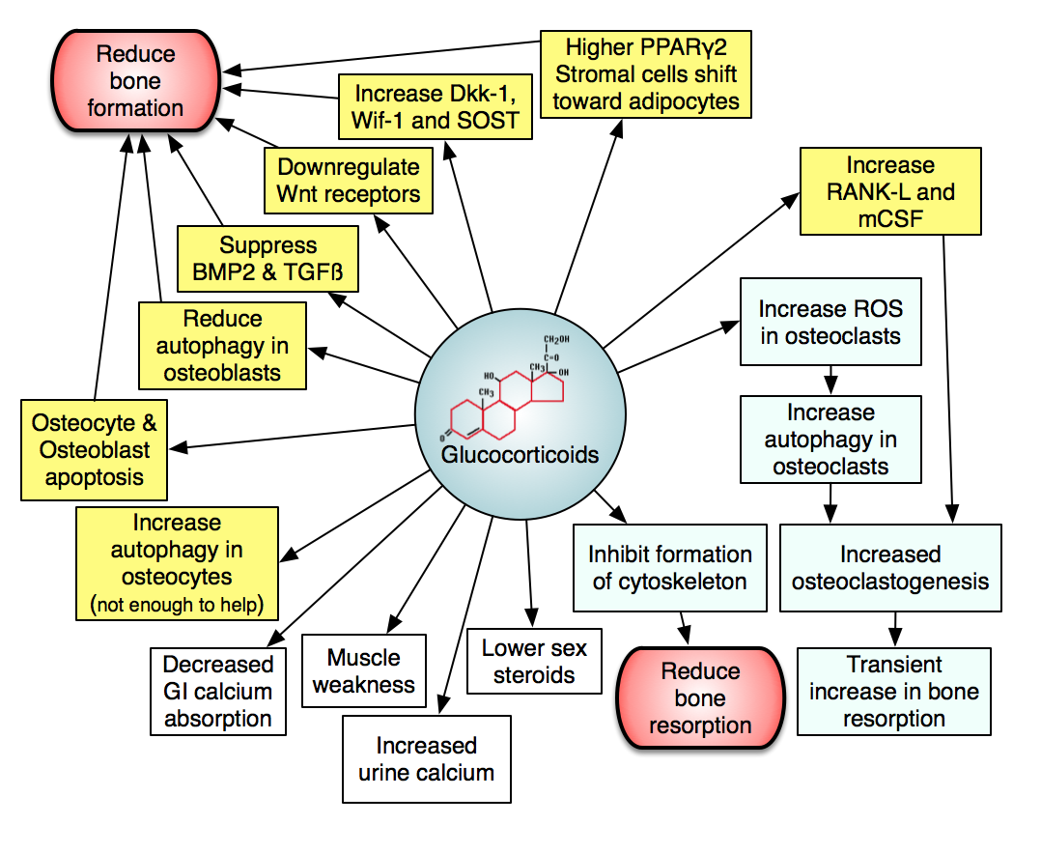

Slide 33
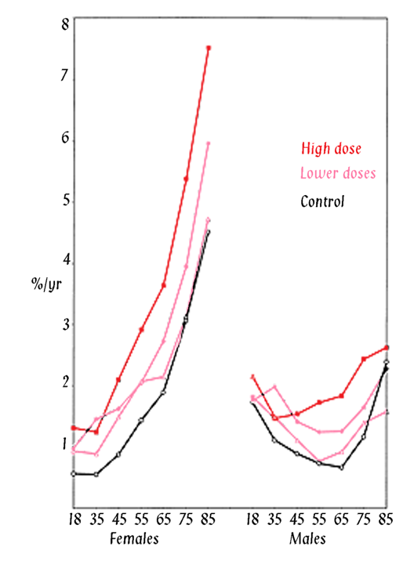
Non-vertebral fracture incidence in patients using corticosteroids
Relative Rates:
Non-vertebral 1.33
Hip 1.61
Vertebral 2.60
244,235 patients
with matched
controls
Van Staa
Osteoporosis Int, 2002

Slide 34
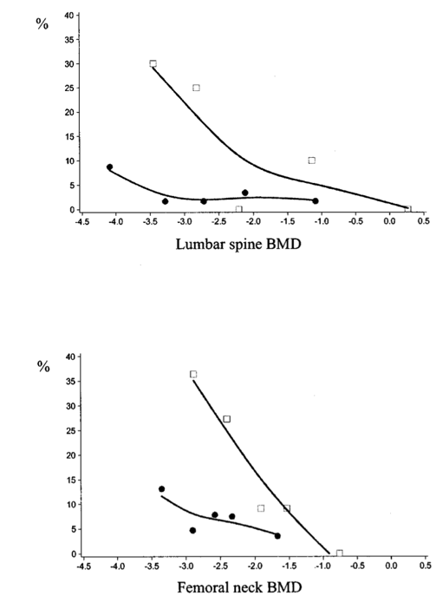
Steroid users fracture at lower BMD
Steroid users
Incidence of vertebral fractures according to BMD from
RCT’s in subjects
either taking steroids
Or non-users
Non-users
Van Staa, Arthritis Rheum, 2003

Slide 35
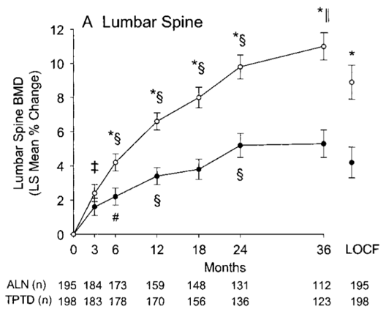
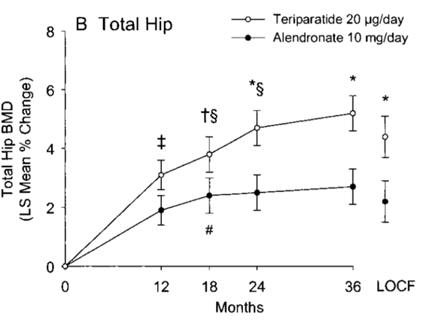
Teriparatide vs Alendronate in GIO: Bone density
Saag, Arthritis Rheum, 2009

Slide 36
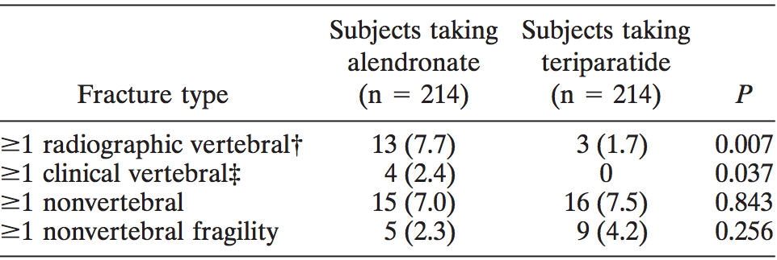
Teriparatide vs Alendronate in GIO: Fractures
Note that 9% of teriparatide and 5% of alendronate had uric acid >9
Saag, Arthritis Rheum, 2009

Slide 37
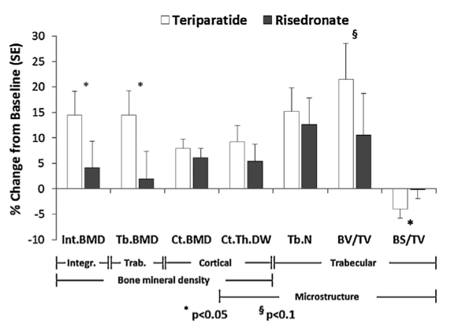
Teriparatide vs risedronate in men with GIO:
Changes in hip BMD
Fractures: 5 in risedronate vs none in teriparatide
Gluer, JBMR, 2013

