Slide 1
Steroid Osteoporosis
Susan Ott
December 2015

Slide 2
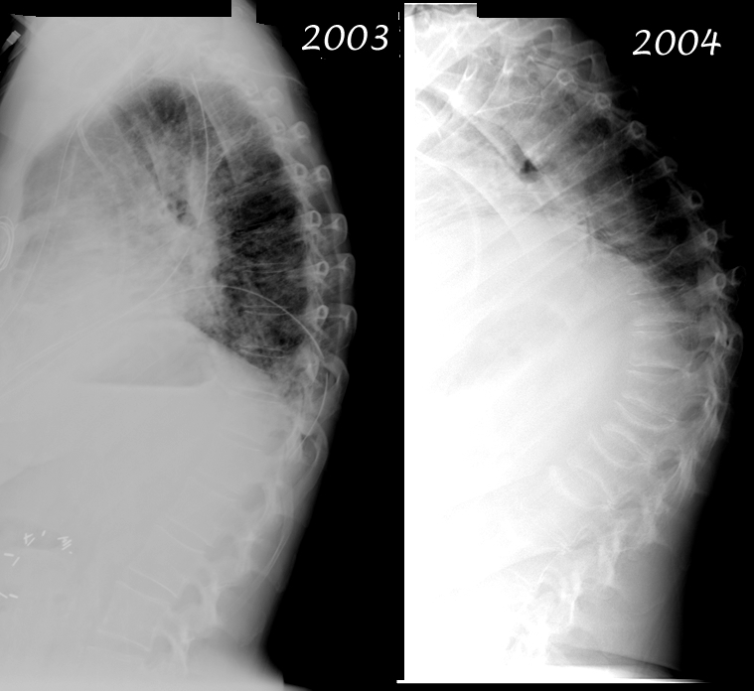
Normal
T-score

Slide 3
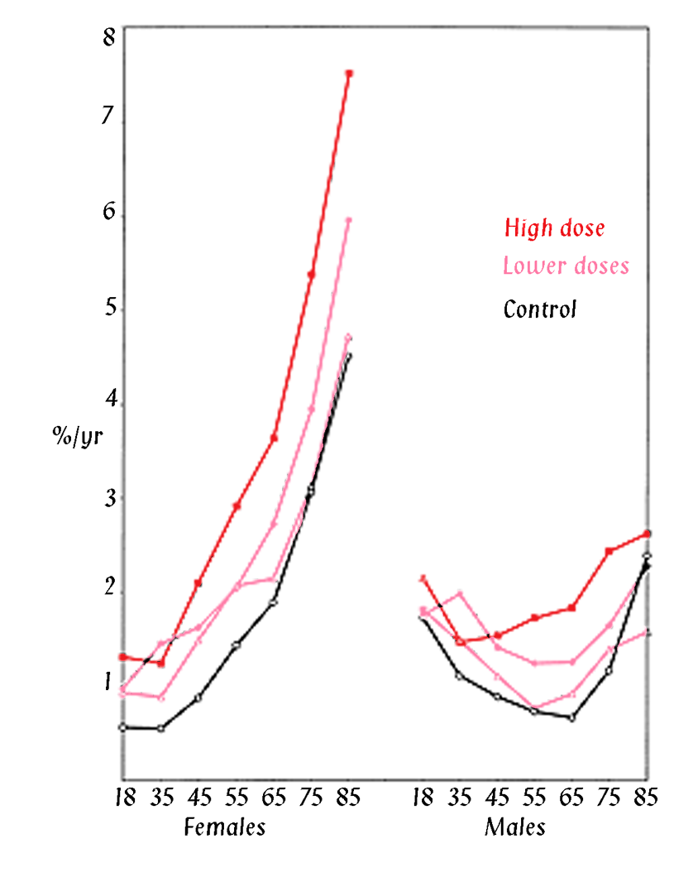
Non-vertebral fracture incidence in patients using corticosteroids
Relative Rates:
Non-vertebral 1.33
Hip 1.61
Vertebral 2.60
244,235 patients
with matched
controls
Van Staa
Osteoporosis Int, 2002

Slide 4
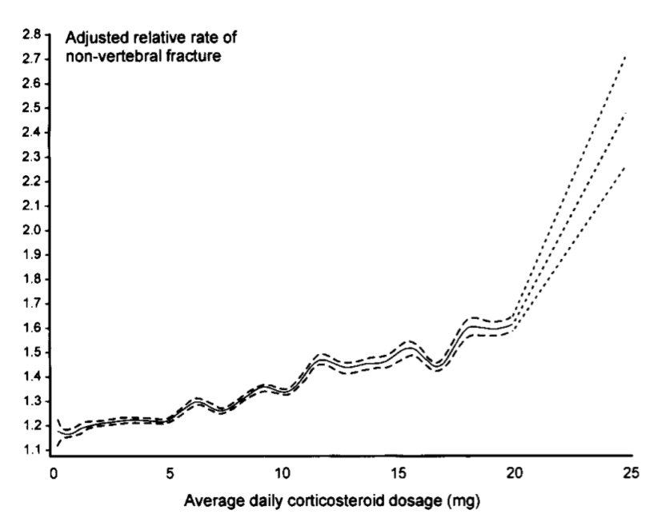
Fractures and steroid dose
N = 244,234 corticosteroid users
and same number of controls.
UK Database
Van Staa, Rheumatology, 2000

Slide 5
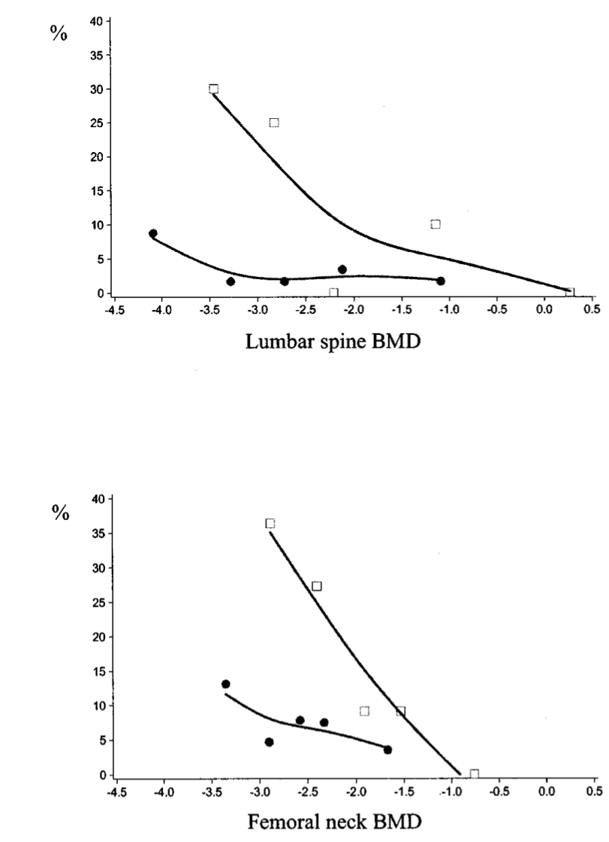
Steroid users fracture at lower BMD
Steroid users
Incidence of vertebral fractures according to BMD from
RCT’s in subjects
either taking steroids
Or non-users
Non-users
Van Staa, Arthritis Rheum, 2003

Slide 6
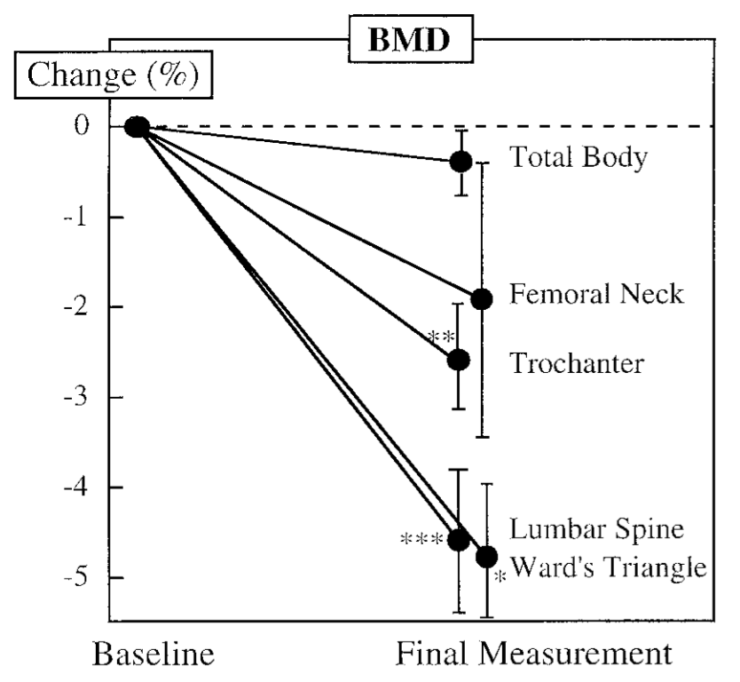
Prednisolone in normal men
9 men treated 1-6 mo
50mg/day
For anti-sperm antibodies
Otherwise healthy
Normal testosterone
Pearce, JCEM, 1998

Slide 7
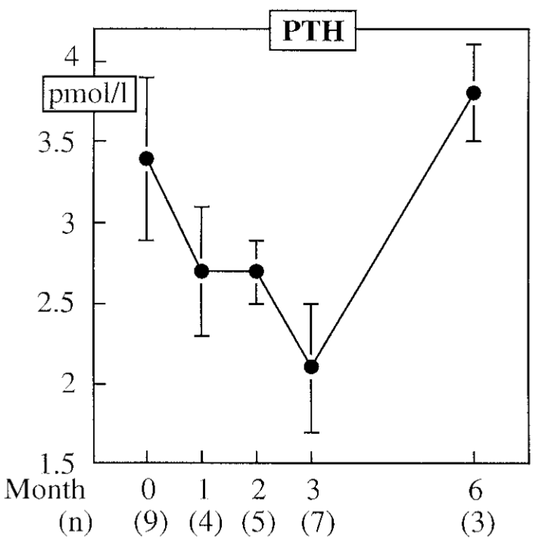
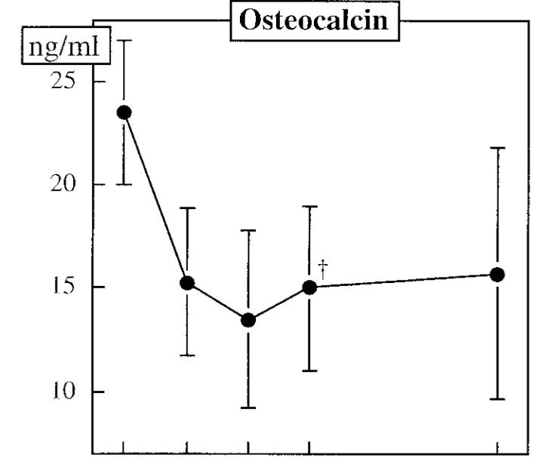
Prednisolone in normal men
Pearce, JCEM, 1998

Slide 8
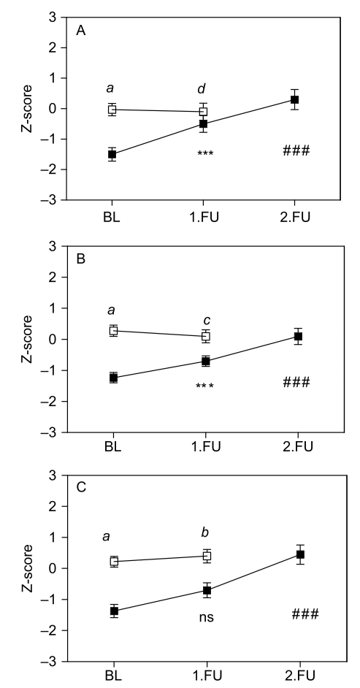
Cushings syndrome: BMD after surgery
Spine
N = 33 patients
Compared to normal controls
Mean followup 71 months
Hip
Body
Kristo, Eur J Endocrine, 2006

Slide 9
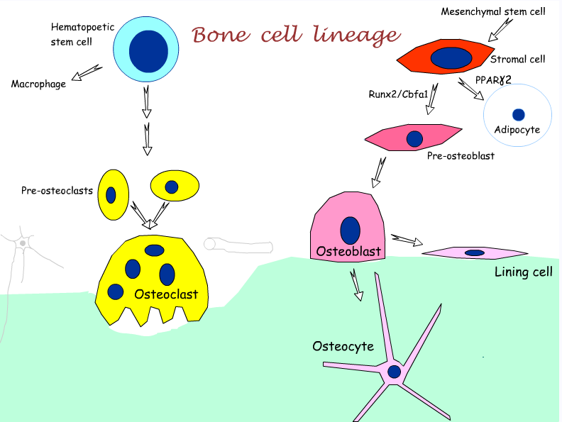

Slide 10
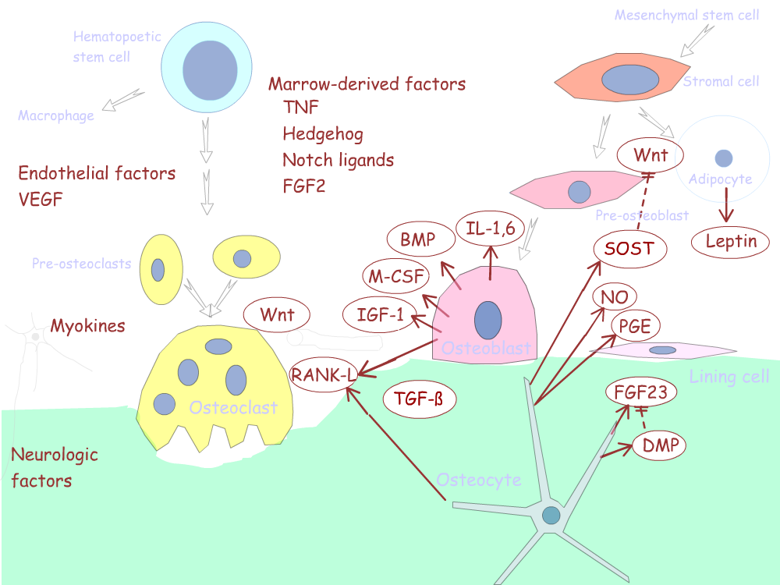
Local factors regulating bone cells

Slide 11
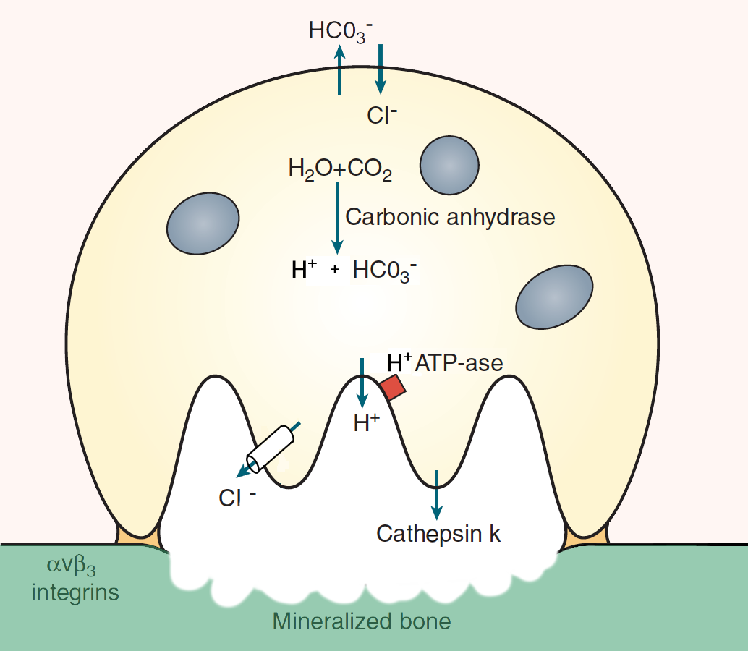
Osteoclast resorbing bone

Slide 12
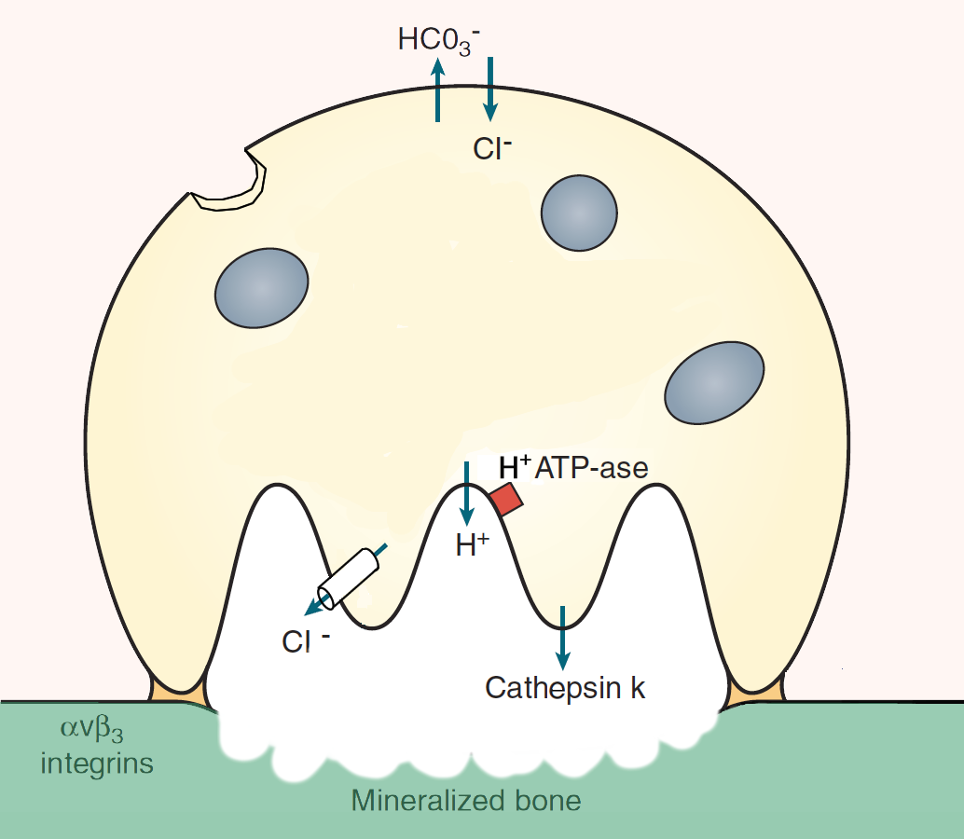
Osteoclast signals back to o’blasts
SMAD
Wnt1
TGF-ß
TGF-ß

Slide 13
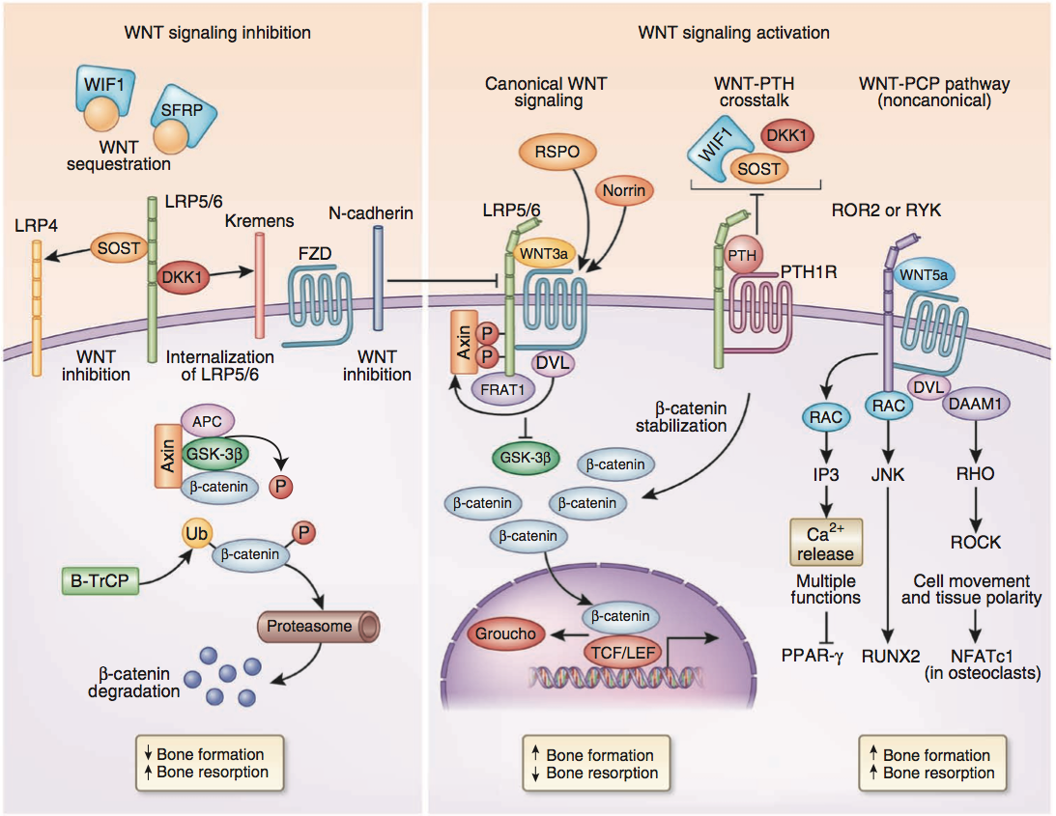
WNT signaling: a simplified view
Baron, Nature Med, 2013

Slide 14
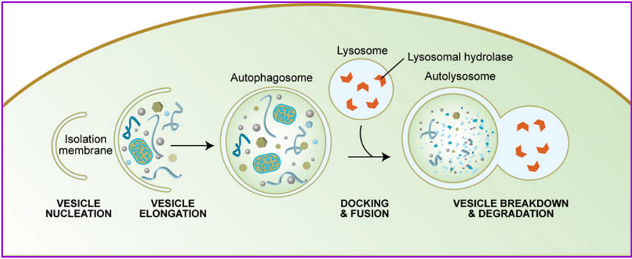
Autophagy
Melendez, Levine, www.wormbook.org

Slide 15
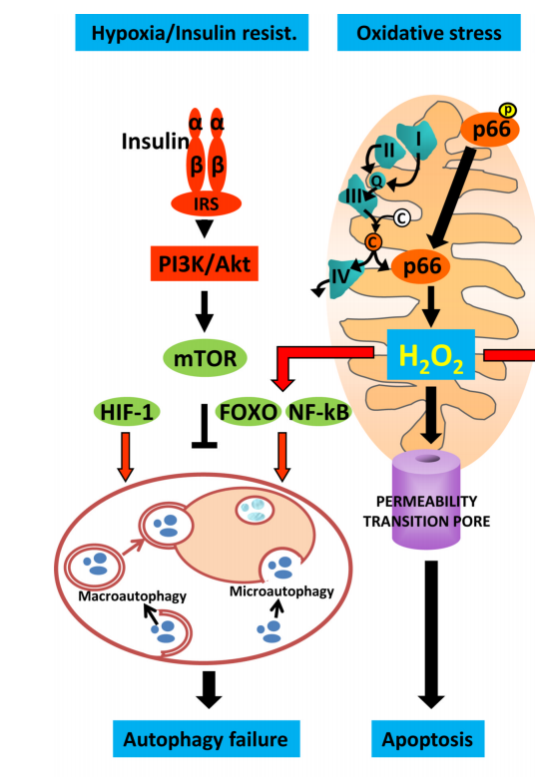
Oxidative stress and Autophagy
Manolagas & Parfitt 2010

Slide 16
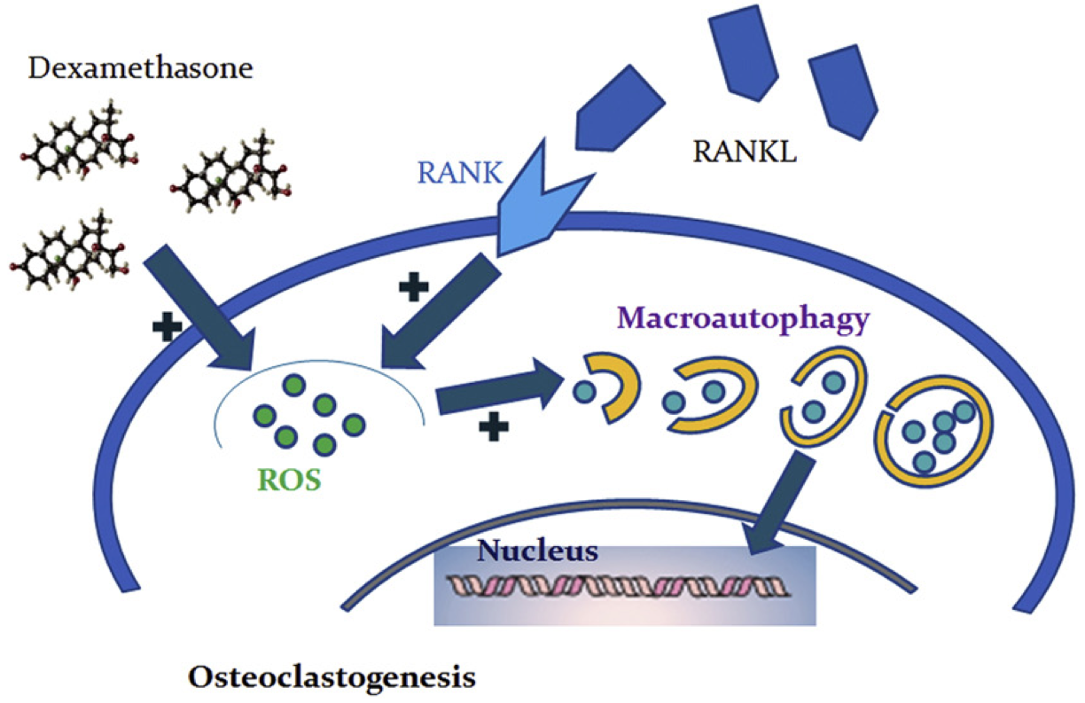
Steroids and osteoclast autophagy
Shi J, Bone, 2015

Slide 17
Osteocytes and Autophagy
Yao, Bone, 2013

Slide 18
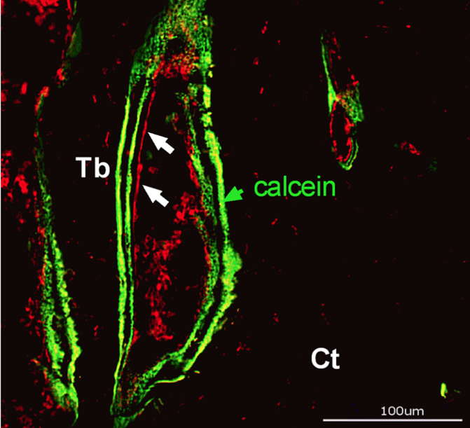
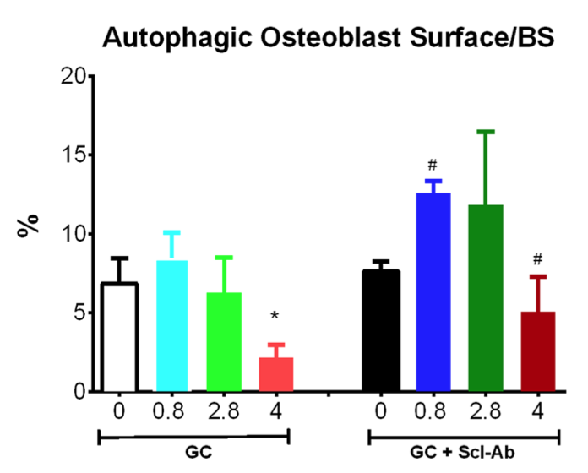
Glucocorticoids and sclerostin-Ab
Study in mice, with reporter for autophagy
Yao, 2015, Osteoporosis Int

Slide 19
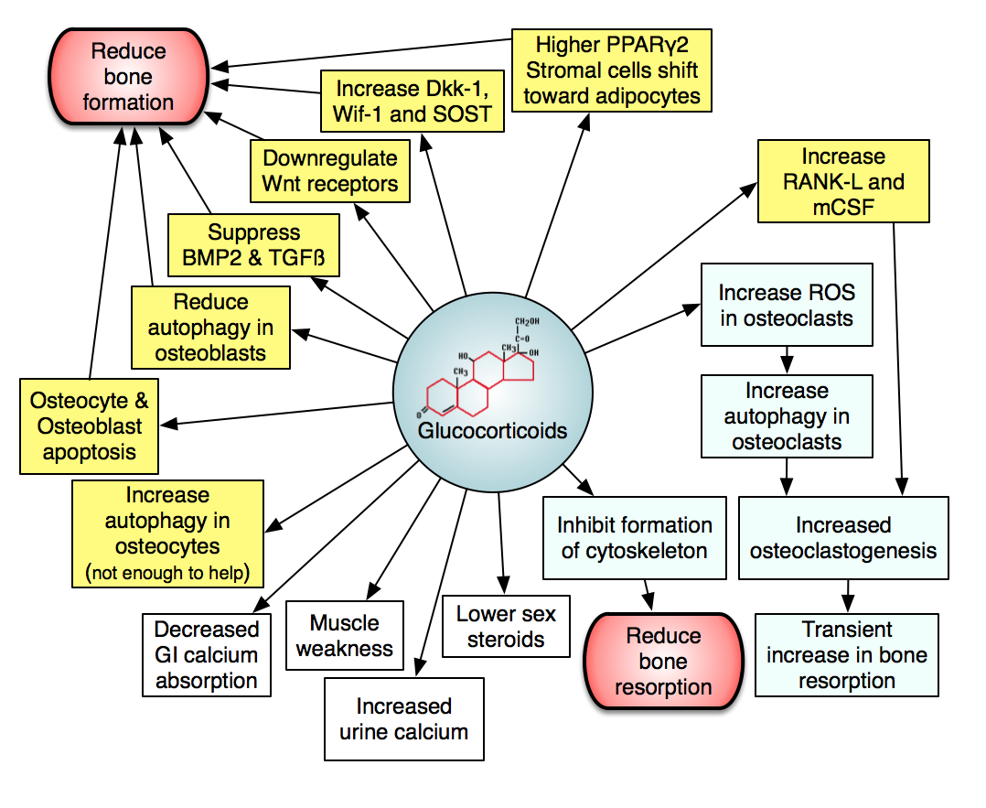

Slide 20
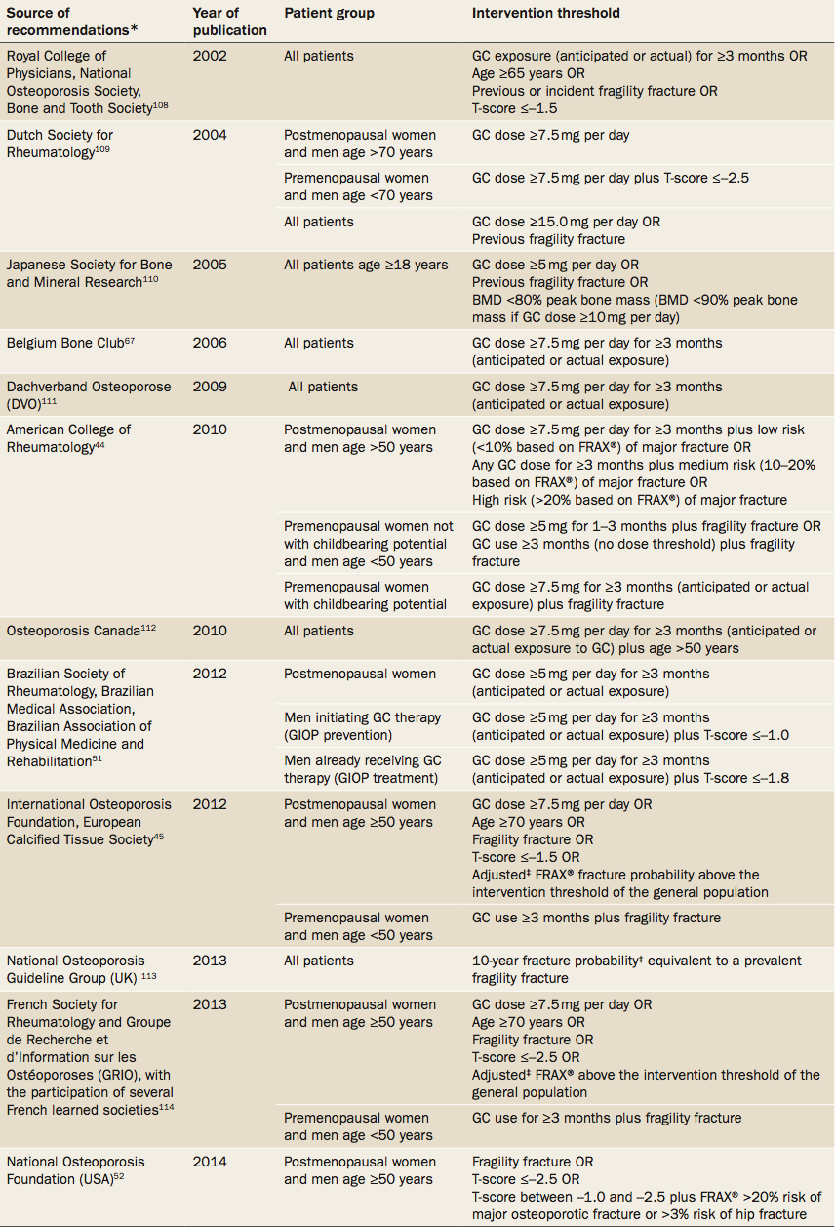
Intervention thresholds
Rizzoli, Nat Rev Rheum, 2015

Slide 21
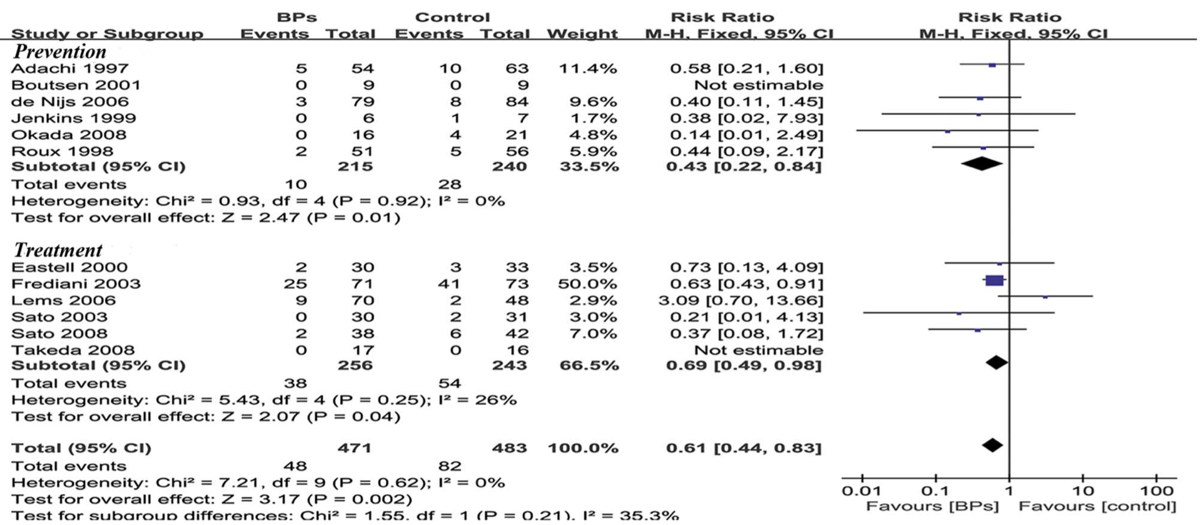
Bisphosphonates in steroid osteoporosis Vertebral fractures
Feng, PLoS ONE, 2013

Slide 22
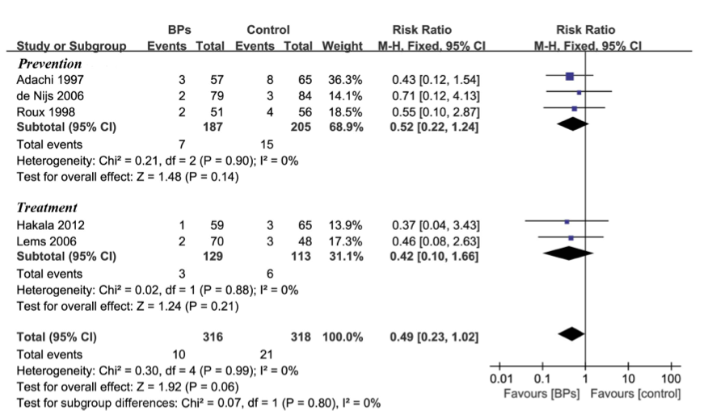
Bisphosphonates in steroid osteoporosis Non-Vertebral fractures
Feng, PLoS ONE, 2013

Slide 23
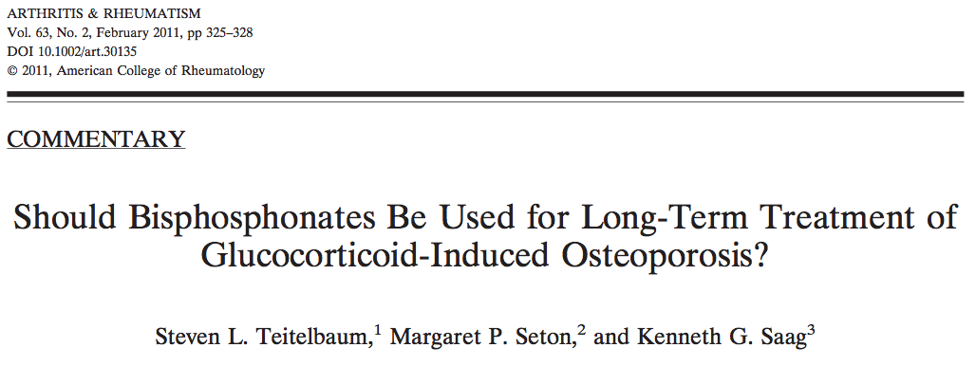
The misconception that glucocorticoids accelerate osteoclast activity, regardless of the duration of treatment, forms the theoretical basis for the recommendations of the American College of Rheumatology, the Royal College of Physicians, and essentially all international guidelines, that bisphosphonates should be routinely administered for the prevention and treatment of glucocorticoid-induced osteoporosis. In fact, during long-term therapeutic exposure to steroids, bone resorption changes from accelerated to diminished, likely due to direct suppression of osteoclasts.

Slide 24
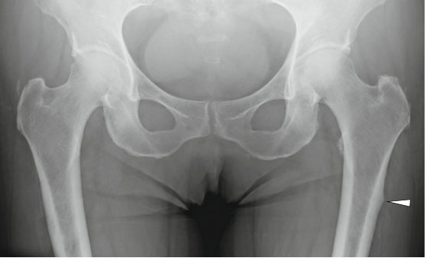
Incidence of beaking in patients taking steroids and bisphosphonates
N = 125 consecutive patients from Japan
X-rays twice, 2 years apart.
Beaking in 8% at baseline and 10% at followup. Beaking did not change in 6 pts; worsened in 7 pts and one had complete Fx
Mean duration bis 6.1 yr
Prednisone 12.7 yrs
More likely to have diabetes
Sato H, Osteoporosis Int, 2015

Slide 25
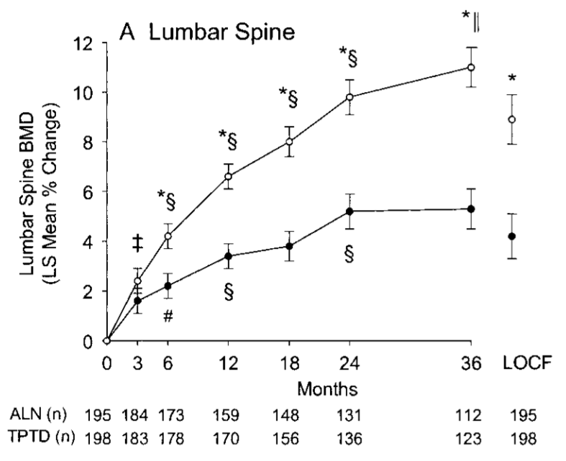
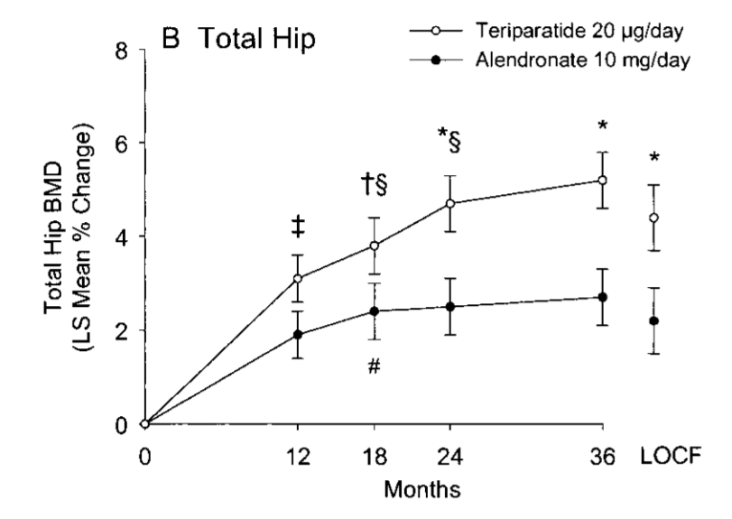
Teriparatide vs Alendronate in GIO: Bone density
Saag, Arthritis Rheum, 2009

Slide 26
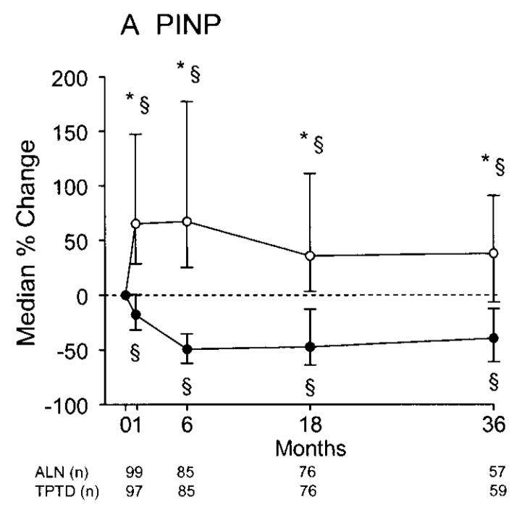
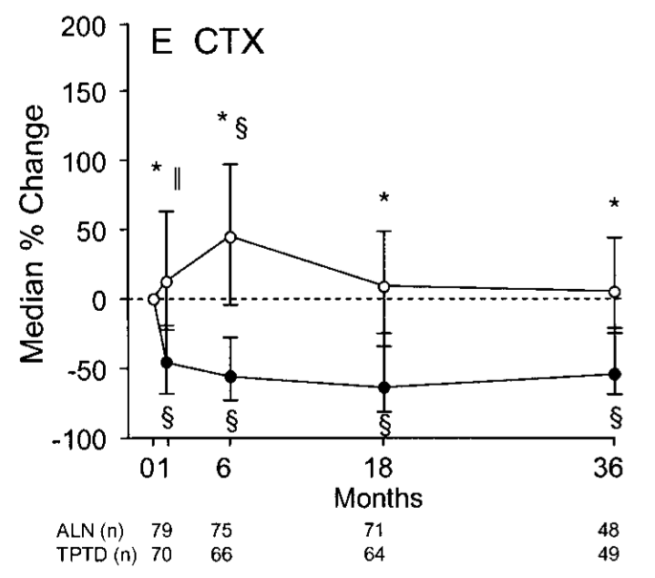
Teriparatide vs Alendronate in GIO: Markers
Saag, Arthritis Rheum, 2009

Slide 27
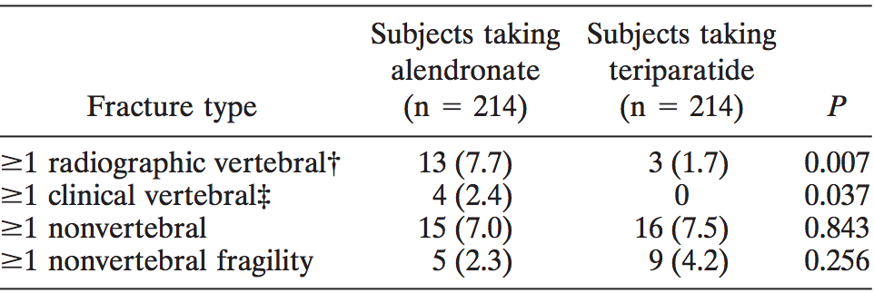
Teriparatide vs Alendronate in GIO: Fractures
Note that 9% of teriparatide and 5% of alendronate had uric acid >9
Saag, Arthritis Rheum, 2009

Slide 28
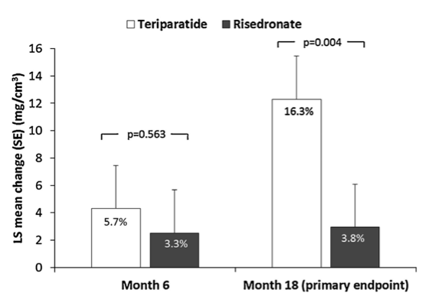
Teriparatide vs risedronate in men with GIO: Changes in spine BMD
N = 92
Gluer, JBMR, 2013

Slide 29
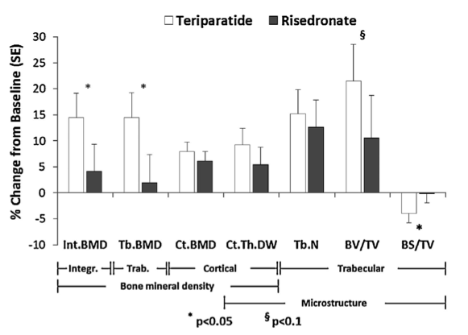
Teriparatide vs risedronate in men with GIO: Changes in hip BMD
Fractures: 5 in risedronate vs none in teriparatide
Gluer, JBMR, 2013

Slide 30
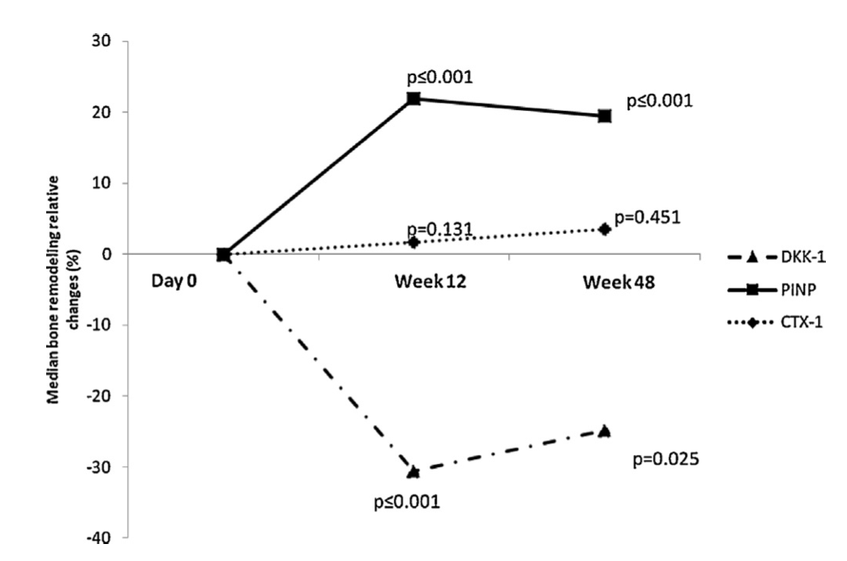
Tocilizumab in RA: bone markers
Briot, J Bone Spine, 2015

Slide 31
Tocilizumab in RA: bone density
Steroid dose mg/d | <0.85 | 0.8-5 | 5-7.5 | >7.5
N | 20 | 19 | 19 | 18
Lumbar Spine | -0.36% | +2.55% | +0.41% | -1.03%
Total hip | -0.20% | +0.16% | -0.84% | -0.11%
Patients had active disease, mean 4 yrs
Dose was AUC over 48 weeks, in quartiles
23 patients also received bisphosphonates
76% on steroids, all on MTX
Briot, J Bone Spine, 2015

Slide 32
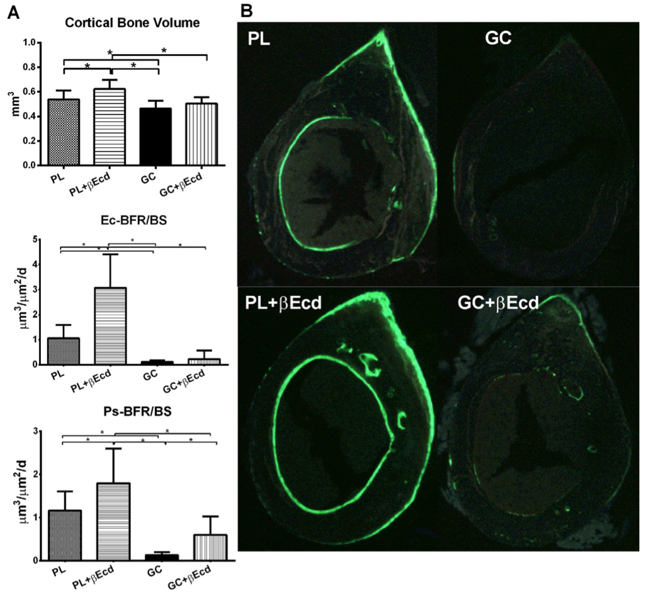
Treatment with beta-ecdysone
Dai W, Bone, 2015

