Slide 1
Virtual Memory
Or how to fake having more memory then you’ve really got.

Slide 2
Processes and Threads
Kernel
Process
Process
Process
Thread
Thread
Thread
Thread
Thread
Thread

Slide 3
Address Translation

Slide 4
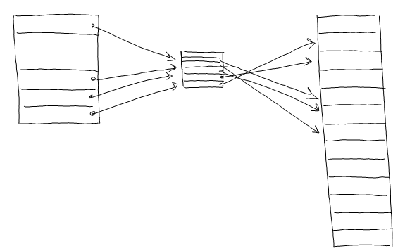
Virtual Page to Physical Page Mapping

Slide 5
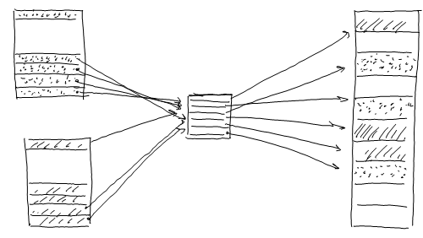
Interleaving of Process pages

Slide 6
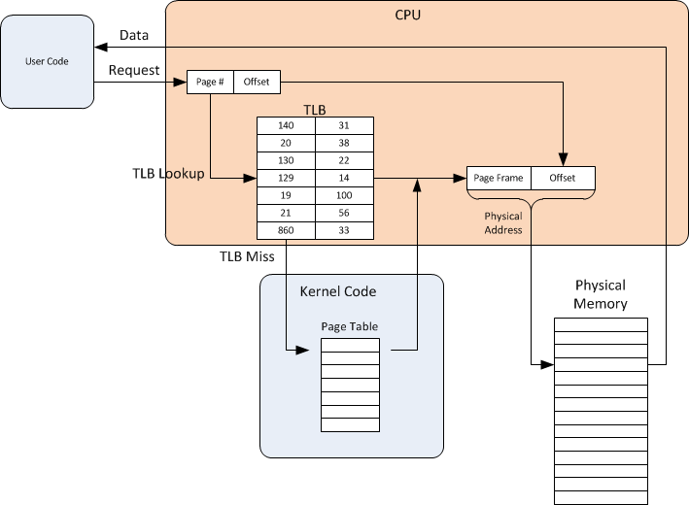
Translation Lookaside Buffer

Slide 7
Page Tables

Slide 8
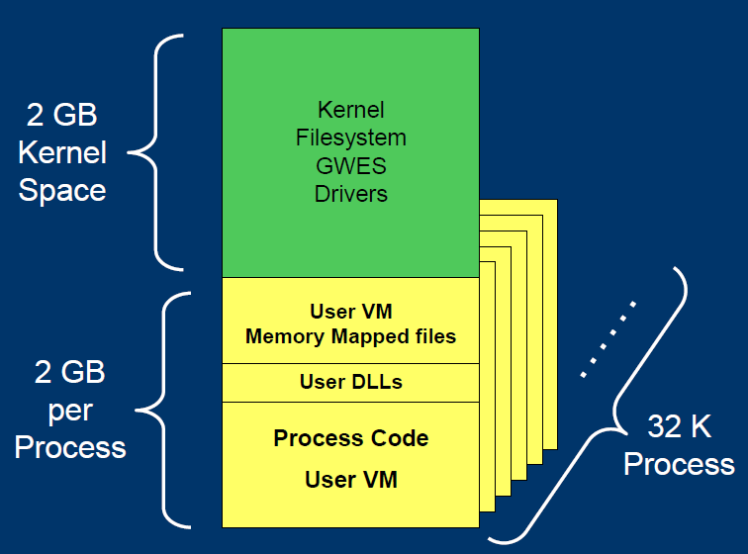
Memory Space

Slide 9
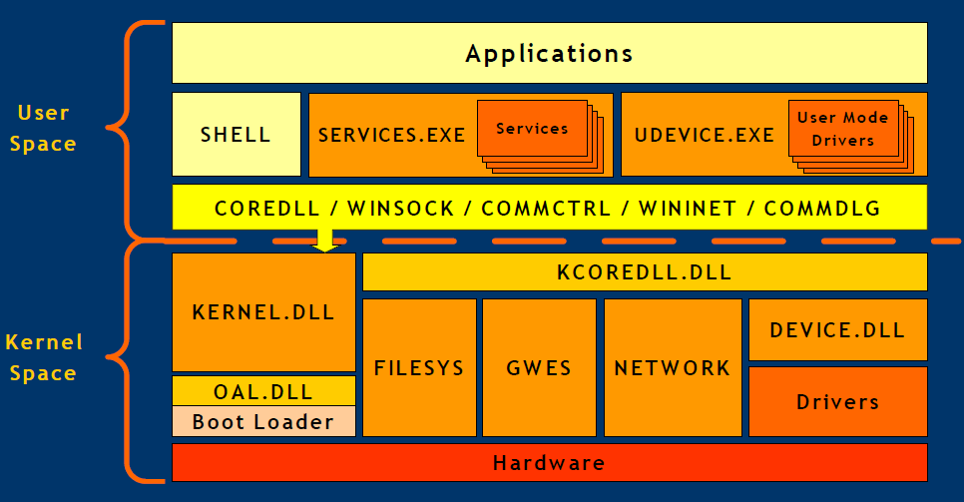
User Space vs. Kernel Space

Slide 10
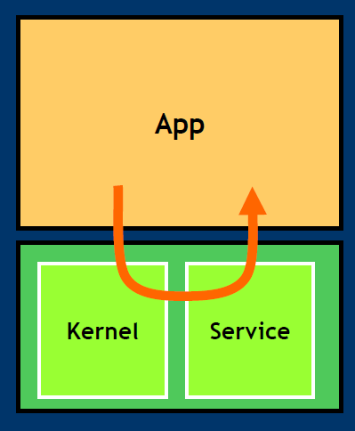
System Calls

