Slide 1
CSS430 Process Management Textbook Chapter 3
Instructor: Stephen G. Dame
e-mail: sdame@uw.edu
These slides were adapted from the OSC textbook slides (Silberschatz, Galvin, and Gagne), Professor Munehiro Fukuda and the instructor’s class materials.

Slide 2
WKP 17
“Simple design, intense content.”
Edward Rolf Tufte is an American statistician and professor emeritus of political science, statistics, and computer science at Yale University. He is noted for his writings on information design and as a pioneer in the field of data visualization.

Slide 3
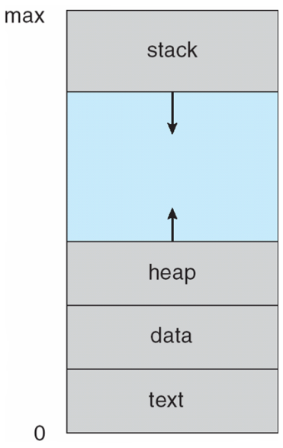
Process Concept
Process – a program in execution; process execution must progress in sequential fashion.
Textbook uses the terms job and process interchangeably.
A process includes:
Program counter
Stack (local variables)
Data section (global data)
Text (code)
Heap (dynamic data)
Files (stdin, stdout, stderr, other file descriptors)

Slide 4
Process State
new
terminated
admitted
interrupt
exit
ready
running
Scheduler dispatch
I/O or event
completion
I/O or event
wait
waiting

Slide 5
Process Control Block
All of the information needed to keep track of a process when switching context.
PCBx
Process ID
Process State
Flags, Switches, Priority
.
.
Code (Text)
.
.
.
Program Counter (PC)
CPU Registers
Memory Limits
Data
List of Open Files
More...

Slide 6
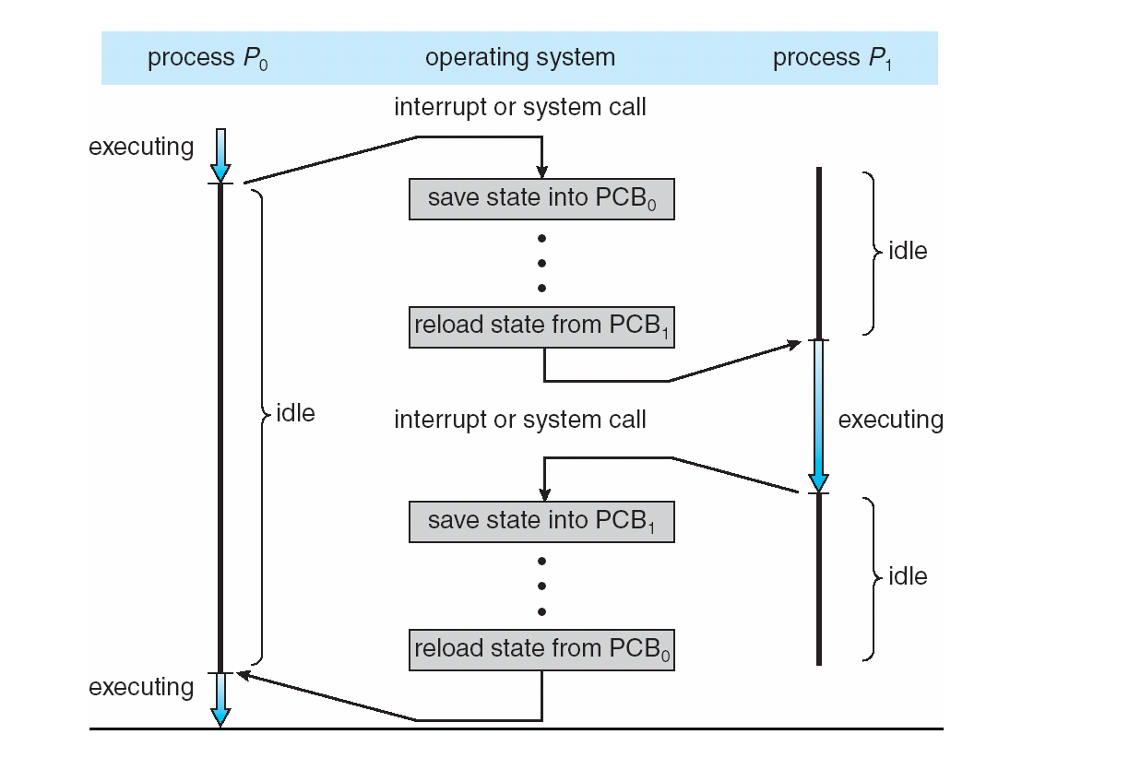
Context Switch
PCB0
PCB1
Process ID
Process ID
Process State
Process State
Flags, Switches, Priority
Flags, Switches, Priority
Program Counter (PC)
Program Counter (PC)
CPU Registers
CPU Registers
Memory Limits
Memory Limits
List of Open Files
List of Open Files
More...
More...
PCB0
PCB1
Process ID
Process ID
Process State
Process State
Flags, Switches, Priority
Flags, Switches, Priority
Program Counter (PC)
Program Counter (PC)
CPU Registers
CPU Registers
Memory Limits
Memory Limits
List of Open Files
List of Open Files
More...
More...
PCB0
PCB1
Process ID
Process ID
Process State
Process State
Flags, Switches, Priority
Flags, Switches, Priority
Program Counter (PC)
Program Counter (PC)
CPU Registers
CPU Registers
Memory Limits
Memory Limits
List of Open Files
List of Open Files
More...
More...

Slide 7
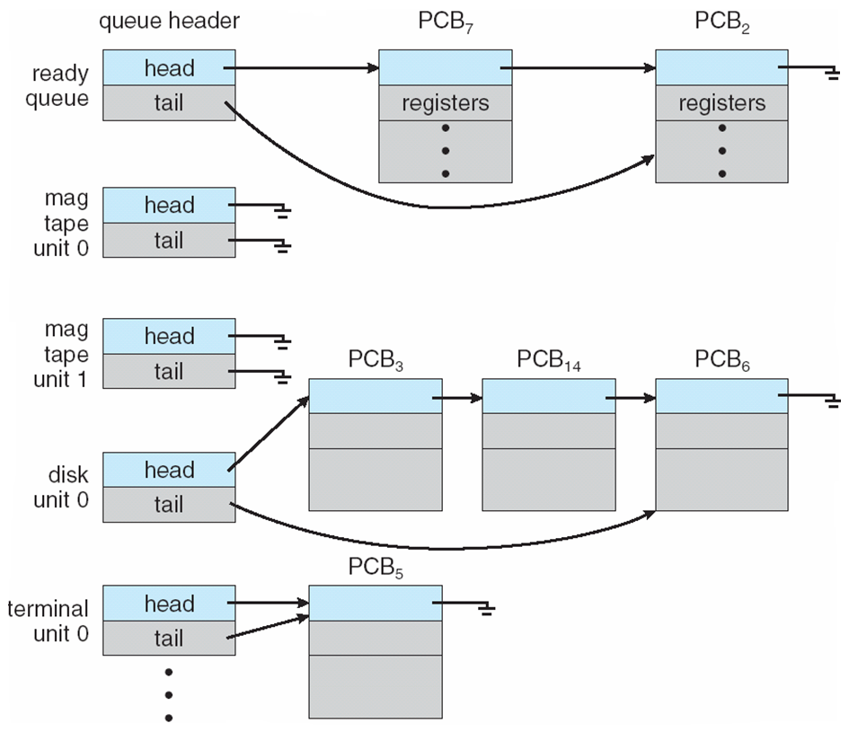
Process Scheduling Queues

Slide 8
Process Schedulers
Long-Term Scheduler (“Job Scheduler”)
Brings processes into the READY list
Period = seconds to minutes
Medium Term Scheduler (“Swapper”)
Swaps inactive processes to disk
Brings back swapped processes on demand
Short-Term Scheduler (“CPU Scheduler”)
Selects processes from the READY list
Allocates CPU time to the process
Period = milliseconds

Slide 9
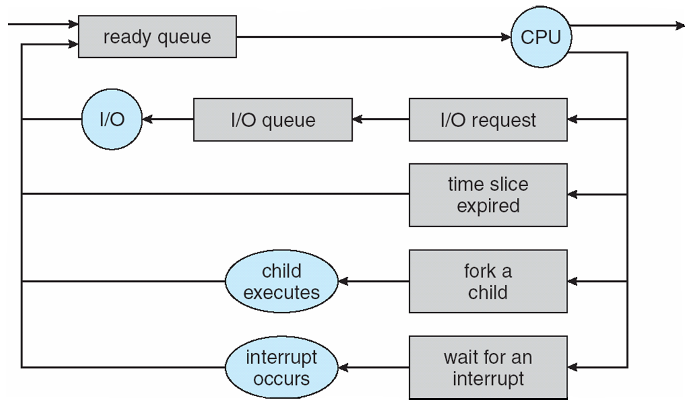
Representation of Process Scheduling
Long-term scheduler
picks up a process from
ready queue every
secs to mins
Short-term scheduler
picks up a process from
ready queue every
10-100ms
Med-term scheduler
swaps I/O waiting processes
in and out of memory

Slide 10
Process Creation
Parent process creates children processes.
Resource sharing
Resource inherited by children: file descriptors, shared memory and system queues
Resource not inherited by children: address space
Execution
Parent and children execute concurrently.
Parent blocks on wait() system call until children terminate.
UNIX examples
fork() system call creates new process.
execlp system call used after a fork() to replace the process’ memory space with a new program.
CSS430-unique ThreadOS: SysLib.exec and Syslib.join

Slide 11
C - Forking a Separate Process
parent
a.out
child
duplicated
a.out
ls
synchronized

Slide 12
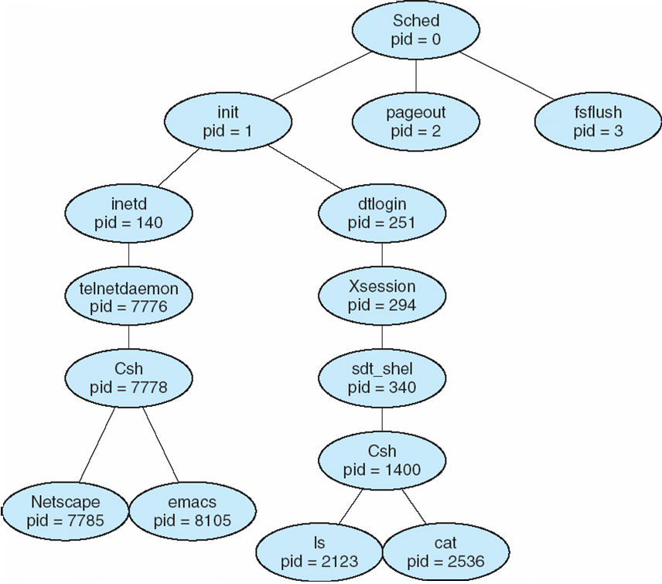
A Tree of Processes On A Typical Unix System

Slide 13
Process Termination
Process termination occurs when
last statement is executed
exit() system called explicitly
Upon process termination
Termination code is passed from:
child (via exit()) → parent (via wait()).
Process resources are deallocated by OS.
Parent may terminate execution of children processes
(via kill()) when:
Child has exceeded allocated resources.
Task assigned to child is no longer required.
Parent is exiting (cascading termination).
Some operating systems do not allow child to continue if its parent terminates.

Slide 14
Discussion 1
What are the differences between CPU bound and I/O bound processes?
What is another name for the text section in a process and what does it contain?
Discuss the differences between short-term, medium-term, and long-term scheduling in the following table:
Scheduler Type | Source of Processes | (approx.) period of execution (sec) | Key Role
Short Term
Medium Term
Long Term

Slide 15
Cooperating Processes
Process independency: Processes belonging to different users do not affect each other unless they give each other certain access permissions
Process Cooperation: Processes spawned from the same user process share some resources and communicate with each other through these resources (e.g. shared memory, message queues, pipes, and files)
Advantages of process cooperation
Information sharing: (sharing files)
Computation speed-up: (parallel programming)
Modularity: (like who | wc –l, one process lists current users and another counts the number of users.)
Convenience: (e.g. web-surfing while working on programming with vim and g++)

Slide 16
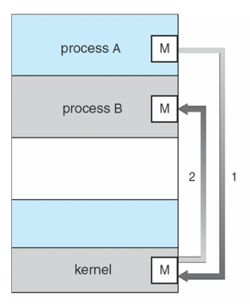
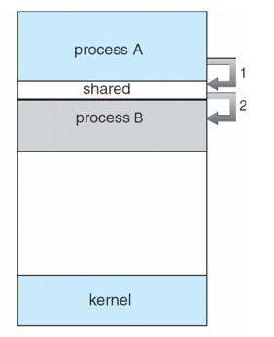
Communication Models
Message Passing | Shared Memory

Slide 17
Message Passing
Message system – processes communicate with each other without resorting to shared variables.
IPC facility provides two operations:
send(message) – message size fixed or variable
receive(message)
If P and Q wish to communicate, they need to:
establish a communication link between them
exchange messages via send/receive
Implementation of communication link
physical (e.g., shared memory, hardware bus)
logical (e.g., logical properties)

Slide 18
Direct Communication

Slide 19
Direct Communication
Processes must name each other explicitly:
send (P, message) – send a message to process P
receive(Q, message) – receive a message from process Q
How can a process locate its partner to communicate with?
Processes are created and terminated dynamically and thus a partner process may have gone.
Direct communication takes place between a parent and its child process in many cases.
Example: pipe(fd)

Slide 20
Producer-Consumer Problems
who | wc -l
who
pipe
wc -l
mfukuda tty1 Apr 1 14:14
stiber tty2 Apr 2 15:19
ksung tty3 Apr 2 15:30
Output:
3
Producer process:
who produces a list of current users.
Consumer process
wc receives it for counting # of users (i.e. lines).
Communication link:
OS provides a pipe.

Slide 21
Direct Communication
Filename: pipe.c
2
parent
fd[0], fd[1]
child
fd[0], fd[1]
Child process
“Hello...”
“Hello...”
4
3
1
pipe
Parent process

Slide 22
pipe, dup2 in C++
Filename: pipe.cpp
Why can’t we use cin >> buf?
2
parent
fd[0], fd[1]
child
fd[0], fd[1]
Child process
cerr <<
read()
“Hello...”
“Hello...”
4
3
1
pipe
Parent process
stdin
stderr

Slide 23
pipe, dup2, execlp in C++
Filename: pipe_exec.cpp
Child
child
fd[0], fd[1]
execlp
replaces
process
image
execlp
Child process
exec’s
stdout
Parent process
pipe
fd[RD]
fd[WR]
parent
stdin
stdout

Slide 24
Indirect Communication (non-hard coded IDs)

Slide 25
Indirect Communication (Message Queues)
Messages are directed and received from mailboxes (also referred to as ports).
Each mailbox has a unique id.
Processes can communicate only if they share a mailbox.
Processes must know only a mailbox id. They do not need to locate their partners
Example: message queue

Slide 26
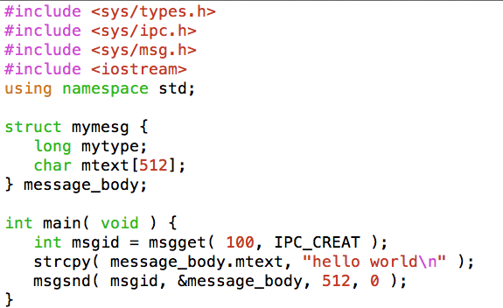
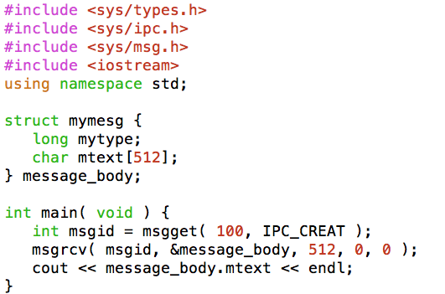
Example: Message Queues
msg_snd.cpp
msg_rcv.cpp
key=100
key=100
Message queue
(id = msgid)
Some other process can
also enqueue and
dequeue a message
(on the same key)
0
1
2

Slide 27
msg_snd.cpp → msg_rcv.cpp
Message queue
(id = msgid)
0
1
2

Slide 28
Shared Mailbox (Java)
Makes use of generics <E>
And Vector<E> to implement a simple Date message mailbox.
Next chapter will show sharing of this mailbox between threads.

Slide 29
Synchronization
Sending Process
Non-Blocking – Sends and resumes execution
Blocking – Sender is blocked until message is received or accepted by buffer.
Receiving Process
Non-Blocking – receives valid or NULL
Blocking – Waits until message arrives

Slide 30
Discussion 2
In the previous example, what will happen if you log into uw1-320-lab run msg_rcv(), then log in from a second shell to uw1-320-lab and run msg_snd()?
What do Vector<E> and Java Generic do for us?
What would be two methods of connecting machines together geographically separated from an indirect ID perspective?

Slide 31
Buffering**
Established by creating a shared memory area between a Producer and a Consumer.
Queue of messages attached to the link; implemented in one of three ways:
1. Zero capacity – 0 messages Producer must wait for Consumer (rendezvous).
2. Bounded capacity – finite length of n messages Producer must wait if link is full (This happens in practical world like sockets).
3. Unbounded capacity – “infinite” length Producer never waits. (Non-blocking send)
** Applies to both Direct and Indirect Communications

Slide 32
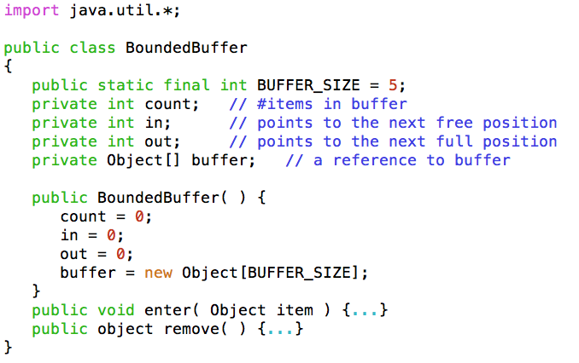
Shared Memory Bounded Buffer
Communication link or media has a bounded space to buffer in-transfer data.
See also (for C++ references):
Beej's Guide to Unix IPC - shm

Slide 33
Producer and Consumer Processes
Producer Process
Consumer Process
Buffer[0] [1] [2] [3] [4]
I
I
I
out=1
in=4

Slide 34
Client-Server Systems
Sockets
Remote Procedure Calls (RPC)
Remote Method Invocation (RMI)

Slide 35
Client-Server Connections

Slide 36
Socket Connection

Slide 37
Socket Client-Server

Slide 38
RPC
C/C++ Only
UDP Based

Slide 39
RMI
Java Based
TCP Based Communications (i.e. more reliable)

Slide 40
Sequence Diagram (RMI)
Stub provides an interface on the client side, which maps to a port on the remote side.
Marshalling - involves packaging the parameters into a form that can be transmitted over a network

Slide 41
ThreadOS SysLib

Slide 42
Shell.java (starter example)

Slide 43
Week 2 Homework
In Unix, the first process is called init. All the others are descendants of “init”. The init process spawns a sshd process that detects a new secure ssh requested connection (WKPort 22). Upon a new connection, sshd spawns a login process that then loads a shell on it when a user successfully logs into the system. Now, assume that the user types who | grep <uwnetid> | wc –l. Draw a process tree from init to those three commands. Add fork, exec, wait, and pipe system calls between any two processes affecting each other.
Consider four different types of inter-process communication (IPC).
Pipe: implemented with pipe, read, and write
Socket: implemented with socket, read, and write
Shared memory: implemented shmget, shmat, and memory read/write
Shared message queue: implemented with msgget, msgsnd, and msgrcv
Which types are based on direct communication?
Which types of communication do not require parent/child process relationship?
If we code a produce/consumer program, which types of communication require us to implement process synchronization?
Which types of communication can be used to communicate with a process running on a remote computers?
Which types of communication must use file descriptors?
Which types of communication need a specific data structure when transferring data?

