Slide 1
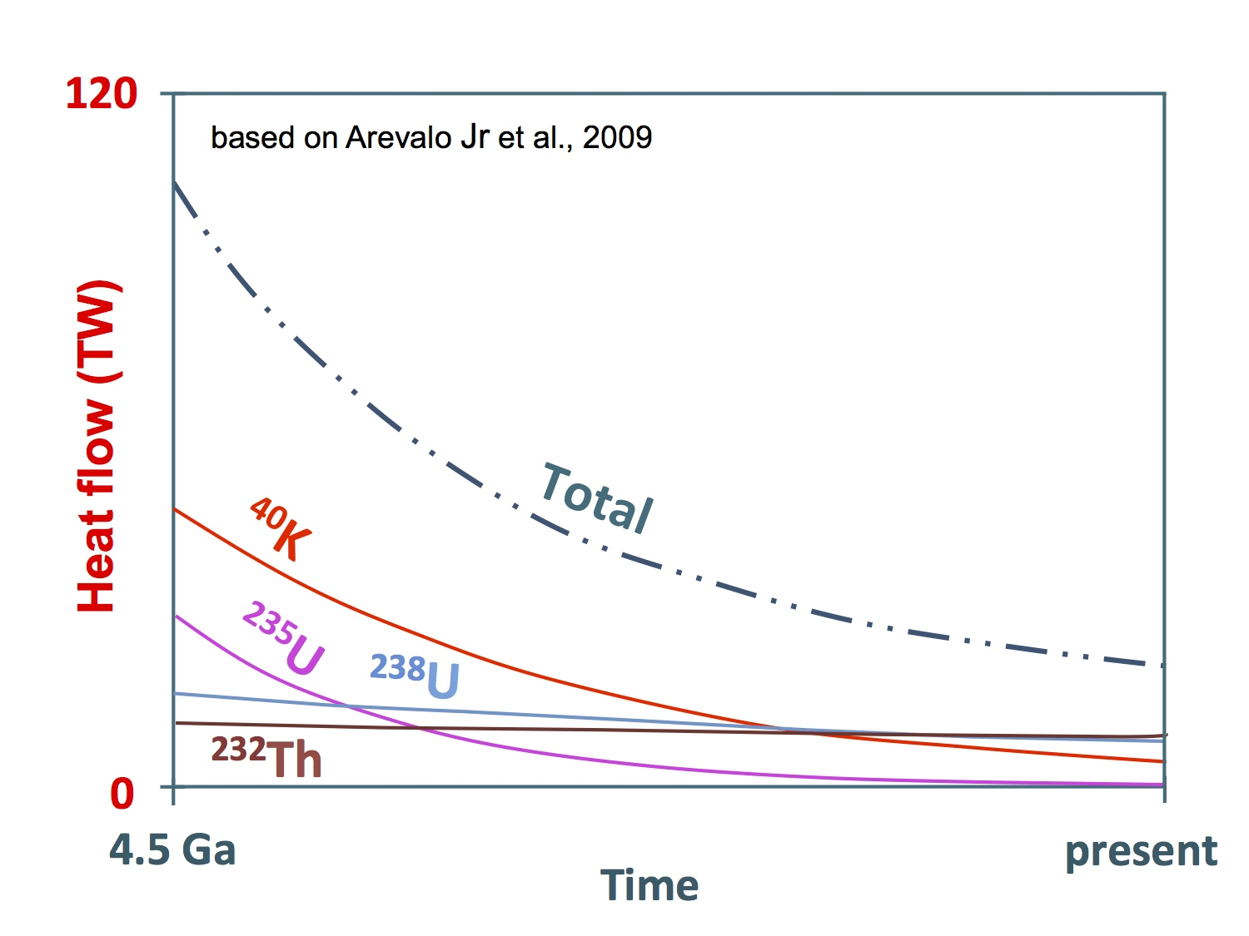
The evolution of Earth's radiogenic heat flow over time.
Notes:
Global map of the flow of heat, in mW/m², from Earth's interior to the surface.^{[1]} Higher heat flows are observed at the locations of mid-ocean ridges, and oceanic crust has relatively higher heat flows than continental crust. Davies, J. H., & Davies, D. R. (2010). Earth's surface heat flux. Solid Earth, 1(1), 5–24.

Slide 2
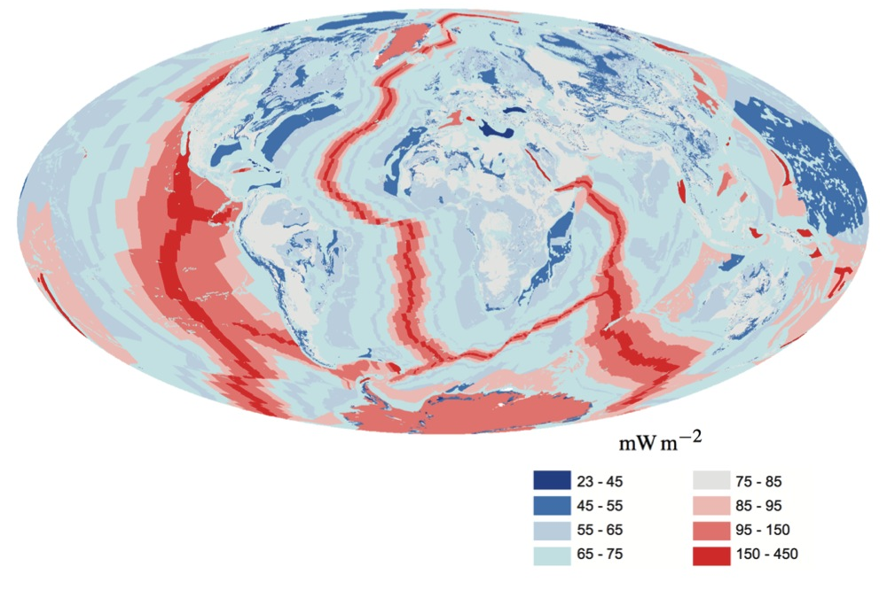
Davies, J. H., & Davies, D. R. (2010). Earth's surface heat flux. Solid Earth, 1(1), 5–24.
Notes:
Global map of the flow of heat, in mW/m², from Earth's interior to the surface.^{[1]} Higher heat flows are observed at the locations of mid-ocean ridges, and oceanic crust has relatively higher heat flows than continental crust. Davies, J. H., & Davies, D. R. (2010). Earth's surface heat flux. Solid Earth, 1(1), 5–24.

Slide 3
from: Stein and Stein, 1992, 1994, 1996;
PSM = Parsons, Sclater and McKenzie;
GDH1=Global Depth and Heat
HS = Half Space Model
Figures 7.6 & 7.7; Fowler
Notes:
From Stein and Stein 1992 and1994

Slide 4
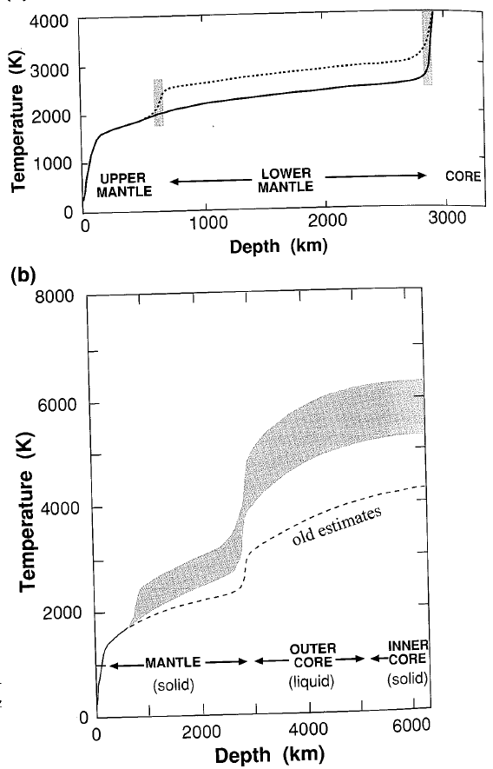
Figure 7.16; Fowler

Slide 5
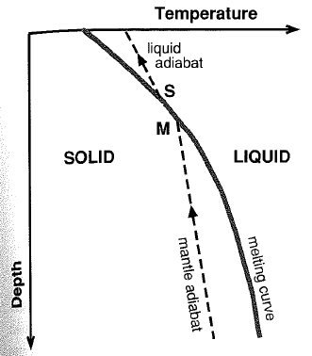
Figure 7.17;
Fowler

