Slide 1
FISH 521 Research Proposal Writing

Slide 2
Synopsis
Mind map
Debriefing
Split into panels
Introduction and Objectives
General points
Some writing guidelines
Writing exercises
Break
Split into Panels
Discuss avenues for introduction & objectives

Slide 3
Plan
Create order
Be selective
Build an argument
LOGICAL FLOW
(Powerpoint is a really cool tool)
You should be able to write up the crux of your argument in 6 – 10 short key sentences

Slide 4
Plan
INTRODUCE
motivate the cause: who cares??!!
CREATE A CASE
(RELATING TO YOUR KEY QUESTIONS)
establish common ground: what do we know?
disruption/question: where’s the problem?
SOLUTION / RESOLUTION
so now what?: aims & objectives OR your opinion / conclusion

Slide 5
General Format
Paper
Proposal
Introduction
Methods
Results
Discussion
Significance
Rationale
Methods
Expected Results
Broader Impact

Slide 6
NSF format
Title
Project Summary
Project description (10 pages)
Introduction & background (why relevant?)
Significance statement
Lead to objectives
Rationale and scope (why appropriate?)
Progress to date
Can end in hypotheses
Research management plan (how?)
Sampling and analyses
Intellectual Merit and Broader Impact
Contributions to education and human resources
References
Biographical Sketches
Budget and budget justification
Current and pending support
Facilities, equipment and other resources

Slide 7
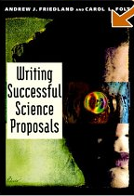
Introduction and objectives
Significance statement in book
Explain why research is important
Significance for scientists outside your field
NSF is basic science funding body
Need to present general significance
Compare NPRB, BPA
need to point out importance for RFP
Probably most important part of proposal
Reviewers make up their minds early on
Need to come to objectives soon
Points to consider (think of audience)
Broad vs narrow disciplinary view
Empirical vs theoretical contributions
Basic vs applied uses
Short vs long term contribution

Slide 8
Introduction
Keep it short
Around 2 pages
Funnel the reader
Start broad, become specific
For class proposal
First paragraph without mentioning
Species
Study system
Structure
What is the issue?
What is known?
Where is the gap?
What will you do about it?
End with clear goals
Overall Aim
Specific objectives

Slide 9
Rationale
Describe the background
What has been done on your specific question?
Background to introduction if needed
Not necessarily on your species or your system
What is known about your approach
E.g. what can fatty acids tell you?
Not necessarily on your species or your system
Why is your study system particularly suitable?
Inherent advantages of system
Is there any urgency?
Special access or expertise of investigators
PI and collaborators
End in a set of specific hypotheses
Can be removed later

Slide 10
Introduction vs Rationale
Objective
Explain significance of project (objective)
Responsiveness to RFP
Explain appropriateness of approach
Provide background to methods
Content
Broad statement of research area
Brief description of what is known
Identification of gaps
Aims and objectives
Current state of knowledge
Preliminary data, esp. your own
Review of approach
Not necessarily on study system
Description of study system
Highlight power of study system, methods and investigators
Specific hypotheses
Target Audience
Review Panel
Program Manager / Director
Reviewers
Review Panel

Slide 11
Measuring genetic diversity in wild populations: molecular and adaptive genetic variation in Trinidadian guppies (Poecilia reticulata)
A fundamental and yet unresolved problem in evolutionary biology is the extent to which variability in molecular genetic markers such as allozyme and DNA polymorphisms can be used to estimate genetic variation in ecologically significant traits[i]. This problem is emphasised by geneticists and ecologists alike[ii], not only because elucidation of their relationship would facilitate powerful insights into the dynamics of stochastic and deterministic microevolutionary forces, but also because the use of molecular markers underpins many current practices in biodiversity conservation and management[iii]. The issue is thus not only of key relevance to our understanding of basic biological processes that determine species distribution and abundance, but also to our attempts to ameliorate the impact of man on the natural world.
It has long been established that the traits of relevance to adaptation such as morphology, behaviour and physiology are controlled by quantitative, continuously varying characters influenced by multiple genes and environmental factors. Although this principle is well entrenched in evolutionary theory there is a dearth of empirical demonstrations on the effects of microevolutionary forces and demographic events on the variance of such characters, largely because of the unreliability of prevailing molecular estimators of adaptive genetic variation. It follows that our capacity to predict and manage the effects of anthropogenic activities such as habitat change and fragmentation, pollution or exploitation relies heavily on the generation of realistic and informative measures of quantitative genetic variation and its fitness consequences. Here, we utilise ecologically and genetically well characterised wild populations of the Trinidadian guppy, Poecilia reticulata, to examine the relationships between molecular genetic diversity and genetic variability in several readily measured ecologically significant traits. In addition, the implications of variable molecular and adaptive diversity will be assessed using fitness estimators.

Slide 12
Objectives & hypotheses
Need to be crystal clear
Often best as bulleted points
Revise as you go along
Start early
Need to be linked to significance statement
Usually at end of significance statement
Objectives
Broad aims of the study
Touching on significance
Best to go beyond species or study system
Hypotheses
Much more specific & testable
Can be presented as a null hypothesis
Date of emergence is not correlated with average winter temperature
Can be used as subheadings for methods

Slide 13
Measuring genetic diversity in wild populations: molecular and adaptive genetic variation in Trinidadian guppies (Poecilia reticulata)
Significance
A fundamental and yet unresolved problem in evolutionary biology is the extent to which variability in molecular genetic markers such as allozyme and DNA polymorphisms can be used to estimate genetic variation in ecologically significant traits.
P. reticulata populations occupying the rivers of N. Trinidad exhibit remarkable molecular, behavioural and morphological diversity12, the extent of which is determined both by deterministic (sexual and natural selection) and stochastic events (e.g. founder effects, genetic drift).
Overall Aim
To examine the relationship between molecular genetic variation and genetic variability in ecologically significant traits of wild populations of Trinidadian guppies, Poecilia reticulata.
Objectives
To investigate the effects of microevolutionary forces on molecular and quantitative genetic variation
To test the predictability of adaptive genetic variation from molecular genetic data
Specific Hypotheses
Introduced populations of guppies show lower levels in both molecular and quantitative genetic variation
Small upland populations have lower genetic diversity than large lowland populations
Genetic variation differs between life-history traits under strong selection and morphological traits under moderate selection
Quantitative genetic variation is correlated with molecular genetic variation

Slide 14
Break
http://www.tedxlausanne.org/speakers/uri-alon

Slide 15
Make it easy on the reader
Target audience
Proposals: Reviewer, panelist, program manager
Manuscripts: Reviewer, editor, reader
Readers have certain expectations
Beginning ➔ middle ➔ end
Simple & familiar ➔ complex & new
In this class
Read your peers’ proposal with the aim of learning
Work out why you like sections and why not
What is different

Slide 16
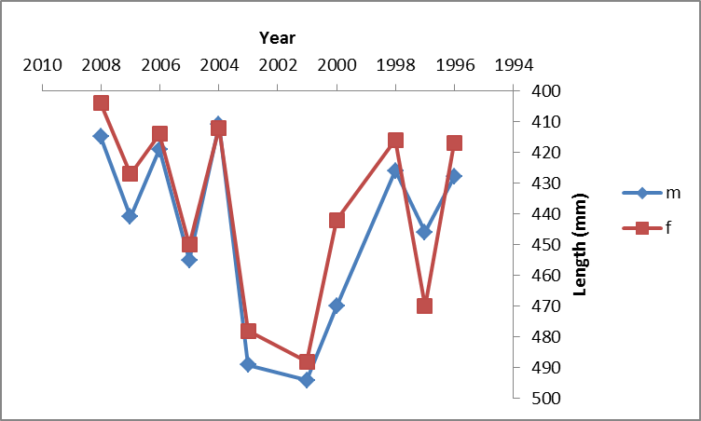
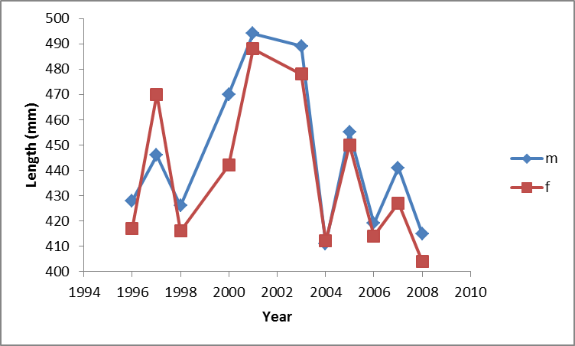
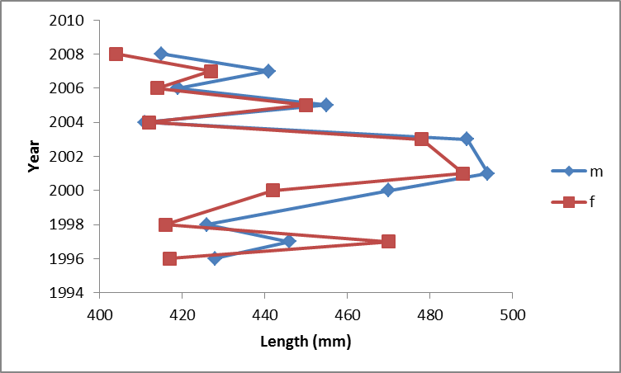
For example, a figure Temporal trends in salmon body length

Slide 17
Structure of introduction & rationale
Plan ahead
Develop an outline for each section
Paragraph by paragraph
Subheadings
Possibly remove
Make sure paragraphs are connected
Tell story
Thread through the narrative
Funnel reader where you want them
Familiar information first
New and complex information later
Readers should know where they are at each point
Why am I reading this?
How does it fit into the story?

Slide 18
Paragraph structure
Conform to readers’ expectations
Anticipate what the reader will want to know
Stick to single points
Start with statement what it is about (topic sentence)
Turan et al. (2014), in a study on Atlantic herring, suggested considerable population differentiation, while Mitchell et al. (2010) could not detect any genetic differences in Pacific herring.
Past research on the population genetics of herring was often contradictory. While considerable differentiation was found in Atlantic herring (Turan et al. 2014), Pacific herring appeared genetically homogenous (Mitchell et al. 2010).
Link paragraphs
Despite such insights into population structure of Atlantic herring, specific information on Pacific herring is scarce.

Slide 19
Sentence structure
Conform to readers’ expectations
Anticipate what the reader will want to know
Readers expect sentences that reflect certain principles
Subject
Make the subject the topic of the sentence
Get to the subject quickly
Avoid opening with long clauses and phrases
Verb
Make the verb the important action
Get past the subject to the verb quickly
Avoid opening with long clauses and phrases
Leave new and complex issues to the end of the sentence
Open sentences with familiar information

Slide 20
For example
Once upon a time, as a walk through the woods was taking place on the part of Little Red Riding Hood, the Wolf’s jump out from behind a tree occurred, causing her fright.
Restructure subjects and verbs

Slide 21
Active vs passive
Who is important?
By early 1945, the Allies had essentially defeated Germany; all that remained was a bloody climax. American, French, British and Russian forces had breached its borders and were bombing it around the clock. But they had not yet so devastated Germany as to destroy its ability to resist.
By early 1945, Germany had essentially been defeated: all that remained was a bloody climax. Its borders had been breached and it was being bombed around the clock. It had not been so devastated, however, that it could not resist.
Do you need to know who is responsible?
Those who are found guilty will be fined
DNA was extracted from muscle tissues

Slide 22
Subjects
Compare
Turan et al. (2014), in a study on Atlantic herring, suggested considerable population differentiation, while Mitchell et al. (2010) could not detect any genetic differences in Pacific herring.
While considerable differentiation was found in Atlantic herring (Turan et al. 2014), Pacific herring appeared genetically homogenous (Mitchell et al. 2010).

Slide 23
Familiar & simple vs new & complex
Compare:
A sociometric and actuarial analysis of Social Security revenues and disbursements for the last six decades to determine changes in projecting deficits is the subject of this study
In this study, we analyze Social Security’s revenues and disbursements for the last six decades, using sociometric and actuarial criteria to determine changes in projecting deficits

Slide 24
Sentence structure
Structure
Subject
Verb
Rest
Fixed
Character
Action
Rest
Variable
Content
Topic
Stress
Familiar & simple
New & complex

Slide 25
Making it easier
Get to the subject of the main clause quickly
Get past the subject to the main verb quickly
Keep subjects short
Use verbs describing specific actions
Don’t bury in abstract nouns
Don’t use ‘was carried out’, ‘was taking place’, etc
Start simple and leave complex statements to the end
Keep subjects consistent
Only one or few topics per paragraph
Keep paragraphs to single or very few topics
Link paragraphs
Familiar information first
New information leads to next paragraph

Slide 26
Panel Exercise
Exercise
Revise sentences
Hand in
Mind map debriefing
Finalize mind maps as much as possible
Structure of Introduction and Rationale
List the main point in your introduction and rationale
Ideally paragraph by paragraph
Decide which points to put where
Identify repetitions
Intentional repetition is ok, if brief
Identify gaps
Discuss

