Slide 1
Ling 566
Oct 17, 2017
How the Grammar Works

Slide 2
Overview
What we’re trying to do
The pieces of our grammar
Two extended examples
Reflection on what we’ve done, what we still have to do
Reading questions

Slide 3
What We’re Trying To Do
Objectives
Develop a theory of knowledge of language
Represent linguistic information explicitly enough to distinguish well-formed from ill-formed expressions
Be parsimonious, capturing linguistically significant generalizations.
Why Formalize?
To formulate testable predictions
To check for consistency
To make it possible to get a computer to do it for us

Slide 4
How We Construct Sentences
The Components of Our Grammar
Grammar rules
Lexical entries
Principles
Type hierarchy (very preliminary, so far)
Initial symbol (S, for now)
We combine constraints from these components.
Q: What says we have to combine them?

Slide 5
An Example
A cat slept.
Can we build this with our tools?
Given the constraints our grammar puts on well-formed sentences, is this one?

Slide 6
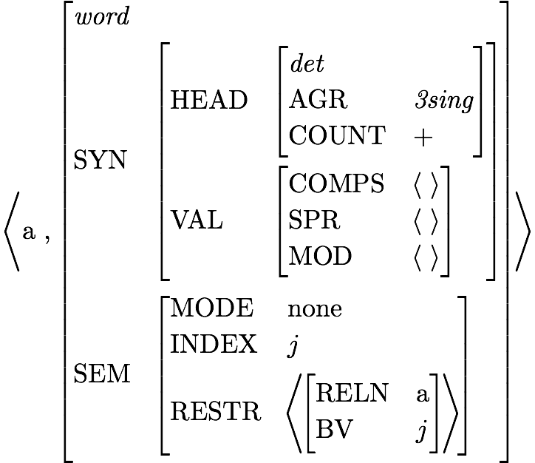
Lexical Entry for a
Is this a fully specified description?
What features are unspecified?
How many word structures can this entry license?

Slide 7
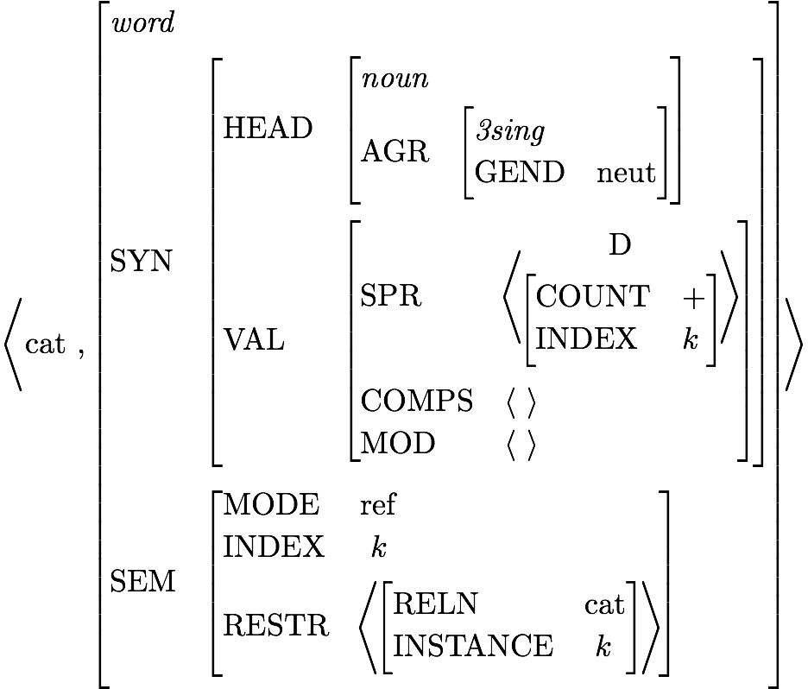
Lexical Entry for cat
Which feature paths are abbreviated?
Is this a fully specified description?
What features are unspecified?
How many word structures can this entry license?

Slide 8
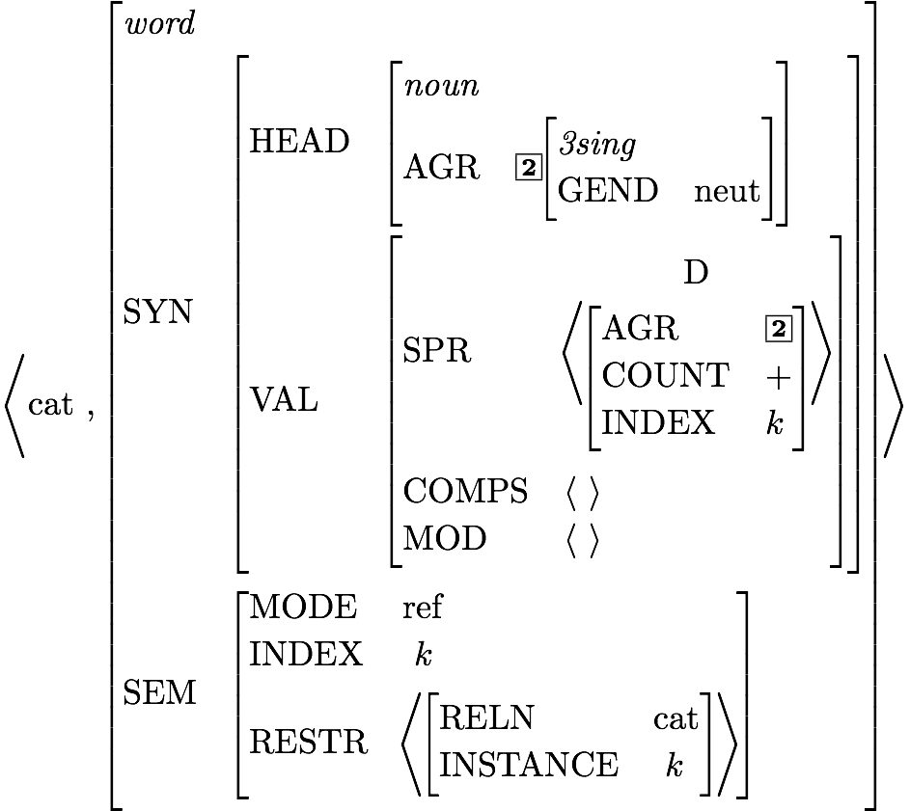
Effect of Principles: the SHAC

Slide 9
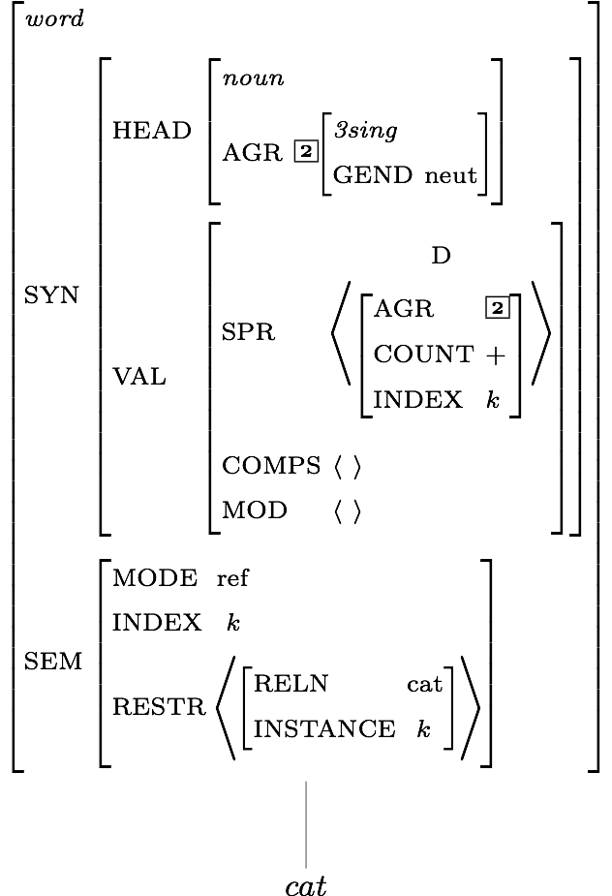
Description of Word Structures for cat

Slide 10
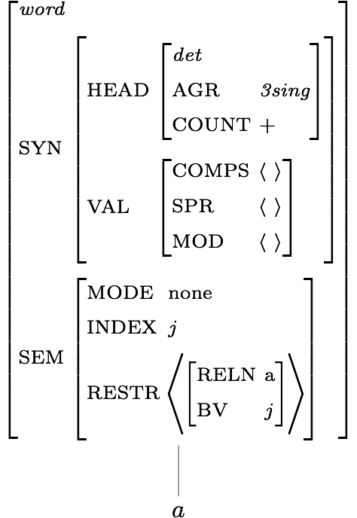
Description of Word Structures for a

Slide 11
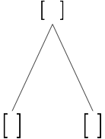
Building a Phrase

Slide 12
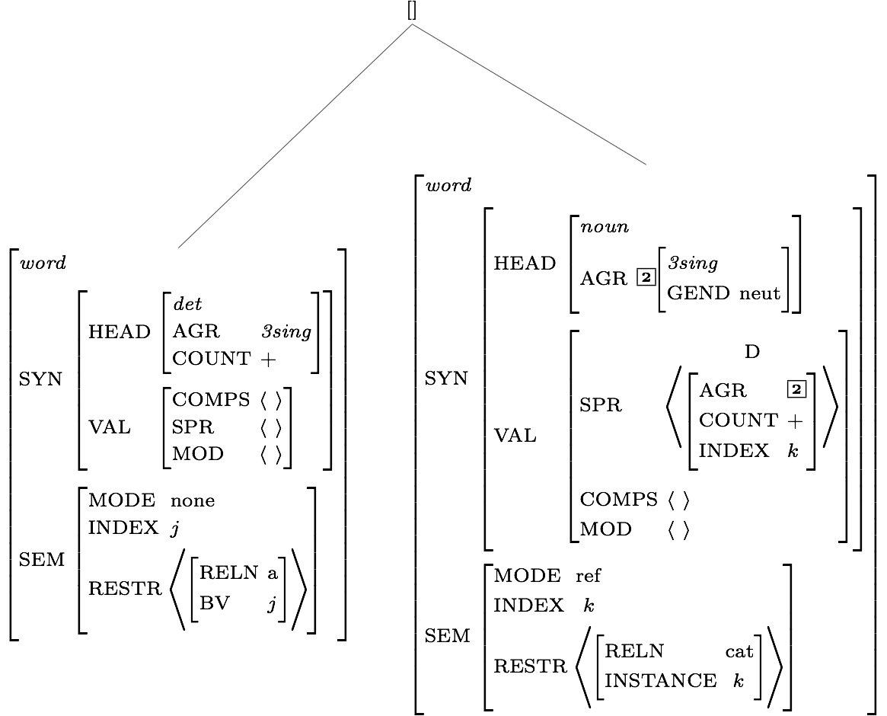
Constraints Contributed by Daughter Subtrees

Slide 13
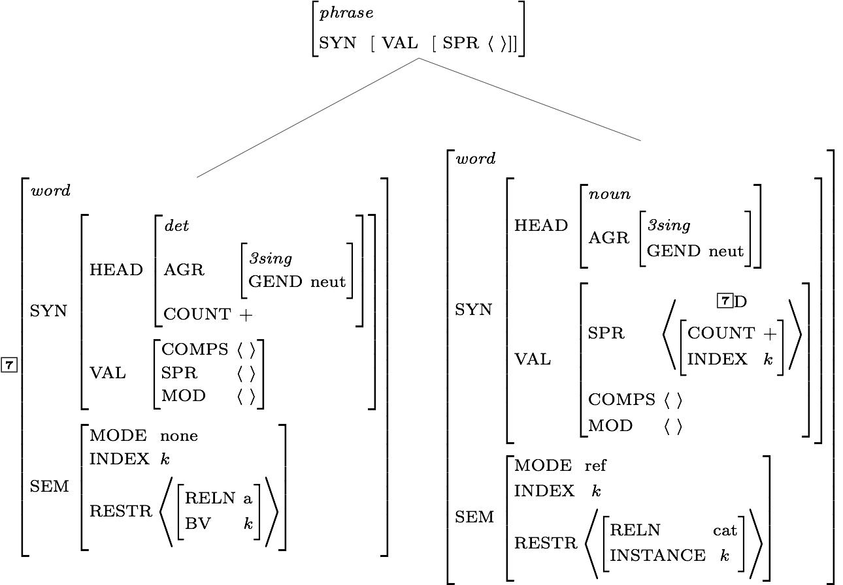
Constraints Contributed by the Grammar Rule

Slide 14
A Constraint Involving the SHAC

Slide 15
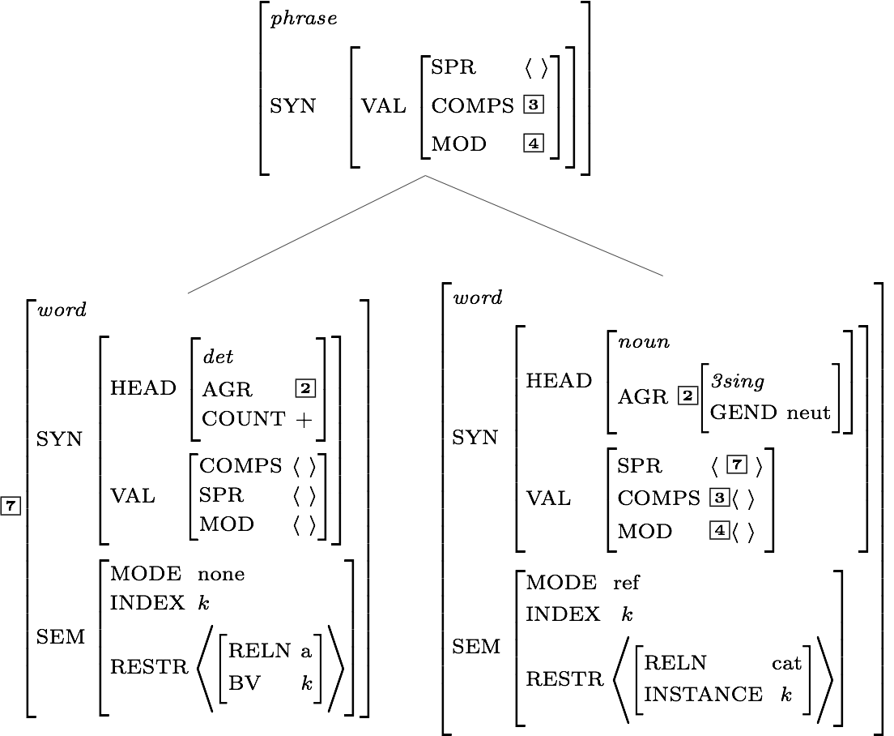
Effects of the Valence Principle

Slide 16
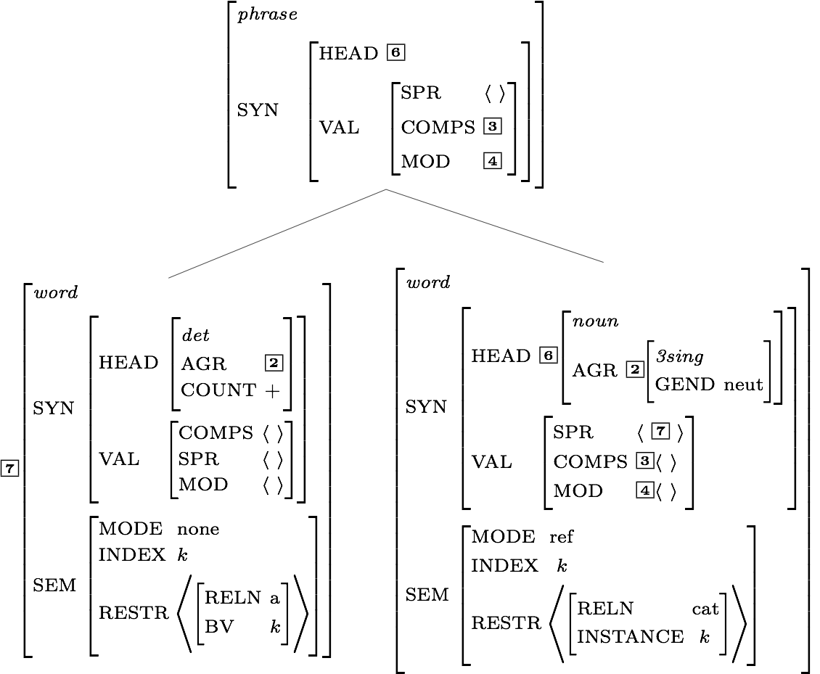
Effects of the Head Feature Principle

Slide 17
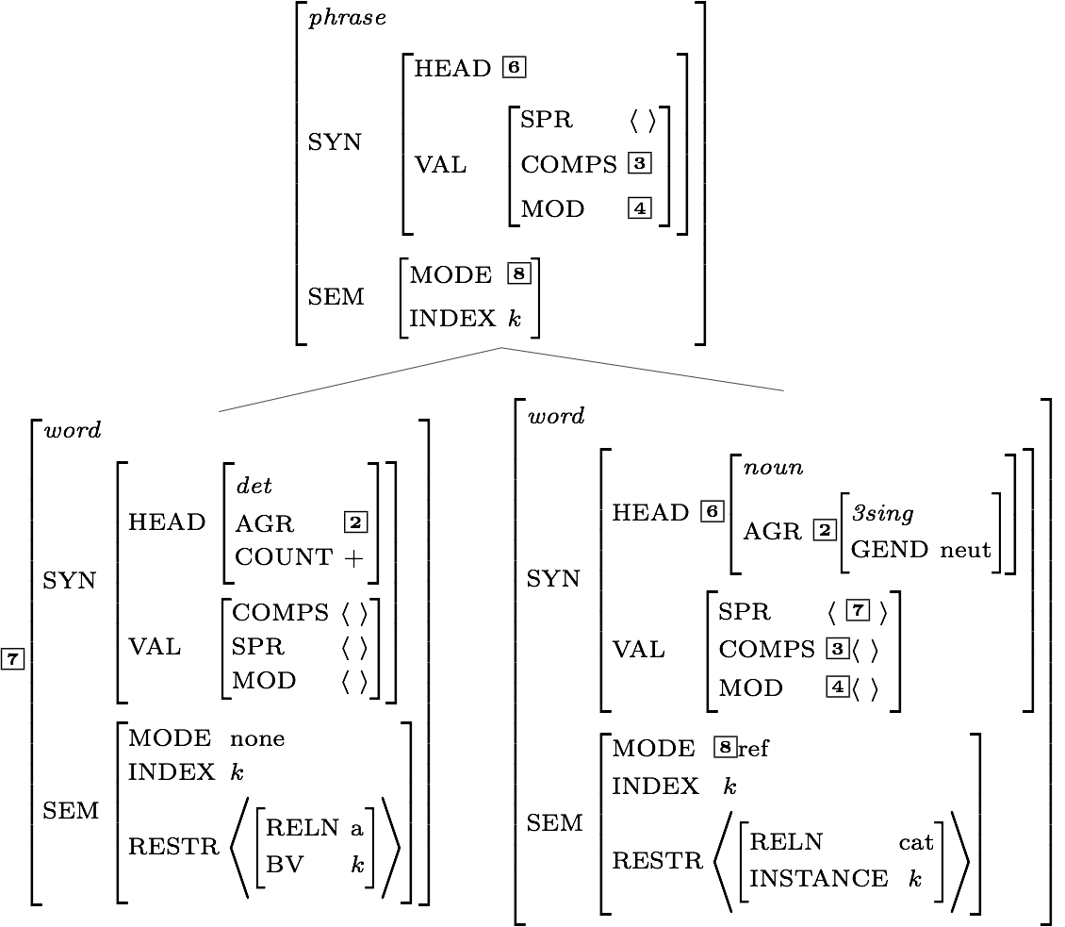
Effects of the Semantic Inheritance Principle

Slide 18
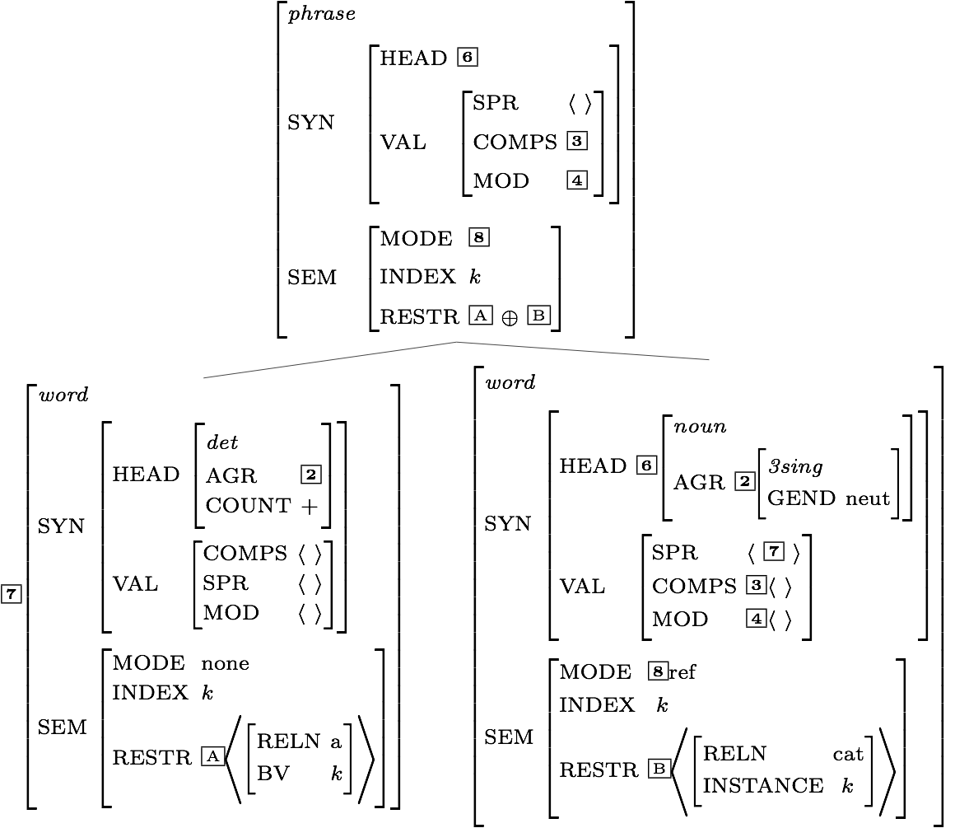
Effects of the Semantic Compositionality Principle

Slide 19
Is the Mother Node Now Completely Specified?

Slide 20
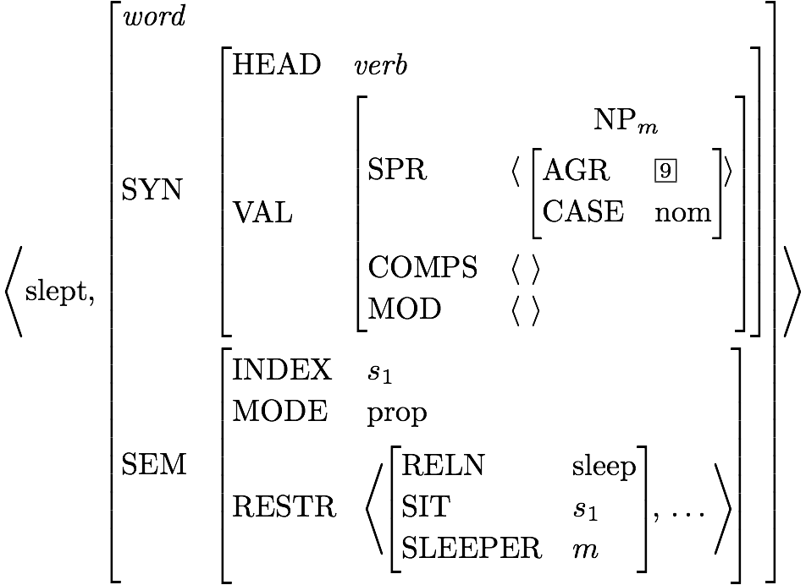
Lexical Entry for slept

Slide 21
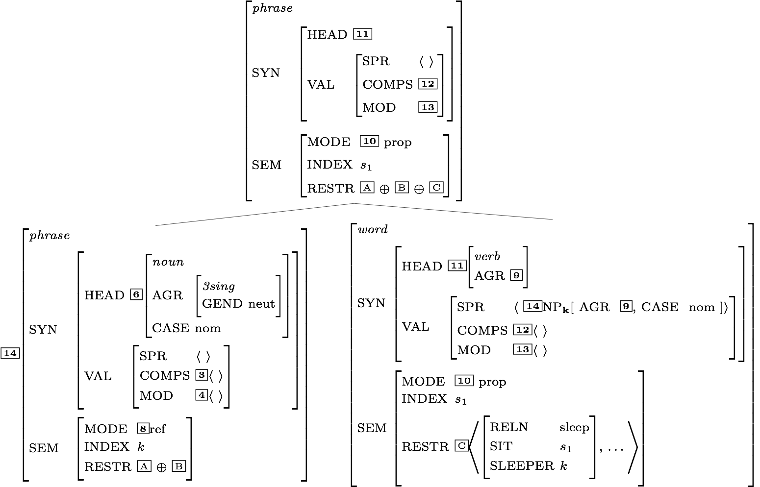
Another Head-Specifier Phrase
Key
 | HSR
 | SHAC
 | Val Prin
 | HFP
 | SIP
 | SCP

Slide 22
Is this description fully specified?

Slide 23
Does the top node satisfy the initial symbol?

Slide 24
RESTR of the S node

Slide 25
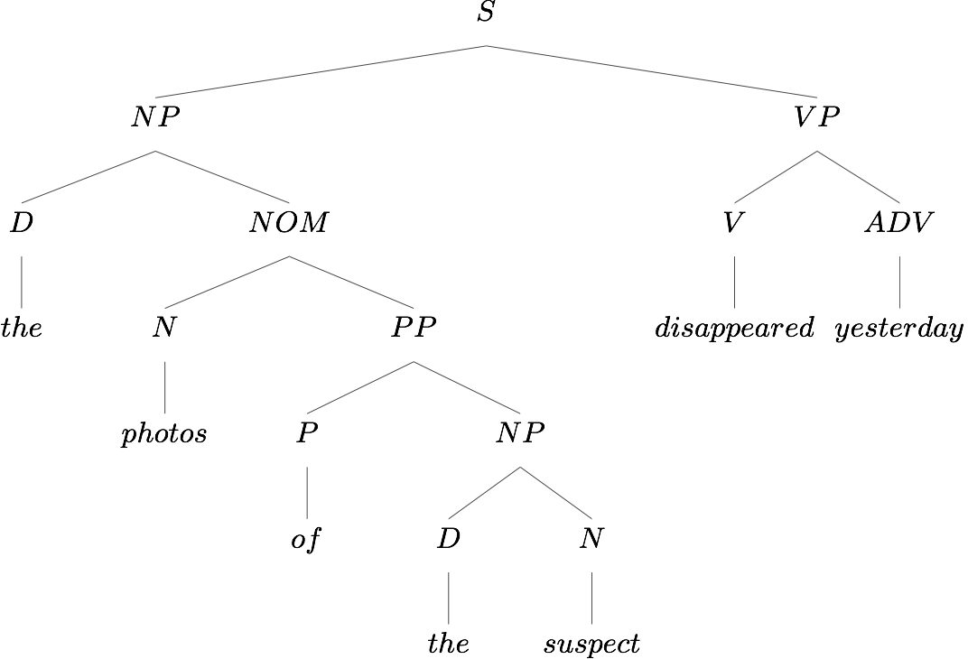
Another Example

Slide 26
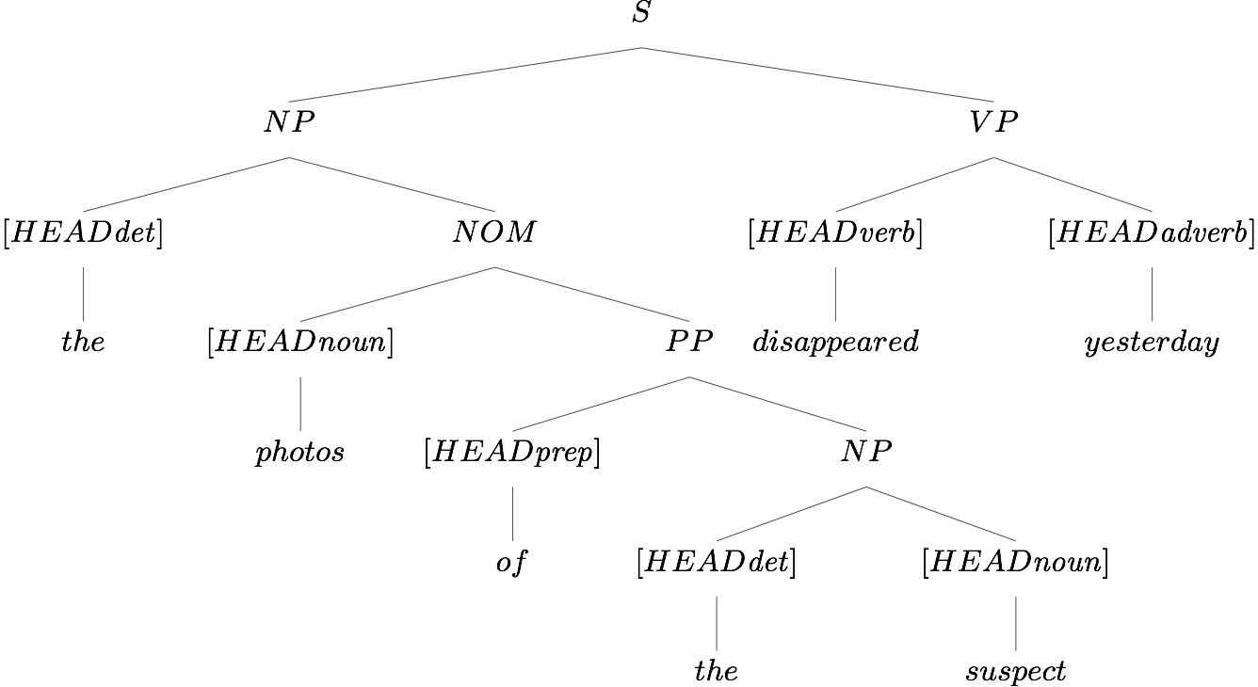
Head Features from Lexical Entries

Slide 27
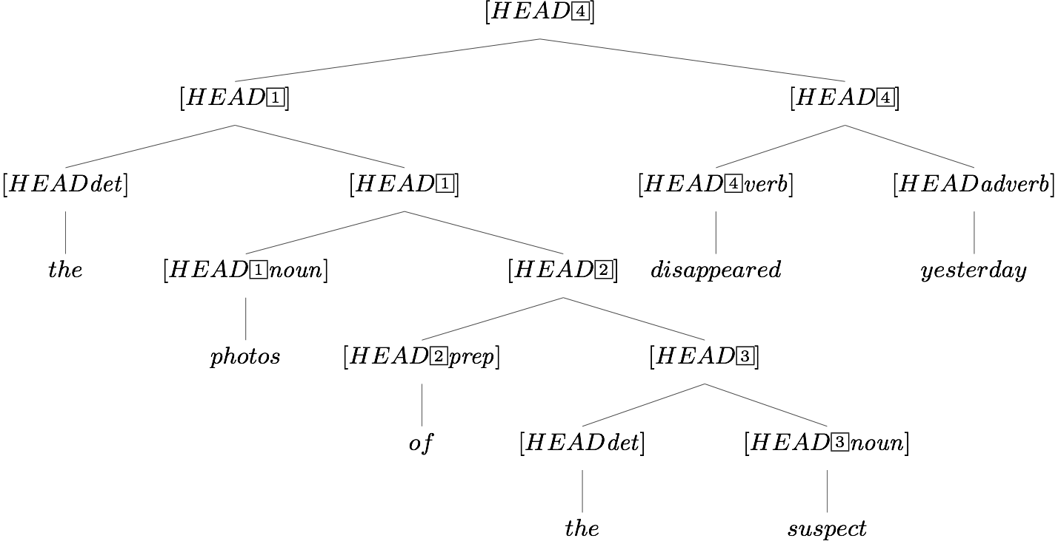
Head Features from Lexical Entries, plus HFP

Slide 28
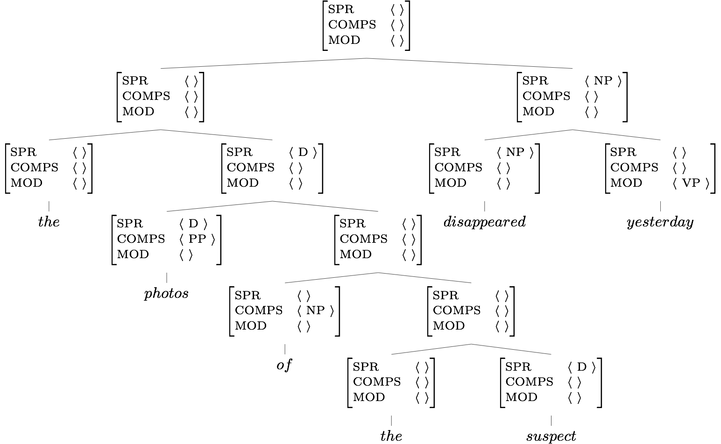
Valence Features:
Lexicon, Rules, and the Valence Principle
Key
 | Lexicon
 | Val. Prin.
 | Rules

Slide 29
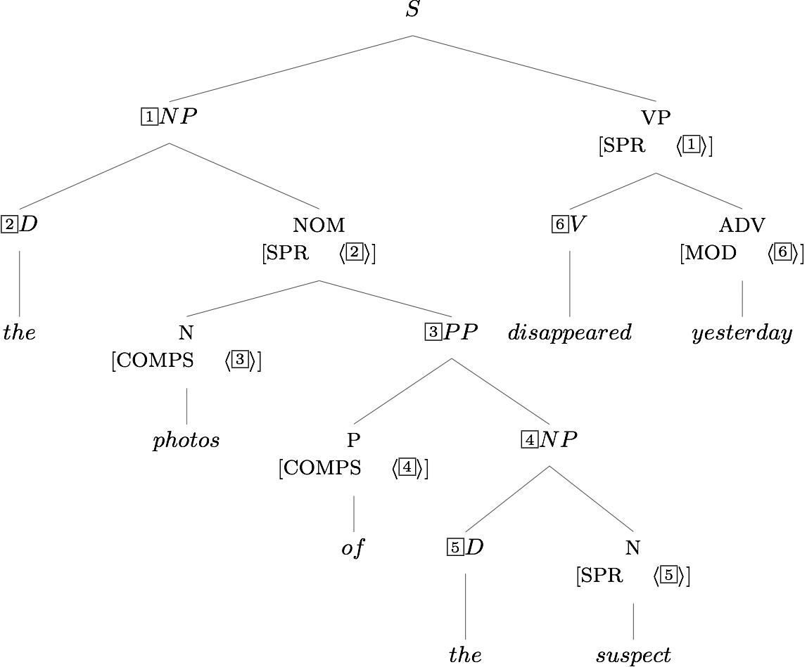
Required Identities: Grammar Rules

Slide 30
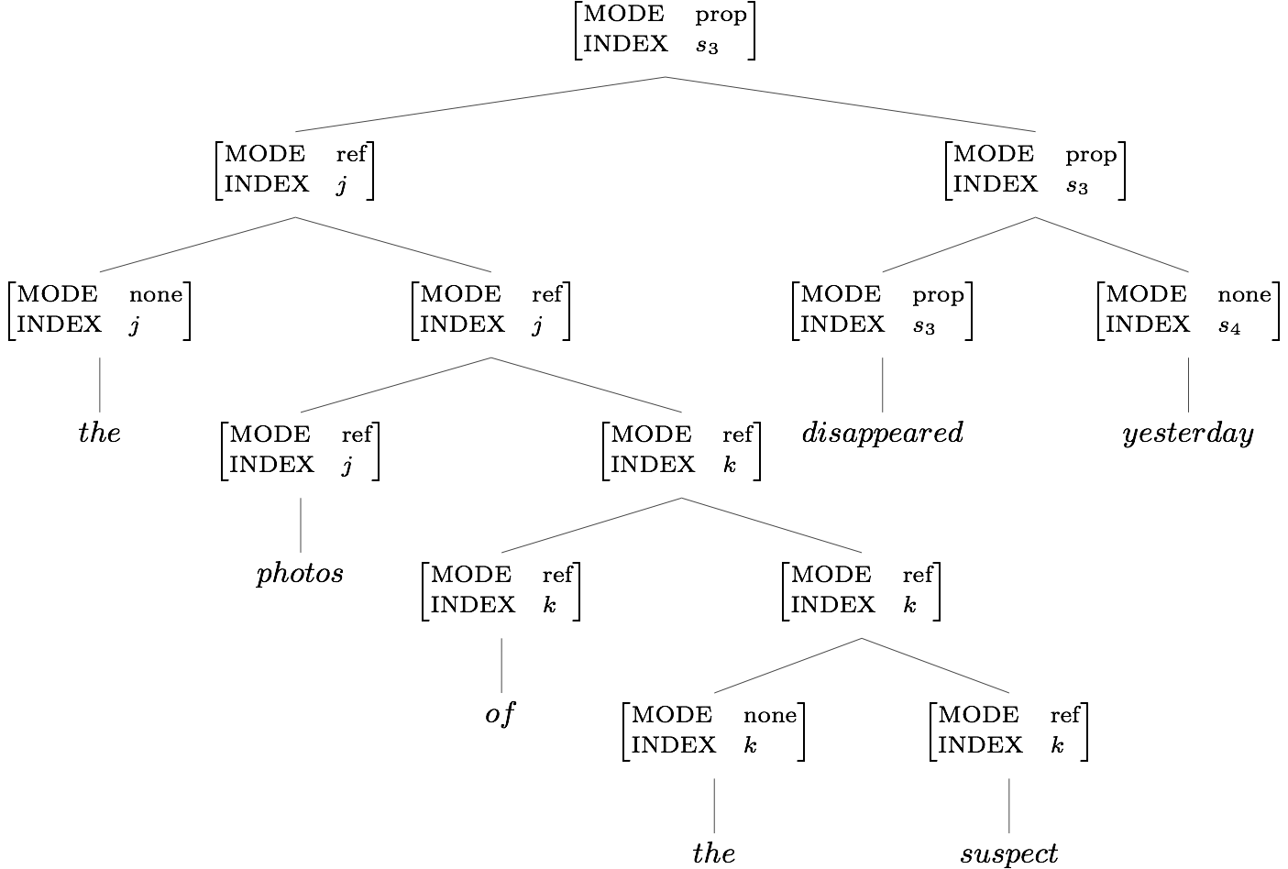
Two Semantic Features: the Lexicon & SIP

Slide 31
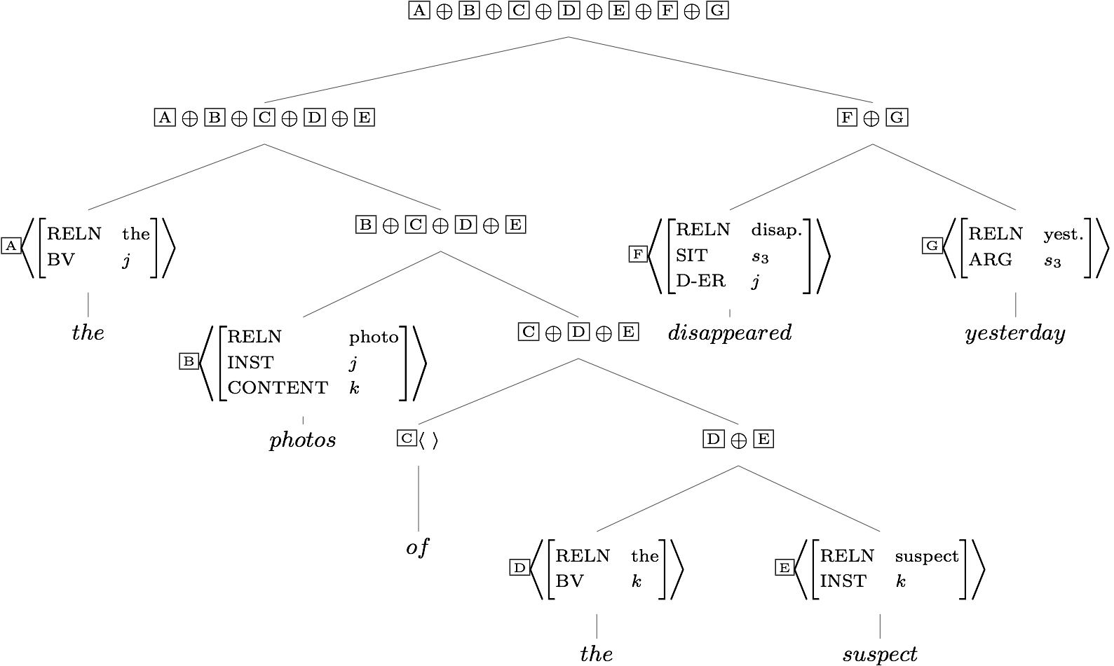
RESTR Values and the SCP

Slide 32
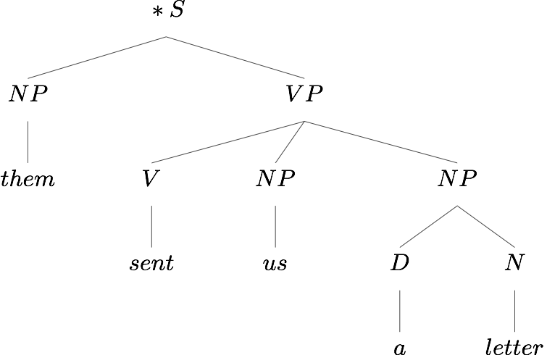
An Ungrammatical Example
What’s wrong with this sentence?

Slide 33
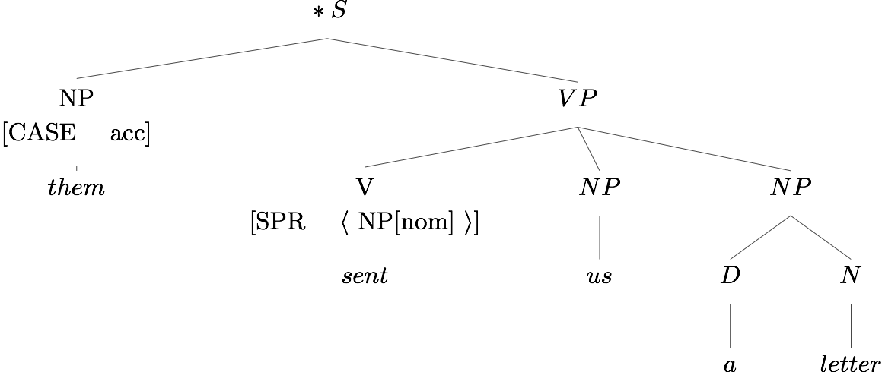
An Ungrammatical Example
What’s wrong with this sentence?
So what?

Slide 34
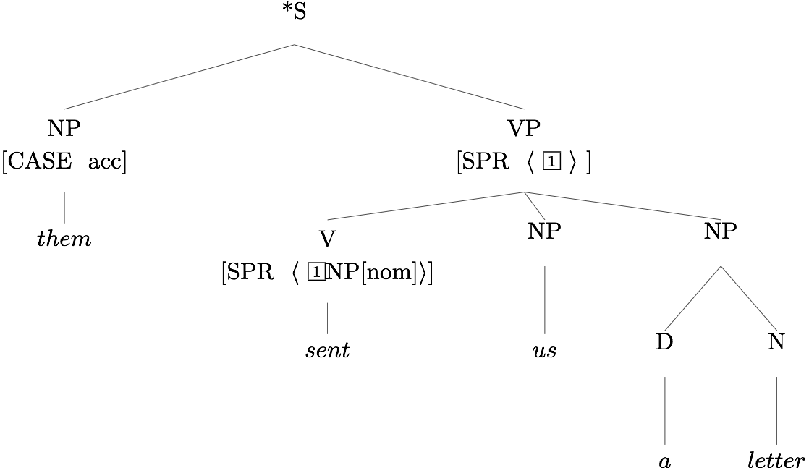
An Ungrammatical Example
The Valence Principle

Slide 35
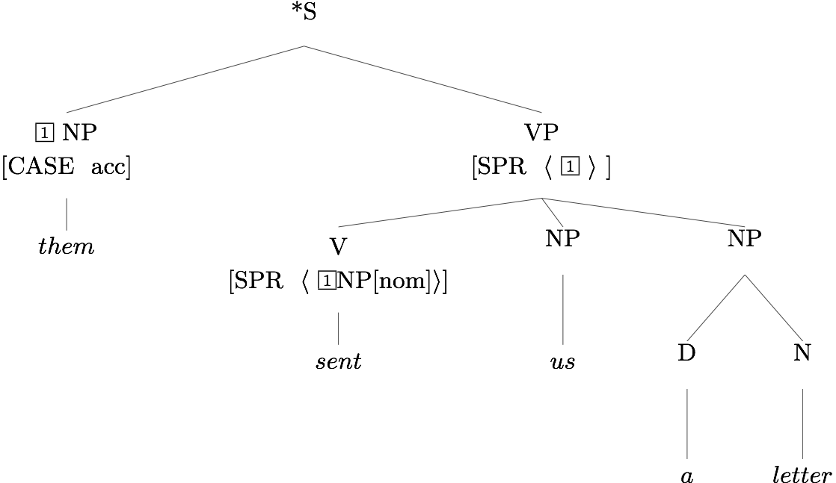
An Ungrammatical Example
Head Specifier Rule
¬contradiction®

Slide 36
Exercise in Critical Thinking
Our grammar has come a long way since Ch 2, as we've added ways of representing different kinds of information:
generalizations across categories
semantics
particular linguistic phenomena: valence, agreement, modification
What else might we add? What facts about language are as yet unrepresented in our model?

Slide 37
Overview
What we’re trying to do
The pieces of our grammar
Two extended examples
Reflection on what we’ve done, what we still have to do
Reading questions

Slide 38
Reading Questions
What's the difference between Rules and Principles?
Tags: it seems like sometimes they originate in the mothers and sometimes the originate in the daughters? For example, on pg 172, why is the [4] tag for AGR up in the mother?
Tags: When do we use them, when do we show the whole feature structure?

Slide 39
Reading Questions
Does s7 in SIT stand for the seven predications listed on example 17? Does it mean that SIT account for the number of predications the sentence has?
Is it true that a lexical entry can satisfy an infinite number of word structures if and only if its SPR or COMPS has selected one or more things on the list? How would this notion of infinity be useful?

Slide 40
Reading Questions
When do we create multiple lexical entries for a given word? Can we use the same lexical entry to denote multiple semantic meanings if they are found in the same syntactic context? Or do we have to split them out for each one? Can we have multiple lexical entries for a word that maintains the same semantic meaning in multiple syntactic contexts?
Can we write one entry for send/sent that gets both the NP NP and NP PP patterns?

Slide 41
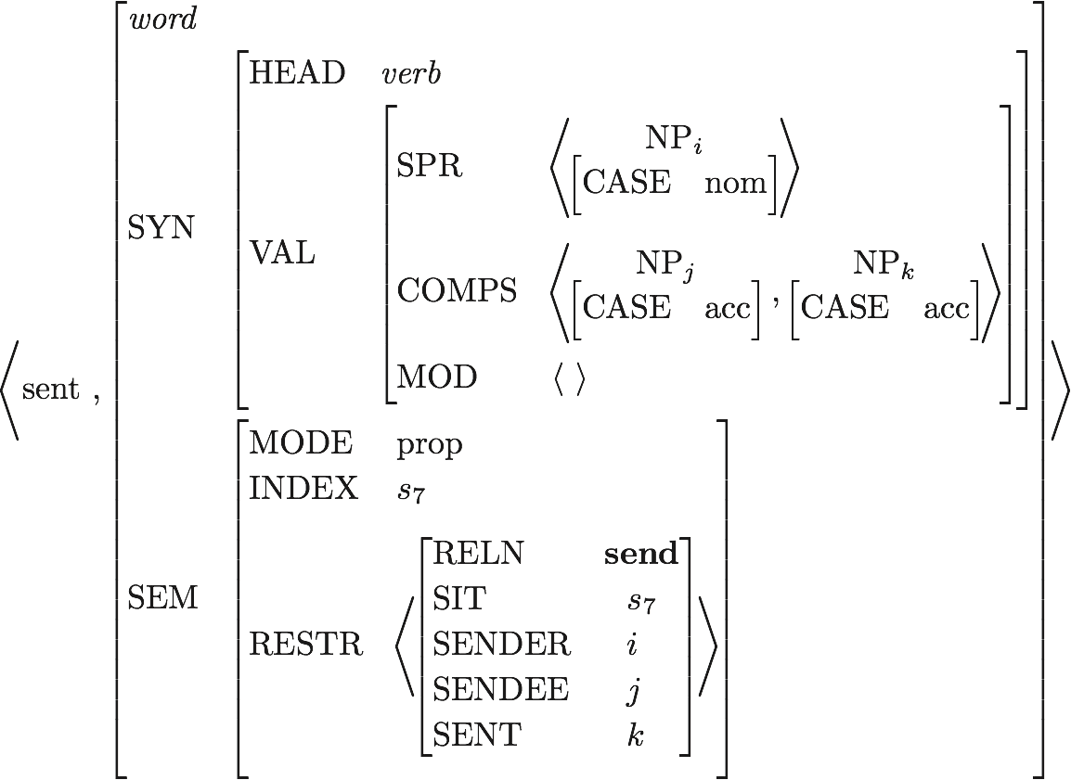

Slide 42
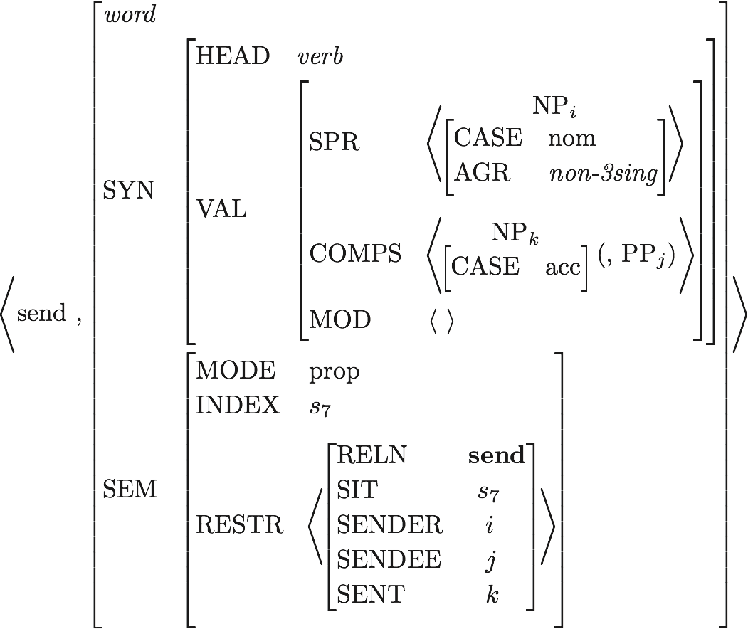

Slide 43
Reading Questions
Is it okay to leave semantic roles unlinked to other roles? (Like SENDEE in one of the structures for send two letter to Lee?)
On page 171, immediately after (8), it says that there is no technical issue with having semantic roles that are not realized syntactically--in this case, there is no constituent that fills the ADDRESSEE role for letter. Is there any benefit to including such roles? Why would we include roles like this when they aren't relevant to the context we're looking at?
P 171 - it's not a problem to have no constituent realizing the ADRESSEE role because we did not impose constraint requiring that semantic roles be realized syntactically. Will we impose such a constraint in other cases - do semantic roles have to be realized syntactically sometimes?

Slide 44
Reading Questions
In page 179, do the predications with RELN group, speaker and member all belong to 'us'? How to interpret those predications?

Slide 45
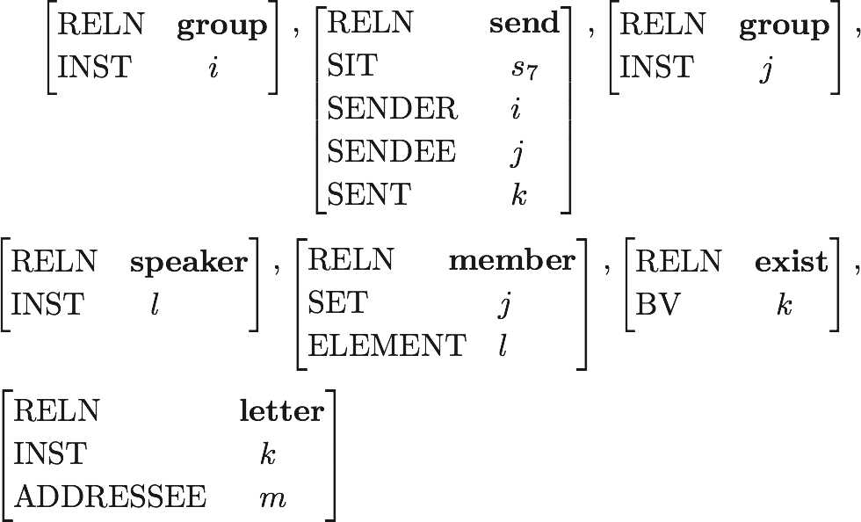

Slide 46
Reading Questions
How do BV & INST end up linked?

Slide 47
Lexical Entry for a
Is this a fully specified description?
What features are unspecified?
How many word structures can this entry license?

Slide 48
Lexical Entry for cat
Which feature paths are abbreviated?
Is this a fully specified description?
What features are unspecified?
How many word structures can this entry license?

Slide 49
Reading Questions
Given the possibility of multiple well-formed parses of an ambiguous sentence, how does parse selection work with HPSG? What would make a parser choose one representation over the other? Is there a way to include a "weight" for parses to indicate preference within the context of a particular corpus?
Has anyone actually built one of these in software?

