Slide 1
Ling 566
  Oct 15, 2024
How the Grammar Works

Slide 2
Overview
What we’re trying to do
The pieces of our grammar
Two extended examples
Reflection on what we’ve done, what we still have to do

Slide 3
What We’re Trying To Do
Objectives
  Develop a theory of knowledge of language
  Represent linguistic information explicitly enough to distinguish well-formed from ill-formed expressions
  Be parsimonious, capturing linguistically significant generalizations.
Why Formalize?
  To formulate testable predictions
  To check for consistency
  To make it possible to get a computer to do it for us

Slide 4
Why does this matter to NLP?
Understand how language works => better positioned to build technology that works with language
For some applications, grammar engineering is a valuable component directly
Grammar engineering can also support extremely detailed annotation

Slide 5
How We Construct Sentences
The Components of Our Grammar
  Grammar rules
  Lexical entries
  Principles
  Type hierarchy (very preliminary, so far)
  Initial symbol (S, for now)
We combine constraints from these components.
  Q: What says we have to combine them?

Slide 6
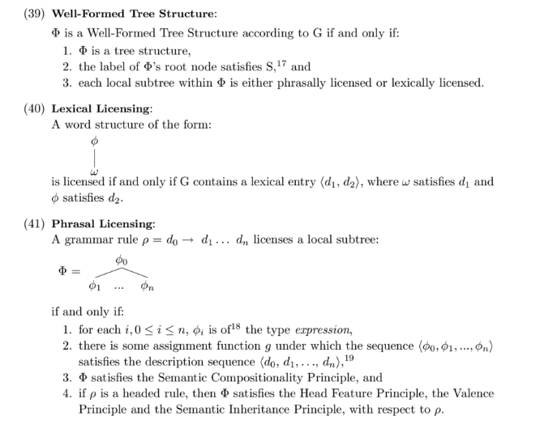
The Definition of Well-Formed Structures

Slide 7
An Example
A cat slept.
Can we build this with our tools?
Given the constraints our grammar puts on well-formed sentences, is this one?

Slide 8
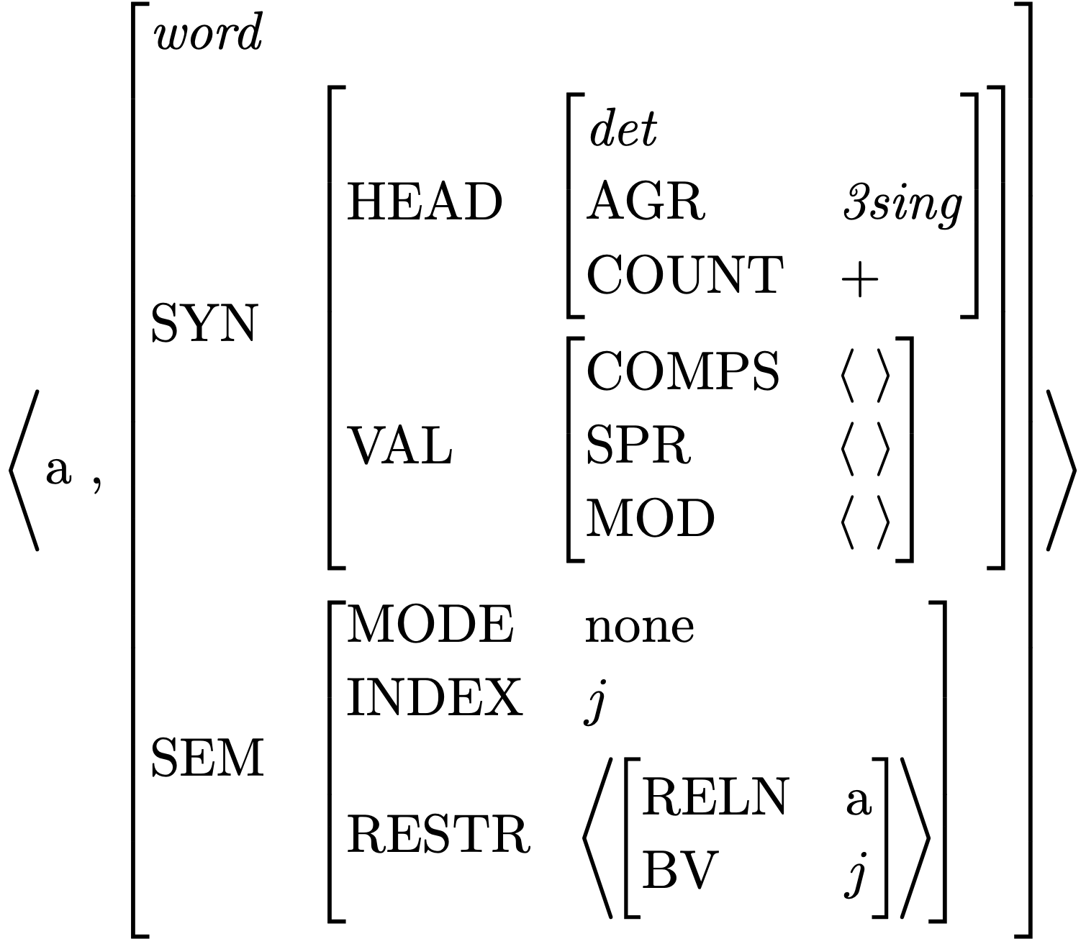
Lexical Entry for a
Is this a fully specified (resolved) description?
What features are unspecified?
How many word structures can this entry license?

Slide 9
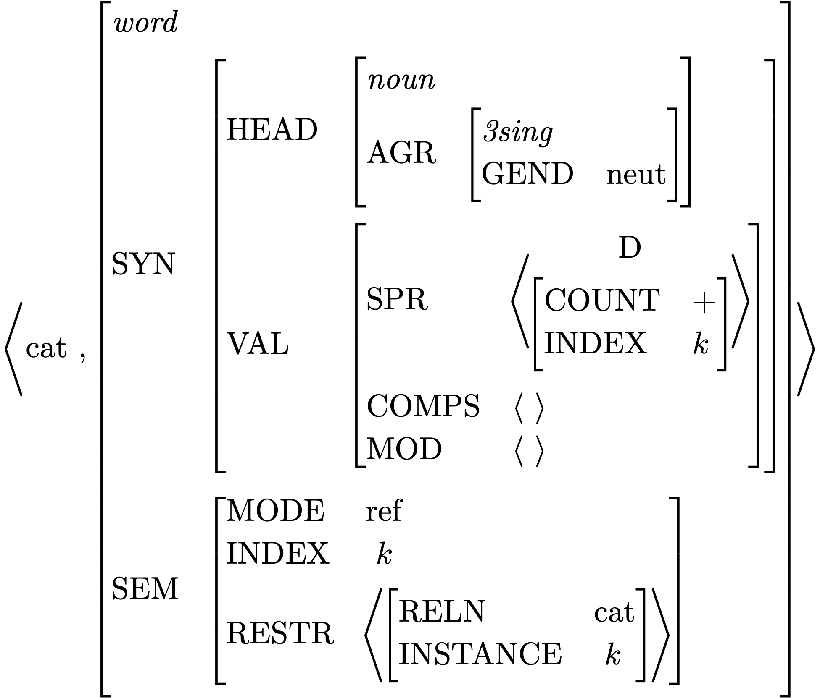
Lexical Entry for cat
Which feature paths are abbreviated?
Is this a fully specified description?
What features are unspecified?
How many word structures can this entry license?

Slide 10
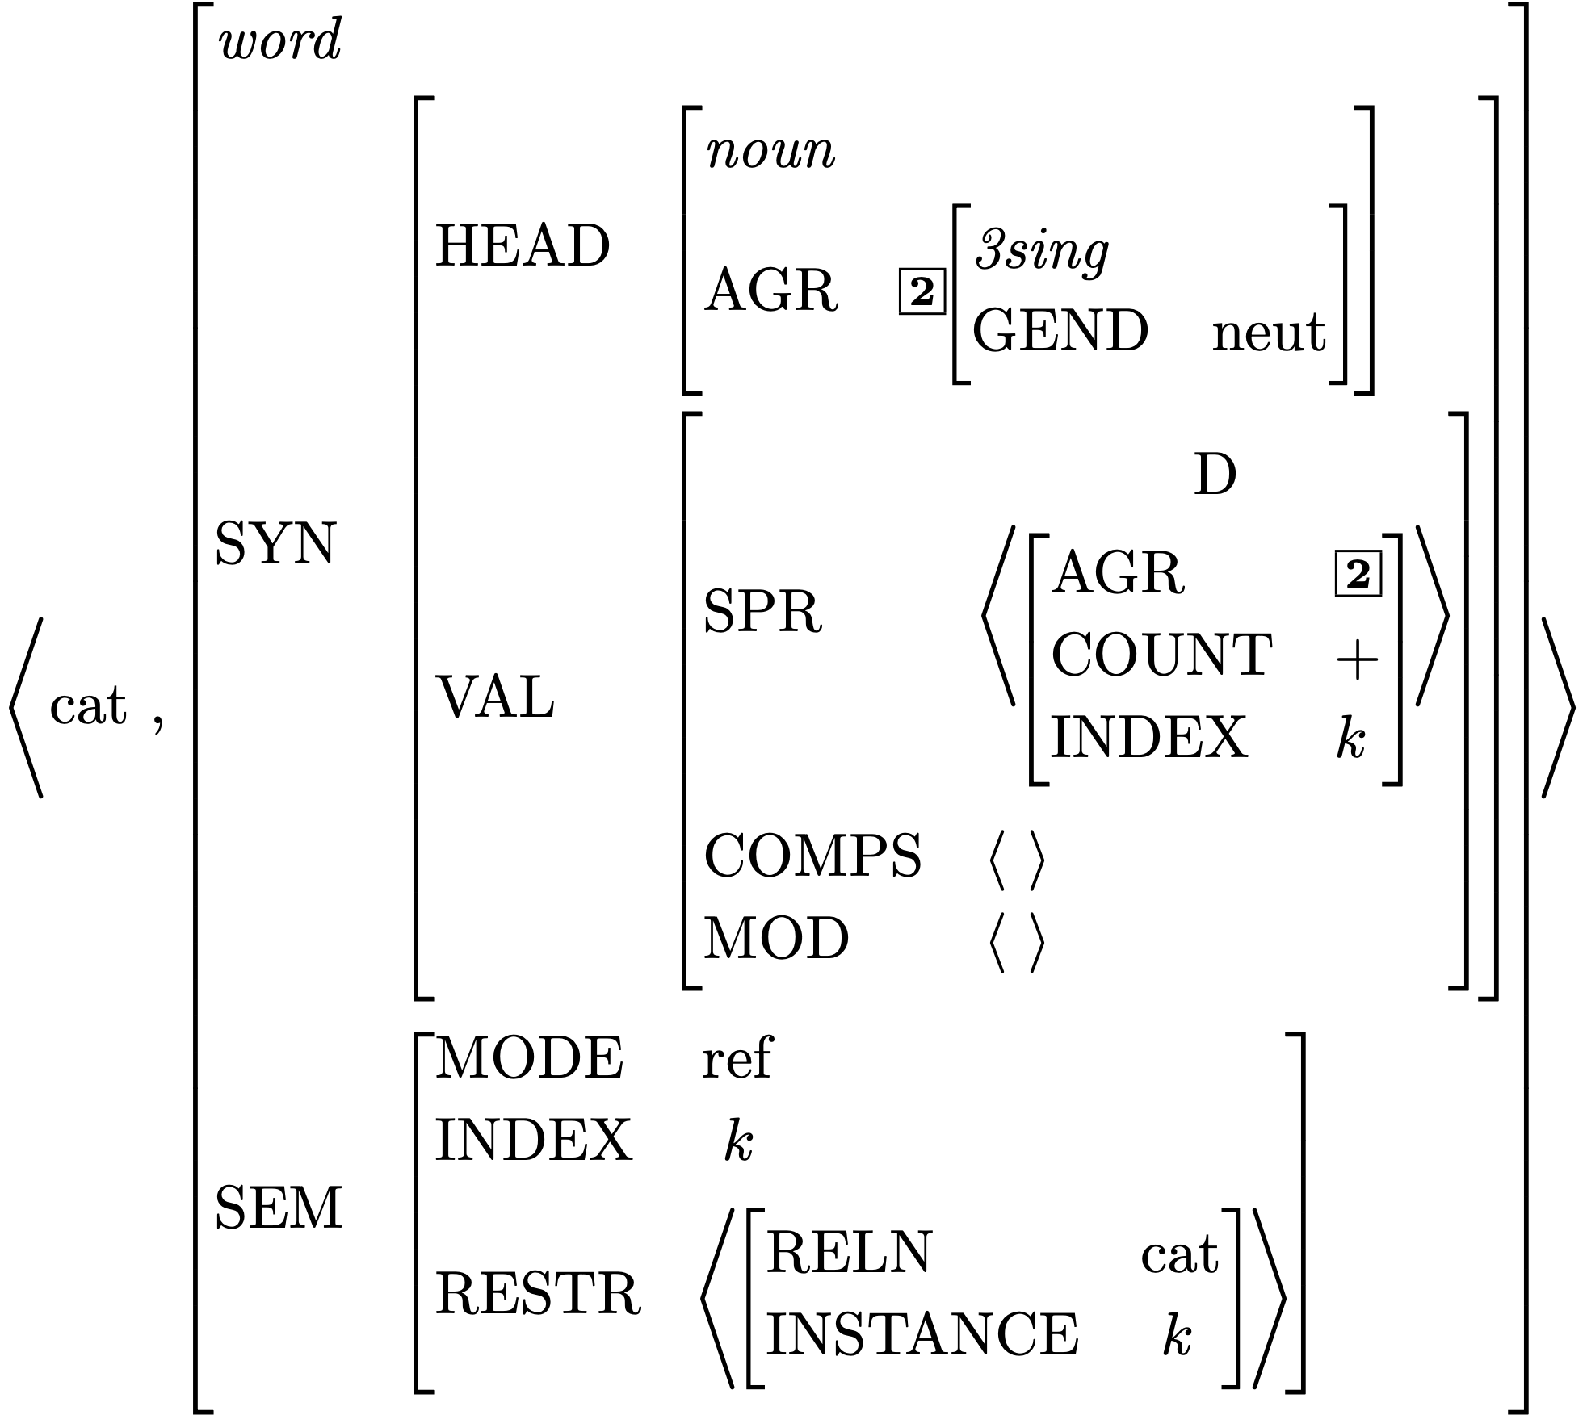
Effect of Principles: the SHAC

Slide 11
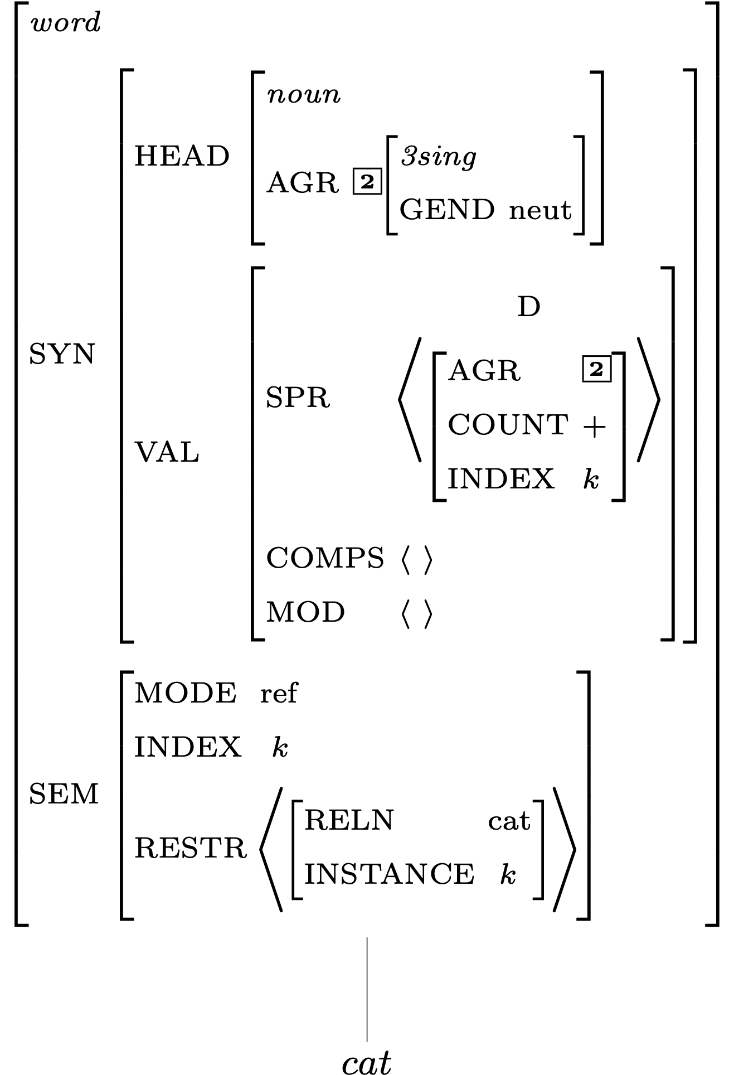
Description of Word Structures for cat

Slide 12
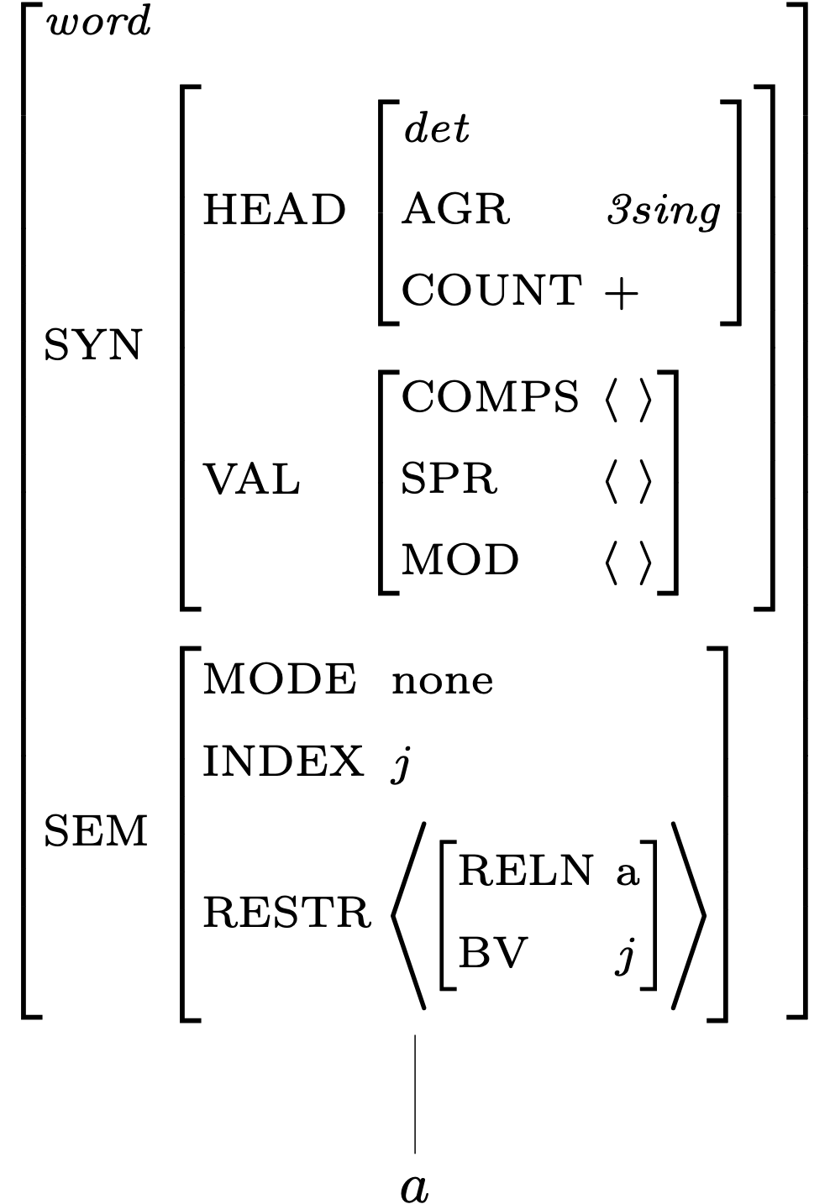
Description of Word Structures for a

Slide 13
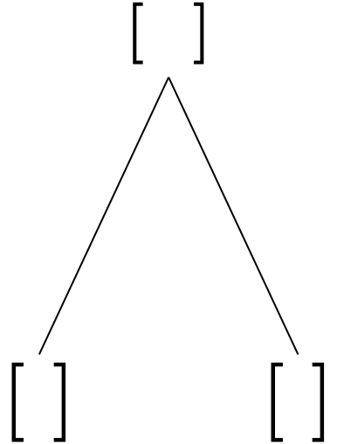
Building a Phrase

Slide 14
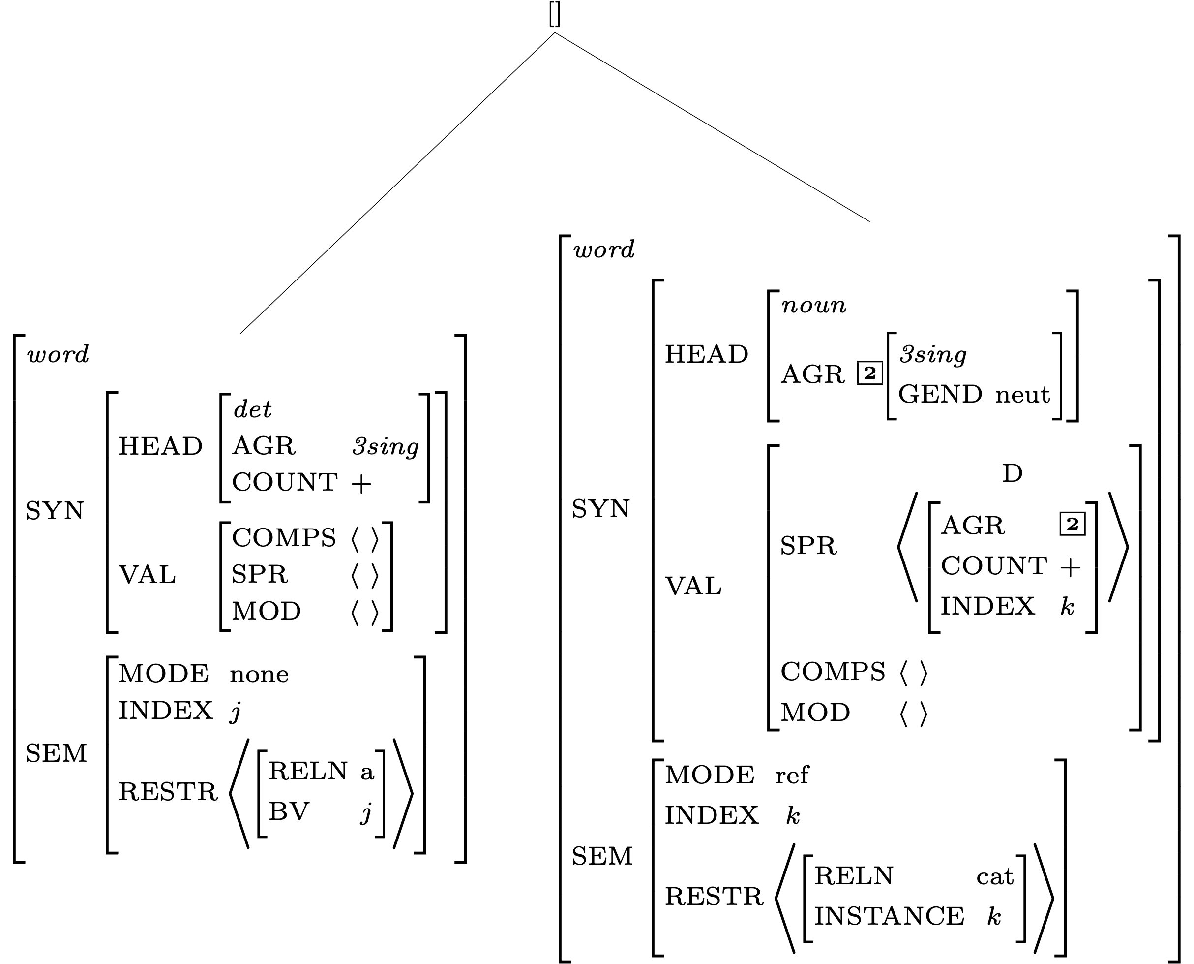
Constraints Contributed by Daughter Subtrees

Slide 15
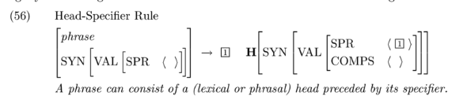
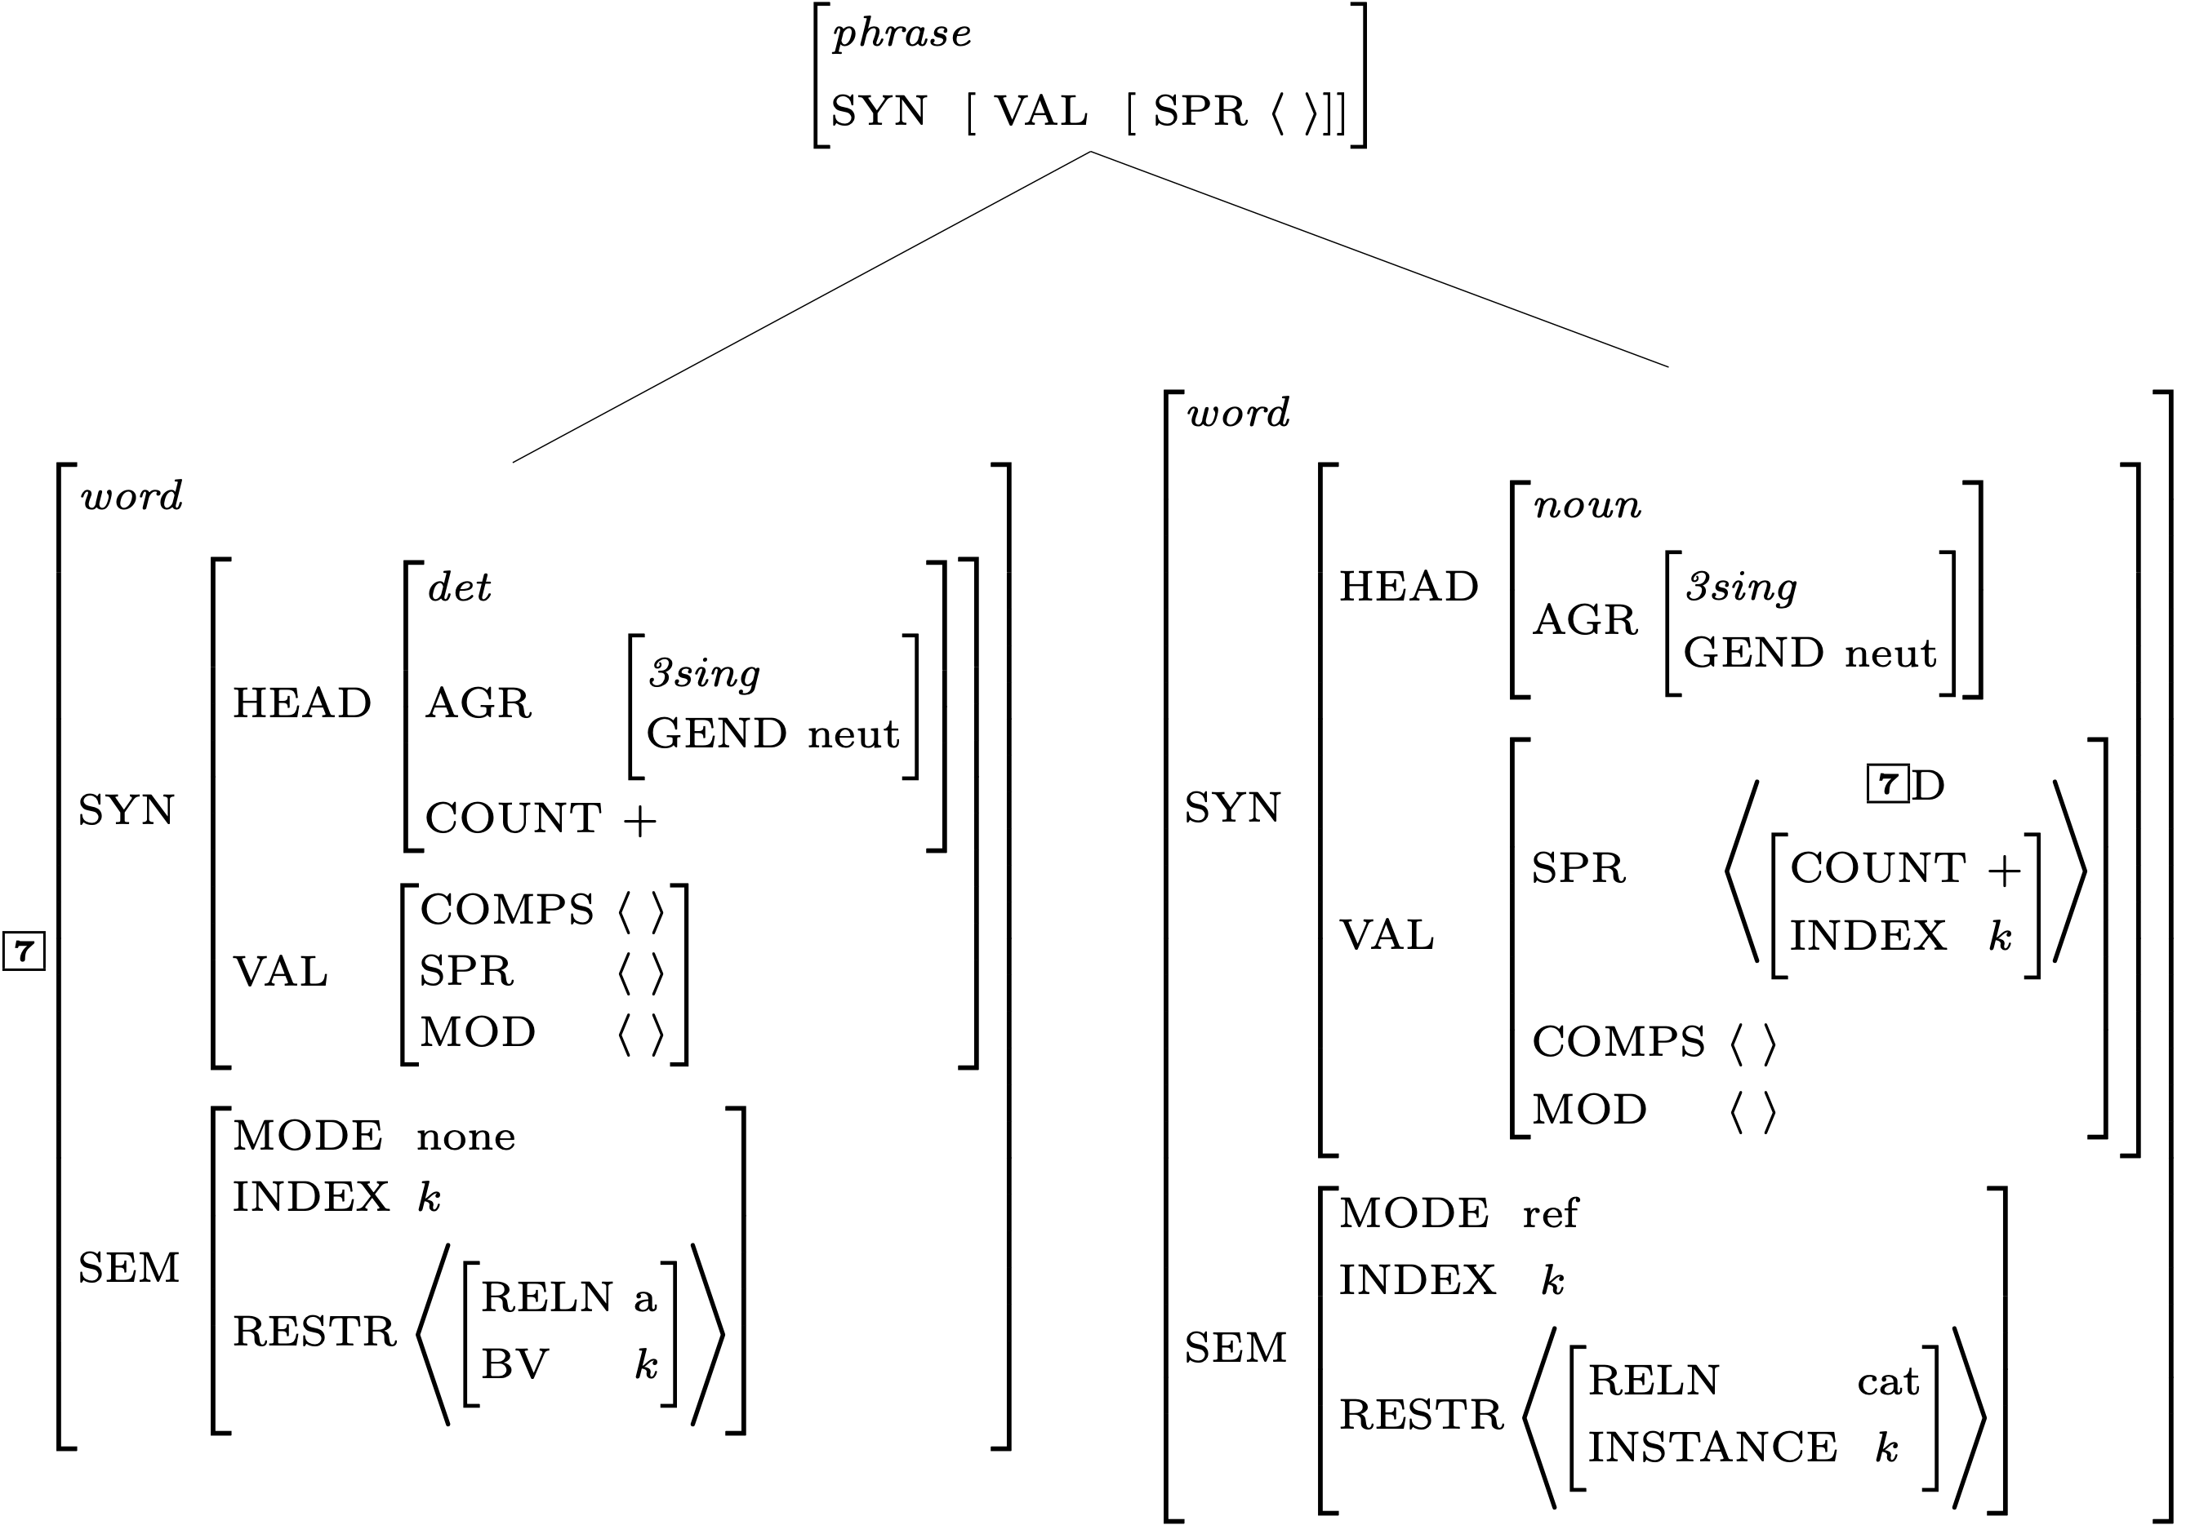
Constraints Contributed by the Grammar Rule

Slide 16
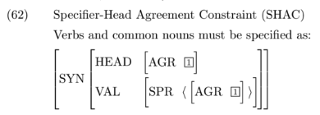
A Constraint Involving the SHAC

Slide 17

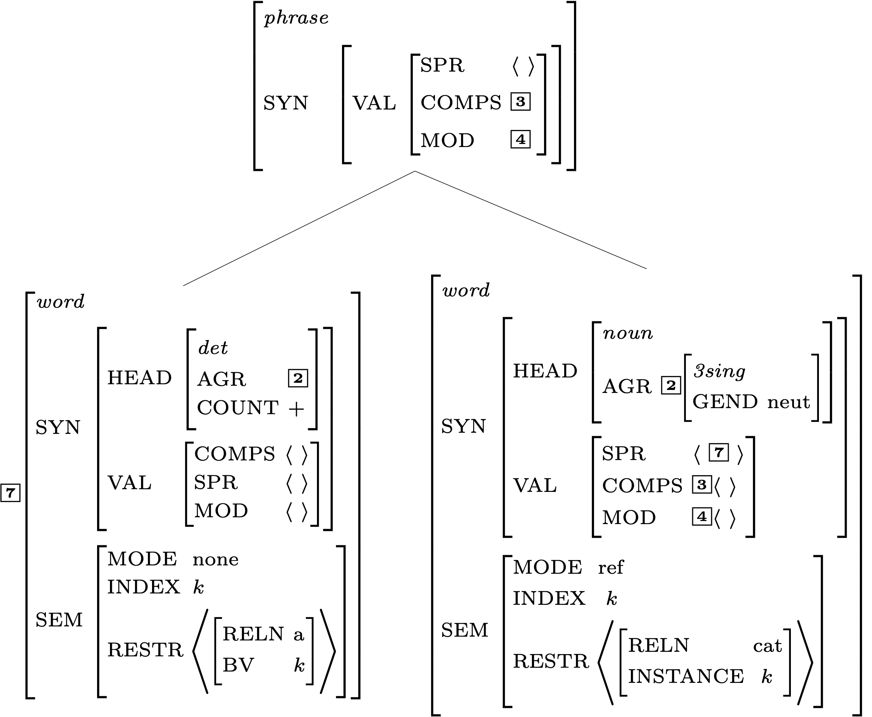
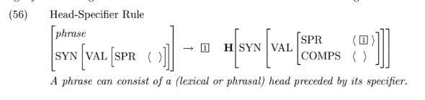
Effects of the Valence Principle

Slide 18
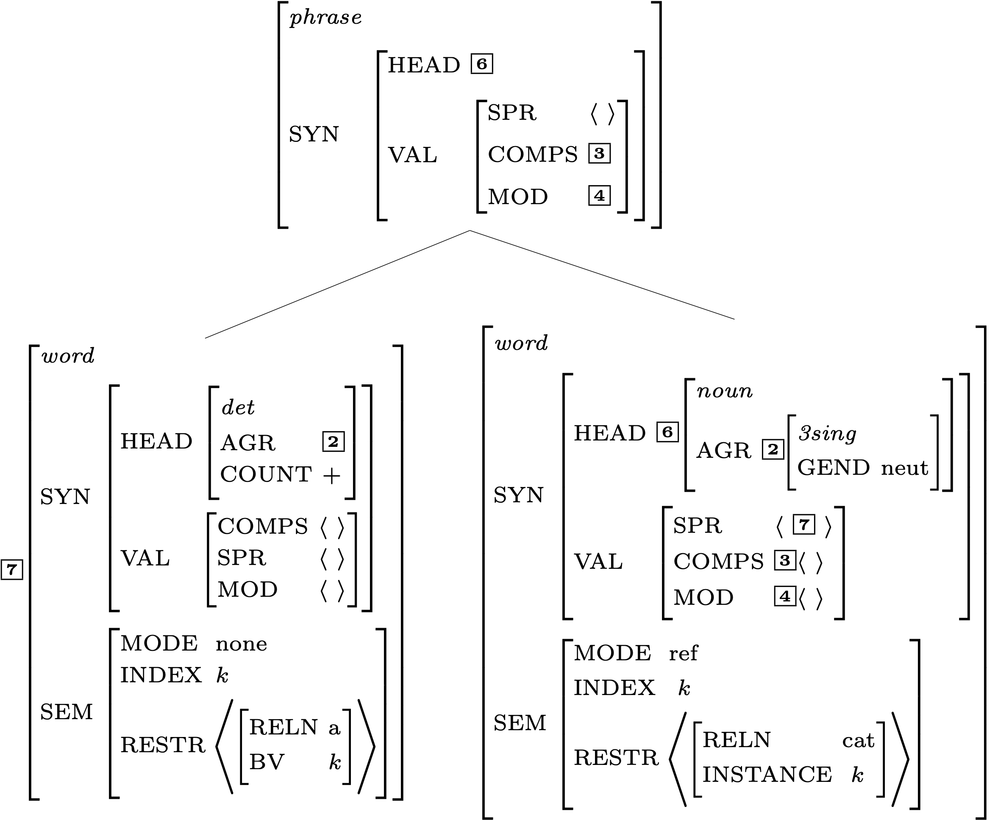

Effects of the Head Feature Principle

Slide 19
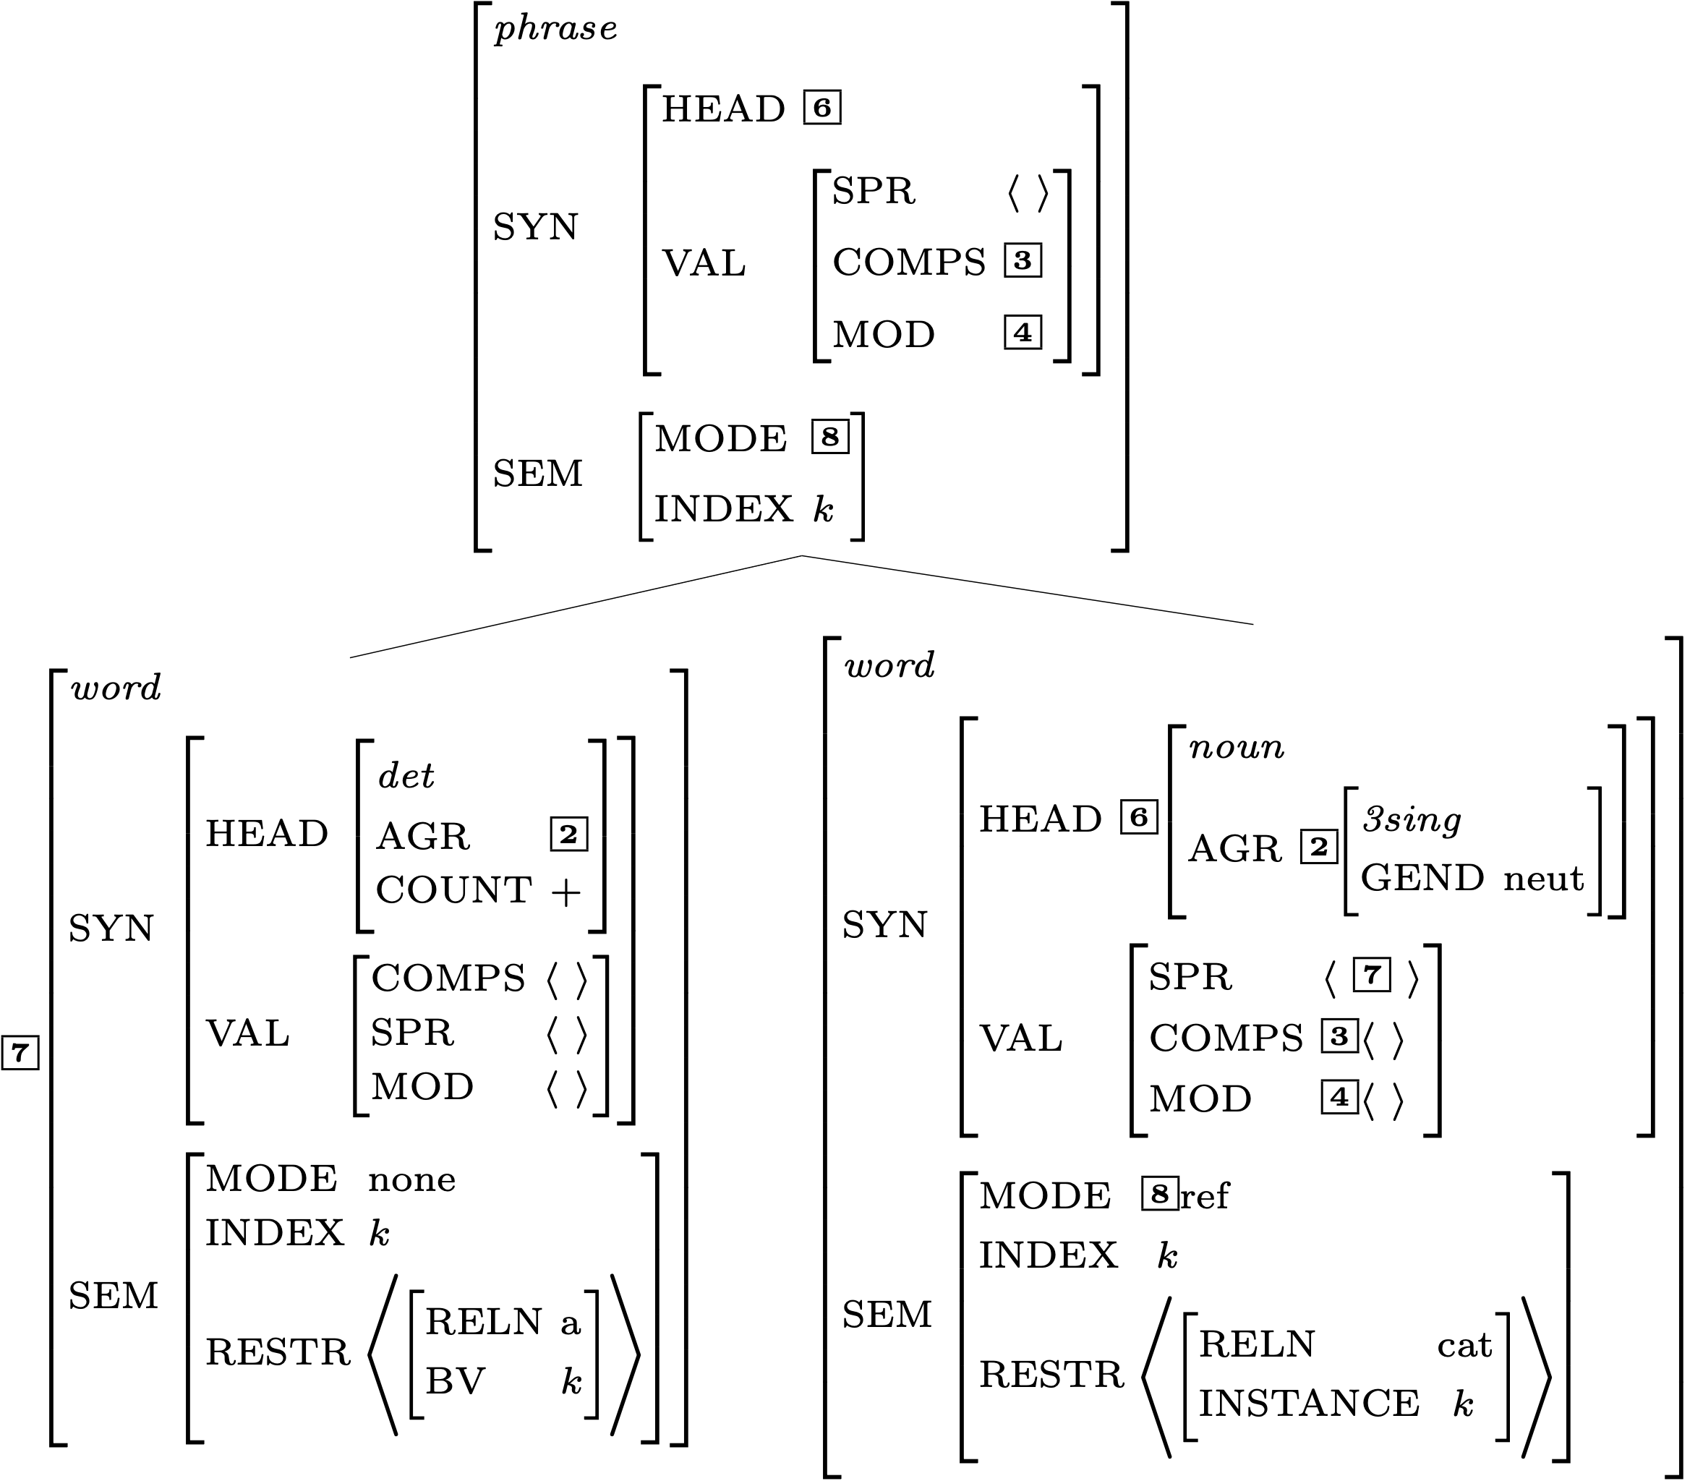

Effects of the Semantic Inheritance Principle

Slide 20
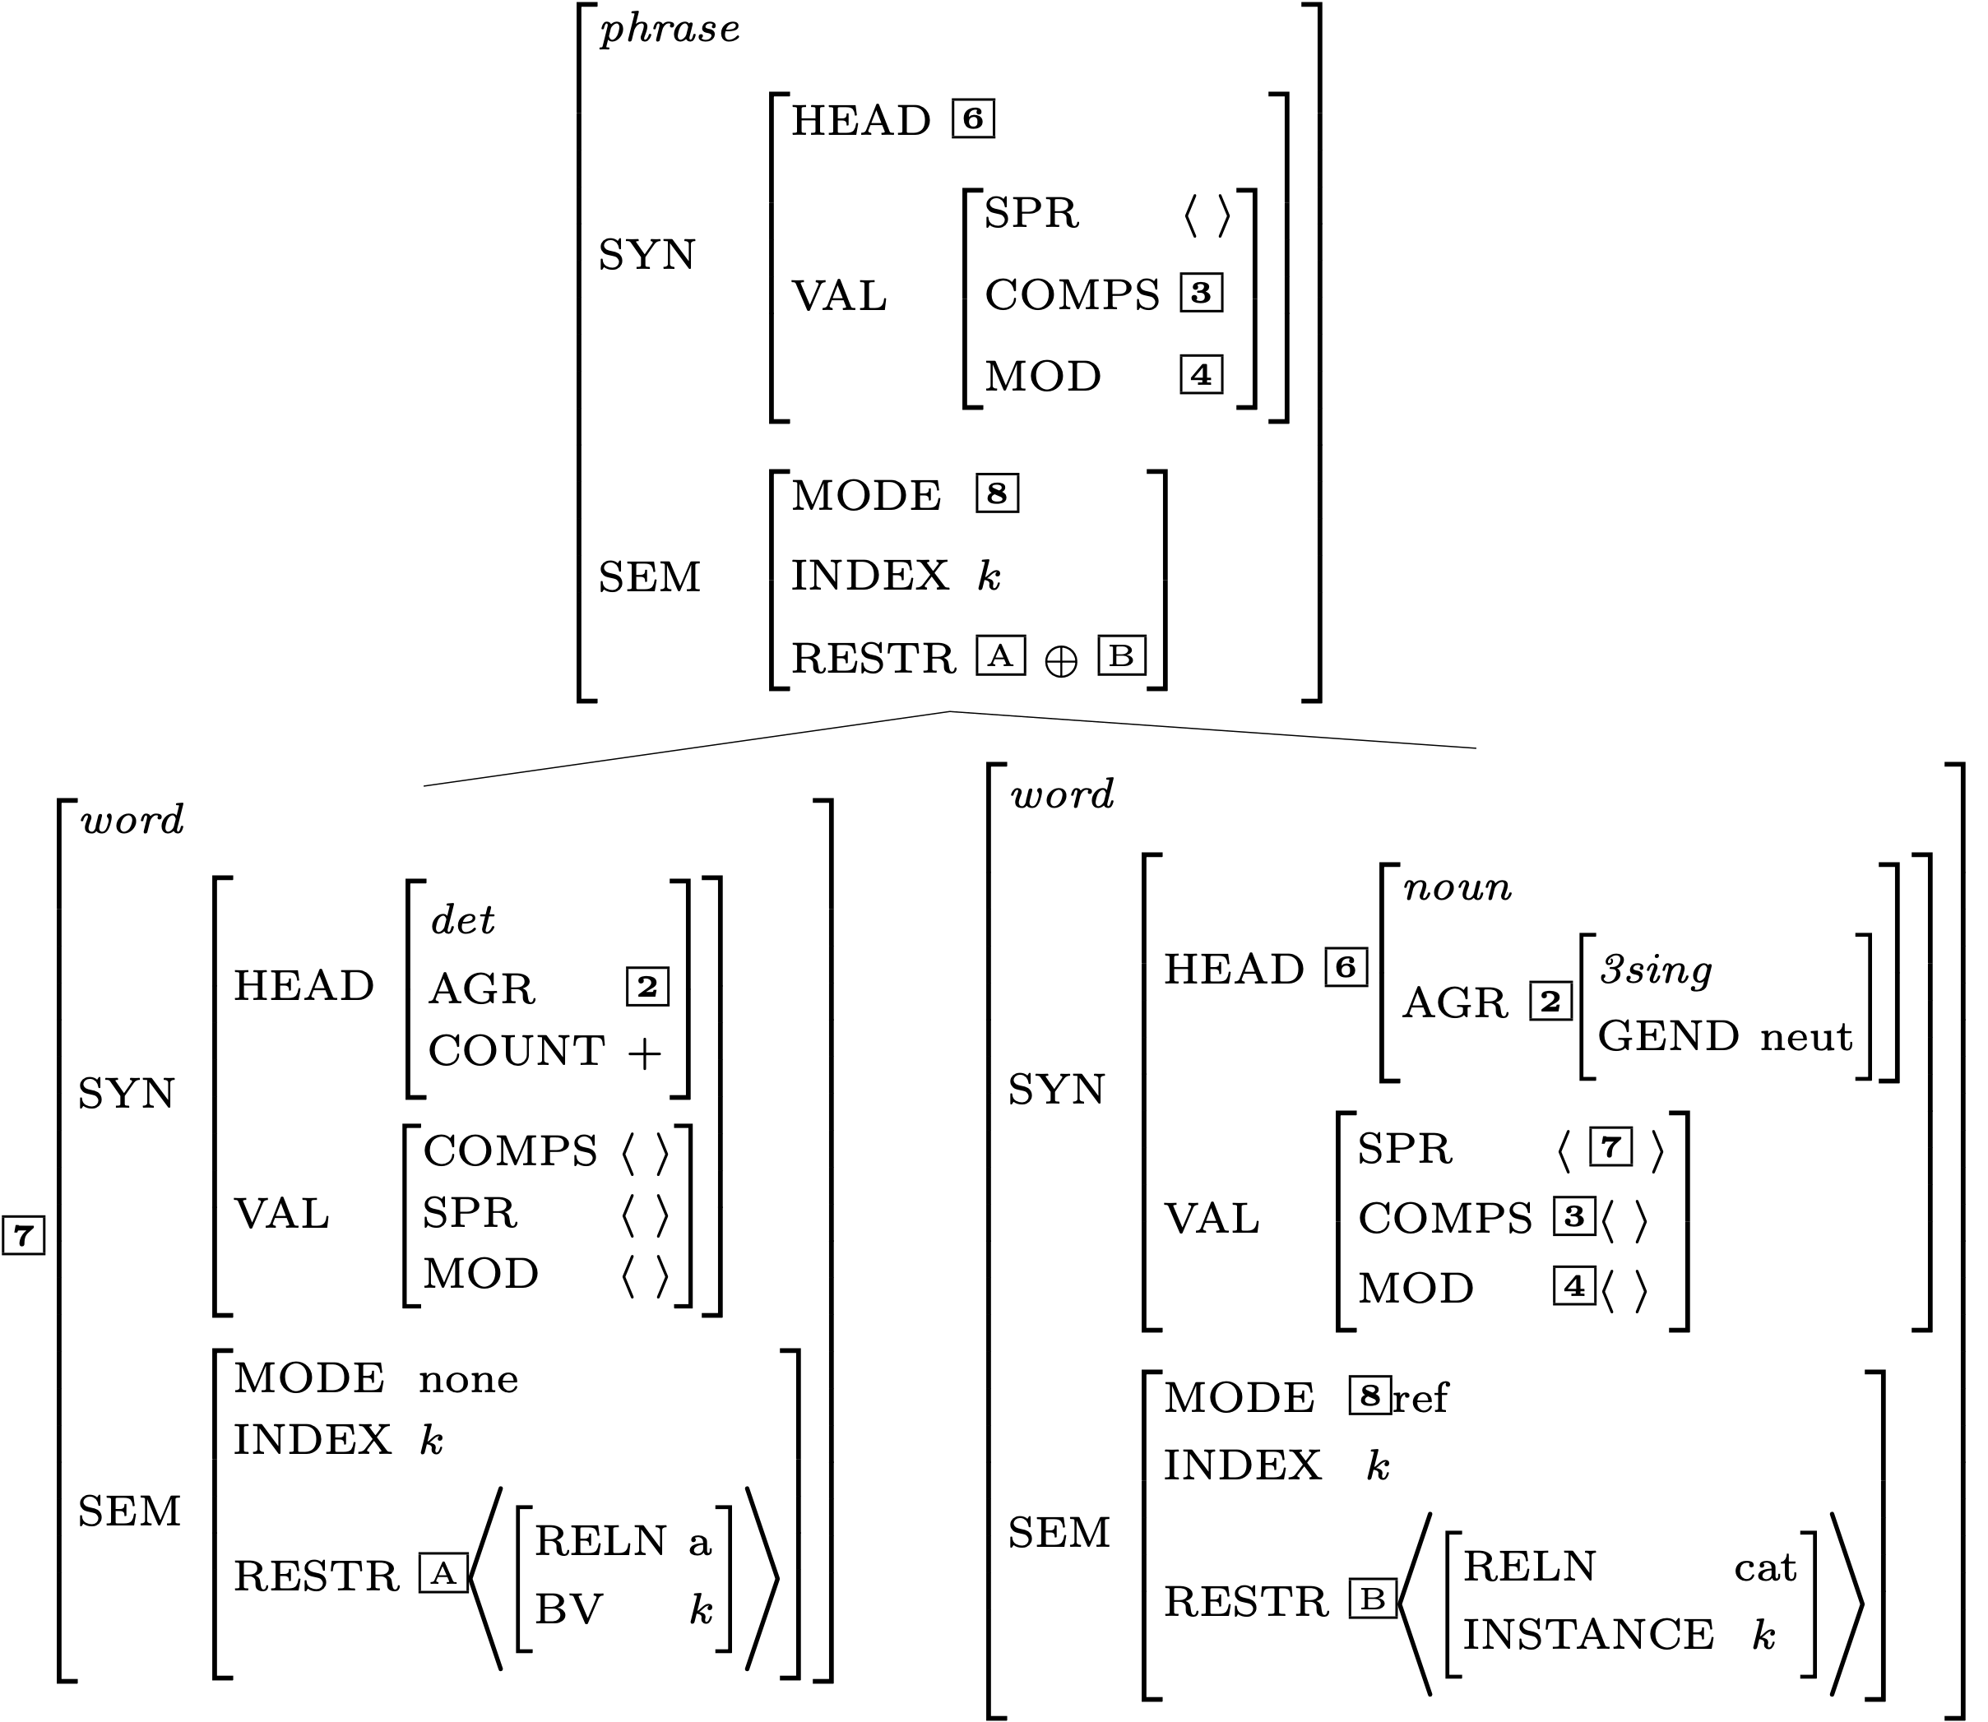

Effects of the Semantic Compositionality Principle

Slide 21
Is the Mother Node Now Completely Specified?

Slide 22
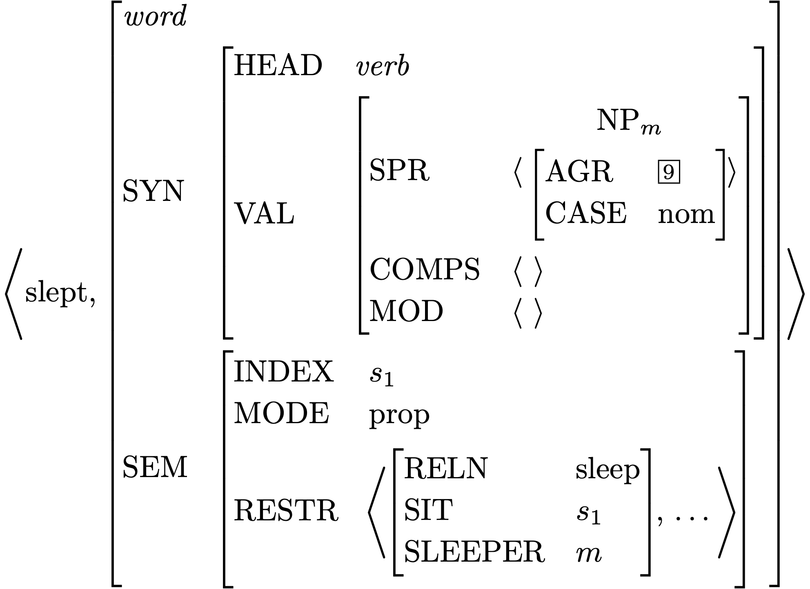
Lexical Entry for slept

Slide 23
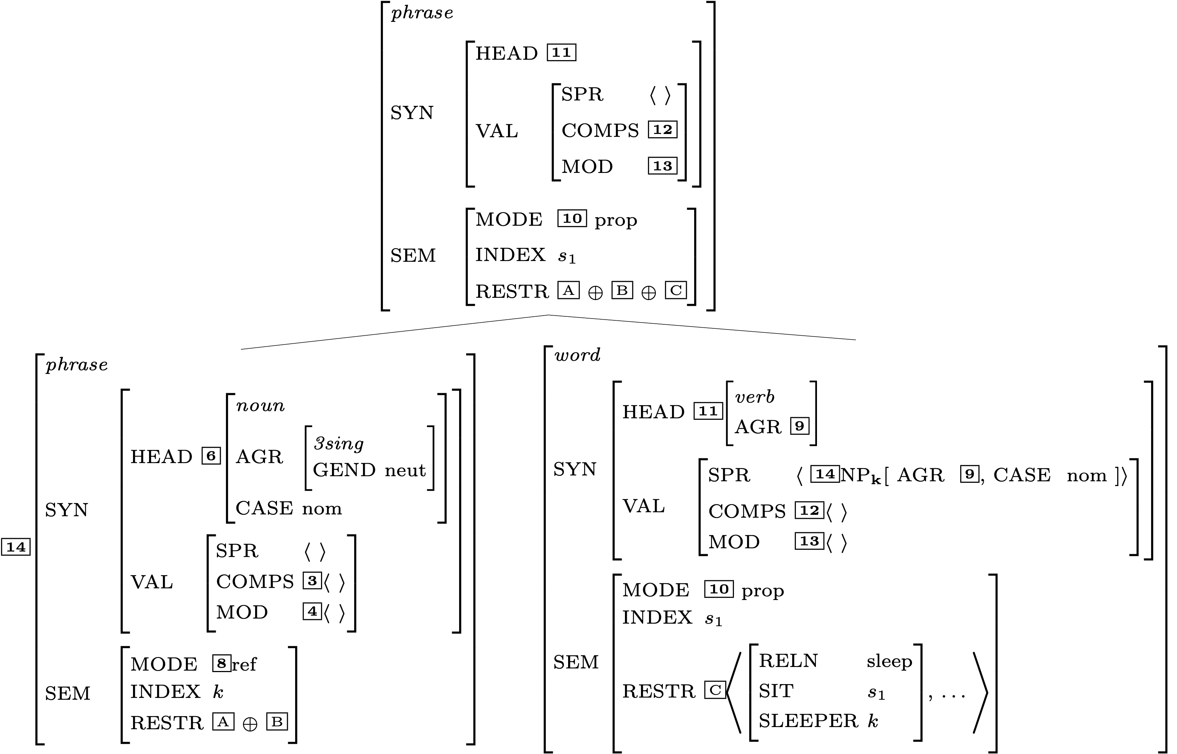
Another Head-Specifier Phrase
Key
 | HSR
 | SHAC
 | Val Prin
 | HFP
 | SIP
 | SCP

Slide 24
Is this description fully specified?

Slide 25
Does the top node satisfy the initial symbol?

Slide 26
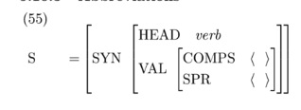
Does the top node satisfy the initial symbol?

Slide 27
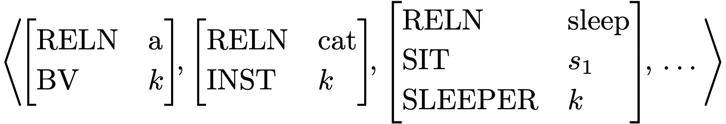
RESTR of the S node

Slide 28
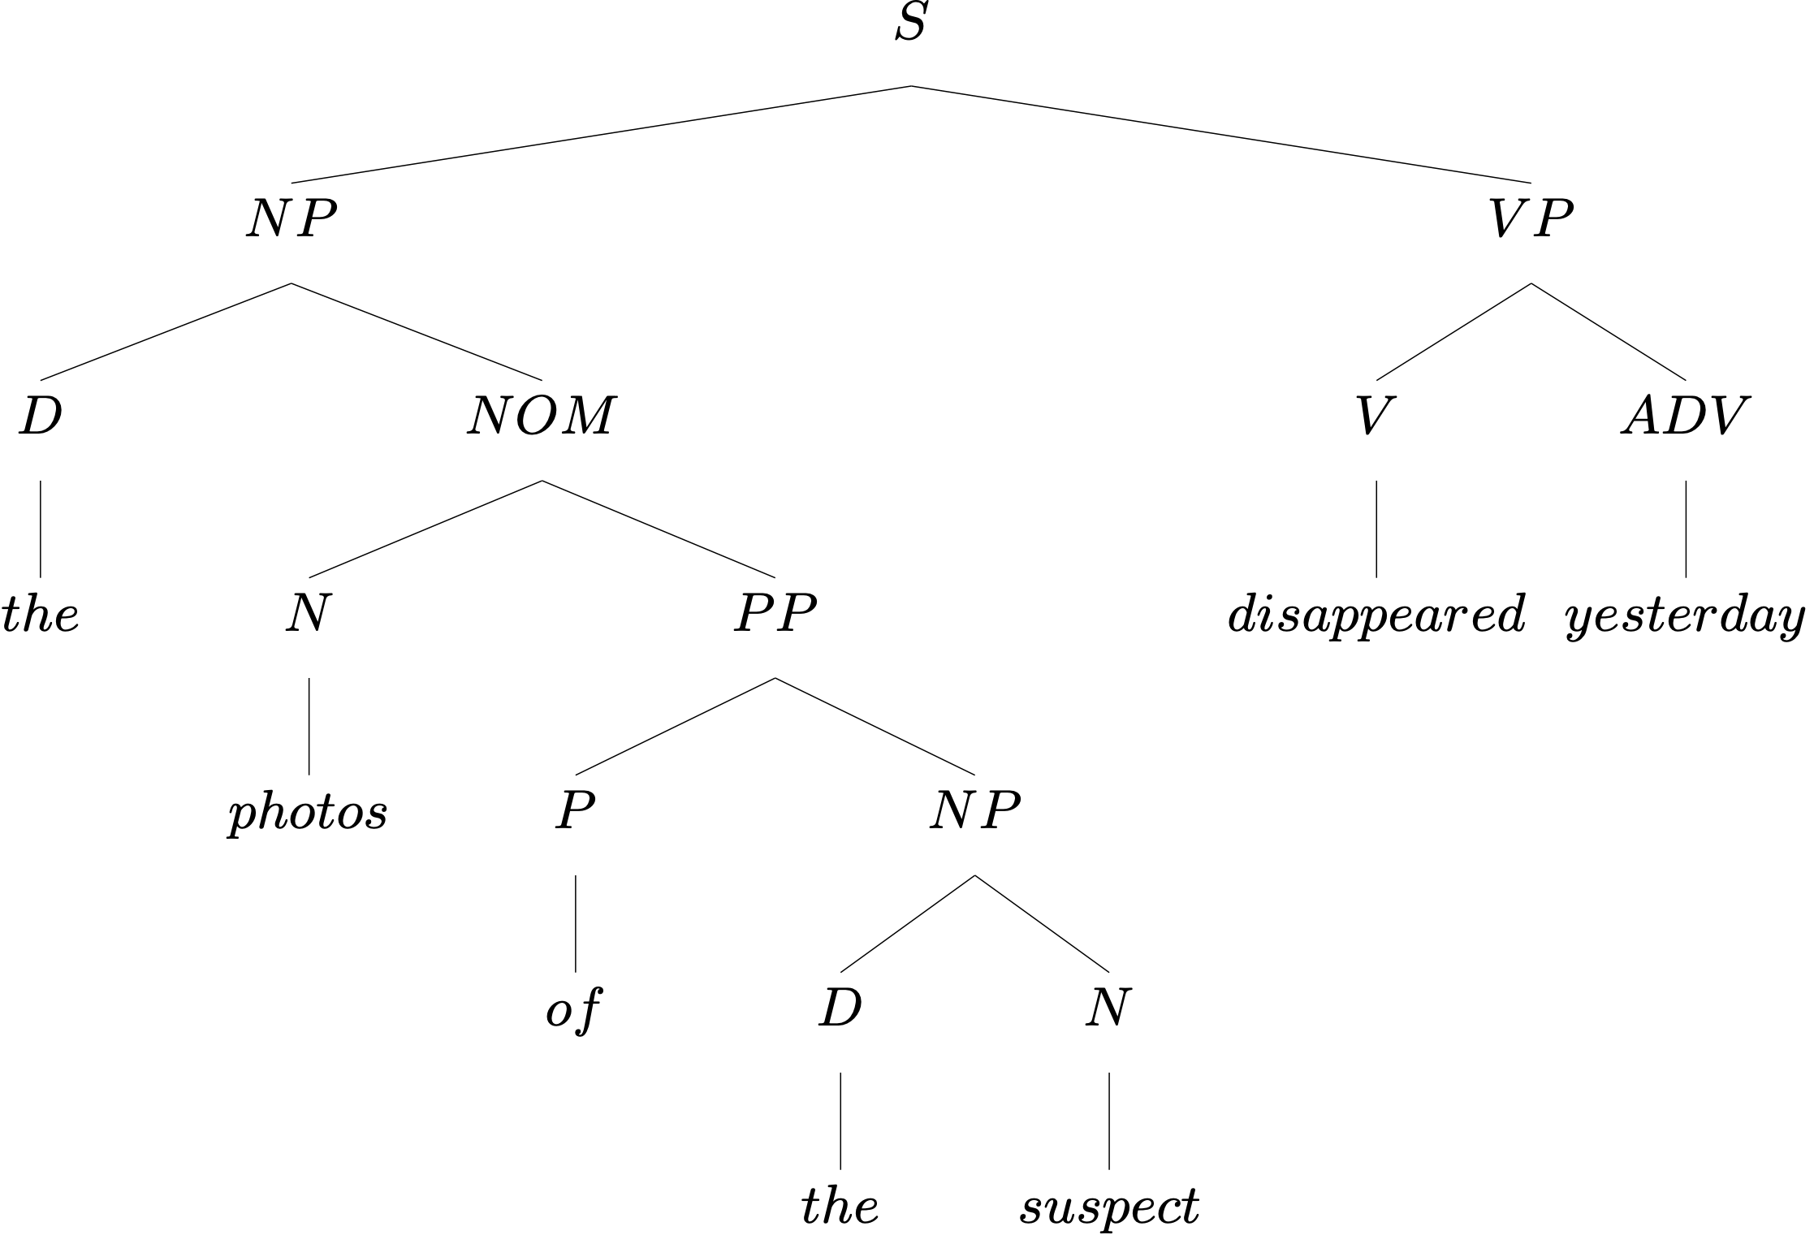
Another Example
What rule builds each subtree?

Slide 29
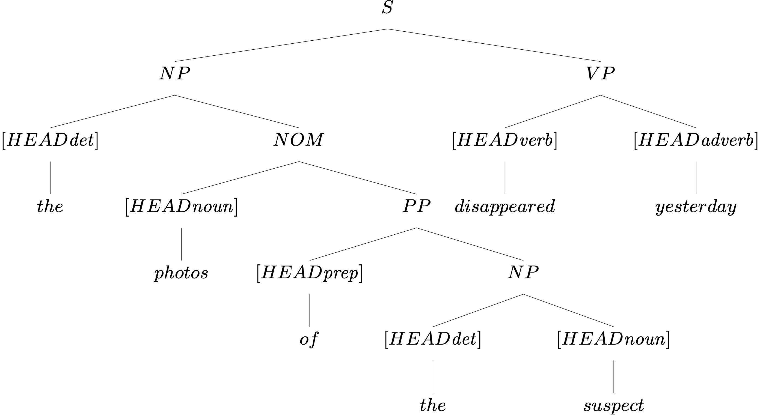
Head Features from Lexical Entries

Slide 30
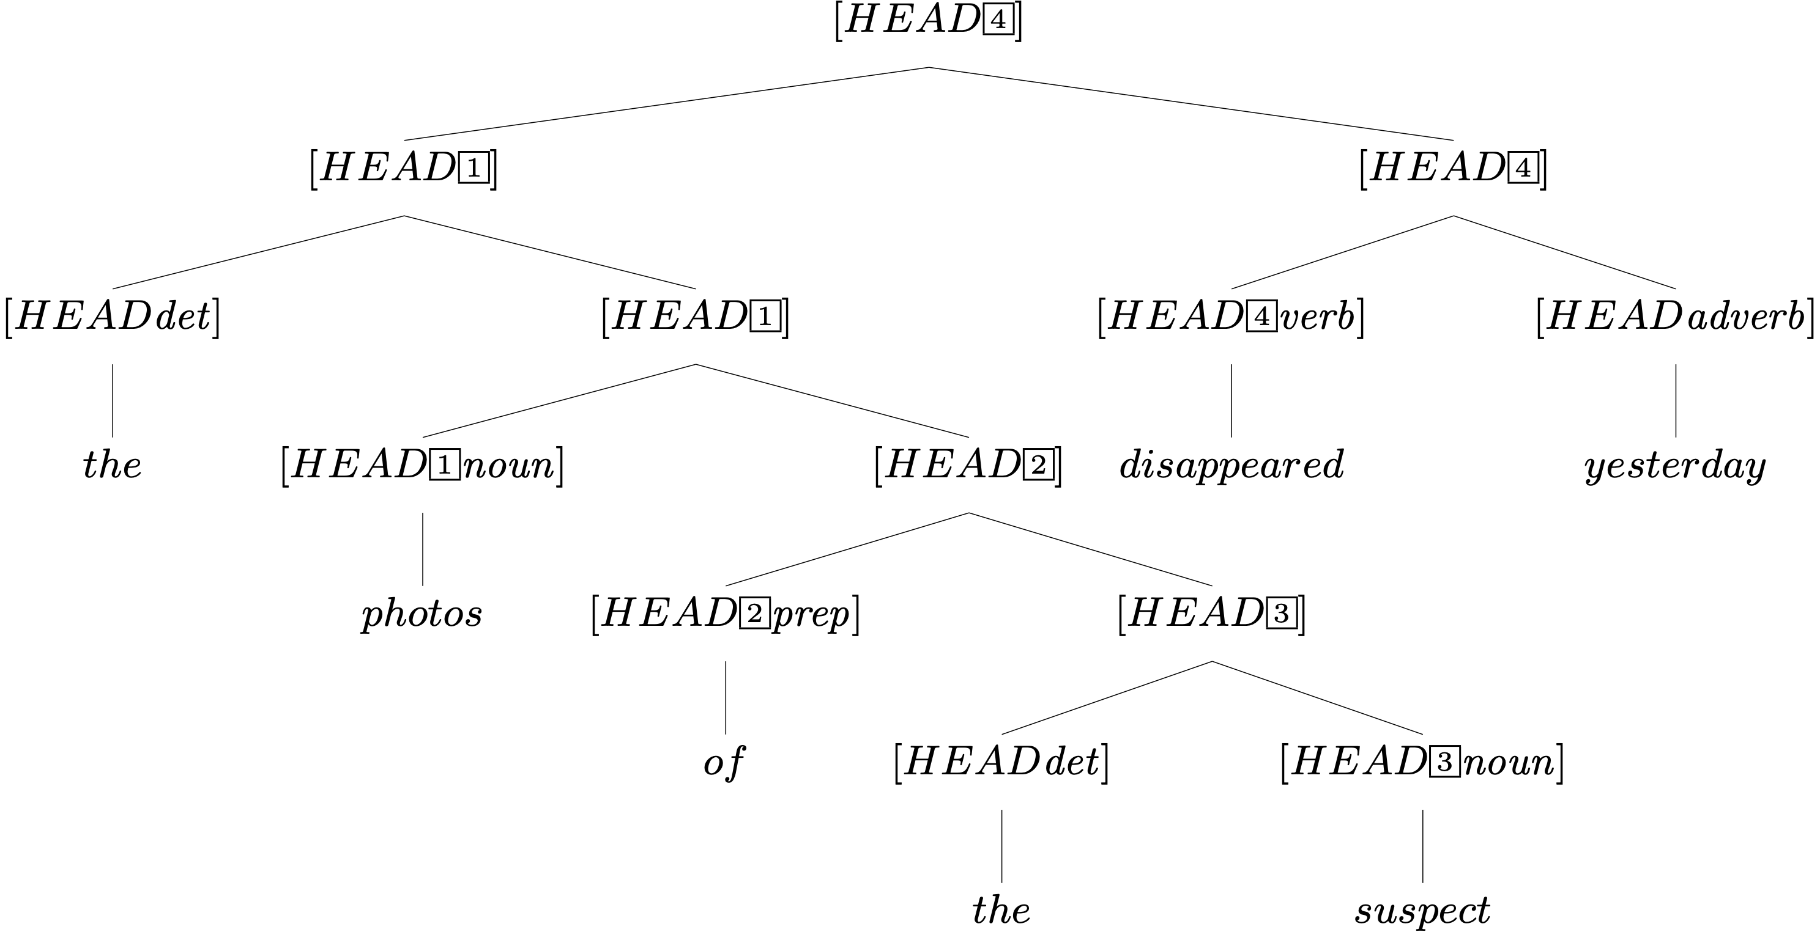
Head Features from Lexical Entries, plus HFP

Slide 31
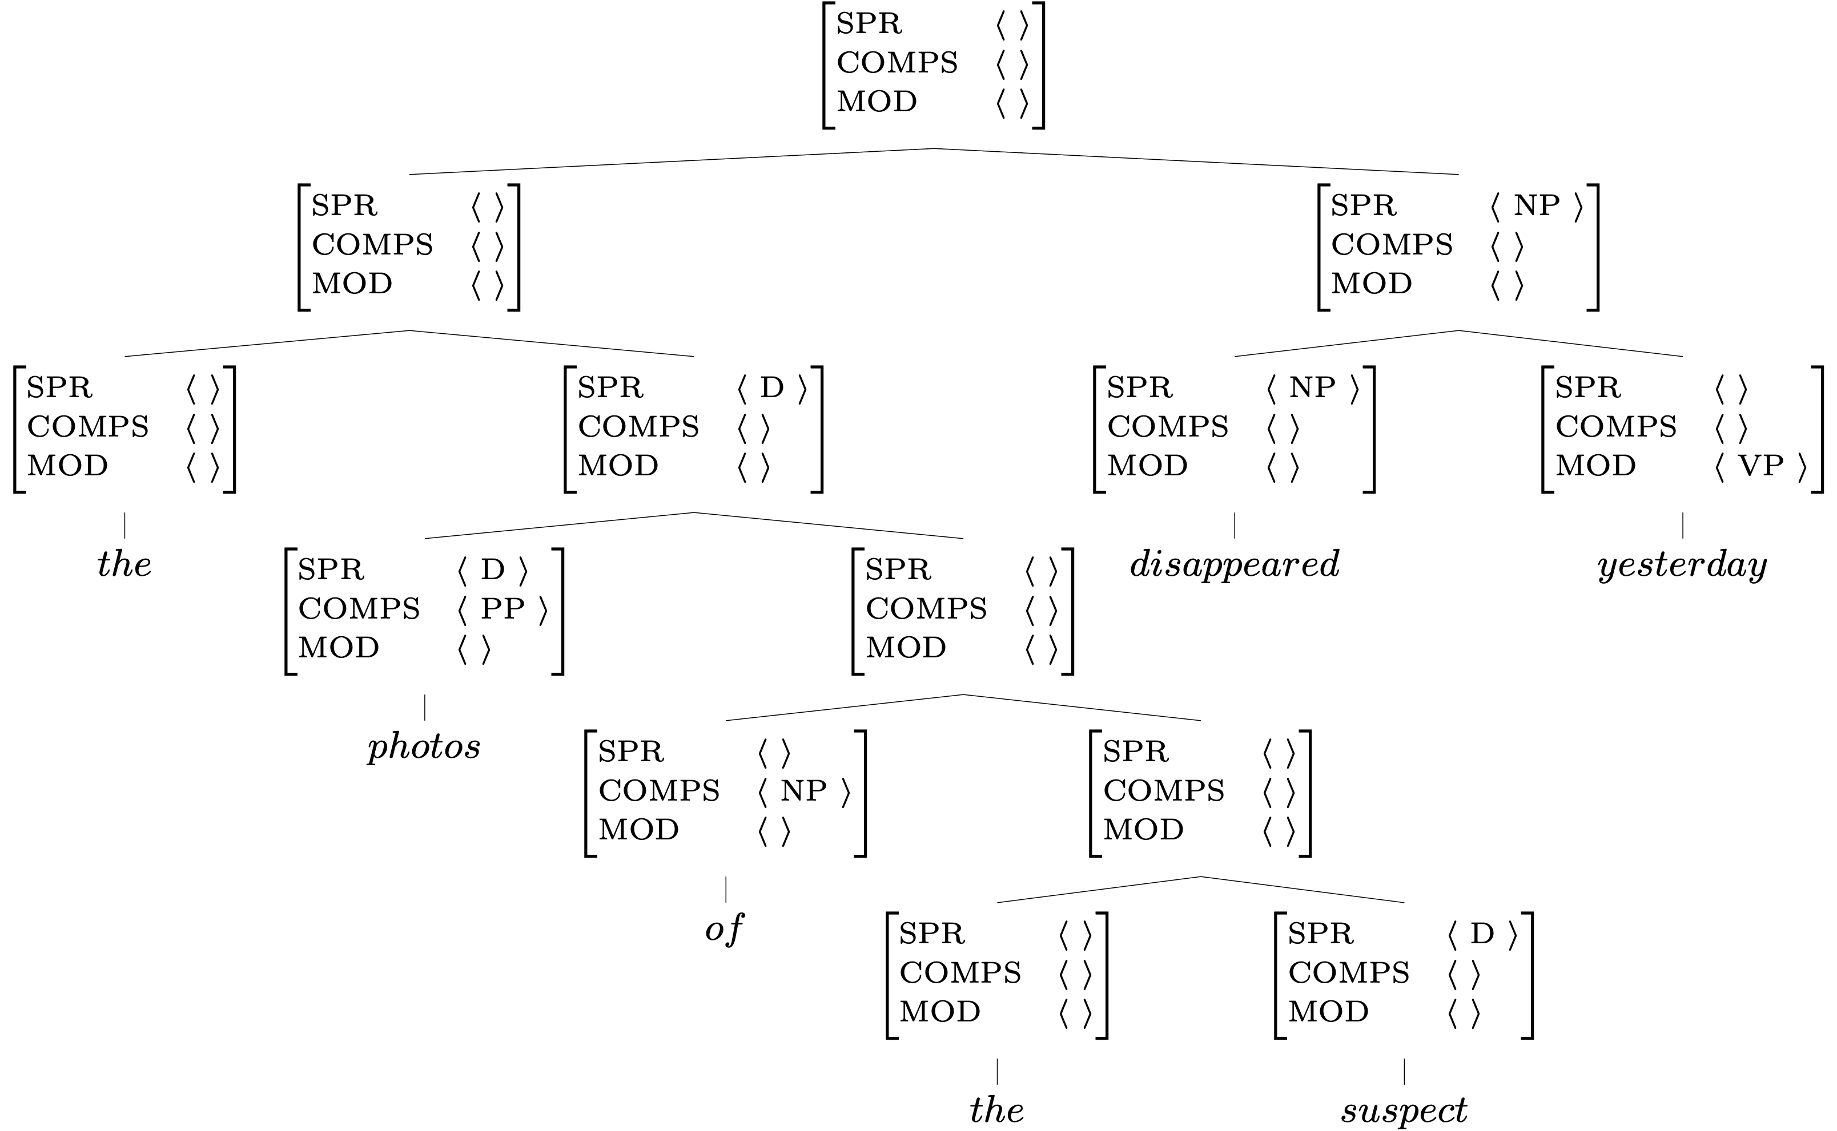
Valence Features:
Lexicon, Rules, and the Valence Principle
Key
 | Lexicon
 | Val. Prin.
 | Rules

Slide 32
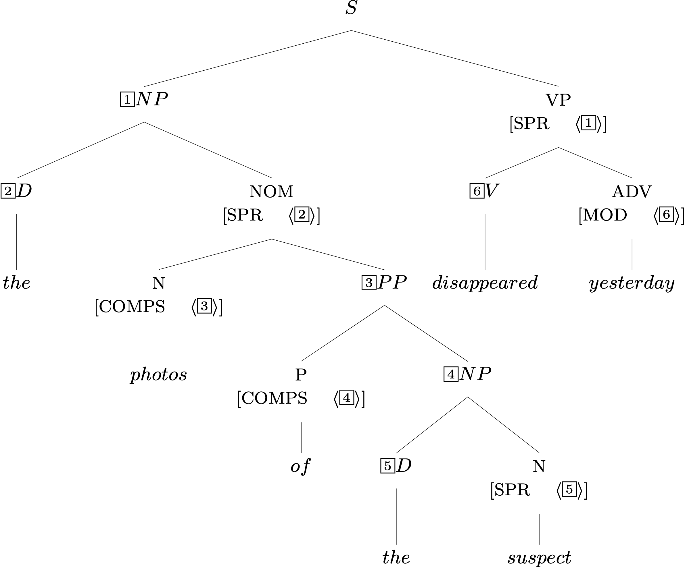
Required Identities: Grammar Rules

Slide 33
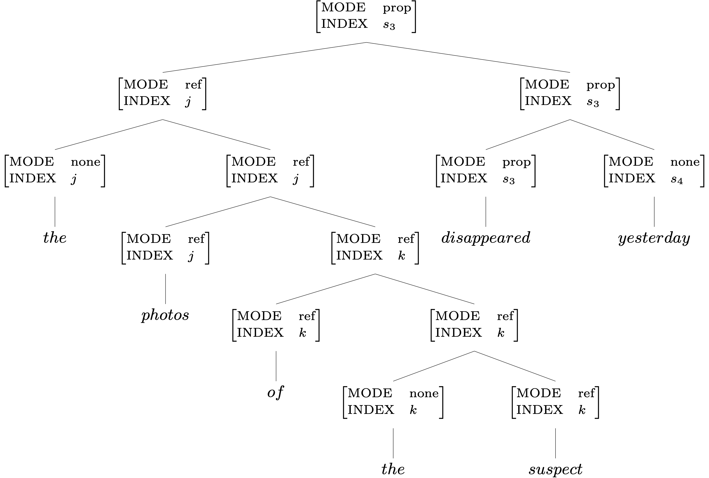
Two Semantic Features: the Lexicon & SIP

Slide 34
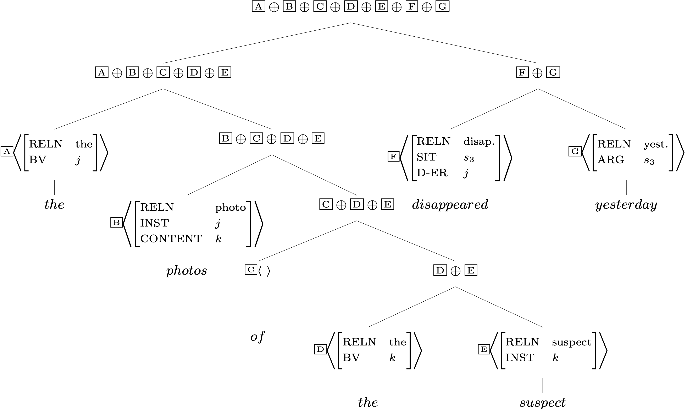
RESTR Values and the SCP

Slide 35
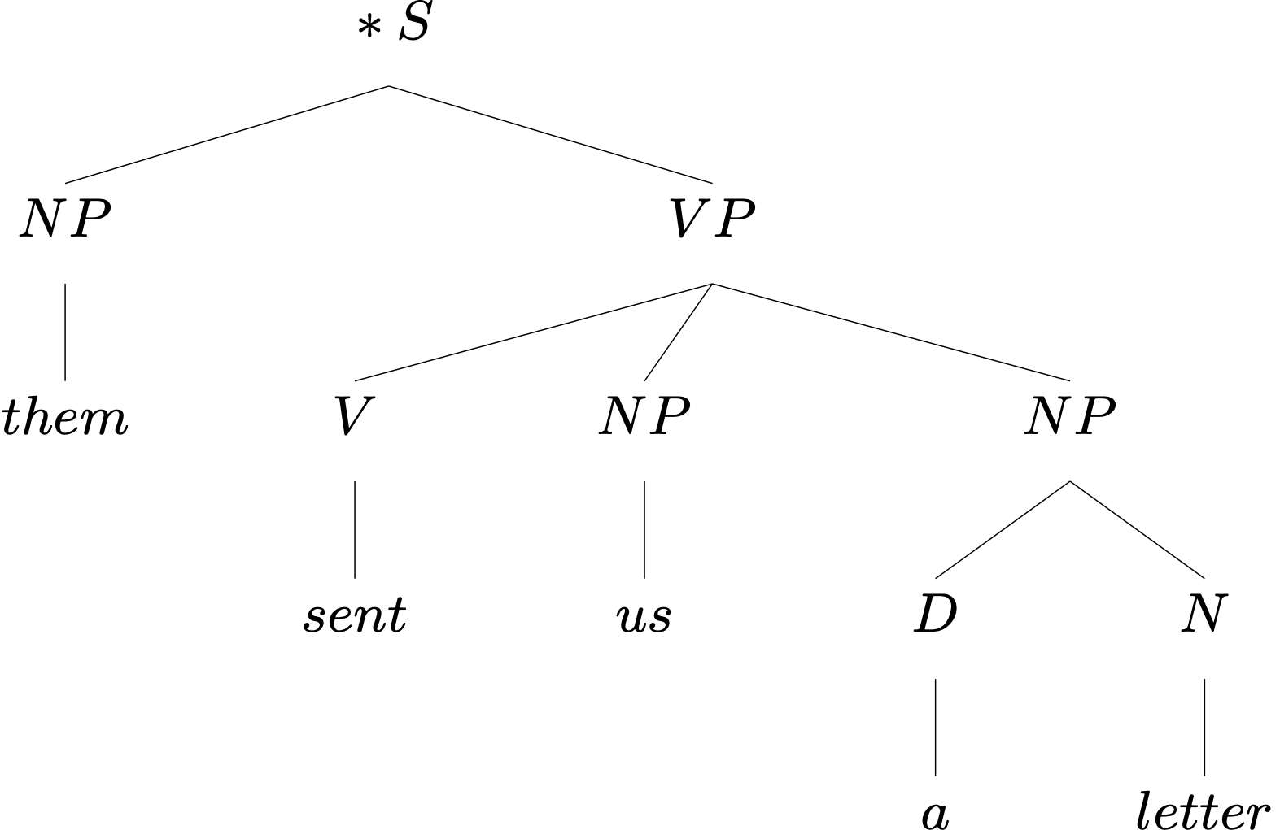
An Ungrammatical Example
What’s wrong with this sentence?

Slide 36
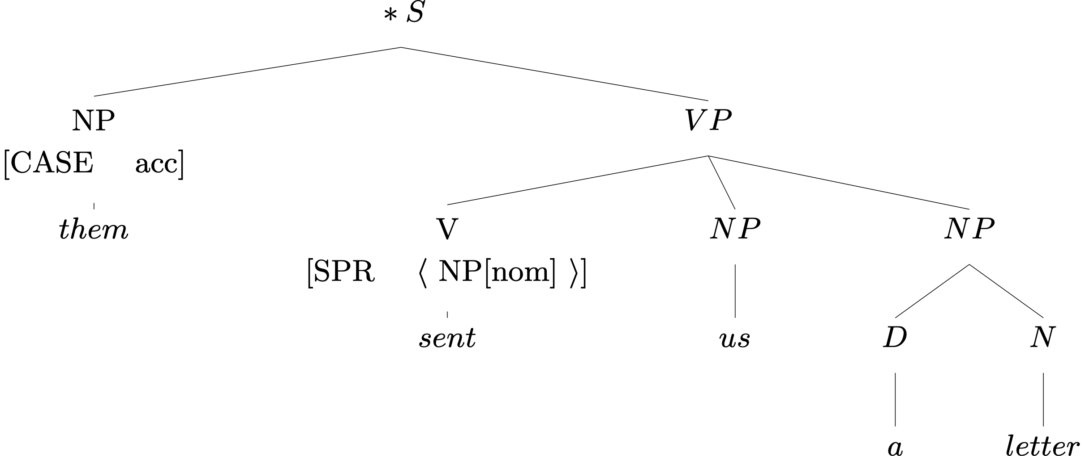
An Ungrammatical Example
What’s wrong with this sentence?
So what?

Slide 37
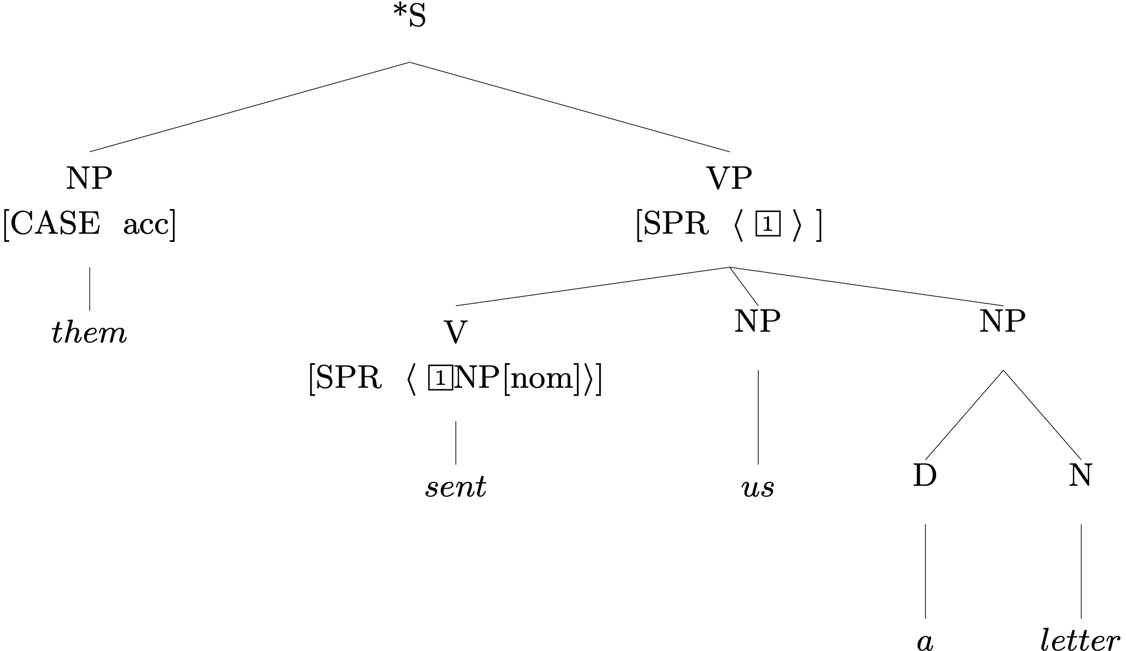
An Ungrammatical Example
The Valence Principle

Slide 38
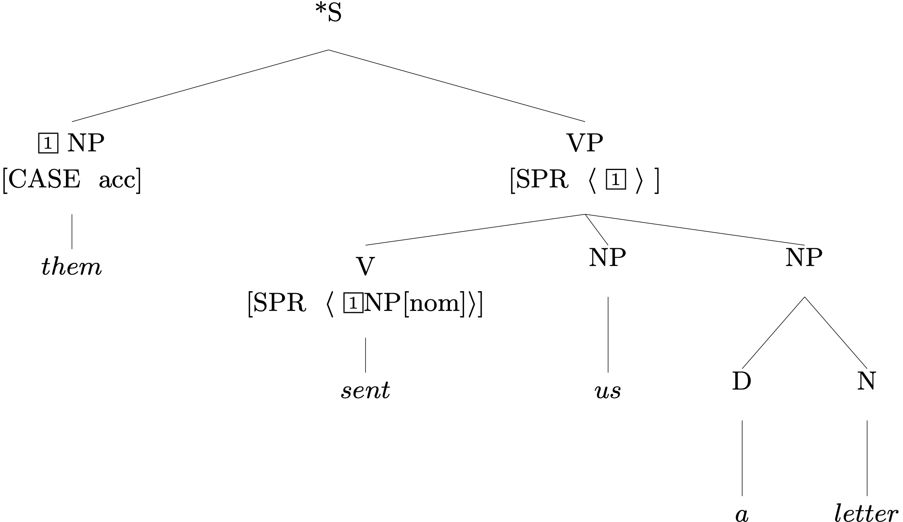
An Ungrammatical Example
Head Specifier Rule
¬contradiction®

Slide 39
Exercise in Critical Thinking
Our grammar has come a long way since Ch 2, as we've added ways of representing different kinds of information:
  generalizations across categories
  semantics
  particular linguistic phenomena: valence, agreement, modification
What else might we add? What facts about language are as yet unrepresented in our model?

Slide 40
Overview
What we’re trying to do
The pieces of our grammar
Two extended examples
Reflection on what we’ve done, what we still have to do

Slide 41
RQs: Licensing trees
Is the difference between lexical entry and word structure whether it's in the context of a tree or not? I just want to make sure I have correct terminology.

Slide 42
RQs: Tag conventions
When to use [A], [1], and i?

Slide 43
RQs: Unexpressed SENDEE/ADDRESSEE
Is that okay? How does that work?
Two interpretations of the sentence 'We send two letters to Lee' are discussed in Chapter 6. One is that Lee is the SENDEE but not the ADDRESSEE, and the other is that Lee is the ADDRESSEE but not the SENDEE. I wonder what the tree would look like in the situation where Lee is both the SENDEE and the ADDRESSEE. Would it look like (30) on page 189, but with a tag for the name predication where the NAMED value is the same for both SENDEE and ADDRESSEE?

Slide 44
RQs: Syntax-semantics interface
What role does proximity play in word order when determining the roles of various NPs in a sentence (in English)? How far can an object be from the verb? Does this change when a preposition is present to mark their relationship?

Slide 45
RQs: BV
Still need some clarification on BV. I've only seen this used to bind a det to its noun, but can it also be used elsewhere?

Slide 46
RQs: How to design grammars
I'm wondering with all the first 6 chapter learnt, with the understanding of complex syntactic roles and feature-value pairs and considering this chapter as how the grammar works, I am wondering how do we effectively differentiate when specific syntactic features like BV or lexical entries should be utilized to maintain grammatical accuracy and coherence?

Slide 47
RQs: Semantically empty prepositions
What's going on in the tree on p. 187?

Slide 48
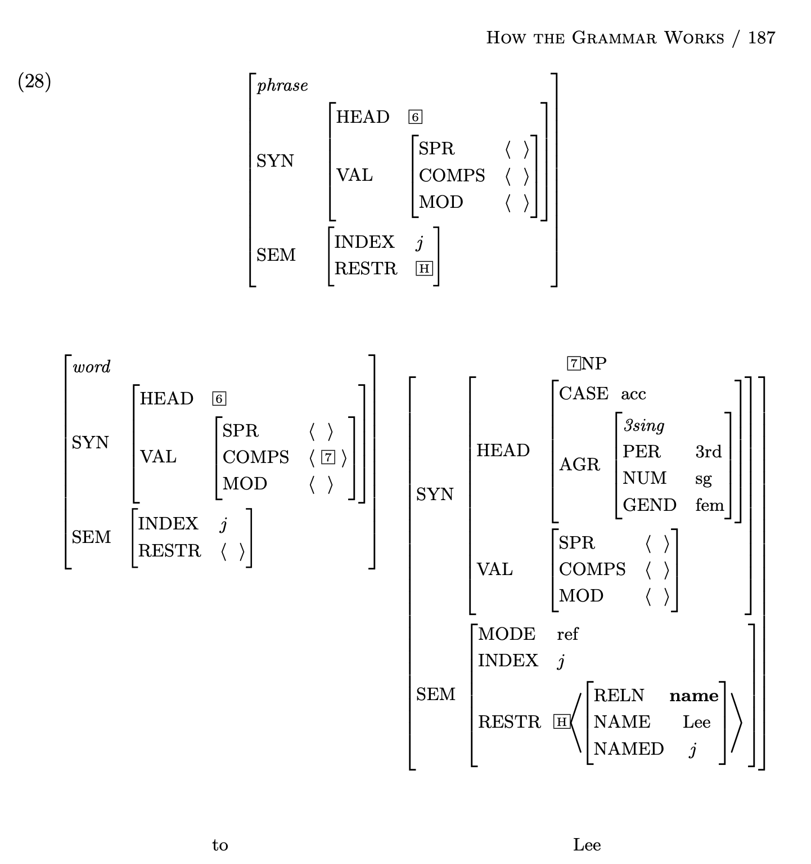

Slide 49
RQs: CASE and AGR
From some representations in this chapter and HW, I am curious about the interactions between case and agreement: should these two be treated as entirely distinct features, or is there theoretical flexibility to consider case as part of the agreement category in contexts where agreement with case features is observed?

