Slide 1
SDSRS
Spoken-Dialog Spaced-Repetition System
Austin Almond

Slide 2
Anki
https://ankiweb.net/
Open-source spaced-repetition system (SRS)
Popular in language-learning communities

Slide 3
Overview – Card Review Mode
Select a deck
App prompts with Front of card
User responds with Back of card
App determines “Again”, “Hard”, or “Easy” based on accuracy and speed of response
Repeat until cards for the day are exhausted

Slide 4
Overview – Card Creation Mode
User selects a deck
App prompts for Front and Back of card
User gives Front and Back of card
Card gets added to user’s deck, and will be included in the next review

Slide 5
Architecture
ASR and TTS provided by API.AI
SDSRS API translates Intents into Anki commands
Simplifies I/O with Anki Sync Server
Anki Sync Server manages cards, decks, and schedules

Slide 6
Example

Slide 7
Speech Chess Interface
Mack Blackburn

Slide 8
Introduction
Speech interface for playing chess against p4wn engine
Minimal chess engine in pure JavaScript
User makes move commands
“Knight to f3”
Doesn’t allow illegal moves
Detects check, checkmate, and stalemate

Slide 9
Commands
Making a move
Asking which piece is at a given position
Asking for a player’s last move
Undoing a move
Starting a new game

Slide 10
Implementation
VoiceXML
<script> tag for JavaScript
chess.xml makes calls to chess.js functions
Make player move, get computer move, etc.

Slide 11
Demo

Slide 12
Planned Additions
Ask for computer suggestions for next move
Ask for locations of certain pieces
Choose starting color

Slide 13
DUNGEON CRAWLER
Karen Kincy

Slide 14
Dungeon Crawler
1

Slide 15
Dungeon Crawler
What is a dungeon crawler?
Old choose-your-own adventure books
Dungeons and Dragons
Wanted a game controlled by dialogue

Slide 16
ASR and TTS
SpeechRecognition library for Python
Several ASR options
Tried Google Speech and Wit.ai API
pyttsx 1.2 library
Wraps TTS in Windows, OS X, or Linux

Slide 17
Dialogue Management
Loop while still playing == true
describe room upon entry
speech recognition
Open prompt: “What would you like to do next?”
repeat ASR output; explicit confirmation
intent resolution
update game state

Slide 18
Game Backend
Represent rooms in map like states in FSM
Description, items, connections to adjacent rooms
Can move in cardinal directions:
north, south, east, west
Inventory of items
Just cake so far

Slide 19
Map of Game
N
Library
W
E
Courtyard
Foyer
Kitchen
Start
S
Bathroom

Slide 20
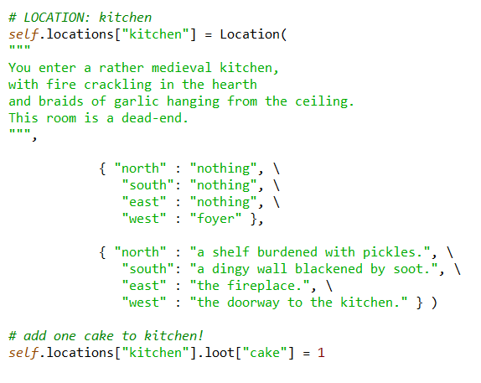
Room: Kitchen
string describing location
dictionary with nearby
locations
descriptions for cardinal directions
loot in this room

Slide 21
Sample Gameplay: Cake!

Slide 22
For the Future
2

Slide 23
Issues to Fix
No barge-in
Can be annoying with long TTS passages
Better TTS would be nice
Delays with ASR
Unavoidable?

Slide 24
#TODO
Add more loot to the game!
Handle plurals
Interactions between items
More dialogue for questions

Slide 25
Resources
https://pypi.python.org/pypi/SpeechRecognition/
https://github.com/jpercent/pyttsx/

Slide 26
Online Knowledge Interface
Ling575 - Project
Elizabeth Nielsen, Eli Miller, and Melina Koukoutchos

Slide 27
Goal
Implement a spoken dialog system for Wolfram Alpha
Added interface to Wikipedia as well
Motivation
Create a user-friendly audio-only interface to common search tools
Notes:
Elizabeth

Slide 28
Approach
OpenDial
Wolfram Alpha’s Spoken Results API
MediaWiki API
Nuance ASR and TTS (via OpenDial plugin)
Notes:
Eli

Slide 29
Architecture
Java wrapper around OpenDial’s dialog system and speech plugin
Core dialog defined in XML spec
API calls made from Java and response added to the OpenDial dialog state
Notes:
Eli

Slide 30
Challenges
ASR
Recording the spoken input
Dialogue timing and flow
Notes:
Melina

Slide 31
Current Status & Demo
Current status:
ASR not working yet; input through command-line typing
Interface to Wolfram Alpha and Wikipedia
TTS
Demo:
Notes:
Melina

Slide 33
Potential Additions
Audio browsing for Wikipedia
Offer information from pages that link to the queried page
How long to do this? Could provide infinite information
Notes:
Elizabeth

Slide 34
Evaluation
Does it work end-to-end?
Can it handle errors?
Not being able to connect to the API
Not getting a response from the API for a given query
Misunderstanding what the user says
Flexibility?
Built into APIs vs. implemented in Dialogue Manager
Notes:
Melina

Slide 35
Mr. Allen is Dead

Slide 36
A Murder Mystery
Notes:
Casts user as detective investigating death of Mr Allen
4 computer characters
-Seargent Inspector
3 suspects
-Angela
-Bianca
-Candice

Slide 37
Looking at Persona in Speech

Slide 38
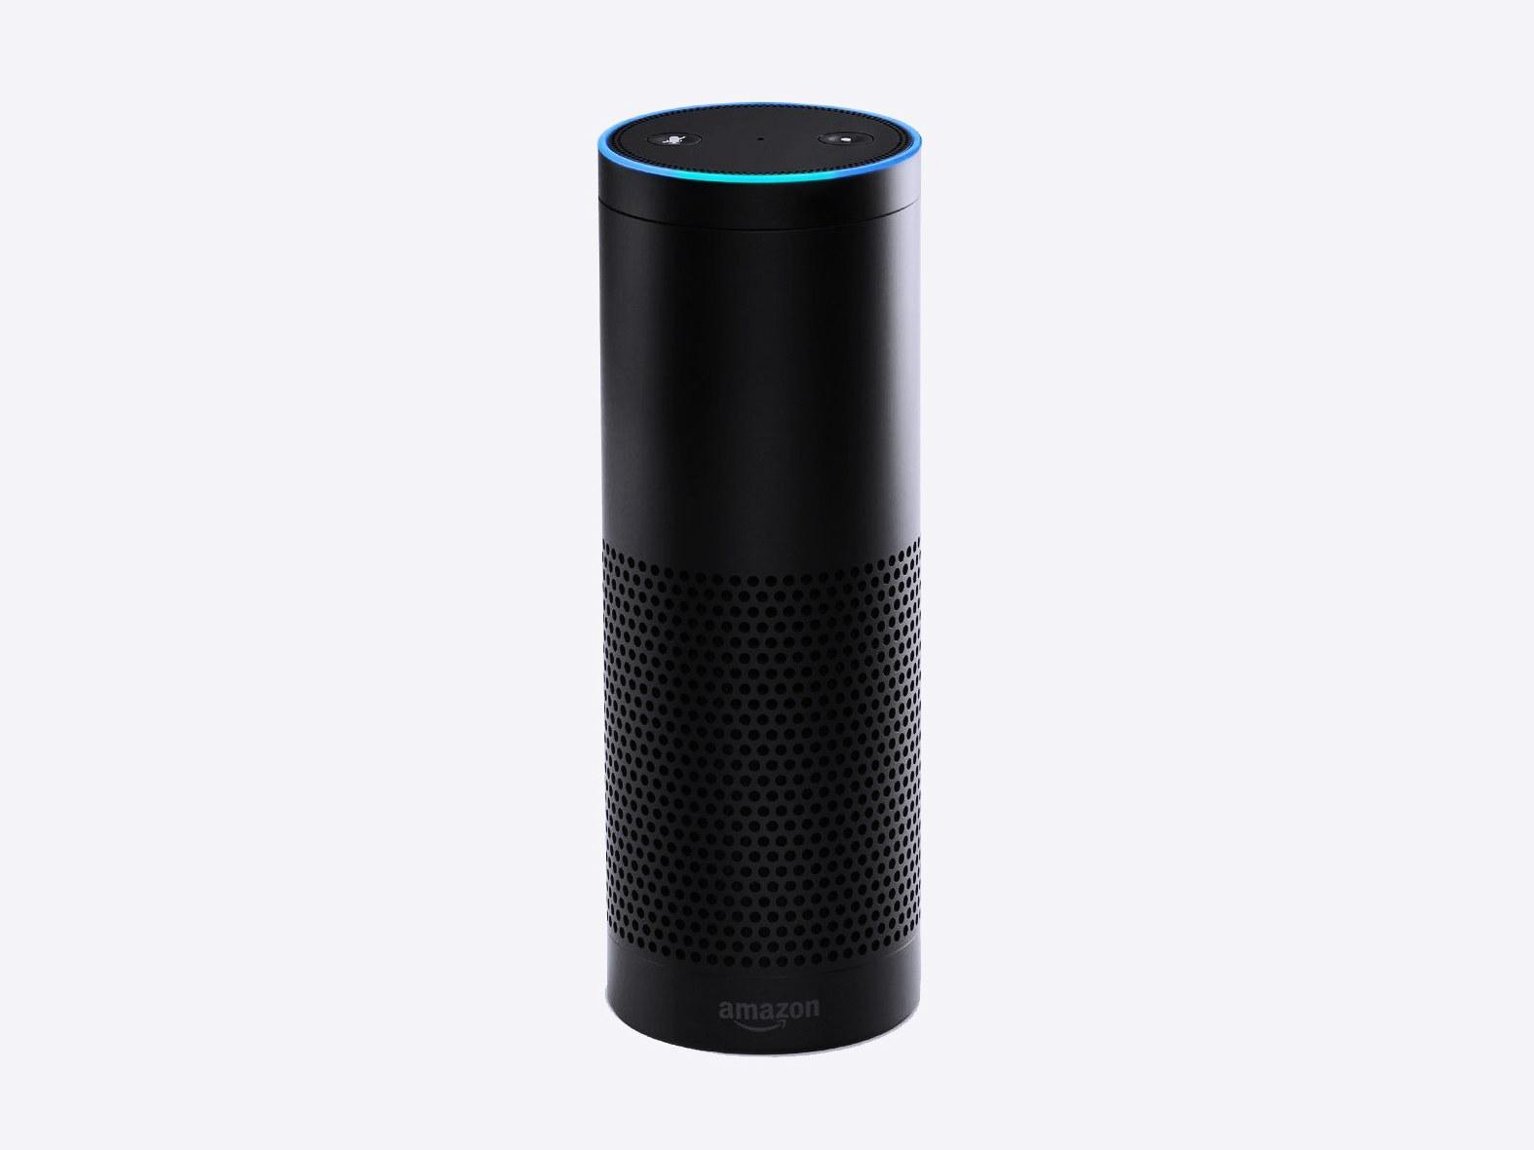
Amazon Alexa Skill

Slide 39
Demos

Slide 40
Alexa saying things
Asking questions

Slide 41
DEMO
Alexa saying things
Asking questions

Slide 42
Current Progress

Slide 43
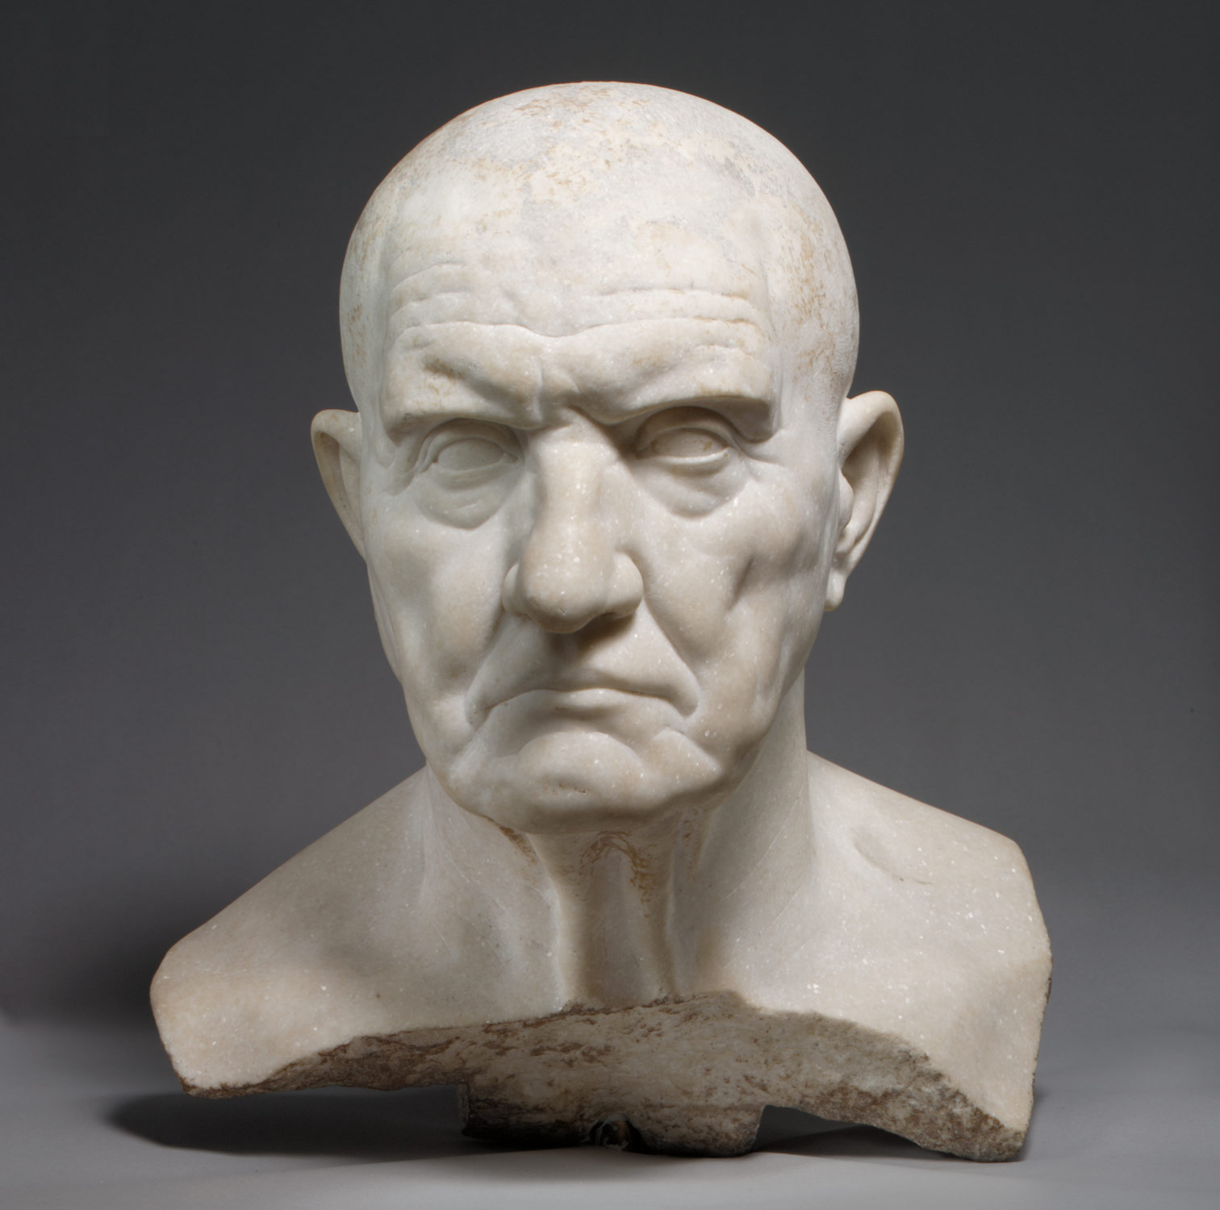
Results So Far

Slide 44
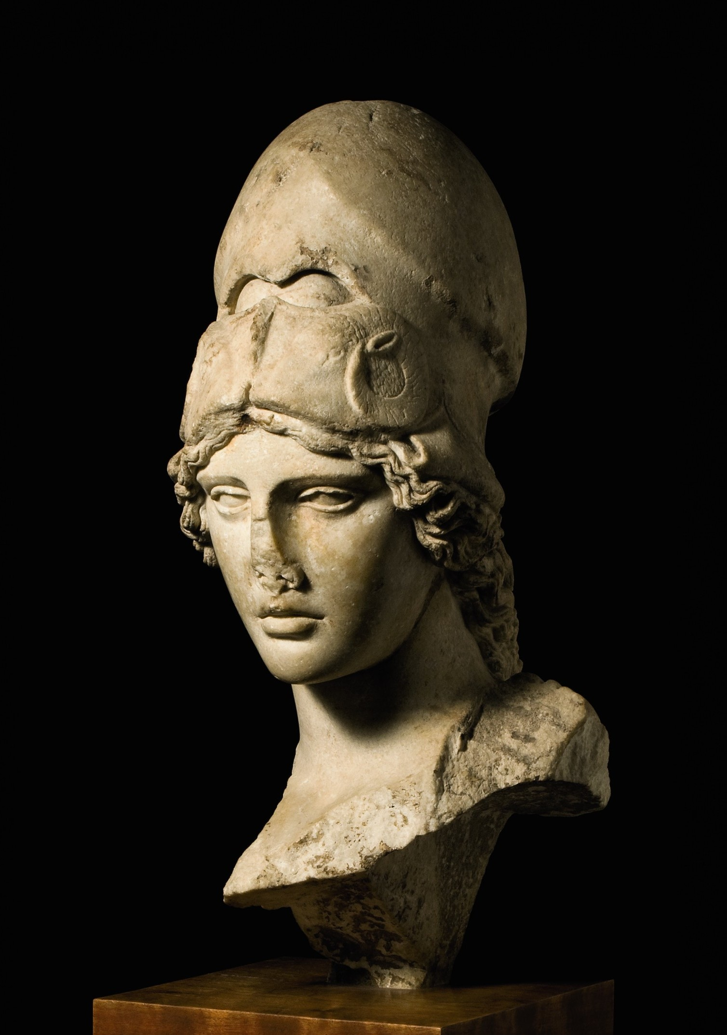
Todo

