Slide 1
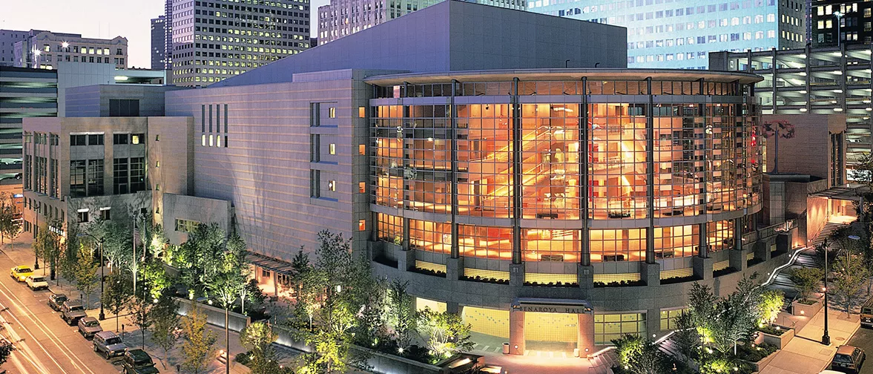
Benaroya Hall
Brigette Sumerlin

Slide 2
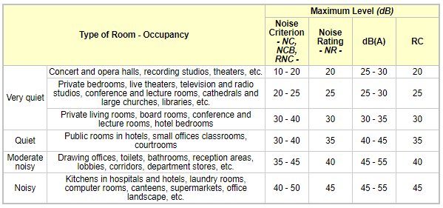
Overview
Seats 2500
Traditional concert hall
No added electronic or mechanical provision for sound
NC-10 and NC-15 with A/C on, inside auditorium

Slide 3
History of Benaroya
118.1 million dollars, opened in September 1998
Locations of the symphony, opera and ballet – no proper location prior to the hall.
Seattle center opera house booked 360 days.
Benaroya hall is the host of over 700 public and private events.
July 2000, Watjen concert organ, 4490 pipe organ built by CB Fisk Inc.
Soundbridge – interactive exhibits.
Jack Benaroya (1921-2012), philanthropist, donated 15 million in March of 1993. Donated as a major gift to the city.
Benaroya worked with Gerard Schwarz, Seattle symphony music director in 1993.

Slide 4
Acoustical consultant
Cyril M Harris (1917-2011)
Studied at Columbia University and published several books on instruments, room acoustics and materials.
Also worked on metropolitan opera house 1966, Powell symphony hall in saint louis 1968, Krannert Center for the Performing Arts in Urbana, Illinois (1969), the Kennedy Center for the Performing Arts (1971), Abravanel Hall in Salt Lake City (1979), and the National Centre for the Performing Arts in Bombay, India (1980).
Publications: Acoustical Designing in Architecture, Noise Control in Buildings, Dictionary of Architecture and Construction, Illustrated Dictionary of Historic Architecture, and the newly published American Architecture: An Illustrated Encyclopedia.

Slide 5
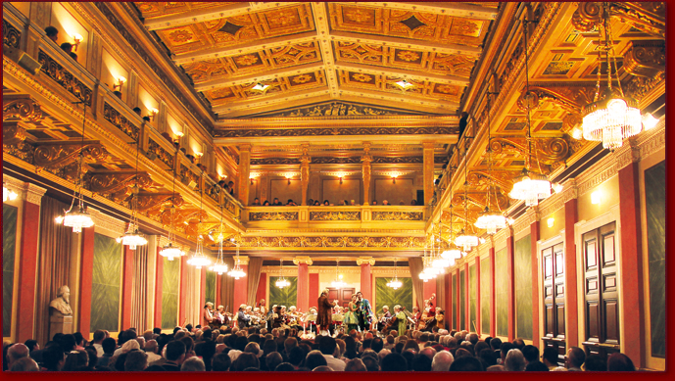
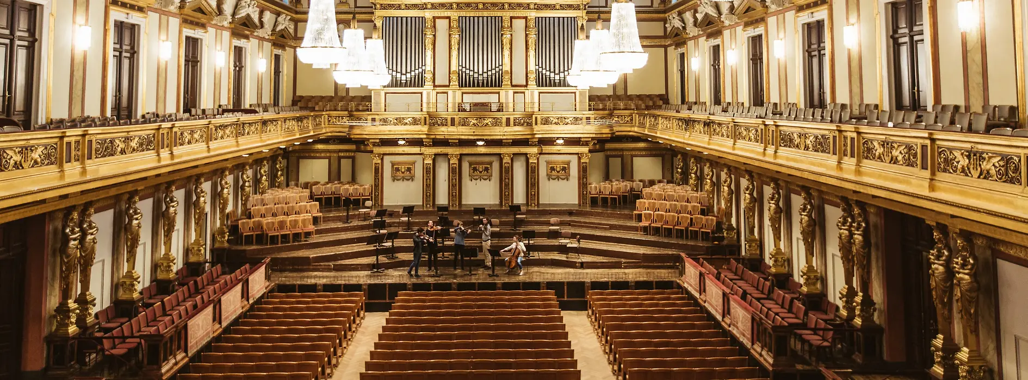
Based on Großer Musikvereinssaal in Vienna
Opened in 1870 – home of the Vienna philharmonic orchestra
Golden Hall (below)
Brahms Hall (right)
Thought to have the best acoustics in the world
Built on land given to Gesellschaft der musikfreunde Wien on a piece of land given by Emperor Franz Joseph
Golden hall seat 1744 +300 standing

Slide 6
Hall Design
Unlike other halls Benaroya has varied width
85 ft at orchestra level
65ft at min between balconies
Stage to rear wall: 114ft at center
Floor finished with oak strips over plywood set on wood joists

Slide 7
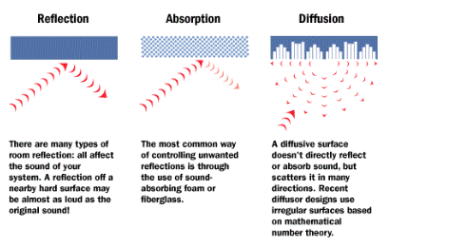
Design
“shoebox” form
Space under balcony have shallow depth and with high ceiling to promote sound
Depth of the balcony not exceed height of the opening
Because of variety of surfaces and lengths, excellent diffusion at wide frequency.

Slide 8
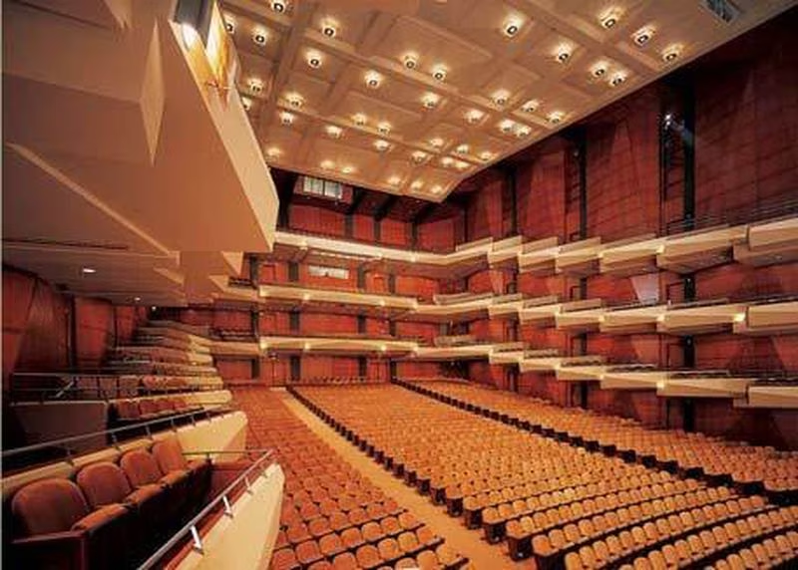
Walls
Colum diffusers
16 ft wide on the side walls
24ft wide on the rear wall
From orchestra floor to ceiling – narrow with increasing height
Project 12-24 from wall depending on location
vertical
2500, ¾” wood panels
Fastened to wood battens fixed to concrete
Precision cut
Balconies finished with plaster-on-metal-lath, rhomboidal - horizontal

Slide 9
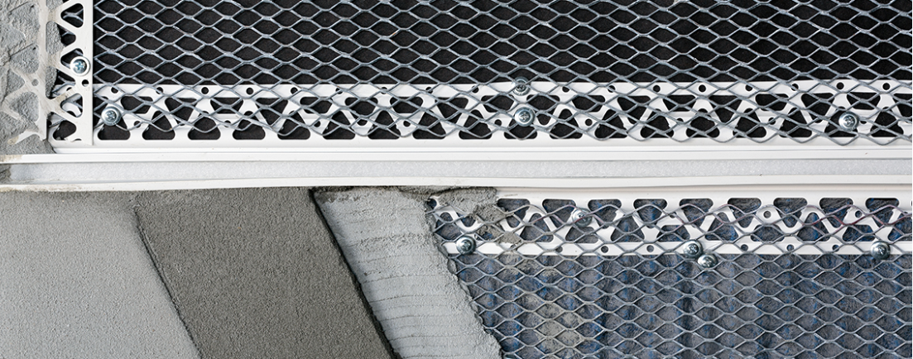
Ceiling
Coffered nonsymmetrical polyhedron shapes installed into the ceiling
Plaster-on-metal-lath
Projects downward

Slide 10
Benefits of diffusion
To increase the uniformity of the distribution of sound throughout the concert hall
To smooth out variations in the rate of growth and rate of decay in the hall.
Overall, allows for consistent sound regardless of location
All you must do is pick where to sit.

Slide 11
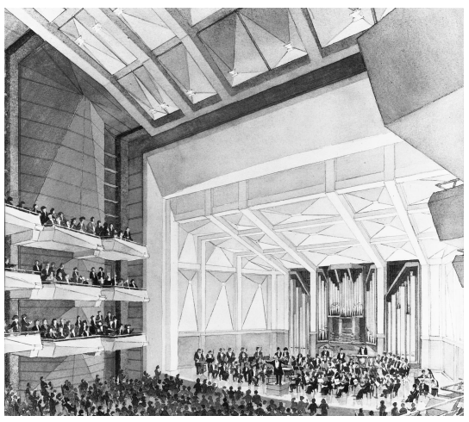
Stage
Floor is ¾ in oak boards
Set on plywood resting on wood sleepers isolated from the concrete stage foundation by elastomeric pads.
42 inches above auditorium floor.
Organ installed on stage and acts as additional scattering surface.
Wood pipes

Slide 12
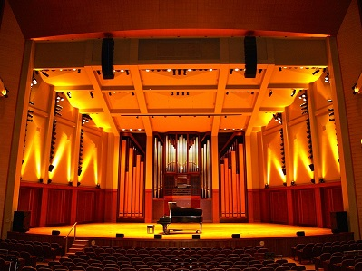
Reverb
At full occupation, within 0.1s of values for Grossermusikvereinssaal
Test setup for occupied
Tape recordings ending with fortissimo into silence
Microphones placed at ear level of orchestra and first tier seats and above the head at orchestral level
Decay rate determined from slope.
Test set up for unoccupied.
A cannon and blank 10-guage shotgun shells

Slide 13
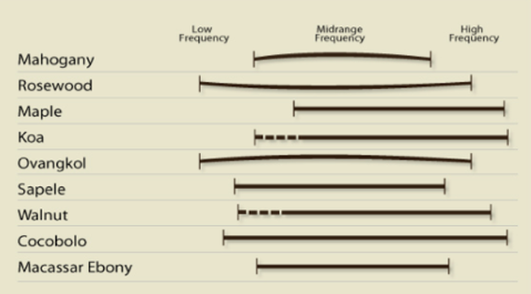
Wood
Mahogany
Black Walnut
Northern Red Oak
Bolivian Rosewood

Slide 14
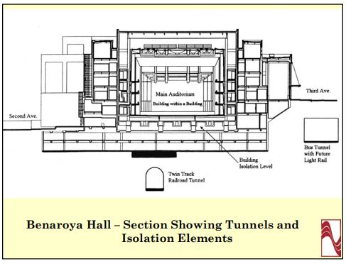
Isolation
Measure ground noise
Isolation system of 4-5 Hz natural frequency
And full reduction of outside noise
Box in a box design
Concert hall is the inner box
6.5ft thick concrete layer and 310 huge rubber pads that serve as vibration isolator which support a concrete slab.

Slide 15
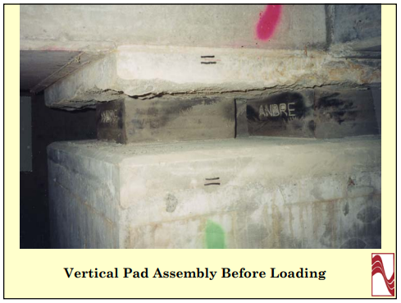
Rubber Pads – Sound Isolation

Slide 16
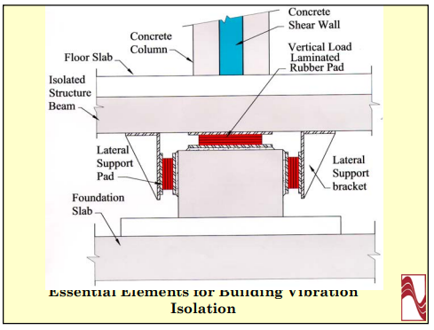
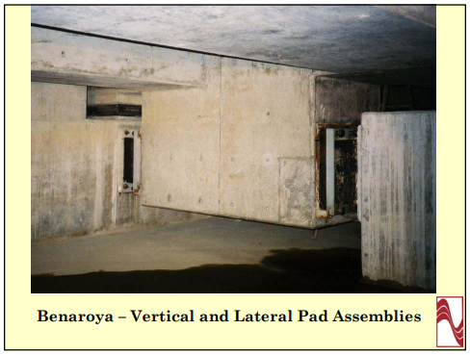
Rubber Pads – Sound Isolation (cont.)

Slide 18
Star Wars Night at the Symphony
Return of the Jedi
June 30-July 2
https://www.seattlesymphony.org/en/concerttickets/calendar/2022-2023/22jedi

Slide 19
Sources
https://asa.scitation.org/doi/10.1121/1.422056
Acoustical design of Benaroya Hall, Seattle Cyril M. Harris Citation: The Journal of the Acoustical Society of America 110, 2841 (2001); doi: 10.1121/1.1416199
https://www.seattlesymphony.org/benaroyahall/about
https://www.seattlesymphony.org/benaroyahall/about/hall-design
https://www.djc.com/special/design97/10032235.htm
https://archive.seattletimes.com/archive/?date=19980621&slug=2757250
http://tonewooddatasource.weebly.com/technical-data.html
https://www.bestbassgear.com/ebass/ideas/picking-a-wood-for-your-bass-have-a-helpful-chart-to-know-word-hardness.html

Slide 20
Images from
https://www.google.com/url?sa=i&url=https%3A%2F%2Fwww.oregonlive.com%2Fperformance%2F2012%2F01%2Foregon_symphony_to_perform_in.html&psig=AOvVaw0Lq7GevHCa-rnSXUWR7DwZ&ust=1677713482182000&source=images&cd=vfe&ved=0CA8QjRxqFwoTCJiShe6vuf0CFQAAAAAdAAAAABAE
https://www.google.com/url?sa=i&url=https%3A%2F%2Fcbfisk.com%2Fopus%2Fopus-114%2F&psig=AOvVaw1yW4uhuIIZDH9zwlQcoKGF&ust=1677713761434000&source=images&cd=vfe&ved=0CA8QjRxqFwoTCNDSifOwuf0CFQAAAAAdAAAAABAP
https://www.google.com/url?sa=i&url=https%3A%2F%2Fdo206.com%2Fevents%2F2012%2F10%2F21%2Fan-evening-with-bill-cosby&psig=AOvVaw3i62XNcke-8-pgVRVkk0I9&ust=1677717607282000&source=images&cd=vfe&ved=0CA8QjRxqFwoTCLinmJ2_uf0CFQAAAAAdAAAAABAX
https://www.mozart.co.at/musikverein-en.php?gclid=Cj0KCQiA6fafBhC1ARIsAIJjL8nKYEpJ-oFhUAztpa0-nDSL2KqOlnsJ_qLZs4F5GYLmJawbKkSJYeIaAnexEALw_wcB
https://cbfisk.com/wp-content/uploads/2019/06/114-Portrait-3-2000x1500-770x1027.jpg

