Slide 1
Sound/music synthesis and neural network-based methods
Xiulong Liu
Department of Electrical and Computer Engineering

Slide 2
Sound Synthesis Methods Overview
Traditional Methods:
Additive Synthesis
Subtractive Synthesis
Physics-modeling based Synthesis
Machine Learning based synthesis(sound-synthesizer-inspired):
DDSP: Differentiable Digital Signal Processing(Addictive + Subtractive Synthesis/Spectral-modeling)

Slide 3
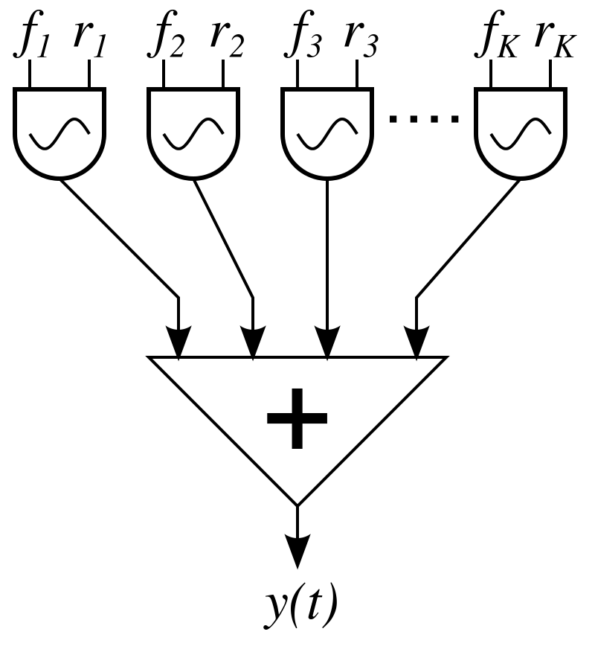
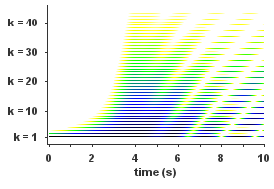
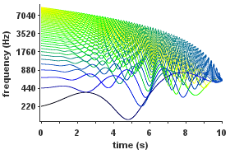
Additive Synthesis
Harmonic Oscillator:
General form both harmonics and inharmonics:
A harmonic additive synthesis
Inharmonic additive synthesis

Slide 4
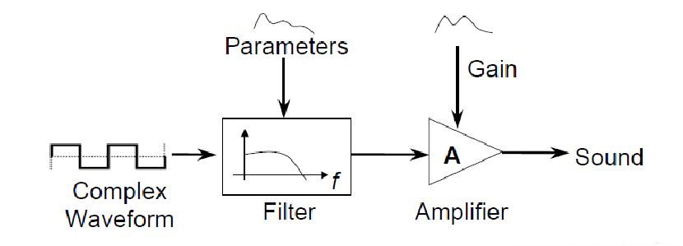
Subtractive Synthesis
Partials of sounds with rich harmonics are removed with designed filters.
Common Sources Sound:
White noise
Result of Mixed harmonics or
several complex waveform like
square wave, sawtooth wave, triangle
wave
Filters design:
Low-pass, band-pass, high-pass
Pole numbers, 1-4 poles

Slide 5
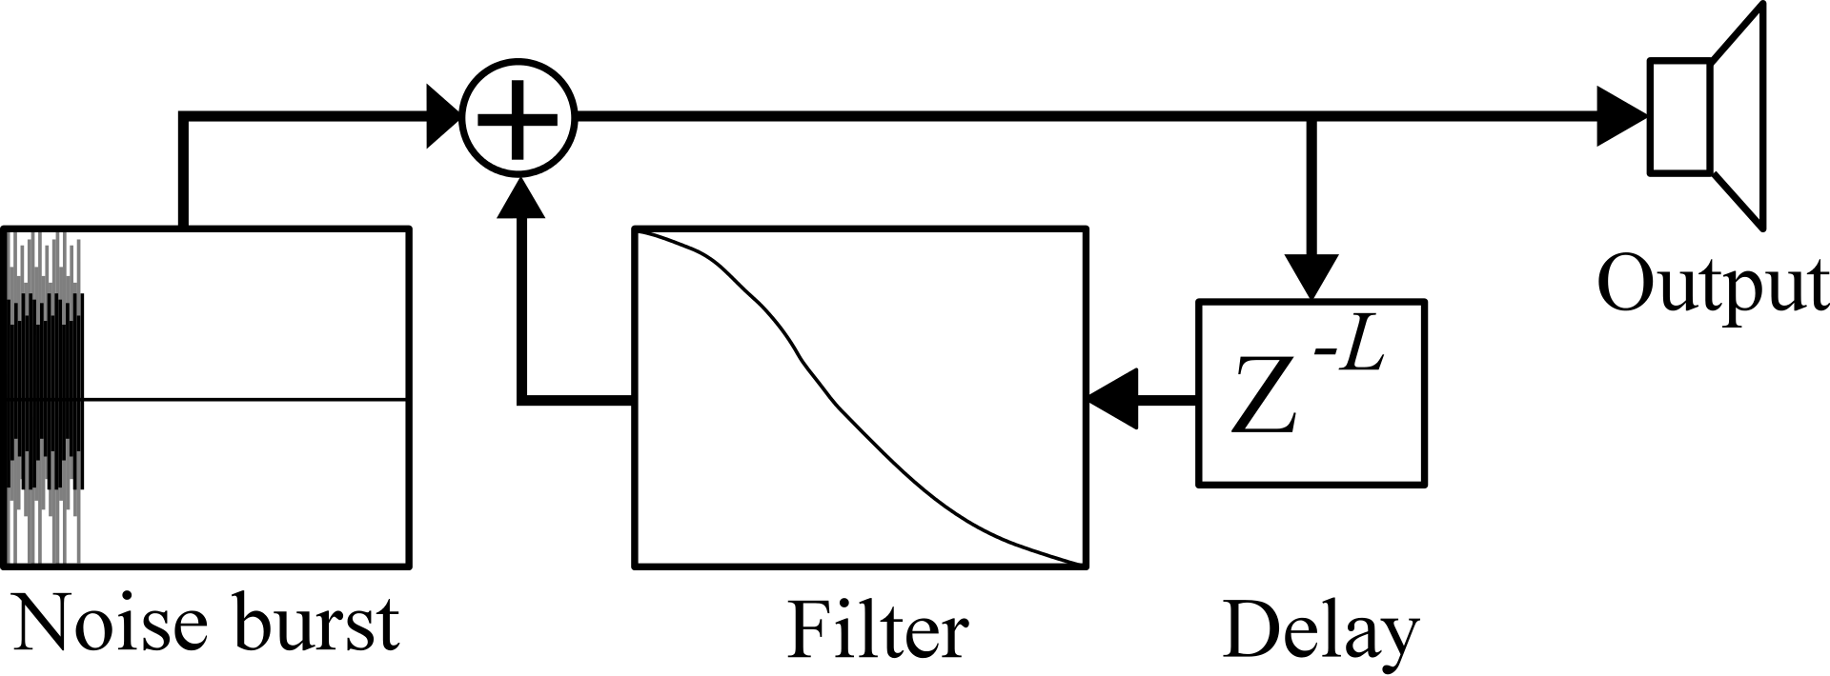
Physics-modeling based synthesis
Emulating the physics-process and simulating the equations
An famous example: Karplus-Strong Algorithm for guitar string synthesis, which simulates the d’Alembert’s Formula:
p(x, t) = 1/2 (f(x + vt) + f(x - vt))

Slide 6
Physics-modeling based synthesis
Details of Karplus-Strong Algorithm(Ring Buffer mechanism):
Exciters: White noise
Energy traveling back and forth with decay:
Python implementation

Slide 7
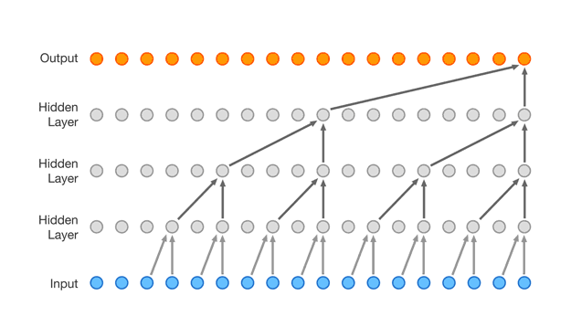
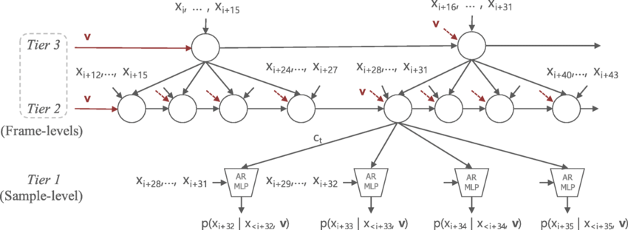
Neural Network based synthesizers(speech, natural sound, music)
Early works apply WaveNet, Sample-RNN (both are hierarchical models dealing with different time resolutions), or GAN-based approach on musical sound synthesis, without interpretability and not easy to control.
Wavenet building blocks: stack dilated causal convolution layers, autoregressive modeling the quantized waveform(mu-law).
SampleRNN building blocks: each tier of Recurrent Neural Network models different resolution scale, from low to high resolution

Slide 8
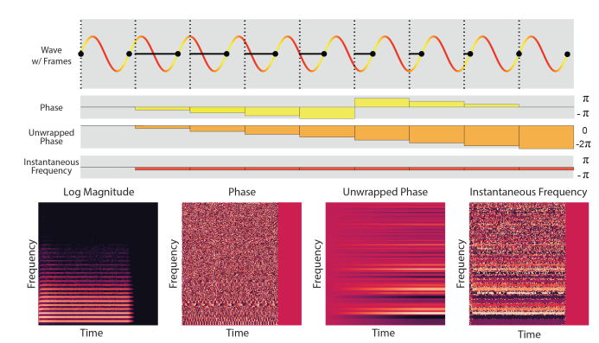
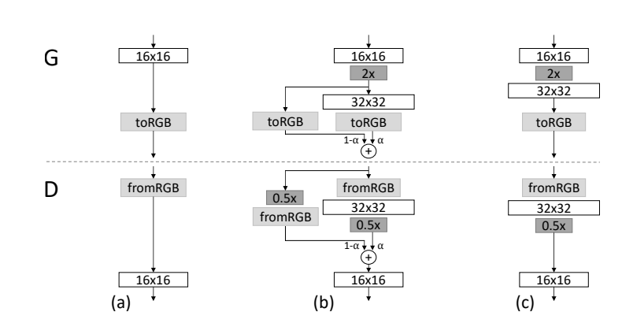
Neural Network based synthesizers
GAN-Synth(Using Progressive Generative-Adversarial Net on log-magnitude Spectrogram)

Slide 9
DDSP: Interpretable and controllable NN synthesis
Harmonic Oscillator + Filtered Noise model(Additive + Synthesis)
Differentiable DSP components into neural networks
Allowing independent control of pitch, loudness and timbre, highly disentangled model.
Each component is interpretable.
Allowing easy transfer of timbres in latent space by interpolation while keeping other features unchanged.
Limitation: Only capable of modeling single monophonic musical instruments.

Slide 10
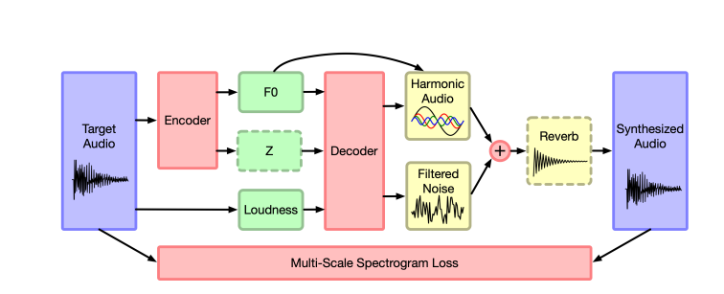
DDSP: Interpretable and controllable NN synthesis
System overview: the DDSP disentangle musical sound into fundamental frequency, amplitude of partials, loudness, and resynthesis the sound using additive + subtractive synth method, optionally adding room reverb for realistic effects like in music hall.

Slide 11
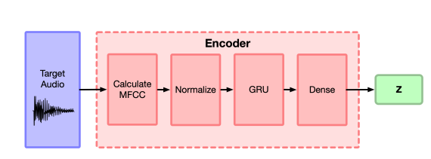
DDSP: Interpretable and controllable NN synthesis
F0 Encoder(CREPE model, supervised)
Loudness Encoder for Amplitude:
Magnitude square of STFT.
Convert dB to linear scale and weighted mean.
Log compression
Normalize
Latent Vector-z Encoder(Representing Timbre)

Slide 12
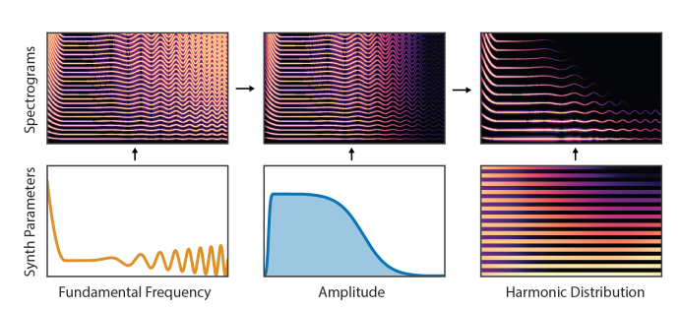
DDSP: Interpretable and controllable NN synthesis
Illustration of how a monophonic sound is decomposed into several components

Slide 13
DDSP: Interpretable and controllable NN synthesis
Decoder: Predicting the additive synthesizer coefficients and subtractive filtered noise representing stochasticity of natural sound
Additive Synth Part – 101 partials coefficients operate at lower res:
Subtractive Synth: LTV-FIR filter(65 coefficients per frame) with white noise:
Y_l = H_l * N_l
Where H_l is time-varying filter coefficient for noise, N_l is spectrum of uniform white noise in [-1, 1].
All components including Fourier and its inverse become part of auto-differentiation components to enable training.

Slide 14
References
DDSP: Differentiable Digital Signal Processing, [2001.04643] DDSP: Differentiable Digital Signal Processing (arxiv.org)
GANSynth: Making music with GANs, [1902.08710] GANSynth: Adversarial Neural Audio Synthesis (arxiv.org)
SampleRNN: An Unconditional End-to-End Neural Audio Generation Model, [1612.07837v2] SampleRNN: An Unconditional End-to-End Neural Audio Generation Model (arxiv.org)
WaveNet: A Generative Model for Raw Audio, [1609.03499] WaveNet: A Generative Model for Raw Audio (arxiv.org)
Digital Synthesis of Plucked String and Drum Timbres, digitar.pdf (ucsc.edu)
Wikipedia page of basic sound synthesis methods, Synthesizer - Wikipedia

